Slide 1
Introduction to Habitats

Slide 2
What do we need to survive?
Humans
Other animals
Water
Space
Food
Shelter
Social interaction
Water
Space
Food
Shelter

Slide 3
What is a habitat?
A habitat is the natural environment of an organism; place that is natural for the life and growth of an organism.

Slide 4
Freshwater habitats
Lake
River
Stream
Pond
Wetland
Billabong
Notes:
Lake
Lakes are large areas of still water. Some large fresh water lakes dry up in times of drought.
River
Rivers are pathways of flowing water. The water can be fast flowing or flowing slowly. Some large rivers in Australia include the Murray River, the Derwent River and the Katherine River.
Stream
Streams are small flows of water. Sometimes they are called creeks or rivulets.
Pond
A pond is a small pool of still water.
Wetland
Wetlands are areas with lots water plants such as reeds, grasses and lilies. Fresh water wetlands increase in size after rain. Lots of birds move into wetlands after rain.
Billabong
Billabongs are small pools of water that appear next to rivers after heavy rain.

Slide 5
Arid Habitats
Tall shrubs
Heath
Grasslands
Sand dunes
Rocky areas
Notes:
Tall shrubs
Tall shrub areas have small eucalypt, mulga and acacia trees. These trees usually have roots that force their way deep into the soil to find water.
Heath
Heath areas are covered in bluebush and saltbush plants. These shrubs are bushy and grow close to the ground. There are many different types of heath found across Australia.
Grasslands
Spinifex grass often grows in arid zone grasslands. Spinifex has leaves that are hard and spiky like needles. This stops the plant from losing lots of water.
Sand dunes
Sand dunes are made by the wind as it blows across the desert. Once a small dune forms it acts as a barrier to the wind. Sand then drops on its slopes and the dune gets bigger.
Rocky areas
Rocky areas provide important shelter for many animals and plants. Caves, cracks and ledges make good homes and a cool place to shelter.

Slide 6
Coastal Habitats
Ocean
Coastal Water
Beach
Sand dunes
Rock pools and rock platforms
Mangroves
Notes:
Ocean
The ocean is a huge area of salt water that covers almost three quarters the earth's surface.
Coastal Water
Coastal water is the seawater around the coast. It is usually more sheltered and shallower than the open ocean.
Beach
Beaches are very often very sandy areas. Beaches also include areas of rocks, dunes and crashing waves
Sand dunes
Sand dunes are formed by the wind blowing off the ocean and dropping sand high along the beach. Storms and people easily damage sand dunes.
Rock pools and rock platforms
Rock pools and platforms are part of the rocky shore environment. Animals and plants in these habitats survive being flooded in high tide and drying out at low tide.
Estuary
Estuaries are where the rivers and streams meet the sea. They provide important shelter for lots of young animals and plants.
Mangroves
Mangroves are groups of shrubs and trees that grow on the mud flats in coastal areas. These areas are often underwater at high tide.

Slide 7
Forest Habitats
Dry Forest
Wet Forest
Rainforest
Notes:
Dry Forest
The trees in dry forests usually do not grow as tall as trees in rainforests and wet forests. The trees are also not as close together so their branches often do not overlap. This means lot of light is able to reach the ground. Grasses, shrubs and groundcovers often grow on the ground in dry forests.
Wet Forest
Wet forests have very tall trees and they are usually found in areas where it rains a lot. The leaves of the trees come together to form a canopy which is quite thick. This means it is not easy to see the sky when you are standing in a wet forest.
Rainforest
Rainforests have trees of all different heights growing close together. Lots of the trees are really tall and their leaves touch at the top to form a really thick canopy. When you look up in a rainforest you can only see small patches of sky. Rainforests can be very wet and dark environments because light from the sun does not get to the ground very often.

Slide 8
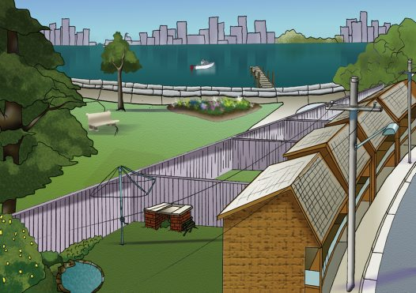
Urban Habitats
Garden
Harbour
Park
High-Rise Buildings
Houses
Notes:
Garden
Lots of animals and plants like to share our gardens with us. Some people create special habitats to encourage animals and plants to live in their yards. Ponds, bird baths and native plants are some ways to make your garden more appealing to local animals.
Harbour
Harbours are sheltered ports where ships often load or unload their cargo. They can be busy places with ferries, water taxis and many other boats getting around on them.
Park
Parks are open natural places in town and cities. There are lots of different types of parks but they all are places where plants and animals live.
High-rise buildings
Big cities often have very tall buildings. While these areas often have little native habitat left some animals still find food and shelter in the middle of the city.
Houses
Houses are not just homes for us but animals and plants often live in them too.

