Slide 1


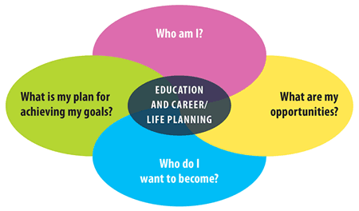
Education Planner – NB Edition
Implementation Strategies
Contact Us!
www.myBlueprint.ca
support@myBlueprint.ca
1-888-901-5505

Slide 2

Agenda
  Introductions
  Our commitment to New Brunswick
  Sharing of Educator Resources (i.e., Lesson Plans, Video Tutorials, etc.)
  Sharing of myBlueprint Implementation Strategies in Canadian School Boards
  Discussing the myBlueprint roll-out strategy for your board
  Questions

Slide 3
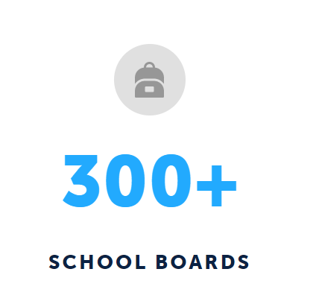
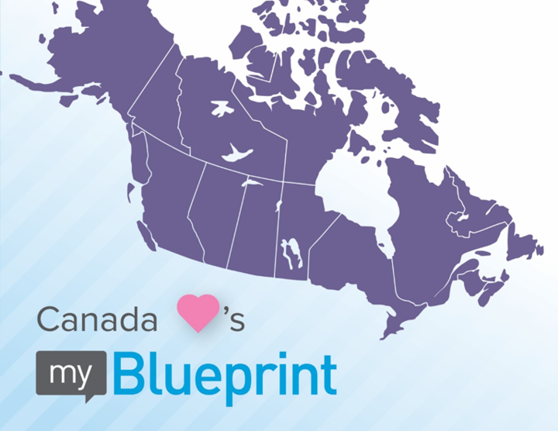

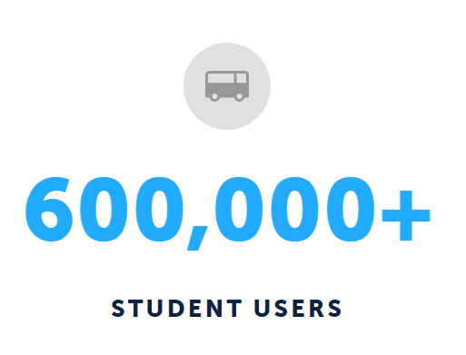
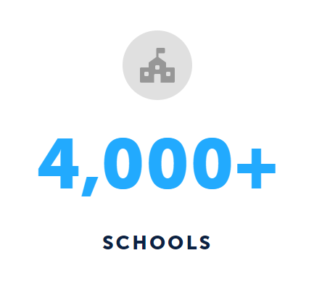
How It All Started
K-12 Career, Education, and Life Planning Programs

Slide 4
Student-Centered & Inquiry-Based Approach

Slide 5

Customized
to Provincial Curriculum &
Local Needs
Dedicated Support
Improvements Based on Feedback
Committed to Engagement

Slide 6
Our Commitment to New Brunswick
NB Secondary School diploma requirements
NB labour market information
NB post-secondary programs (College, University, Apprenticeships)
Supports the 9/10 program’s student-centered approach – the student is the architect of their learning
Supports students with portfolio building and self-reflection of progress and growth over time
Integrates cross-curricular & experiential learning
Connects to Personal Developement and Career Curriculum 6-12:
  Portfolio “Linking to the Future“
  Co-operative Education
  Career Exploration 110
Notes:
“… Gives the students the central role, allowing them to explore various fields that interest them…”
Empowering students to make the most informed decisions about their future

Slide 7
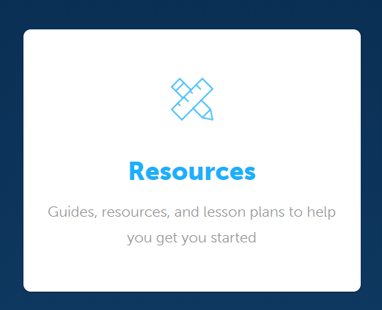
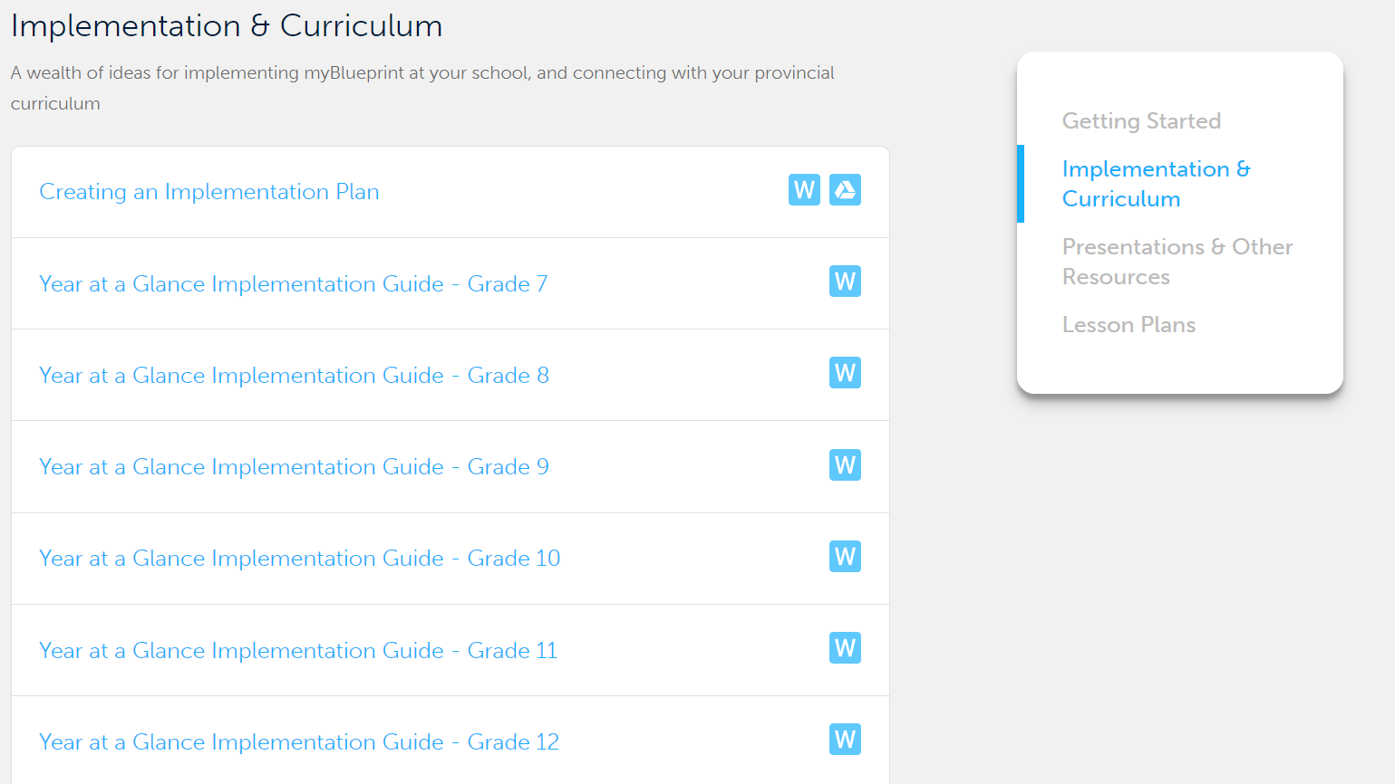
NEW! NB Educator Resources
Year-at-a-Glance Guides (7-12) offer a month-by-month breakdown of myBlueprint student activities related to NB curriculum, and provide a list of lesson plans for successful implementation

Slide 8

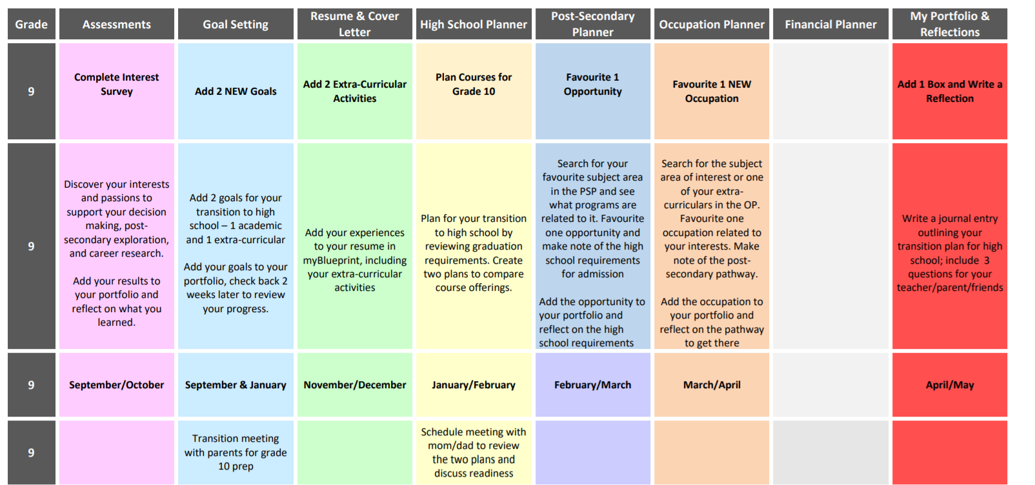
Chinook’s Edge myBlueprint Scope & Sequence
The board lead(s) polled every school to see what initiatives they have in place for career education
Based on poll responses, they created a plan for how myBlueprint could support what they were already doing in their schools for career education
Mapped each IPP activity to a specific month & assigned tasks for staff (i.e. meetings to book, reports to pull, etc.
Added specific activity descriptions to provide students with clear instructions based on board objectives and career education initatives

Slide 9
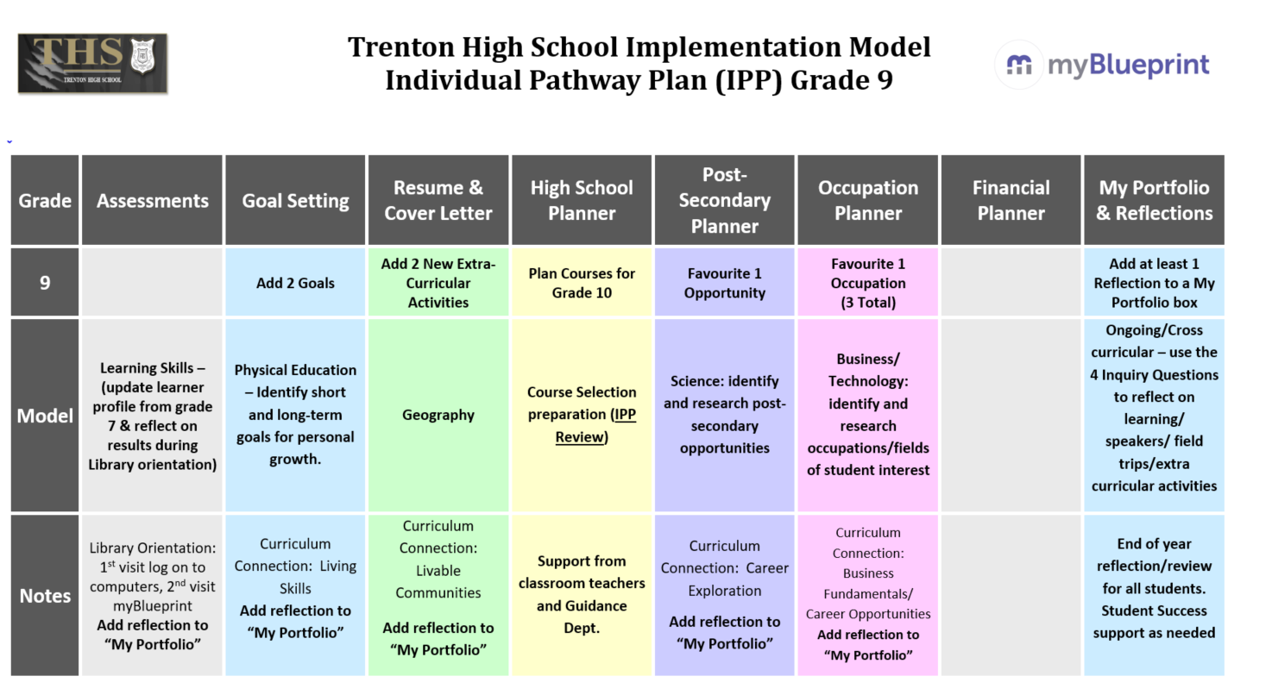

Trenton High School’s Scope & Sequence (Grade 9)
Chose to roll-out myBlueprint by grade (selected Grade 9 as their first year of implementation)
Mapped each Grade 9 myBlueprint IPP activity to a course curriculum
Subject teachers are responsible for having students complete the IPP activity related to their course

Slide 10

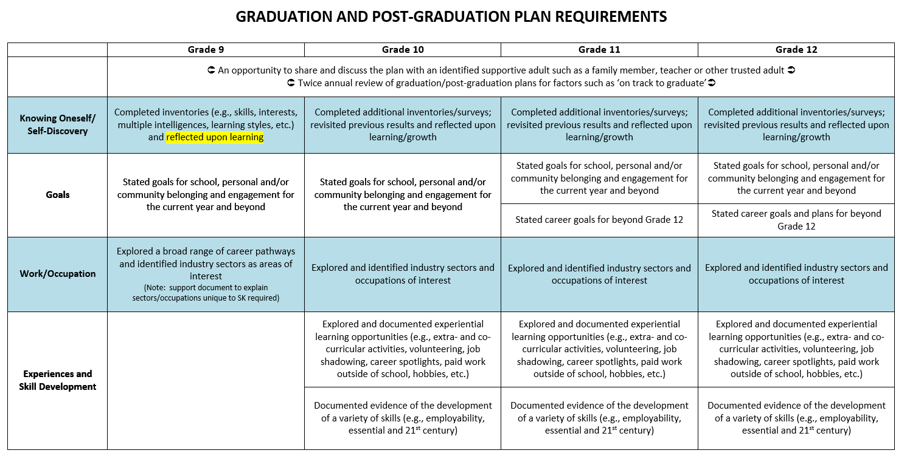
Saskatchewan’s Graduation & Post-Grad Plan Expectations
The SK ministry developed a strategy for all Grade 9 students to have a graduation and post-grad plan
The SK Grad Plan Committee established a process for maintaining those plans through Grade 12 by creating expectations for each grade in line with IPP activities

Slide 11

Top 8 School Board Implementation Ideas
IPP Activities to promote student-centered learning (i.e., custom school prizes), fulfill Creating Pathways to Success mandate requirement, and drive a Teacher Advisory Program
Who Am I Survey(s) completion before guidance meetings
Resumes/Cover Letters to apply for a position on the school’s student council
E-portfolios to track student progress and experiences (e.g., Career Portfolio, Scholarship Application Portfolio, Goal Setting Portfolio, etc.)
Statistics/Reports to guide experiential learning, post-secondary visits, career fairs, and guest speakers
S.M.A.R.T. Goal Setting to support students and teacher-advisors with their Annual Education Plan
Student Resources to share information on scholarships, co-op programs, volunteer opportunities, mental health resources, homework help, etc.
E-portfolios and Custom Class Activities to support students & staff with Cooperative Education

Slide 12
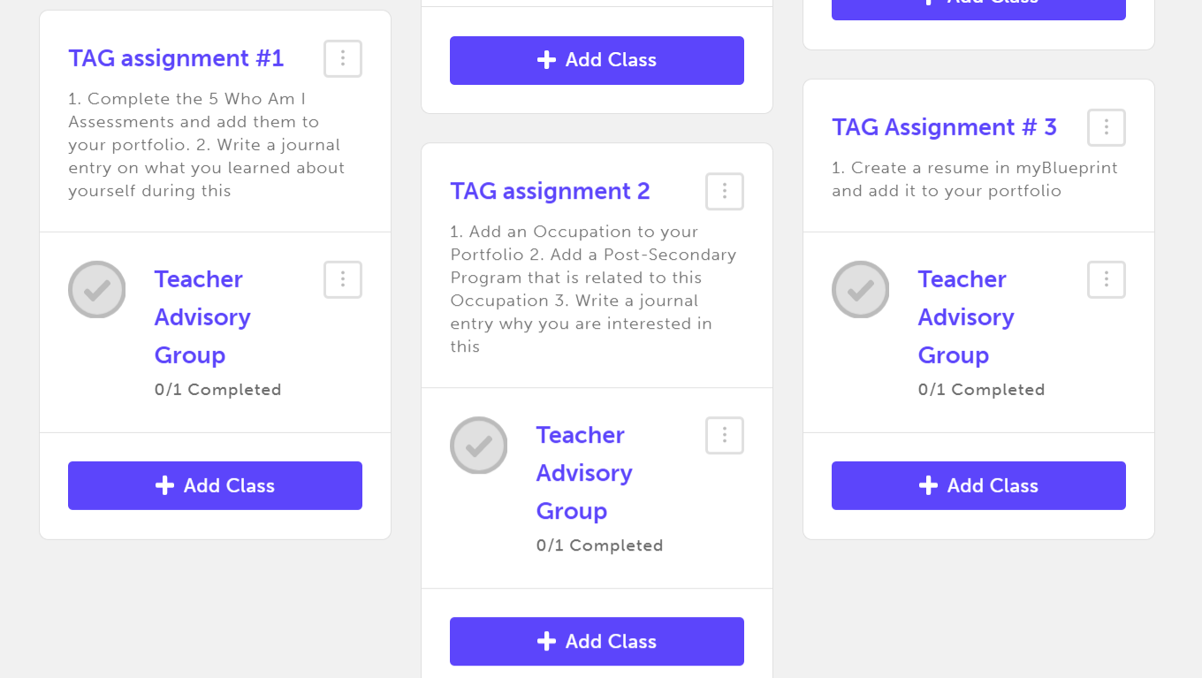
Teacher Advisor Groups
Bnei Akiva Schools, Albert College, most Alberta School Divisions
  1. Students create a Portfolio titled “Teacher Advisory Group” to showcase their:
    Skills and abilities,
    Favourite Occupations and Post-Secondary Programs,
    Resumes and Cover Letters,
    High School Plan,
    And S.M.A.R.T. Goals
  2. Teacher-Advisors create a class for their advisory group, with Custom Class Activities that students complete in myBlueprint to help them create a plan for their transition to Post-Secondary
  3. Teacher-Advisors can monitor student progress and comment on their Portfolio activities through their Teacher Account

Slide 13
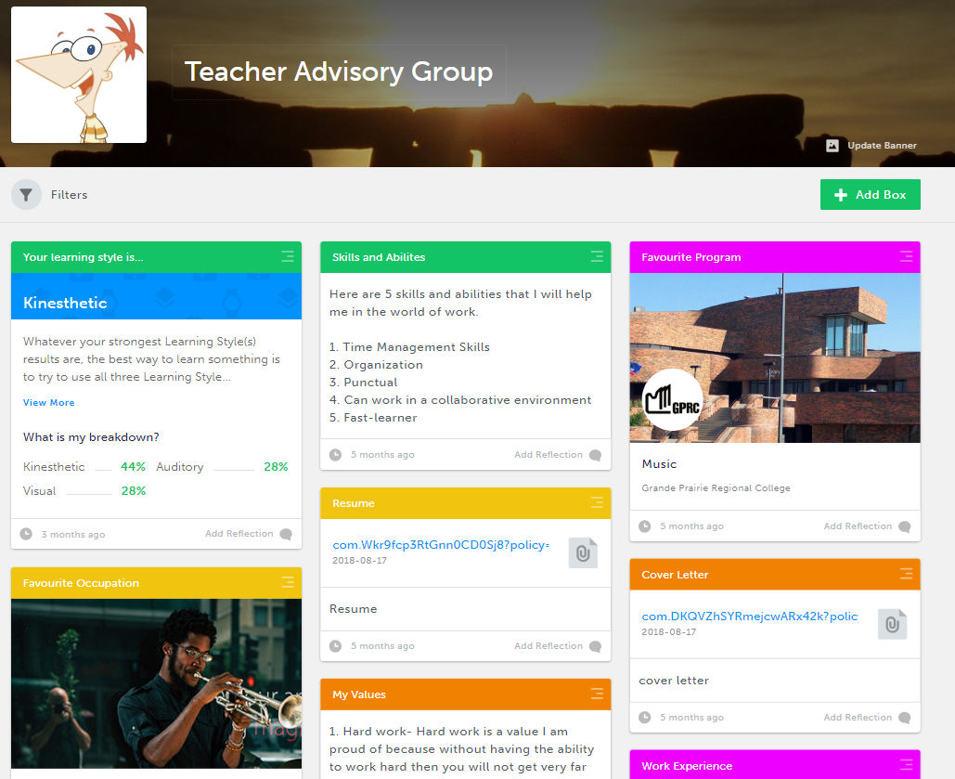
Teacher Advisory Group Portfolio Exemplar

Slide 14

Goal Setting for students’ Annual Education Plan
Albert College
Students create S.M.A.R.T. goals and action plans in myBlueprint and track their progress throughout the school year with the help of a teacher-advisor
Students use the Goal Setting Guide in myBlueprint to breakdown the S.M.A.R.T. goal setting process.
Students add their goals to their “Annual Education Plan Portfolio” and review their plans regularly as they evaluate their progress, gain experiences, and learn more about themselves.
Teacher-Advisors provide feedback on student progress via the Portfolios tool
Parents/Guardians can review their child’s Annual Education Plan by creating a myBlueprint Family Account

Slide 15
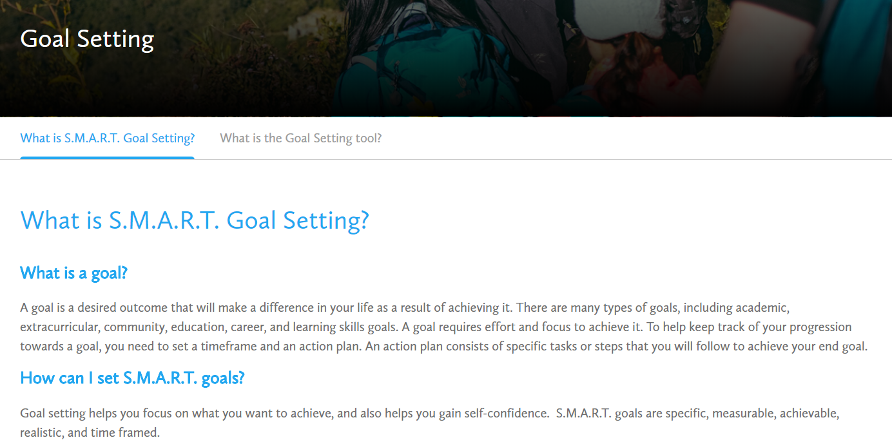
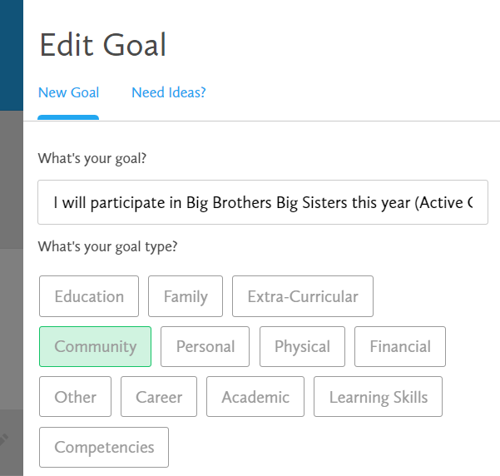
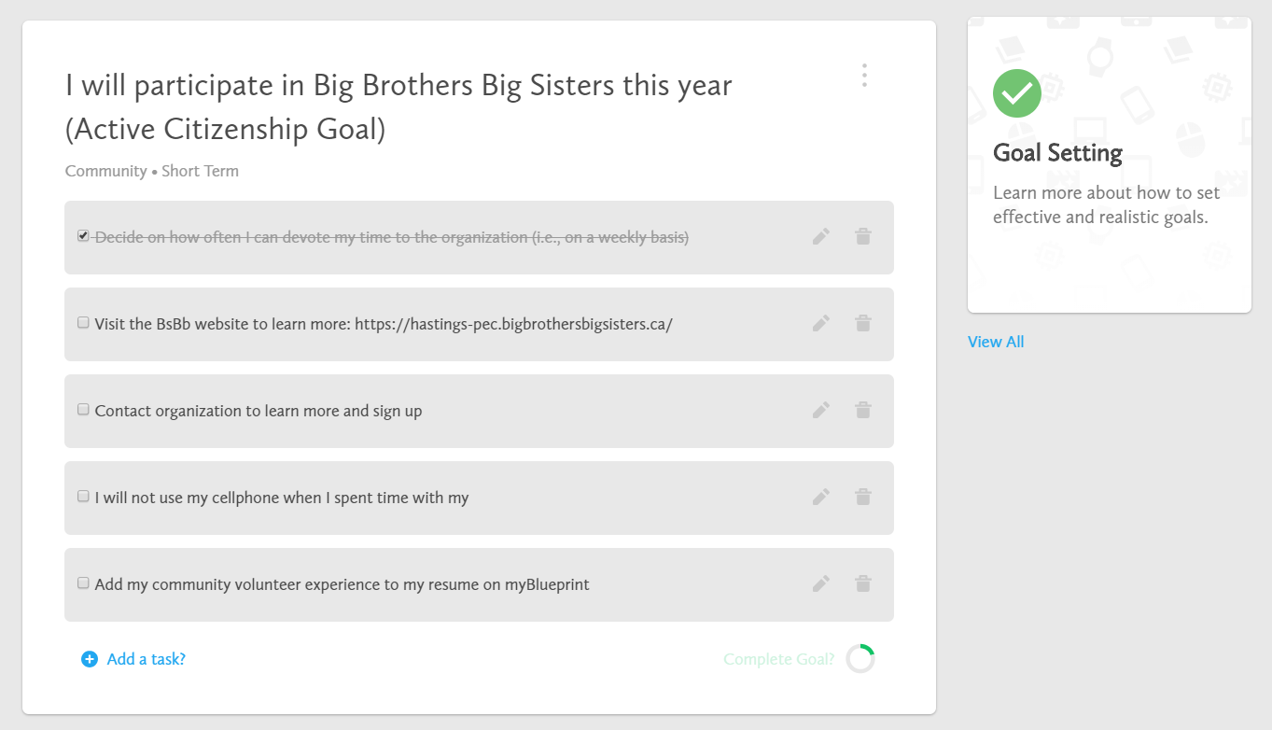

Slide 16
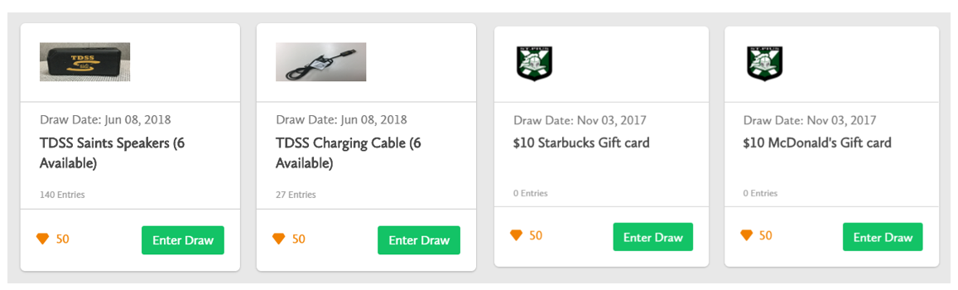
IPP Tasks & School Prizes
Ottawa Catholic SB, District School Board Ontario North East, Hanover SD, & Dufferin-Peel Catholic DSB
Having students complete the grade-specific IPP Activities to document evidence of their learning in an “Individual Pathways Plan” Portfolio
Adding school-specific prizes to engage students in your school
Organizing a “myBlueprint Career Day” where students from each grade log in to their account and complete activities to enter prize draws

Slide 17
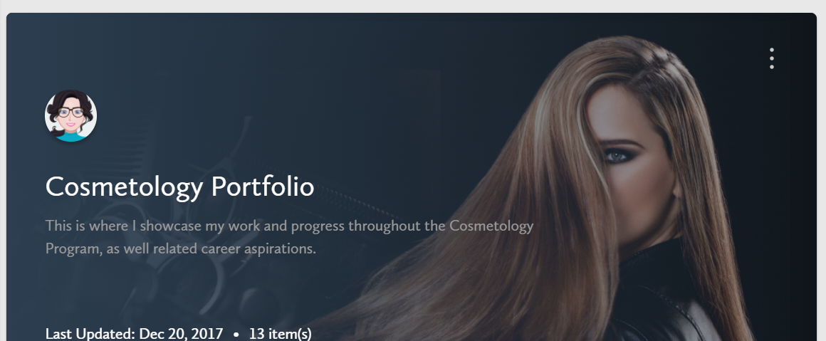
Cooperative/Technology Education Portfolio
Toronto Catholic DSB, Toronto District SB, Halton Catholic DSB, Hanover SD, & Dufferin-Peel Catholic DSB
Students enrolled in vocational programs create a portfolio to showcase their:
    individual work,
    learning experiences,
    skills,
    self-discovery,
    and career exploration
Students self-reflect on their growth and progress by adding reflections to their portfolio artefacts and journal entries
Portfolio is used as a final assessment

Slide 18
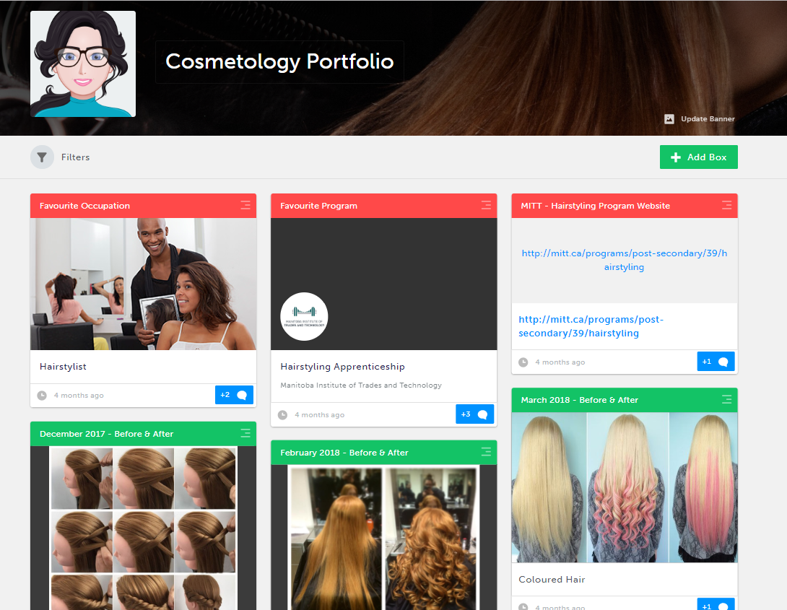
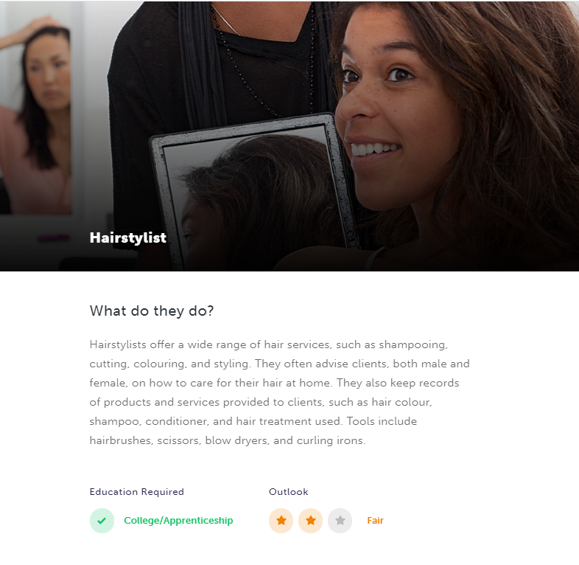
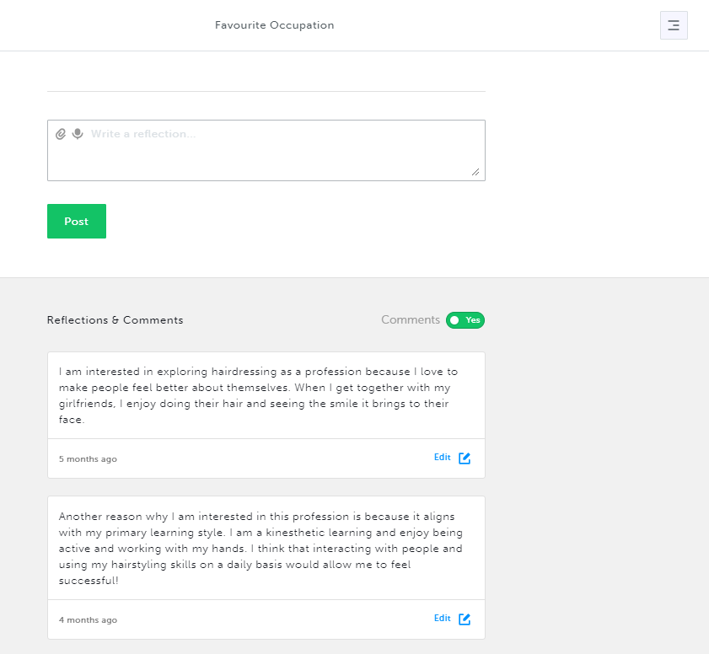
Cooperative/Technology Education Portfolio

Slide 19
Tips from Fort McMurray
Directive needs to come from the principal
Set specific expectations (i.e. use 3-5 times before Holidays in Career Education 9, English, Business, Physical Education, etc.)
Select a class (i.e. English) for all students to create new accounts in September
Indicate one school lead to support school implementation
Use quick overviews of activities, don’t make lesson plans too structured
Be mobile during class activities
Set a goal for your school, and stick to it – check in on progress and offer support

Slide 20
Roll-Out Strategy for the 2018-19 School Year
What are your objectives for Career Education in 2018/19
What are your current initiatives for Career Education across the province and in your boards?
How do you see myBlueprint being a good fit to support staff and students with these initiatives?
Who would you like to target this school year? Admin, counsellors, teachers, etc.
Fill out your Implementation Plan Guide to outline your Board objectives for myBlueprint
Notes:
“… Gives the students the central role, allowing them to explore various fields that interest them…”
Empowering students to make the most informed decisions about their future

Slide 21
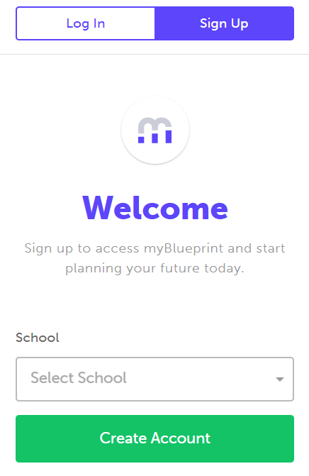
Creating a myBlueprint Account
Visit your District Landing Page
  www.myBlueprint.ca/anglophoneeast
  www.myBlueprint.ca/anglophononorth
  www.myBlueprint.ca/anglophonesouth
  www.myBlueprint.ca/anglophonewest
Select your school from the Sign Up tab
Click Create Account
Select your Role
Notes:
“… Gives the students the central role, allowing them to explore various fields that interest them…”
Empowering students to make the most informed decisions about their future

Slide 22




Thank You!
support@myBlueprint.ca
1-888-901-5505
www.myBlueprint.ca/support
  Getting Started Guides
  Lesson Plans
  Video Tutorials
@my_Blueprint

