Slide 1


BEFORE RUNNING YOUR TRAINING
Review slides 10, 11, and 19
  Add your board/district login information
Please email support@myBlueprint.ca if you are unaware of account access for students or account creation for teachers for All About Me Portfolio – we are happy to help!

Slide 2
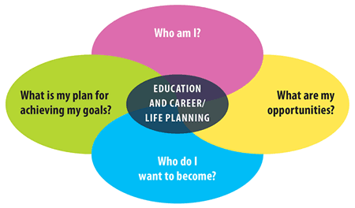
All About Me
Portfolio (K-6)
An introduction to the All About Me Portfolio
“Train The Trainer”
For questions or assistance, please contact:
support@myBlueprint.ca
1-888-901-5505
Notes:
Today I am here to introduce you to the All About Me platform that you will be using to fulfill the Pathways to Success mandate. We will start by discussing pathways, I will give a quick presentation showcasing the All About Me program, and finally give you a chance to explore in a demo student account.

Slide 3

Agenda
Introductions
Student Account Demo
Account Creation & Login Process
Play Time – Explore your Student Account
iOS Class Pass App
BREAK
Teacher Account Demo
Sharing of Educator Resources
Play Time – Create Classes, Explore Educator Resources, and Complete Exit Slip
Discuss our goals for the school year
Teacher Exit Slip Review

Slide 4

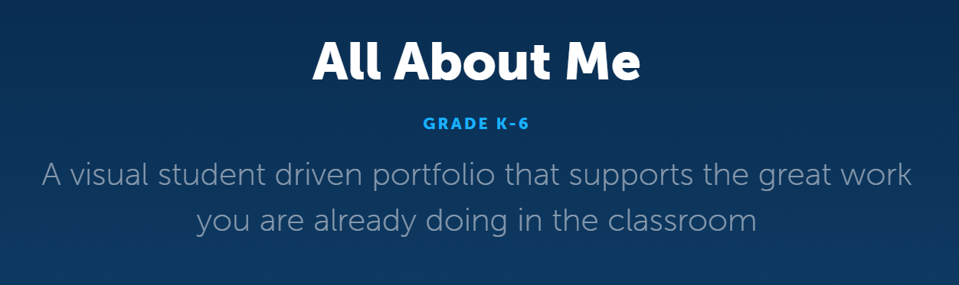
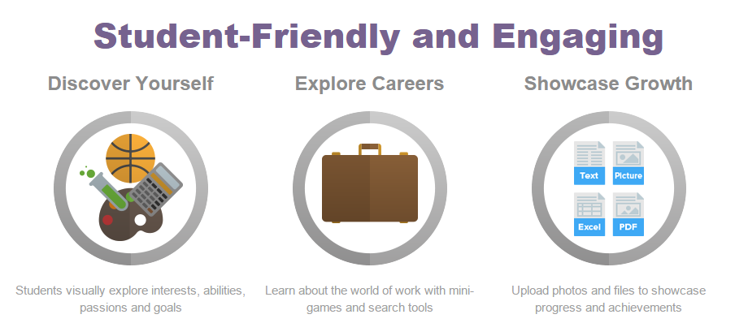
Notes:
We meet with the ministry often, so we knew that Pathways to Success was coming down the pipeline. And we were seeing a growing request to support younger students with career development and portfolio building. SO we launched the All About Me tool to meet the requirements for K-6 students.
Since the release of AAM last year, we have visited a number of schools across the province to run AAM classroom sessions and get feedback from teachers, administrators and students. Based on that feedback we have implemented a number of changes, including revamping our goal setting section, adding mini games and badges for student engagement, and making the design and content more student friendly.

Slide 5
Benefits for Teachers
Meets K-6 curriculum and learning outcomes, and helps students participate in Career Education
Provides opportunities to set goals with students directly related to subject areas, learning skills, and competencies
Encourages self-assessment and reflective inquiry
Promotes student leadership using the All About Me Ambassadors Program
Encourages parent engagement through parent portal
Provides the ability to create custom class activities for students to complete
Integrates with the Education Planner Portfolio (7-12) for a K-12 portfolio solution
Can access 30+ lesson plans and curriculum connection documents, including unlimited support

Slide 6
All About Me Feedback
“The students really like the Avatars, exploring the possible future jobs, and having the chance to reflect by voice to text. The badges are also well liked!!” –Grade 2 Teacher, DPCDSB
“From what I have experienced so far, the program is an easy tool to use for all students. The diverse learners in my classroom have approached myBlueprint with ease.” – Grade 4 Teacher, HCDSB
“Grade 3 students were able to get on easily and very much enjoyed exploring the site. It was easy for students to navigate and they enjoyed collecting the badges.” Grade 3 Teacher, CDSBEO

Slide 7
What are you currently doing to address these four career education inquiry questions?
Who Am I? | What are my opportunities?
Who do I want to become? | How am I going to achieve my goals?
Notes:
Optional: Printout the ‘All About Me Place mat Activity’ and have staff fill in what they are already doing in their classroom to address the four inquiry questions.

Slide 8

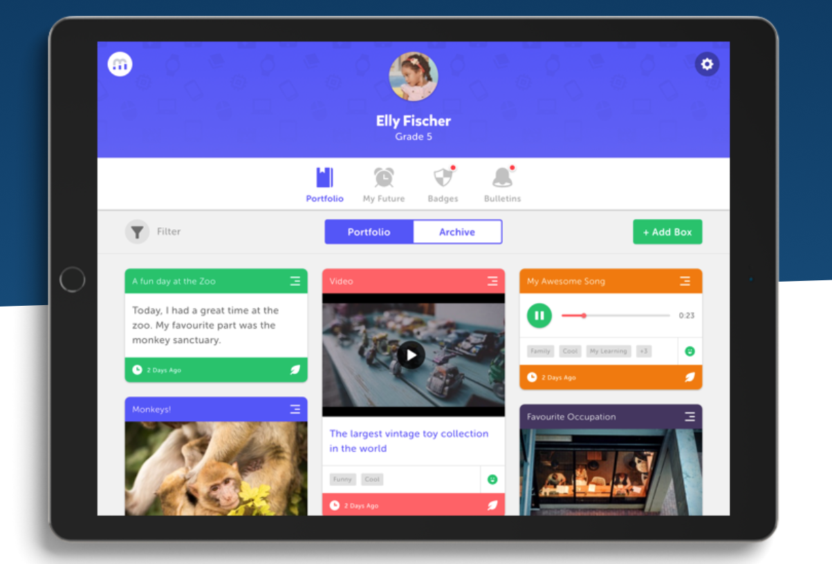
A live walk-through of the Student Account

Slide 9

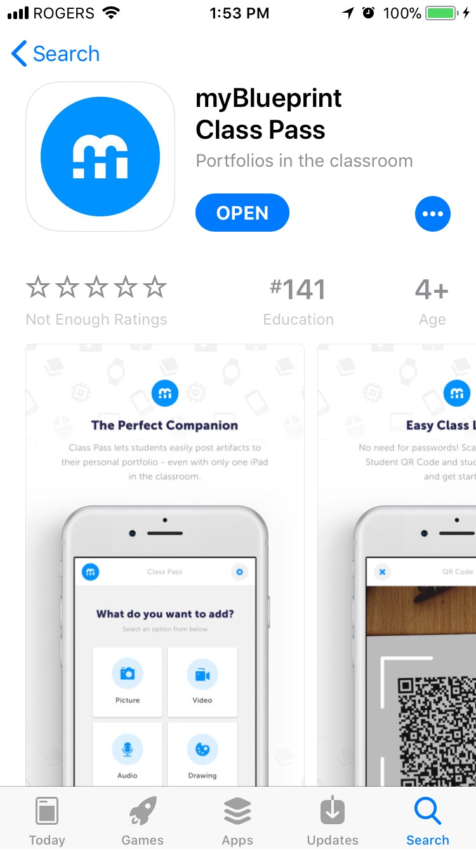
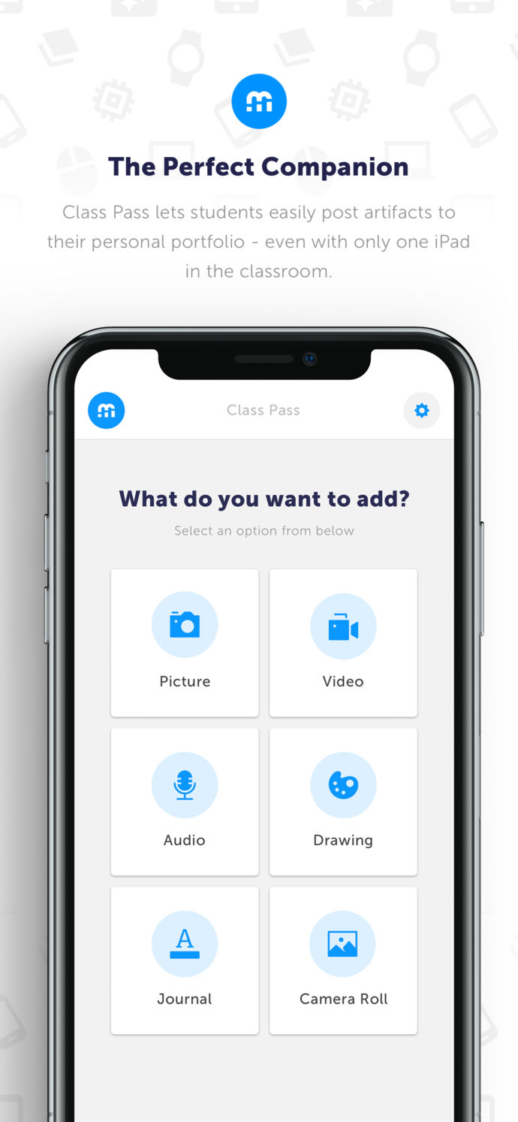
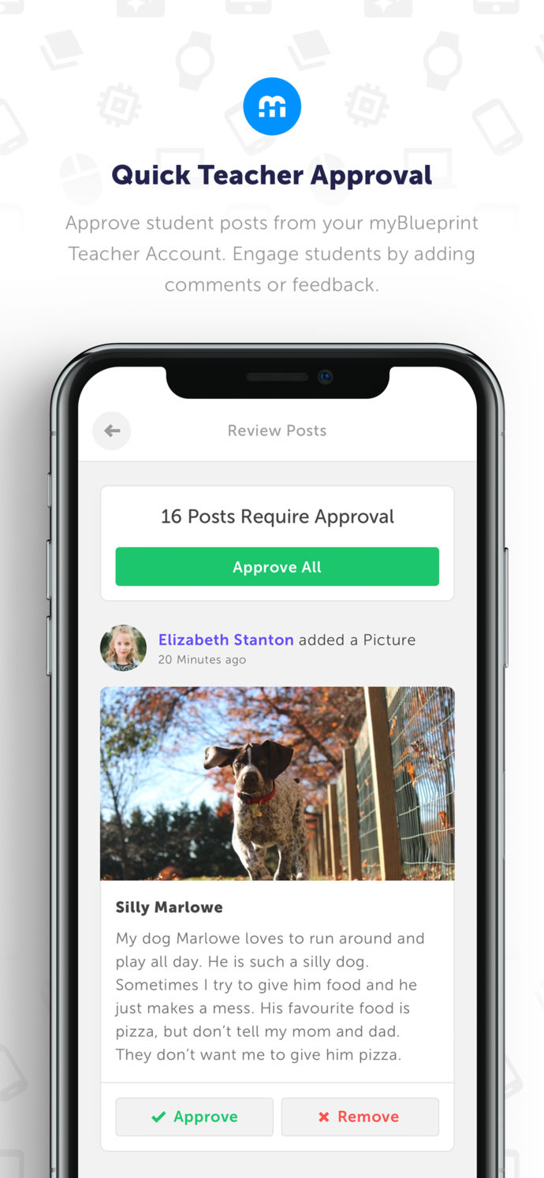
Class Pass App
Easy class login with limited access to technology
Student or Teacher Driven
Easily post artifacts, media, and evidence of learning to multiple All About Me student portfolios
For more info, check out our blog post HERE!
Notes:
After showcasing the Student Account, introduce the iOS Class Pass app to your staff. For more info, check out the blog post linked in the slide.

Slide 10
Student Login Information
Student accounts are pre-created by the myBlueprint team. Therefore, students simply need to login (and can do so right away)!
They will simply:
  Visit www.myblueprint.ca and click Log In
  Enter username: INSERT BOARD/SCHOOL USERNAME
  Enter password: PROVINCIAL EDUCATION NUMBER OR QR CODE
Please email support@myBlueprint.ca if you do not know your students’ username and password combinations.

Slide 11
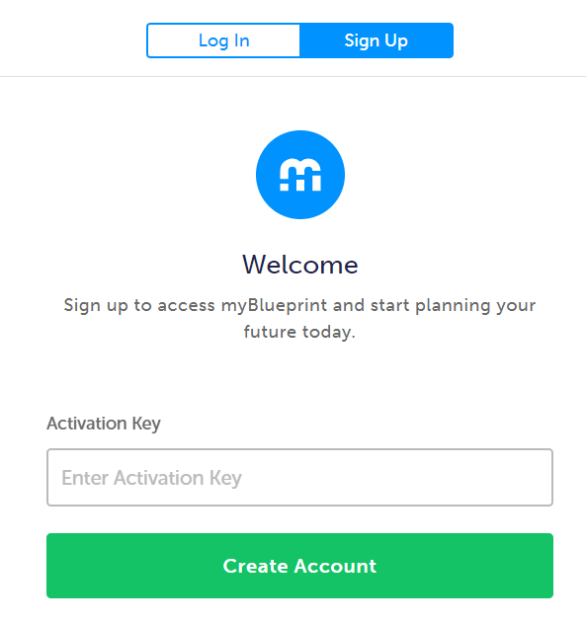
Creating your All About Me Teacher Account
Visit www.myBlueprint.ca
Click Sign Up
Enter your board/division’s activation key and click Create Account
Select your Account Type (i.e., Teacher)
Complete the registration form
Wait briefly for approval – administrator log in and approve accounts
Notes:
Go through the steps on this slide with your staff. You can also hand out the Getting Started Guide for Teachers to support the process.
Make sure that you log in to your account, go to the Staff Manager (from the menu icon or your dashboard), and click Approve to the right of all teacher requests. Alternatively, you will receive emails for each account, and you can simply click Approve from their.

Slide 12
A live walk-through of the Teacher Account
Notes:
Showcase the Teacher Account

Slide 13
Your Next Steps
Step 1: Create a class
Step 2: Explore your Teacher Account
    Complete the Teacher Account Checklist listed in the Getting Started Guide
    Check out the Educator Resources (i.e., Lesson Plans, Curriculum Connections documents www.myBlueprint.ca/Support)
Step 3: Fill out the Teacher Exit Slip
Notes:
Hand out the Getting Started Guide for Teachers as well as the Teacher Exit Slip to support their exploration.

Slide 14
How can All About Me support what you are already doing in the classroom?
Who Am I? | What are my opportunities?
Who do I want to become? | How am I going to achieve my goals?
Notes:
Let’s go back to our previous handout and see how the program can support what we are already doing in the classroom. If you skipped this slide at the beginning, skip it again now.

Slide 15
Team Discussion
In pairs, discuss how you will implement All About Me Portfolio in and outside of your classroom.

Slide 16
Share your Implementation Ideas
In the classroom | Outside of the classroom
- | -
- | -
- | -
- | -
- | -
- | -
Notes:
Next slide has ideas from other schools/boards for your review. You can write a list on the board or directly on the slides. Then you can share the information with all staff as your own list of ideas for them to try in their class. Add to the list after each staff meeting when a teacher presents their ideas.

Slide 17
Example from Starship Elementary School
All students use AAM to run student-led conferences
All students set Learning Skills goals after report cards
Monthly: students use AAM for character education and reflect on the character trait of the month
All Grade 5/6 students trained as AAM Ambassadors to support younger students with portfolio building
School teams/clubs use AAM for goal setting
September/October: share AAM with all parents at curriculum night
Each term: discuss and share AAM portfolio at parent interviews
June: all students add a journal entry to share/reflect on their favourite memory from the year (i.e., grade) and add a picture

Slide 18
Important Implementation Questions
What are your goals for the program for the school year?
Are you interested in implementing the All About Me Ambassadors Program?
How will you introduce the program to students?

Slide 19
Exit Slip Review
Where can you access Video Tutorials for AAM student and teacher account features?
  www.myBlueprint.ca/Support/Videos
2. Where can you access 100+ lesson plans for AAM?
  www.myBlueprint.ca/Support/Lessonplans
3. Where can you find grade-specific AAM Curriculum Connections documents?
  www.myBlueprint.ca/Support/Resources
4. How do students login to their All About Me account?
  Visit www.myBlueprint.ca
  Enter username: INSERT BOARD/SCHOOL USERNAME
  Enter password: PROVINCIAL EDUCATION NUMBER
Notes:
With your staff team, take up the Exit Slip questions using the answer key on slides 18-20.

Slide 20
Exit Slip Review
5. How do teachers log in to their account?
  Visit www.myBlueprint.ca
  Click Log In
  Enter your school email address as your username
  Enter the password you created when signing up
6. How can you view a student’s All About Me Portfolio from your Teacher Account?
  Click on your Class box
  Click on the three dots to the right of a student’s name
  Select View Account
7. Where can you comment on and assess students’ work in your Teacher Account?
  Click on your Class box
  Select the Feed tab

Slide 21
Exit Slip Review
8. How do family members access their child’s portfolio? Can family create an account?
  By receiving an account invitation from a teacher
    Go to Classes
    Click on the class box
    Click on the three dots at the right of the student’s name and select Add Family
    Enter a valid email address and click Add
  By logging in with the student at home
9. What are two benefits of using the iOS Class Pass App and where can you generate a QR Code to log in?
  Can easily integrate All About Me with limited access to technology in the classroom
  Can post artifacts to multiple All About Me student portfolios
10. Where can you generate a class QR Code to login to the Class Pass app?
  Can generate a Class QR Code from your Teacher Account > Classes > Class Options > QR Codes

Slide 22





Connect with us!
@myBlueprint
@myBlueprint
@myBlueprint.ca
community.myBlueprint.ca

Slide 23

Visit our Support Centre
For guides, lesson plans, video tutorials, and more.
myBlueprint.ca/Support

Slide 24
Questions? Feedback?
Contact our amazing Support Team
support@myBlueprint.ca
1-888-901-5505

Slide 25
Thank you!
support@myBlueprint.ca
1-888-901-5505

