Slide 1


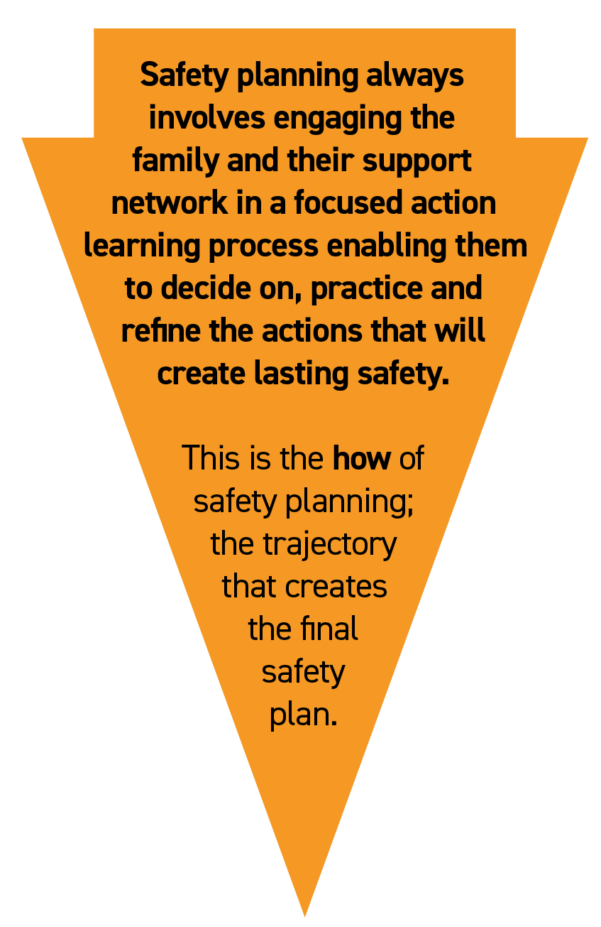




SAFETY PLANNING ROADMAP
WHAT
HOW
(STEPS)
TOOLS
(METHODS)
DANGER STATEMENTS
What Children’s Services is worried will
happen to the child if
nothing changes (the problem that
has to be solved)
Preparations with Professionals
Ongoing
Processes
Develop Paired Danger Statements and Safety Goals with Matched Safety Scales
Simple language, understandable to family.
Harm Matrix
Signs of Safety Mapping
My Three Houses or equivalent
Identify everything constructive in direct parenting
Develop Professional bottom-line requirements
Develop Professional trajectory including timeline
Signs of Safety Trajectory & Timeline
Safety Journal
Build vision of process for family
Build informed network with family
Family Safety Circles, Network-finding Matrix
Create explanation for children (and everyone else)
Words and Pictures
Build Safety Plan with parents and network
Successive process where family demonstrates over time they can
make children safe, regular review — honouring success and
utilising struggles. All participants should rate safety at each meeting using the safety scales.
Need to dig into critical issues — dynamics, triggers and
stressful times that make abuse/neglect more likely. The family
must either come up with or fully own all rules. ‘Denial’ issues
must be dealt with throughout.
Regular Review Meetings
Family and network must be given the
opportunity to fail so they can demonstrate
success, usually through an
increasing process of contact. Professionals must
be mindful of the risk and manage this together with the family.
SAFETY GOALS
What Children’s Services needs to see
to know the child is safe
and they can close the case
(not services)
Involve child
Safety Journal, Safety Object
Practice Rehearsals of Rules
Monitoring by Professionals and network
Create final child-centred Safety Plan
Child-focused Safety Plan
©2018 Resolutions Consultancy

