Slide 1
Introducing apprenticeships with Early connect
Update for parents, guardians and carers to help them support a young person in finding apprenticeship and career opportunities.
Notes:
Welcome
Good afternoon.
Thank you all for joining
Welcome back to those of you returning from Module 1
And Welcome to those of you who are new to this Early Connect Module Series
Facilitator
My name is Anna Morrison, I am the Founder and Director of Amazing Apprenticeships and I am delighted to be facilitating the session today.
Also on the line today is XXX from UCAS and XXX from DfE.
Housekeeping
Before getting started, I just wanted to run through some housekeeping: - Interactive session – so you won’t be muted. You are in control of your own microphones! - Will be using breakout rooms later on so please be prepared to contribute - Mute / unmute microphones. - Chat functionality. - Session will be recorded (not breakout rooms).

Slide 2
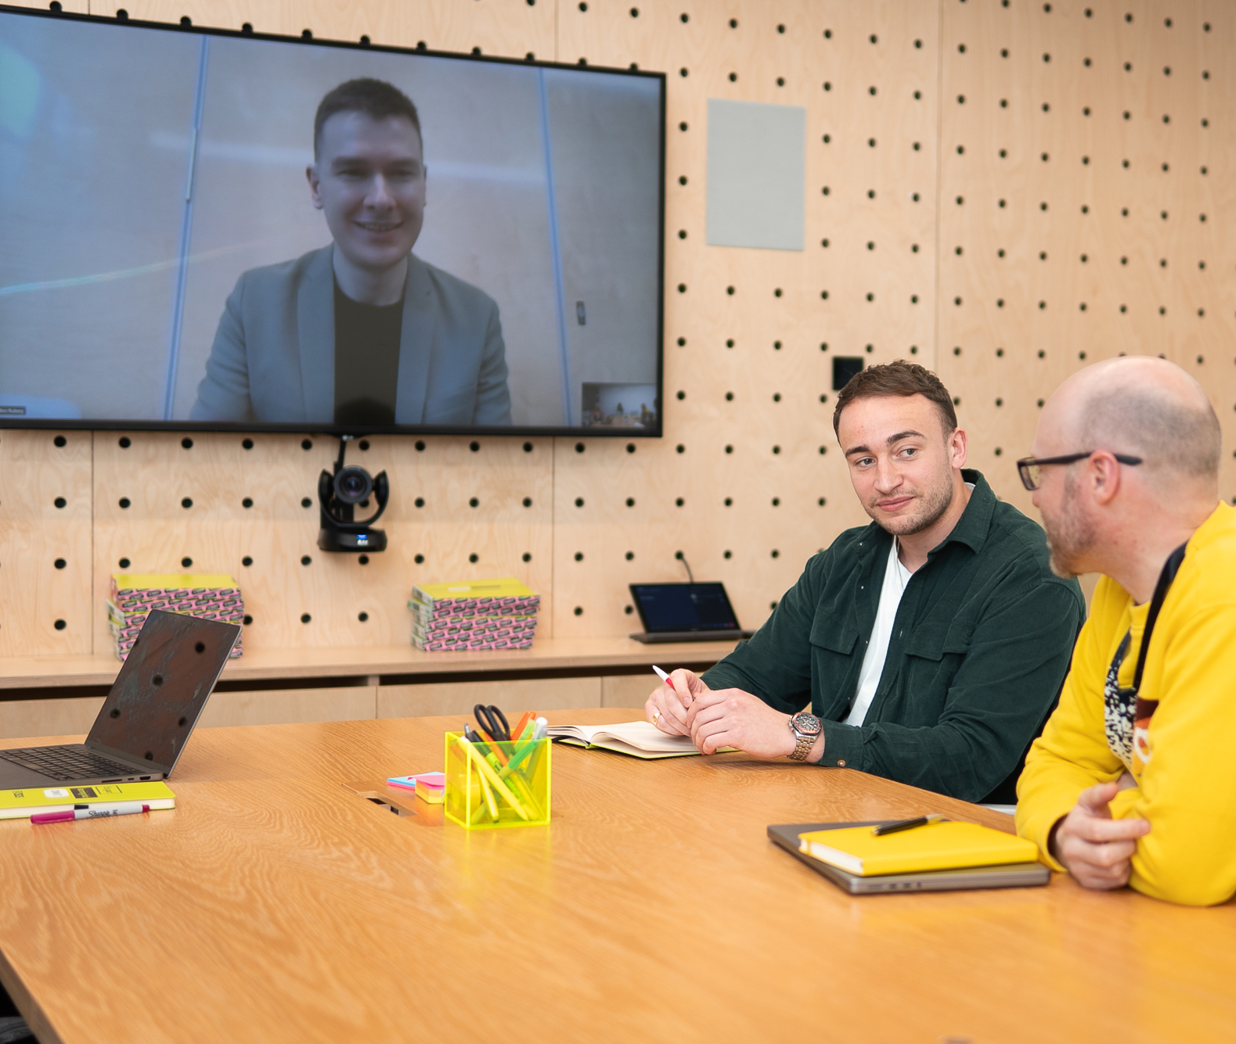
What’s an apprenticeship?
It’s a real job where you learn, gain experience, study for a qualification and get paid.
An apprentice is an employee, with a contract of employment and holiday leave.
Over 650 different apprenticeships available, from nuclear engineer to architect to digital marketer.
Notes:
Although I’m facilitating today’s session – we are also really fortunate to have a colleague from DfE XXX who will be on hand to answer any questions.
Today is the second of four CPD modules that have been designed to support the Early Connect pilot.
So, let’s just run through a little bit of background on Early Connect so we’re all on the same page.
Early Connect context
Early Connect was announced last February by the Department for Education and UCAS and is all about helping students to search and apply for apprenticeships in a more streamlined way.
Through the pilot, the DfE and UCAS aim to support schools/colleges to help their students to find and apply for apprenticeship vacancies on the UCAS Student Hub
Resources
As a part of the package of support, UCAS are developing resources for teachers/careers advisers and students to learn more about the Hub and the apprenticeship opportunities available
CPD offer
Alongside this, the Department for Education have contracted Amazing Apprenticeships to provide specialist expertise on apprenticeships and deliver CPD sessions for participating schools/colleges.
We have developed 4 modules which explore different themes on the apprenticeship journey and aim to support you in supporting your students
Suitable for careers leaders, teachers and all colleagues supporting Yr 13 students with their next steps – so please feel free to share and invite colleagues

Slide 3
3 Key facts about apprenticeships
An apprenticeship takes between one to six years to complete.
Apprentices typically work for a minimum of 30 hours a week (and most will work full time, between 37 – 40 hours per week). Part-time options are also available in some cases.
By the end of an apprenticeship, you’ll have the right skills and knowledge needed for your chosen career.
Notes:
There are lots of different ways to search for apprenticeship vacancies.
Many of which will involve students using real job search skills – that’s what’s unique about apprenticeships.
We need to get students familiar and comfortable with knowing to look in different places and the benefits of each.
UCAS Student Hub
Direct with employer
Social media – especially sites like LinkedIn are becoming a fantastic place for employers to advertise.
Other

Slide 4
How to understand the levels
There is an apprenticeship for everyone: some are more complex than others.
It is important to note that for apprenticeships, levels are only a rough guide.
For a year 13 school leaver with little or no work experience, a level 2 or Level 3 apprenticeship is a perfect entry point, even if you already have A levels, BTEC or T-Levels.
Some higher & degree apprenticeships give you the opportunity to combine university study and work.
LEVEL 2
LEVEL 3
LEVEL 4+
LEVEL 6-7
Intermediate
Advanced
Higher
Degree
Job roles include: Nuclear Operative, Junior Estate Agent, Rail Engineering Operative, Finance Assistant.
Job roles include: Chef De Partie, Fashion Assistant, Veterinary Nurse, IT Solutions Technician.
Job roles include: Marketing Executive, Journalist, Clinical Dental Technician.
Job roles include: Aerospace Engineer, Police Constable, Cyber Security Professional, Ecologist.
Notes:
There are lots of different ways to search for apprenticeship vacancies.
Many of which will involve students using real job search skills – that’s what’s unique about apprenticeships.
We need to get students familiar and comfortable with knowing to look in different places and the benefits of each.
UCAS Student Hub
Direct with employer
Social media – especially sites like LinkedIn are becoming a fantastic place for employers to advertise.
Other

Slide 5
Types of apprenticeships
There are over 650 different apprenticeship roles to consider, here are some examples:
First Officer Pilot
Doctor
Hairdresser
Paralegal
Beauty Therapist
Chef
Quantity Surveyor
Early Years Practitioner
Aerospace Engineer
Paramedic
Business Admin
Dietician
Notes:
There are lots of different ways to search for apprenticeship vacancies.
Many of which will involve students using real job search skills – that’s what’s unique about apprenticeships.
We need to get students familiar and comfortable with knowing to look in different places and the benefits of each.
UCAS Student Hub
Direct with employer
Social media – especially sites like LinkedIn are becoming a fantastic place for employers to advertise.
Other

Slide 6
How it works
Apprenticeships are funded by the Government and/or the employer. This means that apprentices won’t have loans or tuition fees.
Apprentices have time away from their day-job protected for study this tends to equate to a about a day a week but can be delivered in different fashions like blocks of study time or in the work-place. This is called ‘off-the-job’ training and is facilitated by a college, independent training provider, or a university.
The off-the-job time is paid time and included within working hours.
What apprentices earn will depend on the industry, location and type of apprenticeship.
Notes:
There are lots of different ways to search for apprenticeship vacancies.
Many of which will involve students using real job search skills – that’s what’s unique about apprenticeships.
We need to get students familiar and comfortable with knowing to look in different places and the benefits of each.
UCAS Student Hub
Direct with employer
Social media – especially sites like LinkedIn are becoming a fantastic place for employers to advertise.
Other

Slide 7
What is early connect?
A pilot being delivered in partnership between the Department for Education (DfE) and Local regional partners (London, North East, Lancashire).
Their aim is to support more young people onto apprenticeships and make it easier for employers to find apprentices.
To date a variety of employers have pledged thousands of apprenticeship vacancies in the three pilot regions.
Notes:
There are lots of different ways to search for apprenticeship vacancies.
Many of which will involve students using real job search skills – that’s what’s unique about apprenticeships.
We need to get students familiar and comfortable with knowing to look in different places and the benefits of each.
UCAS Student Hub
Direct with employer
Social media – especially sites like LinkedIn are becoming a fantastic place for employers to advertise.
Other

Slide 8
How can you support your child?
Encourage them to be open-minded to the pathway they might take after school/college.
Support them to explore and search for apprenticeship opportunities and encourage them to continue if they’re not successful the first time around.
Where you can, help them to research what the recruitment process might be like and how they might need to prepare.

Slide 9
How to explore and apply for apprenticeships
Students can use Find An Apprenticeship to:
Explore apprenticeship opportunities across all industries, employers and locations
Shortlist their favourites
Apply for apprenticeship vacancies
Set up alerts and notifications around favourite searches

Slide 10
What does your child need to do?
Set up an account on Find An Apprenticeship
Vacancies for summer 2025 starts will be advertised from November 2024
Create Alerts for favourite types of apprenticeship
Be proactive, explore employers own websites in industries of interest
Tailor the application for each vacancy, be positive about skills and experiences
Engage the local support in our pilot areas

Slide 11
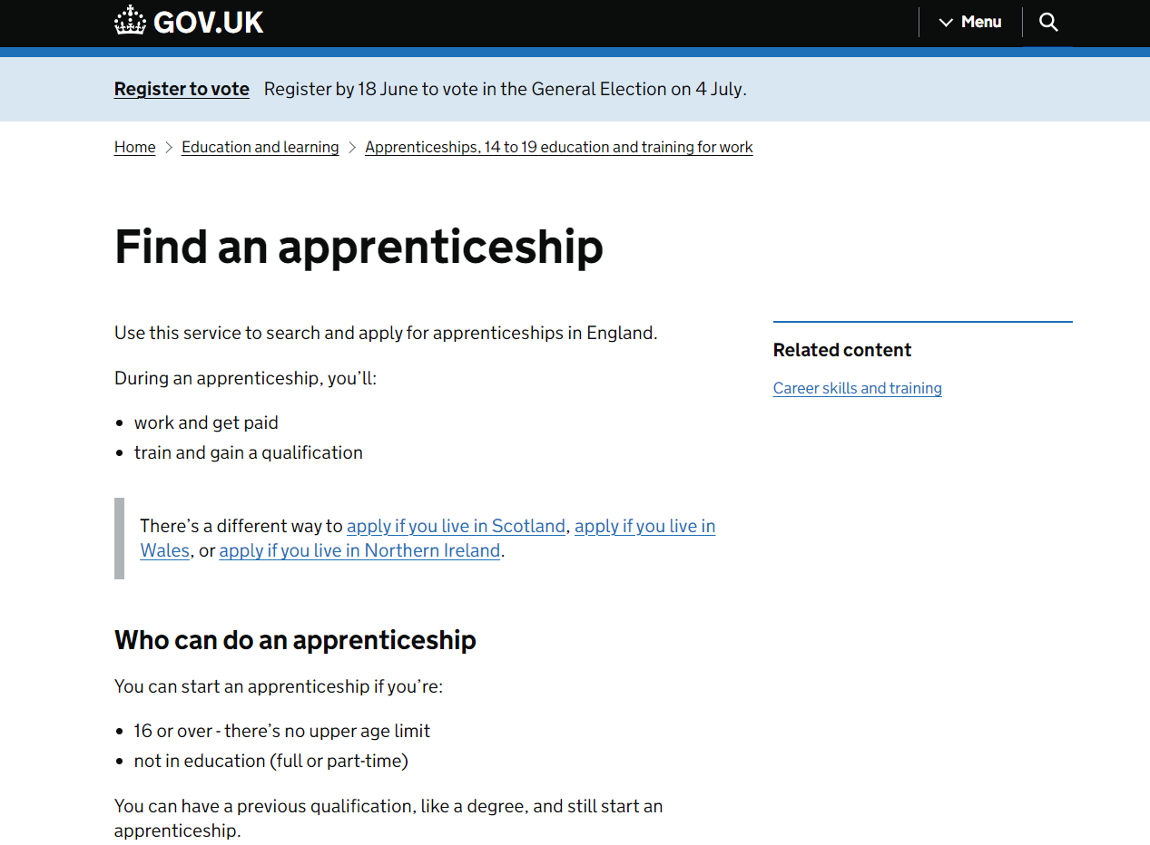
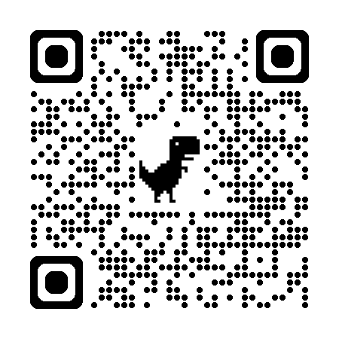
Create an account to search & apply for apprenticeships
Notes:
https://www.apprenticeships.gov.uk/apprentices/create-account

Slide 12
The student journey
Set up Alerts
Student defines interests and can sign up to be alerted when vacancies are added to FAA
October
Advisers signpost students to the FAA
Student registers for FAA
Explore apprenticeships
Search for vacancies
Make an application
Get An Apprenticeship Advisor

Slide 13
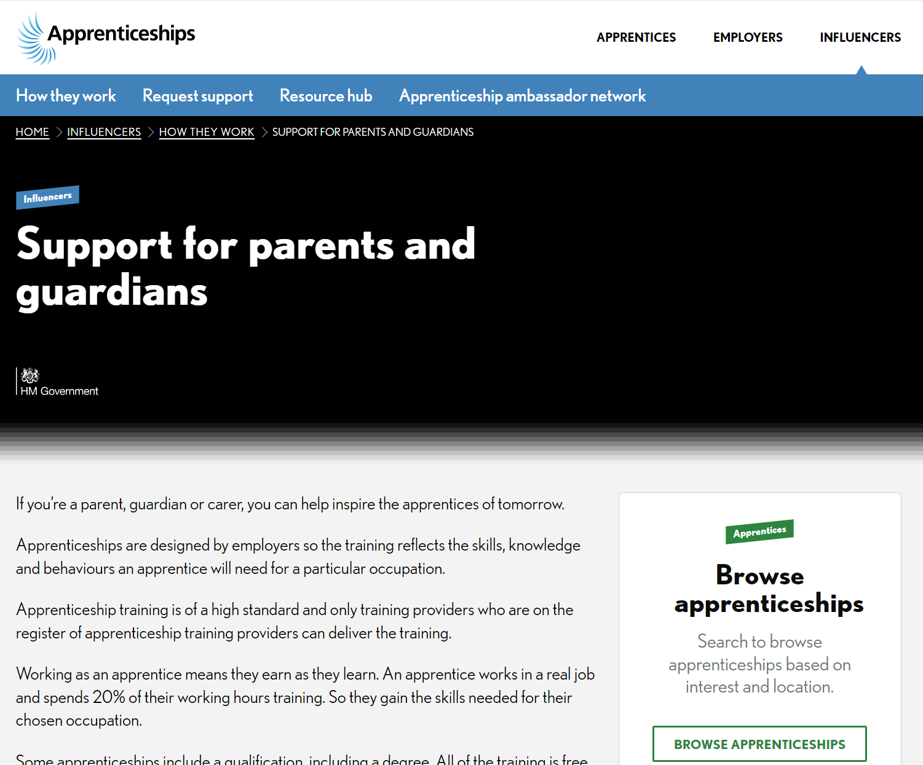
Support for parents
apprenticeships.gov.uk/influencers/support-for-parents-and-guardians
Find out more about apprenticeships
Access resources and support
Learn about apprentices’ real-life stories
Access the latest Parent & Carer apprenticeship newsletter

Slide 14
What local support is available?
For students seeking an apprenticeship and who need some extra support, our region will offer an enhanced support package to students, which could include:
Linking with employers in the area, helping them to broaden their search to consider a wider range of vacancies.
Support with applications, interviews and employability skills.
Additional support where individuals are not initially successful.
Notes:
There are lots of different ways to search for apprenticeship vacancies.
Many of which will involve students using real job search skills – that’s what’s unique about apprenticeships.
We need to get students familiar and comfortable with knowing to look in different places and the benefits of each.
UCAS Student Hub
Direct with employer
Social media – especially sites like LinkedIn are becoming a fantastic place for employers to advertise.
Other

Slide 15
Get An Apprenticeship Adviser
Why
Who
What
How
Harder to find and apply for apprenticeships than university or college courses.
One size does not fit all.
Partners in local areas understand opportunities and challenges.
For anyone in year 13 at school or college interested in securing an apprenticeship this year.
They may or may not have applied to university and have offers.
Share your details securely on digital service to be sent to the right people.
Tailored support from partners in your area by phone or email.
Free service.
Apply directly via an online form.
Contacted within 3 working days of completing form.

Slide 16
Local referral Links
North East
https://earlyconnect.apprenticeships.education.gov.uk/E37000025
London
https://earlyconnect.apprenticeships.education.gov.uk/E37000051
Lancashire
https://earlyconnect.apprenticeships.education.gov.uk/E37000019

Slide 17
If they see it they can be it
Visit the Institute for Apprenticeships for all the latest guidance and advice on future pathways for your students.

