Slide 1
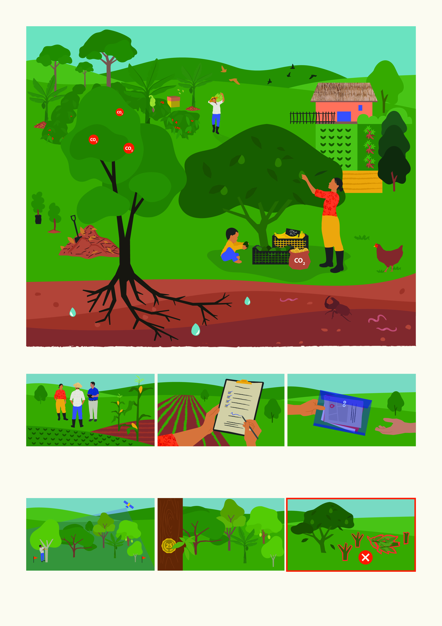

Acorn Carbon Agroforestry Program
increases biodiversity
captures carbon
diversifies income
protects farm
secures food
provides shade
enhances natural
fertilization
prevents erosion
improves soil and
water quality
How do you join Acorn?
Meet with a [local organization] representative and check if you fit the conditions to join Acorn.
Read, consider and sign the Participant Agreement and Consent Form.
Share the required information and show your land boundaries to the [local organization] representative.
What are the payment conditions?
The [local organization] has visited your farm and measured your land. Acorn has measured your trees with satellite technology.
Your trees are healthy, growing, and will remain on your farm for 25 years after they mature.
You haven’t cut or heavily pruned your trees.
Place your logo here

Slide 2
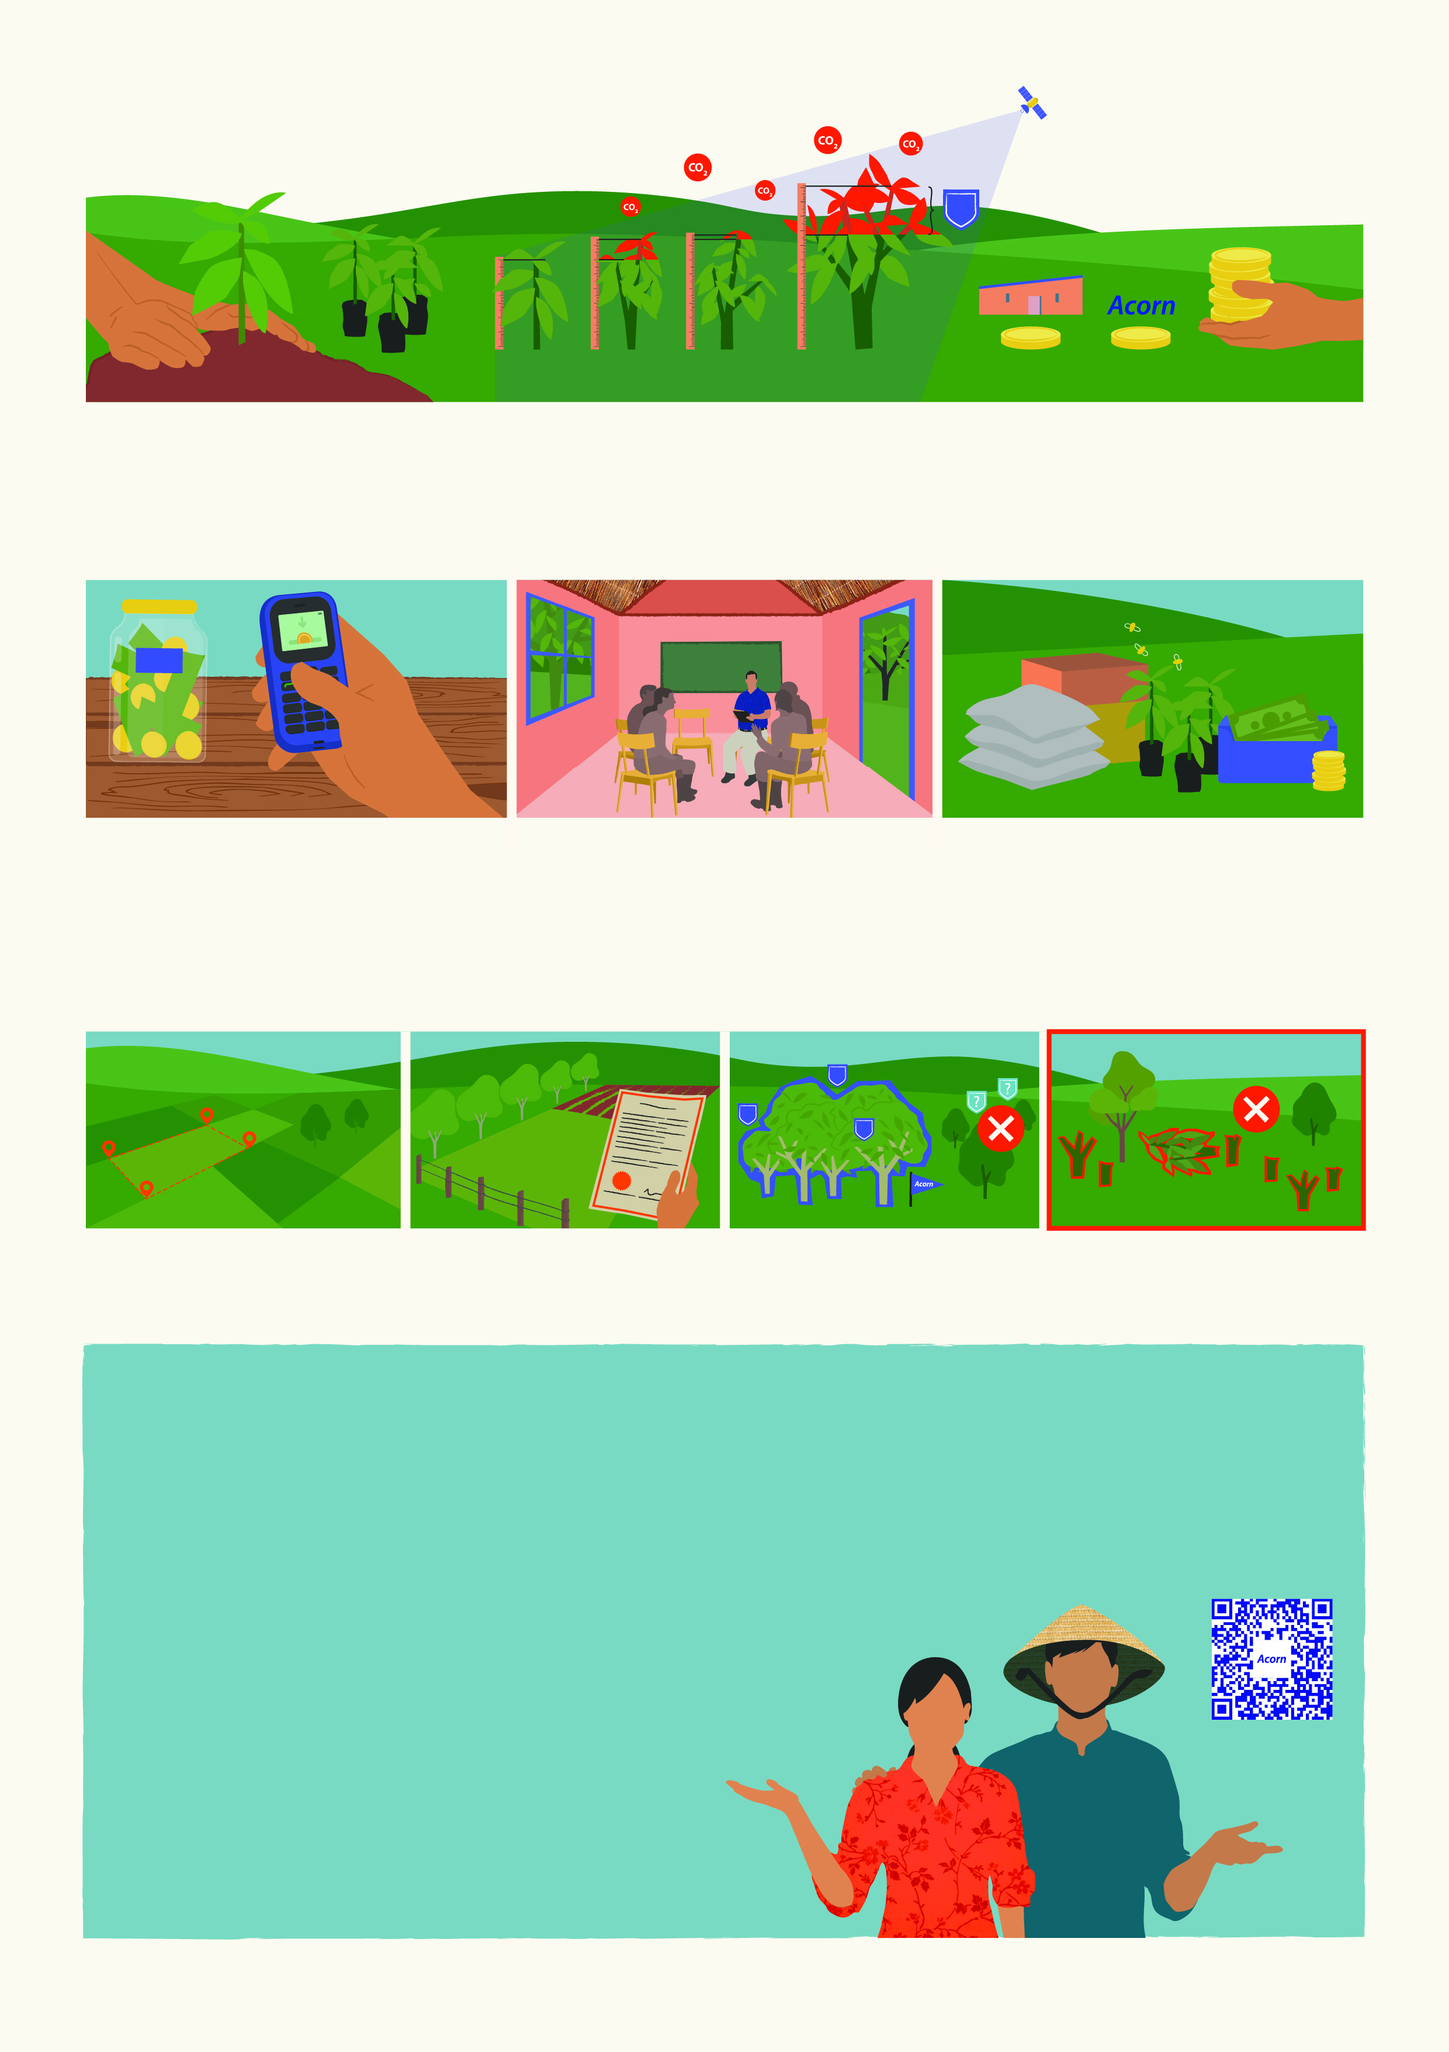
How much do you get paid?
CRU
Year 1
Year 2
Year 3
Year 4
Local organization
Program
You
The amount of your payment depends on the growth of your trees. Payment comes after your trees have grown big enough and stored at least 1 tonne of CO₂. This will take time! Acorn can measure the growth of the trees on your land, and how much CO₂ is stored in one year. This yearly growth is converted into CRUs sold in the Acorn marketplace. The price of 1 CRU depends on the demand of buyers.
How do you get paid and when?
Acorn Project Council Meeting
If you meet all the payment conditions, [the local organization] will deliver the payments annually after the CRUs are sold. Please make sure your contact information is correct.
In the Acorn project council, farmers can decide together how to receive payments and address other matters regarding the project.
Payments can be received in cash or through community projects or investments, like seedlings, beehives, etc.
To join Acorn, you must meet these conditions:
CRU
CRU
CRU
Own 0.1-10 hectares. Acorn only measures trees 5 years or younger.
Have proof of land ownership
in some form.
Acorn is the only tree carbon program you can join.
Have not cut down or cleared a large area of trees from your land in the last 5 years.
Inform your local representative if...
You sell your plot or the ownership changes.
You plan to use more land to plant trees for CRUs.
You have questions or feedback about Acorn.
Your plot is affected by fire or flood.
Someone in your community wants to join Acorn.
You want to stop participating in Acorn.
Your personal information changes (e.g., phone number).
Do you have a problem or concern?
Contact your local representative
[Name]
[Phone number]
[Email]
Scan the code to learn more
Still need help? Contact Acorn
SMS: 003197008101071 (SMS text only, international costs apply)
Email: acorn.complaints@rabobank.com
Place your logo here

Slide 3
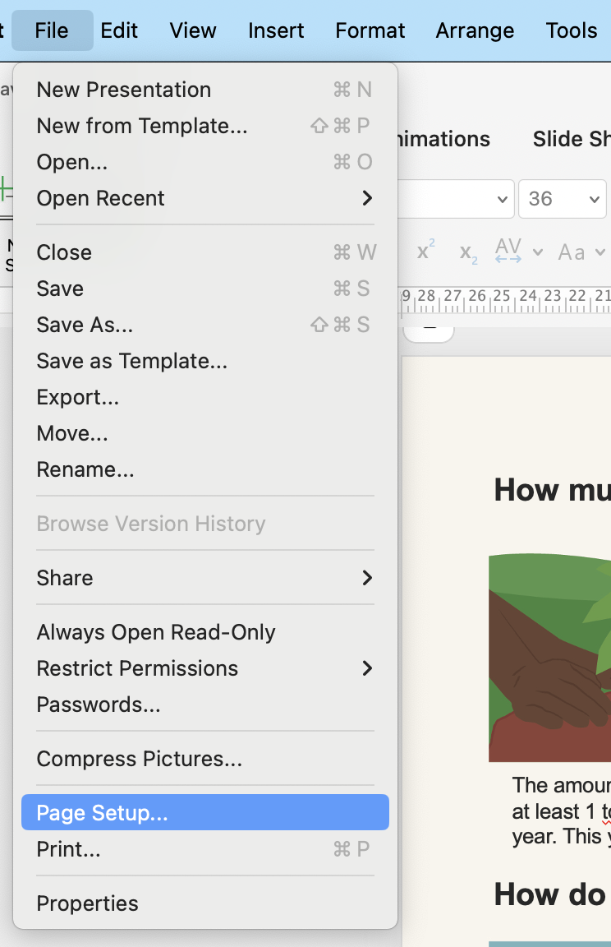
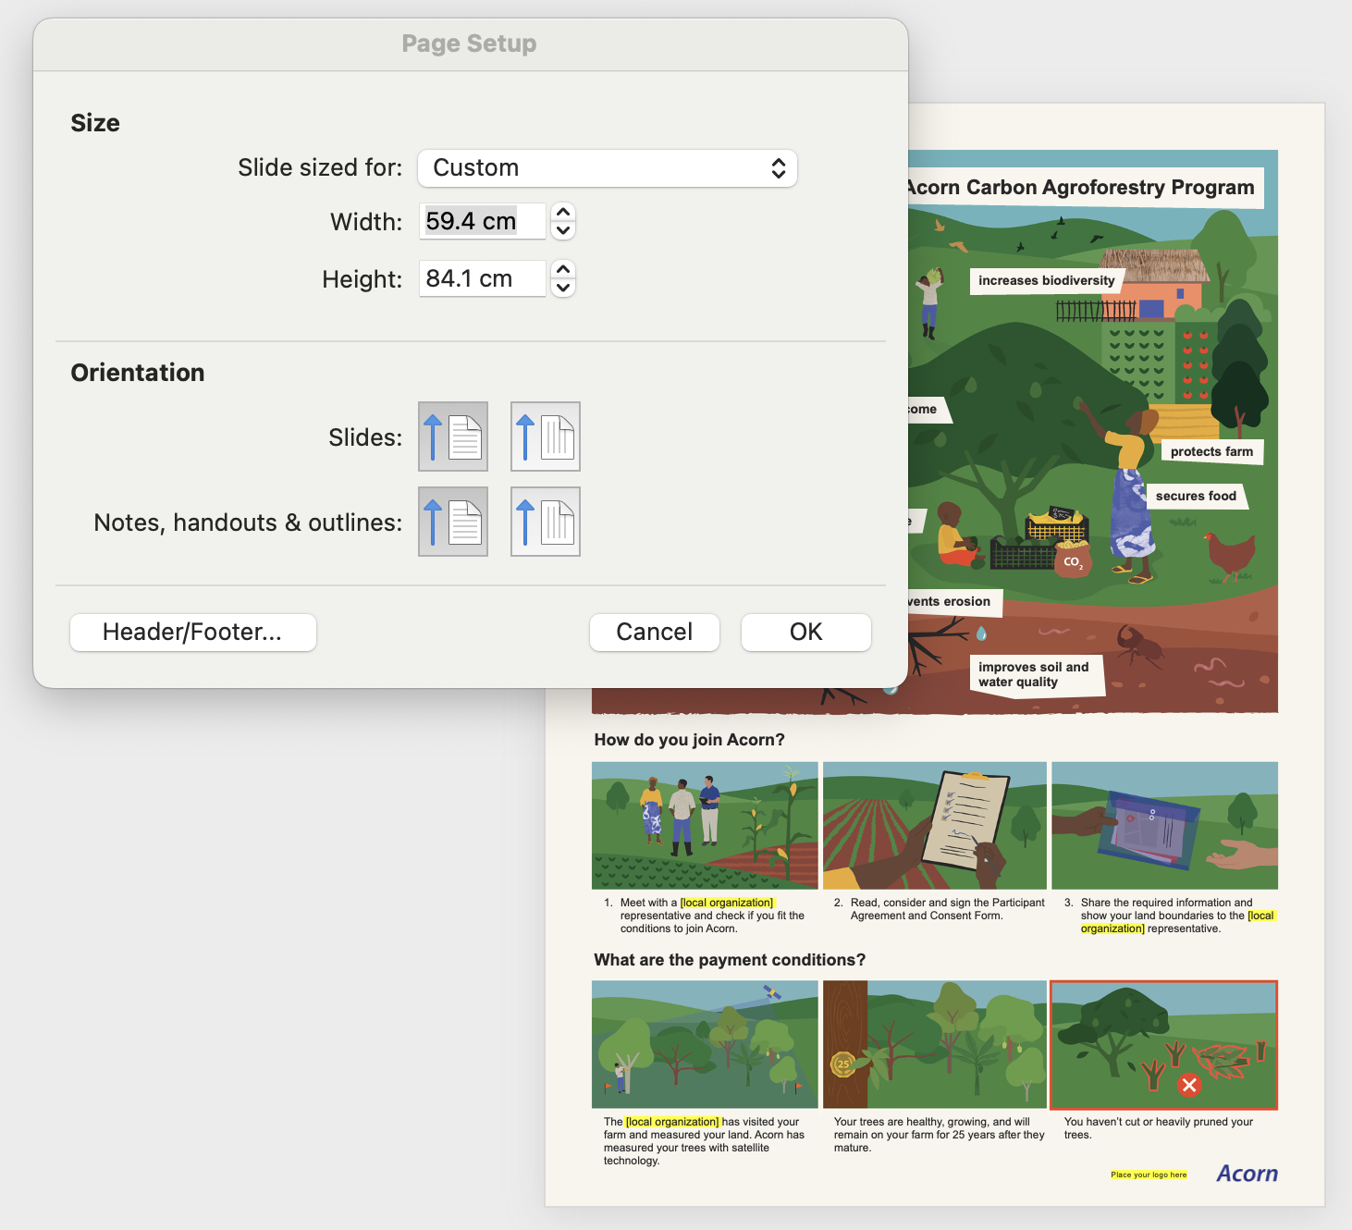
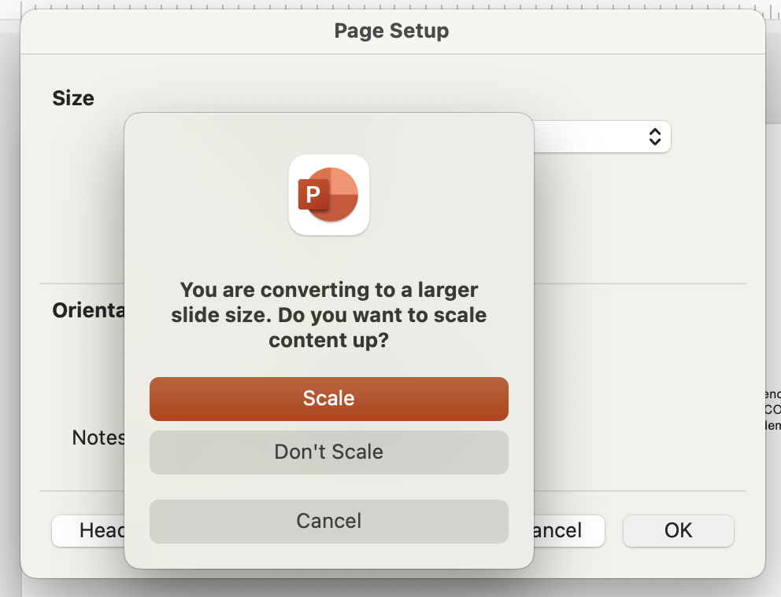
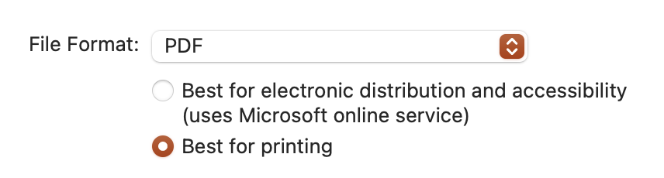
How to resize this file for A0, A1, and A4?
1. Access the slide size settings
Go to file > Page Setup… (or Design > Slide Size > Custom Slide Size, depending on your version of PowerPoint).
2. Enter the desired dimensions
In the "Slide Size" window, set the following dimensions::
For A4: Set the dimensions to 21 cm (Width) x 29.7 cm (Height).
For A1: Set the dimensions to 59.4 cm (Width) x 84.1 cm (Height).
For A0: Set the dimensions to 84.1 cm (Width) x 118.9 cm (Height).
3. Adjust Content
PowerPoint will prompt you with two options: Scale / Don’t Scale.
Click “Scale” to ensure your content fits the new dimensions.
How to export this file to PDF?
To ensure fonts display correctly, save it using the "Print" version of PDF instead of the "Online" version. Here’s how:
Go to “File” > “Save As” or “Export.”
Choose “PDF” as the file format.
In the options, select:
  On Windows: Standard (for printing) instead of Minimum size (for online).
  On Mac: Best for printing instead of Best for electronic distribution.
Save the file.

