Slide 1
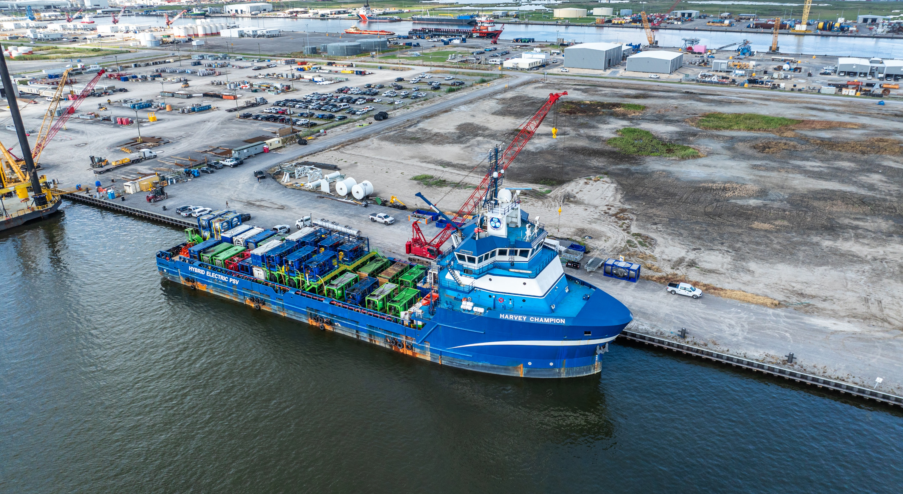
ENERGY SOLUTIONS
CLIENT
LLOG
YEAR
2025
BUSINESS LINE
Energy Solutions
GULF OF MEXICO DEEPWATER PRE-COMMISSIONING SUCCESS
Overcoming heat, space and scale.
We Delivered…
Pipeline experts - ensured rapid adaptation to evolving conditions
Heat Mitigation Plan – Safety protocols designed to safeguard crew wellbeing, and ensure optimal equipment performance
Custom equipment layout – Optimized deck space improved operational performance
Adaptive problem-solving – Real-time decisions overcame offshore technical constraints
Pre-commissioning multiple Gulf of Mexico pipelines for a customer involved two distinct operations: hydrotesting and dewatering, each with its own challenges.
Hydrotesting required high-pressure pumps operating at varying flow rates and pressures tailored to each pipeline section.
Following hydrotesting, dewatering was performed using high-capacity nitrogen systems. The target nitrogen flowrate was 10,000 scfm at up to 5,000 psi to meet the required pig speeds to facilitate dewatering. The Class 320’ vessel had to accommodate not only the large equipment spread, but also storage for fuel, MEG, and a 28-person crew.
Limited deck space, extreme summer heat, and MEG storage added complexity, demanding precise coordination and careful management of personnel and equipment.
EnerMech deployed experienced pipeline personnel who, through early engineering efforts and targeted equipment modifications, collaborated with the client to implement a comprehensive Heat Mitigation Plan addressing elevated deck temperatures and restricted airflow.
Custom manifolds and stacking platforms maximized space efficiency and ventilation.
Close coordination with the FPS, vessel crew, and client ensured real-time problem-solving, maintaining safety and operational continuity throughout the campaign.
The campaign was delivered safely, efficiently, and on schedule, exceeding client expectations in operational performance and team adaptability.
Hydrotesting and dewatering completed within schedule
Nitrogen spread safely operated under extreme heat during the summer months.
Seamless coordination with client and vessel teams
10,000 SCFM Nitrogen
It is the third time EnerMech has mobilized nitrogen at these high flow‑rates in the Gulf of Mexico.
6 Months of Engineered Planning
Six months of engineering went into planning and preparation before mobilization.

