Slide 1
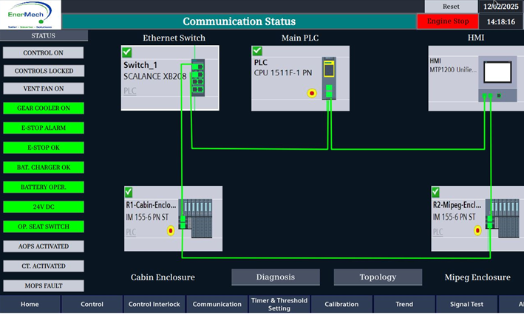

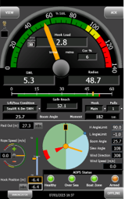
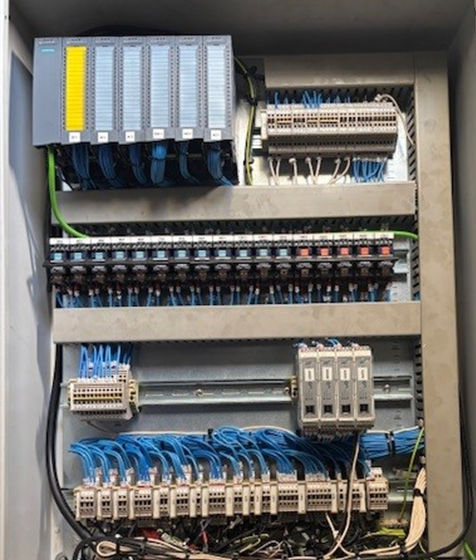
LIFTING SOLUTIONS
Multi-discipline collaboration
Reverse-engineered OEM system
Fit for purpose
CRANE CONTROL SYSTEM UPGRADE – NORTH SEA
Rebuilding performance through practical innovation.
Key achievements
As part of a control system upgrade on a North Sea platform crane in 2018, the OEM SLI system was replaced by a vendor to integrate the crane monitoring system. However, following the upgrade, crane function degraded. Operators identified concerns, particularly during boat lifts, citing inconstant system response and a lack of confidence in the crane control behaviour. As a result, the crane was restricted to essential lifts only and operated under strict Operational Risk Assessments (ORA) for a prolonged period.
EnerMech was approached to conduct a front-end engineering design (FEED) study and propose a technical solution that would address the operational issues, restore crane performance, and improve Operator confidence.
EnerMech developed and implemented a tailored solution aimed at restoring crane functionality and Operator confidence while ensuring reliability and safety. A proven MIPEG ‘X’ rated capacity indicator (RCI) system was installed to provide accurate load monitoring and enhanced safety features. To simplify maintenance and improve system robustness, a streamlined Siemens PLC was selected, focusing on reliability over complexity. The original hydraulic-over-hydraulic crane control system was reinstated to leverage the operators’ familiarity and avoid unnecessary redesign. Safety functions were integrated in accordance with standard, EN13852-1.
Additionally, EnerMech designed and manufactured a bespoke test rig to simulate crane operations, allowing full functional testing and validation of the new system in a controlled workshop environment prior to offshore installation.
EnerMech successfully delivered an in-house designed and fully tested control system that restored the crane’s full operational capability. A bespoke onshore test rig validated the integration of hydraulic and electrical interfaces, ensuring all functions were replicated as practically possible. Offshore installation and commissioning were completed smoothly, with an immediate improvement observed in crane performance and restored Operator confidence. All prior operational restrictions were removed, enabling safe, reliable, and unrestricted crane use.
Fully restored crane functionality and Crane Operator confidence.
Successfully integrated load monitoring and control in a single system.
Delivered a reliable, operator-focused solution using proven systems.
Zero rework required post-commissioning offshore.
This project highlights EnerMech’s commitment to delivering safe, reliable, and innovative solutions for our clients.

