Slide 1
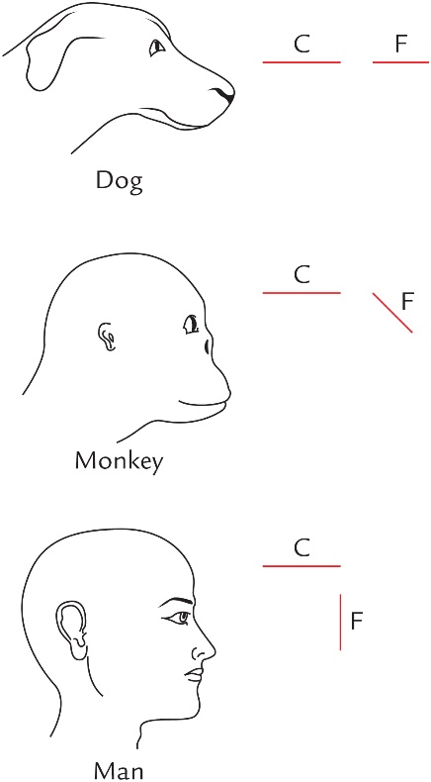
FIG. 1.1 Change in position of face in relation to cranium during evolution. The face is located in front of cranium in dog, below and in front of cranium in monkey and below the anterior part of cranium in man. Note that the size of jaws is inversely proportional to the size of cranium (C, Cranium; F, face).

Slide 2
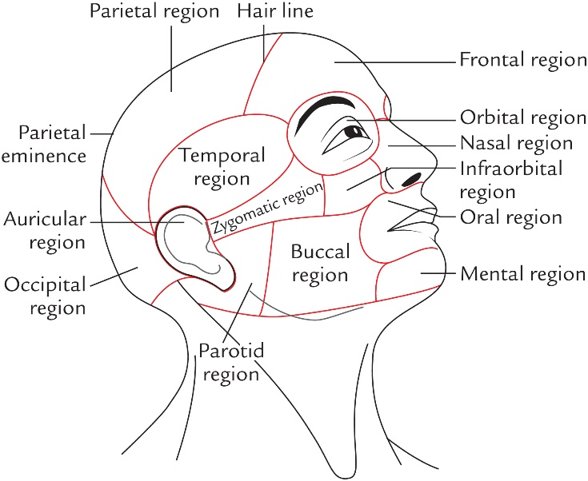
FIG. 1.2 Regions of the head.

Slide 3
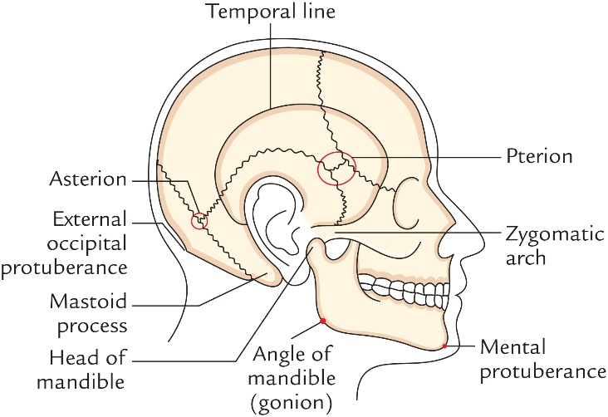
FIG. 1.3 Surface landmarks on the lateral aspect of the head.

Slide 4
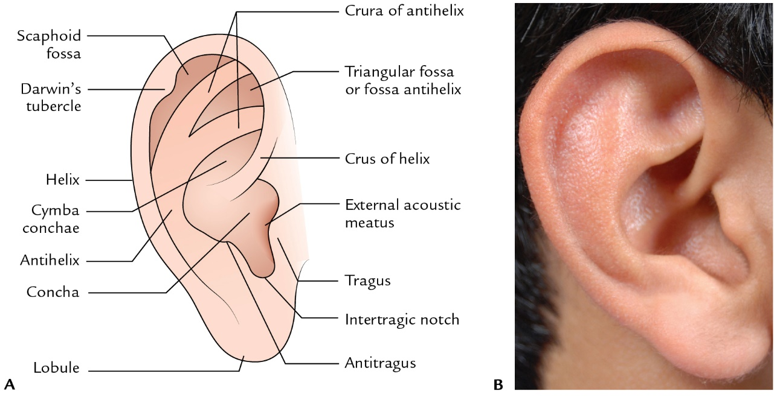
FIG. 1.4 Lateral view of right auricle.
(A) schematic figure (B) actual picture.

Slide 5
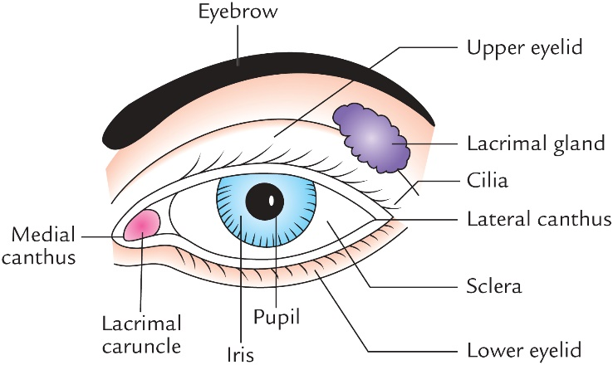
FIG. 1.5 Frontal view of the left eye.

Slide 6
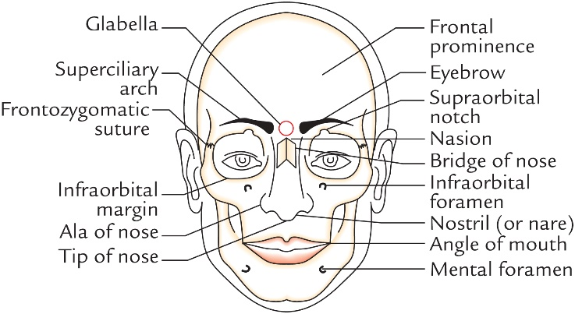
FIG. 1.6 Surface landmarks on frontal aspect of the head.

Slide 7
FIG. 1.7 Frontal view of the lips.
(A) schematic figure; (B) actual picture.

Slide 8
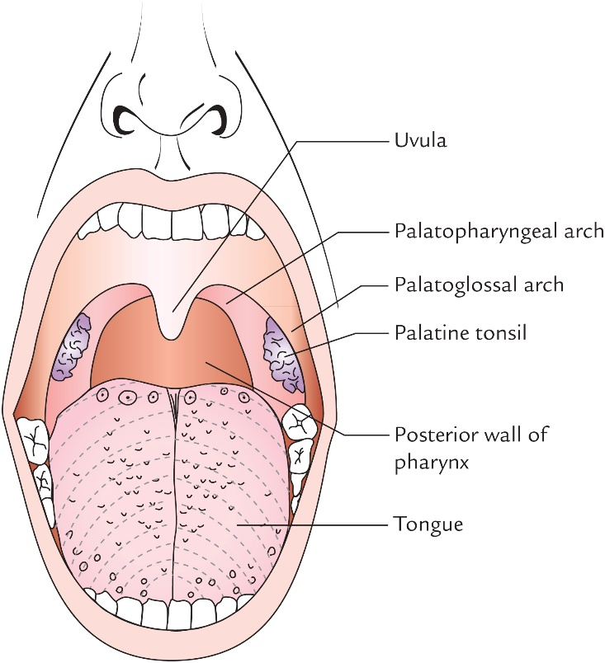
FIG. 1.8 Features of the oral cavity and oropharynx.

Slide 9
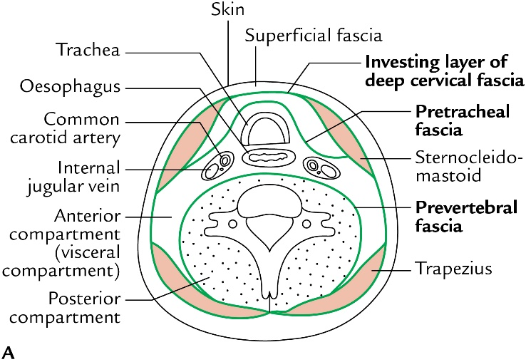
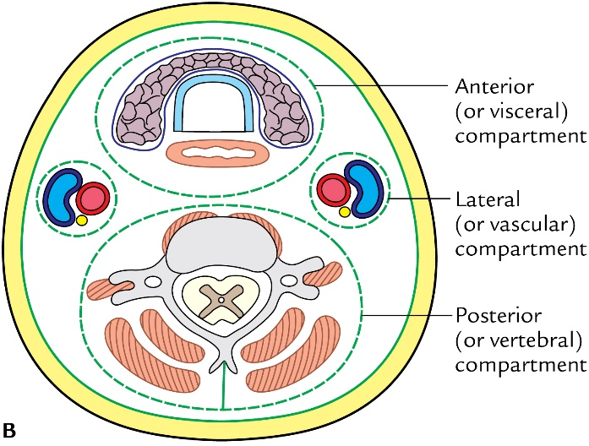
FIG. 1.9 The basic plan of the neck in cross section.
(A) Disposition of deep cervical fascia (B) Compartments of the neck.

Slide 10
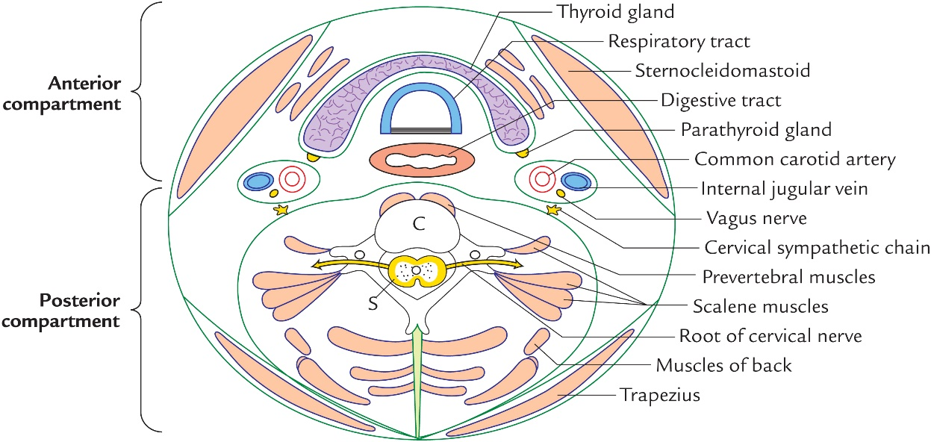
FIG. 1.10 Cross section of the neck showing anatomical details (S, Spinal cord; C, cervical vertebra).

Slide 11
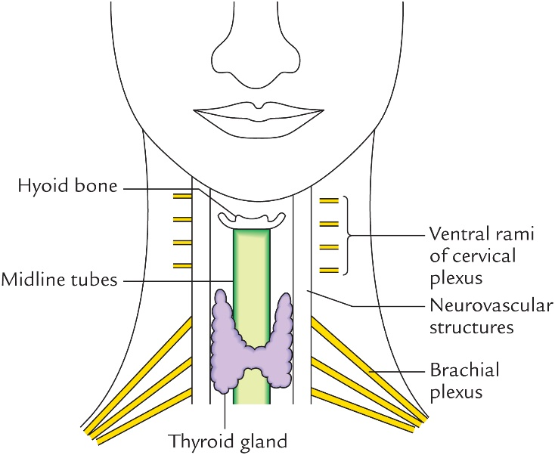
FIG. 1.11 Basic layout of structure of the neck.

Slide 12
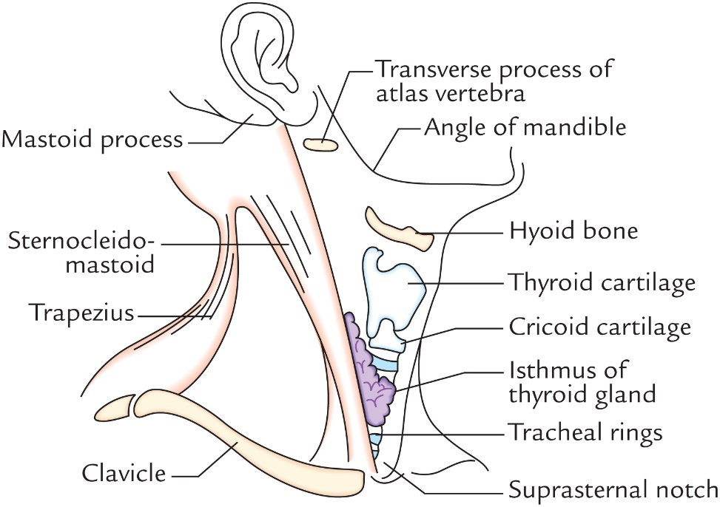
FIG. 1.12 Surface landmarks in the anterior median and lateral regions of the neck.

Slide 13
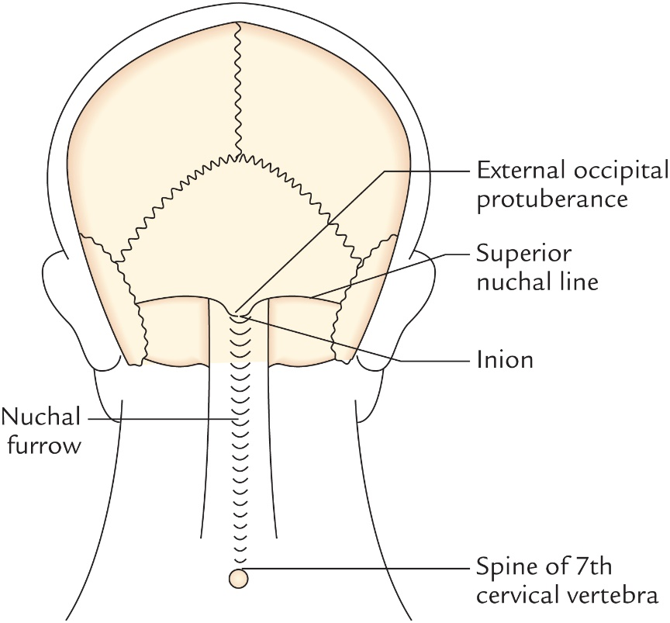
FIG. 1.13 Surface landmarks in the posterior region of the neck.

Slide 14
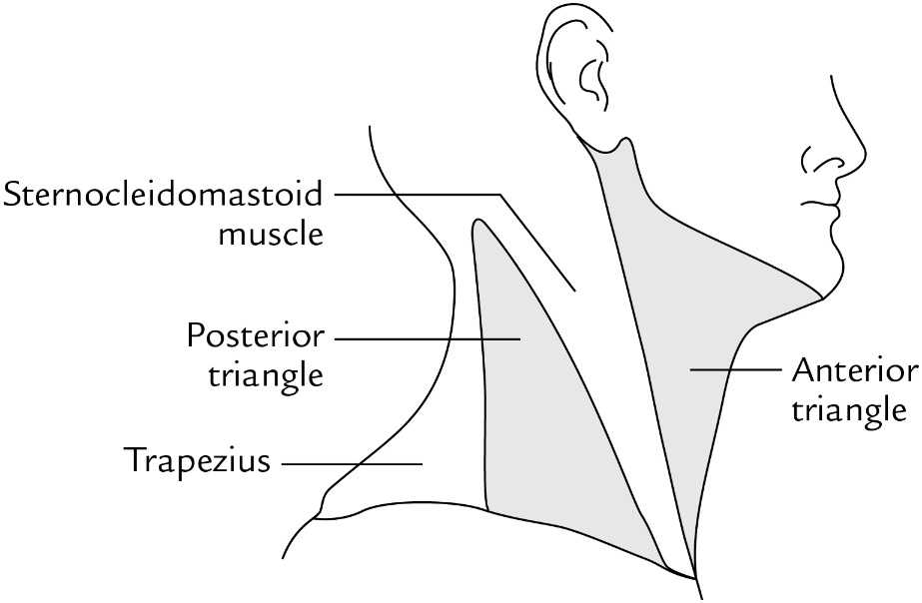
FIG. 1.14 Location of the anterior and posterior triangles of the side of neck.

