Slide 1
PIRCOM
Malaria Free Communities in Mozambique – Inhambane e Gaza
Januar 2017 – January 2020
Maputo, Mozambique

Slide 2
Contents
Progress updates on general key learnings
Key project learning to date (focus on key areas of priority identified for collective learning) including challenges.
Methodologies/tools used
Adaptive measures taken (and any outcomes)
Any evidence/results to support the learning

Slide 3
PIRCOM interest in the collective learning process
Use of SBCC community approaches to improve the adoption of malaria preventive methods and treatment opportunities:
How these approaches are implemented in the different community contexts?
Which are the more/less effectives and in which conditions?
Which are the contributions of these approaches in the impact and sustainability of health information systems?

Slide 4
Project learning questions
What is the contribution of PIRCOM frontline workers for malaria prevention and treatment?
How the community mobilization (focused on women focal group meetings) has influenced the adherence to ANC and TIP and women decision making for their own health situation?
What has been the impact of SBCC in the broader context of health system strengthening, including in case management improvement and malaria information system?

Slide 5
Question 1: Frontline workers – malaria prevention and treatment (1)
Key learnings
The use of diversified network of PIRCOM frontline workers allowed to reach more community members in many locations, using specific messages and without duplication of contents;
This process stimulated the complementarity in place of competitivity/conflicts and confrontations among the PIRCOM frontline workers different types;
Intrinsically, a continuous sequence of actions has been created at community level, where each actor has a specific role for malaria prevention and treatment.

Slide 6
Question 1: Frontline workers – malaria prevention and treatment (2)
Methodologies/tools used
Sermon scripts are used at the places of worship sermon scripts are used; posters and serial albums are used in home visits; specific topics guidelines are used in women focus groups; and radio programs are used in community radio stations;
The people reached are mobilized to use of malaria prevention methods and treatment opportunities; those who are found with febrile symptoms and malaria signs of malaria are referred to APEs and health units; and, when tested with malaria, are recommended for treatment and consultation of control;
Specifically, pregnant women are mobilized to seek / continue ANC, adhere to IPT, and sleep under the mosquito net; caregivers of children under 5 are mobilized to take them to prompt diagnosis and treatment in the health facilities in the case of first feverish symptoms and to make them sleep under the mosquito net;
Information is recorded and sent to district / local supervisors for use and updating of project implementation strategies.

Slide 7
Question 1: Frontline workers – malaria prevention and treatment (3)
Challenges, adaptive measures and supportive consequences
Following-up changes occurring in the community, especially among household members, regarding the use of malaria prevention methods and treatment opportunities
Reinforce follow-up visits (2nd, 3rd and subsequent)
Ensure that the same frontline workers who conducted the first visits, arrange for subsequent visits to the same households
Promote moments and opportunities for frontline workers to exchange experiences on their findings in the implementation of activities
Improved the interaction and humanization of frontline workers – households members relationships;
Increased awareness of people about how to prevent themselves, when to search for health facilities and the importance of taking complete medication;
Improved SBCC techniques from “simply passing awareness messages" to “supportive better use of malaria prevention methods and treatment opportunities"
Improved ability of frontline workers to intervene and communicate with community members and the Health facility staff and APEs

Slide 8
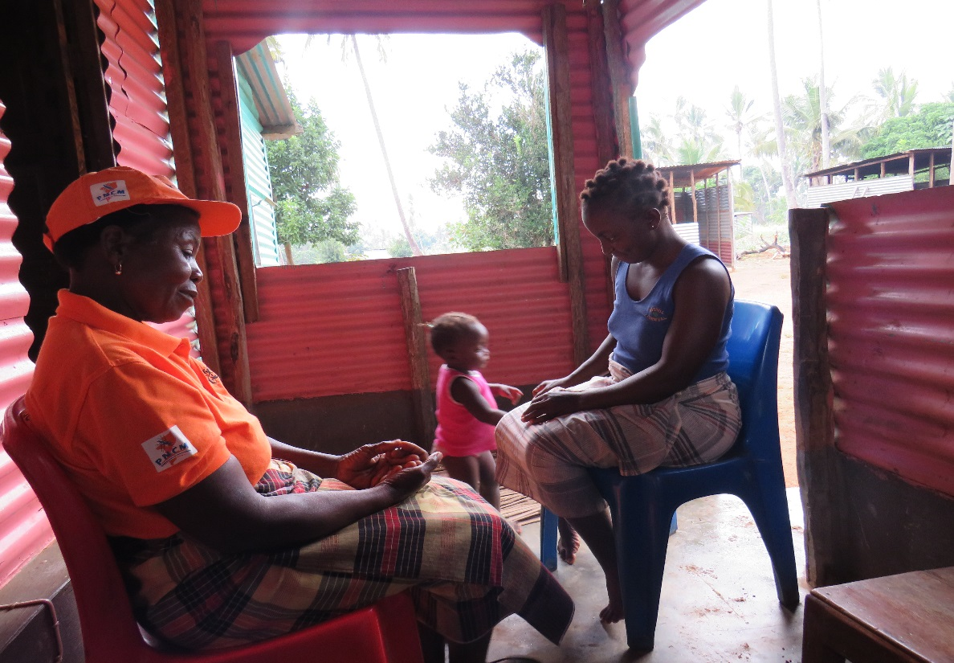
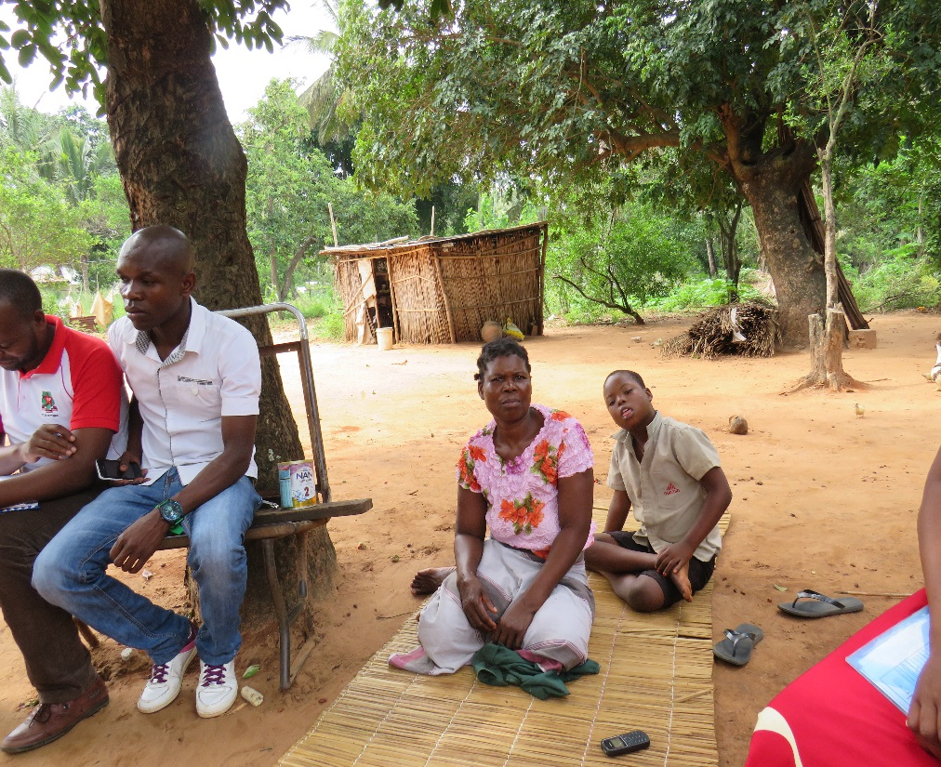
Question 1: Frontline workers – malaria prevention and treatment (4)
Examples of interactions between frontline workers and household members

Slide 9
Question 2: Community mobilization - ANC, PIT and woman health (1)
Key learnings
When focus group meetings are organized at community level, women have been more interested in participating in discussions about how they can make decisions on their own health, children, and entire family.
The use of all local opportunities where women meet, such as “saving" groups, water management committees, working groups in the fields, markets and churches, and neighborhood meetings, helps to have more people and more openness to exchange opinions due to, among other factors, their homogeneity.
It is noted that women become more participatory in discussing local factors that create barriers to improve the community health status, including how they think it can improve and how they can contribute to change the situation.

Slide 10
Question 2: Community mobilization - ANC, IPT and woman health (2)
Methodologies/tools used
The meetings are facilitated by women and involve women of childbearing age, pregnant women, mothers-in-law, elderly women, traditional midwives / midwives, among others. Their spouses and partners also participate when it is possible.
There are 25 participants who discuss maternal and child health issues, prevention of malaria in pregnancy (IPTp) and childhood (IPTi), women's empowerment to make decisions about their health, their children's and family's.
Topics are discussed at least three times a month, where each topic is recorded and reported at the local and district level. Sometimes the topics are introduced by nurses or female APEs, whose choice depends on the local interest according to what they care about them or what they observe in the local health facilities.

Slide 11
Question 2: Community mobilization - ANC, IPT and woman health (3)
Challenges, adaptive measures and supportive consequences
Transform the growing interest of women and their respective spouses and partners to participate in focus group discussions => in the corresponding increase of IPTp and IPTi adherence
Involve the spouses and partners of women of childbearing age, pregnant women, caregivers of children under 5 years, mothers-in-law and midwives in discussions on decision-making about the health of family members
Improve mechanisms for understanding and using information on the factors that create barriers to improve community mobilization actions for malaria prevention and treatment;
Improved openness of household members to discuss issues related to the health of their families among themselves and with their neighbors, frontline workers, APEs and health staff
Improved follow-up of medical recommendations for taking antimalarial drugs by children under 5 in families

Slide 12
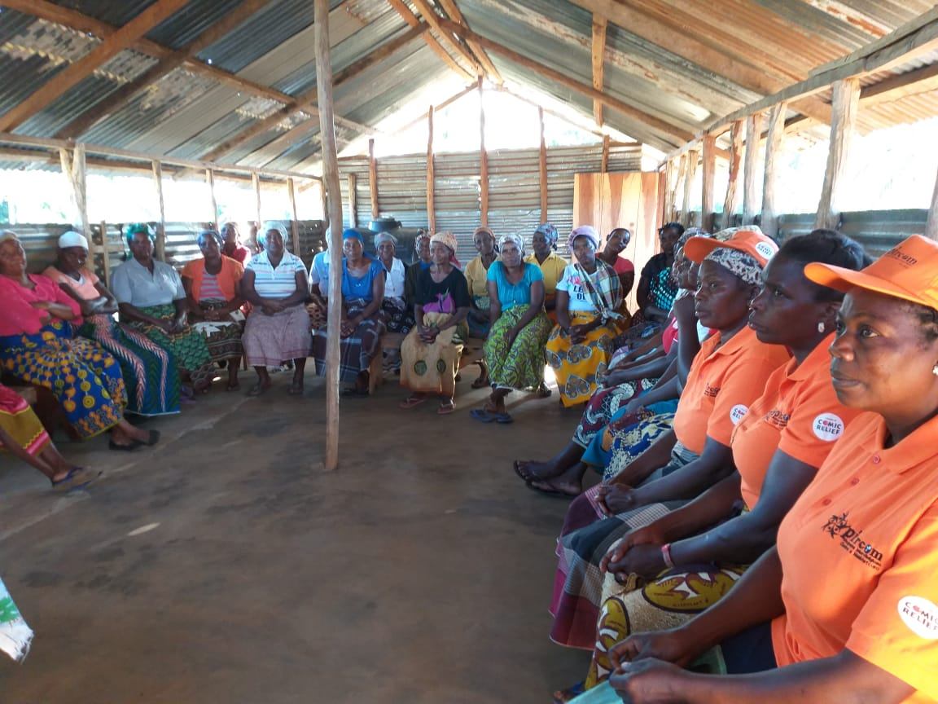
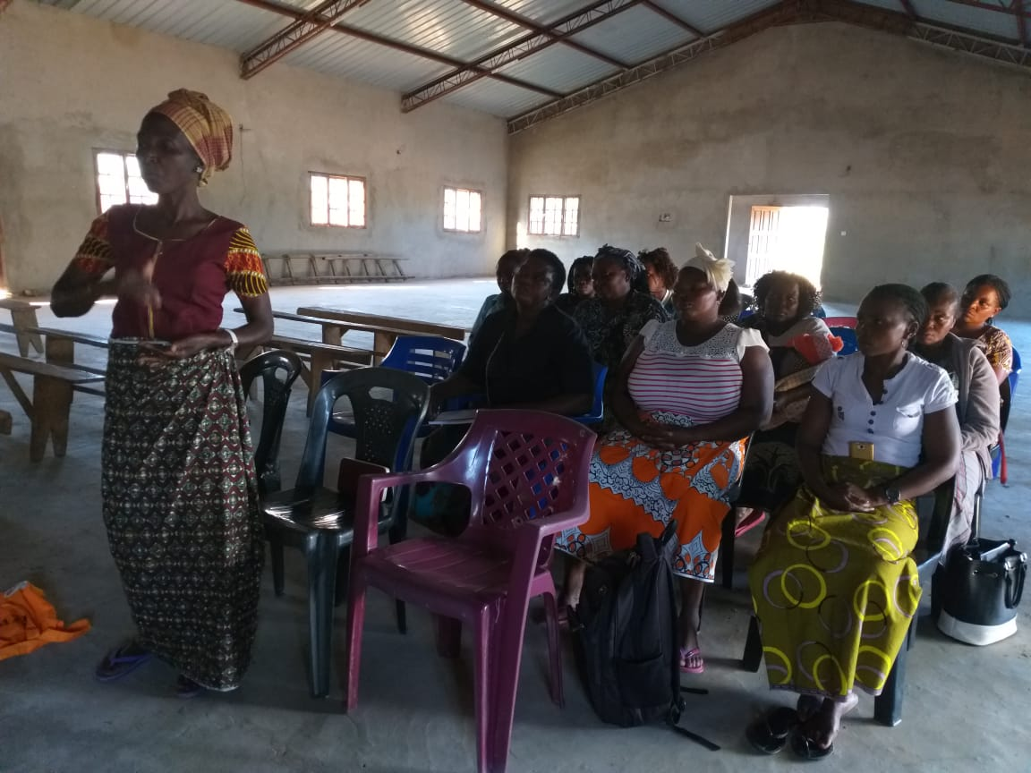
Question 2: Community mobilization - ANC, IPT and woman health (4)
Examples of women focus groups meeting to influence IPT adherence

Slide 13
Question 3: SBCC approaches – health systems strengthening (1)
Key learnings
The coordinated work between the frontline workers and staff of the health units helps to define better strategies for community mobilization, and to adjust the messages-actions to be transmitted to community members.
Health personnel may, through information from hospital registries, inform frontline workers about areas where there are more malaria cases and areas where specific services exist, including APEs and mobile brigades, distribution of mosquito nets, spraying of houses, among others .
The availability and use of information on health statistics (Sentinel Posts) allows frontline workers to monitor at which points patients are having difficulties to follow correct malaria prevention and treatment measures.
Health information has helped project managers to adjust / reorient their implementation strategies

Slide 14
Question 3: SBCC approaches – health systems strengthening (2)
Methodologies/tools used
The project was presented and discussed with health authorities at the district level;
The selection of communities for activities implementation was jointly based on malaria epidemiological data;
The project adopted monitoring tools aligned with the health information system to record data on people reached, referenced, tested positive, taking complete antimalarials medication, returned to follow-up consultations, taking IPT and sleeping under the mosquito net;
The data collected by the project at local and district level about the implementation activities at the community level are compared with health facility records on malaria case management;
Analysis of the project progress towards expected results are carried out taking into account the evolution of the malaria epidemiological situation observed in the health facilities of the catchment area.

Slide 15
Question 3: SBCC approaches – health systems strengthening (3)
Challenges, adaptive measures and supportive consequences
Ensure the use of information generated in the health facilities to improve project community interventions in way to reduce malaria occurrences and all its consequences;
Adopt patient reference cards to follow-up people identified with malaria symptoms and referenced to health facilities for diagnosis and correct treatment;
Use the information produced in the health facilities to reorient/adjust the project implementation strategies and activities.
Identified areas with the highest occurrence of malaria cases and where the project needs to implement specific malaria interventions;
Identified at community level patients who do not follow correctly the medical recommendations for malaria treatment (people who do not take correct and complete medication, those who do not return to the follow-up visits, pregnant women who have stopped ITP, among others).

Slide 16
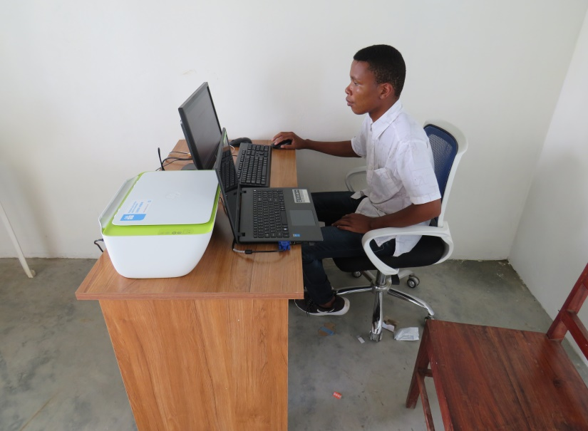
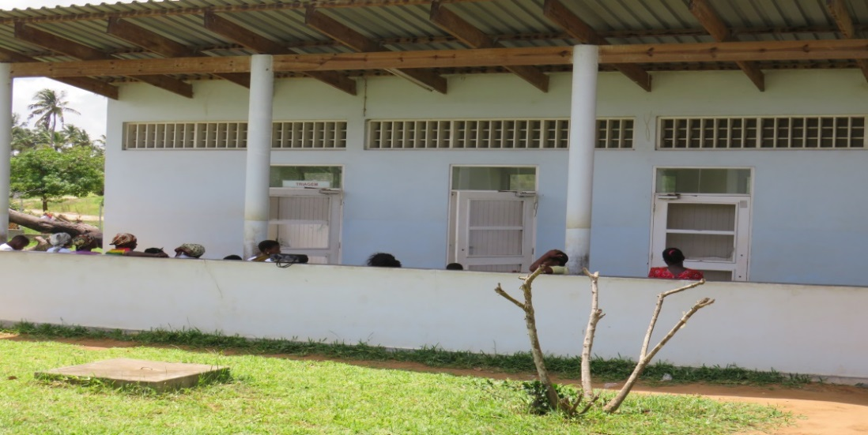
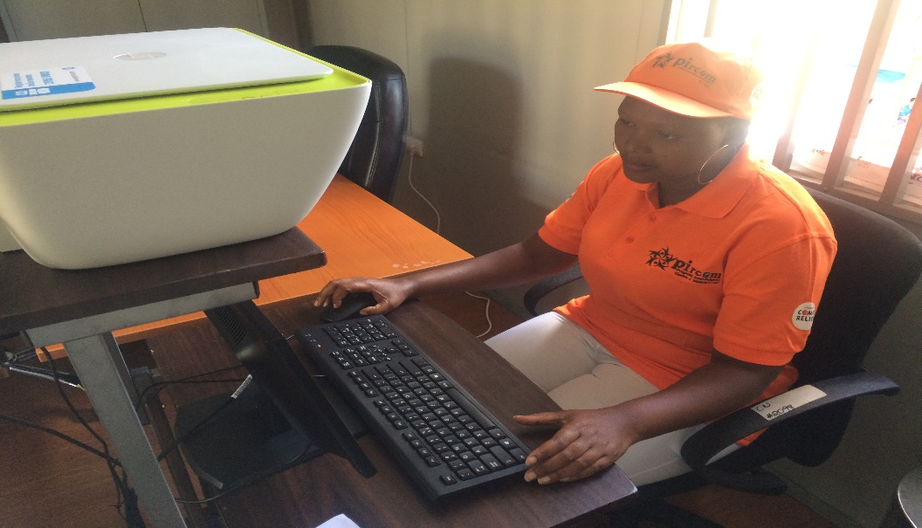
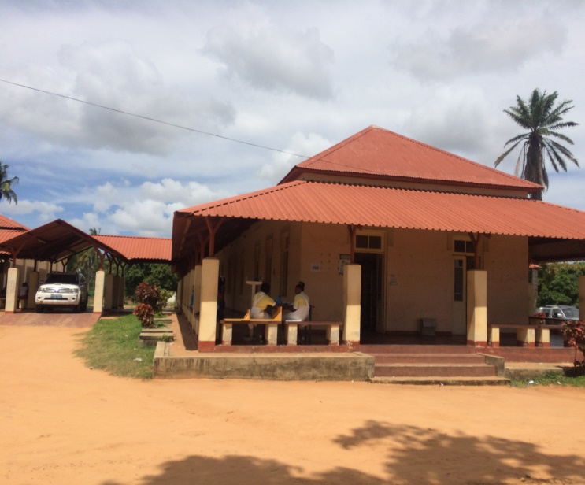
Question 3: SBCC approaches – health systems strengthening (4)
Examples of information sharing to improve project implementation

