Slide 1
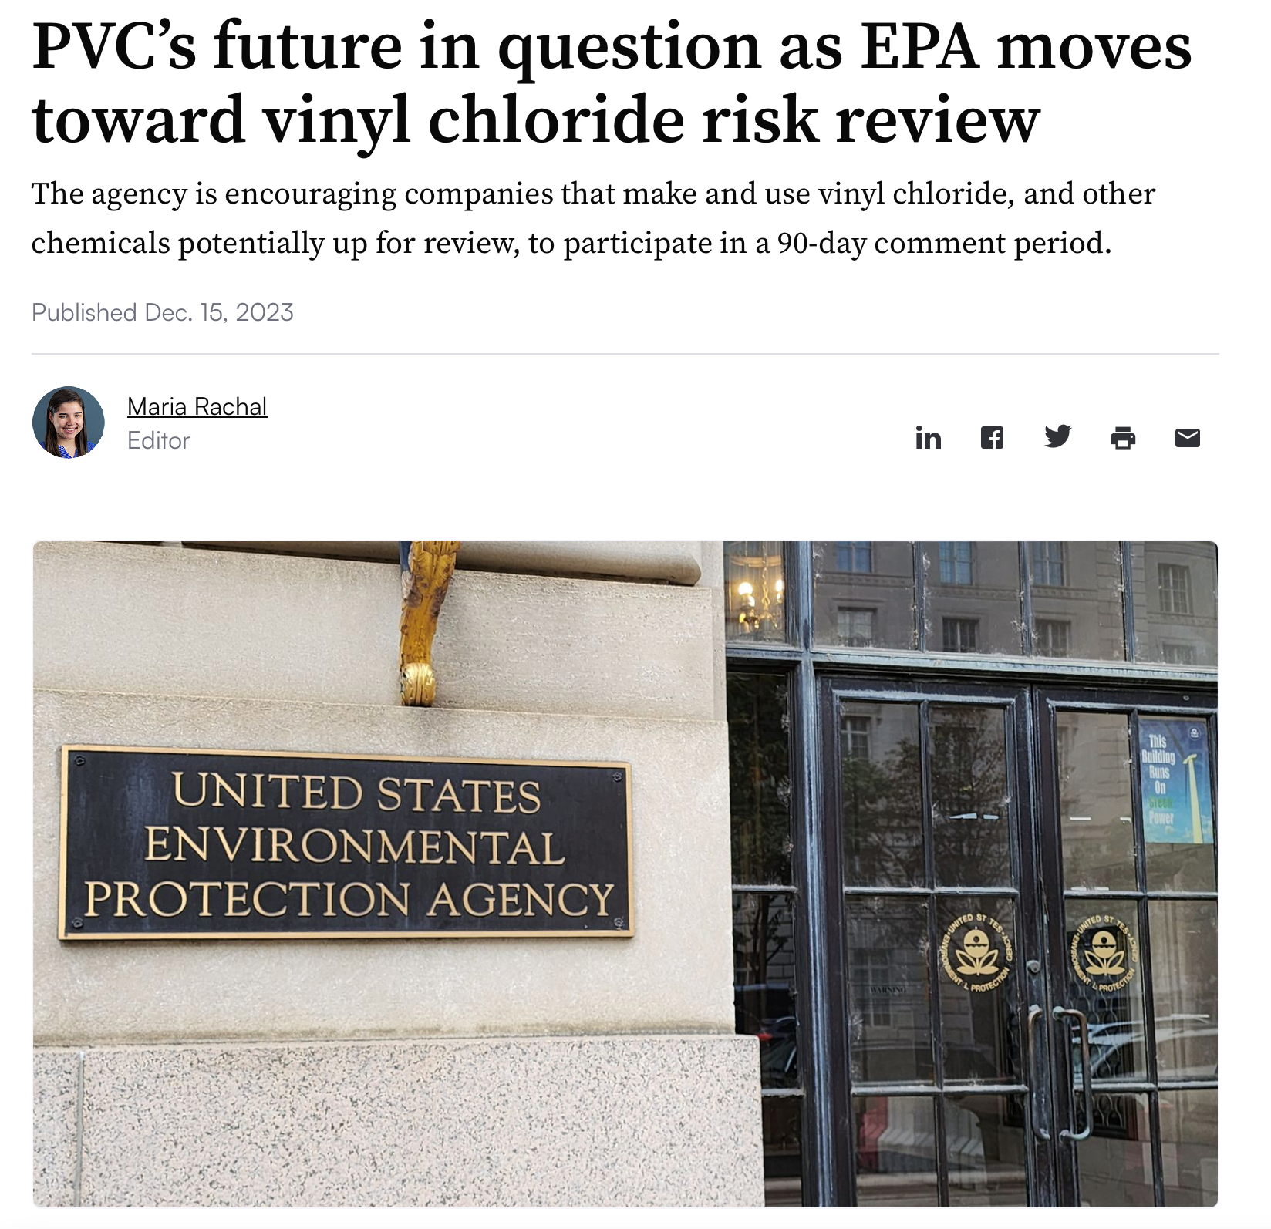
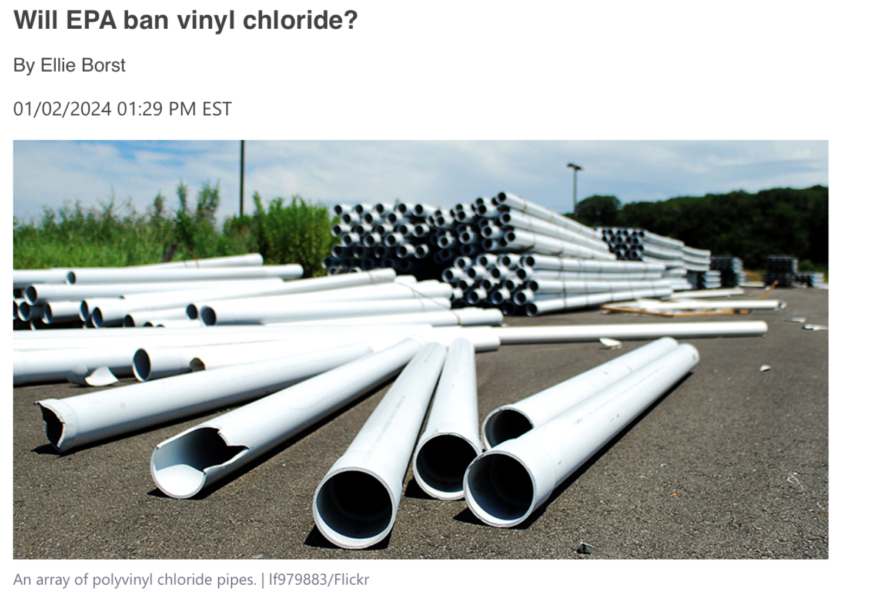
US EPA’s Review of Vinyl Chloride Expected to Result in "High Priority" Status Under Federal Toxic Substances Control Act (TSCA)
The US EPA announced in December 2023 that it was prioritizing a review of vinyl chloride and 4 other chemicals that are used to make plastics. This started a 12-month process that the agency already said it expects will yield a determination that the chemicals will be given "high priority" status under the Toxic Substances Control Act.
Calls for this review strengthened after a 150-car train carrying vinyl chloride and other chemicals derailed in the southeastern Ohio town of East Palestine in February 2023. First responders, in consultation with federal and state officials, conducted a burn off of vinyl chloride that resulted in a giant plume of thick smoke and questions about how far chemical particles dispersed into the air and nearby waterways.
Vinyl chloride, a primary component used in producing PVC plastics, has already been classified as a human carcinogen since 1974, because of its health risks, including brain, lung and blood cancer along with several immune and reproductive system damages. The EPA has stated that vinyl chloride is still used to make PVC and vinyl products such as floor coverings, children’s toys and car components.
Today, there are 10 billion pounds of vinyl chloride produced annually, much of which is converted into PVC resin, which is used to create PVC pipes.
Currently, the EPA is reviewing comments submitted by organizations and individuals during a public comment period. More than 580 comments have been made public by the EPA so far.

