Slide 1
EPA’S Review of Vinyl Chloride
Member Training

Slide 2
Roadmap of what we will cover
The EPA and The Toxic Substances Control Act (TSCA)
What is Vinyl Chloride?
What is it used to make?
Environmental & Health Concerns
East Palestine, OH Disaster
Why is the US EPA investigating Vinyl Chloride, again?
The EPA’s review process and timeline
What are the possible outcomes
What is the plastic industry doing and saying?
What could this mean for water utilities?
What is DIPRA doing?
Member Company Support

Slide 3
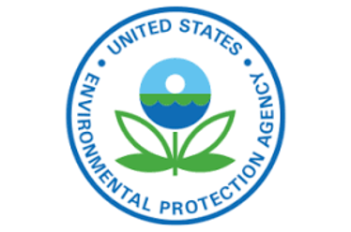
The EPA and the TSCA
The U.S. Environmental Protection Agency (EPA) is responsible for the protection of human health and the environment. It provides technical assistance for recovery planning of public health and infrastructure, such as wastewater treatment plants.
The Toxic Substances Control Act (TSCA) is a United States law that regulates chemicals not covered by other federal statutes, including existing chemicals in commerce and the introduction of new chemicals. Its main objectives are to assess and regulate new commercial chemicals before they enter the market, to regulate existing chemicals that pose an unreasonable risk to health or the environment, and to regulate the distribution and use of these chemicals.

Slide 4
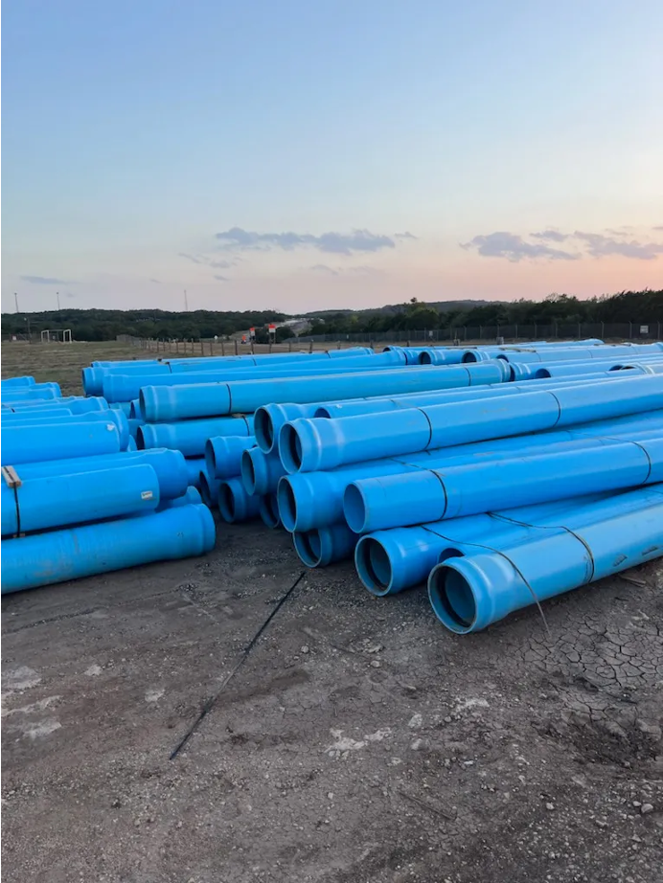
What is Vinyl Chloride?
According to the National Cancer Institute, vinyl chloride “is a colorless gas that burns easily. It does not occur naturally and must be produced industrially for its commercial uses. Vinyl chloride is used primarily to make polyvinyl chloride (PVC), a hard plastic resin used to make a variety of plastic products, including pipes, wire and cable coatings, and packaging materials.”

Slide 5
What is it used to make?
The EPA has had certain bans in place since 1974 for vinyl chloride use:
The Environmental Protection Agency (EPA) has taken significant steps to ban the use of vinyl chloride in various products due to its potential health and environmental risks.
Banned Products:
Aerosol Spray Propellants: Vinyl chloride was commonly used as a propellant in aerosol sprays, but its use has been banned due to associated health risks.
PVC Food Packaging: Certain types of food packaging containing vinyl chloride, particularly polyvinyl chloride (PVC) packaging that comes into direct contact with food, have been restricted or banned by the EPA.
Consumer Products: Vinyl chloride has been banned from use in various consumer products such as certain types of adhesives, sealants, and plastics due to its potential to release harmful vapors.
Objective: These bans and restrictions aim to reduce exposure to vinyl chloride, a known human carcinogen, and to protect public health and the environment.

Slide 6
Environmental Concerns
The U.S. Department of Health and Human Services published a draft toxicological profile for vinyl chloride, highlighting its extensive use in the plastics industry and its potential to leach into groundwater from various sources.
Residents living near plastic manufacturing sites are at risk of inhalation exposure to vinyl chloride, particularly those with pre-existing health conditions.
Five major emitters account for half of the yearly releases of vinyl chloride in the United States, with prominent locations in the Eastern U.S. and the Gulf of Mexico.
In 2021, Formosa Plastics in Texas was the top emitter, releasing over 68,000 pounds of vinyl chloride and violating the Clean Air Act.
The Guardian's analysis identified an average of one chemical accident every two days in the U.S., underscoring the impact of industrial plant leaks and spills on neighboring communities, as exemplified by the East Palestine disaster.

Slide 7
Health Concerns
Exposure to Vinyl Chloride Can Lead to Serious Health Concerns:
The U.S. Department of Health and Human Services (DHHS) has classified vinyl chloride as a human carcinogen, indicating its potential to cause cancer.
The World Health Organization's International Agency for Research on Cancer categorizes vinyl chloride as a group 1 agent, meaning it is "carcinogenic to humans."
Group 1 agents are defined as having sufficient evidence of carcinogenicity in humans and experimental animals.
The National Cancer Institute links vinyl chloride exposure to an increased risk of rare liver cancer (hepatic angiosarcoma), primary liver cancer (hepatocellular carcinoma), brain and lung cancers, lymphoma, and leukemia.

Slide 8
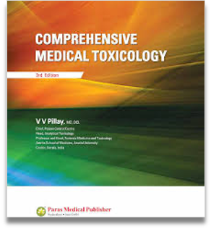
Health Concerns
Risks of PVC and Vinyl Chloride:
In November 2023, The European Chemical Agency (ECHA) highlighted the need for additional regulatory actions to address potential risks from PVC and its additives to human health and the environment.
ECHA's investigation focused on PVC additives, including plasticizers, heat stabilizers, and flame retardants. The key findings suggest the need for regulatory action to minimize risks associated with certain harmful ortho-phthalates in plasticizers, developmental malformations and reproductive harm from heat stabilizing organotin, and emissions of flame retardants. Additionally, technologies to minimize PVC microparticle emissions, especially at recycling facilities and landfills, should be implemented and improved.
The release of PVC microparticles contributes to plastic pollution and contains harmful additives. Therefore, minimizing their release would reduce emissions of these additives.
According to the 2018 Edition of Comprehensive Toxicology, vinyl chloride is an industrial monomer predominantly used in polyvinyl chloride production. It is also present in tobacco smoke and found in numerous Superfund sites due to microbial dechlorination of perchloroethylene and trichloroethylene.
Vinyl chloride is a known human carcinogen, associated with angiosarcoma of the liver, lung tumors, tumors of the hematolymphopoietic system, and brain tumors. It is also mutagenic, causing the formation of DNA adducts including 7-(2′-oxoethyl)guanine.

Slide 9
East Palestine, OH Train Derailment
On February 3, 2023, a freight train carrying hazardous materials derailed in East Palestine, Ohio. Five of the derailed tanker cars were carrying vinyl chloride, a hazardous, odorless chemical that’s mostly used in the manufacturing of plastics.
Vinyl chloride is also a carcinogen that’s been linked to increased risk of liver cancer. The Centers for Disease Control and Prevention warns that breathing vinyl chloride over long periods “may be connected” to brain cancer, lung cancers and some cancers of the blood.
Exposure usually involves inhalation. If someone can smell the chemical, they’re being exposed to unsafe levels of vinyl chloride, according to the Wisconsin Department of Health Services.
According to the CDC, some vinyl chloride can dissolve in water, and it can migrate to groundwater or spread through the breakdown of other chemicals.
The Ohio Department of Natural Resources said the derailment has killed an estimated 3,500 small fish across 7½ miles of streams as of 2/15.

Slide 10
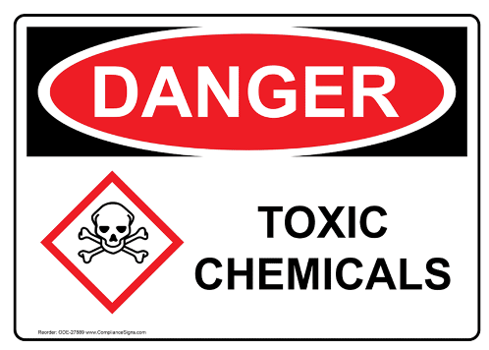
EPA’s Review of Vinyl Chloride as a Toxic Chemical
EPA's Prioritization of Toxic Chemicals for Risk Evaluation:
On December 14th, 2023 - EPA announced the initiation of the process to prioritize 5 additional toxic chemicals for risk evaluation under the nation’s premier chemical safety law.
On July 24th, 2024 - Vinyl Chloride was proposed as a “high-priority substance”, after a 90-day comment period, the EPA will announce the final designation, if confirmed as “high priority”, then the EPA will commence risk evaluations for this chemical.
Vinyl Chloride:
Description: Primarily used in the manufacturing and processing of plastic materials like PVC, plastic resins, and other chemicals.
Usage: Used for pipes, insulating materials, and consumer goods.
Incident: Involved in the Norfolk Southern train derailment in East Palestine, Ohio.
Health Effects: Exposure may result in liver toxicity, and it is a known human carcinogen.
Historical Context: In the 1970s, the White House Council on Environmental Quality and EPA officials raised serious concerns about the health impacts of vinyl chloride, leading to the passage of the “original” TSCA in 1976.

Slide 11
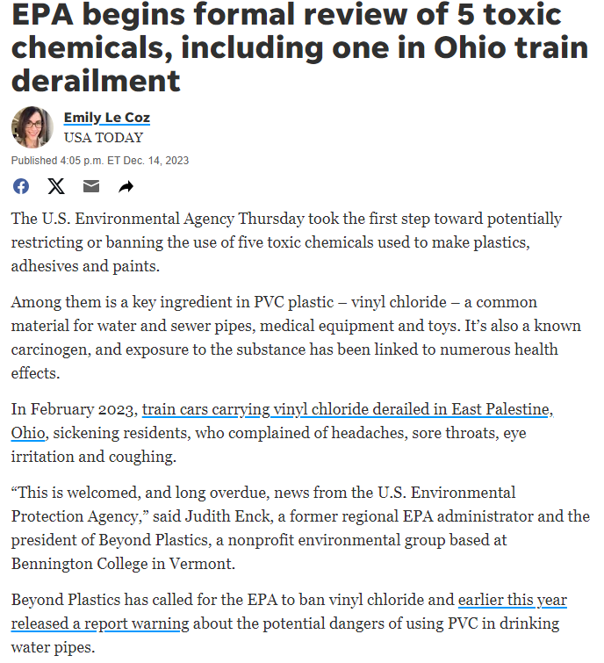
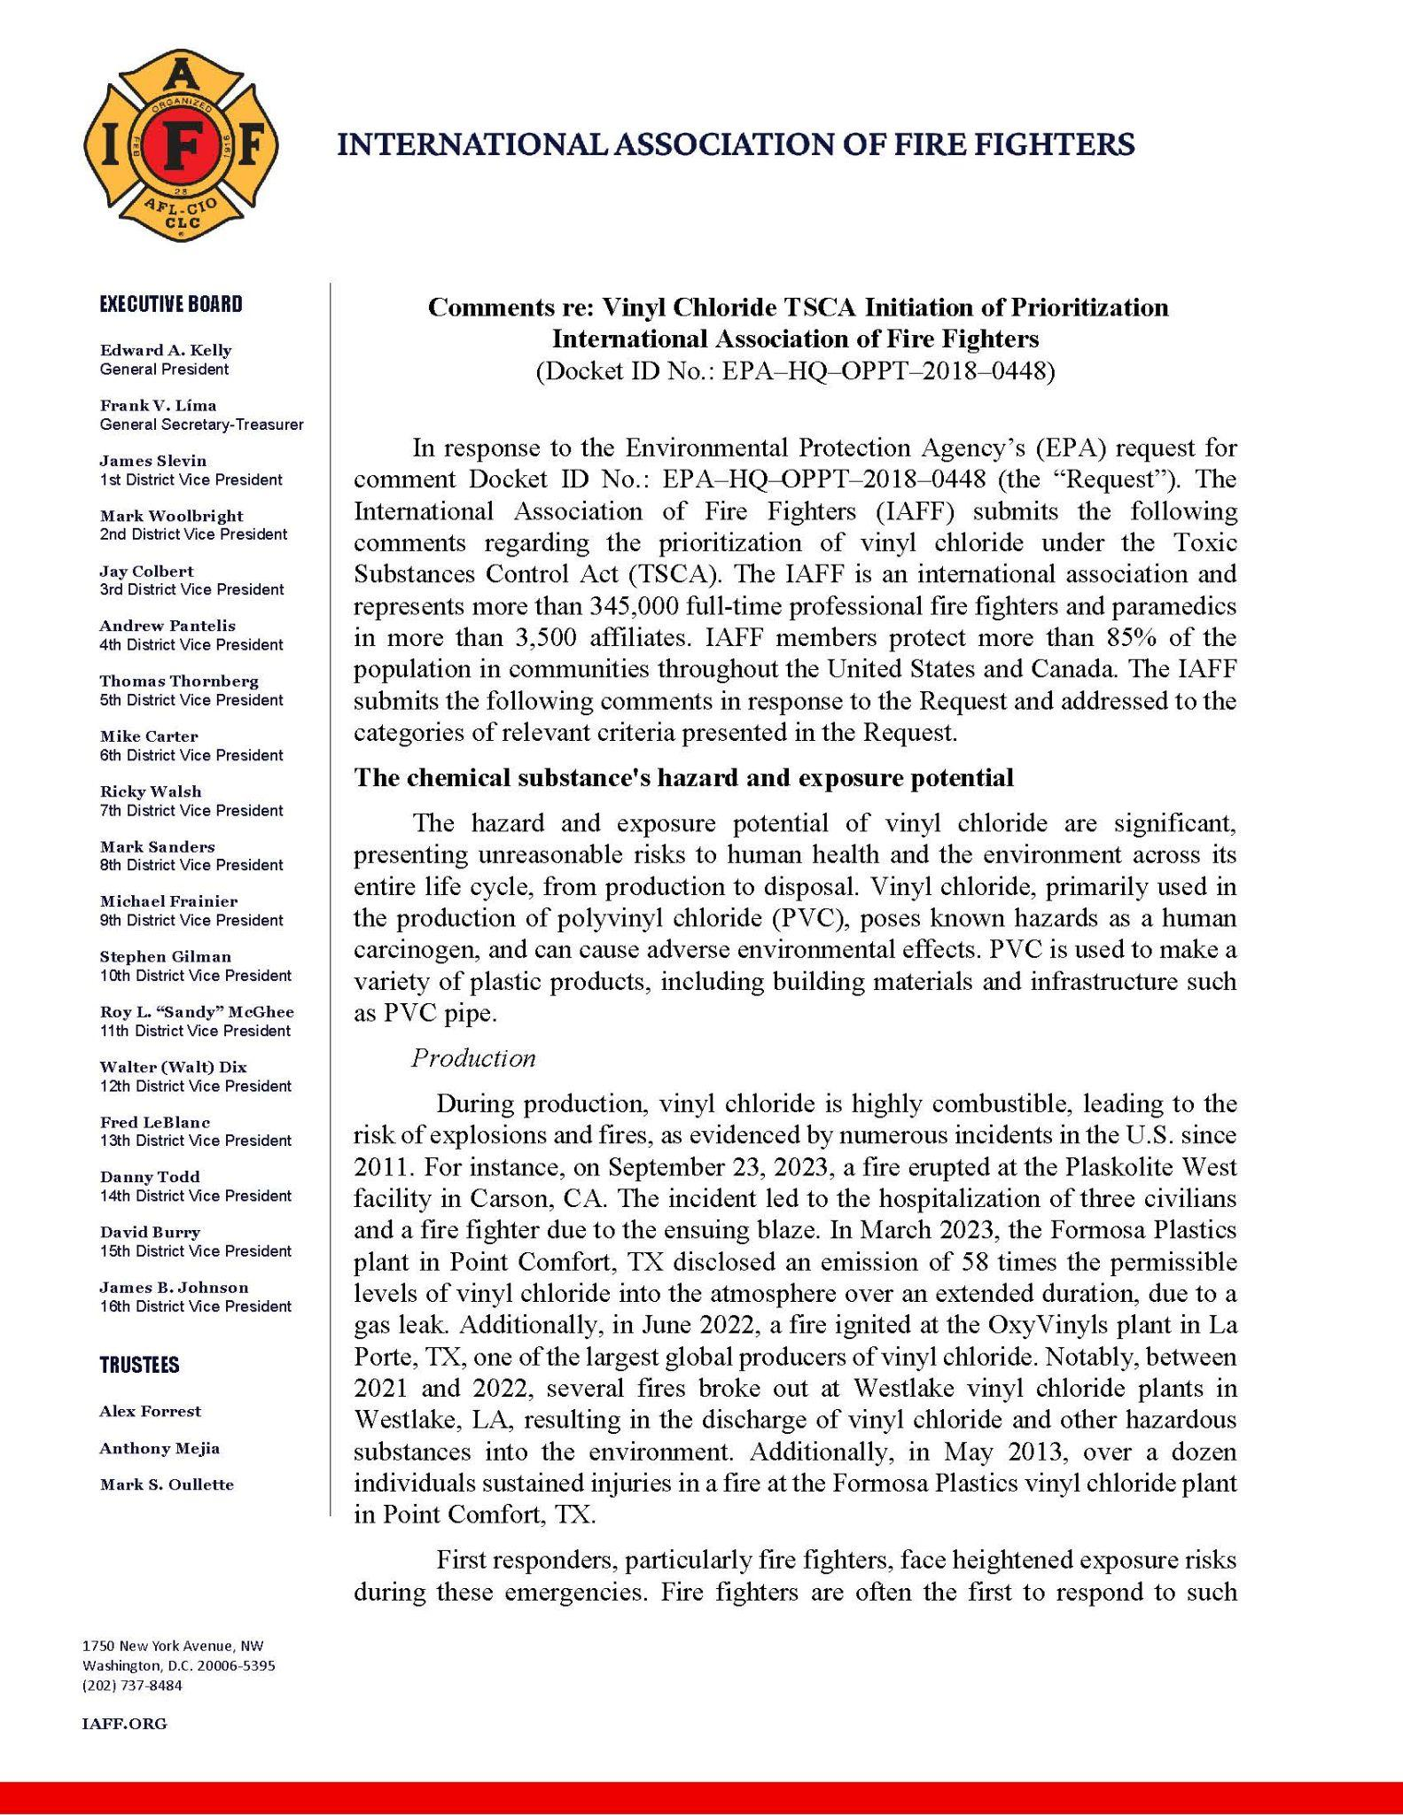
EPA’s Review of Vinyl Chloride as a Toxic Chemical

Slide 12
EPA’s TSCA Process & Timeline

Slide 13
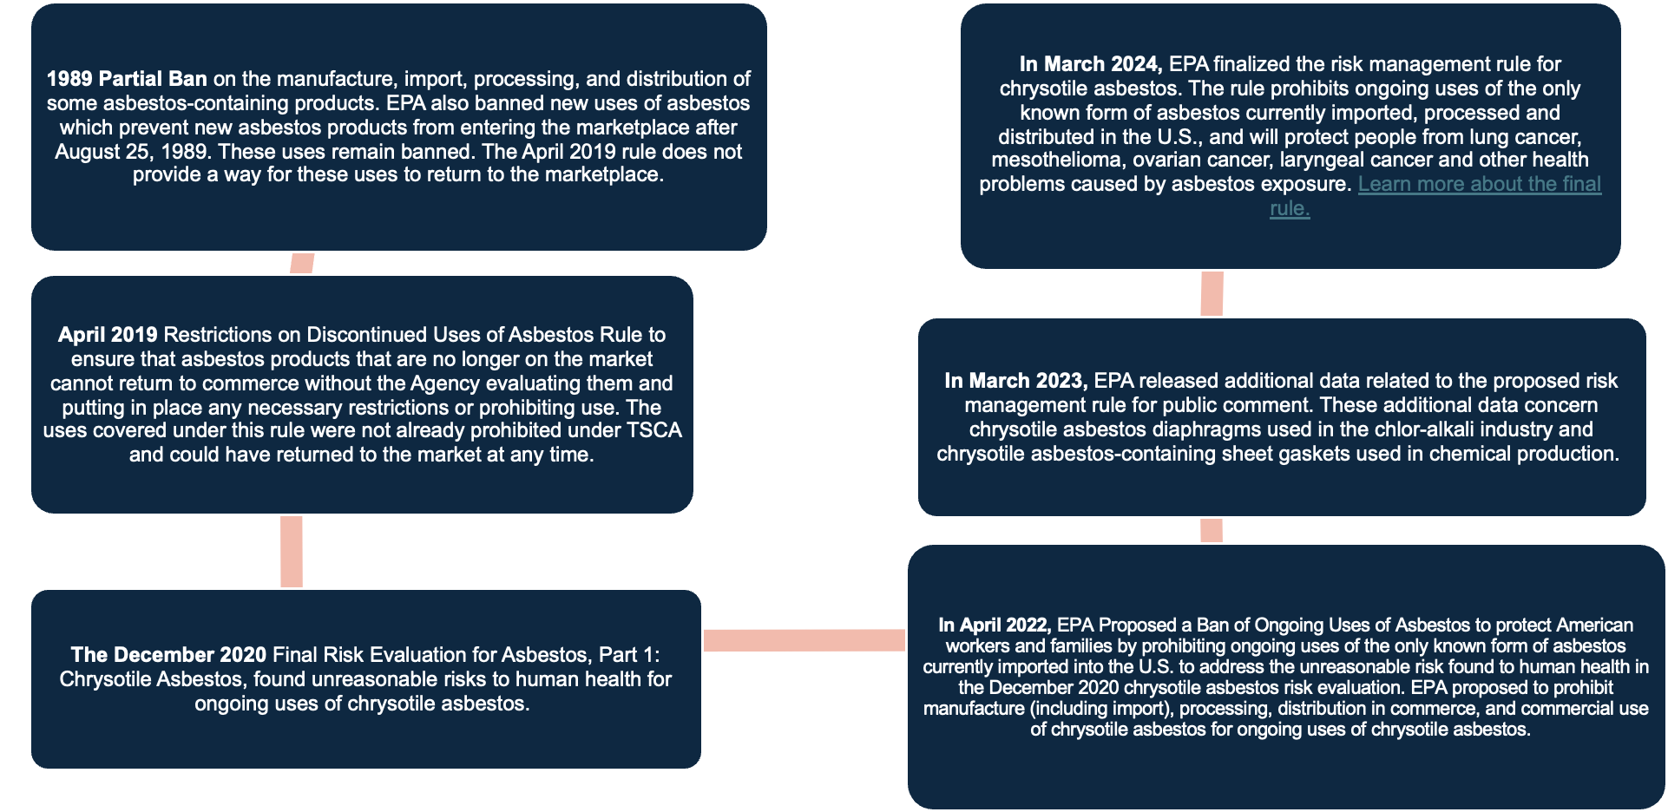
EPA’s Timeline for Reviewing and Banning of Asbestos

Slide 14
Possible Outcomes
EPA’s Response Options for Vinyl Chloride:
No Action: The EPA may determine that vinyl chloride does not pose an "unreasonable" risk to human health, or the environment based on the available data and research, and no further action is taken.
Additional Research or Data Collection: If the existing information about vinyl chloride is insufficient to make a conclusive determination, the EPA may request or conduct additional research or data collection to better understand the potential risks associated with vinyl chloride.
Voluntary Restrictions: The EPA may work with the manufacturer or industry to implement voluntary restrictions or changes in the use of vinyl chloride to mitigate potential risks.
Regulatory Action: Based on the findings of the review, the EPA may decide to impose restrictions, such as banning or limiting the use of vinyl chloride or require labeling and other risk management measures to protect human health and the environment.
Public Notification: The EPA may also decide to inform the public about any potential risks associated with vinyl chloride and provide guidance on safe handling and use. These outcomes are determined based on the EPA's assessment of the potential hazards and risks associated with vinyl chloride.
(Note: The upcoming election could have a negative impact on the EPA's capabilities.)

Slide 15
What is the plastic industry doing and saying?
The plastic industry has responded by emphasizing its commitment to safety and environmental responsibility. Industry representatives have acknowledged the importance of thorough investigations into any potential risks associated with vinyl chloride, while also highlighting the widespread use of vinyl chloride in numerous essential products and industries (such as medical devices).
They have emphasized the need for balanced considerations that consider the benefits of vinyl chloride as well as any potential risks and have expressed a willingness to collaborate with regulatory agencies to ensure that the industry continues to operate safely and responsibly.

Slide 16
What does this mean to water utilities?
If water utilities are forced to restrict or not use products derived from vinyl chloride, such as PVC water mains, they would need to consider alternative materials for their water distribution systems.
Here are some steps they might take:
Evaluate alternative materials: Water utilities would need to assess other suitable materials for water mains. This evaluation would involve considering factors such as longevity, cost, ease of installation, and environmental impact.
Conduct feasibility studies: Utilities would need to conduct feasibility studies to assess the practicality and potential challenges of transitioning away from PVC water mains. This would involve evaluating the impact on existing infrastructure, maintenance requirements, and long-term performance.
Engage stakeholders: It would be important for water utilities to engage with stakeholders, including regulatory agencies, local government, and the public, to communicate the reasons for transitioning away from PVC water mains and to gather input and support for the transition.
Develop a transition plan: Utilities would need to develop a comprehensive transition plan outlining the timeline, budget, and logistics for replacing existing PVC water mains with alternative materials. This plan would also address any training and regulatory requirements, and compliance considerations.
Implement the transition: Once a plan is in place, utilities would need to execute the transition process, which may involve phased replacement of PVC water mains, coordinating with contractors, and ensuring minimal disruption to water service for customers.
Monitor and evaluate: After the transition, water utilities would need to monitor and evaluate the performance of the alternative water mains to ensure they meet safety, quality, and reliability standards.
Transitioning away from PVC water mains would require careful planning, collaboration with stakeholders, and a commitment to ensuring the continued delivery of safe and reliable water services to the community.

Slide 17
What is DIPRA doing?
DIPRA's Efforts to Raise Awareness on the EPA's Investigation
Online news and social media monitoring for promotion and information sharing.
Advertising campaign to raise awareness.
Created an informational One-Page document.
Conducting webinars for the member companies.
Provide PowerPoint slides and supporting graphics.
Monthly updates on EPA's progress through their investigation process.
Utilizing DIPRA Regional Engineers and industry relationships to provide support and information for making informed decisions and updating specifications to exclude PVC.
Engagement with local media outlets to promote awareness about the risks of vinyl chloride.
Maintenance and promotion of a list of health organizations that have conducted studies on the health hazards associated with Vinyl chloride.
Engaging public officials and local policymakers to take action on regulating and reducing the use of vinyl chloride in manufacturing and other industries.

Slide 18
Member Company Support
Recommended Actions to Help with the Current Initiative:
Bring up the EPA's review of vinyl chloride in every conversation and email.
Share the one-page document.
Utilize the provided PowerPoint slide and visuals.
Share your learnings from conversations with utilities.
Request additional materials.
Share success stories of utilities removing PVC from engineering specs.

Slide 19
Q & A

