Slide 1
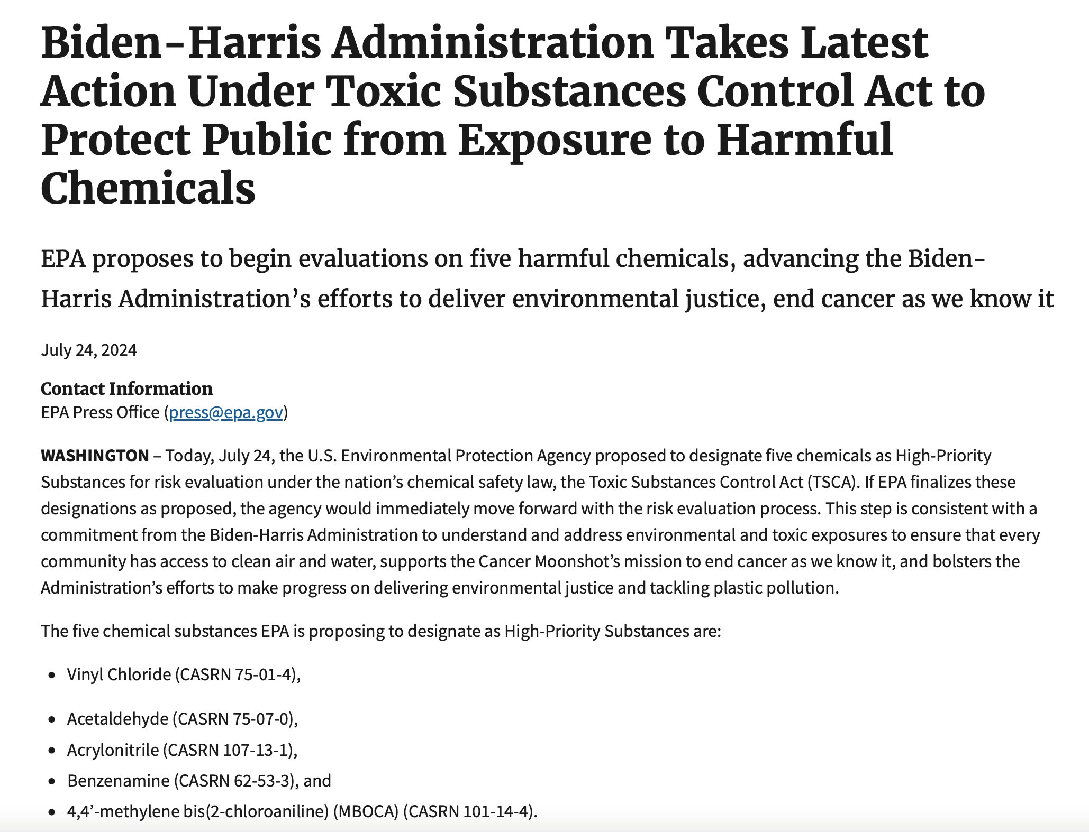
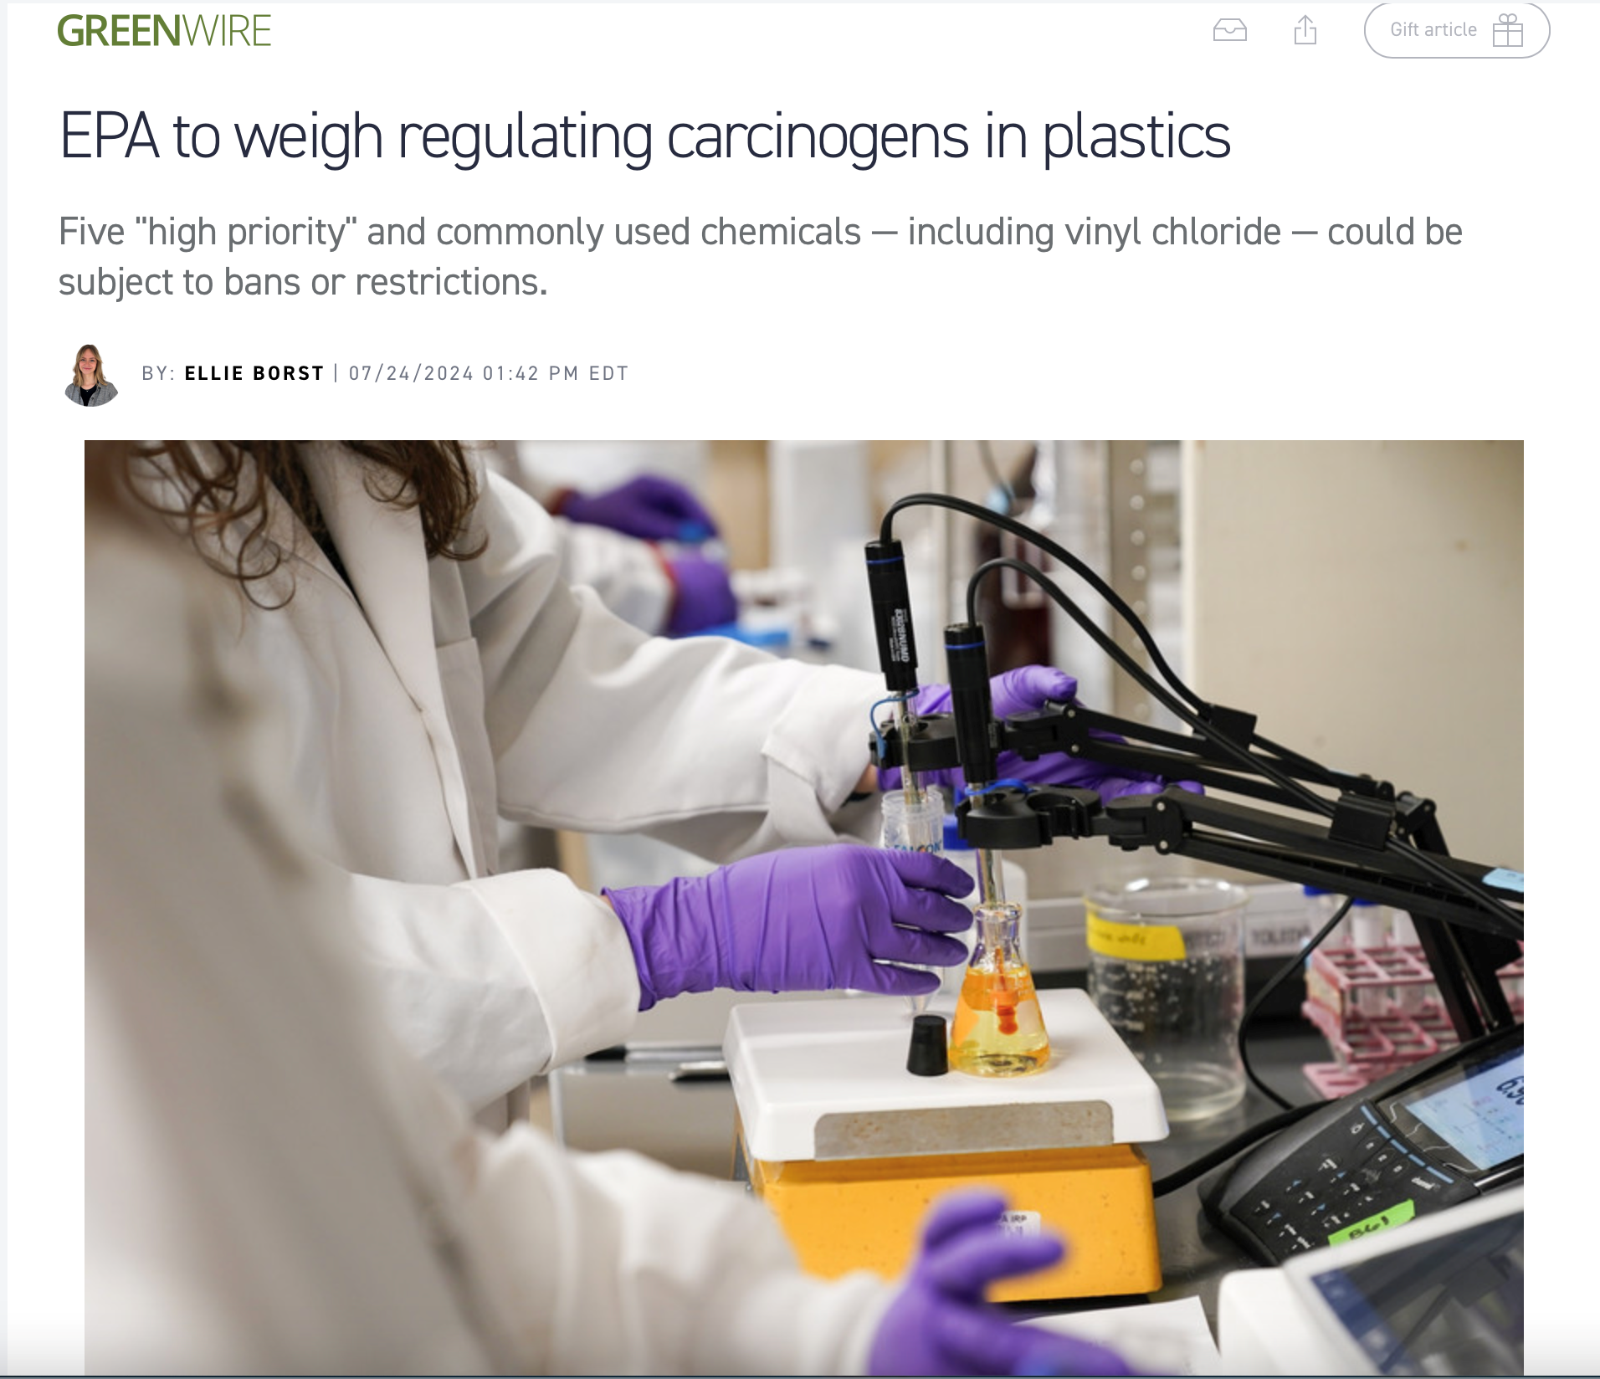
US EPA’s Review of Vinyl Chloride Expected to Result in "High Priority" Status Under Federal Toxic Substances Control Act (TSCA)
The U.S. Environmental Protection Agency (EPA) announced in December 2023 that it would commence a review of vinyl chloride, and four other chemicals used to manufacture various plastics to determine if any of the chemicals should be subject to further regulation under provisions of the federal Toxic Substance Control Act (TSCA).
Calls for this review strengthened after a 150-car train carrying vinyl chloride and other chemicals derailed in the southeastern Ohio town of East Palestine in February 2023. First responders, in consultation with federal and state officials, conducted a burn off of vinyl chloride that resulted in a giant plume of thick smoke and questions about how far chemical particles dispersed into the air and nearby waterways.
Vinyl chloride, a primary component used in producing PVC plastics, has already been classified as a human carcinogen since 1974, because of its health risks, including brain, lung and blood cancer along with several immune and reproductive system damages. The EPA has stated that vinyl chloride is still used to make PVC and vinyl products such as floor coverings, children’s toys and car components.
As of July 24th, 2024, the EPA officially proposed to designate vinyl chloride as "high priority" under the TSCA. This triggers a 90-day public comment period and puts it on track to be finalized around the end of December.
After the 90-day public comment period, if the EPA finalizes these designations, the agency will initiate risk evaluations to determine whether vinyl chloride presents an unreasonable risk to human health, the environment and workers exposed to the chemical. This process can take several years to complete.
If an “unreasonable risk” is determined, the agency will move to a risk management phase during which time officials will consider what additional restrictions it should impose on the use of vinyl chloride. TSCA requires the EPA to issue a proposed risk management rule for the chemical substance no later than 1 year after the date on which the final risk evaluation regarding the chemical substance is published.

