Slide 1
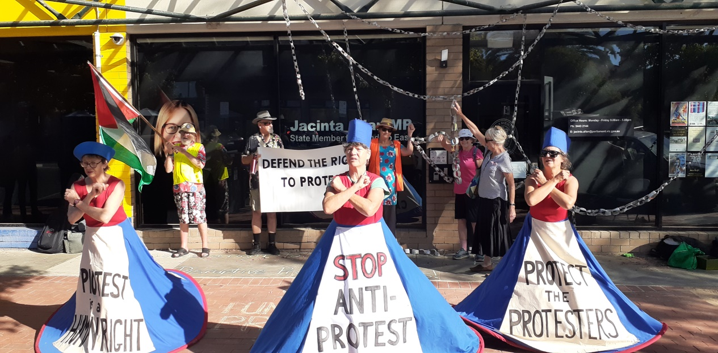
Second meeting of Mount Alexander
Knitting Nannas - Feb 2025
The Federal Election:
How our government has fared
What needs to be done?
What we can do?

Slide 2
Good news!

Slide 3
What happened since our last meeting:
“Tarkyna” film – Bob Brown Foundation raised $6,000, large audience
Protest outside Jacinta Allan’s office (Premier) in Bendigo, 40 people attended, 4 from Knitting Nannas, to protest against the law proposed to criminalise forms of protest used by environmental campaigners and others

Slide 4
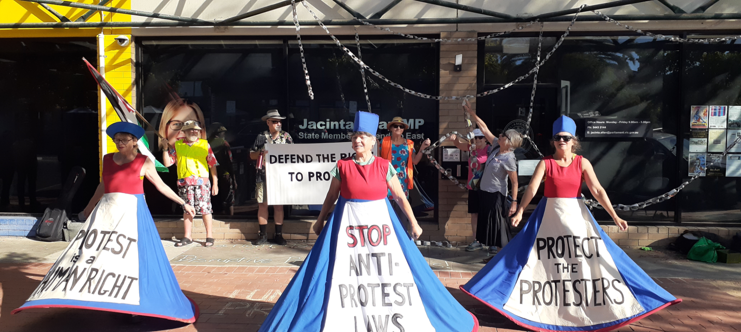
Some issues arising from attending the protest:
A feeling that some of the actions didn’t align with our values
Do things differently next time?

Slide 5
Attending meeting, rallies, protests in the future:
Make sure the rally is relevant to our cause: climate change, the environment, civil liberties
Make contact with the organisers to ensure it will align with our values, that it’s in our interests to attend
Ensure the rally does not obstruct the passage of the general public or create a hazard
At all times, being friendly, polite, cooperative and informative with the public and police
Do not condone, or be seen to endorse any kind of violent or threatening behaviour (in speeches too)
Any member of MAKN has a right to attend any protest but not to be seen to represent MAKN if this protest does not align with our values

Slide 6
Report card on the Federal Labor Government 2022 - 2025
What measures have been put in place to take action on climate change?
Our govt has done some good things but there have been some terrible decisions made to make it much worse.
Good achievements:
😃Emissions are falling (but not fast enough)
😃Labor has brought in some good policies, (although these have not kicked in yet):
Capacity investment scheme - this is designed to boost investment in renewable energy (ways to generate it and store it)
It has reformed the safeguard mechanism
It has improved the fuel efficiency standard (which encourages people to buy cleaner cars)
😃Locally, Lisa Chester has approved a new solar power station in Bendigo - Muskerry and this will reduce greenhouse gas emissions by 495,000 tonnes per annum.

Slide 7
Terrible decisions:
😣Approving 4 new coal mines and new gas projects. This is terrible because it means that a lot more carbon (21 mill tonnes) will be released into the atmosphere between now and 2030, and even more will be released after it is exported and used in other countries.
We are the 3rd largest fossil fuel exporter in the world and we export so much coal that we are the 2nd largest exporter of fossil fuel CO2 emissions
Climate change is such a huge, urgent problem and our federal govt needs to do much more.
Although all levels of govt should be trying to do their bit, it’s the federal govt which controls the money given to industry - e.g. subsidies, tax rules and it’s the fed. govt that really needs to lift its game.

Slide 8
If the fed govt doesn’t improve its record on climate change, unfortunately our climate in Australia and the climate around the world will get worse. Our climate has warmed by 1.51 degrees since 1910 and 8 of the warmest years have occurred since 2013.
The State of the Climate report 2024:
😣oceans around Aust are likely to get even warmer and more acidic, sea levels will rise. There have been more incidents of mass coral bleaching on the Great Barrier Reef.
😣our weather will become more volatile (heatwaves, longer fire seasons, more intense rainfall events, flooding). Some parts of Australia will suffer extreme conditions on a regular basis: flooding, heatwaves, fires. Other regions will become drier and agriculture will become unsustainable. Already, there are some areas where house and property insurance bills have become unaffordable (risen by 30%) and some insurance companies won’t insure in some places. Food will become more expensive if the supply is affected.
😣”many people (84%) have already been directly affected by at least one climate-fuelled disaster since 2019”
😣the cost of damage caused by natural disasters has grown by over 60% to $3.7 billion per year

Slide 9
What do we need to do?
We all need to put pressure on this govt to do much better, especially close to the fed election, to do these things:
No more approvals of fossil fuel mines - coal and gas
Coal-fired power stations need to be closed down and phased out
An ambitious climate pollution target needs to be set, in line with Australia’s Paris commitments
End all subsidies of coal and gas industries, force them to pay their fair share of tax

Slide 10
What have been their actions and policies on native forest logging?
Under Labor, there have been some gains made:
😃$550mill investment to protect threatened plants, mammals and to shield 70 mill hectares of ocean and bush from development
However, there have been many lost opportunities:
😣More mammal species have gone from Australia than any other continent in the world! Our country still has one of the highest rates of species decline in the OECD
😣Every hour in Australia, bulldozers destroy the equivalent of 28 Opera Houses of threatened species habitat (including precious koala habitat). Almost 26,000 hectares of threatened species destruction was approved in 2024, a huge rise from 2023. 3,000 hectares of koala habitat is to be razed.
Since Australia’s national environmental protection law took effect 25 years ago, more than 7 million hectares of threatened species habitat has been destroyed. Many endangered and vulnerable animals are in peril - Pilbara leaf-nosed bat, northern quoll, superb parrot, ghost bat…

Slide 11
What can we do?
We need put pressure on the govt to:
Stop bulldozing the bush and deliver strong laws to protect wildlife and native forests - at a state and federal level
Implement a national plan to end deforestation by 2030
Require businesses to publicly report their impacts and take action to remediate damage caused
Support farmers and restore natural areas on their land
Boost funding for the protection of nature
Occasionally, businesses take action. Recently, Coles has decided that it won’t source meat from areas cleared.

Slide 12
Encouraging renewable energy
Under Labor, renewables have really taken off - is this due to govt incentives or it just makes good business sense and investors and entrepreneurs can see a future in it?
😃Solar and wind energy has been added to the grid
😃There have been more rooftop panels installed - 3.5 million households have solar panels on their roofs, generating 20,000 gigawatts of electricity every year
😃2 more large wind farms installed
😃New solar power station for Bendigo
😃electricity from renewables is growing and in Victoria it makes up 40% of our electrical supply

Slide 13
What more do we have to do?
A lot more needs to be done - more renewable plants need to be built more quickly in the right locations to benefit people.
We could become a renewable manufacturing and export superpower in this industry. We have the expertise and resources but there is not the political will.
We need to support renewable energy, not nuclear, for the following reasons:
Nuclear is 10 times more expensive than producing energy from solar or wind
Nuclear power plants consume enormous volumes of water (24 billion litres a year)
Nuclear power is becoming unpopular overseas and there are fewer trained people to maintain the plants
It is definitely not safe - even new plants have been known to leak - and the technology needs to be updated frequently
The waste from nuclear energy is a huge problem - it has to be securely stored for thousands of years, there are no proven safe ways to manage long-lived radioactive waste

Slide 14
What can WE do?
There are many ways we can put pressure on the govt to do this:
Write letters, petitions to Tanya Plibersek - Market Forces, Australia Institute
Divest our super money out of companies supporting fossil fuel, check our banks
Attend rallies, speak to Lisa Chesters (our local fed rep).
Vote for parties, individuals whose policies are pro-climate and encourage others to do the same
Have conversations with neighbours, friends and family

Slide 15
Where did I get this info from?
Information from:
Australian Conservation Foundation
The Guardian newspaper - Adam Morton, Petra Short, Dan Jervis-Bardy
The Climate Council
Who are our candidates for the upcoming federal election (the seat of Bendigo)?
Lisa Chester - Labor, member of House of Representatives, her office: corner Williamson and Myers Streets, Bendigo, ph: 03 5443 9055
Andrew Lethlean - Nationals
Matt Evans - Liberal
Avery Barnett Darcy - Greens

Slide 16
Housekeeping
Please could people pay $10 joining fee to cover the cost of folders, handouts, printing, craft supplies and tea, milk etc. My bank a/c details on email or cash
We got a grant for $3,000 from Mount Alexander Shire – not retrospective (from April) to pay for T shirts, craft materials, marketing for next few months
Our T shirts are coming

Slide 17
Next meeting:
The issue of native forest logging and destruction – habitat loss, extinction of native species
Guest speaker from Wombat State Forest
What we can do to get involved

Slide 18
Upcoming events
March for the Forests in March – 23/3, 10.30am, Peter Khalil’s office, Coburg, Melbourne
Women’s Climate Congress Conference – Castlemaine Town Hall 28/3 – 30/3

Slide 19
Find someone who…….?
1. Find someone who has travelled extensively
2. Find someone who is a twin
3. Find someone who has had interesting jobs
4. Find someone who has more than 8 grandchildren
5. Find someone who has learnt to parachute
6. Find someone who has led or managed a large business
7. Find someone who is a great-grandmother
8. Find someone who has organised a big event
9. Find someone who has never married
10. Find someone who has had an art exhibition
11. Find someone who has met a very famous person
12. Find someone who protested in the Vietnam moratoriums
13. Find someone who has given a speech in public
14. Find someone who has brought up children on her own
15. Find someone who has written a book

Slide 20
Feedback and get involved
It would be great to hear your thoughts about what we are doing
If anyone would like to get more involved in helping to prepare for meetings, making decisions, presenting…..
Could we have someone to take charge of a catering roster? Sewing/craft workshops? An Instagram page?

