Slide 1
Cloud Tech (Q3 2024): AI advances in Edge and Cloud Optimization; Cloud-native Tech leads funding and M&A Keshawa Perera, CFA

Slide 2
What’s inside?
Key takeaways
Funding
Cloud-native Tech (CNT) surged amid overall decline: Cloud Tech funding saw a dramatic drop (-81% QoQ), totaling USD 699 million across 16 funding rounds. CNT was the only area to show a QoQ increase (+226% QoQ), raising USD 494 million and accounting for ~71% of the total. This surge was spearheaded by Grafana Lab's USD 270 million raise, along with Kong and Supabase, each securing USD 80 million. Additionally, early-stage funding gained traction, with Gcore, Armada, nOps, and Archera raising over USD 30 million each.
Product updates
Elevating edge computing and cloud optimization with AI: Developments in Edge Computing and CNT highlight a strong focus on AI integration, with new offerings from Cognizant, Advantech, SensiML, Red Hat, and Redis aimed at enhancing intelligent decision-making and real-time analytics. Additionally, cloud cost optimization solutions from Harness, Nutanix, Zesty, and Rafay Systems focused on enhancing efficiency and cost management across diverse cloud environments.
Partnerships
Edge AI and CNT enhancements led: Partnerships like Advantech-Canonical and Blaize-Vantiq highlighted AI integration in edge computing, which aim to enhance intelligent decision-making and efficiency in IoT and industrial settings. Meanwhile, CNT enhancements were evident in collaborations such as Platform9-Fairwinds and Dell-Red Hat, focusing on cost management and simplifying AI infrastructure for enterprises.
M&A
CNT carried three out of five deals: K1 Investment Management's acquisition of MariaDB signaled a strategic shift, potentially preparing for future sale or partnerships. IBM strengthened its cloud cost management position by acquiring Kubecost, a specialist in Kubernetes cost monitoring and optimization. HPE’s and Confluent's acquisitions of Morpheus Data and WarpStream, respectively, demonstrate ongoing consolidation and capability expansion in Cloud Tech.
This Insight covers quarterly updates on Cloud Technology and focuses on our coverage of the Cloud-native Tech, Cloud Optimization Tools, Serverless Computing, and Edge Computing industry hubs.
Section 1: Industry outlook
• Key takeaways
• Industry outlook
Section 2: Funding
• Cloud-native Tech surge
Section 3: Product updates
• AI and hardware innovations take the lead
Section 4: Partnerships
• Edge AI and Cloud-native Tech drive activity
Section 5: M&A
• Cloud-native Tech leads a subdued quarter
Industry outlook
Edge AI innovation continued: The Cloud Tech industry is poised for significant advancements in edge computing and AI integration, enabling real-time data processing at the network edge. Red Hat, Google, VMware, and other key players are innovating and collaborating to make edge computing smarter, more efficient, and accessible, addressing latency and data privacy challenges. These developments will unlock new AI-powered applications across various industries such as real-time predictive maintenance for manufacturing, AI-assisted robotic surgery, autonomous vehicle navigation, and intelligent traffic management.
Partnerships boosted cloud-native AI innovation and optimization: Concurrently, cloud-native technologies are evolving, emphasizing improved Kubernetes management and cost optimization. As cloud-native adoption surges, partnerships among Platform9, Fairwinds, Harness, and Google Cloud are tackling cost control challenges and integrating GenAI technologies into cloud deployments. The industry is moving toward more intelligent, automated, and holistic solutions. This trend suggests a future where AI-driven insights, multi-cloud support, and integrated management platforms will become standard, helping businesses become more efficient and cost-effective in their cloud operations.

Slide 3
Funding
CNT accounted for more than two-thirds of Cloud Tech funding led by growth-stage deals
Analyst Take: Cloud Tech startups raised USD 699 million in Q3 2024. This was significantly below the average quarterly funding of USD 1.5 billion over the past three years. Nevertheless, the dip in Cloud Tech funding mirrored the broader decline in global venture funding during this period.
Funding for CNT startups was notable, highlighted by Grafana Labs’ USD 270 million Series D, alongside Kong’s Series E and Supabase’s Series C rounds of USD 80 million each for product development, which together accounted for ~60% of total funding for the quarter.
There was also a notable shift toward early-stage funding, with Gcore (Edge Computing), Armada (Edge Computing), and nOps (Cloud Optimization Tools), each raising over USD 30 million. Armada aims to expand its platform and partnerships, while Gcore focuses on AI innovations with NVIDIA-powered servers. nOps plans to accelerate platform development and integrate with AWS and Karpenter.
Cloud Tech funding mix (Q3 2024)
(USD millions)
Source: Funding data powered by Crunchbase

Slide 4
Funding
CNT was the only bright spot, as funding plummeted from an inflated Q2
Cloud Tech funding by industry
(USD millions)
The median funding round size in Q3 2024 was USD 30 million, a 38% decrease from the previous quarter. Despite the decline, this was substantially higher than the trailing three-year median round size of USD 20 million.
13
11
19
29
15
26
14
21
6
30
21
21
16
48
30
Median funding round size
Q2 funding surge was driven by mega-rounds from Databank and EdgeConnex
+7.3% YoY
Funding, excluding DataBank and EdgeConneX, experienced a significant 37% QoQ decline.
-81.3% QoQ
Excl. Databank and EdgeConnex
+182.0% YoY
-36.9% QoQ
Q3 2024
+226% QoQ
-96% QoQ
-86% QoQ
-79% QoQ
494
117
41
47

Slide 5
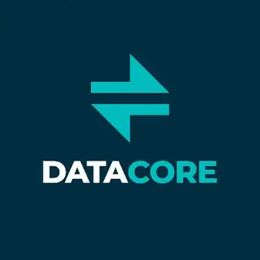
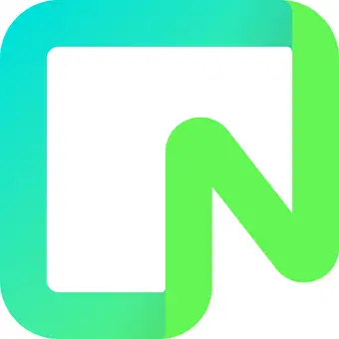
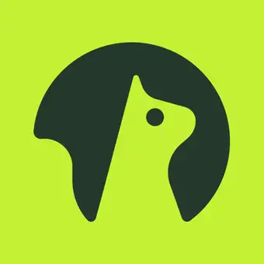
Funding
Early-stage funding picked up; growth and seed saw sharp declines
Funding by stage
(USD millions)
Growth
-88% QoQ
Early
+45% QoQ
Other
Seed
-86% QoQ
Grafana Labs
Series D USD 270 mn
Gcore
Series B USD 60 mn
DataCore Software
PE USD 60 mn
Bluebricks
Seed USD 5 mn
Kong
Series E USD 80 mn
Armada
Series A USD 40 mn
Neon
PE USD 26 mn
Supabase
Series C USD 80 mn
nOps
Series A USD 30 mn
There were no funding rounds in
Notable funding rounds in Q3 2024
Archera
Series A USD 17 mn
Cloud-native Tech
Cloud Optimization Tools
Momento
Series B USD 15 mn
Edge Computing
Serverless Computing
Source: Funding data powered by Crunchbase
Source: Funding data powered by Crunchbase

Slide 6
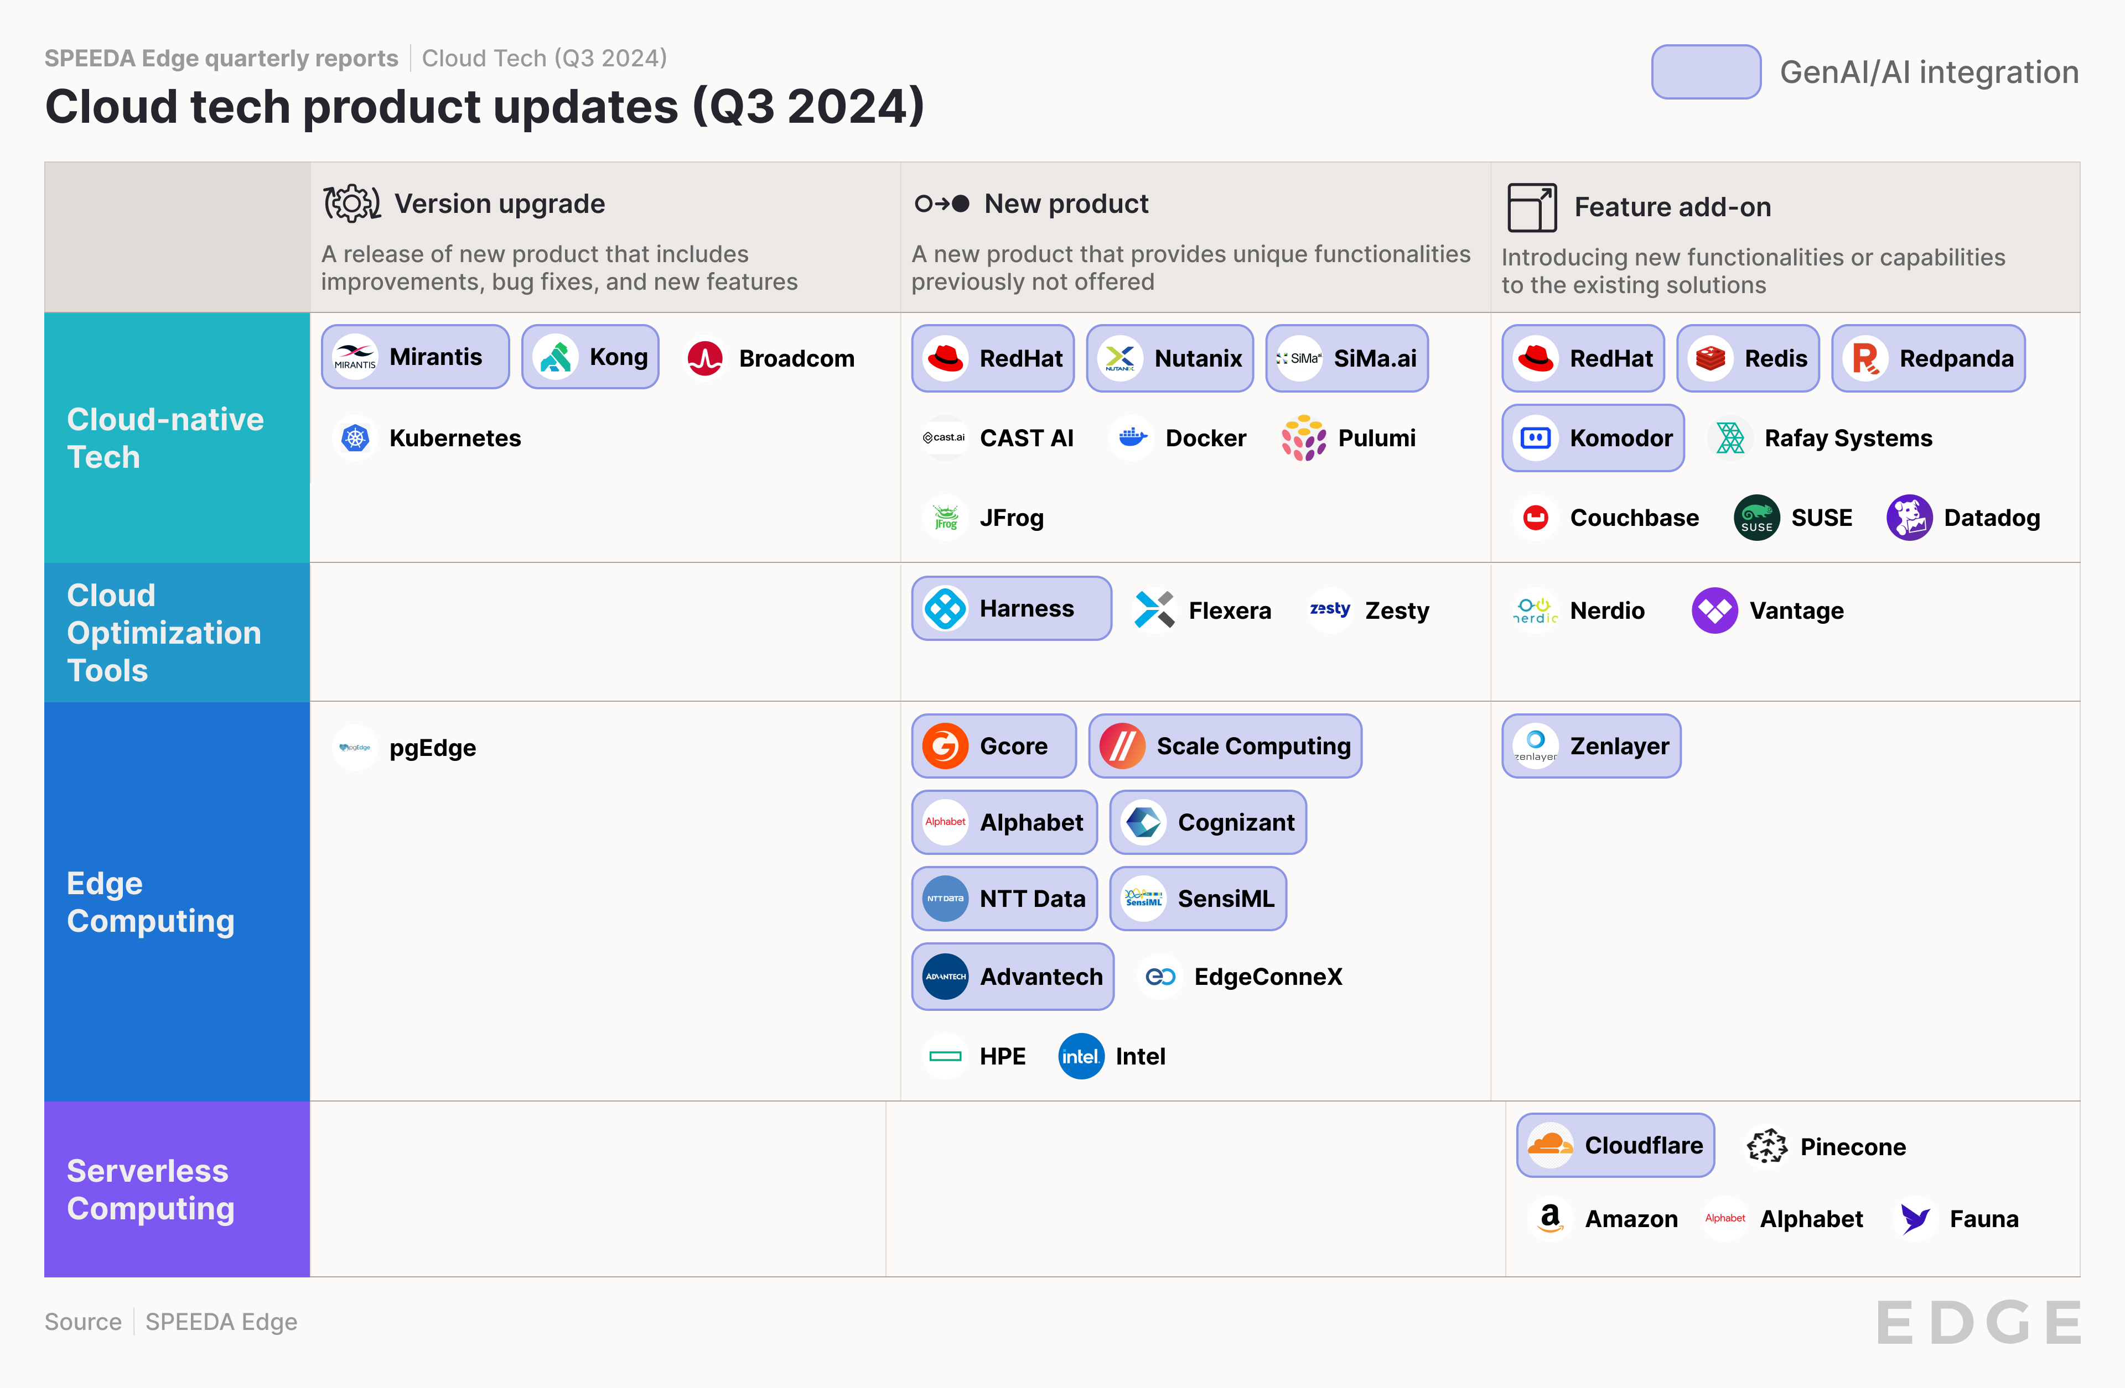
Product updates
AI and hardware innovations for cloud management and edge computing
Analyst Take: AI integration in edge computing and CNT was a prominent theme, with new products and features from Cognizant, Advantech, SensiML, Red Hat, and Redis. These innovations focus on enabling intelligent decision-making, real-time processing, and advanced analytics at the edge and in cloud-native environments.
Cloud cost optimization and management were other focus areas, with new solutions from Harness, Nutanix, Zesty, and Rafay Systems. Recent trends in Cloud Optimization Tools focus on enhancing efficiency and cost management across diverse cloud environments. These new products and features emphasize AI-driven insights, automation, and comprehensive visibility to help organizations optimize their cloud spending and resource use.
Advancements in serverless computing were also seen, with Pinecone expanding its serverless vector database and Cloudflare enhancing its Workers AI platform for scalable, efficient solutions for machine learning and AI-powered applications.

Slide 7
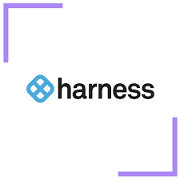
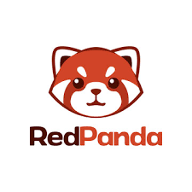
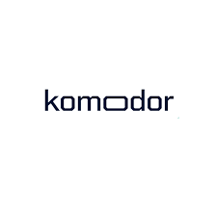
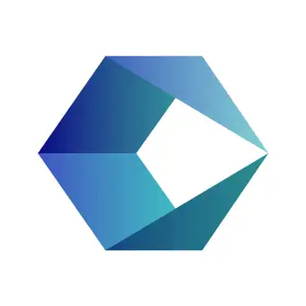
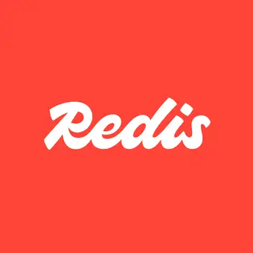
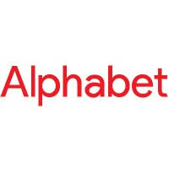
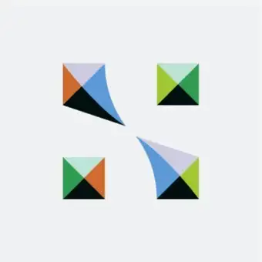
Product updates | AI integrations
Red Hat integrates GenAI into OpenShift; startups advance cloud management and edge computing through AI
Cloud-native Tech
Cloud Optimization Tools
Edge Computing
Products to facilitate Gen AI/AI workloads
GenAI/AI-based product enhancements
Red Hat previewed GenAI capabilities for its OpenShift platform through OpenShift Lightspeed, which simplifies the management of Kubernetes-based OpenShift instances. The feature is available for OpenShift version 4.15 or higher.
Additionally, it launched Red Hat Enterprise Linux (RHEL) AI, a platform for GenAI development in hybrid cloud environments. RHEL AI integrates Granite LLMs and InstructLab tools, enabling users to develop and deploy GenAI models for enterprise applications across cloud and on-premises servers.
Harness introduced multiple AI-powered features to help organizations optimize cloud costs and manage multi-cloud environments.
Gcore launched Gcore WAAP, an AI-driven web application and API protection solution.
RedPanda introduced AI integrations for RedPanda Connect, adding connectors for OpenAI, AWS Bedrock, and vector databases, plus GPU clusters on GCP for AI workloads.
Komodor introduced Klaudia, a GenAI agent for its Kubernetes management platform, to detect issues, prioritize critical problems, and analyze configurations to identify root causes.
Cognizant launched Cognizant Neuro Edge, a platform to allow businesses to leverage AI and GenAI at the edge.
SensiML introduced an open-source AutoML software called "Piccolo AI" for developing intelligent sensor algorithms at the edge.
Redis added new features to streamline development, including Redis Copilot, an AI assistant for providing guidance on database usage and query generation.
Nutanix launched Nutanix Cloud Platform 2.0, with AI-driven operational insights for resource optimization and cost reduction.
Alphabet launched Google Distributed Cloud Edge (GDC), an air-gapped appliance that runs Google's cloud infrastructure stack, including Kubernetes clusters, data security services, and the Vertex AI platform.
SiMa.ai launched MLSoC Modalix for multimodal Edge AI, supporting various AI models such as CNNs, transformers, and GenAI.

Slide 8
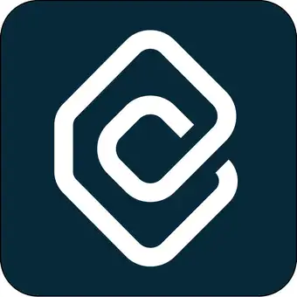
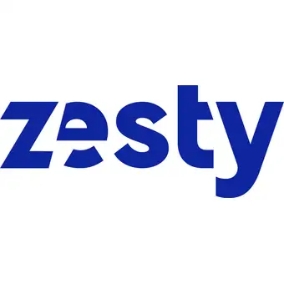
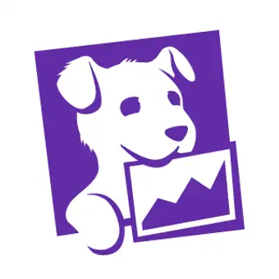
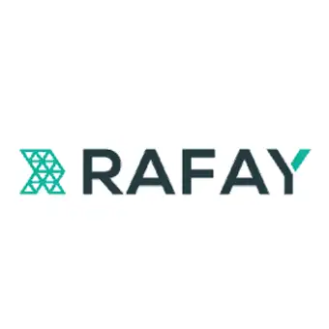
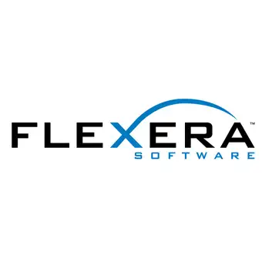
Product updates | Cloud-native Tech and Cloud Optimization Tools
VMware elevates cloud management; SUSE, Datadog, and Zesty drive innovations in cloud monitoring and optimization
Cloud-native Tech
Cloud Optimization Tools
Company | Product | Description
 | VMware Cloud Foundation, Tanzu | Launched VMware Cloud Foundation 9 with enhanced management, security, and self-service features, along with Tanzu 10, which streamlines cloud-native app development and introduces AI solutions for scaling GenAI-powered applications
 | Datadog Monitoring for Oracle Cloud | Released Datadog Monitoring for Oracle Cloud Infrastructure (OCI), allowing Oracle customers to monitor cloud-native and traditional workloads with telemetry
 | Capella Columnar | Couchbase launched Capella Columnar on AWS as part of its database-as-a-service, added vector search to Couchbase Mobile, and introduced a new free tier for developers
 | Rancher Prime | Integrated its recent acquisition, StackState, into Rancher Prime 3.1, enhancing its container management service with full-stack observability
Company | Product | Description
 | Kubernetes Security Posture Management | CAST AI launched a Kubernetes Security Posture Management (KSPM) solution that scans clusters for misconfigurations, vulnerabilities, and compliance issues
 | Cloud Insights and Automation Platform | Launched its Insights and Automation Platform to improve cloud spending efficiency and support multi-cloud strategies
 | Cost optimization suite | Launched a cost optimization suite for Kubernetes, enabling dynamic scaling, auto-rightsizing of clusters, and policy enforcement
 | Technology Intelligence Platform | Launched its Technology Intelligence Platform, powered by Technopedia, to unify IT asset management (ITAM) and FinOps

Slide 9
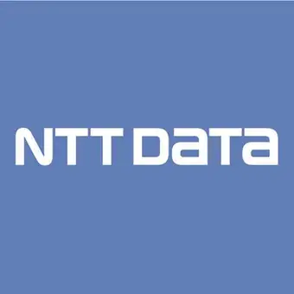
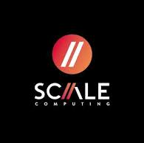
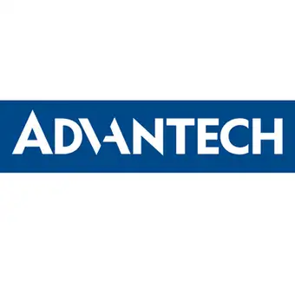
Product updates | Edge Computing and Serverless Computing
Edge hardware innovation continues; Pinecone and Cloudflare advance serverless computing solutions
Edge Computing
Serverless Computing
Company | Product | Description
 | Edge AI platform | Launched an Edge AI platform for industrial and manufacturing sectors, enabling real-time decisions and advanced AI use cases with integrated data processing and AI model management
 | HC3450FG | Introduced HC3450FG, a new GPU-enabled appliance in the HC3000 series, designed for data-intensive applications and AI workloads
 | MIC-733-NEMA | Launched the MIC-733-NEMA, an Edge AI GPU system for intelligent traffic solutions, featuring a compact and fan-less design, wide temperature range, surge protection, flexible expansion, and support for the NVIDIA AI software stack
 | ProLiant DL145 Gen11 server | Hewlett Packard Enterprise (HPE) launched the ProLiant DL145 Gen11 server, a compact solution for diverse Edge locations
Company | Product | Description
 | Pinecone Serverless | Expanded Pinecone Serverless to include Google Cloud and Microsoft Azure and its existing AWS service
 | Workers AI | Cloudflare enhanced its serverless AI platform, Workers AI, with faster inference, support for larger models like Llama 3.1 and 3.2, improved performance analytics, and more affordable queries

Slide 10
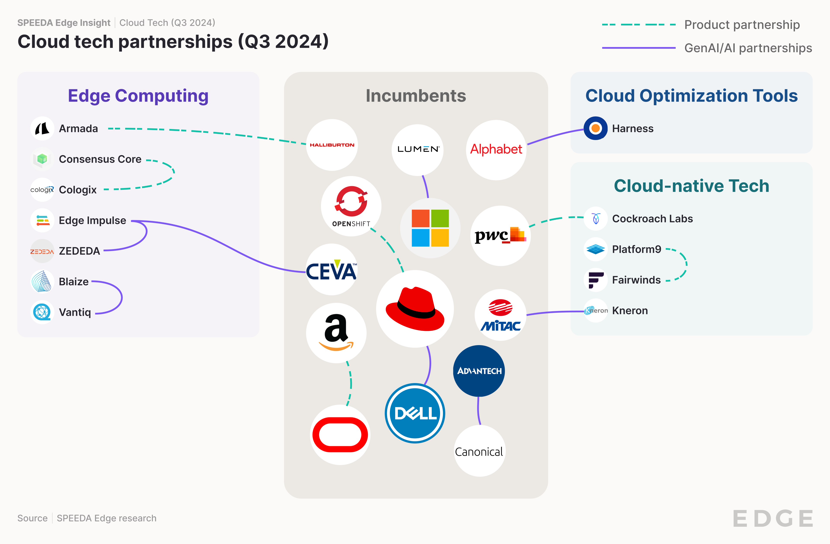
Partnerships
Edge AI and cloud-native tech enhancements drive partnerships
Analyst Take: The integration of edge computing and AI was a dominant theme, with partnerships like Advantech-Canonical, Blaize-Vantiq, ZEDEDA-Edge Impulse, and Ceva-Edge Impulse focusing on embedding AI capabilities into edge platforms. These collaborations aim to enhance intelligent decision-making, improve efficiency, and enable new use cases in IoT and industrial environments like predictive maintenance, autonomous quality control, and smart energy management, highlighting the growing importance of AI at the edge.
Cloud-native technology optimization is evident in partnerships such as Platform9-Fairwinds and Dell-Red Hat. These collaborations address Kubernetes cost management, simplify AI infrastructure deployment, and integrate advanced technologies into existing platforms. The focus is on making cloud-native solutions more accessible, cost-effective, and efficient for enterprises of all sizes.

Slide 11
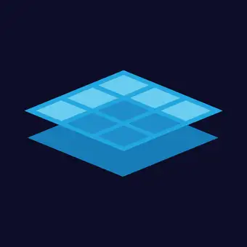
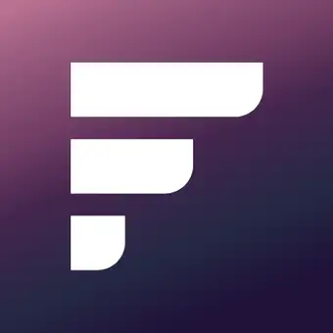
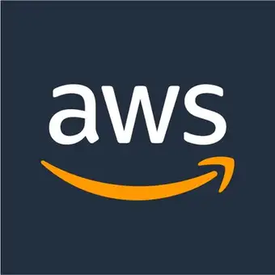
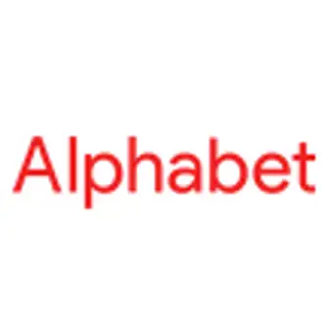
Partnerships | Cloud-native Tech
Red Hat and Harness propel AI development; Oracle and Cockroach Labs pioneer database enhancements
Product partnership
GenAI/AI partnership
Red Hat partnered with Dell to bring the Red Hat Enterprise Linux AI (RHEL AI) platform to Dell's PowerEdge servers for AI development.
Platform9 partnered with Fairwinds to address cost control challenges in public cloud deployments by tackling Kubernetes over-provisioning and enhancing EKS cluster efficiency with its Elastic Machine Pool technology.
Oracle and Amazon Web Services (AWS) partnered to launch Oracle Database@AWS, allowing customers to access Oracle database services within AWS.
Harness expanded its partnership with Google Cloud to integrate GenAI technologies into the software development lifecycle, introducing Harness AI Productivity Insights for Gemini Code Assist to provide metrics on AI-driven productivity gains.
Cockroach Labs partnered with PwC UK to help banks and financial institutions tackle regulatory compliance challenges and modernize outdated platforms.

Slide 12
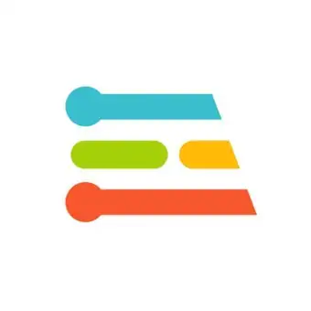
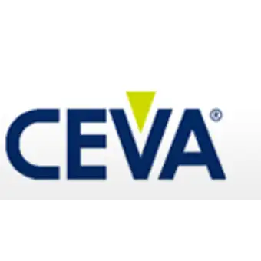
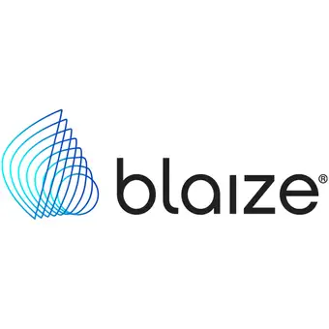
Partnerships | Edge Computing
Blaize, ZEDEDA, Vantiq, and Edge Impulse forge partnerships to advance edge AI solutions
Product partnership
GenAI/AI partnership
ZEDEDA partnered with Edge Impulse to allow customers to deploy Edge Impulse AI models through the ZEDEDA Marketplace.
Ceva and Edge Impulse partnered to integrate Ceva's NeuPro-Nano NPUs with the Edge Impulse Platform, accelerating the development of embedded machine learning applications for IoT devices.
Blaize partnered with Vantiq to launch the Blaize AI Orchestration Platform, combining Blaize's Graph Streaming Processor technology with Vantiq's intelligent software.
Advantech partnered with Canonical to launch Ubuntu Pro for Devices on its edge computing platform, enhancing security, support, and development for IoT, AI, and industrial applications.
Cologix partnered with Consensus Core to launch NVIDIA-powered GPU-as-a-service in Canada.

Slide 13
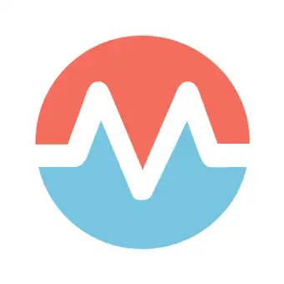
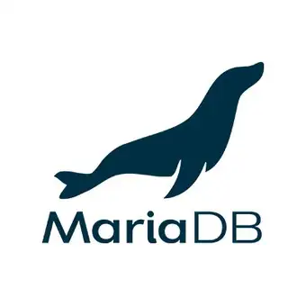
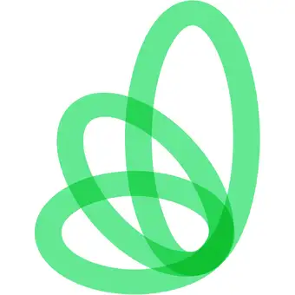
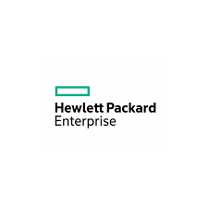
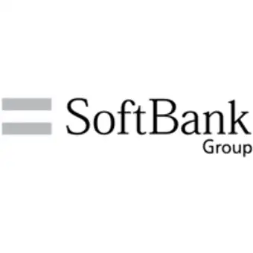
M&As
Confluent and HPE push consolidation strategies, as K1 acquires struggling MariaDB
Analyst Take: The number of Cloud Tech deals halved in Q3 2024 (5 vs. 10 in Q2).
K1 Investment Management's acquisition of MariaDB took the open-source database company private, signaling a strategic shift. With the recently appointed CEO's history of restructuring companies, MariaDB may be preparing for a potential future sale or acquisition, positioning itself for further market consolidation or strategic partnerships.
IBM’s Kubecost deal significantly strengthens IBM's position as the leader in cloud cost management solutions by enhancing its FinOps Suite with Kubernetes-specific cost monitoring.
Meanwhile, HPE’s and Confluent’s acquisitions reflect the ongoing trend of consolidation and capability expansion in Cloud Tech.
Cloud-native Tech
Edge Computing
Cloud Optmization Tools
HPE acquired Morpheus Data, a company specializing in hybrid cloud management and platform operations software.
HPE aims to streamline IT complexity by expanding the hybrid operations capabilities of its HPE GreenLake cloud platform and allowing customers to understand their cloud spending, enforce usage controls, and optimize workloads to reduce costs.
Confluent acquired WarpStream, a Kafka-compatible data streaming platform.
WarpStream's Bring Your Own Cloud (BYOC) architecture, built on object storage, aligns with Confluent's Kora engine and supports large-scale workloads with relaxed latency in customers' cloud environments.
MariaDB, a company that commercializes an open-source relational database, was acquired by K1 Investment Management for an undisclosed amount, taking the company private.
The transaction was set at USD 0.55 per share, valuing the company at ~USD 37 million. MariaDB, after struggling as a public company post-SPAC, faced a failed takeover bid from Progress.
SoftBank acquired UK-based AI chip startup Graphcore. Graphcore has developed a new type of processor called an "intelligence processing unit" (IPU) specifically for AI workloads.
SoftBank is enhancing its AI capabilities by acquiring Graphcore, which will remain a wholly-owned subsidiary and retain its name and offices.
IBM acquired Kubecost, a FinOps startup specializing in Kubernetes cost monitoring and optimization.
IBM will integrate Kubecost into its FinOps Suite, boosting cost transparency and resource optimization for Kubernetes workloads, aligning with its strategy to enhance multi-cloud cost management and IT capabilities.
I
I
I
Incumbent

Slide 14
©2024 Uzabase, Inc. All Rights Reserved. The information contained herein (1) is proprietary to Uzabase Inc. and/or its content providers; (2) may not be copied or distributed; and (3) is not warranted to be accurate, complete, or timely. Neither Uzabase Inc. nor its content providers are responsible for any damages or losses arising from any use of this information.

