Slide 1
Cloud Tech (Q2 2024): Funding rebounds amid IBM’s HashiCorp and RHEL AI plays Keshawa Perera, CFA

Slide 2
What’s inside?
Key takeaways
Funding
Edge Computing mega rounds stood out: Cloud Tech funding reached its highest in the past three years, raising USD 3.7 billion across 19 funding rounds (+4x QoQ and +1.5x YoY). Edge Computing accounted for ~82% of the total raised, led by EdgeConneX’s (USD 1.9 billion) and DataBank’s (USD 725 million) large-debt rounds to expand global data center capacity. Other Edge Computing startups Yondr, Hailo, and Blaize also raised USD 100+ million each, with a notable shift toward growth-stage rounds. Funding in Cloud-native Tech, Serverless Computing, and Cloud Optimization Tools saw significant gains, with Cloud Optimization Tools experiencing an exceptional 45x YoY growth.
Product updates
Red Hat launched RHEL AI: Red Hat Enterprise Linux AI (RHEL AI) enables the efficient, flexible deployment of AI models at the edge by providing optimized container images, hybrid cloud capabilities, and seamless integration with enterprise IT operations. It simplifies scaling AI across distributed edge environments, accelerating the adoption of AI-powered applications in resource-constrained, distributed settings.
Focus on edge AI hardware innovation: The edge AI landscape witnessed a flurry of new chip releases, with EdgeCortix, Hailo, and Kneron introducing advanced edge AI accelerators and servers. Incumbents like Intel and AMD also made significant advancements, with Intel launching edge-optimized CPUs, GPUs, and FPGAs and AMD unveiling its Versal adaptive SoC. Alongside these hardware innovations, we noted numerous product announcements focused on enhancing Kubernetes adoption and capabilities in Cloud-native Tech.
Partnerships
Simplifying AI deployments and enhancing edge management: Collaboration between incumbents and disruptors aimed to simplify and enhance AI deployments and edge management. Noteworthy partnerships included Vapor IO and VAST Data integrating edge and core AI systems and Red Hat with Intel, Cloudera, Veeam, and Nutanix to bolster AI, security, and virtualization. Additionally, Dell partnered with Nvidia to accelerate edge AI adoption.
M&A
IBM acquired HashiCorp: IBM's acquisition of HashiCorp for USD 6.4 billion was a strategic move to enhance its hybrid cloud and AI capabilities. By integrating HashiCorp's tools into its Red Hat OpenShift platform, IBM plans to offer customers greater flexibility in cloud deployments. The combination of IBM's expertise (including Red Hat) and HashiCorp's security and management solutions is expected to create a holistic platform tailored for the AI era, strengthening IBM's position in the rapidly evolving cloud and AI market.
Cloud-native Tech and Serverless Computing dominate activity: We tracked nine other M&A deals, primarily in Cloud-native Tech and Serverless Computing. Harness bolstered its product portfolio by acquiring Split Software, further strengthening its acquisition-driven growth strategy. Other notable transactions included EQT's purchase of WSO2, Timescale's acquisition of PopSQL, and SUSE's buyout of StackState.
This Insight covers quarterly updates on Cloud Technology and focuses on our coverage of the Cloud-native Tech, Cloud Optimization Tools, Serverless Computing, and Edge Computing industry hubs.
Section 1: Industry outlook
• IBM acquires HashiCorp
• Red Hat launches RHEL AI
Section 2: Funding
• Funding surges, driven by edge computing
Section 3: Product updates
• Edge AI hardware
Section 4: Partnerships
• Simplifying AI edge deployments
Section 5: M&A
• Cloud-native Tech and Serverless Computing drive deals

Slide 3
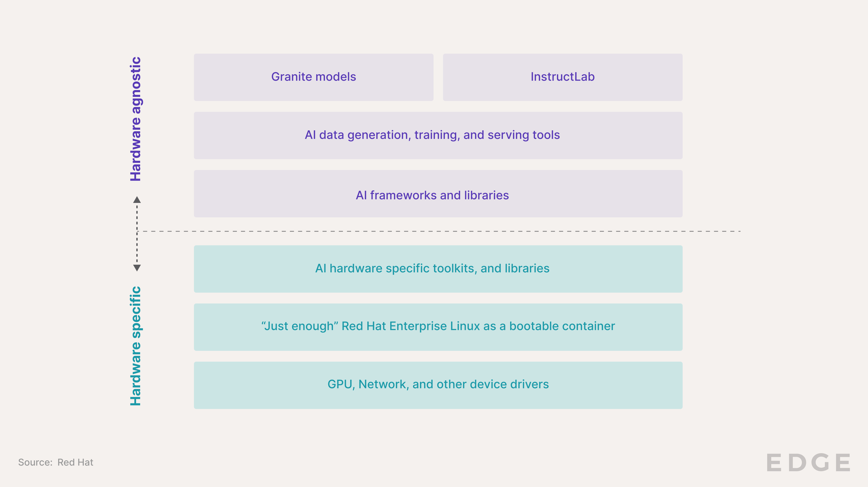
Industry outlook
IBM expands cloud and AI capabilities with HashiCorp acquisition and RHEL AI launch
IBM acquired HashiCorp
IBM announced the acquisition of HashiCorp, a leading provider of multi-cloud infrastructure automation solutions, for USD 6.4 billion.
The acquisition aligns with IBM's goal of creating a holistic hybrid cloud platform designed for the AI era. By integrating HashiCorp's cloud-agnostic infrastructure provisioning and management tools, such as Terraform, into its Red Hat OpenShift platform, IBM aims to provide customers with greater flexibility in their cloud deployments. Additionally, HashiCorp's Vault, a security product for managing sensitive data, can be leveraged to drive revenue growth in IBM's existing accounts and introduce the broader HashiCorp portfolio to new customers.
The acquisition also addresses some challenges HashiCorp has faced in its transition to a SaaS-based subscription model, as IBM's resources and expertise can help the company refocus on its core strengths and deliver value to customers more effectively.
Red Hat launched RHEL AI
Red Hat Enterprise Linux AI (RHEL AI) is a new platform from Red Hat that makes it easier for businesses to use and develop AI technologies. It combines Red Hat's popular Enterprise Linux operating system with open-source AI models and tools, allowing companies to run and customize AI applications easily on their existing IT infrastructure.
RHEL AI includes AI models called "Granite" from IBM Research, which can be fine-tuned by domain experts using the InstructLab project. It also provides tools for deploying AI models across on-premises servers and public clouds. By making AI more accessible and customizable, RHEL AI aims to accelerate the adoption of AI across various industries.
As the cloud and Edge Computing industries continue to evolve, several critical developments are shaping the landscape for GenAI adoption. Key players like Red Hat, SUSE, NVIDIA, AMD, and Intel have unveiled innovative products and platforms to enable the deployment of GenAI models across hybrid cloud and edge environments.
Red Hat's RHEL AI and OpenShift AI, for instance, aim to make open-source AI more accessible and enterprise-ready, while partnerships between companies like VaporIO, Dell, and Red Hat are positioning them to capitalize on the GenAI revolution. Additionally, cloud optimization tools are increasingly incorporating AI-based features, such as Red Hat's "Lightspeed" and CAST AI's AI Advisor, to enhance cloud resource management and governance.
These developments suggest a growing focus on making GenAI more scalable, cost-effective, and user-friendly across diverse cloud and edge computing setups, potentially removing key bottlenecks.
Red Hat Enterprise Linux AI development stack

Slide 4
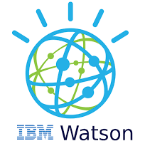
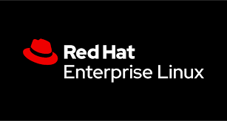
Industry outlook | Red Hat Enterprise Linux AI
RHEL AI aims to make AI development more accessible, customizable, and scalable
Red Hat’s recent announcements provided solutions across the AI application development value chain.
Stages
Open-source AI models
Model fine-tuning and enhancement
Deployment and optimization
Production and scaling
Red Hat solutions
RHEL AI includes the open-source licensed Granite family of large language models (LLMs) developed by IBM Research.
This provides access to high-quality, transparent AI models as a foundation for applications.
Integrates with InstructLab, which provides tools for domain experts to fine-tune and enhance the LLMs.
This enables customization of the AI models to specific use cases without requiring extensive data science expertise.
RHEL AI provides optimized, bootable RHEL container images for deploying the Granite LLMs and InstructLab tools across hybrid cloud environments.
This supports hardware acceleration from AMD, Intel, and NVIDIA to ensure efficient performance of the AI models in production.
Integrates with Red Hat's OpenShift AI platform, which enables running the AI models and InstructLab tools at scale across distributed cluster environments.
This allows enterprises to more easily manage the lifecycle and integration of AI models with their cloud-native applications.
Products
Granite LLMs
InstructLab
RHEL container images
Open-source licensed LLMs from IBM Research for language generation and code assistance
Open-source tools to fine-tune and enhance LLMs using a knowledge and skills taxonomy, based on IBM's LAB methodology
Lightweight, bootable versions of Red Hat Enterprise Linux optimized for running applications in containers
A hybrid machine learning operations platform that enables running RHEL AI models and InstructLab at scale across distributed cluster environments
Source: Red Hat

Slide 5
Funding
Edge Computing mega rounds stand out; Cloud Optimization Tools makes a comeback
Analyst Take: Cloud Tech startups raised USD 3.7 billion during Q2 2024. This figure significantly exceeded the average quarterly funding of USD 1.3 billion over the past three years. The resurgence in cloud tech funding mirrored the broader uptick in global venture funding during this period.
Mega rounds from Edge Computing startups stood out, with EdgeConneX’s USD 1.9 billion and DataBank’s USD 725 million debt rounds to expand global data center capacity comprising ~70% of total Q2 funding. There was also a notable shift toward growth-stage funding, with Yondr, Hailo and Blaize each raising USD 100 million+. Yondr also plans to use the funds for data center expansion, while Hailo, and Blaize focus on advancing GenAI at the edge.
Other notable rounds included Vercel’s USD 250 million in Series E funding to advance AI-powered website generation and security products and Harness’ USD 150 million in debt funding to enhance its platform with GenAI and acquire Split Software.
Cloud Tech funding mix (Q2 2024)
(USD millions)
Source: Funding data powered by Crunchbase

Slide 6
Funding
Funding records a three-year high, led by EdgeConnex and Databank
Cloud Tech funding by industry
(USD millions)
The median funding round size in Q2 2024 reached USD 48 million, a significant 2x increase from the previous quarter. This figure was also substantially higher than the trailing 3-year median round size of USD 18 million
13
11
19
29
15
26
14
21
6
30
21
21
16
48
Median funding round size
+447% QoQ
The funds raised, excluding DataBank and EdgeConneX, experienced a significant 3x QoQ growth, helping funding reach parity with the Q2 2023 level
1,583
587
1,173
1,110
248
385
227
+414% QoQ
Q2 2024
+230% QoQ
+630% QoQ
NA
3,071
222
152
290

Slide 7
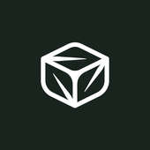
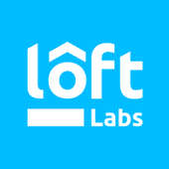
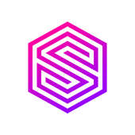
Funding
Growth rounds lead the charge, early and seed stages also sees uptick
Funding by stage
(USD millions)
Growth
+578% QoQ
Early
Seed
Other
+578% QoQ
+27% QoQ
+50% QoQ
No funding in Q2 2024
EdgeConneX
Debt USD 1,900 mn
Finout
Series B USD 26 mn
RunPod
Seed USD 22 mn
DataBank
Debt USD 725 mn
Loft Labs
Series A USD 24 mn
Espresso AI
Seed USD 11 mn
Vercel
Series E USD 250 mn
nOps
Series A USD 20 mn
Major funding rounds in Q2 2024
Harness
Debt USD 150 mn
SurrealDB
Series A USD 20 mn
Cloud-native Tech
Cloud Optimization Tools
Yondr
Debt USD 150 mn
Stacklet
Series B USD 15 mn
Edge Computing
Serverless Computing
Source: Funding data powered by Crunchbase
Source: Funding data powered by Crunchbase

Slide 8
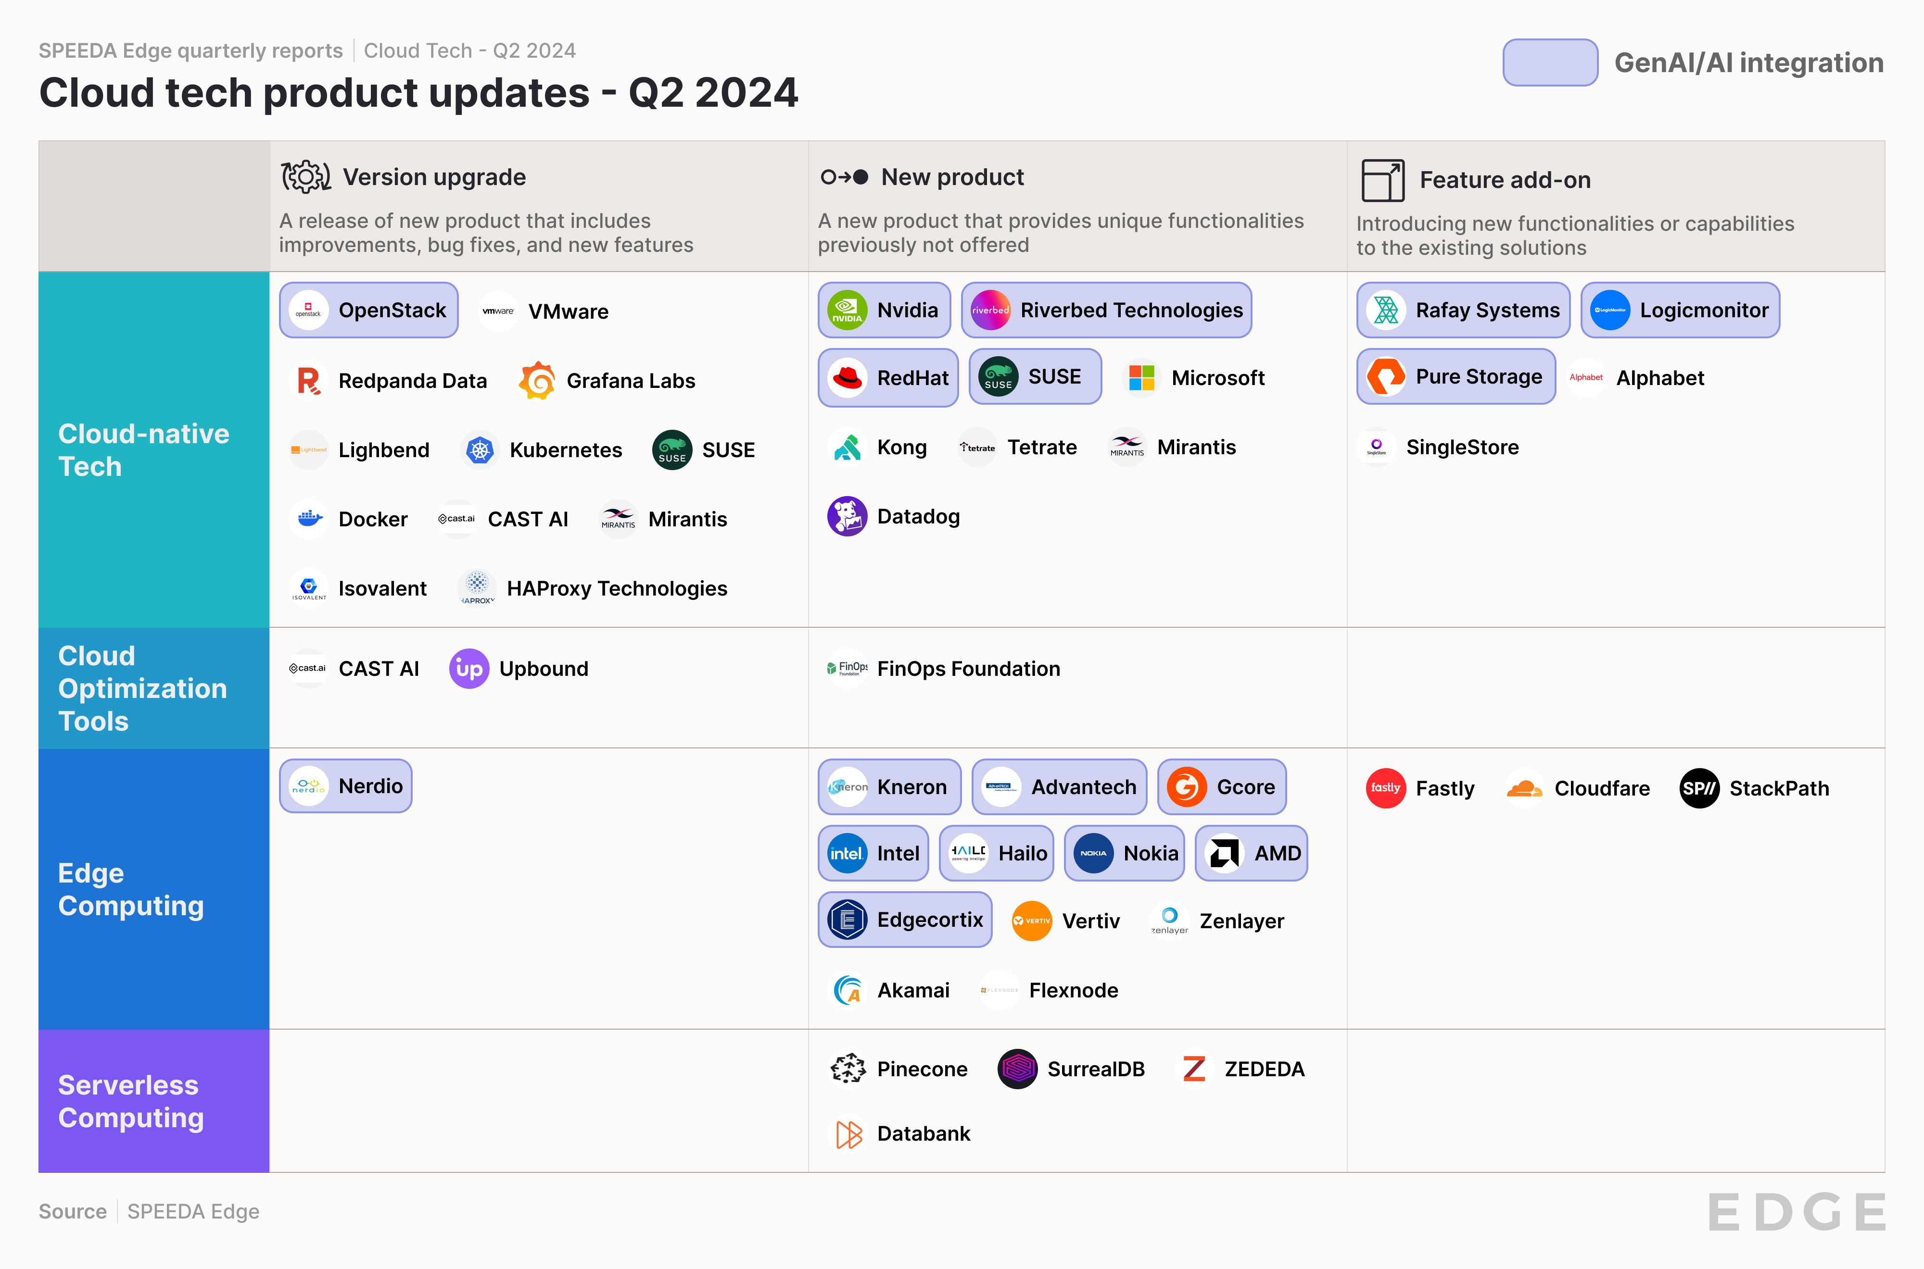
Product updates
Edge AI ecosystem energized by wave of hardware releases
Analyst Take: IBM’s (Red Hat) release of RHEL AI underscores its focus on hybrid cloud as a key enabler of AI. Unlike other tech giants developing proprietary approaches, IBM positions itself as an "open hybrid/multi-cloud provider" that can integrate with competitors' cloud services (AWS, GCP, Azure). By combining infrastructure automation, a leading enterprise Linux distribution, and AI capabilities, IBM aims to provide a holistic solution for enterprises looking to harness AI while maintaining control over their IT environments.
Meanwhile, edge AI chips from companies like EdgeCortix, Hailo, Kneron, Intel, and AMD enable powerful GenAI capabilities on resource-constrained edge devices. These chips accelerate LLMs and multi-modal AI workloads, enabling hybrid cloud-edge architectures that leverage the strengths of both. Software-driven approaches, particularly from EdgeCortix, are democratizing GenAI access by allowing the deployment of edge AI capabilities on existing hardware systems while providing flexible, updatable edge AI solutions that can continuously evolve to meet changing needs.

Slide 9
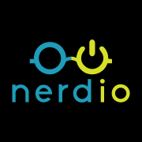
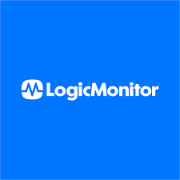
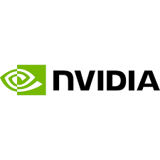
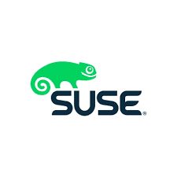
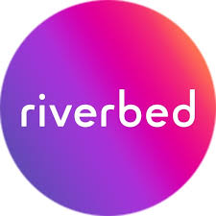
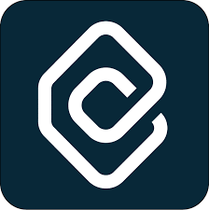
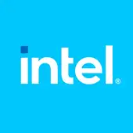
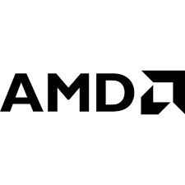
Product updates | AI integrations
Red Hat democratizes open-source AI with RHEL AI and more; disruptors continue to add GenAI-based features
Cloud-native Tech
Cloud Optimization Tools
Edge Computing
Serverless Computing
Products to facilitate Gen AI workloads
GenAI-based product enhancements
Is bolstering its AI and machine learning capabilities across its products. The company has launched RHEL AI, a foundation model platform combining RHEL, open-source Granite models, and InstructLab to simplify working with open-source AI. Red Hat OpenShift AI now enables deploying models to edge environments via single-node OpenShift, allowing both predictive and GenAI on a single platform to reduce costs. Additionally, Podman AI Lab provides developers with local workspace to build GenAI apps using sample models before deployment to OpenShift/Kubernetes.
Expanded Lightspeed AI across OpenShift and RHEL to boost GenAI-powered user assistance
Unveiled GenAI-based upgrades for Nerdio Manager for Enterprise and Nerdio Manager for MSP, enhancing both platforms
Introduced new anomaly detection features using machine learning (ML) to identify threats like ransomware, malicious behavior, and denial-of-service attacks
Its LM Envision platform now includes LM Cost Optimization, an AI-based feature to help manage the complexities and costs of cloud infrastructure
Unveiled NVIDIA NIM, a service offering inference microservices for deploying GenAI applications
Announced its AI strategy and SUSE AI solutions, a new vendor- and LLM-agnostic GenAI platform
Launched an AI-powered observability platform. It uses AI to process and analyze information to identify root causes and initiate automated corrections
Launched an AI Advisor in CAST Highlight to give users quick insights and recommendations for managing their application portfolios more effectively
Launched a series of new chips and FPGAs aimed at expanding AI capabilities to the network edge, including several edge-optimized CPUs and GPUs and the Agilex 5 Series FPGAs
Expanded its Versal adaptive SoC portfolio with AI Edge Series Gen 2 and Prime Series Gen 2

Slide 10
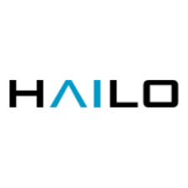
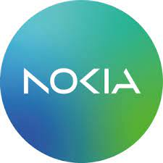
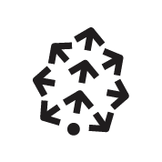
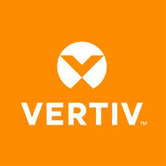
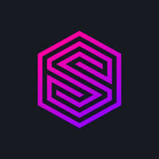
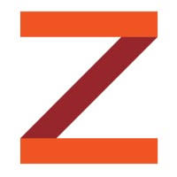
Product updates | Edge Computing and Serverless Computing
EdgeCortix, Hailo, and Kneron propel edge AI forward with innovative deployment platforms
Edge Computing
Serverless Computing
Company | Product | Description
 | SAKURA-II | Unveiled the SAKURA-II edge AI accelerator to handle GenAI tasks efficiently and effectively, especially in restrictive environments at the edge
 | Hailo-10 | Launched the Hailo-10 high-performance GenAI accelerator for lower-latency AI models to run locally at the edge without relying on cloud-based servers
 | KNEO 330 | Launched KNEO 330, its second-generation edge GPT server that can handle AI inference with 48 TOPs of AI computing power
 | SmartRow2 | Launched SmartRow2, a new edge data center solution for streamlined edge deployments with increased scalability and flexibility
 | ZEDEDA Edge Sync | Launched ZEDEDA Edge Sync to address connectivity obstacles in edge deployments that lack consistent access to the cloud
Company | Product | Description
 | Gcore Inference at the Edge | Launched "Gcore Inference at the Edge” to deliver low-latency experiences for AI applications by allowing the distributed deployment of pre-trained machine-learning models to edge inference nodes
 | MX Grid | Introduced MX Grid to enhance operational technology (OT) responsiveness and decision-making in organizations
 | Pinecone Serverless | Released Pinecone Serverless, a serverless vector database for production deployments, enabling complex AI applications
 | Surreal Cloud | Released the beta version of Surreal Cloud, a fully managed version of its scalable database solution for serverless applications

Slide 11
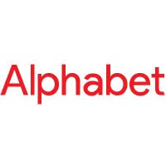
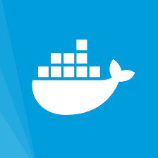
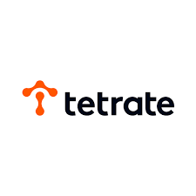
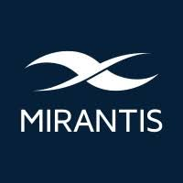
Product updates | Cloud-native Tech and Cloud Optimization Tools
Google, Microsoft, and Mirantis announce major Kubernetes additions alongside new Kubernetes version release
Cloud-native Tech
Cloud Optimization Tools
Company | Product | Description
 | Google Distributed Cloud | Integrated Google Kubernetes Engine (GKE) into its Google Distributed Cloud (GDC) platform, allowing the deployment of IT infrastructure setups on any cloud
 | Automatic | Previewed a new service called "Automatic,” which is designed to streamline the setup of Kubernetes clusters on the Azure Cloud platform
 | k0smotron | Released k0smotron 1.0, an open-source tool for deploying and managing Kubernetes clusters across any infrastructure—private clouds, public clouds, bare metal, or the edge
 | Kubernetes | Introduced the 1.30 update with various feature updates and enhancements to improve resource utilization and scalabilities, fortify security measures, and provide better development support
Company | Product | Description
 | Kong Konnect | Commercially launched its Kong Konnect dedicated cloud gateways on Amazon Web Services (AWS)
 | Docker Desktop | Released Docker Desktop 4.29 with Docker socket mount permissions in ECI, advanced error management, Moby 26, and new beta features
 | AuthService | Launched AuthService, an open-source project to simplify the deployment and management of the existing authorization service for the Istio service mesh
 | FinOps Foundation (an initiative of the Linux Foundation) | Launched version 1.0 of its open-source billing standard, FinOps Open Cost and Usage Specification (FOCUS)
 | Crossplane | Released an enterprise-ready Crossplane solution, providing a unified control plane experience with security, automation, and centralized management for cloud-native platforms

Slide 12
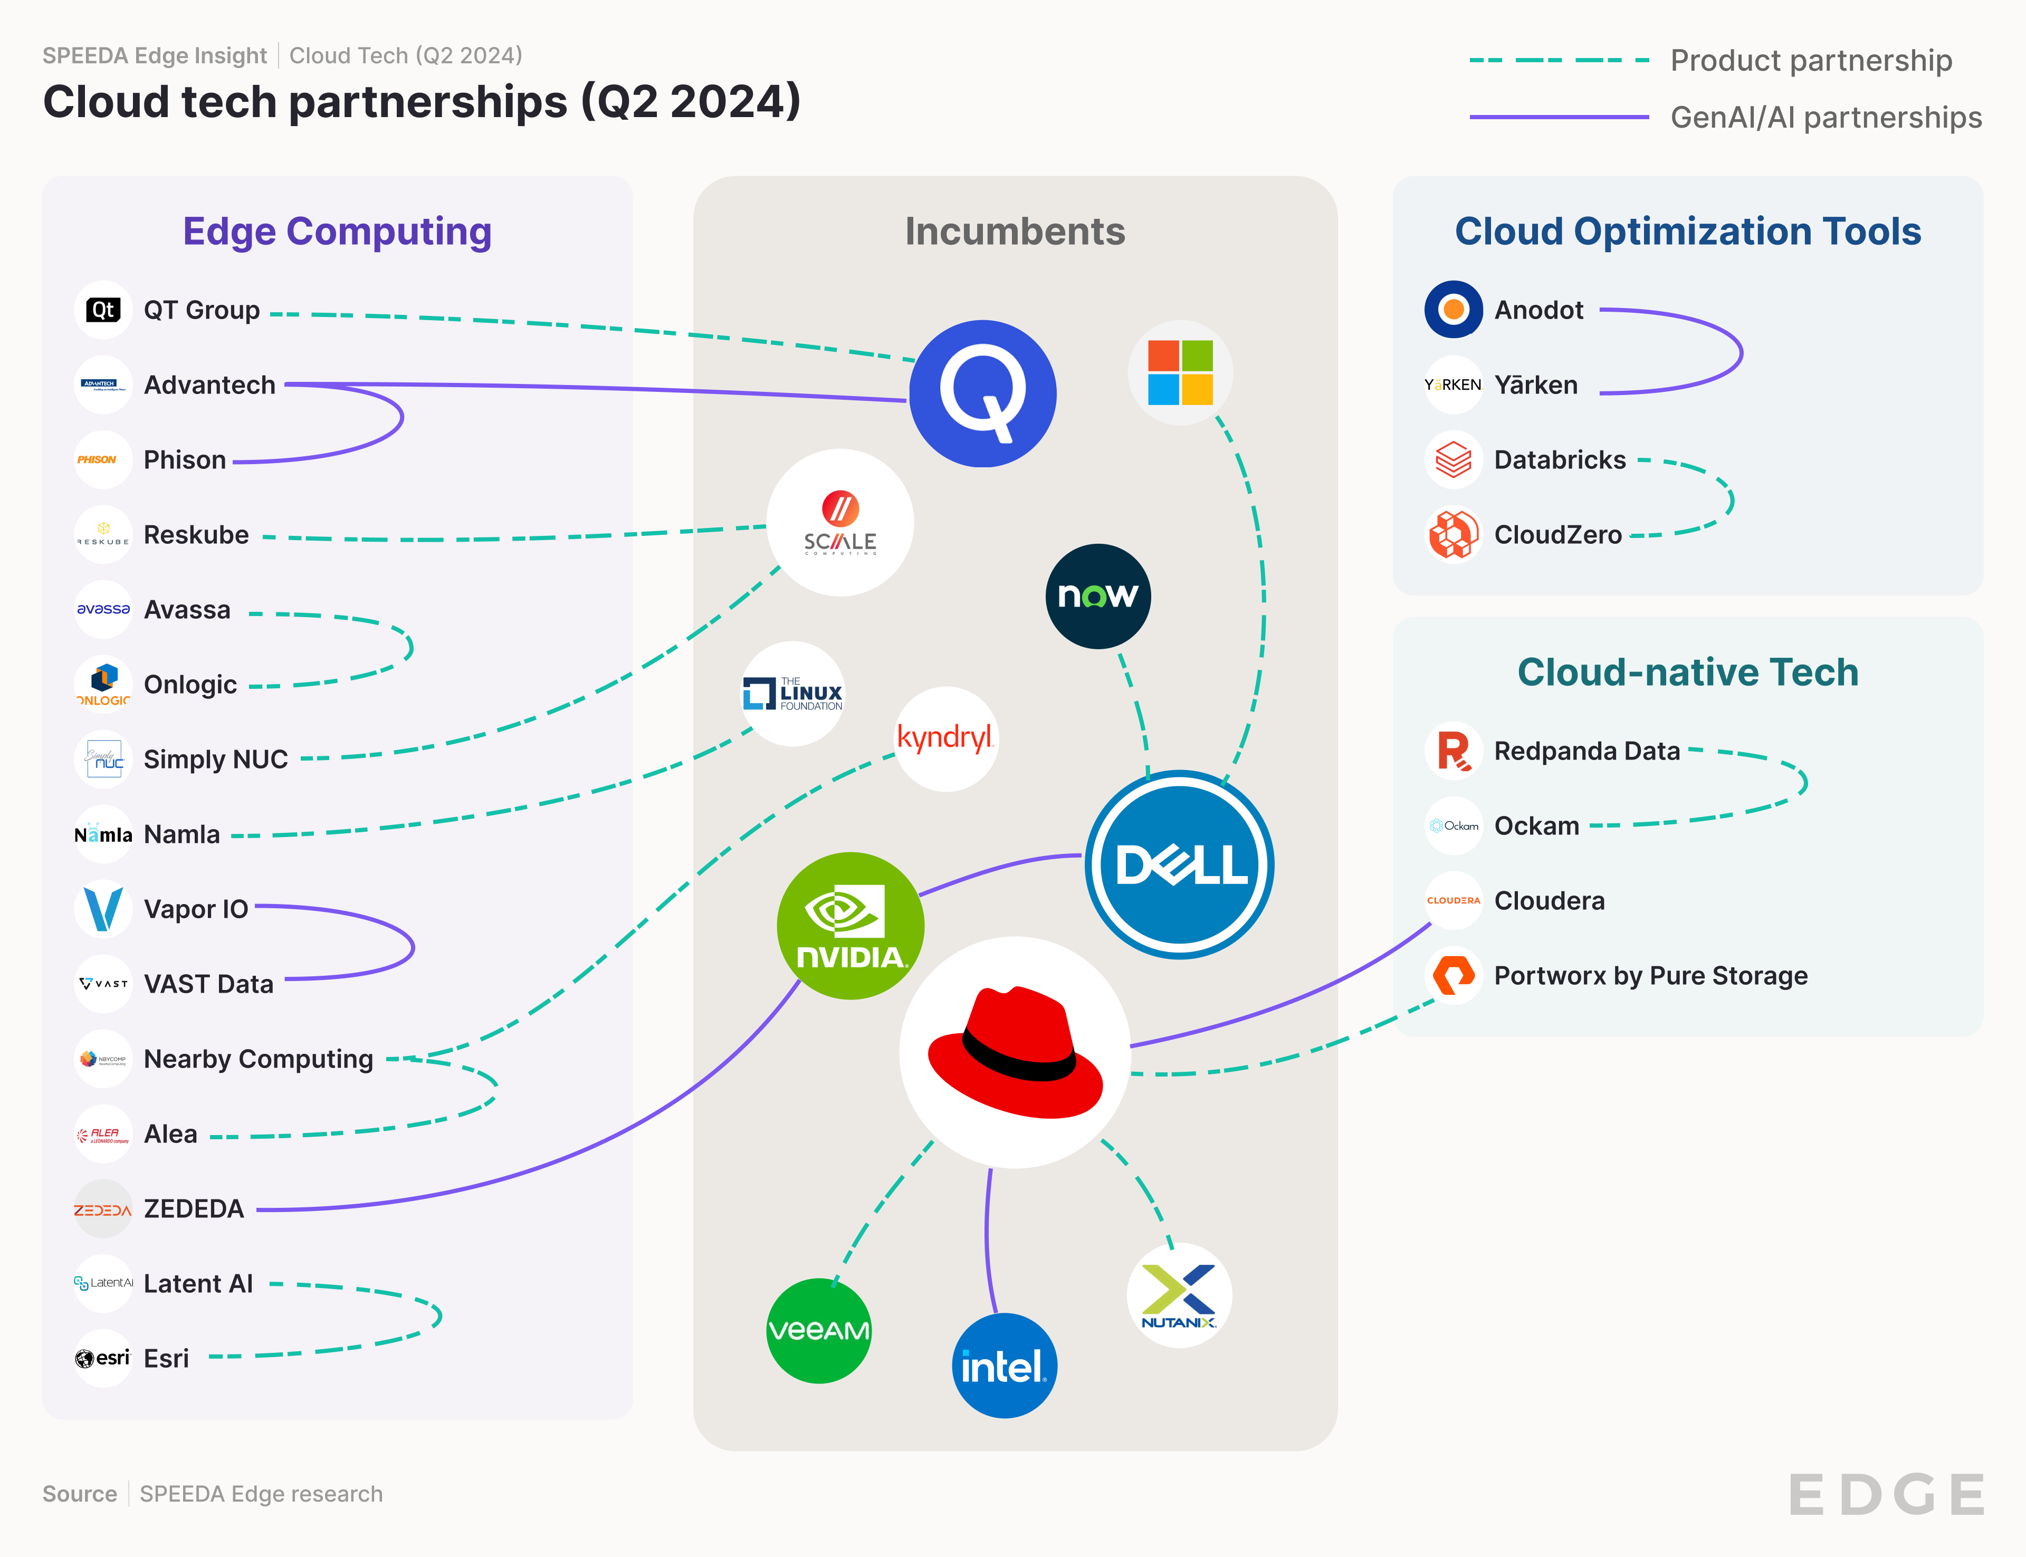
Partnerships
Edge AI ecosystem strengthens through partnerships aimed at GenAI deployment
Analyst Take: Cloud Tech witnessed several notable partnerships, emphasizing advancements in AI, edge computing, and cloud-native workloads. A key trend is the collaborations aiming to simplify and enhance AI deployments and edge management. Noteworthy partnerships include Vapor IO and VAST Data, integrating edge and core AI systems, and Red Hat with Intel, Cloudera, Veeam, and Nutanix to bolster AI, security, and virtualization.
Dell and NVIDIA’s partnership aims to accelerate edge AI adoption through automated deployment and management platforms. Dell's NativeEdge now integrates with NVIDIA's AI Enterprise software stack, enabling developers to deploy AI applications at the edge using frameworks like Metropolis for video analytics and Riva for speech. The NativeEdge platform also integrates with ServiceNow's Now Platform, providing closed-loop automation for orchestrating, managing, and securing Edge AI workloads. These solutions simplify the customer experience and streamline operations, making it easier for organizations to implement and scale AI capabilities at the edge.

Slide 13
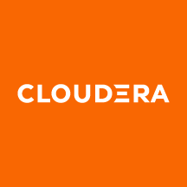
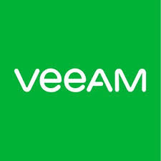
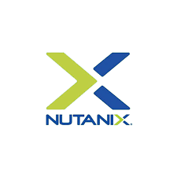
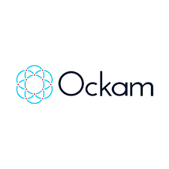
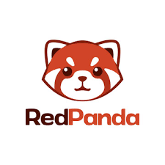
Partnerships | Cloud-native Tech and Cloud Optimization Tools
Red Hat enhances AI and cloud capabilities through partnerships with Intel, Cloudera, and others
Product partnership
Cloud-native Tech
GenAI/AI partnership
Cloud Optimization Tools
Red Hat partnered with Intel to enhance enterprise AI applications through the product, Red Hat OpenShift AI, leveraging various Intel processor technologies.
Red Hat partnered with Cloudera to address growing demand for AI workloads by enhancing cloud infrastructure security and robustness. Additionally, Cloudera is transitioning its public cloud infrastructure to Red Hat's newly unveiled RHEL AI platform.
The partnership between Veeam and Red Hat aims to provide the necessary tools and support for organizations transitioning to OpenShift virtualization, which involves integrating virtual machines and containers.
Nutanix and Red Hat expanded their collaboration to use Red Hat Enterprise Linux as the foundation for Nutanix's cloud platform, providing enterprise-ready Linux capabilities.
Redpanda partnered with Ockam to launch Redpanda Connect with Ockam, a zero-trust streaming data platform developed for large-scale enterprise use.
The partnership between Anodot and YäRKEN aims to provide a cloud cost management solution that integrates on-premises and cloud environments, leveraging Anodot's AI-based optimization and YäRKEN's platform for aligning tech spend with business objectives.

Slide 14
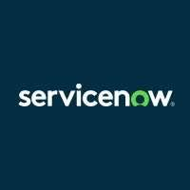
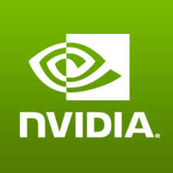
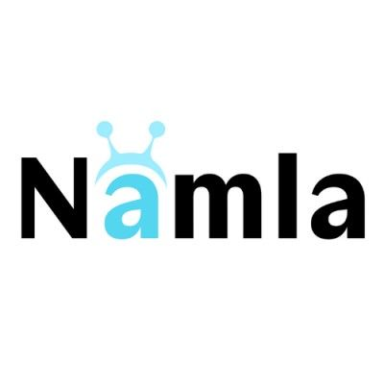
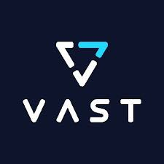
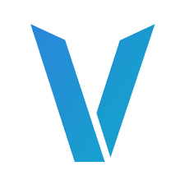
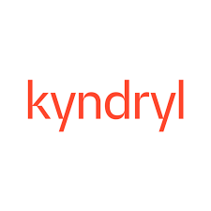
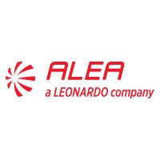
Partnerships | Edge Computing
Dell and partners collaborate to streamline edge computing and AI deployment
Product partnership
GenAI/AI partnership
Dell NativeEdge introduced Azure Arc enablement automation to improve the Azure customer experience and enhance security at the edge, simplify edge operations, and advance AI capabilities.
Dell NativeEdge integrates with ServiceNow's Now Platform to enable businesses to extend IT operations from the data center to the edge, simplifying the orchestration, management, and workflow of edge computing resources.
1
1
Dell NativeEdge became the first edge orchestration platform that automates the delivery of NVIDIA AI Enterprise, enabling the deployment of NVIDIA AI frameworks on Dell NativeEdge Endpoints powered by NVIDIA-accelerated computing.
The partnership between Namla and NVIDIA aims to improve the scalability and management of edge AI deployments across various sectors by integrating NVIDIA's technology into Namla's edge AI platform.
VaporIO partnered with VAST Data to simplify AI deployments for organizations, merging Vapor IO's Zero Gap AI and the VAST Data platform into an integrated edge-to-core AI system.
Nearby Computing partnered with Kyndryl to provide combined edge computing services to customers. Kyndryl will use Nearby Computing's NearbyOne platform to simplify the deployment of industry-specific business applications at the edge.
Nearby Computing and Alea partnered to automate and orchestrate Alea's mission-critical communications applications through Nearby Computing's edge computing platform.

Slide 15
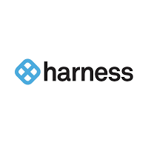
M&As
IBM bolsters cloud capabilities with HashiCorp acquisition during steady M&A period
Analyst Take: The number of deals during the quarter remained broadly flat (10 vs. 11 in Q1 2024). This was amidst a broader trend where the surge in US M&A activity observed in Q1 2024 experienced a slowdown during Q2.
IBM’s USD 6.4 billion acquisition of HashiCorp strengthens its hybrid cloud capabilities by potentially integrating HashiCorp's multi-cloud infrastructure automation tools with Red Hat offerings.
Harness continued its M&A growth strategy, acquiring Split Software to enhance its products. This move comes after Harness' competitor, Octopus Deploy, acquired the struggling Kubernetes continuous delivery expert Codefresh in Q1 2024. Moreover, Suse, Timescale, Cloudflare, Finout, and Vercel enhanced their tech stacks and offerings through acquisitions.
Deal spotlight
I
IBM acquired HashiCorp for USD 6.4 billion.
Harness acquired Split Software to integrate its capabilities and strengthen Harness's offerings.
Announced date: April 24, 2024
Industry hubs: Cloud-native Tech*, Cloud Optimization Tools
Announced date: May 29, 2024
Industry hubs: Cloud Optimization Tools*, Cloud-native Tech
IBM acquired HashiCorp for USD 35 per share, a significant premium over HashiCorp’s pre-announcement trading price of around USD 25.
HashiCorp’s product pillars (Terraform, Vault) align well with Red Hat’s (IBM subsidiary) business and IBM's focus on the hybrid/multi-cloud market.
In 2023, HashiCorp changed its business model, including a shift away from open-source licensing, which drew attention and new competitors.
The transition to a SaaS-style cloud subscription business was taking longer than planned. The company's gross margins on cloud services were only around 60% (FY 2024), while its traditional support revenue had higher margins at 86%.
Harness, a cloud-based software delivery platform, entered an agreement to acquire Split Software Inc., a company that specializes in feature flag management and experimentation.
The acquisition will allow Harness to provide a more robust software delivery platform, including the ability to run A/B tests and measure the performance of new features.
This is Harness' second acquisition in 2024 and its seventh overall. In January 2024 , the company acquired Armory, a continuous delivery platform company, for USD 7 million. This acquisition announcement comes just weeks after Harness secured a USD 150 million debt financing round, backed by Silicon Valley Bank and Hercules Capital.
*Primary industry hub
I
Incumbent

Slide 16
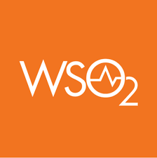
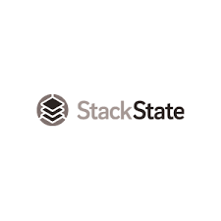
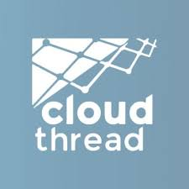
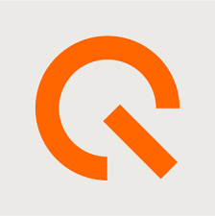
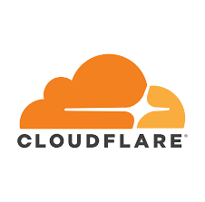
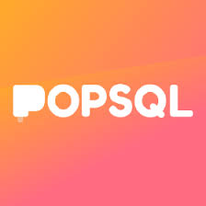
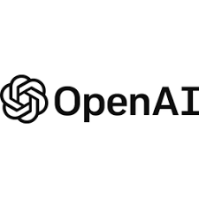
M&A
Activity centered around Cloud-native Tech and Serverless Computing
Cloud-native Tech
Serverless Computing
Cloud-optimization Tools
IBM acquired HashiCorp, a leading multi-cloud infrastructure automation software provider, for USD 6.4 billion. IBM intends to bolster its cloud offerings with the acquisition of HashiCorp
Swedish investment giant EQT acquired API management and identity access management company WSO2 in a deal valued at more than USD 600 million.
SUSE, an open-source enterprise provider, acquired StackState's full-stack observability platform to integrate its capabilities into Rancher Prime.
Cloudflare acquired Baselime, a serverless application observability platform, to expand its capabilities and further enhance the developer experience for building, shipping, and troubleshooting applications on the Cloudflare platform.
Vercel a provider of a serverless web and app development platform acquired ModelFusion.dev, expanding the capabilities of its Vercel AI SDK 3.1 to further position the company as a leader in the enterprise AI development space.
Finout, a cloud cost observability platform provider, acquired Cloudthread, a cloud analytics platform, to enhance Finout's cloud cost optimization and FinOps capabilities.
I
I
I
USD 6.4 bn
USD 600 mn
Timescale, a cloud database company, has acquired PopSQL, an SQL editor and collaboration tool, to offer Timescale customers an intuitive interface for database querying, dashboard creation, and collaborative data analysis.
Redpanda, a streaming data platform, has acquired Benthos, an open-source stream-processing platform, to bolster its end-to-end streaming capabilities for data-intensive applications.
OpenAI has acquired Rockset, a real-time analytics database, to enhance its retrieval infrastructure and enable users, developers, and enterprises to better leverage their own data for more helpful AI applications.
Harness, a cloud-based software delivery platform, acquired Split Software, a feature management and experimentation company, to integrate its capabilities and strengthen Harness’ offerings.

Slide 17
©2025 Uzabase, Inc. All Rights Reserved. The information contained herein (1) is proprietary to Uzabase Inc. and/or its content providers; (2) may not be copied or distributed; and (3) is not warranted to be accurate, complete, or timely. Neither Uzabase Inc. nor its content providers are responsible for any damages or losses arising from any use of this information.

