Slide 1


Words & Stones
Step 2

Slide 2
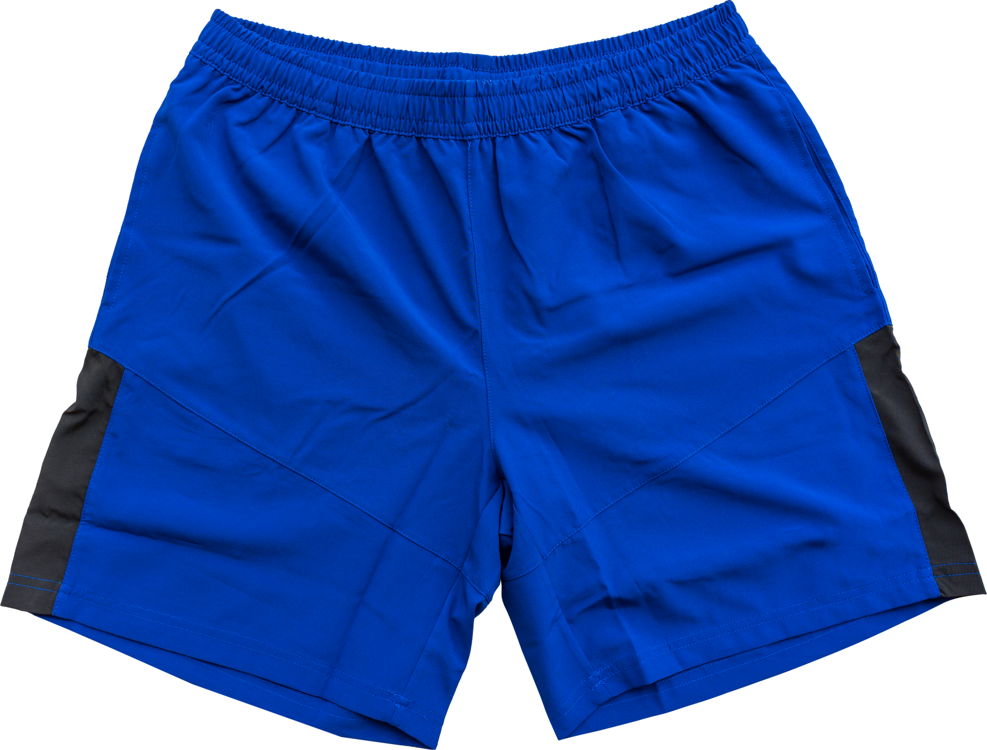
SHORT

Slide 3
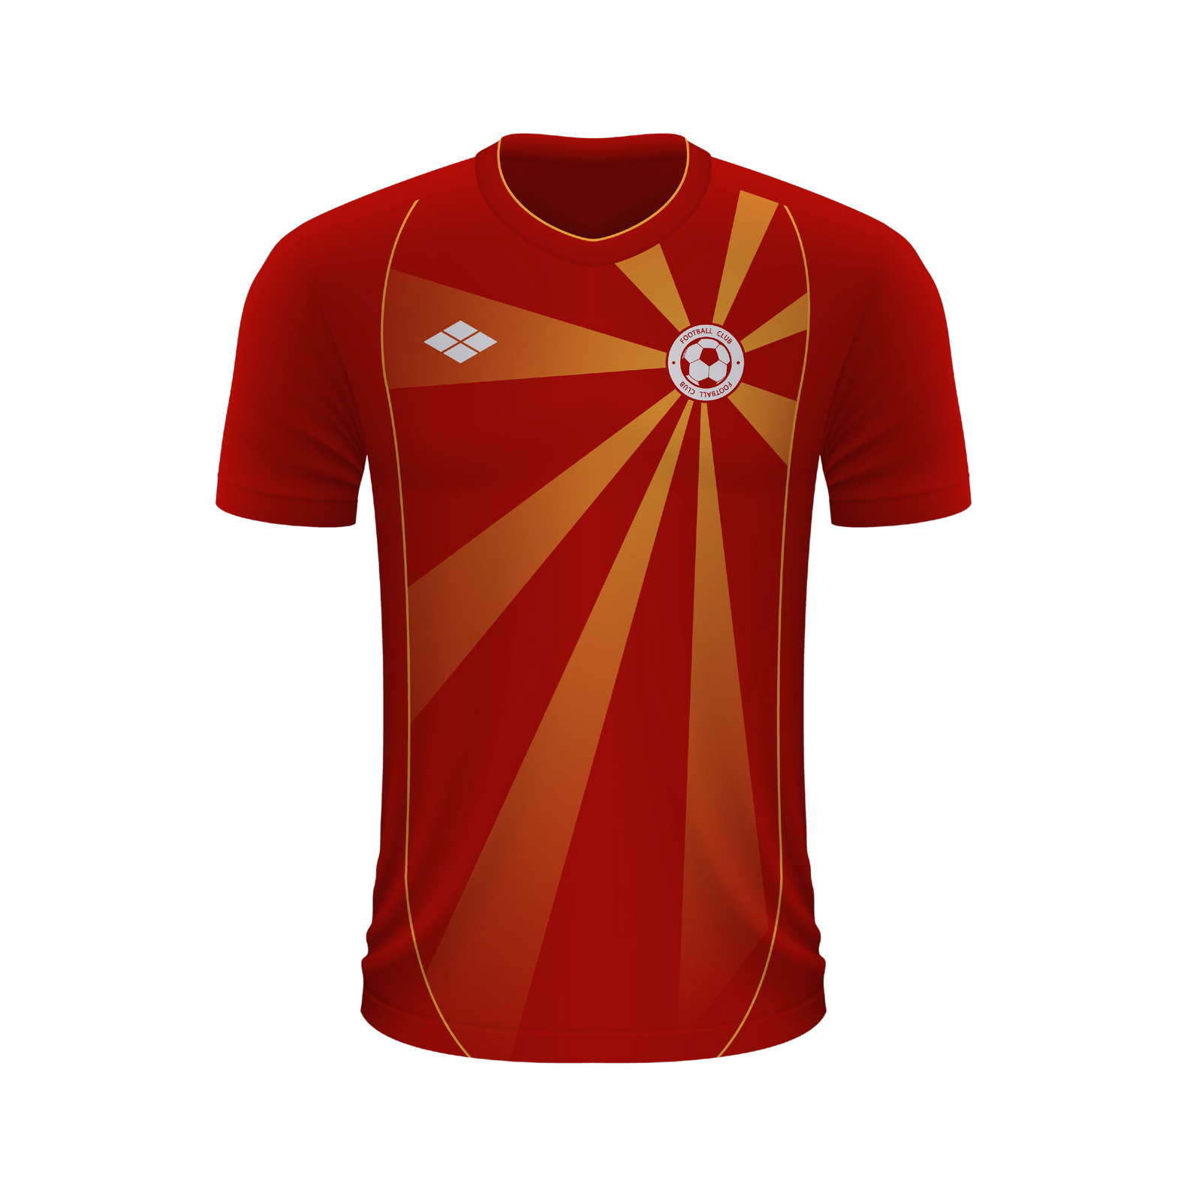
SHIRT

Slide 4
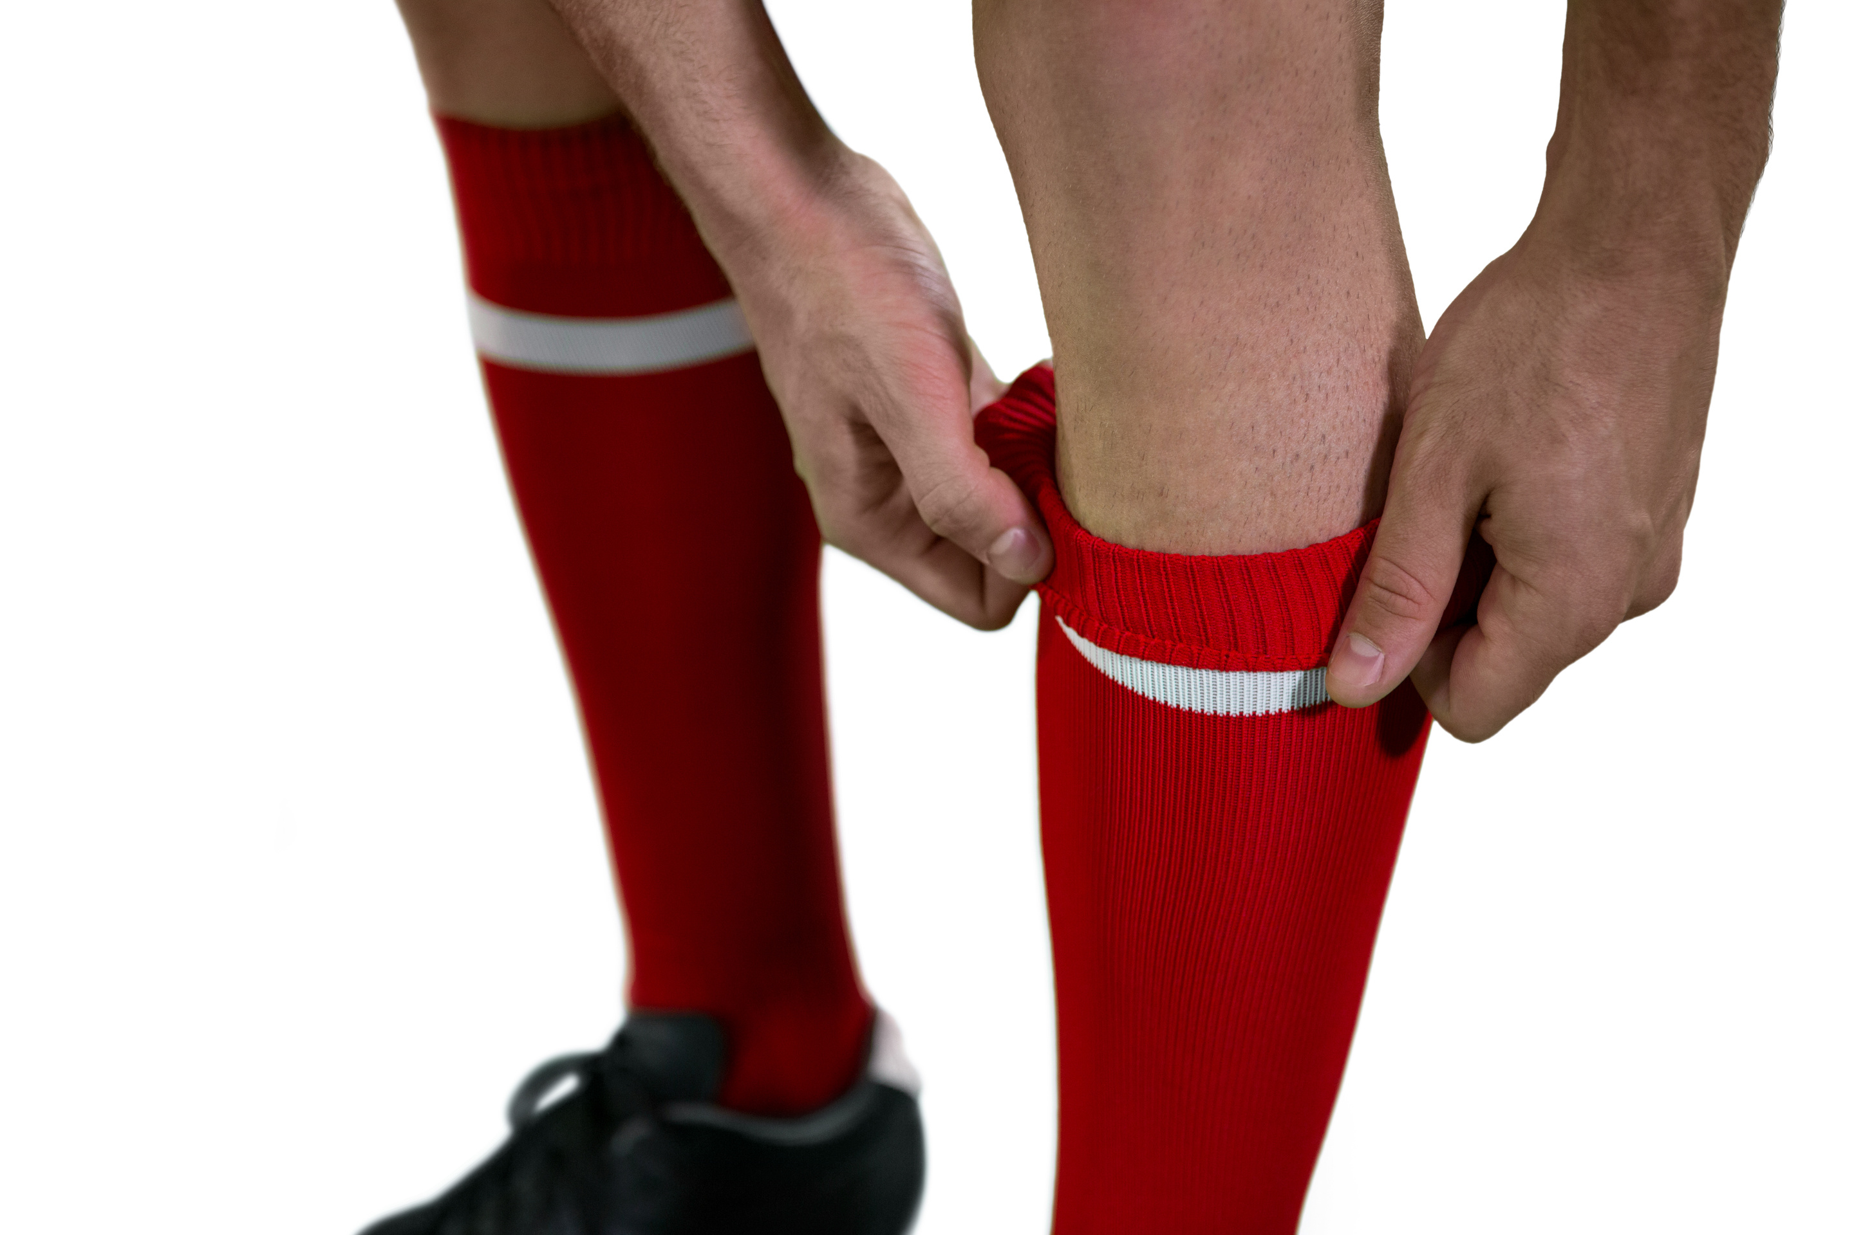
SOCKS

Slide 5
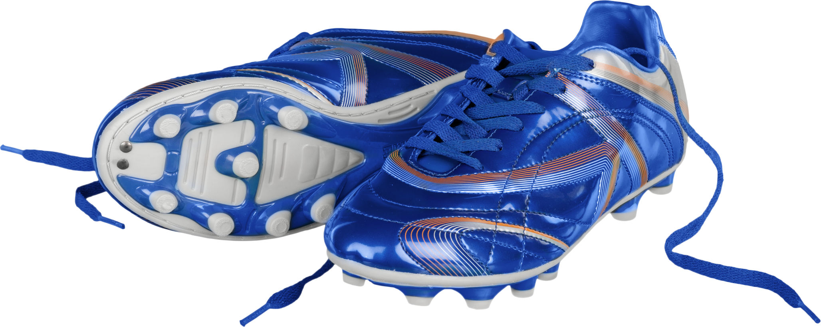
TRAINERS

Slide 6
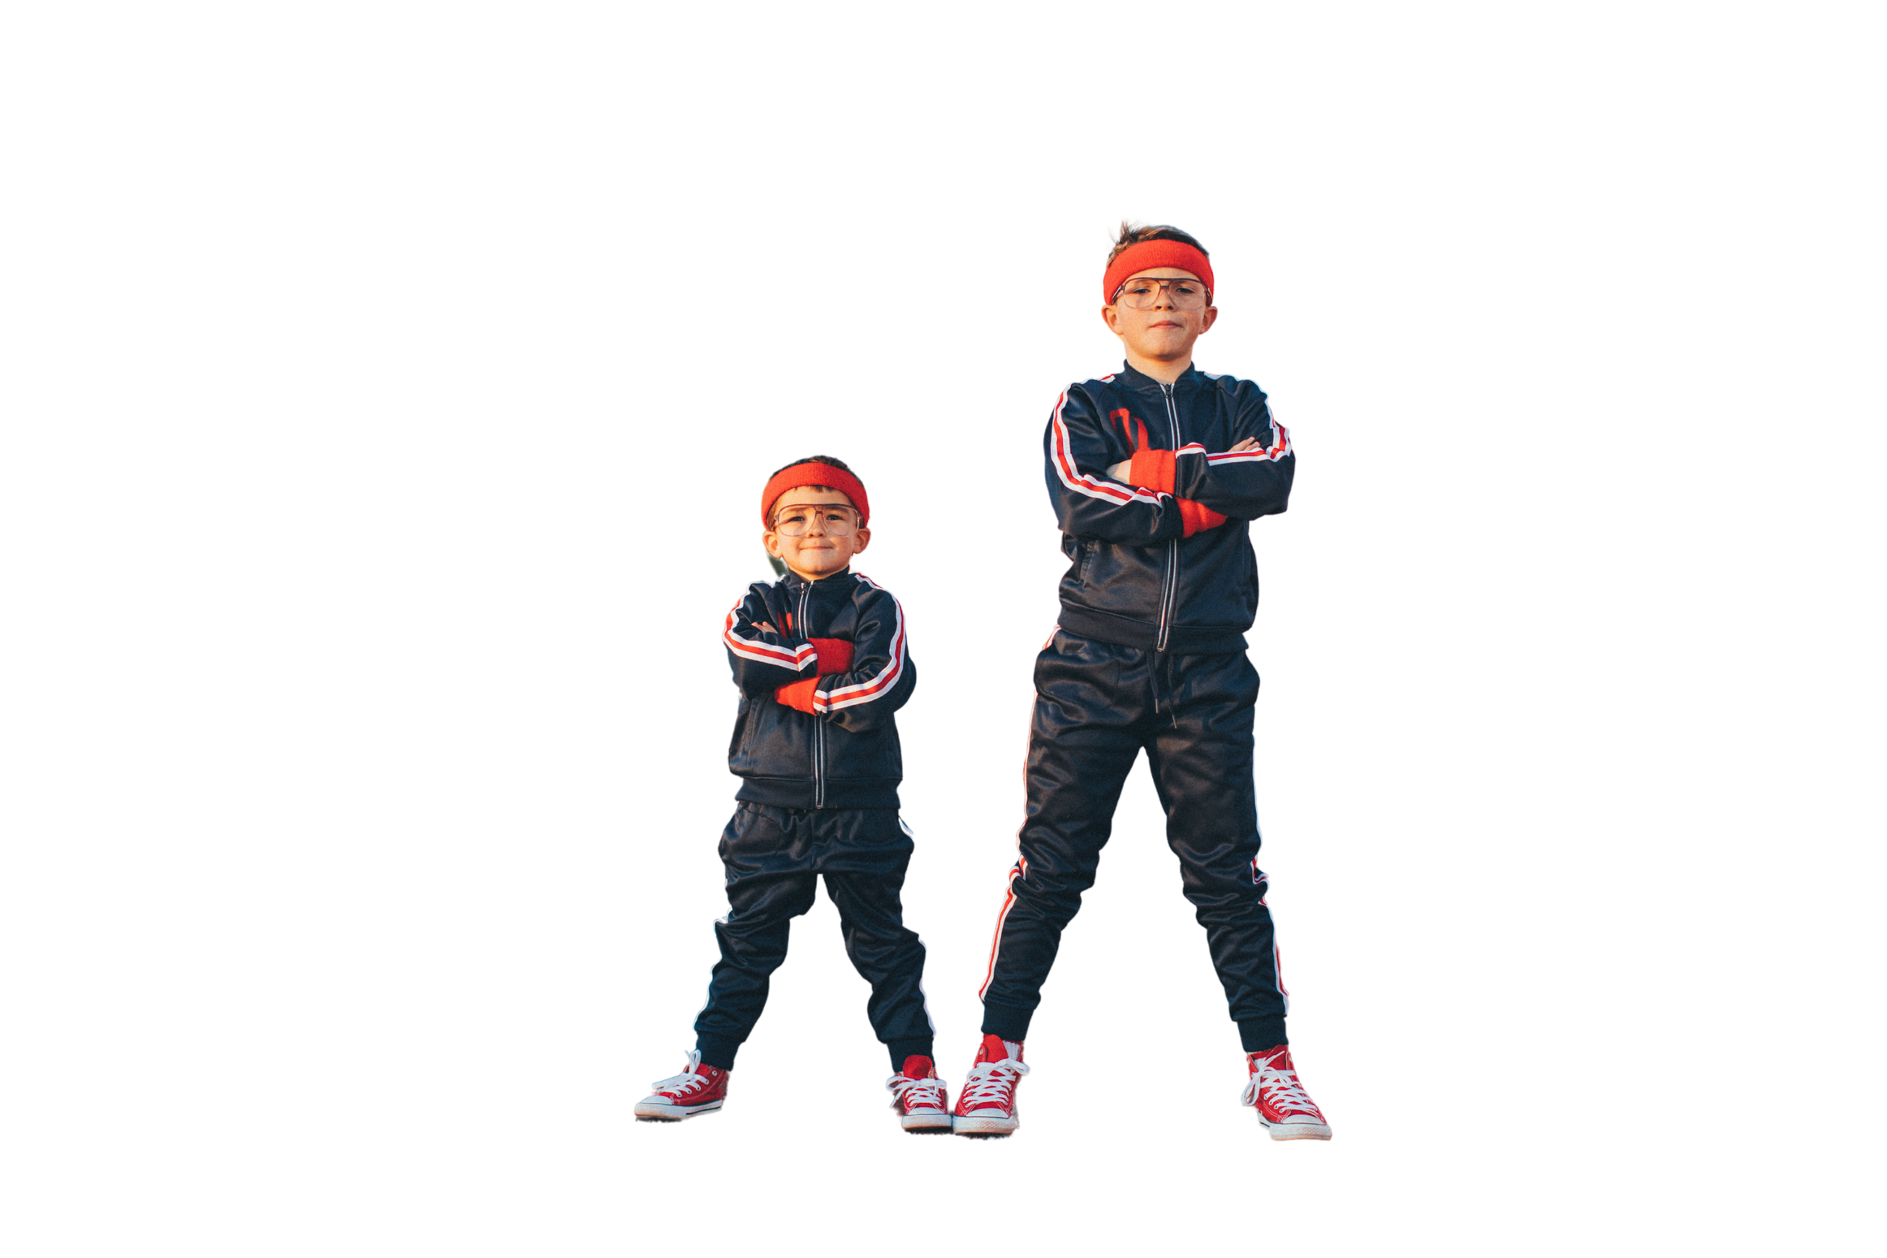
TRACKSUIT

Slide 7
When I play football, I wear ...
When it is warm, I wear ...
When it is cold, I wear ...
STONES

