Slide 1
Part 3
Gambling activities and locations
Key findings from qualitative and quantitative studies in 2019

Slide 2
Introduction
Key Objective: Understand why people gamble, the choices they make and how gambling fits into their day to day lives. Develop a set of ‘typologies’ to categorise the different motivations, drivers and triggers experienced in engaging with gambling and review the differences observed across the different activity types.
Exec Summary
The research for this piece of work consisted of a qualitative phase followed by a quantitative phase to validate the initial findings.
The research created eight typologies which reflect the attitude and motivations towards a certain gambling occasion. Once we had defined the typologies, we wanted to explore how they related to the different gambling activities. This information is detailed in this slide deck.
The research also discussed how mobile technology has enabled ‘low friction’ gambling to happen easily and conveniently at any time meaning that ‘binge’ behaviour can now happen at any time.
The research found that football and gambling have become so tightly linked that some fans feel they are now inseparable.
Points for further consideration
Mobile gambling has enabled the transformation of traditional ‘destination gambling’ types (like football & bingo) to function in a similar way to instant win games in terms of ease/convenience of play. Frictionless gambling is gaining pace and we need to further understand how gambling and gaming online are creating triggers so that we can better predict and respond to problematic play.​
​
Gambling habits can intersect with sport (particularly football) that watching the sport can be a major trigger to bet. With multiple match days throughout the week, self-discipline is required to manage gambling frequency. We need to ensure that players have the right tools and information required to self-regulate their behaviour.

Slide 3
Methodology & sample
Stage 1: Qualitative Research
Stage 2: Quantitative Research
In the early part of 2019, 2CV worked closely with the Gambling Commission to deliver the “Gambling Lives” research project – a qualitative exploration of why people gamble, the choices they make and how it fits into their day to day lives. This was a nationwide study, using digital and face to face research methods to get deep insight into the lifestyles and moments of the modern gambler to help guide the Gambling Commission’s planning, communication and policy-making.
Following the qualitative findings, 2CV undertook a quantitative stage of research to validate and build on these.
This took the form of an online survey among 1,693 people aged 18+ in Great Britain. All must have taken part in a gambling activity in the last four weeks. Quotas were applied to ensure the sample reflected the national profile of gamblers. From these respondents, 2,899 gambling occasions were covered.
The questionnaire covered the following:
Screening – covering demographics and broad definitions of gambling
General gambling attitudinal perspectives
Hot states & ‘binge’ gambling
Occasion specific details – asked for up to three different gambling occasions
  Nature of the occasion (who with, how played, etc.)
  Motivations & triggers
  Attitudinal perspectives
Classification

Slide 4





Stage 1 – Qualitative research, our approach in numbers
Self-ethnography
Immersions
Workshops
53 participants
5 locations
London, Midlands, North of England, Scotland & Wales + a spread of urban/suburban
10 day Digital diaries from 3rd December to 17th Dec capturing all gambling activity in-the-moment
165 gambling activities logged Between 1 and 11 per participant
18 participants
5 locations
London, Midlands, North of England, Scotland & Wales + a spread of urban/suburban
90 minute
In-home / in-situ immersions
Exploring personal perspectives on gambling/ moments /patterns of play / underlying motivations and experiences
40 participants
3 locations Birmingham, London and Manchester
2-hour sessions
Focusing on group perspectives of journey exploration, media and comms, and gaming

Slide 5
Stage 2 – Quantitative research - Background & Objectives
Following from the initial qualitative stage of the research, the aims for the quantitative stage were to validate these findings among a robust sample and build on them where relevant.
In particular, ​
  Measure attitudes towards gambling – reward, emotion, temptation, risk​
  Size and validate the key typologies of play identified​
  Understand how different audience types relate to the different drivers
This slide deck is part of a series produced in this research. Refer to our website for further insights and findings:
Part 1 - Understanding why people gamble and creating gambling typologies
Part 2 – Hot-states and “binge” gambling

Slide 6
Through the research, we identified eight typologies of gambling behaviour
Wise
decision
Gambling is a matter of skill and I’m confident in my ability to get it right, which is why I enjoy turning events into another opportunity to test my skills
Money to burn
I’m just using up some leftover credit on a bit of a whim – nothing to lose!
Social play
Gambling is something my friends and I love doing together, whether it’s having a friendly competition, adding more excitement to an event, or just for a bit of fun
‘Me’ time
I love to play and indulge in a little ‘me’ time, with the added reward of knowing I will probably come out lucky
Along for the Ride
Gambling isn’t something I’m particularly interested in, it’s just a way I get to enjoy being with others, even if it means I will possibly end up out of pocket!
Just what I do
Gambling is just something I’ve been doing for a while, and I enjoy it as a little treat regardless of whether I win or not
Feeling Lucky
Sometimes those lucky chances come my way and I can’t help but take a gamble, especially if it gives me an opportunity to prove myself
For the money
I don’t put much thought into gambling, I just like the idea of winning big even if it is a long shot

Slide 7
Exploring types of gambling

Slide 8
Once we had defined the typologies, we wanted to explore how they related to the different gambling activities
Gambling activities done on occasion
Total | ‘Me’ time | Feeling lucky | Along for the ride | For the money | Money to burn | Social play | Just what I do | Wise decision
 | 9% | 16% | 31% | 70% | 20% | 4% | 27% | 1%
 | 19% | 16% | 8% | 3% | 9% | 16% | 12% | 42%
 | 12% | 11% | 21% | 14% | 18% | 8% | 20% | 1%
 | 10% | 9% | 8% | 2% | 5% | 16% | 9% | 29%
 | 9% | 6% | 2% | 5% | 16% | 1% | 9% | 1%
 | 7% | 6% | 0% | 1% | 5% | 5% | 6% | 6%
 | 7% | 5% | 1% | 2% | 11% | 3% | 6% | 5%
 | 12% | 5% | 1% | 1% | 8% | 2% | 5% | 2%
 | 8% | 8% | 5% | 2% | 5% | 6% | 3% | 1%
 | 1% | 5% | 10% | 0% | 0% | 17% | 0% | 2%
 | 3% | 3% | 10% | 1% | 2% | 15% | 1% | 1%
 | 1% | 3% | 0% | 0% | 1% | 2% | 0% | 4%
 | 1% | 3% | 2% | 0% | 0% | 4% | 0% | 2%
 | 1% | 4% | 0% | 0% | 0% | 0% | 1% | 2%
 | 0% | 1% | 1% | 0% | 0% | 1% | 0% | 1%
 | Over-index vs. average

Slide 9

Activity summary
LOTTERY
Key typologies: For the money, Along for the ride, Just what I do
Key demographics:
TYPICAL OCCASION:
Takes under a minute
Usually buy only one ticket
Play alone or with partner
Typically bought in person
Very routined – exact value and game known
FOR THE MONEY
More women than men tend to play
Preferred by older players, especially 55+
Players tend to be from lower income households, pension or benefit dependent.
Not normally associated with problem gambling
I don’t put much thought into gambling, I just like the idea of winning big even if it is a long shot
ALONG FOR THE RIDE
MOTIVATIONS & TRIGGERS:
To win large amount of money
Triggered by big jackpots, or it’s part of their routine
Gambling is just a way I get to enjoy being with others, even if it does mean I will possibly end up out of pocket!
JUST WHAT I DO
PREFERRED INTERVENTION:
No action preferred
Gambling is just something I’ve been doing for a while, and I enjoy it as a little treat regardless of whether I win or not
SOURCES OF INFORMATION
(when not gambling)
None

Slide 10
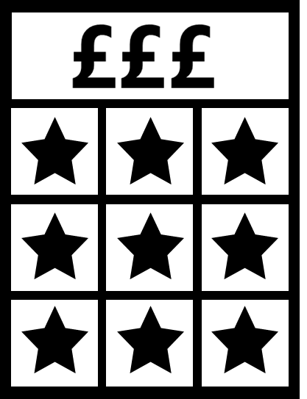
Activity summary
SCRATCHCARDS
Key typologies: Along for the ride, Just what I do, Money to burn
Key demographics:
TYPICAL OCCASION:
Short duration – under 5 minutes
Buy one, maybe two, cards
Play alone or with partner
Unplanned
ALONG FOR THE RIDE
More women than men tend to play
Players tend to be from lower income households, pension or benefit dependent.
Not normally associated with problem gambling
Gambling is just a way I get to enjoy being with others, even if it does mean I will possibly end up out of pocket!
MOTIVATIONS & TRIGGERS:
Spontaneous decision
A treat
Hoping for a big win
Typically purchasing something else when the thought occurs / catches your eye
JUST WHAT I DO
Gambling is just something I’ve been doing for a while, and I enjoy it as a little treat regardless of whether I win or not
PREFERRED INTERVENTION:
More likely to prefer a temporary prevention from playing (though still minority)
MONEY TO BURN
I’m just using up some leftover credit on a bit of a whim – nothing to lose!
SOURCES OF INFORMATION
(when not gambling)
None

Slide 11

Activity summary
INSTANT WIN GAMES
Key typologies: Money to burn, Just what I do, Me time
Key demographics:
TYPICAL OCCASION:
Short duration – max 30mins, often under 5mins
Rarely more than 5 games played
Solo activity
Typically played through a website rather than app
Unplanned
MONEY TO BURN
More women than men tend to play
Players more likely to be younger (18-34)
High density of play in the Midlands region.
Potentially a low risk gambler
I’m just using up some leftover credit on a bit of a whim – nothing to lose!
JUST WHAT I DO
MOTIVATIONS & TRIGGERS:
To win small amounts
Spontaneous decision
Using up leftover credit
More likely to be prompted by advertising than most activities
Gambling is just something I’ve been doing for a while, and I enjoy it as a little treat regardless of whether I win or not
ME TIME
PREFERRED INTERVENTION:
Automatic pause to gaming preferred (that can’t be overridden)
I love to play and indulge in a little ‘me’ time, with the added reward of knowing I will probably come out lucky
SOURCES OF INFORMATION
(when not gambling)
The company’s website

Slide 12
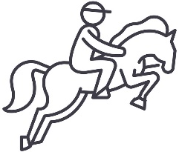
Activity summary
SPORTS BETTING ON RACES
Key typologies: Wise Decision, Social play
Key demographics:
TYPICAL OCCASION:
Long duration - over 3 hours
Planned
More men than women tend to play
More likely to be identified as a problem gambler.
WISE DECISION
MOTIVATIONS & TRIGGERS:
To add excitement to an experience
It’s a regular activity
To be part of something
Gambling is a matter of skill and I’m confident in my ability to get it right, which is why I enjoy turning events into another opportunity to test my skills
PREFERRED INTERVENTION:
Inform that behaviour is different, but don’t impose or suggest restrictions
SOCIAL PLAY
Gambling is something my friends and I love doing together, whether it’s having a friendly competition, adding more excitement to an event, or just for a bit of fun
SOURCES OF INFORMATION
(when not gambling)
Talking to staff
Reading magazines/ papers/ booklets related to activity

Slide 13

Activity summary
Sports betting – on games
Key typologies: Wise Decision, Me time
Key demographics:
TYPICAL OCCASION:
Lasts a couple of hours
Involves one or two separate bets
Take part alone
Online
Routined (not spontaneous)
More men than women tend to play
Players tend to be from a higher social grade
More likely to be identified as a problem gambler.
WISE DECISION
Gambling is a matter of skill and I’m confident in my ability to get it right, which is why I enjoy turning events into another opportunity to test my skills
MOTIVATIONS & TRIGGERS:
To add excitement to a game or experience
PREFERRED INTERVENTION:
Inform your behaviour is different, and suggest a pause / break
Do nothing
ME TIME
I love to play and indulge in a little ‘me’ time, with the added reward of knowing I will probably come out lucky
SOURCES OF INFORMATION
(when not gambling)
Company’s website

Slide 14
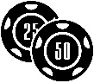
Activity summary
ONLINE CASINOS
Key typologies: Me time, Feeling lucky
Key demographics:
TYPICAL OCCASION:
Typically lasts 30 minutes- 1 hour
Solo activity
More likely that the occasion is planned, but not the specific activity; or taking opportunity to gamble as it arises
More men than women tend to play
Players are more likely to be younger (18-34)
Players tend to be from middle to higher income households
More likely to be identified as a moderate to high risk problem gambler.
ME TIME
I love to play and indulge in a little ‘me’ time, with the added reward of knowing I will probably come out lucky
MOTIVATIONS & TRIGGERS:
Motivated by game enjoyment
Triggered by spare money in online account, being given free goes/credit, or having just been paid
PREFERRED INTERVENTION:
Far more likely to want intervention of some kind
Suggested pause most popular
FEELING LUCKY
Sometimes those lucky chances come my way and I can’t help but take a gamble, especially if it gives me an opportunity to prove myself
SOURCES OF INFORMATION
(when not gambling)
The company’s website
Social media influencers
Online chat rooms/forums

Slide 15
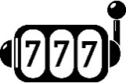
Activity summary
ONLINE SLOT MACHINES
Key typologies: Money to burn, Me Time
Key demographics:
TYPICAL OCCASION:
Typically lasts under an hour
Often involves high number of bets placed (11+)
Solo activity
Players are more likely to be under 55
More likely to be identified as a moderate to high risk problem gambler.
ME TIME
I love to play and indulge in a little ‘me’ time, with the added reward of knowing I will probably come out lucky
MOTIVATIONS & TRIGGERS:
For enjoyment
To win money
Triggered by being given free go’s/ account up, leftover money in account & seeing advertising
MONEY TO BURN
I’m just using up some leftover credit on a bit of a whim – nothing to lose!
PREFERRED INTERVENTION:
Suggested (but not enforced) pause to play is preferred
SOURCES OF INFORMATION
(when not gambling)
The company’s website
Company’s social media pages

Slide 16

Activity summary
ARCADES
Key typologies: Social play, Along for the ride
Key demographics:
TYPICAL OCCASION:
Lasts 5-30mins
Take part in a small group (2-5) or with their partner
In person
More likely to be unplanned
More women than men tend to play
Players are more likely to be younger (18-34)
More likely to be identified as a moderate risk problem gambler.
SOCIAL PLAY
Gambling is something my friends and I love doing together, whether it’s having a friendly competition, adding more excitement to an event, or just for a bit of fun
MOTIVATIONS & TRIGGERS:
To have fun and be social
Triggered by having some loose change
PREFERRED INTERVENTION:
Temporary preventions from play are more popular
ALONG FOR THE RIDE
Gambling is just a way I get to enjoy being with others, even if it does mean I will possibly end up out of pocket!
SOURCES OF INFORMATION
(when not gambling)
More likely to talk to staff than most activities, but most don’t encounter it outside of the activity

Slide 17
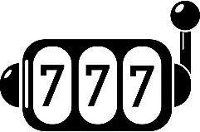
Activity summary
FRUIT OR SLOT MACHINES
Key typologies: Feeling lucky, Me time
Key demographics:
TYPICAL OCCASION:
High number of bets played
Typically played with partner or independently (not groups)
Unplanned, take advantage when an appropriate moment arises
More men than women tend to play
More likely to be identified as a moderate risk problem gambler.
FEELING LUCKY
Sometimes those lucky chances come my way and I can’t help but take a gamble, especially if it gives me an opportunity to prove myself
MOTIVATIONS & TRIGGERS:
Spontaneous decision
Often triggered by finding loose change
ME TIME
PREFERRED INTERVENTION:
Automatic pauses strongly disliked
I love to play and indulge in a little ‘me’ time, with the added reward of knowing I will probably come out lucky
SOURCES OF INFORMATION
(when not gambling)
More likely to encounter the company across a broad range of touchpoints

Slide 18

Activity summary
ONLINE BINGO
Key typologies: Money to burn, Me Time
Key demographics:
TYPICAL OCCASION:
Typically lasts under an hour
Involves a high number of bets placed
Solo activity
More women than men tend to play
Players are more likely to be under 55
Players tend to be from lower income households, pension or benefit dependent.
More likely to be identified as a high risk problem gambler.
MONEY TO BURN
I’m just using up some leftover credit on a bit of a whim – nothing to lose!
MOTIVATIONS & TRIGGERS:
To pass the time
Saw it advertised
Given free goes/ an account top up
Had some money left over
ME TIME
I love to play and indulge in a little ‘me’ time, with the added reward of knowing I will probably come out lucky
PREFERRED INTERVENTION:
Automatic pause to gaming preferred (that can’t be overridden)
SOURCES OF INFORMATION
(when not gambling)
Company's website

Slide 19
Activity summary
Bingo (in person)
Key typologies: Social play, Along for the ride
Key demographics:
TYPICAL OCCASION
Lasts a couple of hours
Involve multiple bets placed
Take part with friends & family
More women than men tend to play
Players are more likely to be 55+
Players tend to be from lower income households, pension or benefit dependent.
SOCIAL PLAY
Gambling is something my friends and I love doing together, whether it’s having a friendly competition, adding more excitement to an event, or just for a bit of fun
MOTIVATIONS & TRIGGERS:
To be social
To have fun
PREFERRED INTERVENTION:
Do nothing
Inform your behaviour is different, and suggest a pause / break
ALONG FOR THE RIDE
Gambling is just a way I get to enjoy being with others, even if it does mean I will possibly end up out of pocket!
SOURCES OF INFORMATION
(when not gambling)
None

Slide 20
Motivations and attitudes to different activities

Slide 21

Gambling very much exists as ‘just something else I do’, the absolute cost can be different, but the time is valued the same and comparable to other activities. The primary exception to this rule is the overlap between gambling and passion for football/sports betting – which can be powerfully and consciously linked.
Passionate sportsman
Gambling to be social and have fun
“I would say I’m quite athletic and good with anything hands on, but I do love football and boxing so I do dream of making it as either”
25, Male, London, Occasional Player
“I just see gambling as a fun game, especially when you gamble and you’re with friends who are gambling too while watching some sport - it can be really fun!” 25, Male, London, Occasional Player
Gambling adds a thrill to sport
Passionate ‘clean-eater’
“Gambling comes with the sports and the knowledge that I have of them. Usually, I know when a team will win or when a boxer will lose so I like the thrill of taking the chance”
39, Male, London Frequent Player
“My life revolves around sports and health. I like to eat clean, workout and look good”
39, Male, London Frequent Player
Passionate sports fan
Gambling to support your team
“You can gamble on all these sports and I usually do. Football pretty much every night, boxing and the horses when it is the big events….I find it far more enjoyable when betting on my favourite team or sports man/woman to win!”
30, Male, Midlands, Frequent Player
“I'm a massive football fan but I also am a big sports fan in general - I watch everything!”
30, Male, Midlands, Frequent Player

Slide 22

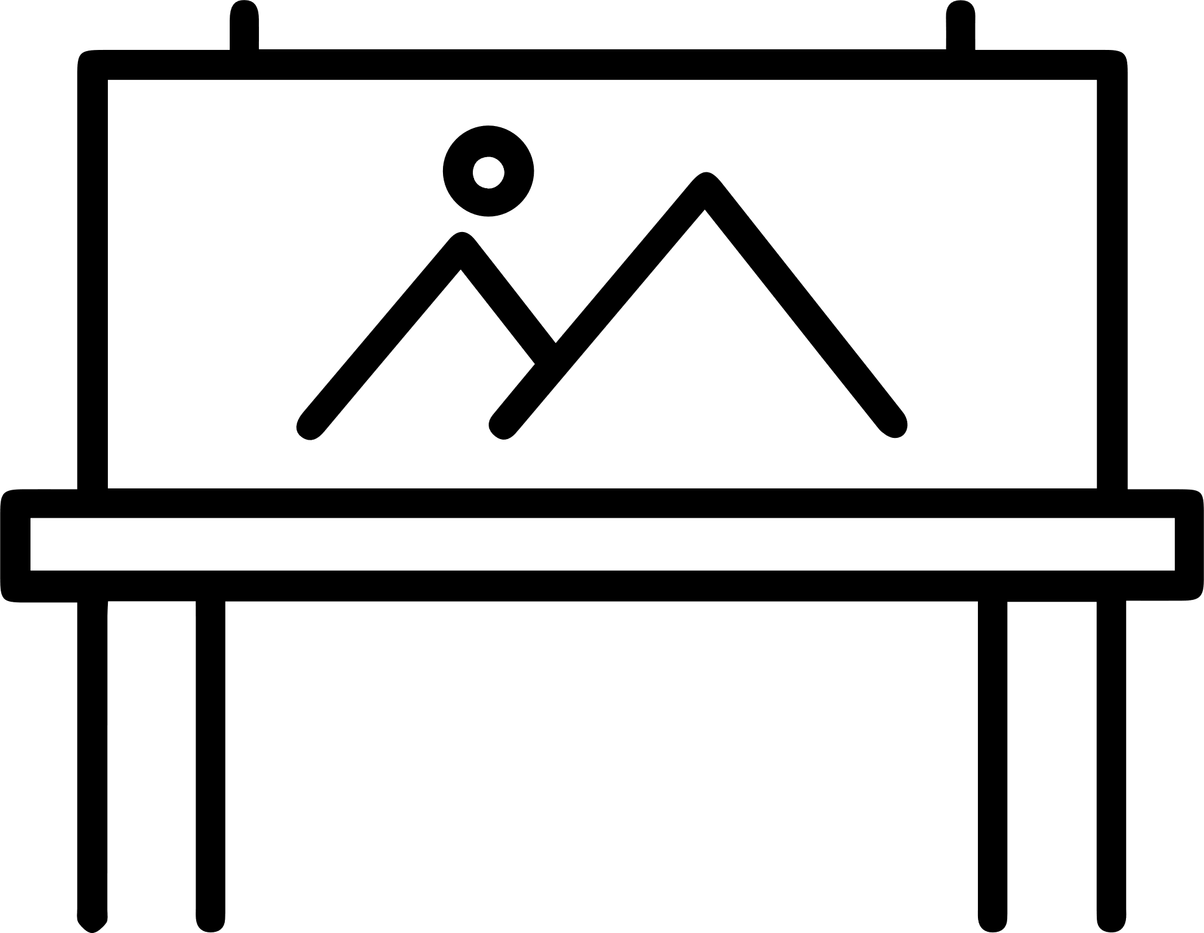

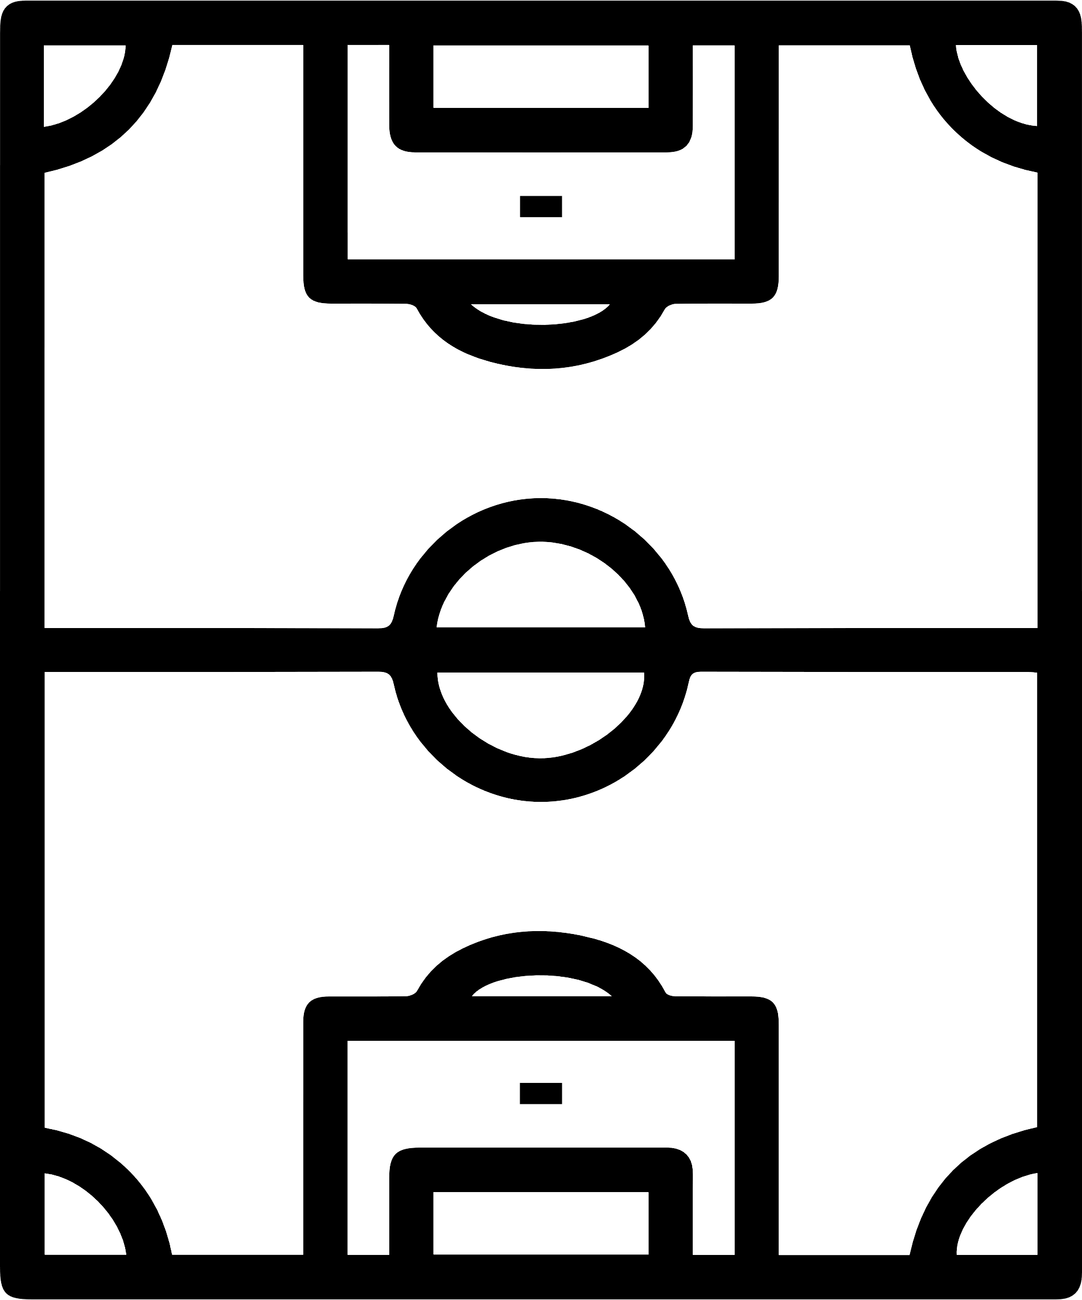
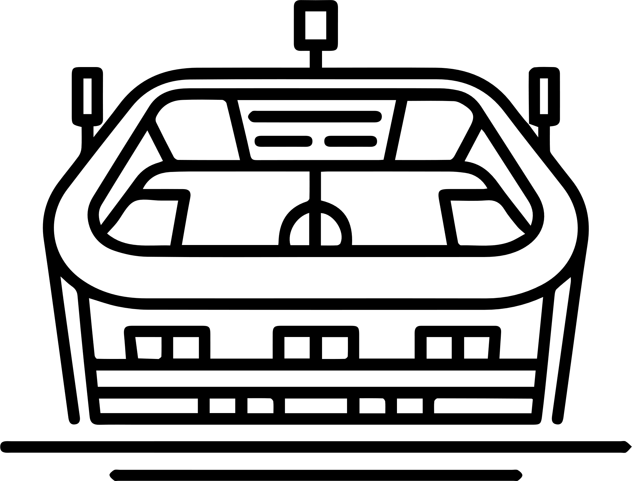





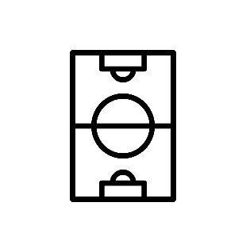
Football and gambling have become so tightly linked that some fans feel they are now inseparable – with a huge range of crossover touchpoints mentioned
ON PITCH/ STADIUM/ PRESS ROOM ADVERTISING
  PRIVATE AND ‘PROPER’ BETS WITH FRIENDS
SHIRT
SPONSORSHIP
BOOKMAKERS
(IN AND OUT OF STADIUM)
WEEKEND ACCUMULATORS
WHATSAPP GROUPS
ADVERTISING SPONSORSHIP ON TV/ RADIO /APPS/ SOCIAL MEDIA ETC
FANTASY FOOTBALL
‘PROFESSIONAL’ TIP SITES/BLOGS

Slide 23



There is a role for betting regardless of your level of engagement in football
MAJOR FOOTBALL FAN
LIGHT FOOTBALL FAN
CASUAL/SOCIAL FOOTBALL FAN
EXCLUDED FOOTBALL FAN
A bet can be a way of showing knowledge and fuelling banter
A bet on a match fuels more excitement and investment in the outcome of a game
A way of fuelling banter and still being part of the conversation, creating engagement in an area that is less of an interest
Social exclusion due to lack of gambling knowledge when football chat is replaced by gambling chat

Slide 24
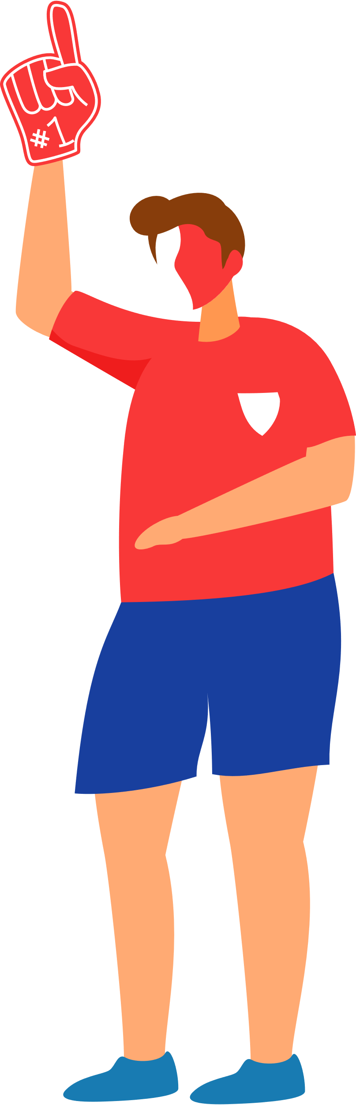
For football fans who are frequent gamblers, the thrill of the bet can overtake passion for the game itself – resulting in risky play unconnected to fandom
Gambling habits can intersect so much with sport that watching the sport can be a major prompt to bet
  Opportunities to satisfy gambling drivers are vast from Wise Decision knowledge, to Social Play fantasy football groups and Feeling Lucky bet in play moments and cash out opportunities akin to instant win games
It’s the cue to bet and with multiple ways to bet, things to bet on and games in every country it’s the trigger that is constantly being pulled
With multiple match days throughout the week, self-discipline is required to manage gambling frequency – people self-limit their play to certain occasions:
“I only bet on the weekend games”
“I only bet when I go to a game”
“I only bet on first goal scorer or time of goal rather than match results”
“My brother got in too deep with gambling. I watched the football with him on a Saturday and he says, ‘I can’t watch this’, I asked him why and he says, ‘I just feel like I want to put a bet on’. It’s not even a gambling activity it’s a sport but it’s (gambling) just always there and now he can’t watch it. Even things like Soccer 6 feel like gambling, you just can’t avoid it”
Male, 32, Occasional Gambler, Midlands
Some passionate football fans we spoke to were looking to reclaim the sport from betting

Slide 25

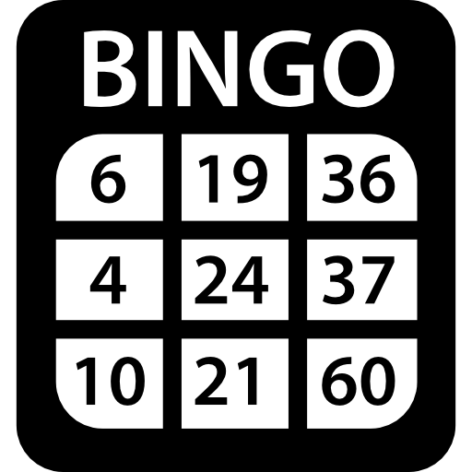
While Bingo doesn’t tap into a passion necessarily, it does often overlap with a personal interests and needs – particularly the social aspect of it
Club/Hall Bingo
People can find bingo exciting and use it to socialise - but it isn’t seen as a ‘passion’
  It is difficult to discuss outside of game play and external to the moment and environment
It is however an enjoyable way of satisfying a need. Bingo acts as a social conduit or me time and the game/winning is often secondary to the primary desire to socialise or relax
Online bingo has allowed for more instant, habitual play - boosted by social interaction
While primarily for passing the time, there can still be a sense of community as forums and private messaging are features, and people describe the supportive atmosphere of them
  Online bingo has adopted the social mechanics of online gaming to build communities of players (which could lead to extended play behaviours)
Passionate home-maker
Plays bingo during ‘me time’
“I obsess over my home being clean and tidy, cooking and baking and running the home. At the weekends I go to bingo in the afternoon either by myself or with one of my children”
54, Female, Wales, Frequent Player
“I make sure I have some ‘me time’ and gambling is part of that. I always try to get a day when I can go and gamble. I do play online but I much prefer going to my bingo club”
54, Female, Wales, Frequent Player
Some
Overlap
Passionate organiser
Plays bingo socially & regularly
“I thrive on being an organised individual. In my spare time which is rare, I drink coffee... coffee shops take most of my money. If the house is quiet, I’ll pick up a book which doesn’t happen often!”
34, Female, Wales, Frequent
“The only thing I do which could be described as gambling would be Bingo. I go maybe every 2-3 weeks at a local hall. I don't pay a lot it's more of a social thing. In fact, I've never won! Although we always share its always the girls that win!”
34, Female, Wales, Frequent
Online Bingo:
Some
Overlap
Passionate socialiser
Plays bingo socially & regularly
“I like to read and watch quiz shows, I like to socialize with friends at my local club”
56, Female, Scotland, Frequent
“I play bingo at my local club; I buy lotto and Euromillions but I’m not an extensive gambler”
56, Female, Scotland, Frequent
Some
Overlap

Slide 26
At the other end of the spectrum – Draw Based Games are perceived as being much more casual in the moment games, with barely any cross-over with personal passions
Draw Based Games are usually part of a regular routine – done with very little thought or much consideration of it being ‘gambling’
The main appeal of Draw Based Games is the ‘big dream’ that they promote if you win, which creates minimal emotional investment as the odds are so low
  The dream and opportunity can become compelling and the desire to keep feeding that dream prompts repeat play – but expectations of winning are low
For frequent/occasional players - Scratchcards can be more difficult to resist due to their availability in everyday situations
  They become part of a well-rehearsed ritual that creates moments of enjoyment but are similar to buying a bar of chocolate – the experience is momentary and then forgotten
“I don’t really think of the Lottery as gambling, but I guess it is. It’s just one of those things, I pick up my paper and the lottery on a Saturday morning then I go back home have a cuppa and read the paper.”
64, Male, Wales, Frequent
“My sister started me off with Scratchcards because she’s really lucky and she does really well and I thought I need to have a bit of that and then that feeling gets really addictive. Some days I go in and I say to myself I’m not going to get one today but then the person in front of me gets one or two and I think I have to get one of those too because if she doesn’t win I will”
52, Female, Midlands, Occasional

Slide 27
Location of gambling

Slide 28



Players are aware that the ease of gambling has increased dramatically in recent years due to tech innovation – particularly the growth of gambling via smartphones
“I do it all on my bookmakers app and sometimes it’ll send me a reminder when I haven’t bet on games that week”
“I have my lottery set up online via Direct Debit with the same numbers every week. I rarely check and it will tell me I’ve won occasionally”
“My foster father used to go to the bookies every Friday and place his bets and once I was old enough I used to go with him”
Drivers to play
Ease of Play
Apps saved on their phone send reminders & save payment cards
Adverts on websites & social media
Friends sharing news of winnings & bets on social media
Drivers to play
Online subscription via DD’s
Membership allowed providers to give more tailored offers
CRM emails remind them to play and send promotions/ offers
Drivers to play
‘Destination’ betting makes it more socially entrenched and encouraged by others to gamble
Barriers to play
Self imposed restrictions on their play habits e.g cooling off periods, setting payment limits
Barriers to play
Barriers to play
Bookmaker opening times & number of locations
Reliance on cash vs. card transaction
Less variety of games/betting
Not able to gamble on-the-move
Online reminders to gamble responsibly (on-site)
Gambling History

Slide 29



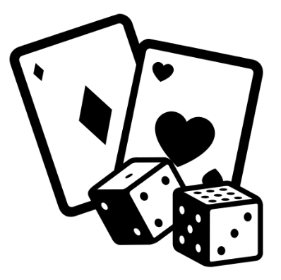
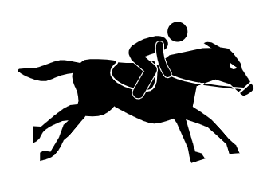
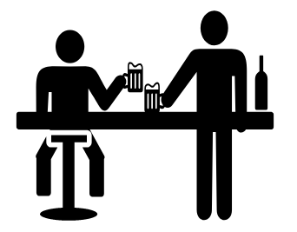



People are conscious that mobile technology enables easy anytime gambling (low friction) vs destination gambling which is location specific (high friction)
Mobile Gambling (low friction play)
Destination Gambling (high friction play)
Mobile technology enables ‘low friction’ gambling to happen easily and conveniently at any time :
‘High friction’ gambling happens in specific locations (often dedicated spaces for gambling):
In-Transit
In-Stasis
At Home
Casinos
Bingo Hall
Racecourse/Track
Social
Environments
At Work
Bookmakers
In-Store
Arcades
Mobile gambling is a behaviour ingrained within daily routine - habitual play can be more easily formed
Destination gambling is ‘an event’ – unique from everyday life and easier to avoid/compartmentalise behaviour

Slide 30
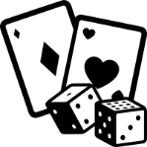


Players openly speak about occasions where removal of these environmental barriers has facilitated repetitive play and accumulating wins/losses rapidly
The low friction nature of mobile play means that ‘binge’ behaviour can happen at any time
Certain types of online gambling are particularly prone to repetitive play:
Instant win games & Online casino games
“I'll be sat in front of the TV and I will just have my phone out and I will be just keeping one eye on it while I'm watching TV and playing the slot machines over and over.” 32, Female, North England, Frequent
Online bingo
“I had a bit of a bingo phase where I was just sitting on it in the evening and playing it for hours at a time. I was on a bit of a winning streak and I even found myself talking on the group chat with the other players” 30, Male, North England, Occasional
Although sports/event based betting in comparison generally have more of a delay to outcomes (limiting repetitive play) – frequent players find ways to overcome this (betting on games in other countries/leagues etc.)
Mobile gambling has enabled the transformation of traditional ‘destination gambling’ types (like football & bingo) to function in a similar way to instant win games in terms of ease/convenience of play

Slide 31



Removal of environmental barriers has impacted the visibility and convenience of gambling behaviour, it can be done privately without judgement or intervention
Due to the rise of mobile gambling – physical environment plays less of a role in preventing/intervening in repetitive play
  Social taboo/shame around gambling easier to avoid when the behaviour is less visible
Certain audiences more likely to self-exclude from gambling previously (e.g. women from bookmakers, men from bingo halls) now feel more comfortable gambling in a greater range of ways
  Ability to gamble in more comfortable moments e.g. bingo at home on the sofa & football betting in the pub
  Less of a concern around pressure to understand game rules in high pressure environments e.g. blackjack at casino
“I can gamble at home in my leisure time where I'm playing games or sitting about watching TV or listening to music or chilling out with a group of friends. When I'm at the pub having a drink with mates or at the casino. Or when I visit a local newsagents or shop when grocery shopping.” 22, Male, North England, Frequent Player
“The ease of apps has changed it massively to be anywhere and everywhere. Growing up it was only shops in locations. This makes it easier for you to be doing 2 things at once. You had to make time, effort and a journey to do it not too long ago!”
30, Female, Midlands, Occasional Player
“I tend to bet a lot at home because I have more time to think about my bet with a clear head. Sometimes I will be out with friends which can help because you can ask for tips on certain bets from them which I often do. I don’t really go into the bookies that much to place bets as it’s all so much easier online.”
25, Male, London, Occasional Player

Slide 32
Conclusion
Stage 1 & 2: Qualitative and Quantitative Research
The research has enabled us to see how gambling activities appeal to different people and provide an insight to how gambling destinations are now not just associated with “bricks and mortar” but popular gambling websites and apps. Mobile gambling has increased in popularity and removed some of the barriers to gamble.
It also shows how for some players, gambling and sports or personal interests have become part of the whole player experience.
This research has enabled us to understand why people gamble, the choices they make and how gambling fits into their day to day lives. The development of the ‘typologies’ has enabled us to identify the different drivers and prompts which motivate plays, but also how this can help to identify the potential associated risks.
Revealing how players experience and engage with gambling, across the different activity types has enabled us to better understand the why people gamble and how it fits into their daily lives.

