Slide 1

Behaviours and Attitudes towards Gambling with Credit Cards
Prepared on behalf of the Gambling Commission
October 2019

Slide 2
Background and Summary of Findings

Slide 3

Reasons the Gambling Commission is interested in credit card gamblers…
Excerpt from the consultation
The Gambling Commission conducted a call for evidence on gambling with credit cards between February and May 2019. Following this, a formal consultation was published between August-November 2019.
We are persuaded that there are risks of harm associated with using credit cards for online gambling and that we need to act to protect consumers. We are therefore now consulting specifically on two separate options of either banning or restricting the use of credit cards for all forms of remote gambling i.e. betting, gaming and lotteries
We would like to obtain further evidence about consumers’ motivations for using credit cards to gamble, and specific benefits of using them. The call for evidence uncovered little in this regard, but we must take account of the extent of any impact that a ban or restrictions may represent for gamblers who are not experiencing harm
Gambling with borrowed money is a risk factor for harmful gambling because it increases the risk that people will gamble with more than they can afford
2CV conducted at online survey with n=474 people who have used a credit card to gamble at least once in the past year. They were asked about their rationale for using the card and their awareness of charges related to using it
https://consult.gamblingcommission.gov.uk/author/consultation-on-gambling-with-credit-cards/

Slide 4
Incorporating the Gambling Literacy Score
We have found the GLS classification a useful lens through which to analyse the credit card attitudes, because there is such a strong correlation between credit card gambling and a low GLS, and with heavy/frequent gambling
We will refer to this often throughout, typically contrasting the Low GLS group with the High GLS group
Gambling Literacy – Positive Player Scores by key subgroups
Literacy.1.2.3. Below are some things that other people have said about gambling. To what extent do you agree with these? n=474, Credit Card Gamblers

Slide 5
How the Gambling Literacy Score is calculated…
High GLS = Must score 6/7 (Strongly Agree) that Gambling is not a good way to make money AND score 1 / 2 (Strongly Disagree) at My chances of winning get better after I have lost AND that If I gamble more often it will help me to win more than I lose
Medium GLS = Must score 4-7 (Agree) that Gambling is not a good way to make money AND score 1-4 (Disagree) at My chances of winning get better after I have lost AND at If I gamble more often it will help me to win more than I lose
Low GLS = Must score 1-3 (Disagree) that Gambling is not a good way to make money OR score 5-7 (Agree) at My chances of winning get better after I have lost OR at If I gamble more often it will help me to win more than I lose
These questions came from The Positive Play Scale (PPS) was developed in Canada to measure levels of positive gambling related beliefs and behaviours amongst players, offering something different to standard problem gambling measures. National Validation of the Positive Play Scale: Assessing Responsible Gambling Across Canada (Wood, Wohl & Tabri, 2018)
To what extent do you agree or disagree with the following statements? LITERACY FALLOUT
Gambling is not a good way to make money
My chances of winning get better after I have lost
If I gamble more often, it will help me to win more than I lose
45% agree
63% agree
37% disagree
72% disagree
38% disagree
74% disagree
Literacy.1.2.3. Below are some things that other people have said about gambling. To what extent do you agree with these? n=474, Credit Card Gamblers

Slide 6
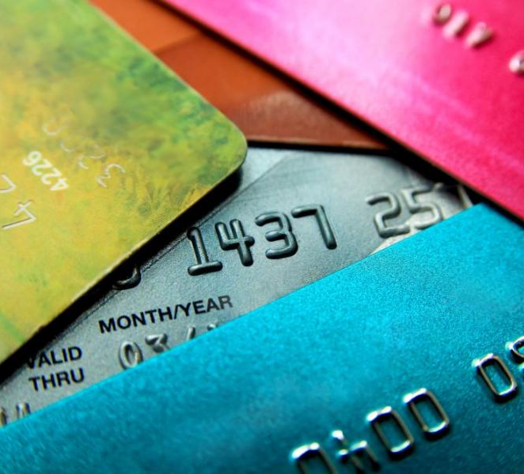
Summary of Findings – Credit Card Gamblers
1
Credit card (CC) users tend to be highly engaged with gambling. For most it’s embedded in a frequent routine that they carry out at least monthly. Most common gambling activities for CC users are online betting/casino and bingo, as well as placing bets in person.
2
Many CC users are younger, with good incomes and full time jobs. But half have a Low Gambling Literacy Score (GLS), indicating a strong potential to encounter harm when gambling.
3
6 in 10 have borrowed money to gamble in other ways apart from CCs, rising to 75% among those with a Low GLS, highlighting some normalisation of this behaviour.
4
A quarter indicate more problematic reasons for using CCs, including not having money available, or not wanting it to appear on a bank statement. Of these, 40% claim to have felt guilty, or more worried about losing. 53% have decreased their spend or played safer odds: this audience knows their gambling could be risky, but they do it anyway.
5
Those using CCs are more likely to prioritise things that could help them manage their gambling when considering which brands to gamble with in future, also suggesting some awareness or knowledge that their own behaviour could become problematic if unchecked.
If CCs were no longer an option to gamble with, this would likely not lead to a mass reduction in borrowing to gamble. For those least gambling literate, just over half said they would either stop or use their own funds and 48% said they would consider other forms of borrowing in lieu of credit cards. Some of these forms could bring similar or higher risks of harm than credit card gambling.
6

Slide 7
Credit Card Gamblers - Profile

Slide 8







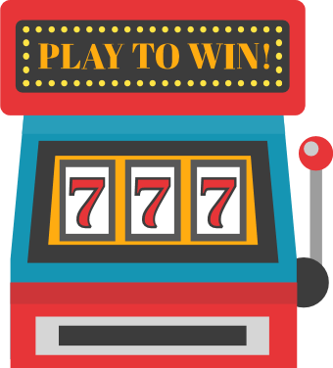


Compared to non credit card gamblers, credit card gamblers are significantly more likely to…
Be London (13% v 8%) /
South based (35% v 29%)
Be younger (18-44) (58% v 24%)
Be BAME (11% v 3%)
Be working full time (30+ hours a week) (60% v 38%)
Be of middle-high income (£50k+)
(31% v 17%)
Be a home owner with a mortgage (31% v 21%)
Have children in the household (43% v 30%)
Be heavy gamblers (a little or a lot more than most) (35% v 15%), playing bingo (38% v 25%) or any betting game (63% v 43%)
Have a Low gambling literacy score (50% v 20%)
DCHILDREN. WORK. DAGE. DREGION. HOUSE. DETHNICITY. INCOME. C1 Gambling behaviour. Literacy GLS. N=467 Credit Card Gamblers. N=560 non credit-card gamblers

Slide 9
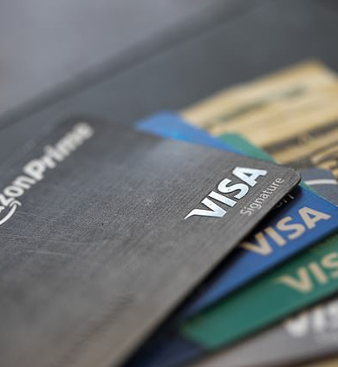
Those using a credit card to gamble typically do so frequently
1/3 use daily to weekly
More than 7/10 use every month
It’s far less common to use a credit card just a couple of times a year – the behaviour tends to be habitual and well embedded for those who do it
NET: 71% using every month
C1a. How frequently, if at all, have you used a credit card for gambling in the past twelve months? N=474 Credit Card Gamblers

Slide 10

CC gamblers skew to online activities, the primary activity being online betting
CC gamblers are significantly more engaged with a variety of activities, except lotteries and scratch cards. Over half are making bets online, while 1 in 3 are playing slots or casino games online.
Gambling activities taken part in the last 4 weeks
NB: it’s not possible to use a credit card in person so online skew is expected. One option gamblers may be using is withdrawing cash using a credit card for use in person
 | CC | Non-CC
Net: Any lottery | 30% | 47%
Net: Any bingo | 38% | 25%
Net: Any betting | 63% | 43%
Average no. taking part in | 2.50 | 1.60
S1. Which of the following, if any, have you taken part in in the last four weeks? N=1020

Slide 11
38% are spending £10 or less each time, but 30% spend more than £50 per go
Different spend observed for different audiences, with those using games machines, frequent gamblers, and Low GLS gamblers often spending high amounts
Typical spend each time using a CC to gamble
High spending audiences – note that “games machines in person” refers to the people who do this, not necessarily that they use the CC to fund this specific activity
More
30%
More than £50
69%
Low spending audiences
Less
£50 or less
C2. What is/was the average amount that you typically spend/spent each time you use(d) a credit card to gamble? N=474, Credit Card Gamblers

Slide 12
Nearly 6/10 have borrowed money in other ways apart from CCs to fund gambling
The most common way being credit card transfers, followed by borrowing from family members or using overdrafts
Other means of borrowing money to fund gambling
NET: 58% have ever borrowed money in one of these ways
NET = 75% for Low GLS gamblers, 28% for High GLS
NET: Ever used this means of borrowing to gamble
43% | 38% | 38% | 35% | 34% | 33% | 32% | 27%
C5. We’d now like you to think about an occasion when you have borrowed money in other ways to gamble (e.g. instead of choosing a credit card). Have you used any of these forms of borrowing to fund gambling before? N=474, Credit Card Gamblers

Slide 13
Credit Card Gamblers –
Why do they use credit cards to gamble?

Slide 14
1 in 4 use credit cards due to a lack of funds or to conceal behaviour from others
While the majority claim to be using credit cards for positive reasons such as payment security or benefits, or even just out of habit, there is a core group using for problematic reasons
“Never to deposit more than £10 and not more than once a month!”
Reason for using credit card when gambling
My rules for gambling on CC – Problematic User, F, 36
NET: 54% claim to use credit cards to get rewards or protection, or habitually
NET: 25% demonstrating problematic use of credit cards to gamble
C3. Below are some reasons other people have said why they use a credit card when gambling (e.g. instead of choosing to use a debit card/cash). Which of these, if any, apply to you? N=474

Slide 15

Significant differences between Problematic and Reward-seeking/habitual gamblers
Be younger (18-44) (21% v 10%)
Problematic
I didn't have the money available in my bank account
So that it doesn’t appear on my bank statement/app that someone else will see
Gamble a little/lot more than most (51% v 37%)
Rent from private landlord/agency (25% v 12%)
Have a low Gambling Literacy Score
(61% v 50%)
Reward-seeking/habitual
For added protection (e.g. against fraud) or payment security
I earn benefits when using my credit card (e.g. cashback, air miles, points)
I do all or most of my spending on credit cards and gambling is no different
Be older (65+)
(15% v 2%)
Own home outright (39% vs 28%)
Have a high Gambling Literacy Score
(24% v 14%)
DAGE. HOUSE. C1 Gambling behaviour. Literacy GLS. S1 Gambling activities in the last 4 weeks. Problematic n=117; Benefits n=254

Slide 16

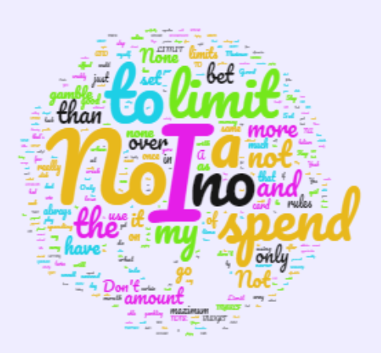
Regardless of whether they are Problematic or Reward-Seeking, the majority either don’t have rules, or just tend to set a spend threshold
From the word cloud, Reward seeking/habitual CC users look slightly more conscious of spending limits than problematic CC users
Open answers – do you set yourselves any rules when using credit cards?
Problematic CC Users
Reward Seeking/Habitual CC Users
“Never deposit more than £20 at any one time”
“Do not get carried away using it”
“I am not to exceed my spending amount which is €500”
“Don’t spend more than 100 quid a month”
“I never gamble more than a few quid at a time, that's my overall rule and I always abide by it”
“To not go above 50 pounds at a time”
“Don't let it show as bookies on credit card”
“I have a limit on how much I'll spend each time I sign online to gamble, if I lose my money that's too bad, I have to stop until I play another day. I don't believe in 'throwing good money after bad' - if I lose I don't believe that my next gamble will win. It's time to stop.”
“Not to use it very often at all and only allowed at any one time to use just two times”
“To pay off the card straight away and stick to a budget”
C4. Do you have any particular ‘rules’ for yourself when using a credit card for gambling? N=474, Credit Card Gamblers

Slide 17
Some have experienced the dangers of CCs, while others consider this to be normal spending
Open answers – do you set yourselves any rules when using credit cards?
Problematic CC Users
Reward Seeking/Habitual CC Users
I no longer have credit cards after getting into difficulties due to compulsive gambling. I still gamble but debit card only now and a max of £20 per day. In the past I spent up to £1000 per day on credit card funding
I have no problems with self control with regards gambling, so using my card gets me nice loyalty rewards just the same as popping to Tesco or any other banal activity, no additional risk.
C4. Do you have any particular ‘rules’ for yourself when using a credit card for gambling? N=474, Credit Card Gamblers

Slide 18
Using a CC means many spend less. 1/4 say it made they feel more worried or guilty
If the gambler feels the question applies, the majority exhibit more cautious behaviour, or feel more concerned/guilty about losses
NET: 42% decreased their spend or were more conscious of safety
Did you do anything differently when gambling with a CC?
46%
(53% for Problematic CC Users)
Of credit card users feel their gambling behaviour and emotions don’t change when using a credit card (i.e. none of these apply to me)
NET: 26% felt worried or guilty
And how did you feel about it?
46%
(40% for Problematic CC Users)
C7. Thinking about any occasions where you have borrowed money to gamble in the past (including using credit cards), did you do anything differently, compared to when you use your own funds to play/bet? C8. And how did you feel about the activity when using borrowed money to gamble (including using credit cards), compared to using your own funds? N=474 Credit Card Gamblers

Slide 19
But Credit Card gamblers place more importance on ways to manage their gambling
Biggest gaps in importance seen for behaviour management aspects, with “reality checks” being of particular relative importance
Free bets and bonus offers are also more important, showing this group is looking for opportunities to play
Importance of factors when considering where to gamble – gap between CC and Non CC gamblers
NB: Number 1 most important factor is “reputation of company for being trustworthy” – 77%
GAP between CC users and Non-CC Users
+20% | +19% | +17% | +16% | +16% | +15% | +15% | +14% | +10%
A2. Importance of factors when choosing where to gamble (T2B), n=474, Credit Card Gamblers; N=560 non credit-card gamblers

Slide 20
Credit Card Gamblers –
Looking ahead – potential impact of banning credit cards for gambling purposes
(NB – GLS groups used in this section in order to maximise base sizes for analysis and outline the difference in attitude between these groups)

Slide 21

8/10 have a knowledge gap around the cost of using a credit card to gamble
Transaction fees have stronger awareness than higher interest rates
3/10 are unaware of both transaction fees and higher interest rates, but those with lowest awareness are at least risk of harm
Awareness of fees/interest
NET: 82% not fully aware of the financial implications of using credit cards
(i.e. unaware of either transaction fees, interest rates or both)
Low awareness groups:
55+ = 41%
High GLS = 39%
Infrequent gamblers = 43%
C12. We would now like to ask you a few quick questions about transaction fees for credit card gambling. Explanation of fees and interest inserted. Were you aware of this? N=474

Slide 22

Fees/higher interest are most likely to deter those with higher literacy score
Raising awareness of CC costs could lead to a significant proportion (6/10) stopping using a credit card
Would transaction fees and higher interest rates stop you using a CC to gamble?
Highest intent to stop among most gambling literate players
C12. Would credit card transaction fees and higher rates of interest stop you from using a credit card for gambling? N=390, Unaware of some either transaction fees, interest rates, or both

Slide 23
¼ of credit card users say they will stop gambling altogether if CCs are not allowed
Majority of current players would still gamble – most popular alternative is to use own funds
Next most common option would be to do a credit card money transfer – effectively still using a credit card
If it was no longer possible to gamble with a credit card, what do you think you would do?
NB: this is claimed future behaviour – results indicative of what people might do
C13. Effect if not possible to gamble with credit card. N=474, Credit Card Gamblers

Slide 24
If CCs aren’t an option, there’s a danger that at-risk gamblers could look for riskier ways to borrow
Almost Half of Low GLS gamblers say they will still borrow money to play - remember this group accounts for 50% of CC gamblers
This means that ~a quarter of at risk of harm gamblers using credit cards could end up finding riskier ways to fund their play
If it was no longer possible to gamble with a credit card, what do you think you would do?
NET: Borrow money:
31% Total, 48% Low GLS, 7% High GLS
C13. Effect if not possible to gamble with credit card. N=474, Credit Card Gamblers

Slide 25
Possible implications and considerations for the Gambling Commission
1
Those using credit cards are looking to brands to help them manage their gambling behaviour. The Gambling Commission should consider how brands could best highlight to users when their gambling could be becoming problematic, to help them avoid difficult situations that might lead to further credit card (or riskier) borrowing.
2
There is rationale for raising awareness of the costs of gambling with a credit card, in particular of higher interest rates. While this is most likely to discourage the most responsible gamblers rather than those at risk, it would support the narrative around transparency, and the desire from gamblers for the brands they use to be trustworthy.
Any change to the regulation of credit cards for gambling could mean that CC gamblers need more support to avoid risky borrowing. There may be a behavioural change with CC gamblers getting creative about how they borrow - nearly half of low GLS CC gamblers said they would consider borrowing from other means if they could not gamble with CCs. Similarly to how brands should take a role in prompting re-evaluation of gambling behaviour, this possible legislation change could also be an opportunity to encourage gamblers to reflect on the real risks they are taking, and adopt safer practices.
3

Slide 26
Appendix & Follow Ups
Profiling the GLS Groups

Slide 27
Strong correlation with gambling literacy and credit card usage for gambling
Those with a higher gambling literacy score much less likely to be using CCs than those with a low score
Frequency of credit card usage for gambling
% say they’ve used this year
46%
26%
44%
69%
C1a. How frequently, if at all, have you used a credit card for gambling in the past twelve months? N=1027 people in GB who have gambled in the past 4 weeks. n=363 High GLS, n=314 Med GLS, n=350 Low GLS

Slide 28
Those who use credit cards to gamble, and who have a low literacy score, tend to take part in a higher number of gambling activities
Gambling activities taken part in the last 4 weeks
 | Total CC Users | High GLS | Medium GLS | Low GLS
Average number taken part in | 2.5 | 2.1 | 2.4 | 2.8
S1. Which of the following, if any, have you taken part in in the last four weeks? N= 474 CC gamblers, n=96 High GLS, n=137 Med GLS, n=241 Low GLS

Slide 29
The amount spent on CCs increases, the lower the gambling literacy score
More than half of those with a low GLS spend more than £50 each time they use a CC to gamble
Typical spend each time using a CC to gamble
More
30%
More than £50
69%
Under £50 | 91%
Over £50 | 9%
Under £50 | 84%
Over £50 | 15%
Under £50 | 52%
Over £50 | 47%
Less
£50 or less
C2. What is/was the average amount that you typically spend/spent each time you use(d) a credit card to gamble? N= 474 CC gamblers, n=96 High GLS, n=137 Med GLS, n=241 Low GLS

Slide 30
1 in 4 use credit cards due to a lack of funds or to conceal behaviour from others
While the majority claim to be using credit cards for positive reasons such as payment security or benefits, or even just out of habit, there is a core group using for problematic reasons
Reason for using credit card when gambling
C3. Below are some reasons other people have said why they use a credit card when gambling (e.g. instead of choosing to use a debit card/cash). Which of these, if any, apply to you? N= 474 CC gamblers, n=96 High GLS, n=137 Med GLS, n=241 Low GLS

Slide 31
Nearly 6/10 have borrowed money in other ways apart from CCs to fund gambling
The most common way being credit card transfers, followed by borrowing from family members or using overdrafts
% EVER used this means of borrowing money to fund gambling
NET: 58% have ever borrowed money in one of these ways
NET = 75% for Low GLS gamblers, 28% for High GLS
C5. We’d now like you to think about an occasion when you have borrowed money in other ways to gamble (e.g. instead of choosing a credit card). Have you used any of these forms of borrowing to fund gambling before? N= 474 CC gamblers, n=96 High GLS, n=137 Med GLS, n=241 Low GLS

Slide 32

Using a CC means many spend less, and play safer odds
The majority exhibit more cautious behaviour, or feel more concerned/guilty about losses
Did you do anything differently when gambling with a CC?
And how did you feel about it?
C7. Thinking about any occasions where you have borrowed money to gamble in the past (including using credit cards), did you do anything differently, compared to when you use your own funds to play/bet? C8. And how did you feel about the activity when using borrowed money to gamble (including using credit cards), compared to using your own funds? N= 474 CC gamblers, n=96 High GLS, n=137 Med GLS, n=241 Low GLS

Slide 33
8/10 have a knowledge gap around the cost of using a credit card to gamble
Siloed awareness among those with a Low gambling literacy score – more likely to be aware of one or the other (transaction fees or interest rates) but not both
Awareness of fees/interest
Total
83% not fully aware
High GLS
76% not fully aware
Medium GLS
82% not fully aware
Low GLS
87% not fully aware
C12. We would now like to ask you a few quick questions about transaction fees for credit card gambling. Explanation of fees and interest inserted. Were you aware of this? N= 474 CC gamblers, n=96 High GLS, n=137 Med GLS, n=241 Low GLS

Slide 34
If CCs aren’t an option, there’s a danger that at-risk gamblers could look for riskier ways to borrow. Only 1/5 say they will stop gambling
Almost Half of Low GLS gamblers say they will still borrow money to play - remember this group accounts for 50% of CC gamblers
If it was no longer possible to gamble with a credit card, what do you think you would do?
NET: Borrow money:
48% Low GLS, 7% High GLS
C13. Effect if not possible to gamble with credit card. N= 474 CC gamblers, n=96 High GLS, n=137 Med GLS, n=241 Low GLS

Slide 35
If CCs were banned for gambling purposes, the majority of those who might turn to illegal loans instead have used them to gamble with before
This action would not be likely to bring in large numbers of new users of illegal loans – those turning to them have typically used before, and this is one of many routes they might go down to obtain gambling funds, as they are a particularly vulnerable group
D
If it was no longer possible to gamble with a credit card, what do you think you would do?
D
Profile of illegal loan users (ever used)
Indicates problematic gambling behaviour
Low gambling literacy score: 84% Low vs. 34% total
Use credit cards to gamble for problematic reasons i.e. not having cash available, wanting to conceal activity: 41% vs. 25%
Younger: 82% under 44 (vs. 40% total)
Frequent gamblers – 65% self-report as gambling more than most (vs. 24% total)
Average of 2.9 gambling activities in past 4 weeks (vs. 2.0 total)
C13. Effect if not possible to gamble with credit card. N=474, Credit Card Gamblers, Ever used an illegal loan N=127, Never used an illegal loan N=347

Slide 36
Thank You
Jessica.Boize@2cv.com
Camille.Damsleth@2cv.com

