Slide 1
CLT Part 150 Update – Progress of TAC
ACR – October 2022

Slide 2
TAC
- First meeting held September 14th, 2022
- Introduction of consultant, CLT staff
Overview of terms, definitions (65 DNL, etc)
Overview of primary elements – Noise Exposure Maps and Noise Compatibility Program

Slide 3
Primary Elements
Noise Exposure Map
- Description of noise levels for current and future conditions
- Future model takes physical and operational changes into consideration
Noise Compatibility Program
-Recommendations for reducing, minimizing, and/or mitigating aircraft noise and land use conflicts
• Noise Abatement
• Land Use Mitigation
• Implementation Measures

Slide 4
TAC Meeting #1 Items
Feedback on fleet mix for model inputs
Review of roles/participation in future TAC meetings
Confirmation on organizations/groups to include in public meetings
Approval of monitoring locations
Procedural questions from TAC members
Notes:
24 monitoring locations used to validate the model input data. This took place between October 4 and 11

Slide 5
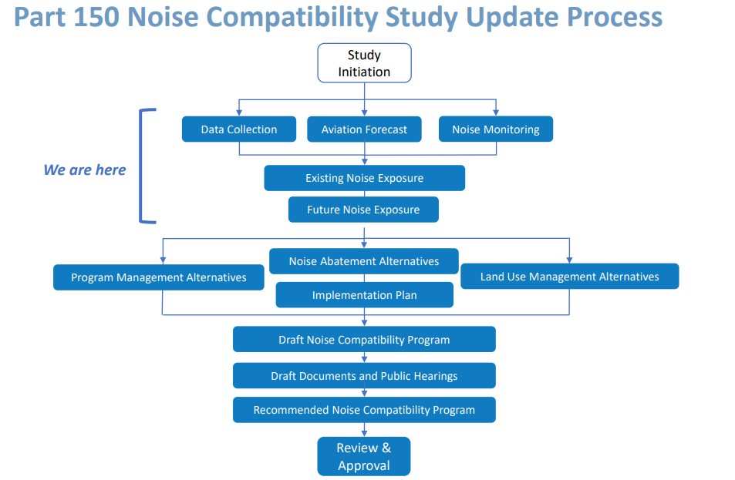

Slide 6
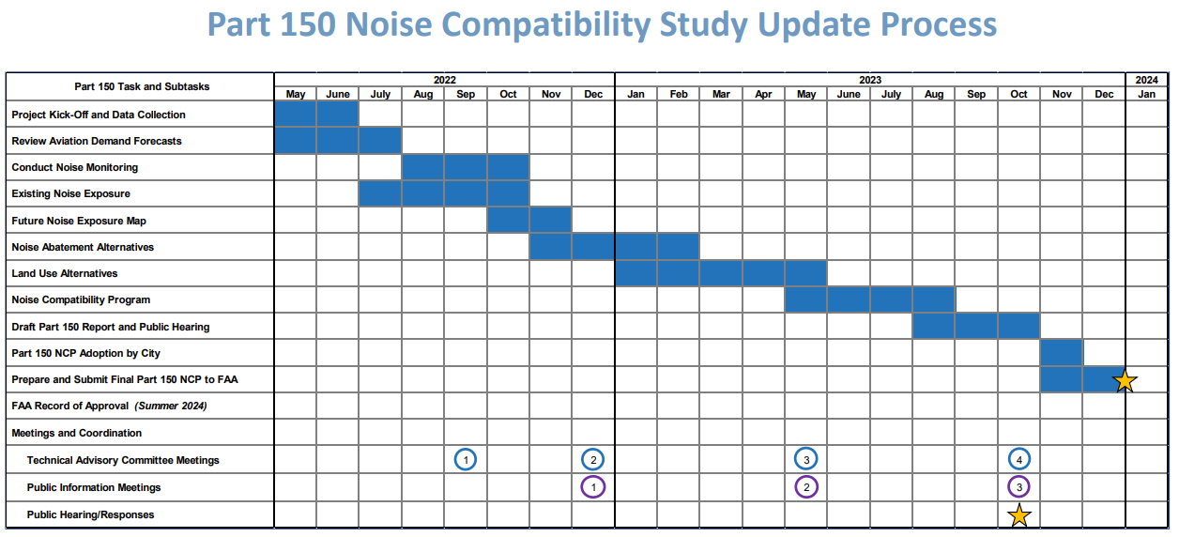

Slide 7
