Slide 1
About Guardian® on the Exchange
Guardian products are those identified as having been issued or underwritten by The Guardian Life Insurance Company of America® (Guardian) or a named Guardian owned subsidiary. ® 2022 GUARDIAN®, is a registered service mark of The Guardian Life Insurance Company of America® .
Guardian Confidential

Slide 2
Table of Contents
Guardian Overview
01
2023 Plan Options
02
2023 Service Areas
03
Find a Dentist
04
Get Appointed
05

Slide 3
Guardian Overview

Slide 4
Guardian Life Insurance Company of America
Guardian History
1860 - The Germania Life Insurance Company of America is created by Hugo Wesendonck.
1918 - The company changes its name to The Guardian Life Insurance Company of America.
1925 - Guardian converts into a wholly owned mutual company, fully owned by its policyholders.
1957 - Guardian enters the employee benefits market.
2020 - Guardian celebrates its 160th anniversary.
What we stand for
We do the right thing for our policyholders and customers.
We believe people count.
We courageously share the future together.
We go above and beyond for the people we serve.

Slide 5
Affordable
We offer affordable priced dental plans for any budget.
Choice
A variety of plans to choose from that fits your needs.
Access
Dental insurance plans that give you access to a large national network.

Slide 6
Guardian 2023 Plan Options on the Exchange

Slide 7
Guardian 2023 plan options.*
Guardian Standard ACA Plans
Guardian Essentials for Families and Individuals
Guardian Select for Families and Individuals
Guardian Basics for Families and Individuals
Guardian Preventive Plus for Families and Individuals
Managed DentalGuard DHMO for Families and Individuals
*Plans may not be available in all states.
Guardian State Specific ACA Plans
Guardian Choice for Families and Individuals (AZ, TX & UT)
Guardian Basics, Essential & Preventive Plus Indemnity Plans (MT)
Guardian Preferred for Families and Individuals (NJ)
Guardian PPO for Families and Individuals (NY)
Guardian PPO for Children (NY)
Managed DentalGuard DHMO for Children (NY)
Managed DentalGuard DHMO for Families and Individuals (NY)

Slide 8
Visit our website to view 2023 state plan options.* dentalexchange.guardiandirect.com
*Plans may not be available in all states.

Slide 9
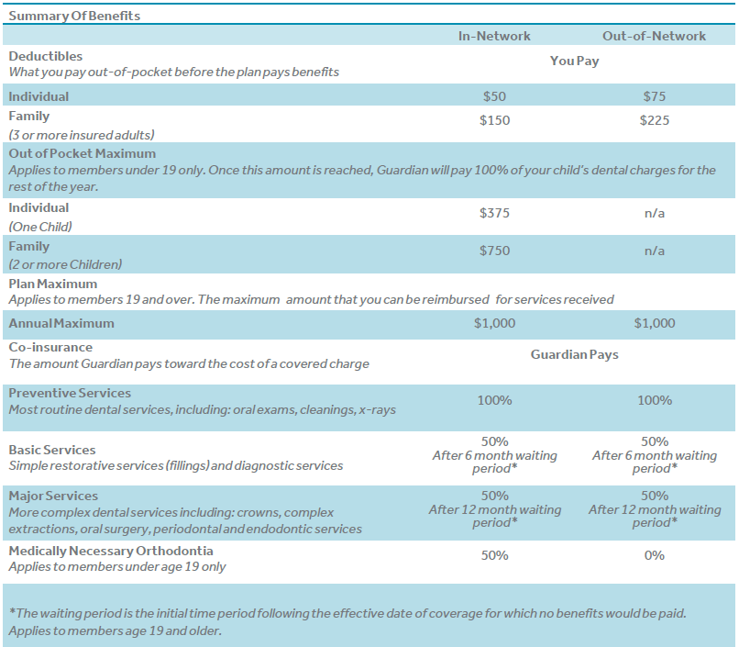
Guardian® Essentials for Families and Individuals⁺
The Essentials plan is a comprehensive traditional plan, covering all three classes of benefits; Preventive, Basic & Major.
The Essentials plan also includes the pediatric dental Essential Health Benefit (EHB) as mandated by the Affordable Care Act (ACA), which is a comprehensive set of dental services for children under age 19.
See any dentist you want but you can save more when you visit a dentist that participates in Guardian’s DentalGuard Preferred network. As one of the largest networks nationwide, chances are your dentist is already participating. Charges for services provided by participating dentists are reimbursed directly from Guardian.
⁺Deductibles, waiting periods, limitations and exclusions may vary by state.

Slide 10
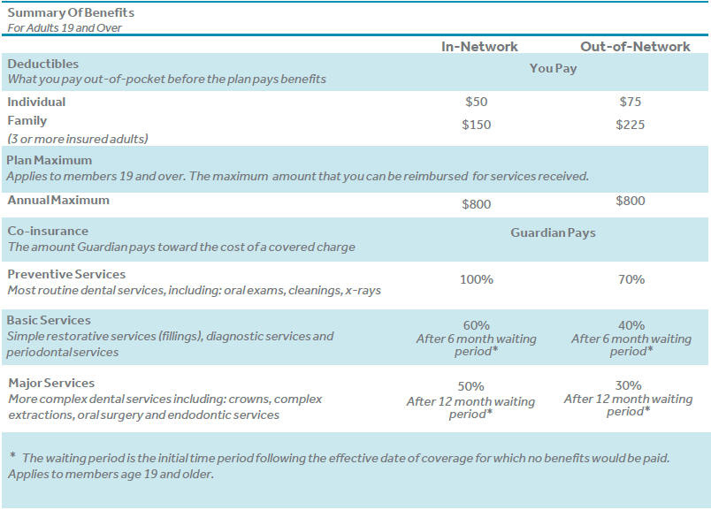
Guardian® Select for Families and Individuals⁺
The Select plan is a comprehensive incentivized plan, covering all three classes of benefits; Preventive, Basic & Major.
The Select plan also includes the pediatric dental Essential Health Benefit (EHB) as mandated by the Affordable Care Act (ACA), which is a comprehensive set of dental services for children under age 19.
See any dentist you want but you can save more when you visit a dentist that participates in Guardian’s DentalGuard Preferred network. As one of the largest networks nationwide, chances are your dentist is already participating. Charges for services provided by participating dentists are reimbursed directly from Guardian.
⁺Deductibles, waiting periods, limitations and exclusions may vary by state.

Slide 11
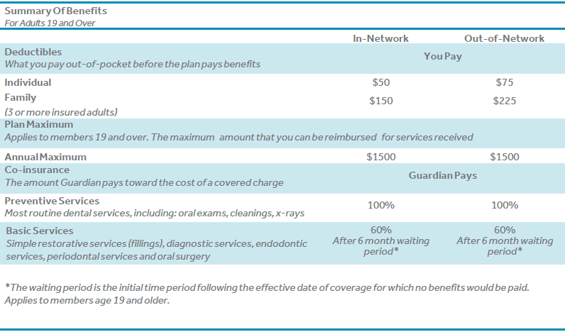
Guardian® Basics for Families and Individuals⁺
The Basics plan is for those that have no foreseeable need for major services. This plan does include Endo, Perio & Simple Extractions.
The Basics plan also includes the pediatric dental Essential Health Benefit (EHB) as mandated by the Affordable Care Act (ACA), which is a comprehensive set of dental services for children under age 19.
See any dentist you want but you can save more when you visit a dentist that participates in Guardian’s DentalGuard Preferred network. As one of the largest networks nationwide, chances are your dentist is already participating. Charges for services provided by participating dentists are reimbursed directly from Guardian.
⁺Deductibles, waiting periods, limitations and exclusions may vary by state.

Slide 12
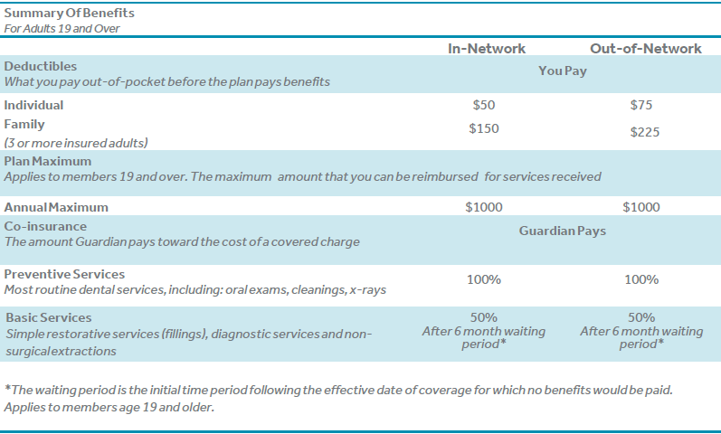
Guardian® Preventive Plus for Families and Individuals⁺
The Preventive Plus plan is for those that have a need for routine cleanings and check-ups.
The Preventive Plus plan also includes the pediatric dental Essential Health Benefit (EHB) as mandated by the Affordable Care Act (ACA), which is a comprehensive set of dental services for children under age 19.
See any dentist you want but you can save more when you visit a dentist that participates in Guardian’s DentalGuard Preferred network. As one of the largest networks nationwide, chances are your dentist is already participating. Charges for services provided by participating dentists are reimbursed directly from Guardian.
⁺Deductibles, waiting periods, limitations and exclusions may vary by state.

Slide 13
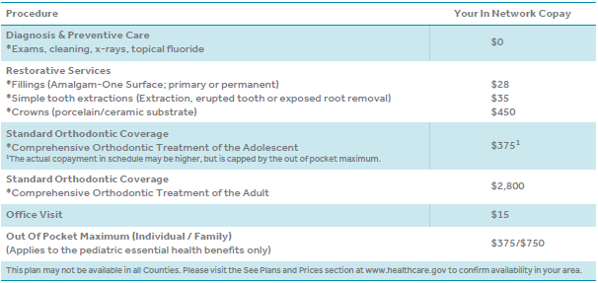
Managed DentalGuard DHMO for Families and Individuals⁺
The Managed DentalGuard DHMO plan allows you to choose to receive care from any participating dentist in the network and pay set co-pays for your office visits and services.
The Managed DentalGuard DHMO plan also includes the pediatric dental Essential Health Benefit (EHB) as mandated by the Affordable Care Act (ACA), which is a comprehensive set of dental services for children under age 19.
Under this plan, you must be assigned to a primary care dentist of your choice from our network of contracted providers. All care must be provided or arranged by your primary care dentist.
⁺Copayments, limitations and exclusions may vary by state.

Slide 14
Guardian 2023 Service Areas

Slide 15
2023 Guardian Service Areas in Green

Slide 16
Find a Dentist

Slide 17
Visit dentalexchange.guardiandirect.com/find-a-dentist

Slide 18
Get Appointed with Guardian

Slide 19
Interested in getting Appointed with Guardian?
Email our Broker Services Department @ brokerservices@glic.com
Individual Broker Agency
First Name First Name
Last Name Last Name
SSN/Tax ID Tax ID
Email address Email Address
1
Contact our Customer Care Team @ 1-844-561-5600
2

Slide 20
Visit https://dentalexchange.guardiandirect.com/brokers

Slide 21
Welcome to Guardian Exchange
Guardian products are those identified as having been issued or underwritten by The Guardian Life Insurance Company of America® (Guardian) or a named Guardian owned subsidiary. ® 2022 GUARDIAN®, is a registered service mark of The Guardian Life Insurance Company of America® 2022-145351

