Slide 1
The State of Meetings
2024 Research

Slide 2
How to use this deck
The State of Meetings 2024
In this slide deck, you’ll find rich insights into how meetings are evolving, based on data from over 1,200 business leaders worldwide.
These slides are designed for easy copy-pasting into your own internal or external presentations, whether you’re highlighting what kinds of meetings people find valuable, how the meetings we attend affect our productivity, or how attitudes toward meetings differ based on on location, role, age, and more. Feel free to make a copy and use whichever slides you need. We encourage you to use this data to spark discussions and improve meeting culture in your organization!
For the full report, including a video walkthrough and further recommendations for better meetings, visit calendly.com/guides/2024-state-of-meetings-report.

Slide 3
Part one:
Meeting productivity

Slide 4
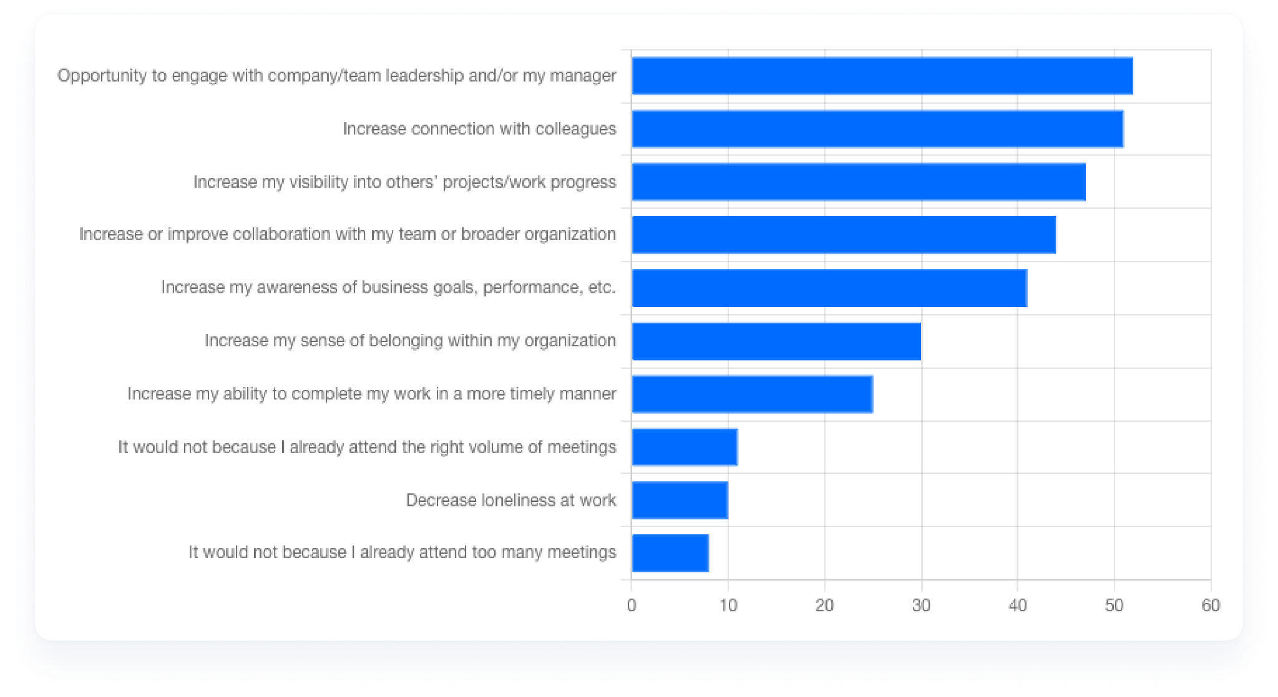
81% of workers feel more meetings would help them in some way
When asked “In what ways would attending more meetings help you?” the top three responses were engaging with management, connecting with colleagues, and increasing visibility into others’ work.

Slide 5
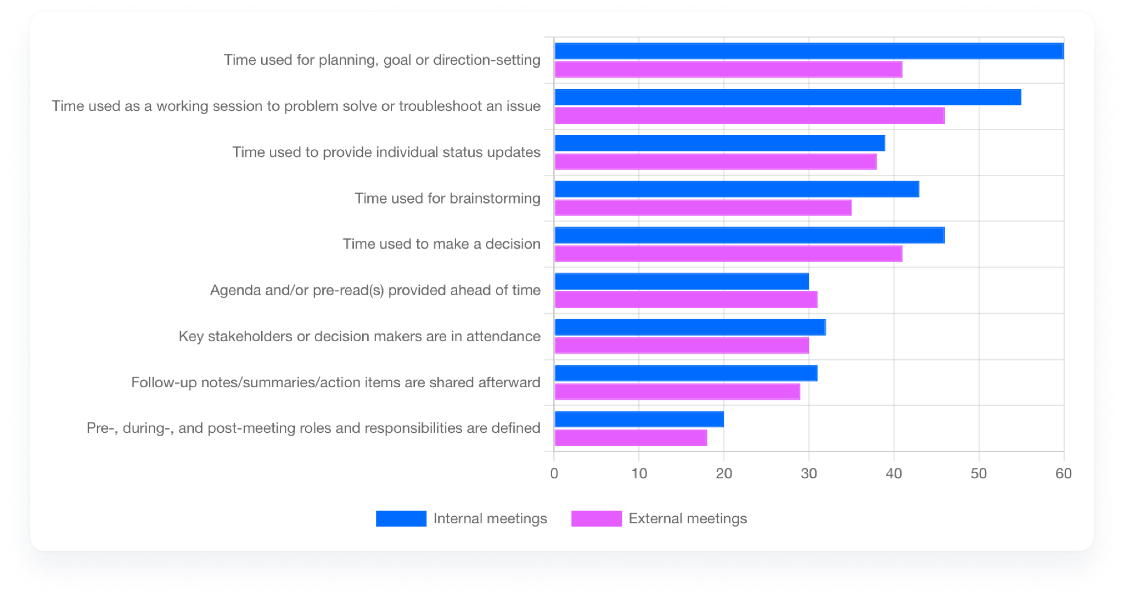
Meetings are best used for troubleshooting, goal setting, and decision making
When asked which kinds of meetings are the most productive, the most common answers (for both internal and external meetings) were:
Planning or goal-setting meetings
Working sessions to troubleshoot an issue
Decision-making meetings

Slide 6
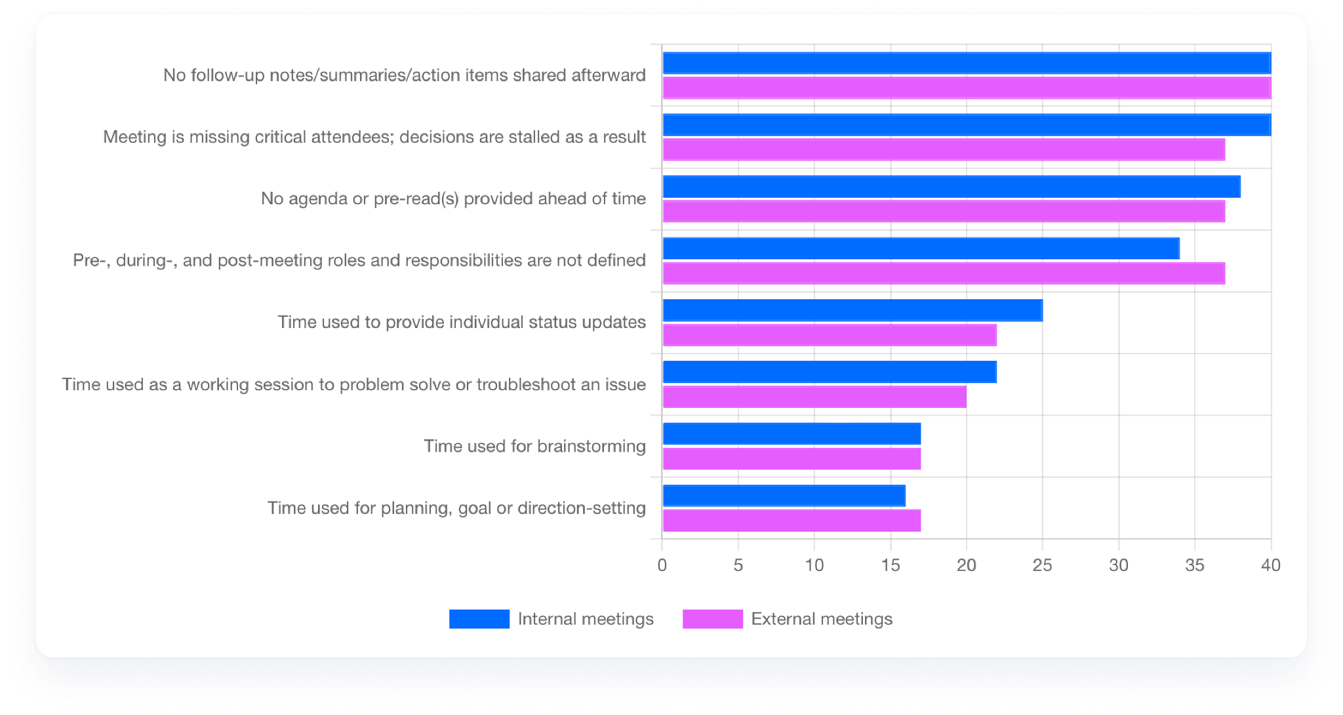
The worst meetings lack agendas, key attendees, and follow-throughs
When we asked what’s typically true of the least productive meetings, the top three responses (for both internal and external meetings) were a lack of follow-up notes or action items after the meeting; missing critical attendees leading to stalled decisions; and no agenda or pre-read provided ahead of time.

Slide 7
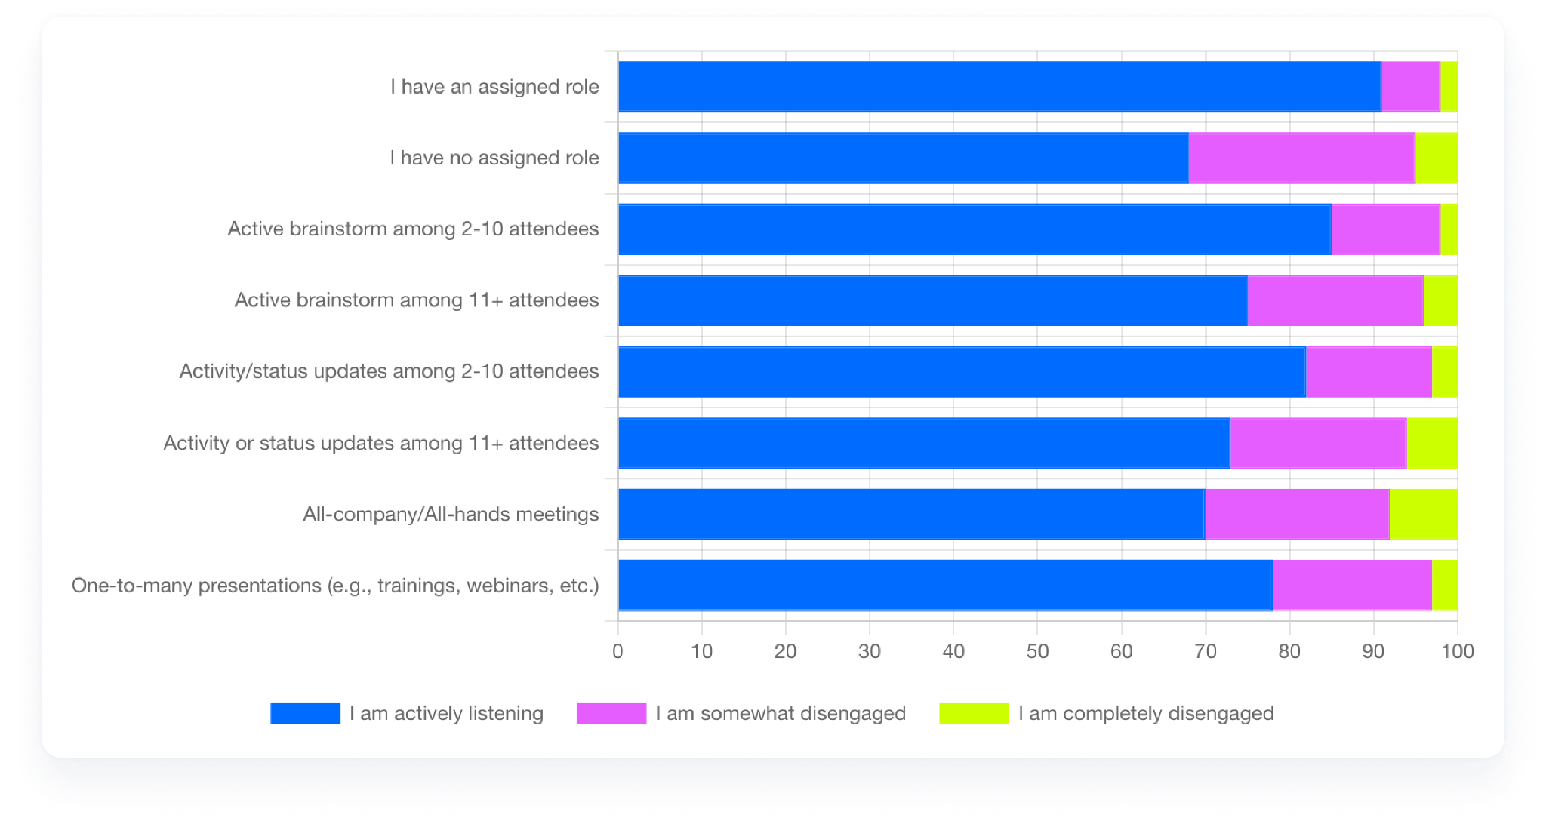
The #1 way to engage meeting attendees is to assign them a specific role
People reported feeling more engaged in meetings where they had an active role — especially brainstorming meetings and smaller meetings. During larger gatherings, such as “All Hands” meetings or one-to-many presentations, people are less likely to be engaged.

Slide 8
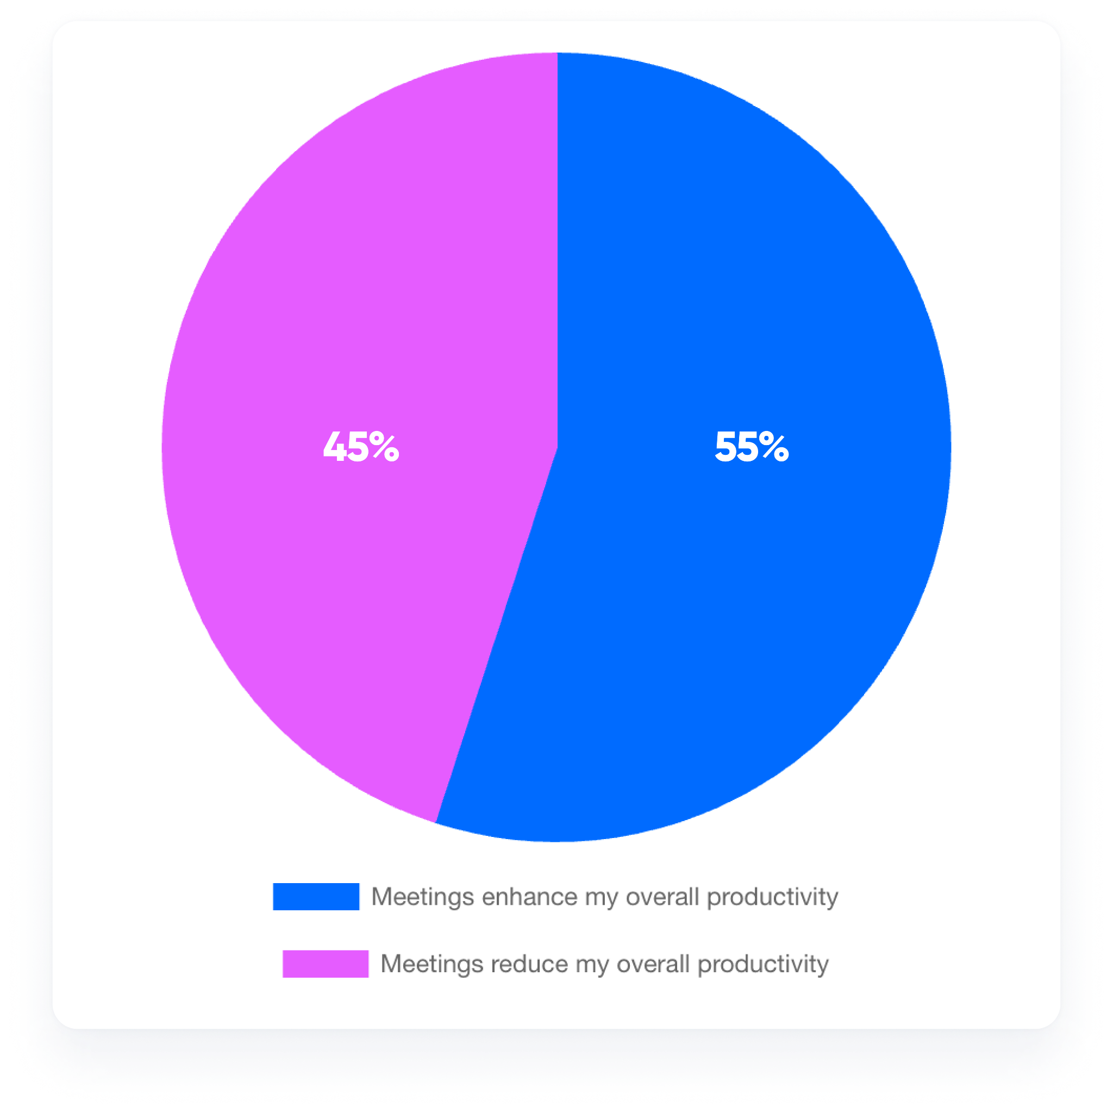
A slight majority agrees meetings positively impact their productivity
55% of respondents reported their productivity is enhanced due to the meetings they’re in.
45% feel the time they spend in meetings each week reduces their overall productivity.

Slide 9
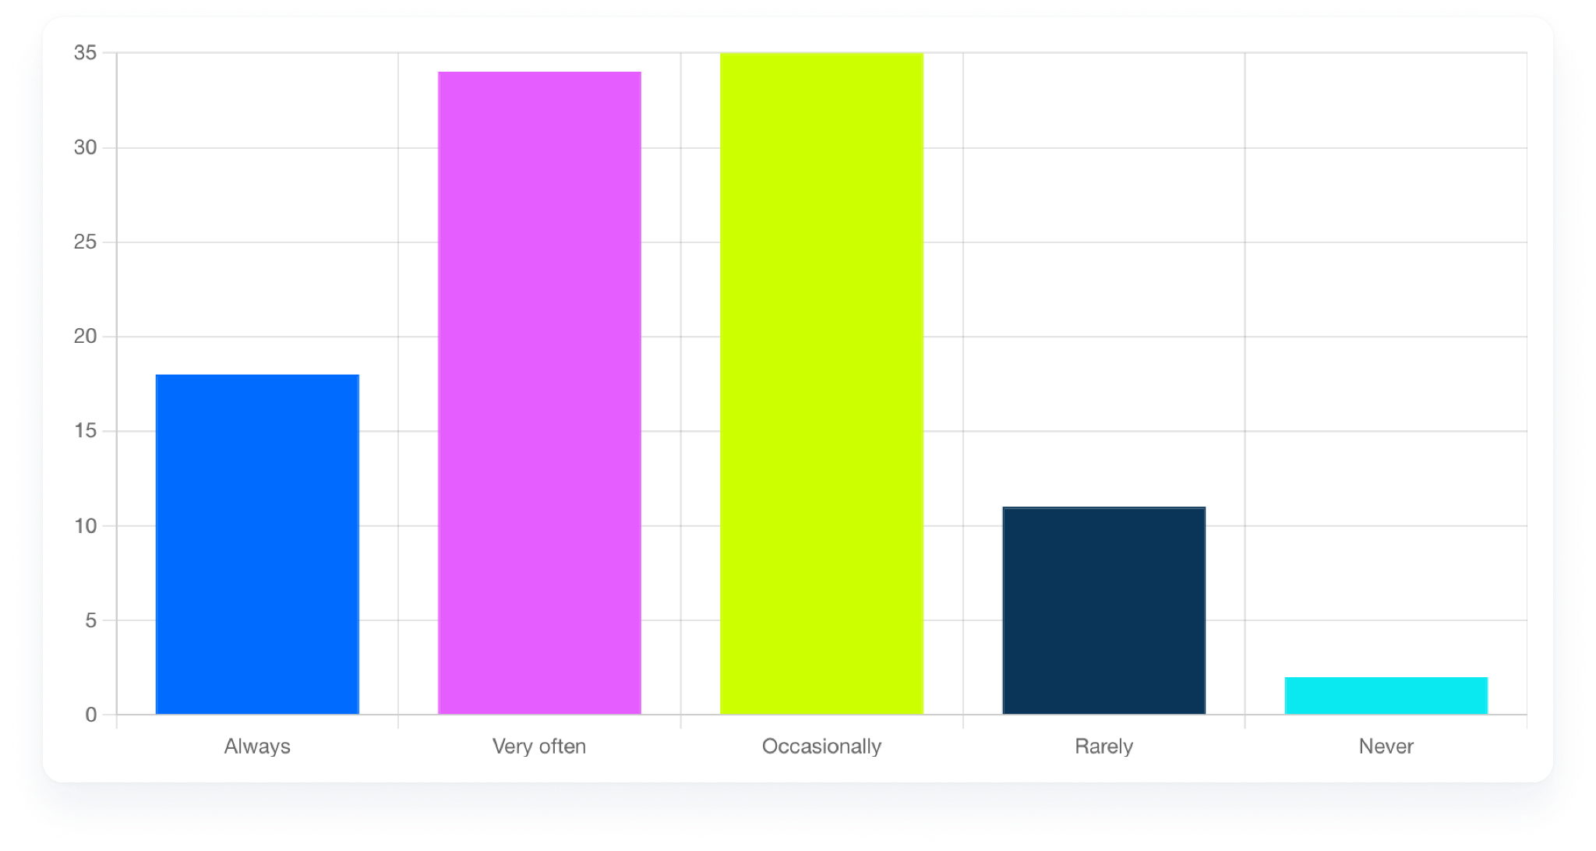
52% of workers often or always multitask during virtual meetings with 2+ attendees
Younger workers are especially likely to multitask: 60% of Gen Z workers admit to “always” or “very often” multitasking during meetings, compared to 56% of Millennials, 47% of Gen X-ers and 34% of Baby Boomers.
52% of workers report multitasking often (34%) or always (18%) during virtual meetings with 2+ attendees.

Slide 10
Part two:
Personal impact

Slide 11
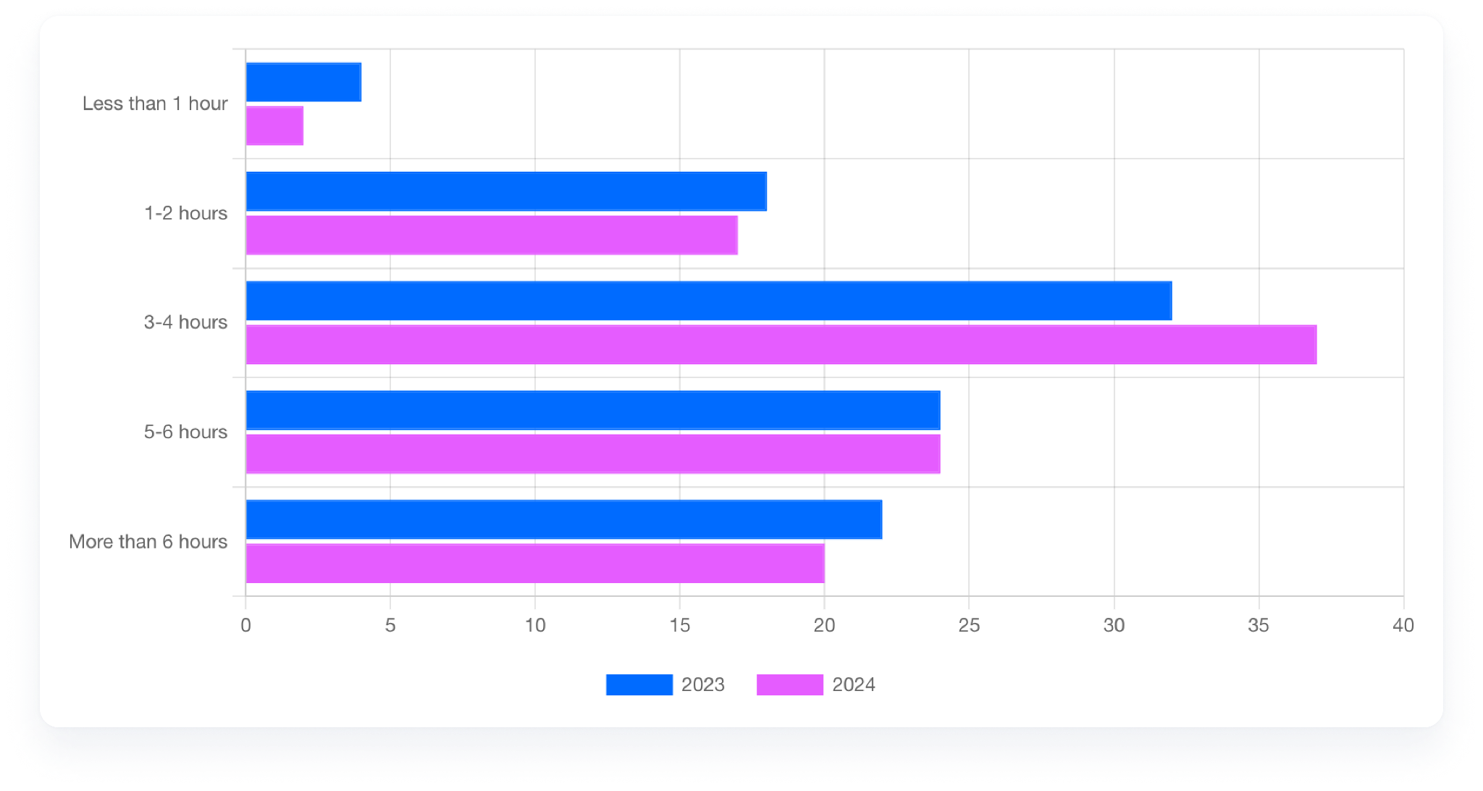
Most workers spend 3+ hours/week in meetings
How much time we spend in meetings every week, 2023 vs. 2024

Slide 12
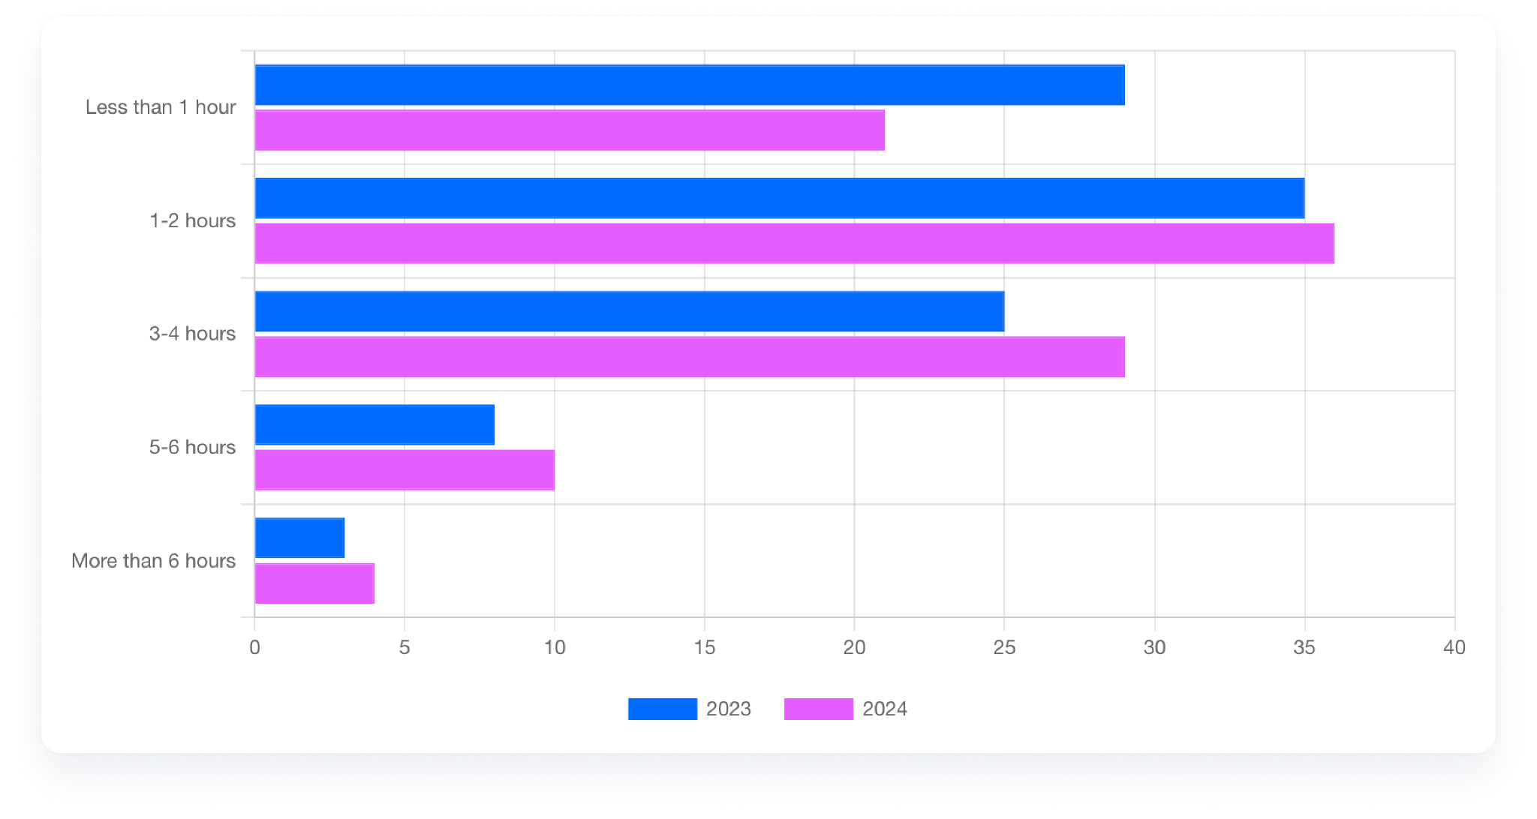
43% of workers spend 3+ hours a week scheduling meetings
Compared to last year's research, 36% more workers reported spending at least three hours per week scheduling meetings in 2024.

Slide 13
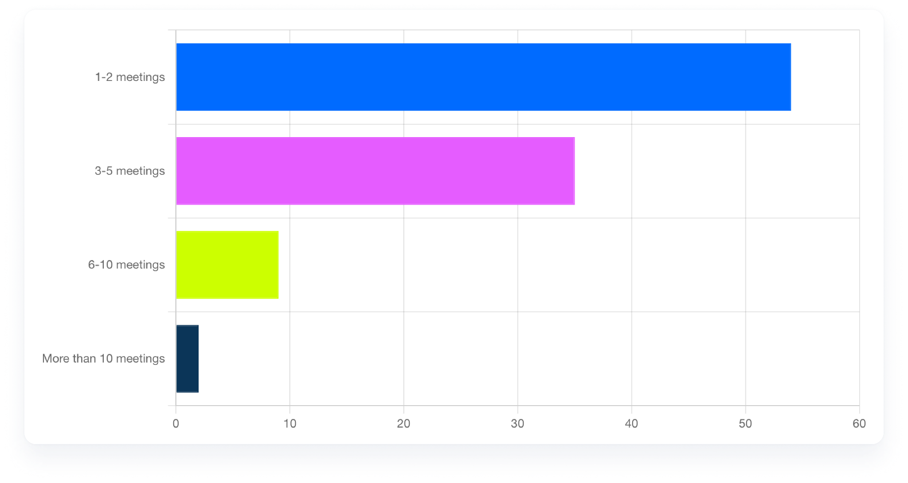
46% of workers are in 3+ meetings every day
How many meetings are you in each day?
These numbers go up for certain populations:
Half of sales professionals are in five or more hours of meetings every day
85% of UK workers spend three or more hours per week in meetings, (vs. 78% of U.S. workers)
59% of enterprise employees spend five or more hours per week in meetings (vs. 32% of SMB employees)

Slide 14
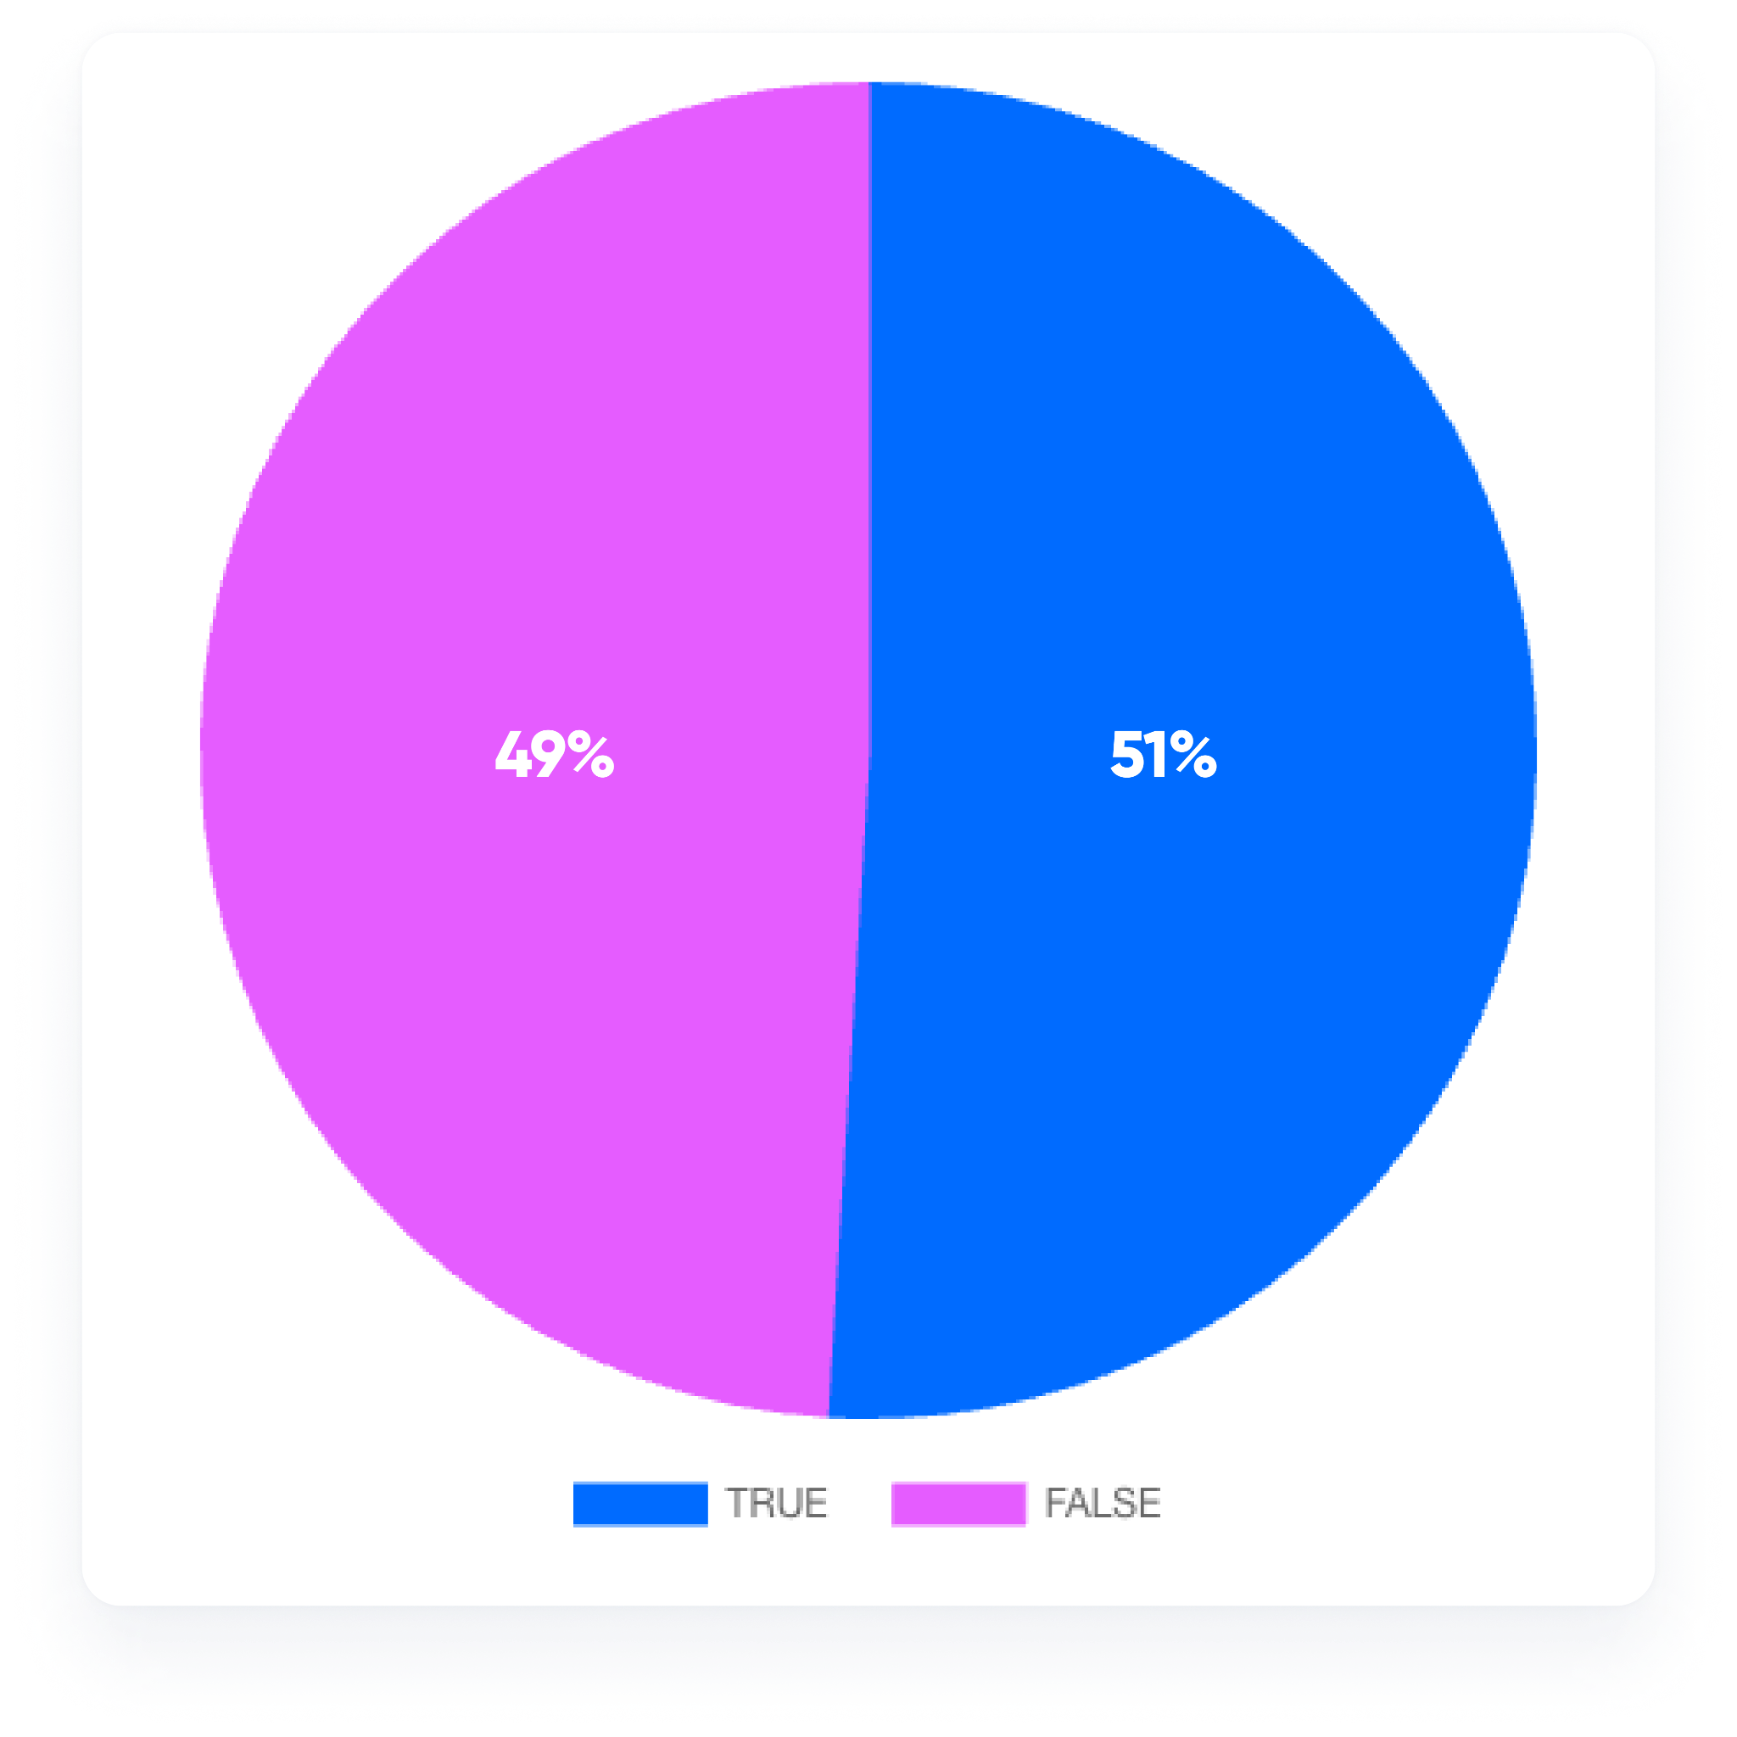
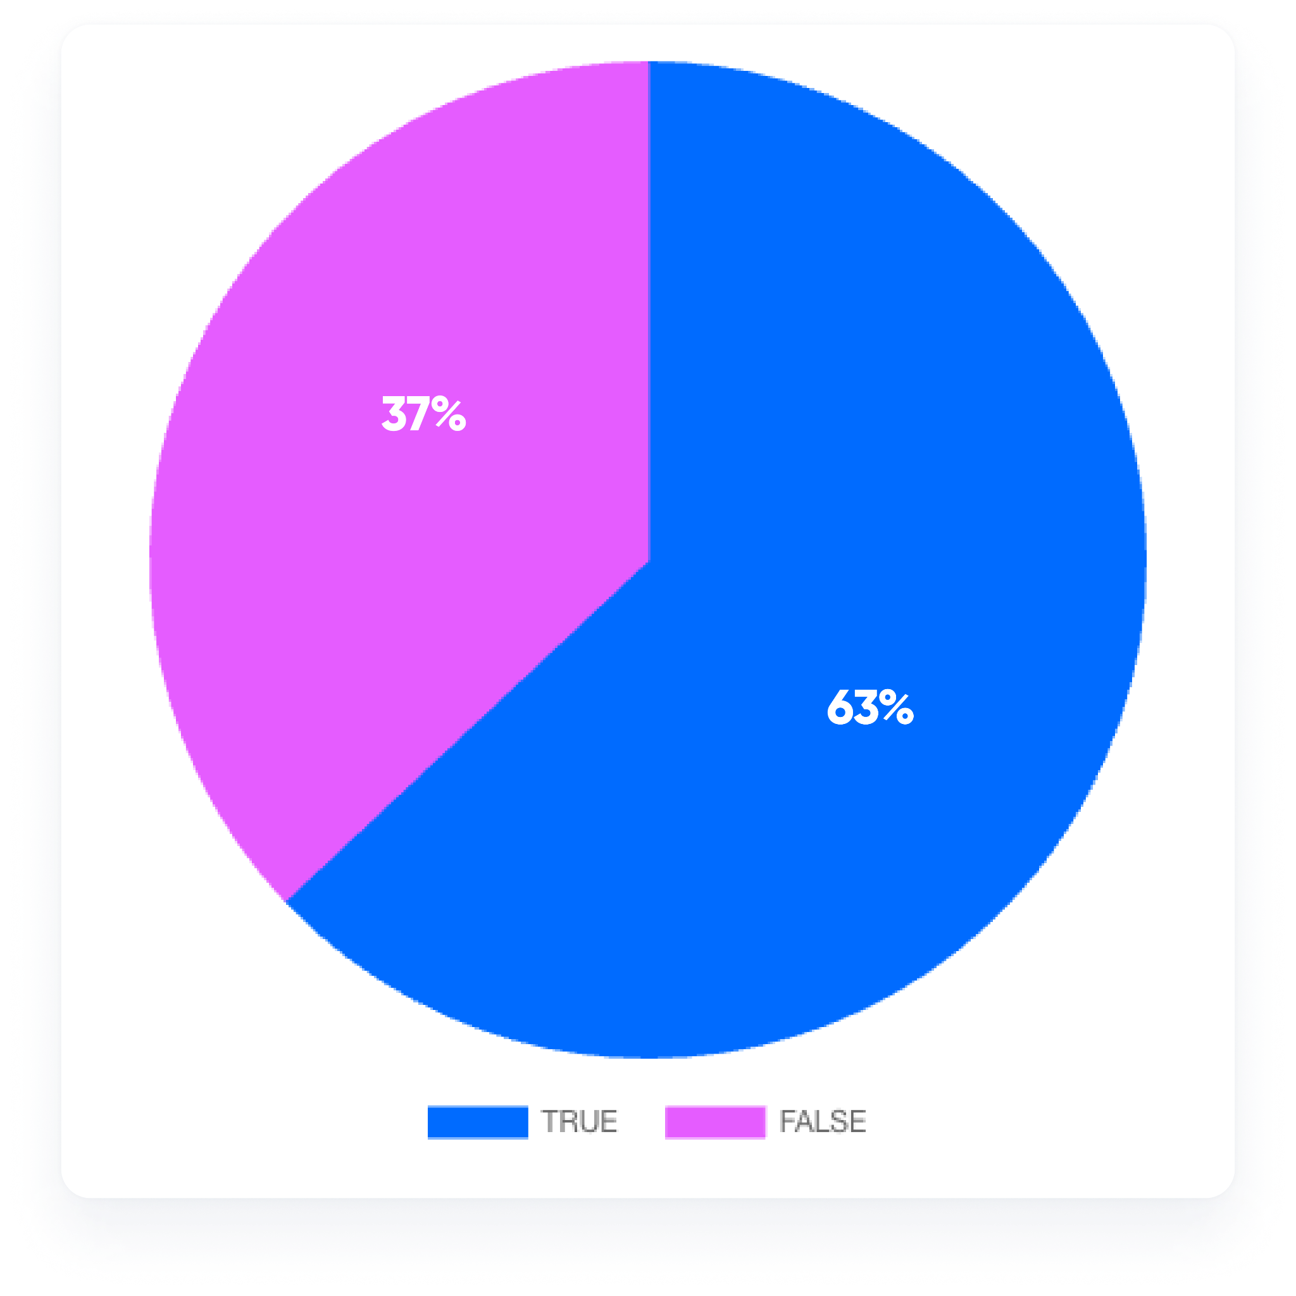
People are split on whether meetings impact their work-life balance
“Meetings do not impact my work-life balance.”
“I have sufficient time for my work and personal life despite meetings.”
51% of workers report that meetings do not impact their work-life balance
69% report working outside normal business hours to make up for the time they spend in meetings

Slide 15
Part three:
Generational differences

Slide 16
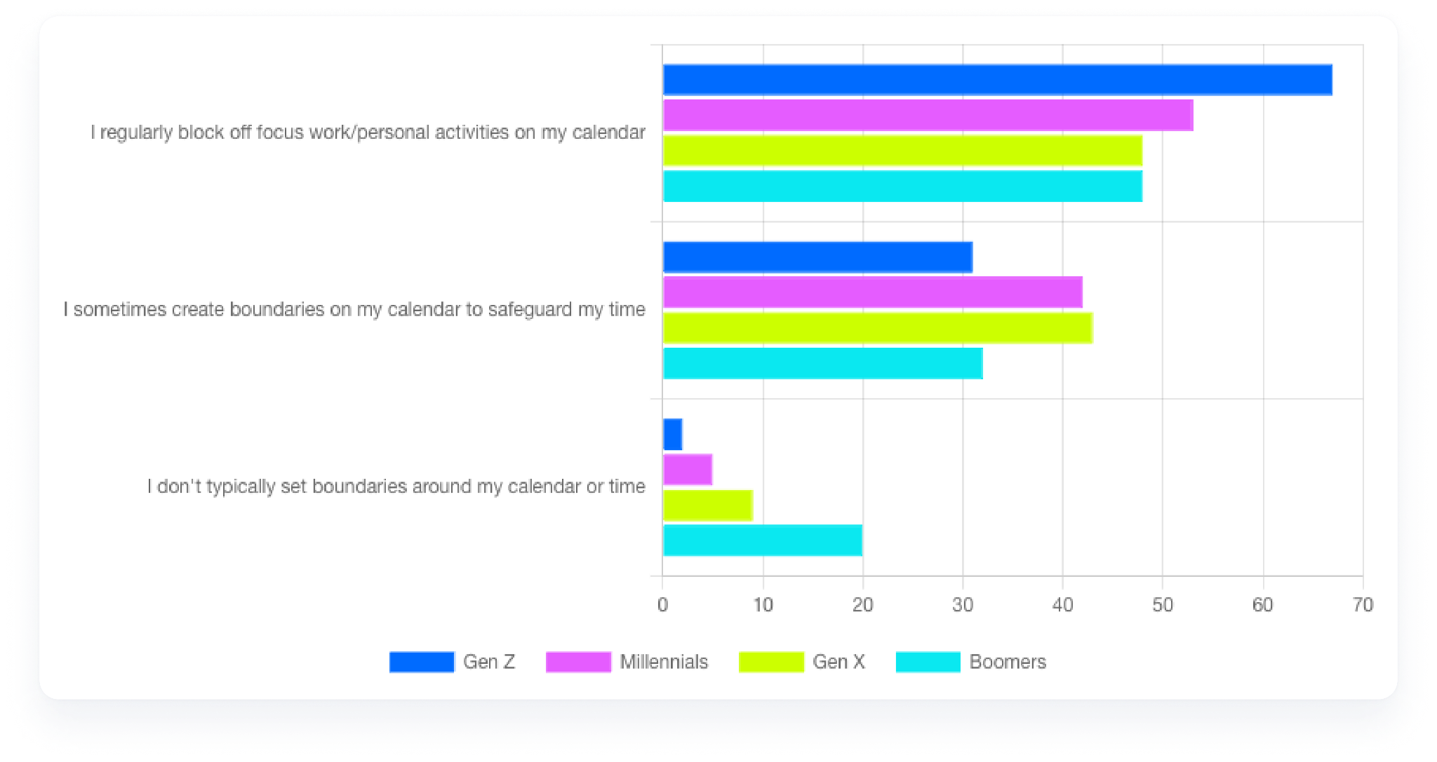
Younger workers are more likely to establish boundaries with their calendar
When asked “Do you actively establish any guardrails or boundaries around your calendar or block time to protect specific periods for focused work or personal activities?”, 67% of Gen Z respondents said they do, compared to 53% of Millennials, 48% of Gen-Xers, and 48% of Baby Boomers.

Slide 17
Younger workers feel meetings enhance productivity, are more excited about AI
70%
63%
64%
of Gen Z workers and 60% of Millennial workers said the number of meetings they’re in enhances their productivity, vs. only 44% of Gen X workers and 37% of Baby Boomer workers.
of Boomers report taking notes by hand, compared to 54% of Gen Z and Millennials, and 59% of Gen X. Millennials are most likely to use AI or automated transcription tools for notetaking (32%).
When asked what benefits of using AI for productivity they were most excited about, 64% and 59% of Gen Z and Millennials, respectively, called out smart scheduling assistance (compared to 43% and 40% of Gen X and Boomers, respectively). Boomers were most likely to report being unsure or unexcited by using AI for productivity (24%), compared to 3% of Gen Z, 5% of Millennials, and 13% of Gen X.

Slide 18
Part four:
Meeting etiquette

Slide 19
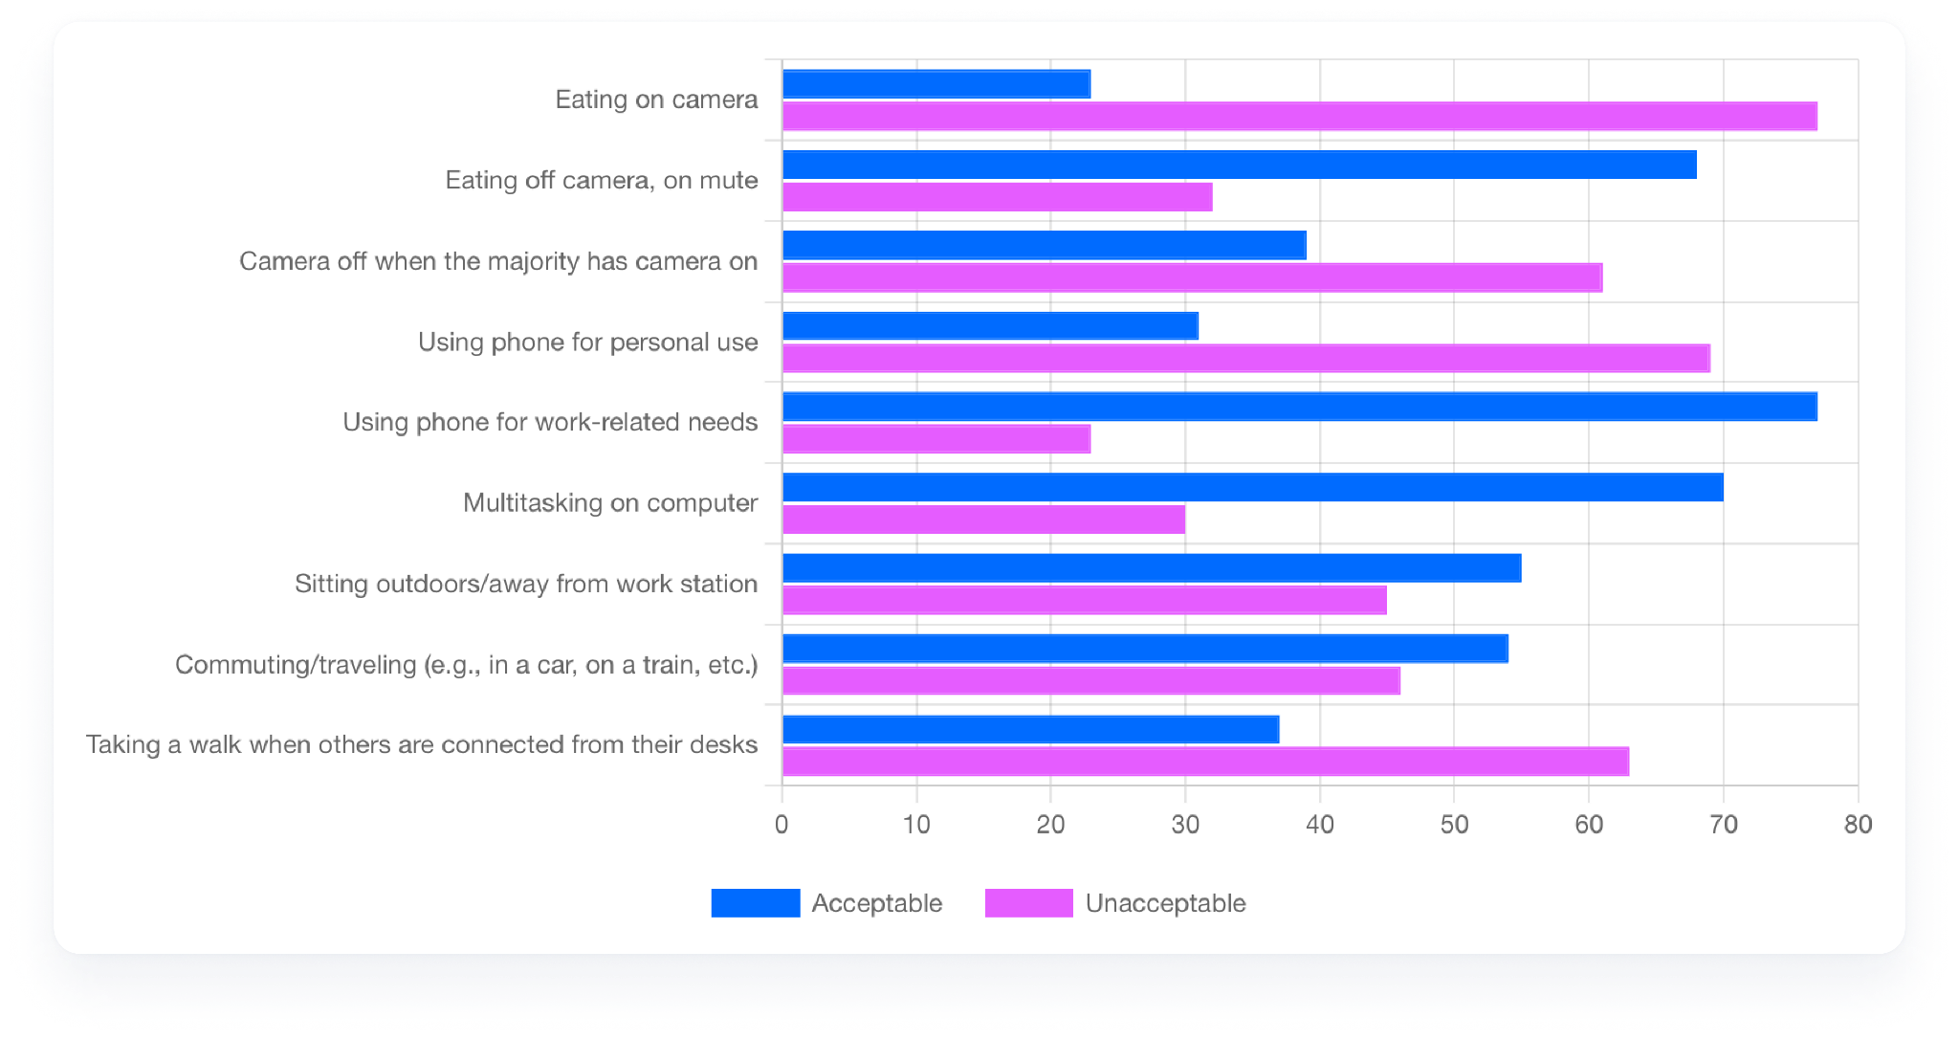
Virtual meetings: Eating on camera is the biggest no-no
For virtual meetings, eating on camera, using phones for personal use, and taking a walk are the 3 least acceptable meeting behaviors.

Slide 20
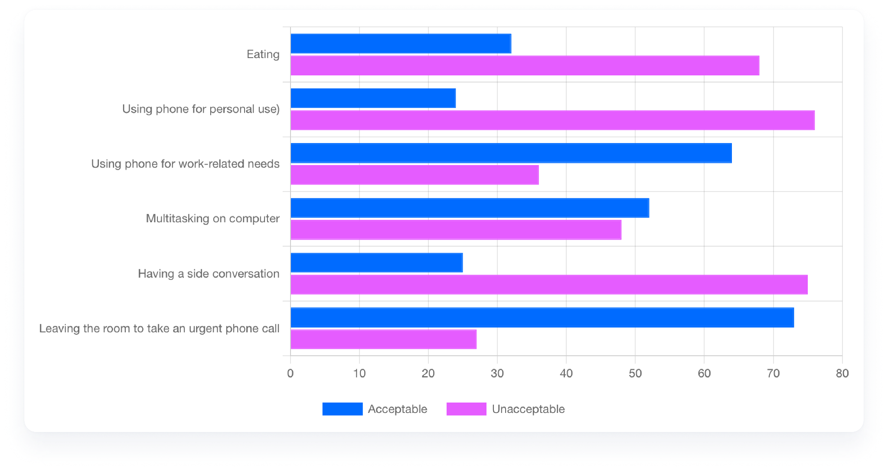
In-person meetings: Personal phone use is the biggest no-no
For in-person meetings, using phones for personal use, having side conversations, and eating are the 3 least acceptable behaviors.

Slide 21
Meeting etiquette varies widely across different demographics
U.S. workers skew slightly more accepting of various meeting behaviors than their UK counterparts
Remote workers are more comfortable declining meetings
Education professionals are choosier about meeting times
Baby Boomers are less likely to approve of “al fresco” meetings
For example, 72% in the U.S. feel it’s OK to eat off camera compared to 64% in the U.K.
75% of workers in fully remote roles feel it’s appropriate to decline a meeting if it’s scheduled over another meeting — higher than people in fully onsite roles (63%) and people in hybrid roles (69%).
For example, 68% feel it’s not OK to schedule during the lunch hour, compared to 53% of tech workers..
56% of Baby Boomers find sitting outdoors or away from the workstation during virtual meetings unacceptable, compared to 44% of Gen Z, 41% of Millennials, and 47% of Gen X workers.

Slide 22
Part five:
How different roles experience meetings

Slide 23
Sales teams and meetings
50%
72%
41%
Sales professionals have the most meetings of every role we surveyed — half of them spend five or more hours in meetings every day.
The majority of salespeople admit they sometimes work longer hours due to the number of meetings they attend.
Sales have the highest percentage of meetings with people outside their organization. 41% of sales pros report that at least 41% of their meetings are with external-only attendees.

Slide 24
CX teams and meetings
50%
68%
74%
CX professionals have the lowest boundaries around their calendar time of all of the roles we surveyed, with 50% admitting they never or only occasionally create boundaries to safeguard specific time.
Out of all the roles we surveyed, CX spends the least amount of time scheduling meetings: 68% of CX professionals spend less than 2 hours per week on scheduling.
CX professionals have the highest proportion of meetings with people inside their organization — 74% report that at least 41% of their meetings are with internal-only attendees.

Slide 25
HR teams and meetings
56%
71%
of HR professionals believe that the meetings they attend impact their work-life balance.
Compared to other roles, HR professionals reported the highest productivity enhancement for team projects: 71% feel the number of meetings they attend positively impacts their ability to move team projects forward.

Slide 26
Marketing
69%
41%
Marketers were the likeliest to report that the meetings they attend help them move their individual projects forward — 69% of them believe that to be the case.
Marketers are the most likely to intervene during meetings “when someone asks a very unrelated question” — 41% feel that’s appropriate, compared to 32% of sales or HR professionals.

Slide 27
Part six:
The role of AI

Slide 28
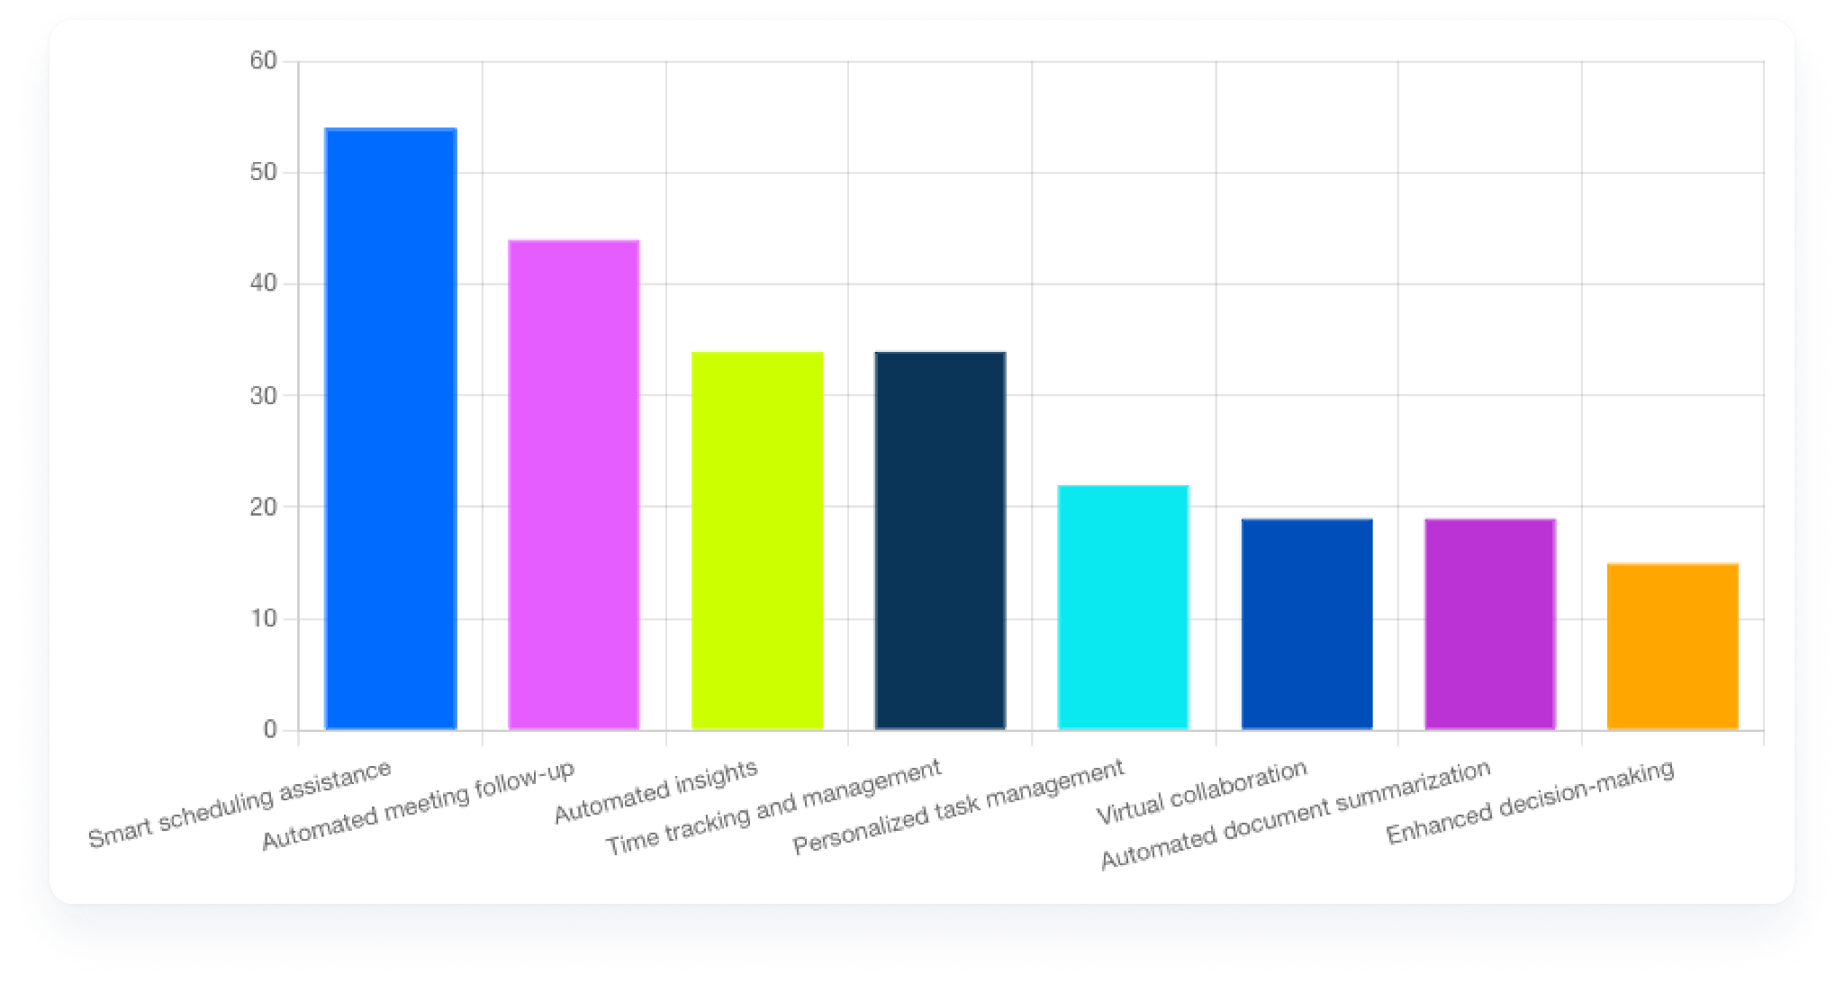
‘Smart scheduling assistance’ is the #1 benefit of AI workers are excited about
The benefits of using AI for productivity that people are most excited about: smart scheduling assistance (54%), automated meeting follow-up (44%), and automated insights + time tracking (34%).

Slide 29
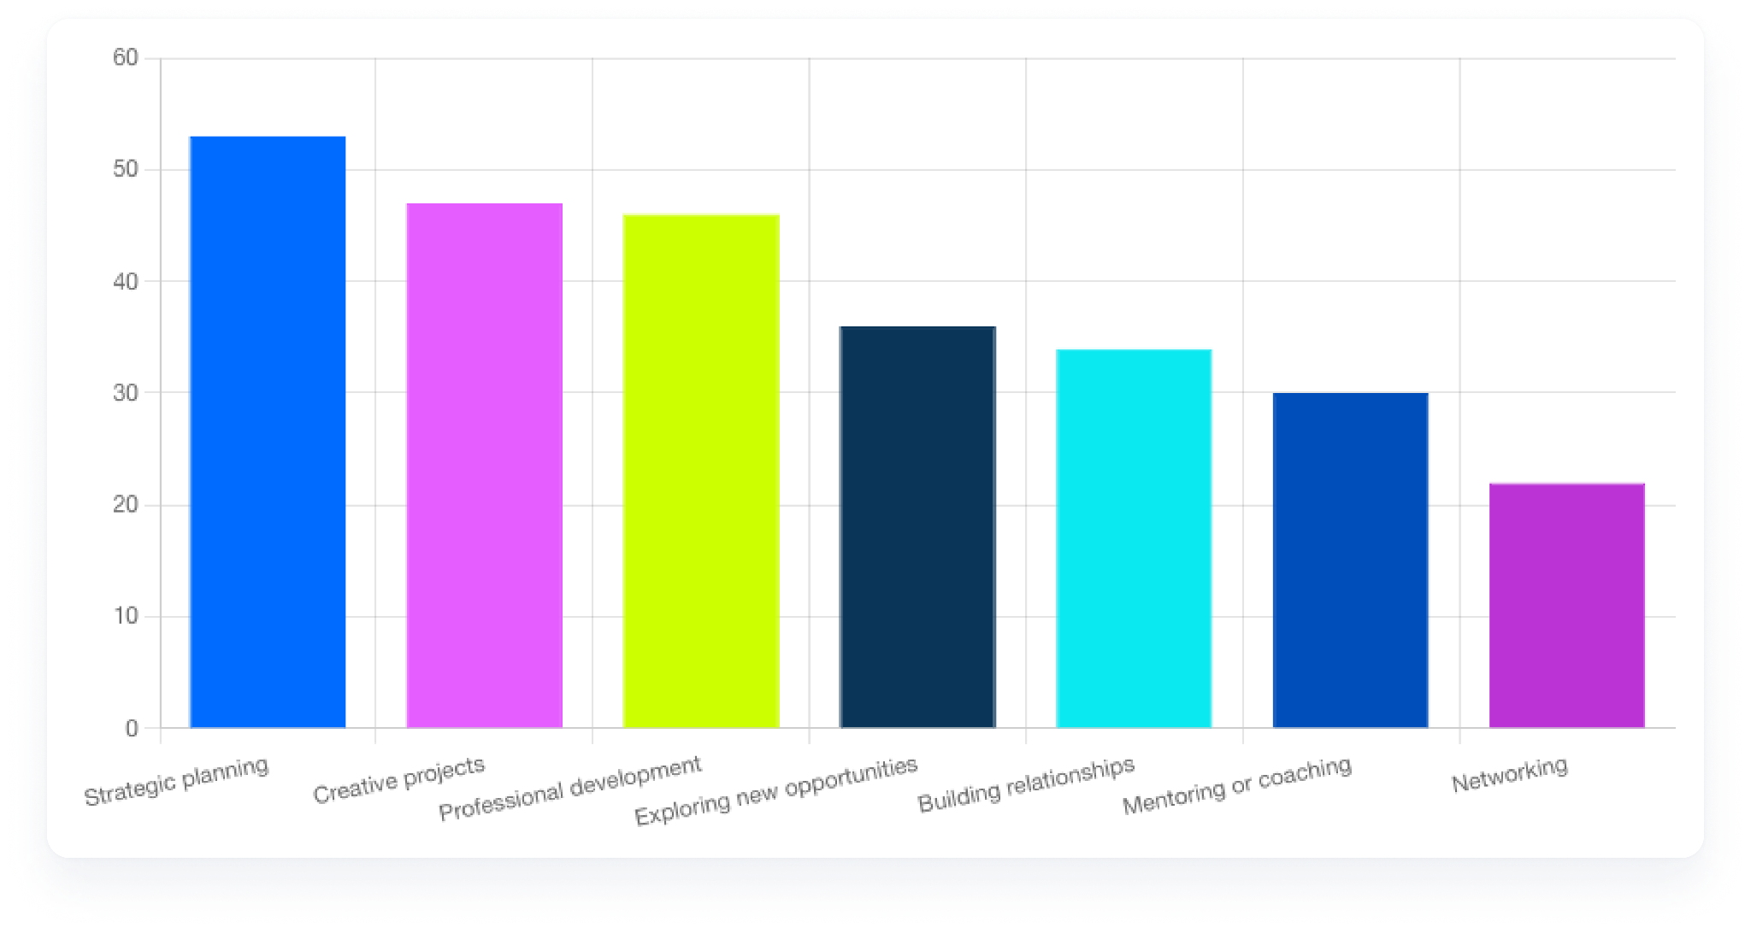
Top 3 areas for AI-driven time savings: strategic planning, creative projects, and professional development
Like last year, the top three areas respondents would invest AI-driven time savings include strategic planning, creative projects, and professional development.
Unlike last year, close to half of all respondents indicated interest in AI — compared to only about 17% in 2023.

Slide 31
Appendix

Slide 32
Methodology and definitions
Calendly’s State of Meetings Report was conducted by independent research firm Brand Over Matter from June 25–July 25, 2024. The survey gathered responses from 1,244 workers across the U.S. and UK, covering a range of industries, job roles, and company sizes:
Company sizes: SMB (≤250 employees), mid-market (251-1000), and enterprise (1000+)
Roles surveyed: Customer Support and Success (CX), Sales, Marketing, and HR/Recruiting
Participants self-identified their job levels, with 50% describing themselves as managers, and included a strong representation of senior roles (director to C-suite). Because Calendly serves 200+ million customers in a variety of industries, the report represents customers in some of Calendly’s largest demographic segments, such as financial services, tech, education, and professional services.
Respondents were split across generations as follows:
Generations: Gen Z (23%), Millennials (39%), Gen X (26%), and Baby Boomers (12%). Gen Z = born between 1997–2012; Millennials 1981–1996; Gen X 1965–1980; and Baby Boomers 1946–1964.
For media inquiries, please contact media@calendly.com.

