Slide 1
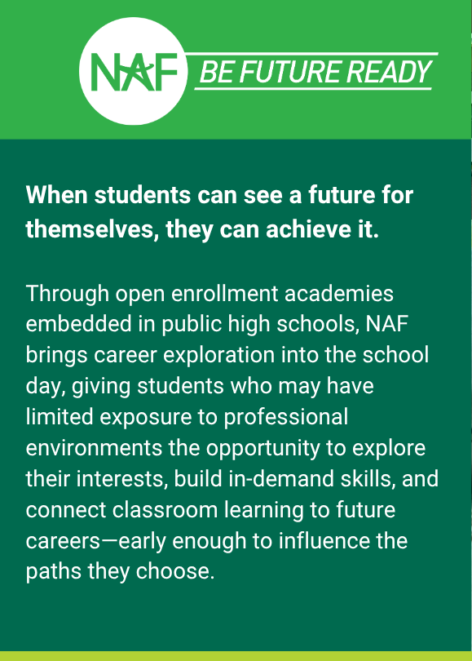
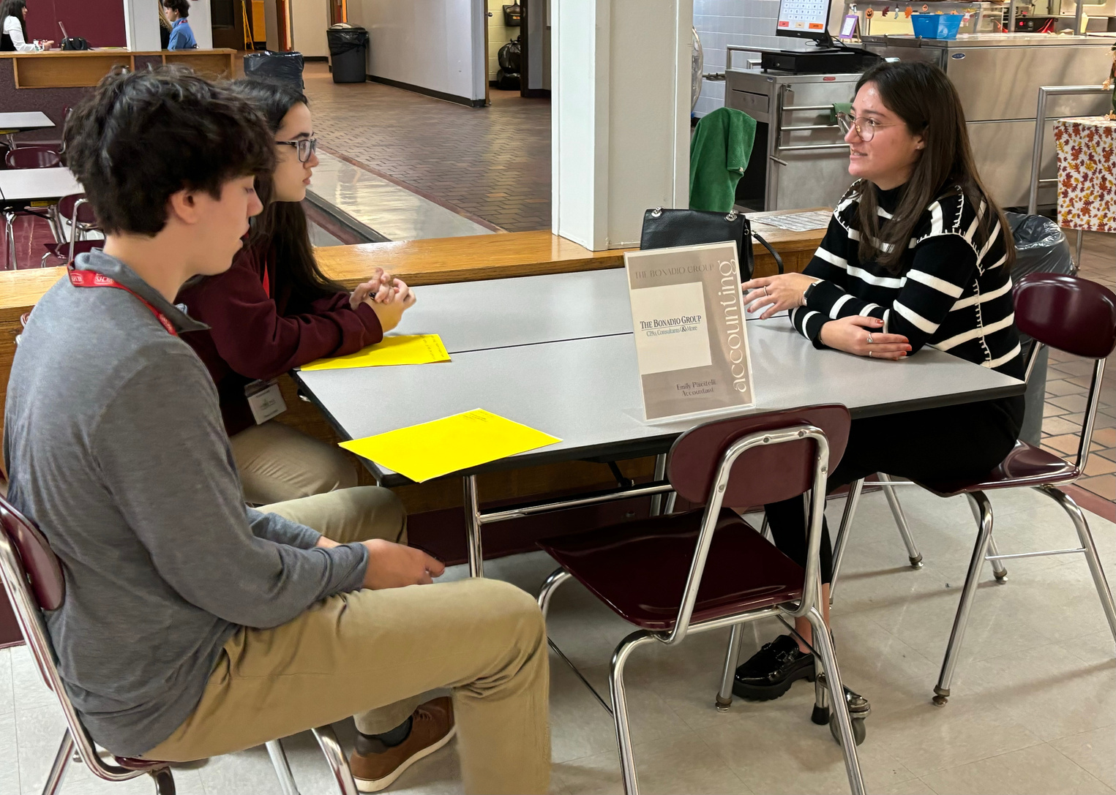





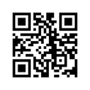

MAKE A DIFFERENCE IN THE LIVES OF HIGH SCHOOL STUDENTS
About Our Academy
  Career-connected courses:
  Student clubs:
  WBL activities:
WAYS TO SUPPORT STUDENTS
Share your career path
  Serve as a guest speaker
  Have a career conversation/informational interview
  Host a worksite tour or job shadow
Support skill development
  Offer resume reviews/coaching
  Facilitate a mock interview
  Present a skills workshop
000
Provide internships & other on-the-job experiences
Students
Questions?
Contact <name>
<title>
<email>
Volunteer Interest Form

