Slide 1
Outcomes-Driven Work-Based Learning Approach: How Advisory Board Members can Help

Slide 2
AGENDA
What Outcomes-Driven Work-Based Learning (ODWBL) is and how you can support it as Advisory Board members
Tech tools for collecting and analyzing data on ODWBL’s impact
Resources
Q&A
Notes:
Thank you so much for being part of our Advisory Board. We are excited to share some information about ways to elevate the impact of WBL on students and the role you can have it doing so. Here is what we’ll cover today.

Slide 3
OUTCOMES-DRIVEN WORK-BASED LEARNING
ASPIRATIONS
One career path, defined and mapped
SIX FUTURE READY SKILLS, with feedback from industry partners
At least three career related professional CONNECTIONS
Notes:
Our goal is for all NAF academy students to achieve these 3 desired outcomes.
As AB members, you can support all 3 outcomes:
Aspirations
Hold discussions with you to find out more about what careers students have expressed interest in and then help plan around those
Support Career Awareness and Exploration events where students can discover new options
Help secure internship opportunities
Share the stories of their career journeys
Skills
As Advisory Board members, you should help plan and participate in work-based learning activities designed for students to develop the Future Ready skills. While Career Awareness activities (for example, guest speakers) enable students to learn more about different careers, they typically do not provide students with the chance to build skills and hear professionals’ perspectives on their progress. Focus on partnering with educators and Academy leads to create events where students have to prepare, actively participate, and reflect on their experience, as well as receive feedback on their skills. Internships are invaluable for students to expand their skills and as an Advisory Board member, helping to find, fund, or furnish these opportunities is vital.
Connections
You can get to know students and share their own experiences of how their network has impacted their professional and personal growth. As part of supporting Academy work-based learning, you can help plan events where students learn about how to build their network and get to practice their communication skills. Given the more in-depth nature of students’ interactions with professionals during internships, working to secure these opportunities is a way for AB members to directly help students expand their network. Additionally, introducing students to people in their network when/where possible is very helpful.

Slide 4
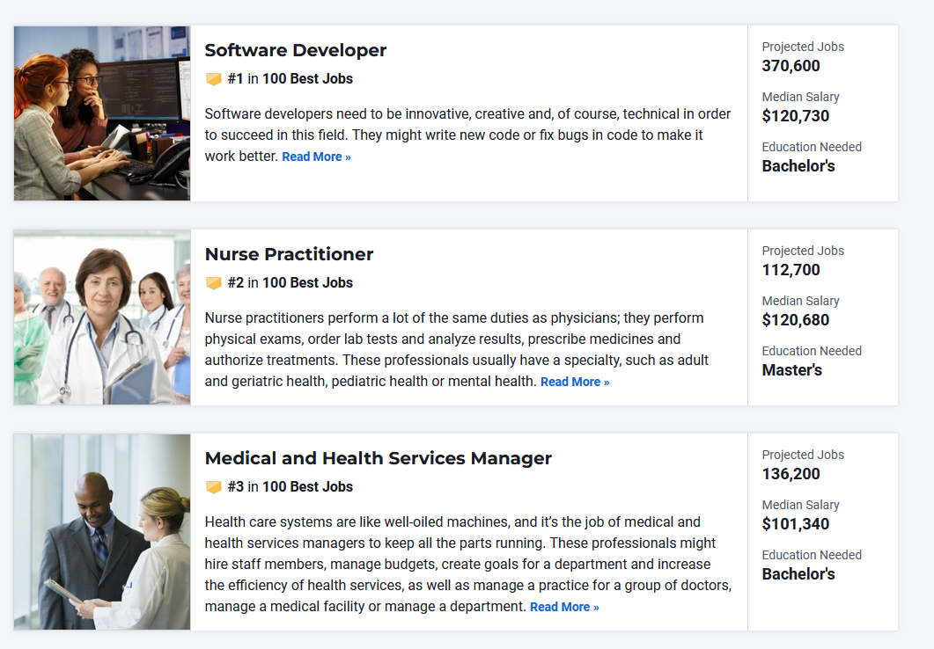
ASPIRATIONS
What career did you want as a child?
How do students learn about current and future careers?
Notes:
Through WBL activities, students can gain clarity about their career(s) of interest and learn about the education, certifications, and experience needed for that career.

Slide 5
FUTURE READY SKILLS
COLLABORATION
COMMUNICATION
PROBLEM SOLVING
INITIATIVE & SELF-DIRECTION
SOCIAL AWARENESS
PLANNING FOR SUCCESS
Notes:
An overwhelming majority ― 93% of employers ― say “soft skills play a critical role in their decision about whom they want to hire,” Ian Siegel, co-founder and CEO of ZipRecruiter, said in the company’s recent report The Job Market Outlook for Grads.
Communication skills, 6.1 million, Customer service 5.5 million, Scheduling 5 million, Time Management 3.6 Million
Project Management 2.8 million, Analytical Thinking 2.7 Million

Slide 6
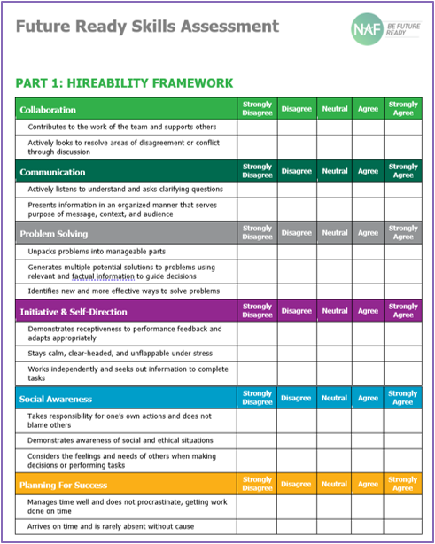
FEEDBACK FOR STUDENTS
Notes:
Part of the Skills outcome is for students to get continuous feedback from industry professionals during different WBL activities. For shorter-term engagements like mock interviews, there is a Skills Feedback survey with a few quick questions. For longer-term activities like internships, supervisors complete a Future Ready Skills Assessment. Students get to see all the feedback so they have a better sense of their strengths as well as areas to work on.

Slide 7
CONNECTIONS
Notes:
Who students know makes a difference. By helping them build professional connections during high school, they will be better positioned for after high school.

Slide 8
CONNECTIONS
“NAF provided me with opportunities that allowed me to take part in the farm at Woodlawn High School and introduced me to my current employer, Jones Valley Teaching Farm.
Today, as a farm & apprenticeship manager, I get to play the role that others in the NAF community played for me, helping students ignite their passion for learning.”
Mohamed Jalloh 2022 NAF Alumni Award Winner
Notes:
Mohamed is a great example of how building connections results in post-graduate opportunities.

Slide 9
ADVISORY BOARD MEMBER ROLES
Participating in a variety of in-person and virtual classroom activities and student projects
Securing and coordinating a sequence of WBL experiences based on the academy's work-based learning calendar
Finding, funding, or furnishing paid internship opportunities
Leveraging connections to raise awareness of the academy[-ies] and build community support
Notes:
As AB members, these are the main ways you support NAF academies when it comes to Work-Based Learning activities. We know every member’s interest vary but these are the high-level functions the Board should be supporting as a whole.

Slide 10
WBL CONTINUUM: HOW YOU CAN GET INVOLVED
IMPACTFUL
MORE IMPACTFUL
MOST IMPACTFUL
Career
Awareness
Career
Exploration
Career
Preparation
Guest Speaker Worksite Tour Career Fair
Informational Interview Job Shadow
Resume Coaching/Review Session
Mock Interview
Mentorship Skills Workshop Partner Engagement Project
Internship
Clinical Experience
Apprenticeship
Youth Apprenticeship
Mentored Industry Project
Notes:
WBL falls under the umbrella of career readiness
Awareness: Students build career awareness and aspirations, observing and receiving information through research and questioning
Exploration: Students explore the workplace and build career skills, playing an active role in interacting with adults.
Preparation: Students apply learning and skills through practical experiences with industry professionals, making connections with for conditioned growth.
Reminder that WBL requires a 2-way interaction with partners/professionals where students can identify careers of interest, build skills and get feedback on those skills, and make connections to build professional network.

Slide 11
TECH TOOLS TO SUPPORT ODWBL
Note: Data reports from these tools can be run by academy leads and educators.
Skills Feedback Survey
Future Ready Skills Assessment
WBL Participation Tracker
WBL Reflection Form
Notes:
There are multiple data sources you will be able to review and discuss during AB meetings. As an AB member, you don’t have access to run these reports but you are able to work with the academy lead and/or educators to review this data, including the frequency of data review.
Tech Tools: The WBL Participation Tracker, the WBL Reflection Form, and two student assessments completed by industry professionals interacting with students, one for after career preparation activities such as internships, and one for after career exploration activities such as job shadows.

Slide 12
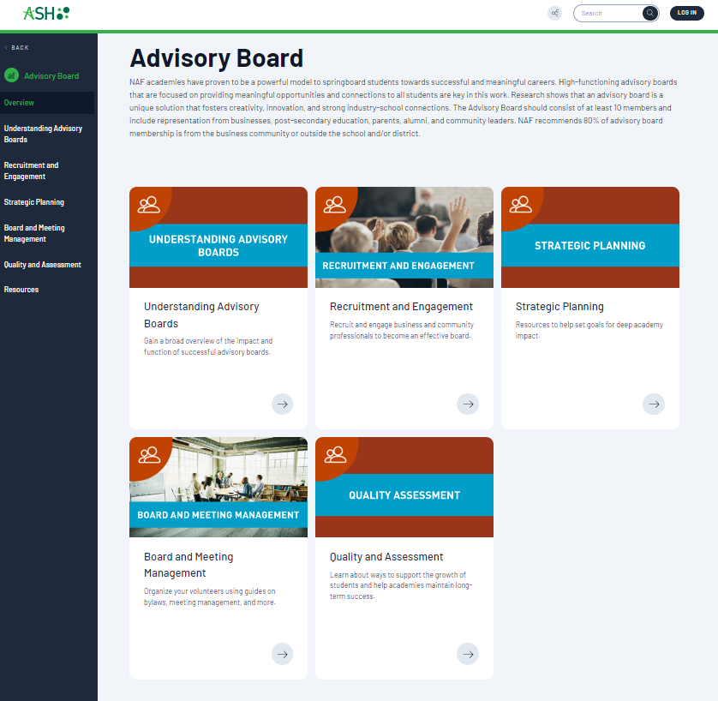
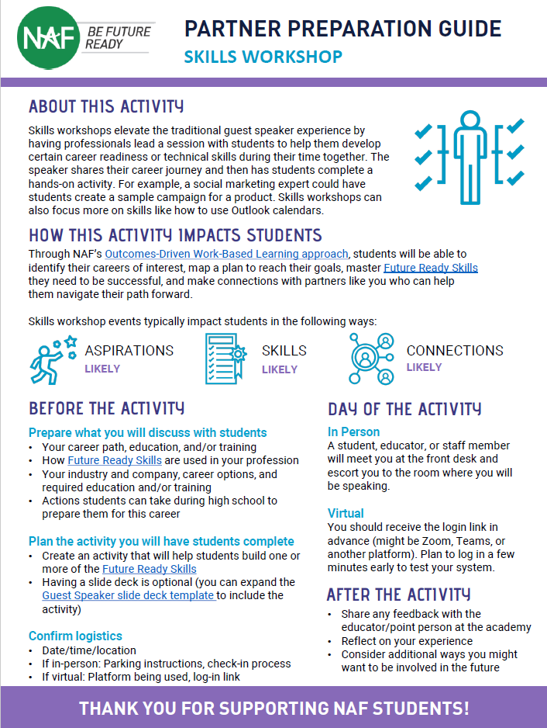
ADVISORY BOARD RESOURCES
Advisory Board section of ASH
ODWBL overview
WBL activity prep guides
Notes:
We encourage you to explore the many NAF-created resources to learn more about how you can support work-based learning.

Slide 13
Q&A

