Slide 1


2025 NAF Alumni Mentorship Program

Slide 2
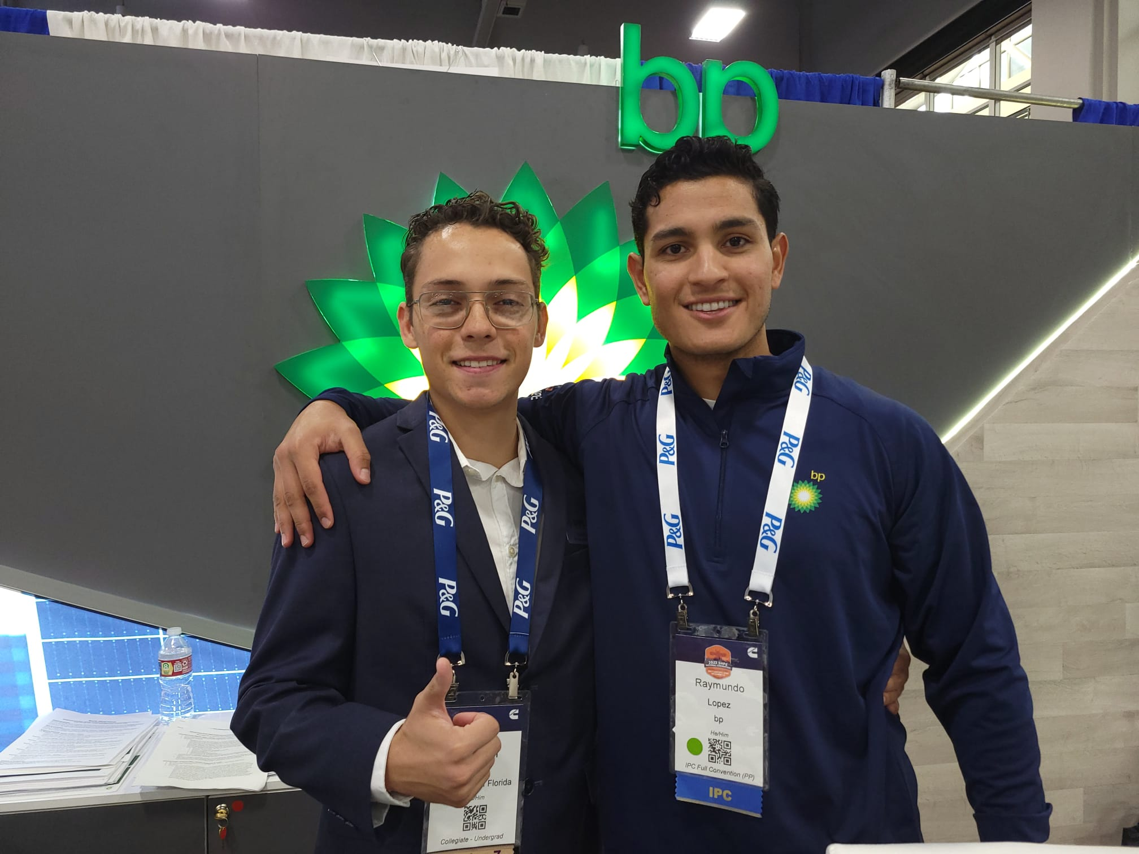
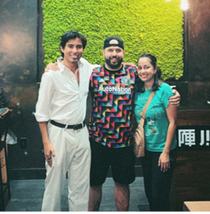
Program Background and Information
The NAF Alumni Mentorship Program was started during the 2020-2021 school year with the purpose of providing meaningful mentoring relationships for college-aged individuals who completed their academy program and have moved into the postsecondary phase of their lives.
The program also provides seasoned alumni professionals with a chance to reconnect with NAF and make a difference in a young person’s life and career.
Over 250 NAF alumni have participated in the program since its inception!

Slide 3

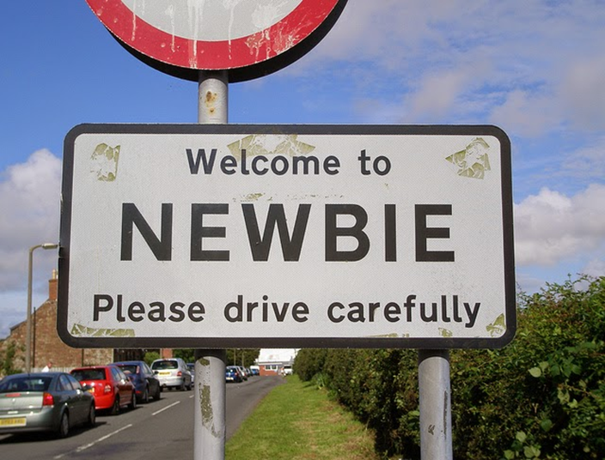
Have You Been in a Mentoring Program Before?
-OR-

Slide 4

Getting to Know Each Other
Name
Where You’re From
High School/NAF Academy
What You’re Doing Now (College, Working, Etc.)
Why You Signed Up for this Program

Slide 5
Mentor/Mentee Roles,
Program Logistics, &
Goal-Setting

Slide 6
What is the Role of a Mentor?
Mentors in this program are NAF alumni and seasoned industry professionals who build ongoing relationships with mentees to guide them in their post-secondary and career journey.
Mentors help mentees:
  by providing guidance on navigating college majors and/or interested career pathways
  build their professional network
  model necessary soft skills needed in the workplace
  develop their resumes and honing interviewing skills
  navigate work-life balance, and more!

Slide 7
What is the Role of a Mentee?
As a NAF alumni mentee, you will be assigned a mentor who will serve as a guide and resource and who will share their college, postsecondary and professional experiences helping to pave the way for you to succeed in college and beyond. The partnership between mentor and mentee is built upon trust, respect, and professionalism.
You are expected to:
  proactively reach out to you mentor to set meeting times
  think of goals/what you want to get out of this partnership
  respond to emails from your mentor and NAF staff in a timely manner
  keep an open mind when receiving advice from your mentor

Slide 8
Expectations and Responsibilities
Attend the virtual 1-hour orientation or watch the recording of this session
Commit to the full 9-month** mentorship program
Communicate with Susan if there is a problem reaching your partner
Meet with your partner for a minimum of one hour per month (virtual or in-person)
  During your first meeting, you and your partner will set goals and determine monthly meeting cadence.
Fill out the feedback survey at the end of the program
Participate in a virtual wrap-up session at the end of the program (optional)
Need Support?
Contact me!
Susan Climan – Manager, Alumni Engagement (scliman@naf.org)
  General questions about the NAF Alumni Mentorship Program
  Concerns about your partner

Slide 9

Don’t Be a Ghost!
The Ghosting Partner
REACH OUT TO SUSAN IF YOU ARE HAVING ANY ISSUES!
If your partner cannot reach you AND I can’t reach you via email and phone, you will be removed from the program.

Slide 10

Getting in Touch/The First Meeting
Susan sent introduction emails connecting mentors and mentees on March 24th. This email also included the Program Guide for Mentors and Mentees.
REMINDER: Check your Spam/Junk folder for emails from me and your mentor!
Week 0 (1 week prior to the mentorship start date)
MENTEES: Be proactive and reach out!
Introduce yourself + give your mentor insight into who you are:
  Share where you’re from
  Your school/major or where you work
  Your career interests
Set up initial meeting date/time for April
During initial meeting (April)
Talk about your NAF academy experience and your postsecondary/career journey so far
Ask your partner questions to get to know them
Set up goals with your mentor based on what YOU want to get out of this mentoring experience
  Not sure where to start? Reference your Program Guide or this helpful blog: https://www.togetherplatform.com/blog/examples-of-mentoring-program-goals
Set up meeting cadence for duration of 9-month program (April-December 2025)

Slide 11


MentorCity Online Mentoring Platform
Brian Anderson
Account Manager
**New this year – an online mentoring platform! Let’s talk about:
What is this platform and why do I need to use it?
Creating your profile
Scheduling meetings with your partner
Events, Resources and Discussions
…and more!

Slide 12
Resources & Questions

Slide 13

Resources to Support You
Program Guide for Mentees
Program Guide for Mentors
Examples of Mentoring Program Goals – https://www.togetherplatform.com/blog/examples-of-mentoring-program-goals
TEDx Talk for Mentees – 3 key elements for thriving mentorship
MENTOR – Becoming a Better Mentor – Strategies for Being There for Young People: https://www.mentoring.org/resource/becoming-a-better-mentor/

Slide 14

Questions?
If any questions pop up after this session, feel free to contact me!
Susan Climan
Manager, Alumni Engagement
scliman@naf.org

Slide 15
Thank You!
Visit NAF.org for more information.
@NAFCareerAcads
#BeFutureReady

