Slide 1
Alumni Industry Ambassadors Program
Orientation Session

Slide 2
Agenda
Alumni Industry Ambassadors Program overview
Specific options for getting involved
Resources
Next steps
Q&A
Notes:
We’re so grateful you’re interested in being part of the NAF Alumni Industry Ambassadors Program! During this Orientation, we’re going to cover what this program is, ways you can get involved as an AIA, NAF resources, next steps, and Q&A.

Slide 3
Alumni Industry Ambassadors Program Overview
Connect with NAF academies and pursue ways to make an impact
Examples:
Host students at your work site for a job shadow opportunity
Join the Advisory Board
Facilitate connections between academies and industry professionals
Highlight and share academy activities on social media
Notes:
What is the Alumni Industry Ambassadors program all about? IMPACT! We want you to get engaged with NAF academies in ways that are meaningful for you. Here are just a few of the many options to consider.

Slide 4
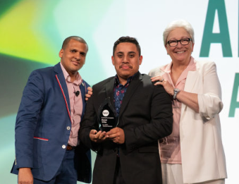
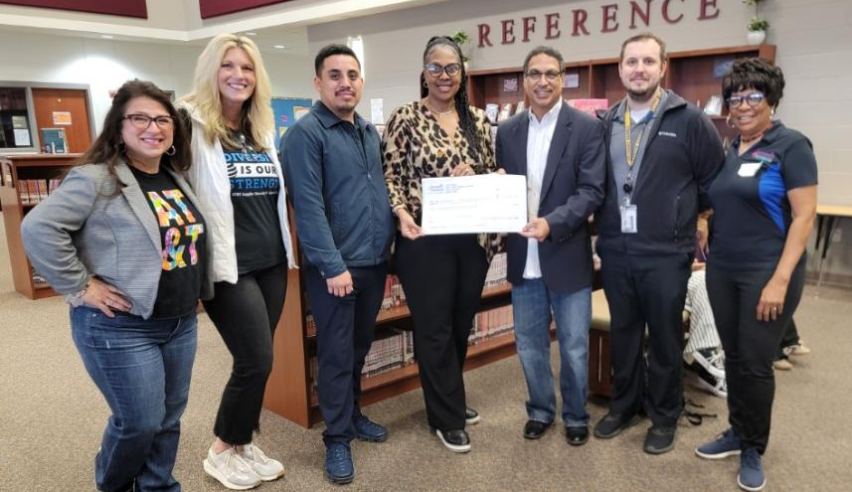
You’re Paying It Forward
I participated in internships that pushed me to work with different kinds of people in areas that I knew nothing about like marketing and event planning.
The support I received from my academy instructors still has a marked influence on me. For all you teachers, I hope you never forget the difference you can make in a student’s life.
Daniel Uribe
Class of 2018
Kimball High School
Daniel Uribe today
Manager, Ardent Edges
WBL Partner &
Internship Provider
Notes:
We know you each have your own unique story about how your NAF academy experience impacted you and becoming an AIA is a way to pay it forward.
Here’s an example: Daniel Uribe, a teen parent who joined the NAF academy at Kimball and went on to college to study engineering, who now works at Argent Edges and regularly supports Dallas students in WBL including by hiring interns!

Slide 5
Work-Based Learning: An Essential Part of College & Career Readiness
College Readiness Activities
Career Readiness Activities
Learning about options
College Tours
College Fairs
Admissions rep. visits
Application Logistics
FAFSA
Common App and other applications
Career-Connected Curriculum
Teacher-led activities (for example, students creating a resume draft)
Career research projects
Work-Based Learning
Involves industry professionals interacting with students
Can take place in or out of the classroom
Notes:
WBL is a subcategory of career readiness and it’s an essential component of students’ academy experience. How did WBL impact you?

Slide 6
NAF’s Outcomes-Driven Approach to Work-Based Learning
ASPIRATIONS
SKILLS
CONNECTIONS
Define and map a plan for at least one career of interest
Build the 6 Future Ready skills
Receive continuous feedback from industry professionals
Be able to articulate their strengths
Develop at least three professional connections
Notes:
NAF academies are now implementing an Outcomes Driven Work-Based Learning program focused on student outcomes and impact to ensure students are Future Ready.
These are the 3 goals we want all NAF students to achieve by the end of their NAF academy experience.

Slide 7
Future Ready Skills
COLLABORATION
COMMUNICATION
PROBLEM SOLVING
INITIATIVE & SELF-DIRECTION
SOCIAL AWARENESS
PLANNING FOR SUCCESS
Notes:
These 6 skills were carefully selected after working with MHA Labs to build upon their thorough research and holding conversations across the NAF Network. By building these skills through work-based learning activities and receiving feedback from professionals, students will be positioned for success in the world of work today and tomorrow.

Slide 8
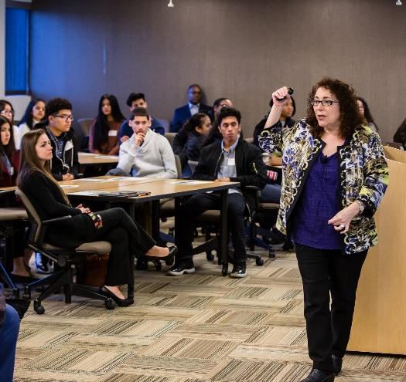
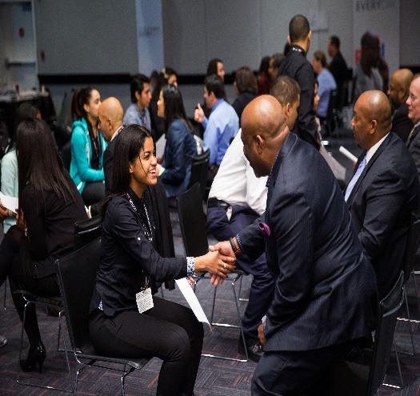
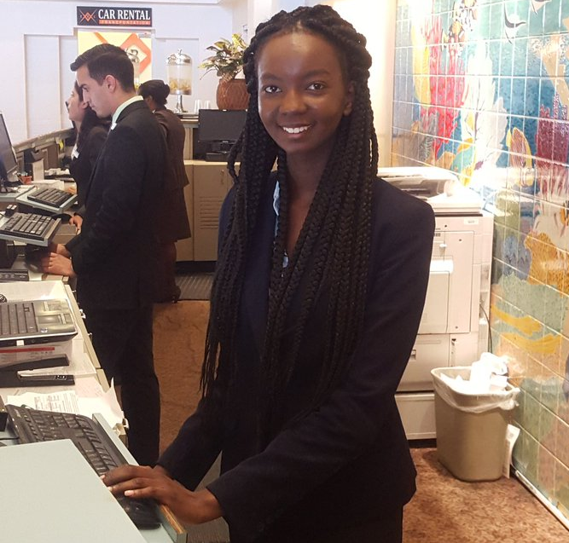
WBL Continuum: Lots of Activities You Can Participate to Support Students
IMPACTFUL
MORE IMPACTFUL
MOST IMPACTFUL
Career
Awareness
Career
Exploration
Career
Preparation
Guest Speaker
Worksite Tour
Career Fair
Informational Interview
Job Shadow
Resume Coaching/Review Session
Mock Interview
Mentorship
Skills Workshop
Partner Engagement Project
Internship
Clinical Experience
Apprenticeship/Youth Apprenticeship
Mentored Industry Project
Notes:
NAF’s WBL continuum provides a roadmap for WBL activities. Students start with Awareness activities to begin identifying areas of interest through observing and receiving information and asking questions. Next students gain a deeper understanding of the workplace through Exploration activities where they can begin to apply their knowledge through interactions with adults. Finally, Preparation activities allow students to apply their learnings through practical experiences with industry professionals.
These are all places you can help as a NAF alumnus/a.

Slide 9
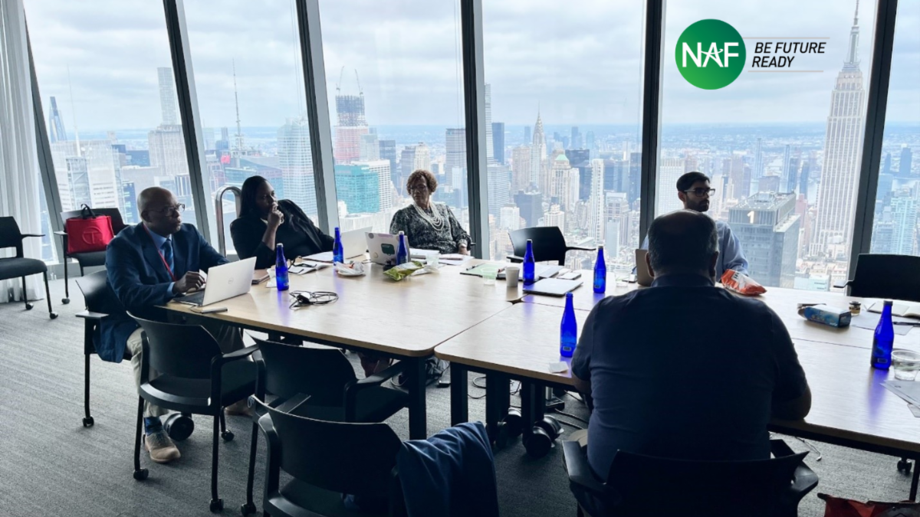
Join or Support an Advisory Board
Meet monthly or quarterly
Great place to network
Leadership opportunities
Not sure about whether joining is right for you?
Talk to academy leaders and the AB chair
Notes:
Becoming part of an Advisory Board is another way to support NAF academies. This often entails attending meetings, being part of planning and participating in WBL activities, and providing overall support and guidance to academies.

Slide 10
Facilitate Connections between Academies & Industry Professionals
One of the top challenges for academies is building connections with industry professionals…they need your help!
Identify potential people in your Network that you could introduce to NAF academy leaders
Encourage colleagues at your organization to get involved
Help academies brainstorm and reach out to organizations in your community
Notes:
We consistently hear from academy leads and teachers that it is very hard for them to find people and companies to offer opportunities to students and get involved in the academy. Here are a few ways you can help!

Slide 11
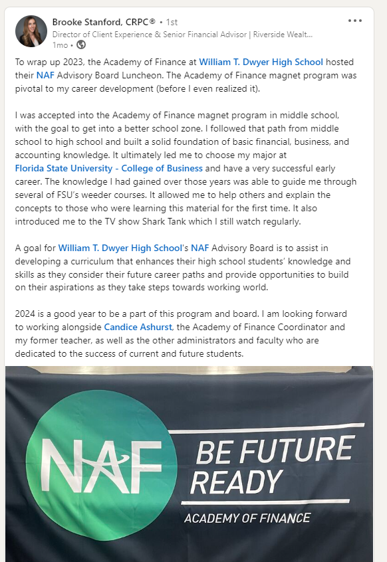
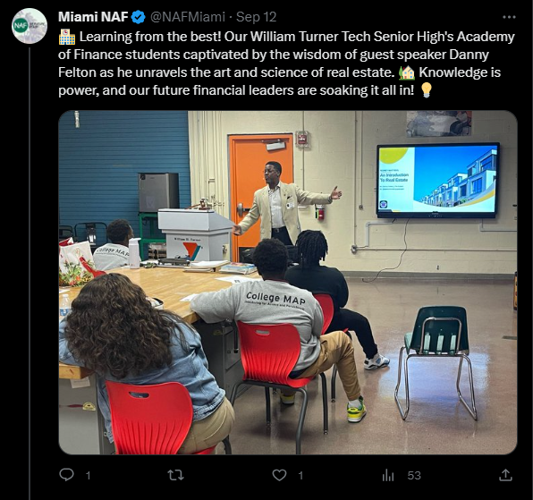
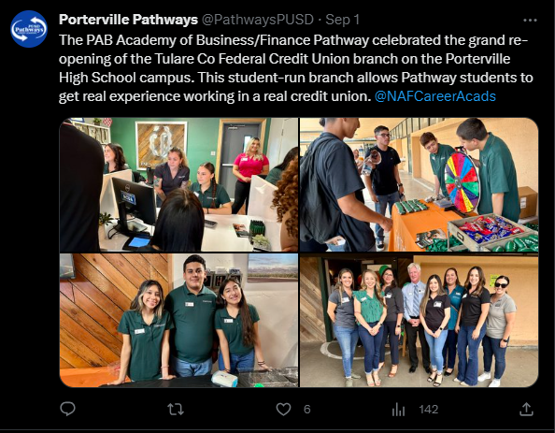
Highlight and Share Academy Activities on Social Media
Posting or reposting on LinkedIn, X, or other social media platforms helps spread the word about what academies are doing and how to get involved!
Notes:
Academies can always use help getting the word out there about what they are doing and also having you highlight the ways you are involved. Please post/repost to your Network!

Slide 12
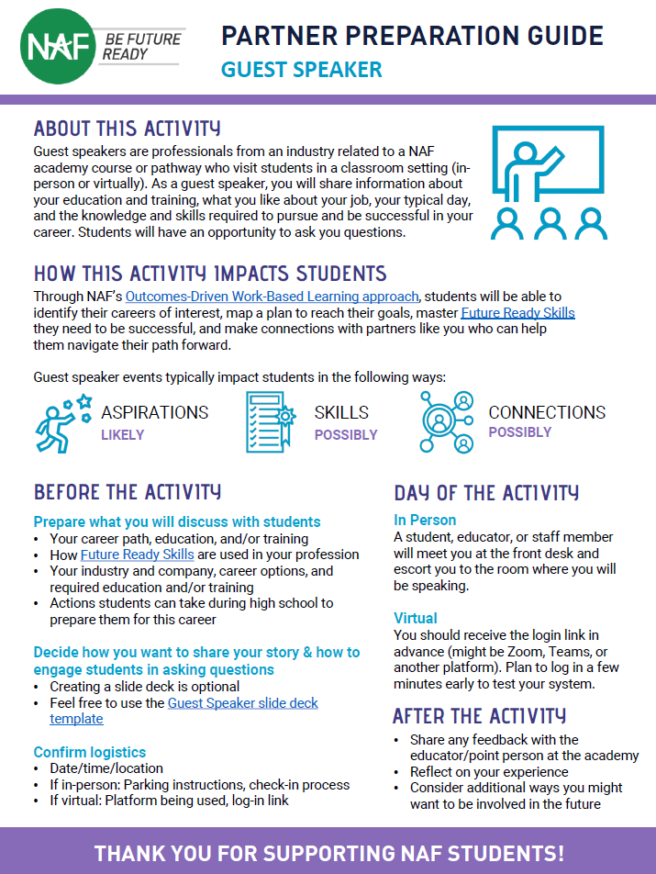
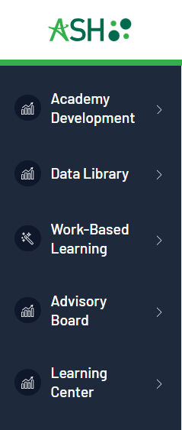
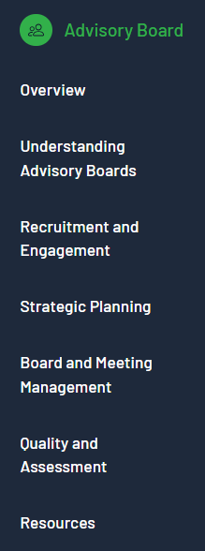
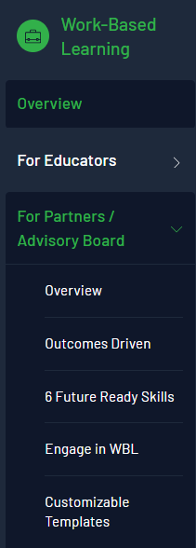
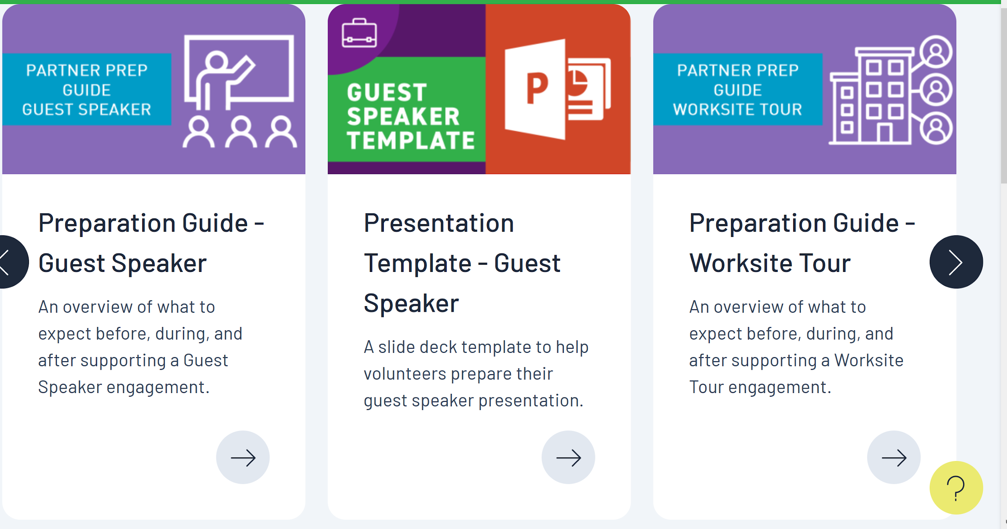
Resources
https://ash.naf.org/public/
Notes:
NAF has created a lot of resources related WBL and Advisory Boards and these can be found on ash.naf.org. They are publicly available and don’t require a log-in. We encourage you to browse!

Slide 13
Next Steps
Connect with the Portfolio Managers for academies in your area (we’ll help introduce you to them)
Think about what involvement would be most meaningful for you
Join the NAF Alumni LinkedIn group (if you’re not already there!) https://www.linkedin.com/groups/4555300/
Start sharing NAF academy highlights on social media
Notes:
Where do you go from here? These are some specific steps we recommend.

Slide 14
Q&A

