Slide 1
AI FOR CREATIVITY
SKILLS WORKSHOP
Notes:
Welcome! Today, we’re going to take a deep dive into several different ways you can use AI for creativity. This will include some activities where you will be testing out AI tools directly. Make sure to have your desktop or laptop computer ready!

Slide 2
HOW TO USE THIS TEMPLATE
This skills workshop can be delivered by a partner or could be co-presented (educator & partner)
Skills workshops count as a Career Exploration activity
Slides you’re not using can be hidden or deleted
Each slide has speaker notes that can be customized and there is also a facilitation guide
The length of the activities can be adjusted as needed

Slide 3
Speaker
Add photo
Name
Title
Company
Email (if you are comfortable listing it)
Notes:
Introduce yourself
Give a brief overview of your career
Talk about how/when you started using AI and how you use it in your job today

Slide 4
Topics for Today
AI overview
AI in the workplace
Ways to use AI to boost creativity
  Brainstorming
  Refining ideas
  Creating visuals (images, videos, etc.)
Notes:
We’re going to explore the following topics:
AI overview – How does AI actually work? How do you access AI tools?
AI in the workplace – What do employers expect when it comes to AI?
Ways to use AI to boost creativity – How can AI help with different creative projects? What are ways it can support brainstorming, refining ideas, and creating visuals?

Slide 5
How many of you are
currently using AI?
Which one(s) are you using and how?
Notes:
Ask students questions to learn more about how they are currently using AI. You can change these questions depending on the situation. If you are delivering this workshop virtually, you can have students answer questions in the Chat.
Some additional potential questions:
How did you get started using AI?
What kinds of tasks have you used it for?
Have you only used it for school or do you use it in other ways?
How comfortable/confident do you feel using AI?
What do you know about AI and how do you feel about it?

Slide 6
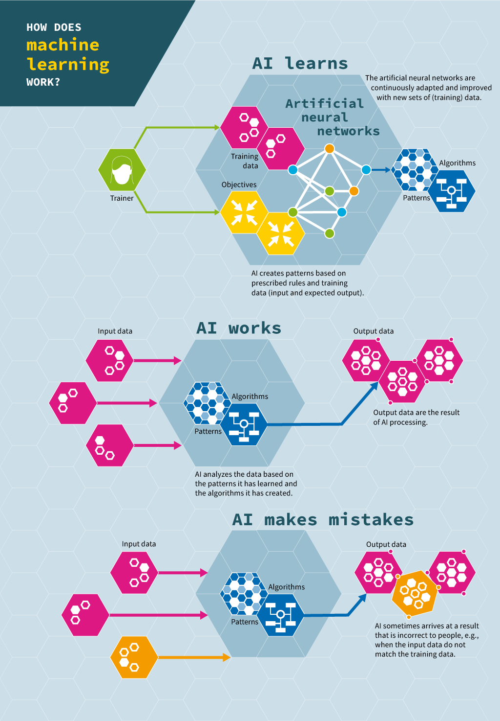

How does generative AI work?
Human trainer
Siemens Stiftung Media Portal for STEM Learning
Notes:
Walk students through the visual so they gain a better understanding of how AI learns and how AI works. Specific elements to point out:
A human trainer decides what to have AI learn on (how much information, what information, where it is, etc.)
AI continuously learns as it gains exposure to more information; it begins to develop pattern recognition
Once AI has learned and been tested, it is released more widely
The user inputs data (“prompt engineering”, then AI uses its knowledge to generate and produce something new
Outputs depend on many factors, including the prompt used, what that AI tool learned on, and other issues
The user can then refine the output by continuing to go back and forth with AI

Slide 7
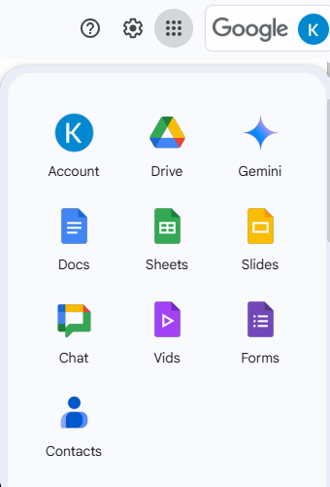
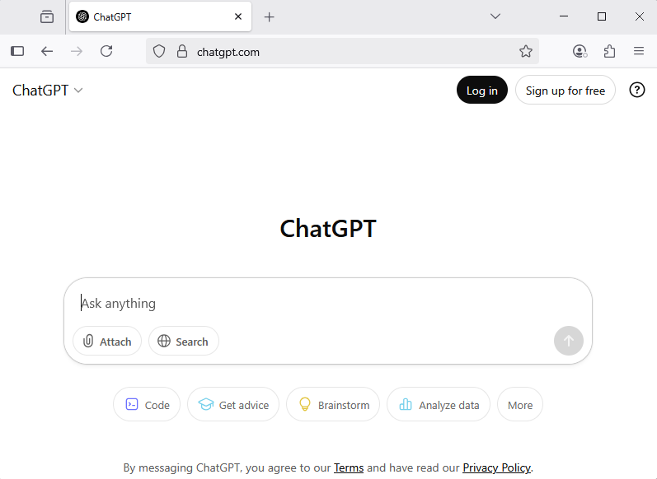
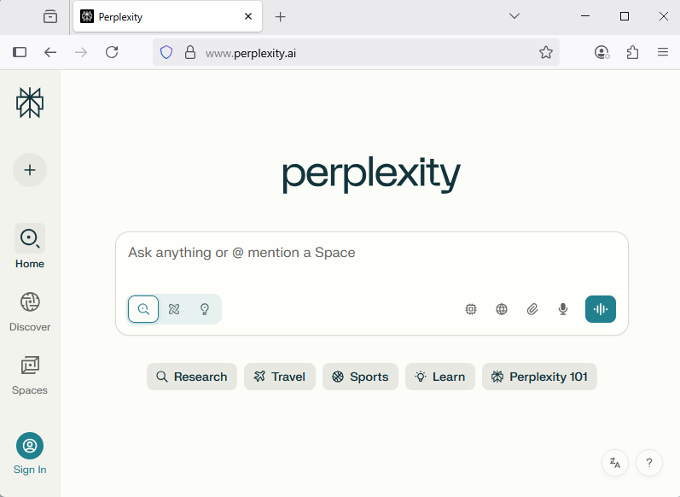
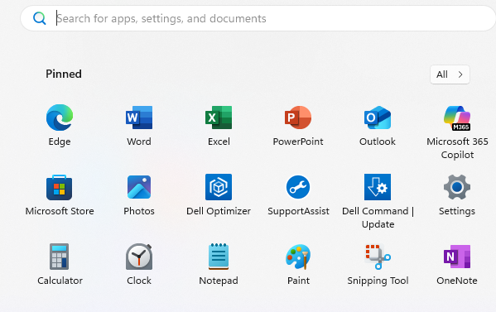
Accessing AI tools
Standalone systems with free and paid account options
AI tools built directly into
other systems
Notes:
There are a number of different AI tools available…over 10,000!
Some can handle multiple kinds of tasks while others are focused on one particular task (for example, editing sound).
The most common structures are standalone systems with free and paid account options and AI tools that are built directly into other systems.

Slide 8
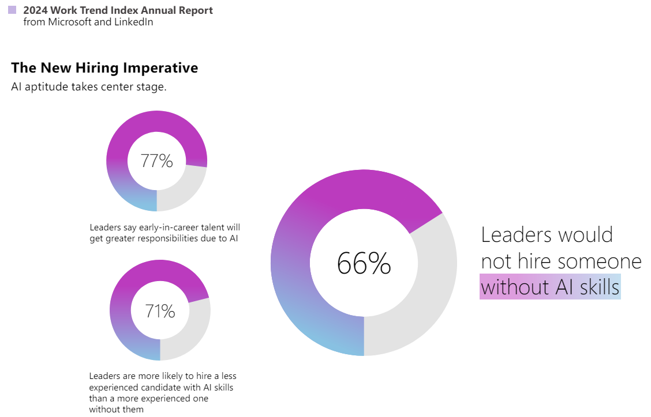

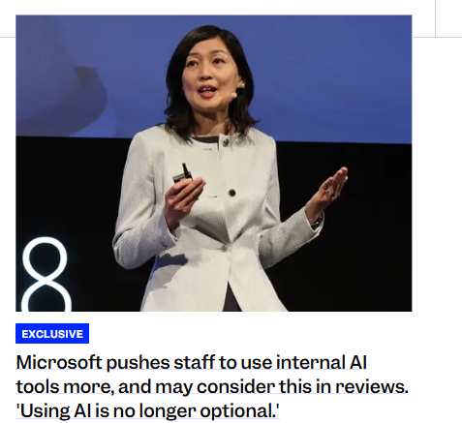
Employers value AI skills
Notes:
Employers now expect new hires to have AI skills that they can apply in their jobs. Questions about how you use AI might be asked during job interviews. The data on this slide really drives that point home and these numbers are even higher now. One key data point here is the fact that 71% of leaders are more likely to hire a less experienced candidate with AI skills than a more experienced one without them. This means that if you can show you have AI skills, you can be a stronger candidate.

Slide 9




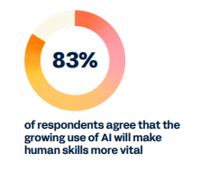

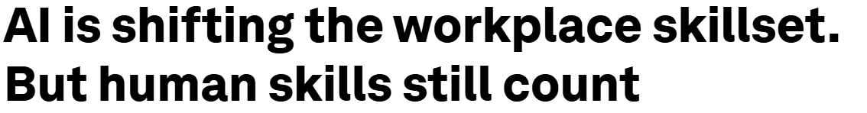
…but employers also still value human skills
Notes:
Employers still want their staff members to have strong communication, problem-solving, collaboration, and other skills. These are becoming even more important as more work incorporates AI elements. These are the exact kinds of skills you are developing in your NAF academy! ☺

Slide 10
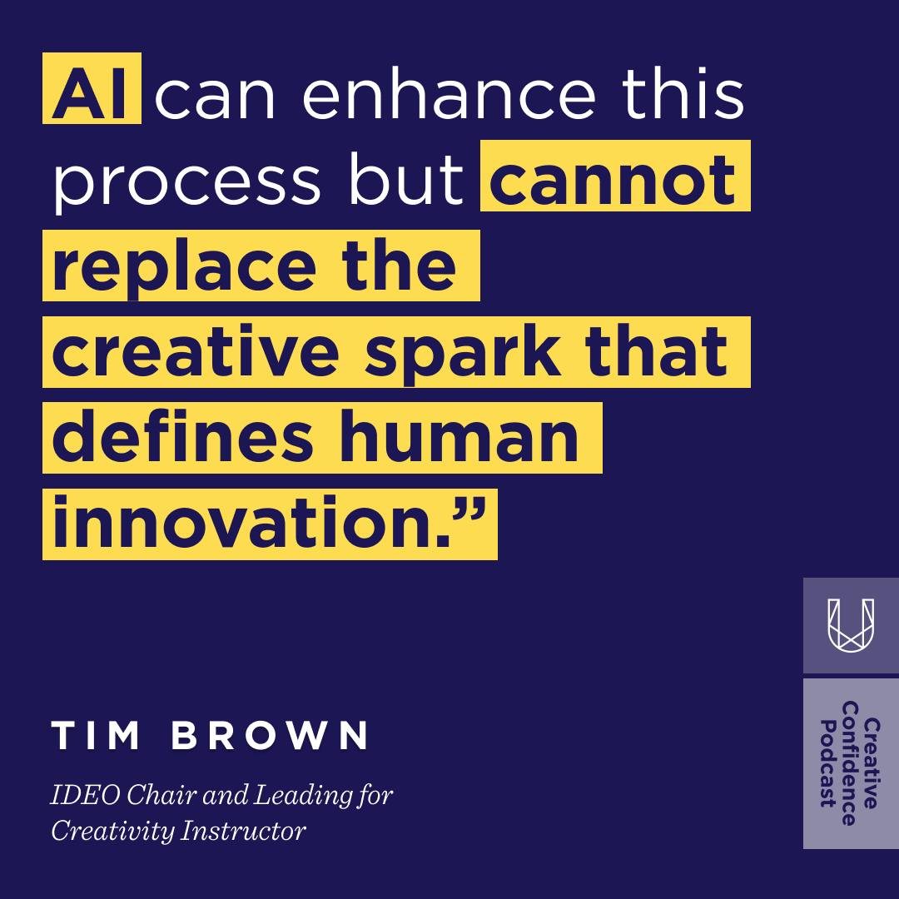
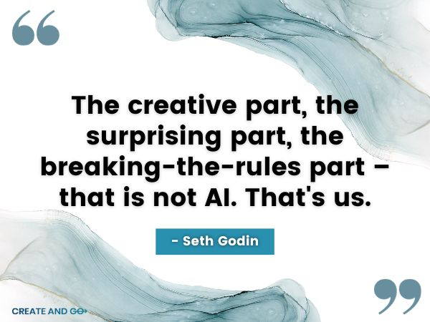
AI as a creativity amplifier, not a human replacement
Notes:
There are a lot of conversations going on within the creative community and beyond about how AI should be used and whether it will take away creative jobs. They are pushing for more regulations around when and how AI can be used. A segment of the creative community is advocating for AI tools to become amplifiers of creativity. Tim Brown and Seth Godin are both leading voices in the design and innovation areas and these quotes capture why the human element is still essential.

Slide 11





Using AI for brainstorming
Spark potential ideas
Be specific
Refine the output
Double-check what is generated
Notes:
AI is helpful for coming up with potential ideas, whether it’s for a small task like a concept for an event or larger ideas like research projects
The more specific you can be in the prompt you enter, the better results you will get
You may need to go back and forth with AI (similar to a conversation) to refine the output
Make sure to check what’s generated and personalize/customize it

Slide 12
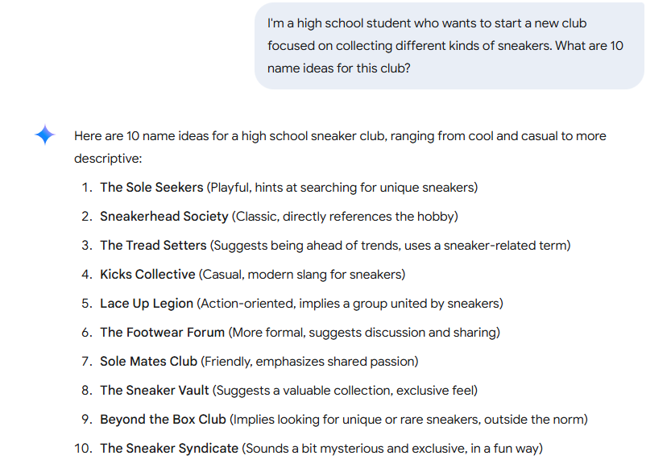
AI brainstorming example
AI used: Gemini
Notes:
This example uses Gemini, Google’s AI tool. Let’s look at some of the elements in this prompt. The user specified a little about who they are (in high school), what their goal is (starting a sneaker collecting club), and asked for a specific number of ideas in the output. Gemini then created those 10 ideas, giving some background on each one. This user could then choose a few to have Gemini expand on or they could decide they don’t like any of these and give Gemini more guidance on what they want.

Slide 13
Let’s try it!
Open a new browser tab and go to one of the following:
https://gemini.google.com/app
https://chatgpt.com/
https://copilot.microsoft.com/
Use AI to brainstorm ideas for one of the following:
  A mascot (for yourself, your family, school, town, etc.)
  A name for a new water bottle
  Menu options for a dessert-themed food truck
What do you think about the ideas AI came up with?
Notes:
Give students about 5-10 minutes for this activity.
Get them set up so they have an AI tool they are using and give them instructions about using that tool to brainstorm ideas based on one of the categories above. Once students have completed the activity, bring them back together and debrief on their experience.

Slide 14



Using AI for refining ideas
Sorts ideas
Assess strengths & weaknesses
Helps identify best option(s) based on your criteria
Notes:
AI can help sort through different ideas, assess strengths and weaknesses, and identify which one(s) might be best.
As with any AI tool, the more specific you are in your prompts about what you want AI to do, the better.
AI can do this with ideas it generates or you can add or upload your ideas to get feedback on. You can even have AI take on different personas (for example, a judge of a competition who is tough and looks for weaknesses).

Slide 15
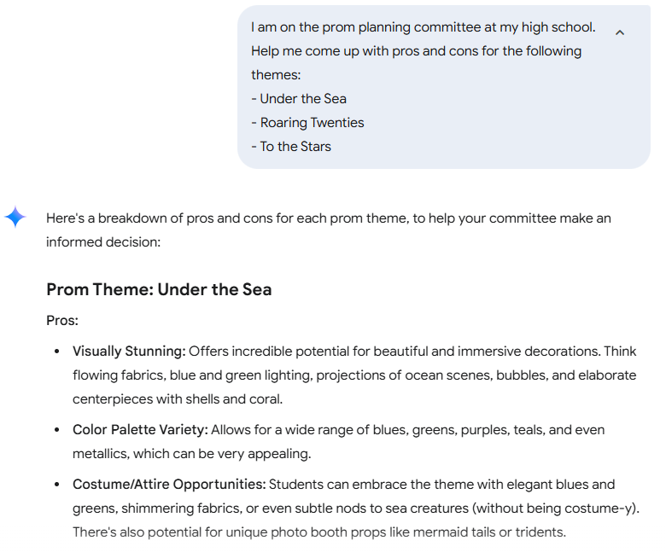
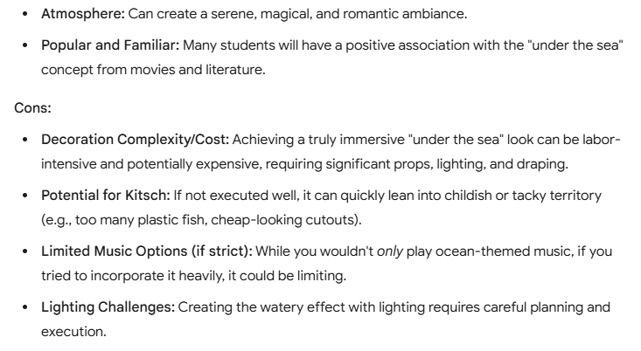
AI idea refining example
AI used: Gemini
Notes:
In this example using Gemini, the user is trying to decide between multiple ideas for a prom theme. If we look at the prompt elements, the user gave Gemini instructions about what output they want (pros and cons). They could have asked for this information in a specific format (for example, a table with different columns) or framed this prompt in a different way (for example, Our prom committee has to present our ideas to the school leadership for approval and we need to rank our ideas).

Slide 16
Let’s try it!
Open a new browser tab and go to one of the following:
  https://chatgpt.com/
  https://gemini.google.com/app
  https://copilot.microsoft.com/
Have AI refine the ideas from the brainstorming session or a new group of ideas you list.
How did this go? What might you do next?
Notes:
Give students about 5-10 minutes for this activity.
Get them set up so they have an AI tool they are using and give them instructions about using that tool to refine ideas. They could do it based on the brainstorming activity they did earlier or they can choose something new and create a prompt focused on a short list of their ideas.
Once students have completed the activity, bring them back together and debrief on their experience.

Slide 17




Using AI to create visuals
Decide on format
Choose the
right AI tool
Think about ethical considerations
Notes:
One of the most wide-spread uses of AI is to generate images and videos
There are general AI tools that can handle bigger picture tasks related to visuals and there are very focused AI tools for specific elements (for example, taking a still image and creating an avatar). Based on what you are trying to create, you can select the AI tool that will best accomplish your goal. Depending on what you are trying to do, you may choose a free tool or a paid tool.
There are a lot of questions, debates, and even lawsuits related to AI image and video generation
Ethical use of AI is key; not replacing artists but being a tool artists can use

Slide 18
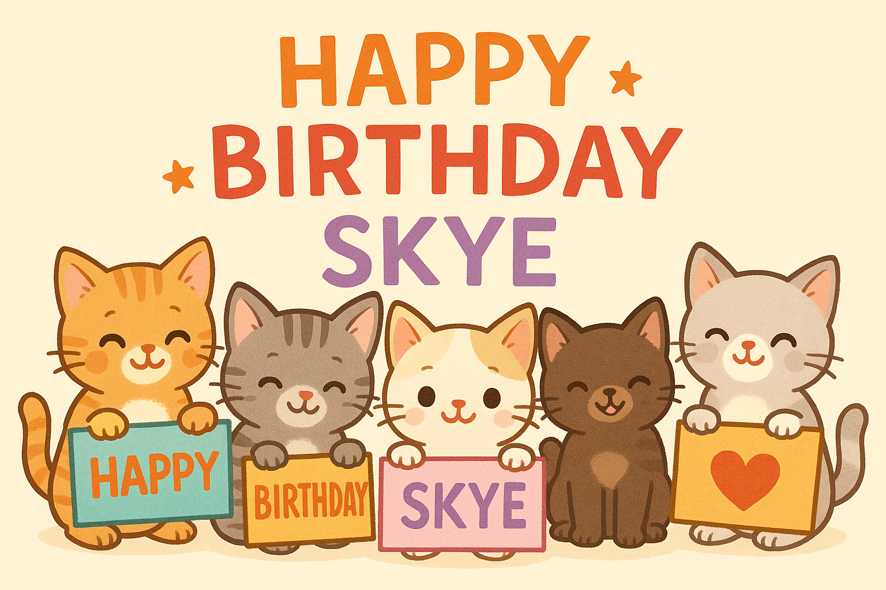
AI image generation example
Prompt: Create an image of a group of cute kittens wishing my friend Skye a happy birthday
AI used: ChatGPT
Notes:
In this example, the user asked ChatGPT to generate an image with specific features (cute kittens, their friend’s name, and wanting to wish them “Happy Birthday.” Different image generators will handle the same prompt very differently based on what they learned on. The user could have given more details initially about the style they wanted ChatGPT to use (drawing, photo-realistic, the number of kittens, etc.) or they could refine it after they see what ChatGPT came up with.

Slide 19
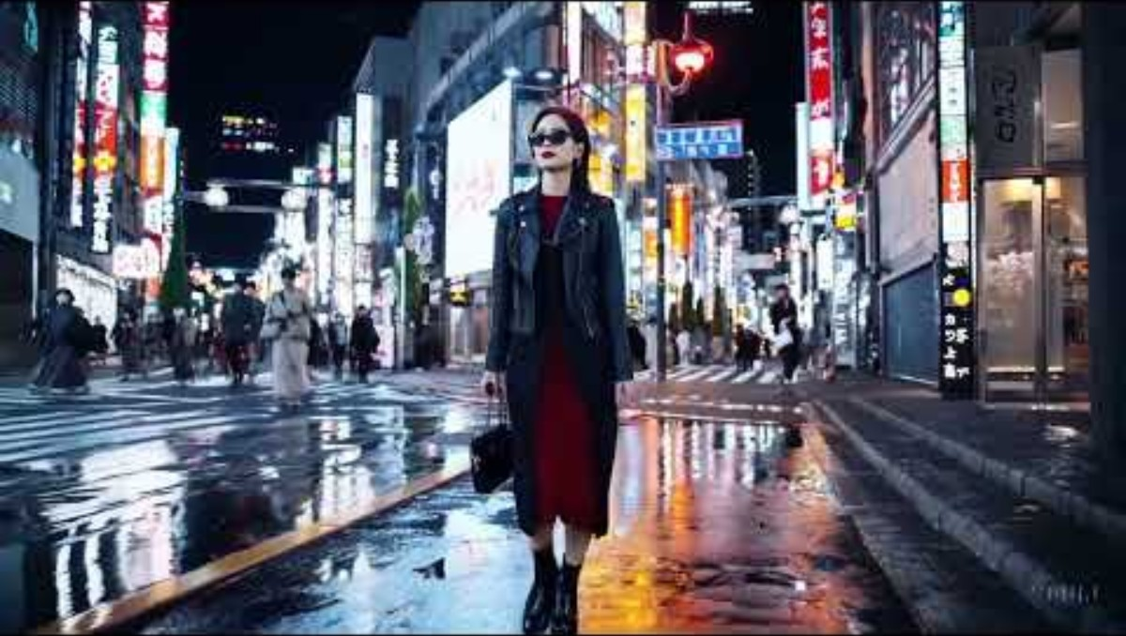
AI video generation example
Example video created by Sora by OpenAI
Prompt: A stylish woman walks down a Tokyo street filled with warm glowing neon and animated city signage. She wears a black leather jacket, a long red dress, and black boots, and carries a black purse. She wears sunglasses and red lipstick. She walks confidently and casually. The street is damp and reflective, creating a mirror effect of the colorful lights. Many pedestrians walk about.
Source: SEO.ai blog
Notes:
AI video generation has advanced dramatically in a very short time. This is Sora, created by OpenAI (the same company that created ChatGPT). By entering a detailed prompt, Sora can generate a short video. Google just came out with their latest tool, Veo 3 and it can create amazing videos. They are 8 seconds each but can be edited together using a separate Google AI tool. These are paid tools. There are plenty of free AI video generator tools available as well.

Slide 20
Let’s try it!
Open a new browser tab and go to one of the following:
Magic Studio - https://magicstudio.com/ai-art-generator/ (no log in needed)
If you want to have the following AI tools generate images, you need to create a free account and log in.
  https://chatgpt.com/
  https://gemini.google.com/app (can use a Google account if you already have one)
  https://copilot.microsoft.com/
  https://www.canva.com/
Enter a prompt to generate an image. Be specific about what you want.
Refine the initial output as needed.
What do you think of what AI came up with?
Notes:
Give students about 5-10 minutes for this activity.
For image generation, they often need to be logged in to an AI tool. Make sure they are set up. Magic Studio usually lets you create a basic image without logging in.
If they need more guidance about what kind of image to generate, you can give them some ideas or they could also use pieces from the earlier activities. Specify that their image should be appropriate for all audiences (it should not contain anything inappropriate).
Once the students complete the activity, bring them back together and debrief. Ask some of them to share their image if they are willing to.

Slide 21



Takeaways
Many different paths and options for using AI
Be thoughtful and ask questions about AI
Be curious!
Notes:
AI can be used in a variety of ways to help amplify creativity.
It is important to use AI in a thoughtful, ethical way. For any AI tool, you can learn more about what information the AI was trained on, how your own information is used, and how that company approaches the ethical use of AI.
Be curious! The more you experiment with AI tools for creativity, the better your skills will be!

Slide 22
Q&A
What’s one new thing that
you learned today?
Notes:
Encourage students to reflect on the activities and the other information covered in the workshop. What is something new they learned? What surprised them most about what they experienced? What are they going to do next?

Slide 23
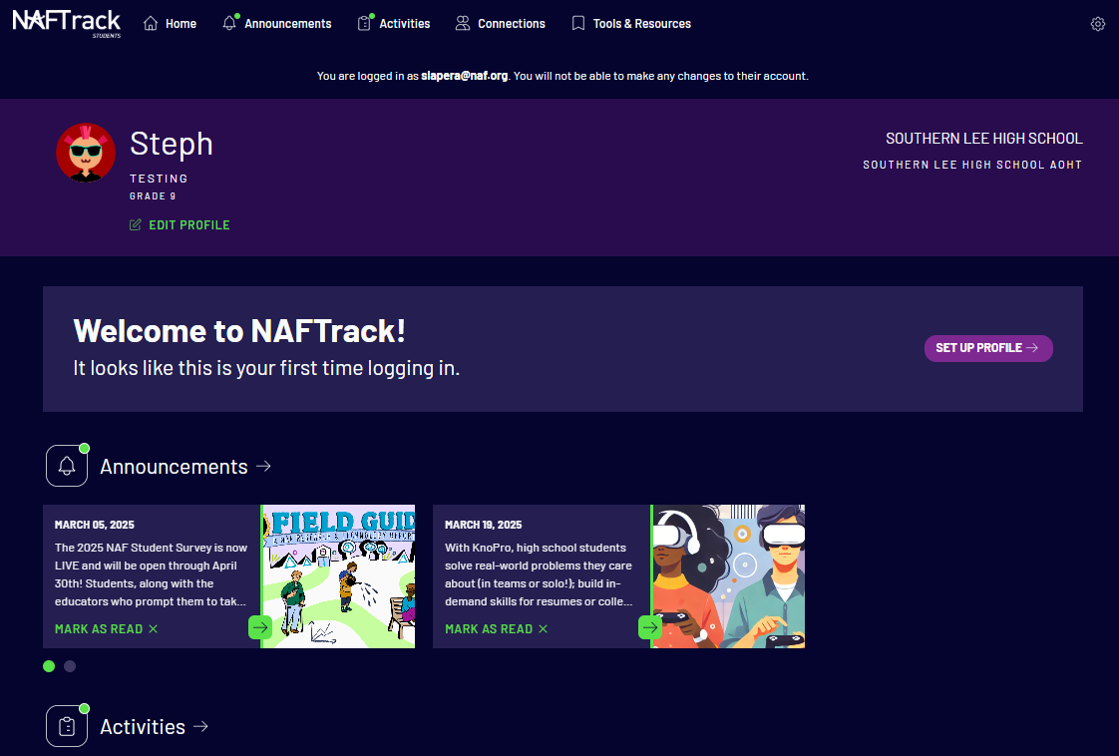
Complete your WBL Reflection Form!
Go to students.naftrack.org
Look for the WBL Reflection Form for the AI for Creativity Skills Workshop in the Activities section
Complete the form
If the form isn’t visible yet, check back tomorrow

