Slide 2
"Closing the Gap: Logistics and Supply Chain Pathways"

Slide 3
"Closing the Gap: Logistics and Supply Chain Pathways"
Patricia V. Richardson, MLSCM
Lean Six Sigma Green Belt
Certified SCPro Fundamentals CSCMP
Certified APICS Global Logistics Associate

Slide 4
AGENDA:
1. Introduction to Logistics and Supply Chain Management
Definition and Scope
Components of SCM
2. Importance of Logistics and Supply Chain
Economic Impact
Real-World Examples
3. Career Opportunities in Logistics and Supply Chain
Job Roles and Titles
Skills and Qualifications
Education Pathways

Slide 5
AGENDA:
4. Addressing the Skills Gap
Current Challenges
Strategies to Close the Gap
5. Integrating Logistics and SCM into High School Curriculum
Curriculum Development
Experiential Learning
Extracurricular Activities

Slide 6
AGENDA:
6. Resources and Support for Teachers
Professional Development
Teaching Materials
Collaboration Opportunities
7. Conclusion
Recap of Key Points
Call to Action
8. Q&A Session

Slide 7
WARM UP:
Activity: "The Journey of a Product“
Where in the world was my _____________ made?
Tell us what mode of transportation did you use to get here?
Name any supplies used in your doctor’s office, hotel, and how much it cost to source the product.

Slide 8
Patricia V. Richardson
Miami Dade County Public Schools (MDCPS)Title goes here
Prichar@dadeschools.net

Slide 9
INTRODUCTION TO LOGISTICS AND SUPPLY CHAIN
• Definition and Scope:
Explain what logistics and supply chain management (SCM) are.
Discuss the importance of logistics and SCM in the global economy.
• Components of SCM
Procurement Manufacturing
Distribution Inventory management
Transportation Information systems

Slide 10
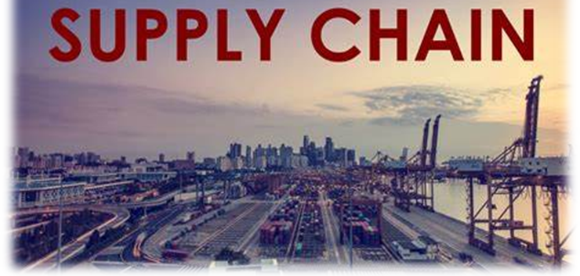
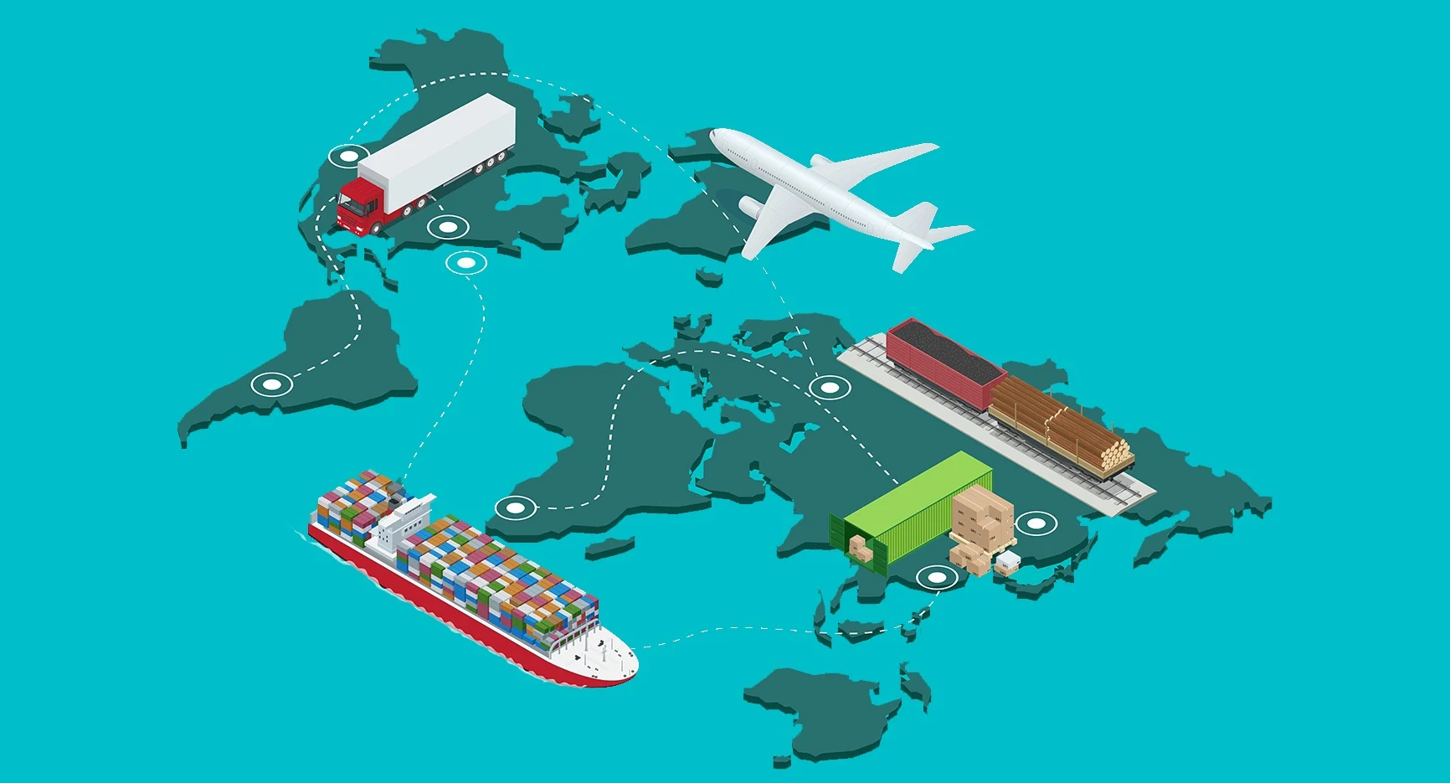
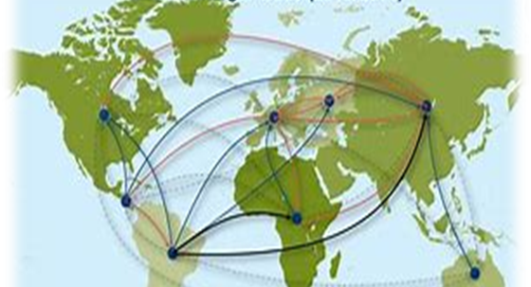
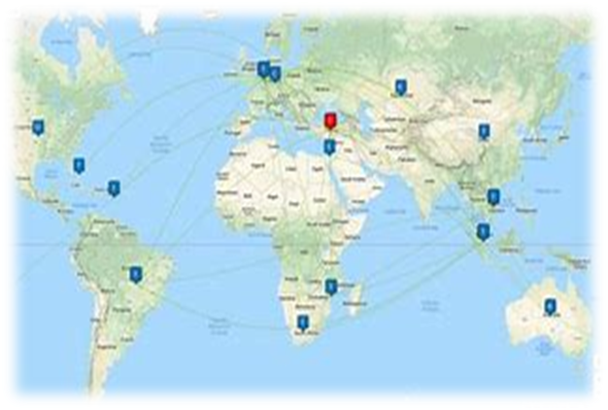
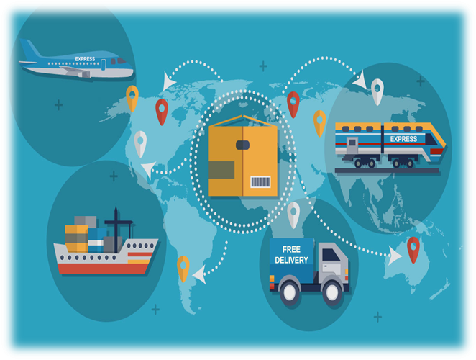
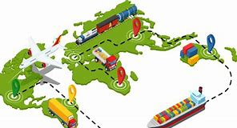

Slide 11
IMPORTANCE OF LOGISTICS AND SUPPLY CHAIN
• Economic Impact
Contribution to global and local economies.
Job creation and variety of roles within the industry.
• Real-World Examples
Case studies of successful companies (e.g., Amazon, Walmart).
Impact of efficient supply chains on product availability and cost.

Slide 12
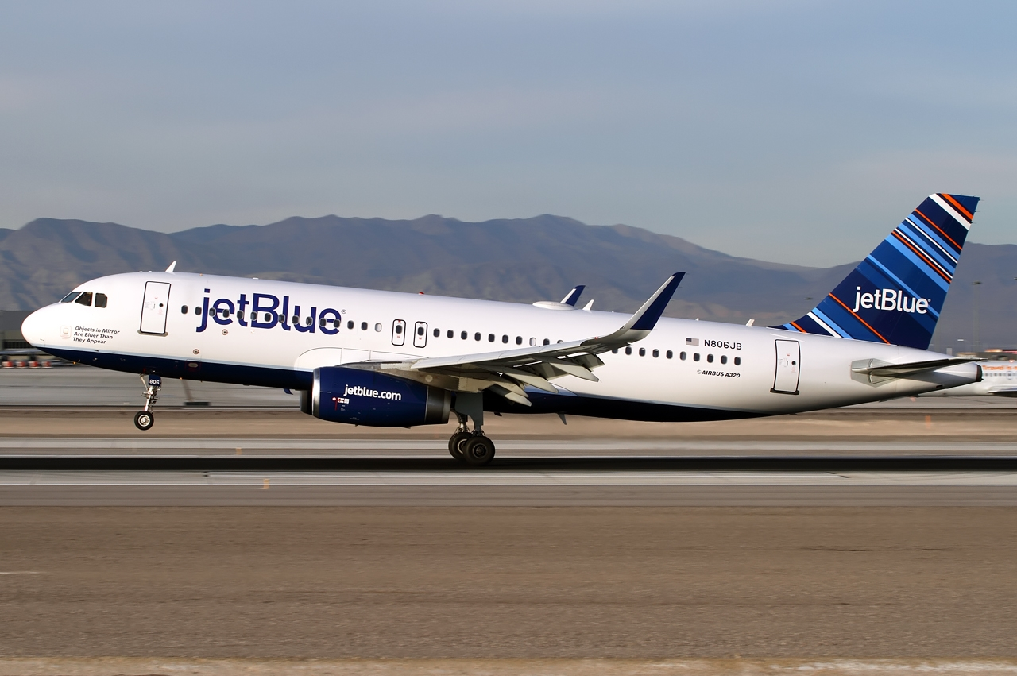
AIR TRANSPORTATION

Slide 13
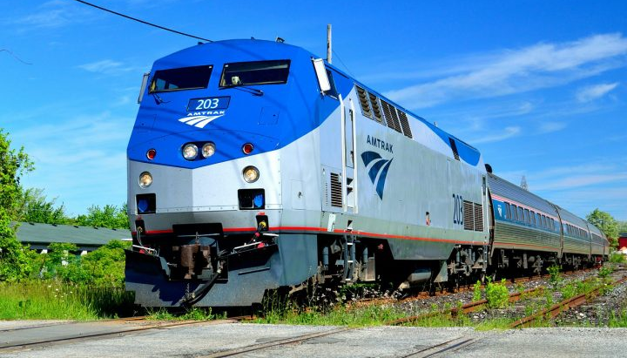
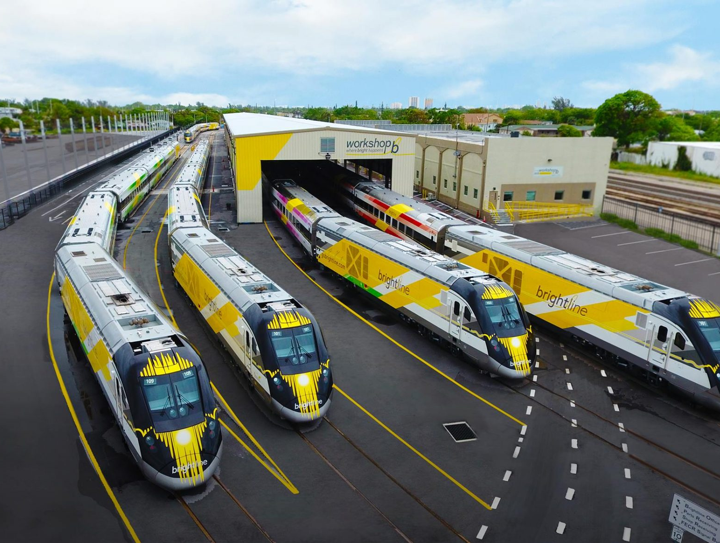
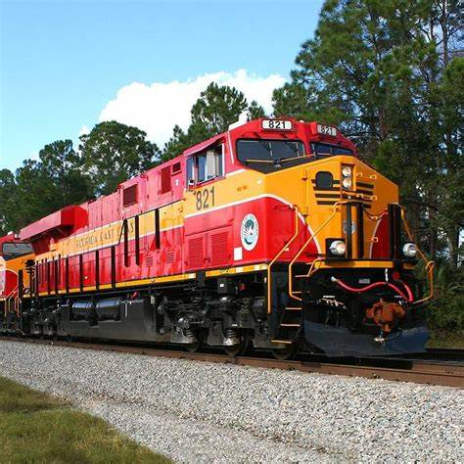
Rail Transportation
This Photo by Unknown Author is licensed under CC BY-ND
This Photo by Unknown Author is licensed under CC BY-NC-ND
(Import – Export)
Florida Railroad
CSX
Florida East Coast Railway
Intra –Inter State Trucking
Drone Delivery

Slide 14
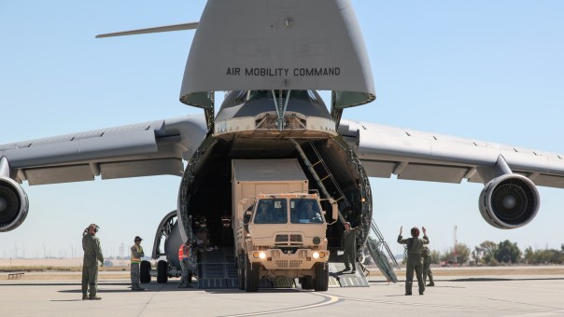
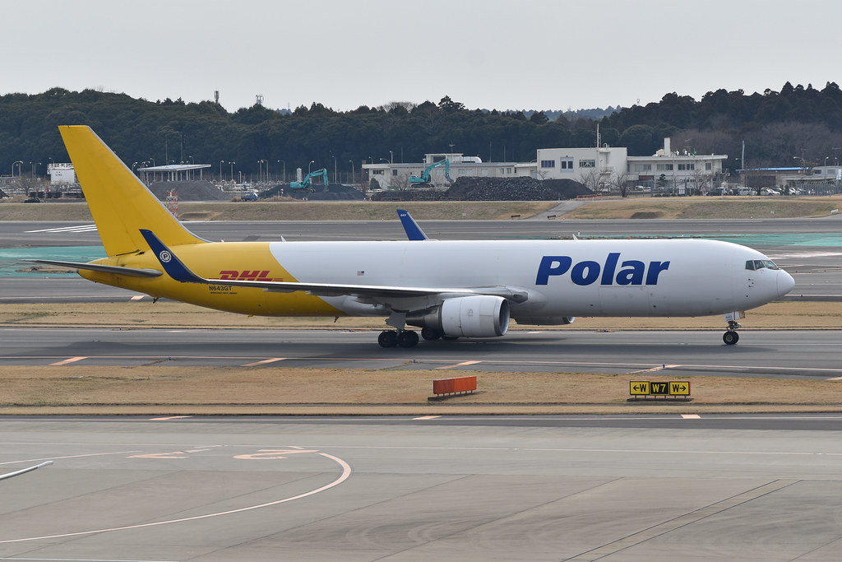
Air Transportation – Cargo
USA Military
This Photo by Unknown Author is licensed under CC BY-SA

Slide 15
VIDEOS:
Bing Videos Manufacturing Coca Cola
https://youtu.be/P7fi4hP_y80 BMW Car Factory ROBOTS

Slide 16
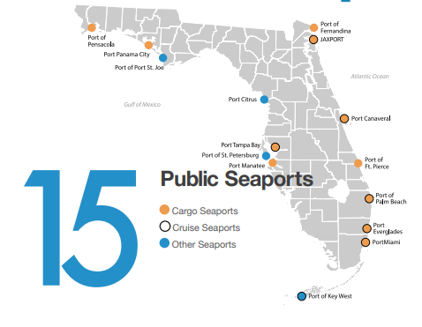
Sea Transportation – Cargo

Slide 17
Types of Pipeline Transportation
Oil and gas pipelines
Slurry pipelines
Water and sewer pipelines
Beer pipelines
Hydrogen pipeline
Pipelines for other liquids/solid particles using air
https://bit.ly/4bnBrpK
https://bit.ly/3OnVbzK

Slide 18
INTEGRATING LOGISTICS AND SCM INTO HIGH SCHOOL CURRICULUM
• Curriculum Development
Examples of logistics and SCM modules or courses.
Incorporating case studies and real-world projects.
• Experiential Learning
Field trips to warehouses, distribution centers, and manufacturing plants.
Guest speakers from the industry.
• Extracurricular Activities
Logistics and SCM clubs or competitions.
Participation in national or regional supply chain events.

Slide 19
Supply Chain Skills
Supply chain planning
Commitment to quality
Time management
Knowledge of
e-commerce

Slide 20
CAREER OPPORTUNITIES IN LOGISTICS AND SUPPLY CHAIN
• Job Roles and Titles
Logistics coordinator, supply chain analyst, procurement manager, etc.
Emerging roles in technology and data analytics.
• Skills and Qualifications
Technical skills (e.g., inventory management software, ERP systems).
Soft skills (e.g., problem-solving, communication).
• Education Pathways
Relevant high school courses (e.g., business, IT, mathematics).
Post-secondary options (e.g., vocational training, college degrees, certifications).

Slide 21
CAREER OPPORTUNITIES IN LOGISTICS AND SUPPLY CHAIN
LHH — www.lhh.com
ASCM — Supply Chain Salary and Career Survey Report | ASCM ascm.org
BLS.gov — Logisticians : Occupational Outlook Handbook: : U.S. Bureau of Labor Statistics bls.gov

Slide 22
CAREER OPPORTUNITIES IN LOGISTICS AND SUPPLY CHAIN
Logistics manager
National average salary: $68,225 per year
Purchasing manager
National average salary: $78,483 per year
Process engineer
National average salary: $87,550 per year
Supply chain manager
National average salary: $89,569 per year
Transportation director
National average salary: $97,636 per year
Commodity manager
National average salary: $98,627 per year

Slide 24
ADDRESSING THE SKILLS GAP
• Current Challenges
Shortage of skilled professionals in logistics and SCM.
Mismatch between industry needs and educational output.
• Strategies to Close the Gap
Enhancing curriculum to include logistics and SCM topics.
Partnering with local businesses for internships and apprenticeships.
Encouraging industry certifications (e.g., APICS, CSCMP).

Slide 25
RESOURCES AND SUPPORT FOR TEACHERS
• Professional Development
Workshops, online courses, and certifications for teachers.
• Teaching Materials
Textbooks, online resources, and simulation tools.
• Collaboration Opportunities
Networking with industry professionals and educational organizations.

Slide 26
College and Universities
https://www.intelligent.com/best-supply-chain-management-degree-programs/
https://business.fiu.edu/fiubusiness/mslscm-online/
https://www.mdc.edu/supplychainanalytics/default.aspx
https://www.broward.edu/academics/imct/supply-chain/
https://blog.collegevine.com/us-colleges-with-supply-chain-management-major/

Slide 27
RESOURCES
https://www.bls.gov/ooh/production/home.htm4
Supply Chain Career Paths – Forbes Advisor
Supply Chain | Industry Week
https://www.indeed.com/career-advice/finding-a-job/supply-chain-career-path
https://bit.ly/47ZJ0jt
https://www.youtube.com/watch?v=Mi1QBxVjZAw&list=PLCD3E338A3E58E906&index=1
https://bit.ly/3vUZXOy
https://bit.ly/3vUZXOy
https://www.bls.gov/ooh/transportation-and-material-moving/home.htm
https://www.transportation.gov/

Slide 28
Supply Chain Sustainability

Slide 29
CONCLUSION
• Recap of Key Points
Importance of logistics and SCM.
Career opportunities and required skills.
Strategies for integrating SCM into education to close the skills gap.
• Call to Action
Encourage teachers to incorporate logistics and SCM topics in their teaching.
Highlight the importance of continuous learning and adaptation to industry trends.

