Slide 1
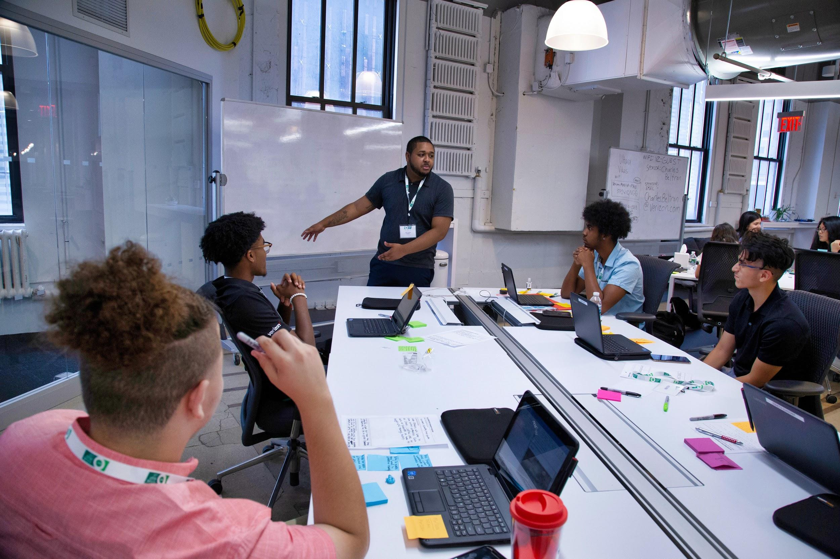
Guest Speaker Training
JANUARY 2021
Notes:
Hello and welcome. Thank you for agreeing to be a guest speaker.

Slide 2
Training Agenda
NAF Overview and Introductions
College and Career Readiness Skills
Logistics and Expectations
Best Practices
Follow - Up Items
Questions and Contact Information
Notes:
Guest speakers are a key part of work-based learning and we are thrilled that you are volunteering your time to speak to NAF students. Here is the agenda for the training. We hope this training provides you insight into what NAF as an organization does, and what is expected of you in your role.

Slide 3
NAF Overview
NAF solves some of the biggest challenges facing education and the economy by bringing education, business, and community leaders to transform the high school experience.
Notes:
NAF is a national network of education, business, and community leaders who work together to ensure high school students are college, career, and future ready. Since 1982, NAF has been partnering with existing high schools to transform the high school experience, ignite students’ passion for learning and give businesses the opportunity to shape America’s future workforce.
Too many students, especially minorities living below or near the poverty line, are disengaged because they don’t have strong mentors in their lives and they don’t understand the relevance of their high school education.
In the meantime, businesses are struggling because they have limited access to a diverse, well educated, and future ready workforce – hindering their ability to compete in a global economic landscape.
A staggering one-third of America’s unemployment rate is due to the growing chasm between employee skills and open jobs. While the number of available jobs is increasing, the number of people qualified to fill them is not.
We envision a world in which all young people have equal opportunity for successful futures and businesses have a highly-skilled and diverse workforce.

Slide 4
Academy Information
Placeholder for Academy Information
Include information such as number of students in the academy, mission statement, internship information, etc.

Slide 5
College and Career Readiness Skills
NAF partnered with industry leaders to identify skills required for student’s postsecondary and career success. Eight skill categories were identified and developed through the academy experience. When students go through an internship, they are also assessed by their supervisors on these skills.
As you work with NAF students and develop your guest speaking session, keep these skill areas in mind.

Slide 6
Guest Speaker – Benefits
Expose to various careers
Network with professionals
Enhance college and career readiness skills
Enhance knowledge of different companies and career fields
Increase industry knowledge
Introduction to a diverse talent pipeline
Showcase career opportunities within your organization or field
Elevate your company’s reputation in the community
Gain fresh perspective from student interns
Opportunity for ongoing interaction and mentorship with students in the community
For NAF students
For Guest Speakers

Slide 7
Guest Speaker – Roles and Responsibilities
Lead session to support students’ career interest and course content by applying individual and professional career expertise
Share industry insight and expertise during an interactive session with students
Cover specific topics as stipulated by the planning arrangements
Lead engagement which typically lasts one hour in length

Slide 8
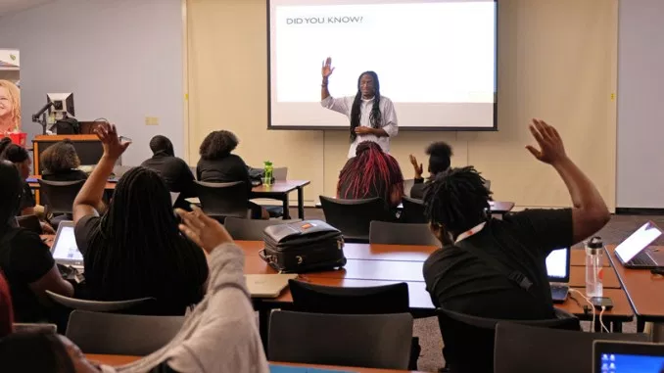
Guest Speaker – Preparation and What to Expect
Calendar invitation
(agree on a technology if virtual)
Check-in/reminder email with logistical information one-week prior to engagement
Notes:
In addition to a confirmation email one month prior to your engagement, you should receive a calendar invitation from the planning contact that reflects the day, time, and location for the guest speaking engagement.
You can also expect to receive an email the week before your engagement that will supply any additional logistical information for your arrival and your engagement. If the engagement is virtual, you should have received technology platform and call information. Make sure to test this out to be sure of access as well as audio/video functionality.

Slide 9
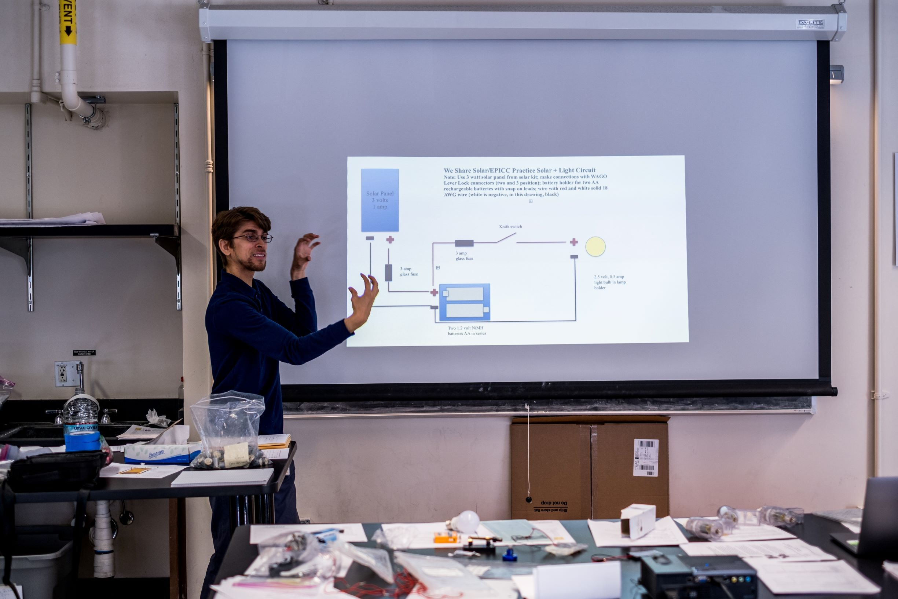
Guest Speaker – Sample Agenda
5 min
Students seated, attendance taken, guest speaker introduced
30 min
Interactive presentation
5 min
Q&A
10 min
Students network with guest speaker
Notes:
There is a specific format that NAF recommends for guest speakers - this of course is to be worked out between the guest speaker and the planning point of contact:
The first 10-15 minutes should be spent with the speaker introducing themselves to interns in a personal way, allowing them to get to know who the speaker is, how they became interested in this field and their journey into their role within their business/organization.
The remaining time should focus on their area of expertise or the content which has been requested by the planning point of contact. What can interns learn from you that they can use both immediately and also in the future? If you have templates or strategies to store information, please share with the students. You may be introducing them to a new tool they haven’t used before that will enhance their technical skills.

Slide 10
Guest Speaker – Best Practices
Be personable and relatable – share personal anecdotes and stories
Encourage intern participation and interaction, this is especially important for a virtual engagement where research says interactivity should be incorporated at least every 7 minutes.
Share a new tool or skill to assist interns with their classwork and explain how it will be useful to them

Slide 11
Guest Speaker Virtual Engagements – Best Practices
Agree on a technology platform that will work for both the guest speaker and students. Many districts and companies have restrictions on which platforms can be used. Test before the engagement.
Be efficient by sending any prep materials or activity sheets ahead of time so that these can be distributed to students and they can be ready to engage
Encourage participation and interaction of students by starting with an icebreaker, facilitating discussions, calling on students, checking-in to assess understanding, by completing an activity, and by utilizing interactive tools (whiteboard, quizzes, polls, etc.) Click to view recommended tools
Notes:
Some additional best practices for virtual engagements:
A virtual engagement should not exceed 90 minutes, and interactivity should be incorporated at least every seven minutes. This can be done through chat, polls, whiteboards, Q&A, an activity, a breakout session, use of emojis and more!
Reinforce relationships and energize your audience by kicking off with an icebreaker or with a 5-10-minute personal introduction. Share your education and career journey, hobbies, and any other information that might spark relatability and student interest.
Use video to personalize the conversation and keep students engaged.

Slide 12
Guest Speaker – Working with Academy Students
Extend respect to students and expect students to reciprocate - don’t talk “down” to students.
Share personal stories of your own educational and career journey - both the struggles and the successes. Brief narratives of your experiences can be engaging and informative.
Help reinforce the importance of college and career readiness skills (slide 5).
Model professionalism and other career-ready skills. While the classroom atmosphere is more casual, please wear your usual workplace attire and model the skills you expect from your employees and colleagues (attire adjustments for virtual engagements).
Remember to use the academy theme as a context for learning. Use every opportunity to draw connections between academy theme, your specific work, and the industry as a whole.
Show examples of your work and engage students by using visuals and artifacts.
Keep the presentation interactive by having students move, speak, and get involved.
Present without worries since an educator will be present to deal with any unexpected behavior management issues.

Slide 13
Guest Speaker – Preparation Checklist
Reach out to the planning contact in case of a scheduling change
Test out any technology prior to a virtual engagement
Send any prep materials or activities for students at least one week prior to your engagement
Have the planning contact review your engagement content and agenda, if time allows
Double-check that your engagement is interactive and participatory (see best practices)
Bring business cards to hand out (optional)
Notes:
If something comes up and you are no longer able to keep your speaking engagement, please contact the planning contact as soon as possible to reschedule, or even pre-record a session to provide in place of a live engagement.

Slide 14
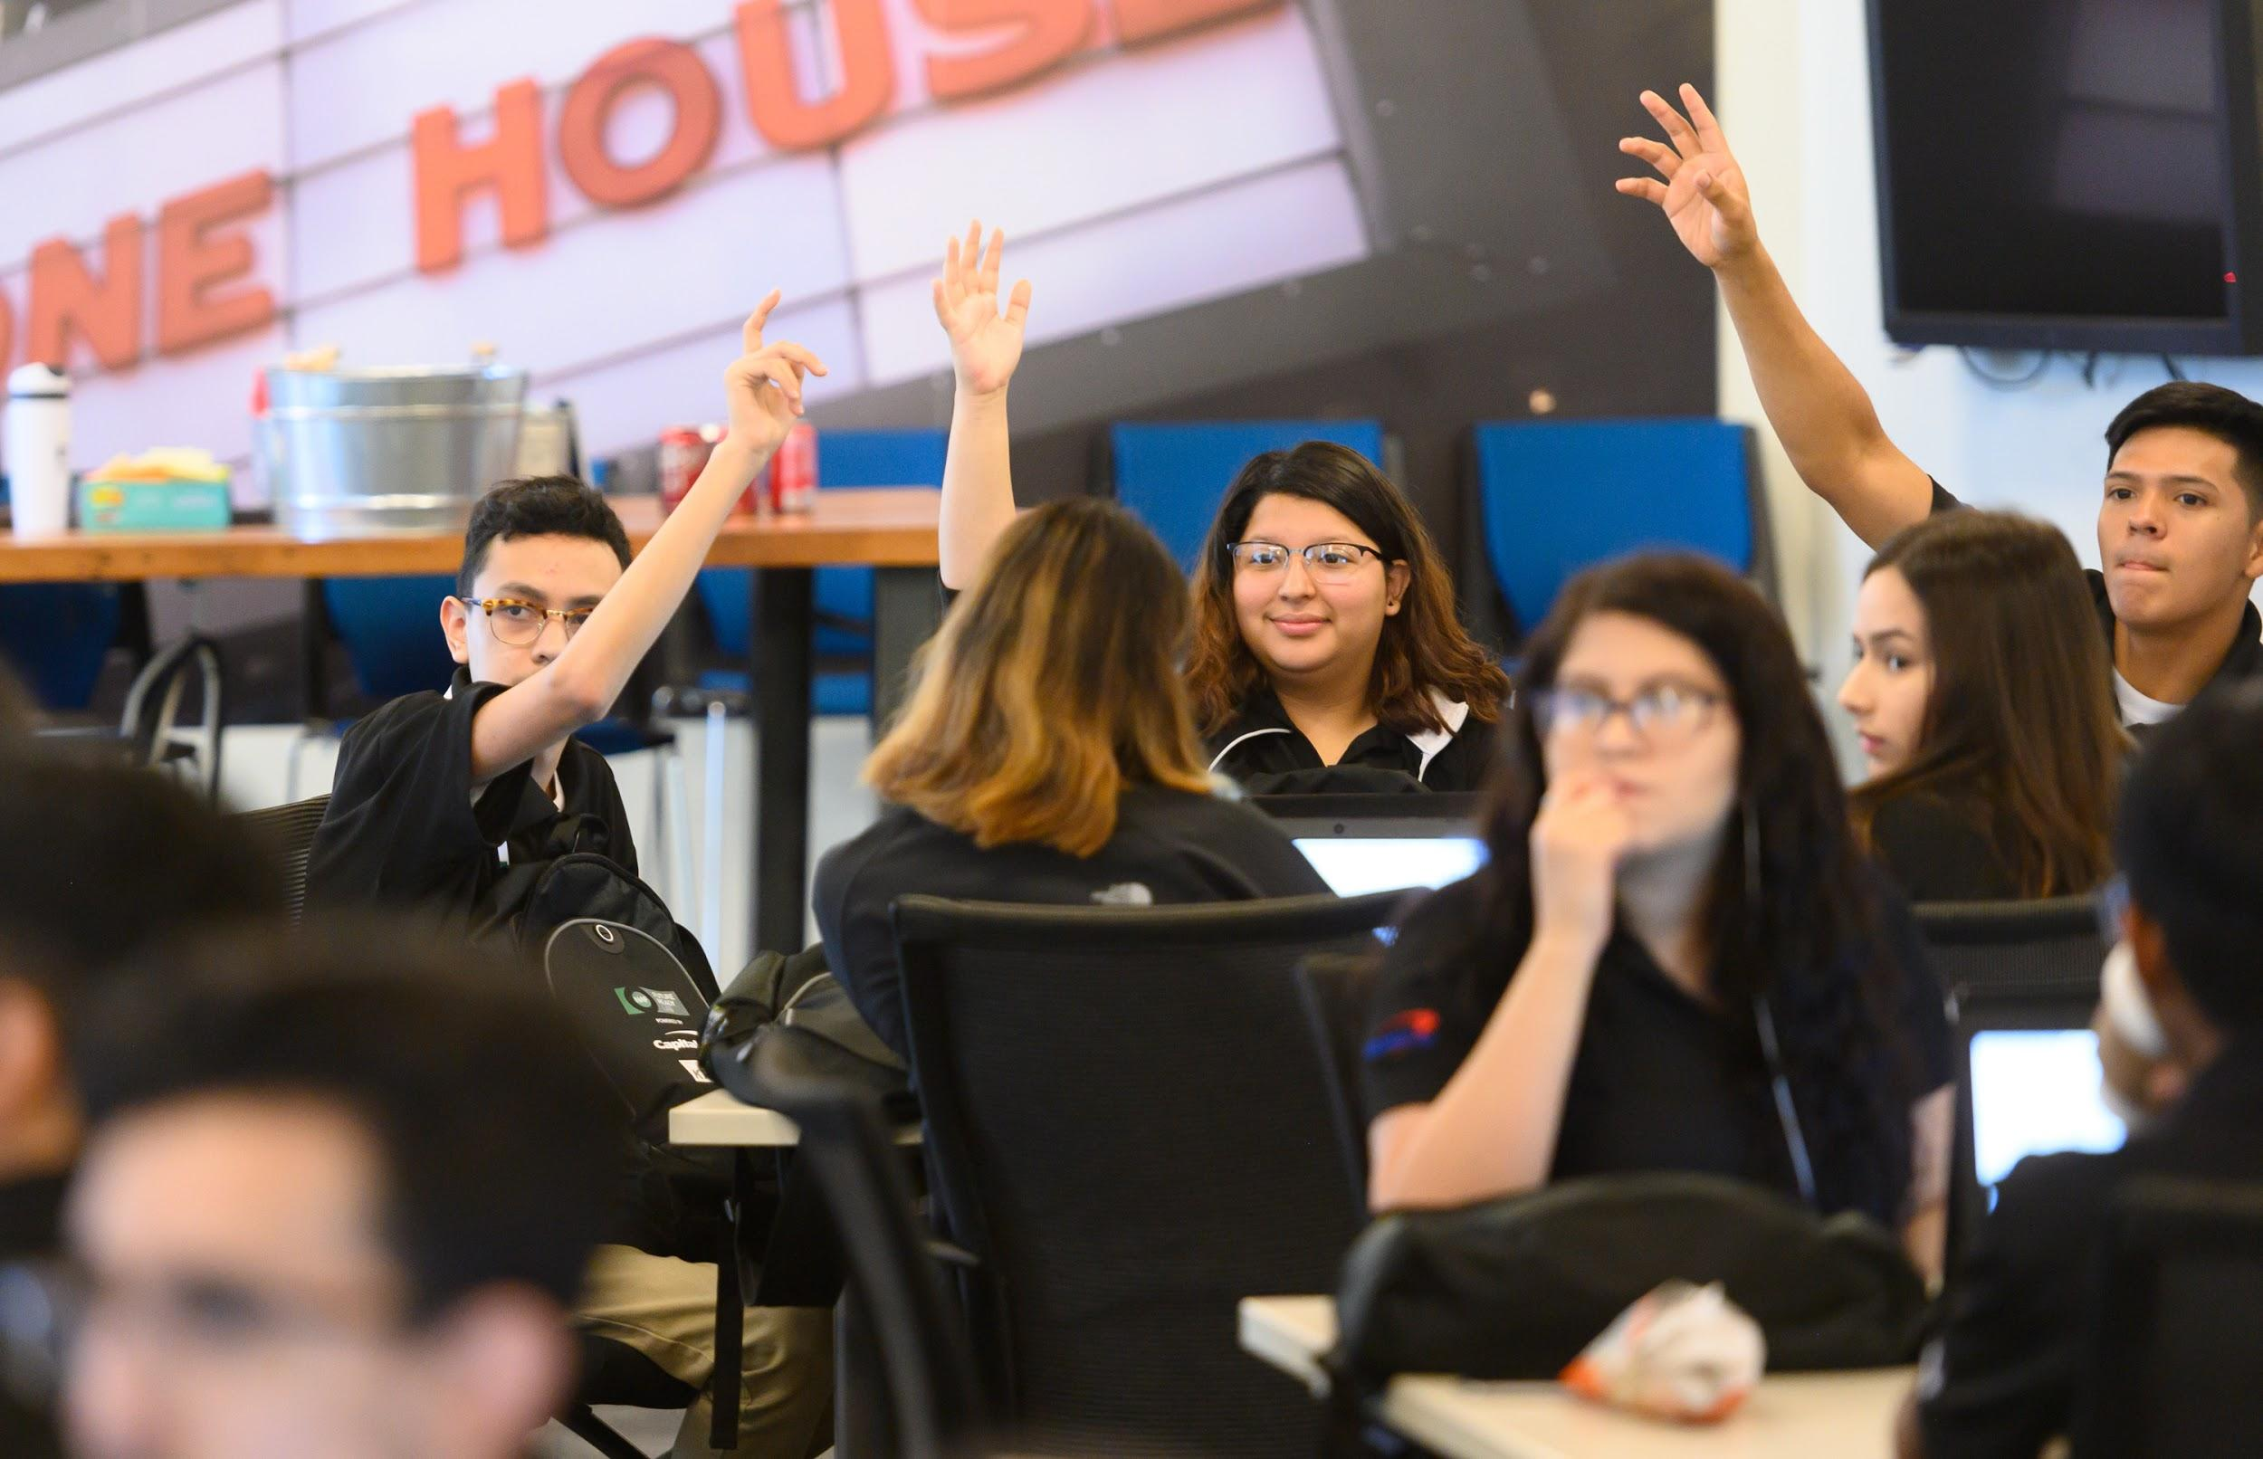
THANK YOU!
Notes:
Thank so much for the time you are dedicating to our NAF students. We believe this will be a transformative experience for all who are involved.

