Slide 1
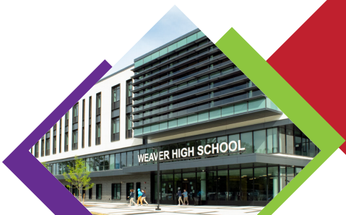
Weaver High School: Insurance & Finance (I&F) Pathway
Industry Advisory Board Supported Activities (as of 9/12/22)
DRAFT
 | Academic Success Committee: Classroom Engagement Cameron, John, Rachel |  | Strong Culture Committee: Student Support Enzo, Kevin, Ethan, Trudy |  | Career Readiness Committee: Professional Support Jeff, Jocelyn, Tara, Cindy, Keith
 | Activity | Outcome | Activity | Outcome | Activity | Outcome
9th I&F pathway awareness |  |  | 9th grade pathway sign up week | Increase exposure to I&F and # students selecting pathway | Industry site tours RoadTrip Nation & MyPath | Exposure to insurance and finance job sites
10th Internship awareness & exploration | Teacher externships | Teacher professional development Introduction to industry experts |  | Develop social skills, encourage academic achievement, and provide life-enriching experiences for students | Basic Microsoft training Presentation Skill Development Resume & Interview support Mock Interviews JA Job Shadows PELabs | Obtain understanding of workplace cultures and basic skills Develop professional skills and experience in I&F All Students will start resumes. Students will receive feedback/rubric following interviews. X% of students will job shadow and present to students
11th Internships | ID additional certs. Case competition | Skill development & resume booster Team work & public speaking | Provide business attire | + Mentor review resume, student profile, and college essays | Future Ready Lab (incl. Info. Mtg) Mock Interviews Traditional Internships | Obtain work experience
12th Post grad. preparedness | Capstone support | Capstone aligned with industry | Provide business attire | + Mentor help with interview prep. | Traditional Internships Future Ready Lab | Prepare for job or college Obtain work experience
Goals | Graduate with NAF Accreditation |  | Cultivate a network of I&F professionals to support student growth |  | College or Workforce Readiness for I&F Career
NAF Compliant
Mentorships
I&F branded items
Industry Speakers (curriculum specific)
+New Member/Partnership Recruitment: Susan, Rachel, Jocelyn, Tara
Notes:
+Sustainability committee (new members)
Ensure NAF/state approved curriculum is in place and that students are completing program of study

