Slide 1

Big Energy Saving Network
Training Presentation
[insert your name and job title / team here]

Slide 2
Introduction
In the chat box please introduce yourself:
What is your name?
Which organisation you are from and what is your role?
Have you delivered energy advice before?
What are you hoping to learn today?

Slide 3
Optional Contents Slide
[insert heading] | [insert slide number]
[insert sub heading] | [insert slide number]
[insert heading] | [insert slide number]
[insert sub heading] | [insert slide number]
[insert heading] | [insert slide number]
[insert sub heading] | [insert slide number]
[insert heading] | [insert slide number]
[insert sub heading] | [insert slide number]

Slide 4
Optional Agenda slide
Timings | Agenda
[insert time here] | [insert item name here] – [insert description here]
[insert time here] | [insert item name here] – [insert description here]
[insert time here] | [insert item name here] – [insert description here]
[insert time here] | [break]
[insert time here] | [insert item name here] – [insert description here]
[insert time here] | [insert item name here] – [insert description here]
[insert time here] | [insert item name here] – [insert description here]

Slide 5
Your organisation
Please draft a short slide introducing yourself and your organisation. This is a good opportunity to establish your credibility, as well explaining how you could help clients in the future.

Slide 6

Fuel Poverty
“Low income households that cannot afford to heat their homes and meet their other energy needs”

Slide 7
What is fuel poverty?
Different approaches to measuring fuel poverty in England and Wales
New low income/low energy efficiency (LILEE) definition about to be introduced in England
Will replace the low income/high fuel costs (LIHC) definition
England: A household is in fuel poverty if:
The energy performance certificate (EPC) rating of their property is less than EPC Band C AND
Their net disposable income after housing costs is below the poverty line
Wales: A household is in fuel poverty if:
They have to spend more than 10% of their disposable income (before housing costs) on maintaining a satisfactory heating regime and meet their other energy needs
Note: definition is based on required fuel expenditure NOT actual fuel expenditure

Slide 8
How many people are affected?
England:
3.66 million households (2016) on LILEE definition
16% of all households
Wales:
155,000 households (2018) on 10% definition
12% of all households
Further 145,000 households at risk of fuel poverty
Need to spend 8-10% of income on fuel costs
Covid pandemic likely to have increased these numbers substantially

Slide 9
Causes of fuel poverty
Income- LOW INCOME
Costs- HIGH ENERGY BILLS
Homes- ENERGY INEFFICIENCY
Appliances/usage- ENERGY INEFFICIENCY
Fuel poverty is caused by a combination of high energy costs and low incomes coupled with people living in older properties which have insufficient insulation and inefficient heating systems.

Slide 10
Low income
Household composition | Annual income after housing costs | Monthly income
1 Adult | £9,300 | £775
and 1 child | £12,200 | £1,017
and 2 children | £15,000 | £1,250
and 3 children | £18,000 | £1,500
and 4+ children | £21,000 | £1,750
2 Adults | £15,200 | £1,267
and 1 child | £18,200 | £1,517
and 2 children | £21,100 | £1,758
and 3 children | £24,100 | £2,008
and 4+ children | £26,800 | £2,233
The low income threshold is usually adjusted for household size (just as benefit rates are meant to reflect the fact that larger households need a higher income than smaller households)
Rough rule of thumb: household with disposable income of less than £1500 per month

Slide 11
Causes- high bills
The average family energy bill in the UK is roughly £110 per month.
Many households either pay more to stay warm or cut back to save costs and go cold as a result.
Causes of either high fuel bills or rationing of fuel use include:
Paying an expensive fuel tariff
Living in a home with poor energy efficiency, e.g. built with solid walls
Living in a home off the gas network
Not using energy efficiently in the home
Arrears are included in fuel bills

Slide 12
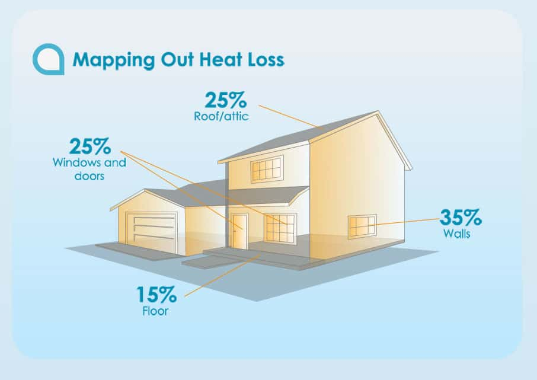
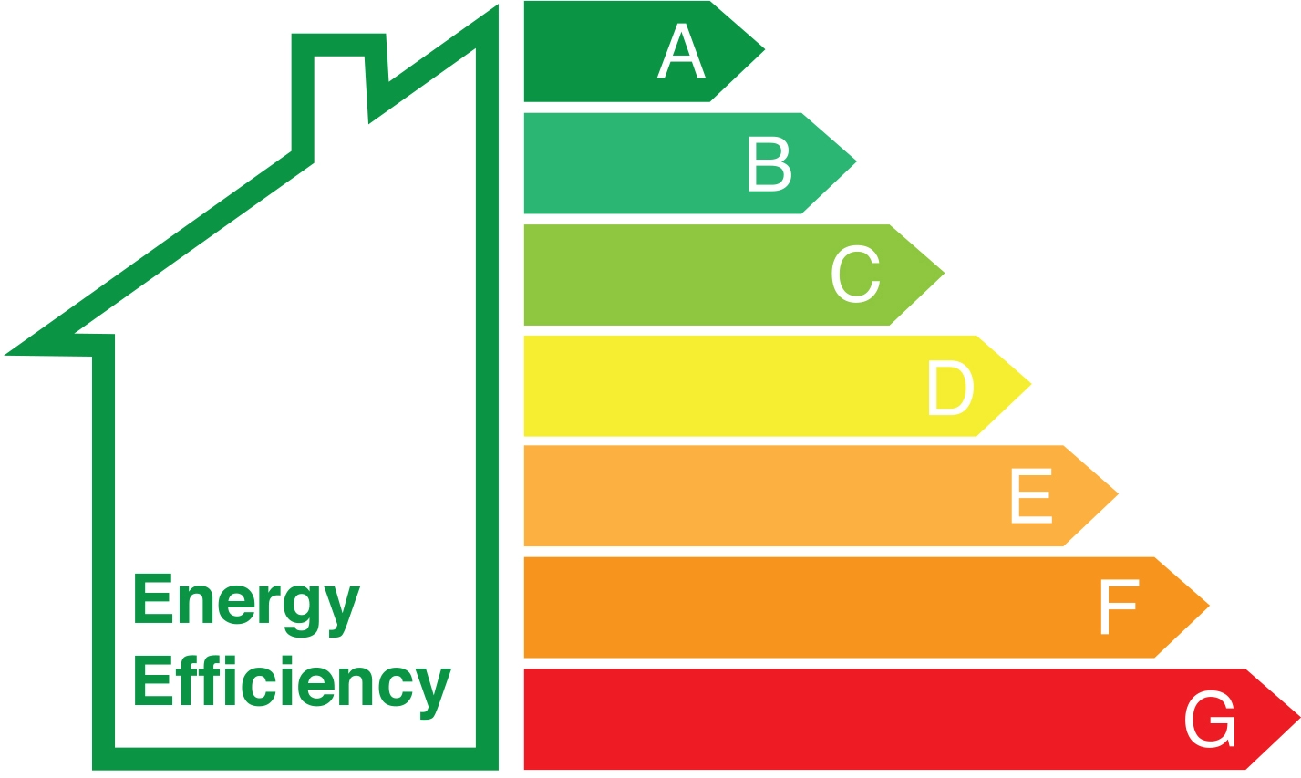
Causes- poor energy efficiency
Heat wasted from poorly insulated homes.
Energy Performance Certificates (EPC) measure the energy efficiency standard of homes.
Homes rated F or G are considered dangerously cold and a risk to health.

Slide 13
Health and cold homes
Temperature | Effect
18ºC | Minimal risk to healthy person Vulnerable households may need higher temperatures
Under 18ºC | May increase blood pressure & risk of cardiovascular disease
Under 16ºC | May diminish resistance to respiratory diseases
4-8ºC | Outdoor temperature threshold for risk of death
5ºC | High risk of hypothermia
Source: Public Health England & NHS England, Cold Weather Plan, 2017

Slide 14
Causes- cold homes
Expensive energy bills
Households have to make tough decisions about where to spend their income
Heat or eat choices
‘Spatial shrink’ - households turn heating off in some rooms, sometimes to one room only
Stress and anxiety about unaffordable fuel bills
Social isolation - less willing to invite friends and family to home
Poorly heated rooms
Condensation on cold surfaces
Leads to damp which will cause wallpaper and paint to peel
Rapid growth of black mould in damp environments
Black mould spores are bad for health
Respiratory complications
Evidence of link with chronic fatigue syndrome

Slide 15
Health and cold homes
Impact of cold homes
The body burns excessive levels of calories to keep itself warm
Healthy people more likely to develop health conditions and worsen existing conditions
Reduced immunity to viruses
Health conditions closely associated with cold homes
Cardiovascular illness, e.g. coronary heart disease, stroke, hypertension
Respiratory illness, e.g. seasonal flu, COPD (chronic obstructive pulmonary disease), asthma
Poor mental health
Increased risk of falls
Excess winter deaths
30% of excess winter deaths (the difference between winter & summer deaths) are due to cold homes
On average about 10,000 people every year die because of cold homes
Vast majority occur in the over 75s
Three main causes of these deaths are cardiovascular, respiratory & dementia

Slide 16
COVID-19 and fuel poverty
Increased unemployment and reduced income due to pandemic measures
Estimated 200,000 (at least) more households in fuel poverty
Home confinement means higher energy bills
First lockdown: moderate increase in bills
Current lockdown: increase likely to be much higher due to winter heating bills
Increased risk of fuel debt or rationing of fuel use among low income households
Health implications of cold homes & Covid-19
Evidence of increased susceptibility to Covid-19
Increased risk of severe symptoms
Slower recovery for those returning from hospital (as is the case for many illnesses)

Slide 17
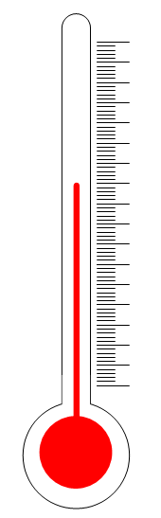
Adequate warmth
You can’t avoid/escape fuel poverty by switching off all your appliances and heating system in order to reduce your fuel bills.
You need to ensure your home can provide you with an “adequate level of warmth”.
18-21℃ is an adequate level of warmth
for healthy adults in living rooms where we are less active
When providing advice for heating levels around the home, we focus on the “living space” - the places in our home where we spend much of our time and are least active.
If we’re walking up/down the stairs, we generate our own body heat.
If we’re cooking in the kitchen, we benefit from the heat from the oven or hobs.
If we’ve got a decent duvet, we can trap heat in our beds.

Slide 18
Vulnerable groups
Vulnerable people are those who aren’t capable of generating enough body heat, and require their living space to provide them with additional comfort.
People with poor mobility might struggle to generate body heat due to lack of movement, they require their living space to be warm enough to provide the additional warmth needed.
The elderly take longer to warm up, and are more likely to feel the cold. This means they need to turn the thermostat up higher than a healthy person to stay well. But...
At 24℃ dehydration can set in. It can cause forgetfulness and clumsiness. People have been misdiagnosed with dementia because their heating is too set too high.
Advice around energy use and energy efficiency is vital for health.
Cold homes are also linked to reduced cognitive ability:
Children may find they struggle to complete homework
Older people are more likely to suffer trips and falls
People recently discharged from hospital may suffer relapse

Slide 19

Providing advice
Identifying people’s issues and helping energy consumers to save money and keep their homes warmer

Slide 20
Why do we give Energy Advice?
Raise the awareness of problems caused by living in a cold home and the effect on health and wellbeing.
Increased consumer confidence to deal with energy issues.
Integrate energy advice into the welfare rights advice offer.

Slide 21
What's available?
Income maximisation advice
Reducing costs by switching tariff or provider or changing payment method
Advice around energy efficiency
Bills and metering to reduce costs
Warm Home Discount
Priority Services Register
Fuel debt problems
Welfare Benefits checks and assistance

Slide 22
Spotting the signs of fuel poverty
Is the home feeling cold/draughty?
Are they using single point heaters/no central heating?
Is there mould on the walls/peeling wallpaper?
Is there dust on radiators or heating elements- indicating non use?
Do they have water?
Are blankets and/or outdoor coats used inside to keep warm?
Are fuel bills too high so usage is self restricted/rationed?
Is money owed to energy supplier?
Is there self disconnection?

Slide 23
Finding the best deal
NOT shopping around, can cost people hundreds of
pounds more than they need to pay
This can be done:
Through a price comparison website - make sure it is Ofgem accredited
Use the Citizens Advice website: customer service rating as well as price comparison
By getting in touch with the supplier directly
You’ll need to know:
Name of the current supplier and tariffs
How much energy was used in the past year
How energy is currently paid for (for example, prepayment meter or direct debit)
Notes:
Facilitator notes
Show where users can find the Citizens Advice price comparison tool and demonstrate how it can be used to compare energy tariffs. Encourage users to also look at the Citizens Advice star rating system which compares suppliers’ performance on such issues as customer service and treatment of vulnerable consumers.
Explain that they will need the information detailed on the slide to use the tool. Note, the tool can be used without knowing how much energy you have used in the past year - but providing this information will give a more accurate quote.
You could also demonstrate how the Citizens Advice understanding your energy bill tool can be used to find this information.

Slide 24
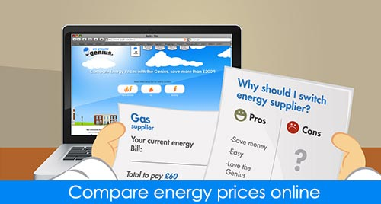
Before switching
Before considering switching consumers should:
Check which type of meter they are using
Find out if their existing contract has an ‘exit fee’ for leaving early - it’s usually on the bill
Look at the tariffs offered by the current supplier; switching may not be needed
If claiming the Warm Home Discount, check the new supplier also offers this
Notes:
Facilitator notes
Explain that if you have a prepayment meter you’ll usually be restricted to ‘prepayment tariffs’. There are fewer of these to choose from and will be more expensive than direct debit tariffs.
Explain that if you have a contract with a current supplier for a set period of time you may have to pay an ‘exit fee’ if you wish to leave the contract early. This can usually be found on an energy bill and the Citizens Advice ‘Understanding your energy bill’ tool can help you find this information.

Slide 25
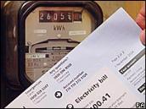
Meter readings
Remember to:
Take a meter reading on the day of the switch
Give this reading to the new supplier - this means they won’t charge for energy used before the switch
Retain the reading to avoid any potential hiccups
Notes:
Facilitator notes
Your new supplier will read the meter, or ask you to take a reading, around the time of changing supplier.
Your old supplier will use this reading to work out your final bill and the new supplier will use it to start the new account.
You should keep a note of the reading in case of any future dispute.

Slide 26
Switching while in debt to a supplier
If you use a prepayment meter:
If you owe less than £500 for each fuel you can still switch
Your debt will transfer with you
If you don’t have a prepayment meter:
A supplier can stop you switching until you’ve paid off your debt
Ensure the debt is based on an ACTUAL not ESTIMATED meter reading
With estimated bills, it’s possible that energy debts can accrue without knowledge via a credit meter
We can help negotiate payments and switch when the accounts are cleared
Notes:
Facilitator notes
If you are in debt to your current supplier it is possible that they can stop you from switching until you have paid off your debt.
If you have a prepayment meter you can change supplier if you owe less than £500 for each fuel (gas and electricity). Your debt will transfer with you but you may benefit from a lower price which could help you pay it off faster.
If you don’t have a prepayment meter and have an outstanding debt your supplier has the right to prevent you leaving. They can’t stop you leaving if it is their fault you are in debt, for example, if they billed you incorrectly.

Slide 27
Disconnection
Energy suppliers generally no longer disconnect their customers
However, they have the right to force their way into a home via a warrant to swap a consumer’s credit meter with a prepayment meter
A prepayment meter won’t provide energy without immediate payment
Suppliers regard such action as protecting their financial interests
Prepayment meter consumers
When consumers cannot afford to feed their meter, they are said to “self-disconnect”
Depending on a customer’s circumstances, and who their supplier is, it may be possible to apply for a grant to clear the debt
Seek advice in such situations

Slide 28
Warm Home Discount
This is a scheme delivered by all electricity suppliers with more than 150,000 customers.
It is a £140 one off credit towards energy costs ( usually on your electric bill) if you’re either:
In the ‘Core Group’ are customers who are in receipt of the Guarantee Credit element of Pension Credit.
Each year the Department for Work and Pensions identifies these customers, and their supplier credits their account with £140.
In the ‘Broader Group’ are customers who are in receipt of other benefits, or are otherwise on a low income. These customers do not get the discount automatically and have to apply
Remember each supplier sets its own ‘Broader Group’ eligibility criteria.
Only companies with more than 250,000 customers are required to deliver the discount to ‘broader group’ consumers.
Notes:
Facilitator notes
Key points to cover:
Some electricity suppliers offer a discount of £140 off your energy bill if you are eligible.
The money is not paid to you - it is a one-off discount on your electricity bill between September and March.
You may be able to get the discount on your gas bill instead if your supplier provides you with both gas and electricity. Contact your supplier to find out.
You can still get the discount if you have a pre-pay or pay as you go meter. If you’re eligible your supplier can tell you how you’ll get the discount, for example as a voucher you can use to top up your meter.
If you currently get the discount and are thinking of switching supplier, check that the new supplier offers the discount. If it does not, you may find the offer is not such a good deal.

Slide 29
Warm Home Discount
Applications for the broader group tend to open around September each year and are run on a first-come, first-served basis.
Funds are usually exhausted by Christmas. If successful, the credit is applied to the electricity account before the end of March.
If you received the discount last year and apply this year, you will receive it.
If oversubscribed all other applicants go into a draw and will be advised later if they are successful.
Utilita works slightly differently: the past two years they have opened their applications for a single week in August.

Slide 30

Priority Services Register
Offers extra services free of charge if someone:
Is of pensionable age
Is disabled or chronically sick
Has a long-term medical condition
Has a hearing or visual impairment or additional communication needs
Is in a vulnerable situation
To be added to their Priority Services Register you contact both the network/energy supplier.
Notes:
Facilitator notes
Explain that each energy network offers different support and that you should call your energy network before you apply to join the Priority Services Register to check exactly which services you could get.
Example services include:
Improved access to your meter
Password protection scheme - to help you confirm staff are genuine when they visit your home
Bill nominee scheme - arranging for bills to be sent to the address of a friend, relative or carer
Advance notice and support during power cuts and interruptions
Services for customers with impaired hearing or vision
Free gas appliance safety check

Slide 31
Priority Services Register- benefits
Advance notice of planned power cuts
If you rely medically on your energy supply you can arrange for the network operator to give you advance notice of planned power cuts, e.g due to engineering work.
Priority support in an emergency
The network operator can provide alternative heating and cooking facilities in the event of a supply interruption.
The British Red Cross may be able to provide hot food, blankets and emergency batteries to vulnerable customers without power
Identification scheme
Reassurance that callers, for example meter readers, are genuine
Suppliers have to provide additional support to help identify someone acting on their behalf
May include arranging a password or showing an agreed picture card upon visit
Password protection
Network operators must offer to agree a password with you (or your representative) that can be used by any representative of the company to enable you to identify them
Notes:
Facilitator notes
Explain that each energy network offers different support and that you should call your energy network before you apply to join the Priority Services Register to check exactly which services you could get.
Example services include:
Improved access to your meter
Password protection scheme - to help you confirm staff are genuine when they visit your home
Bill nominee scheme - arranging for bills to be sent to the address of a friend, relative or carer
Advance notice and support during power cuts and interruptions
Services for customers with impaired hearing or vision
Free gas appliance safety check

Slide 32
Priority Services Register- benefits
Nominee scheme
Customers can ask their supplier to send communications (such as account statements or bills) to someone you have nominated, e.g. family member, carer or someone you trust.
Arrangements to ensure safe and practical use of your prepayment meter
For example moving a prepayment meter if you are unable to access it safely to top it up
Meter reading services at appropriate intervals.
If nobody living at your property is able to read the meter and there isn’t anyone else you can nominate to read the meter on your behalf, your supplier may be able to read it for you.
Accessible information
Account and bill information in an accessible format, e.g. larger print or braille
Free gas safety checks, e.g. for a gas boiler, for eligible homeowners every 12 months
Eligibility criteria:
  means-tested benefit and live with a child under five
  live alone and are of pensionable age, disabled or chronically sick and live alone
  live with others who are of pensionable age, disabled, chronically sick or under 18 and you are also of pensionable age, disabled or chronically sick.

Slide 33
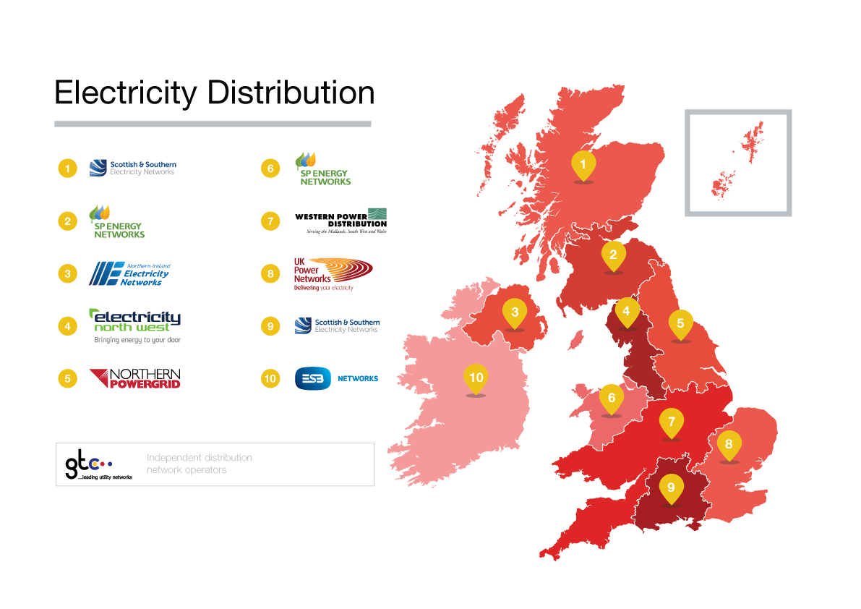
DNOs
(District Network Operators)
These are the companies who manage the electricity cables beneath the streets.

Slide 34
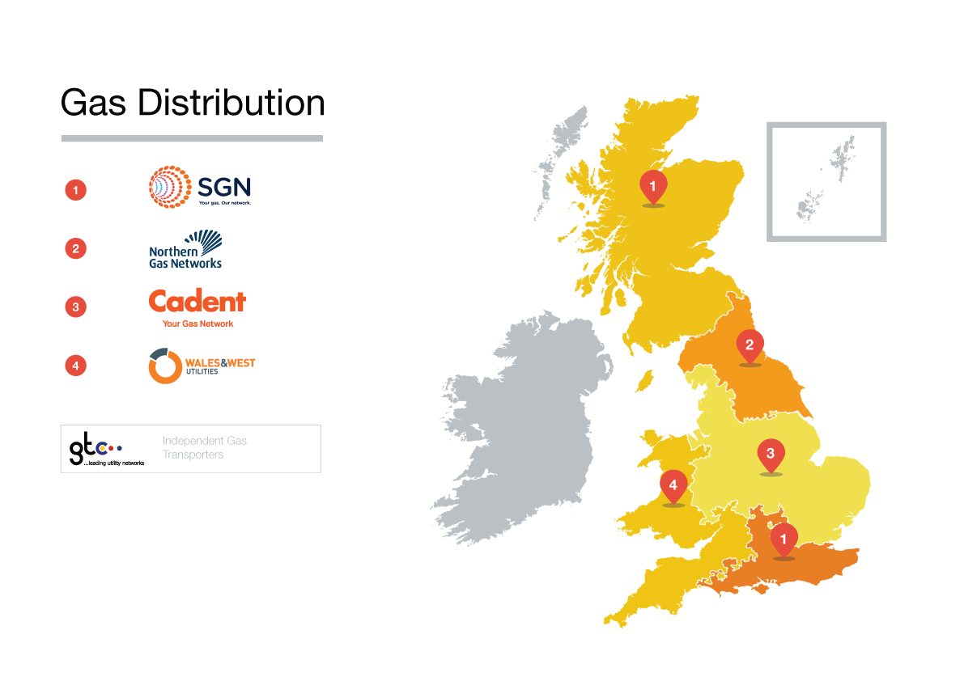
Gas networks
These are the companies who manage the gas pipes beneath the streets.

Slide 35
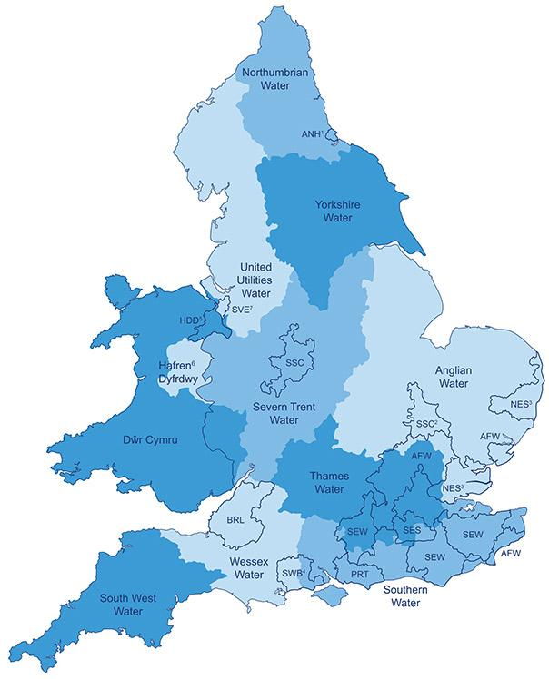
Water companies
Water companies also hold a priority services register for vulnerable clients and provide further support if needed with water related problems for example providing bottled water if supply is interrupted.

Slide 36
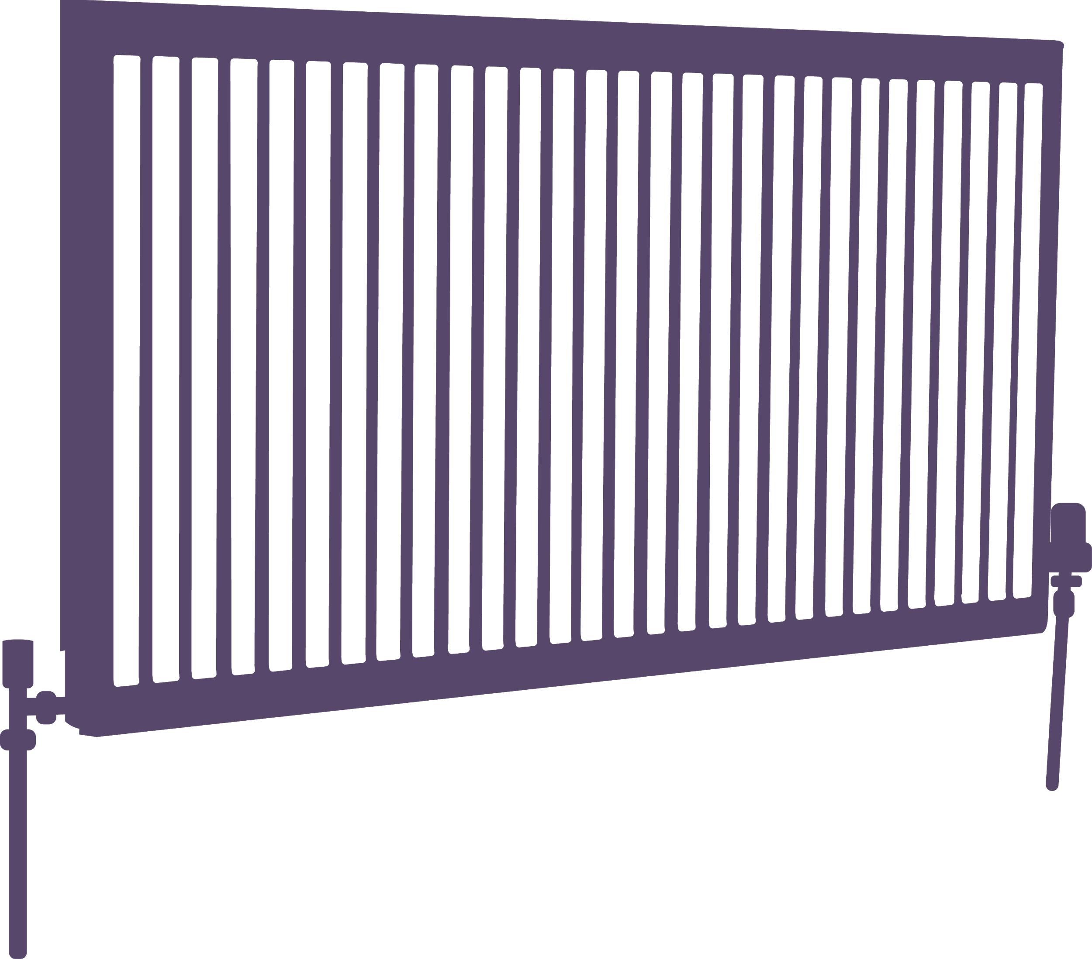
Other schemes
There are further schemes available to help clients

Slide 37
Green homes grants
Grants (vouchers) for insulation and low carbon heating (only England)
General scheme:
  All owner occupiers
  Private rented sector landlords
  Social housing landlords
  Park home owners
  Voucher will cover up to ⅔ of cost of measures - up to £5,000
Low income scheme:
  Owner occupiers only
  In receipt of certain means-tested benefits
  Voucher will cover full cost of measures - up to £10,000

Slide 38
GHG
Measures
Primary | Secondary*
Loft/roof insulation | Upgrading to energy efficient doors
Solid wall insulation | Double/triple glazing where replacing single glazing
Cavity wall insulation | Secondary glazing
Insulation on a park home | Draught proofing
Under-floor Insulation | Hot water tank insulation
Heat pumps | Heating controls
Solar Thermal heating | * Can only claim if installed alongside a primary measure. Funding for a secondary measure can only be up to the same value as primary measure (within total grant)
Biomass boilers

Slide 39
Simple Energy Advice
This is the main source of information on Green Home Grants
Allows household to carry out simple survey of home
Recommends appropriate energy efficiency measures for home
Information on best return for investment
Provides list of approved tradespeople in your area
  Insulation & energy efficiency companies must be registered with Trustmark
  Low carbon heating companies must be registered with Microgeneration Certification Scheme (MCS)
Only homeowners (not installers) can apply
Simple Energy Advice website

Slide 40
Energy Company Obligation
Gives grants for efficient boilers, loft and cavity wall insulation
Delivered by large energy companies
Each company has slightly different rules for measures offered
Available to people receiving certain benefits in England, Wales & Scotland
If you’re not on certain benefits but on a low income or have a health condition you may be able to get help under the ‘ECO local flexibility’ scheme which some local authorities have set up with fuel companies
Recipients often have to make a contribution towards costs of measures

Slide 41
Nest
Welsh Government scheme - only for residents in Wales
Free advice on energy efficiency
Grants for efficient boilers, central heating and insulation to eligible households
Eligibility criteria:
  You own or privately rent your home (not from a council or housing association)
  Your home is energy inefficient and expensive to heat
  You or some you live with receives a means tested benefit
  You or someone you live with has a chronic respiratory, circulatory or mental health condition and an income below certain defined thresholds
More information at www.nest.gov.wales or call Freephone 0808 808 2244

Slide 42
What can front line workers do?
Be more aware of the cold home issues and fuel poverty causes
Reassure your clients there is help available
Encourage annual energy “MOT”s to ensure income is maximized and energy bills are as low as possible
Refer and encourage vulnerable clients to ask us for energy advice and energy efficiency information, to reduce the risk of health problems associated with cold homes

Slide 43
Other schemes
Please include a slide or two to remind people about your organisation, ask them to complete the follow up survey, and let them know how to get in touch with you.
Link to feedback form: https://forms.gle/p42zLu6frhvZMHhW8

Slide 44
Thank you
[insert name of team presenter]
[insert contact details]
[insert organisation logo]

