Slide 1
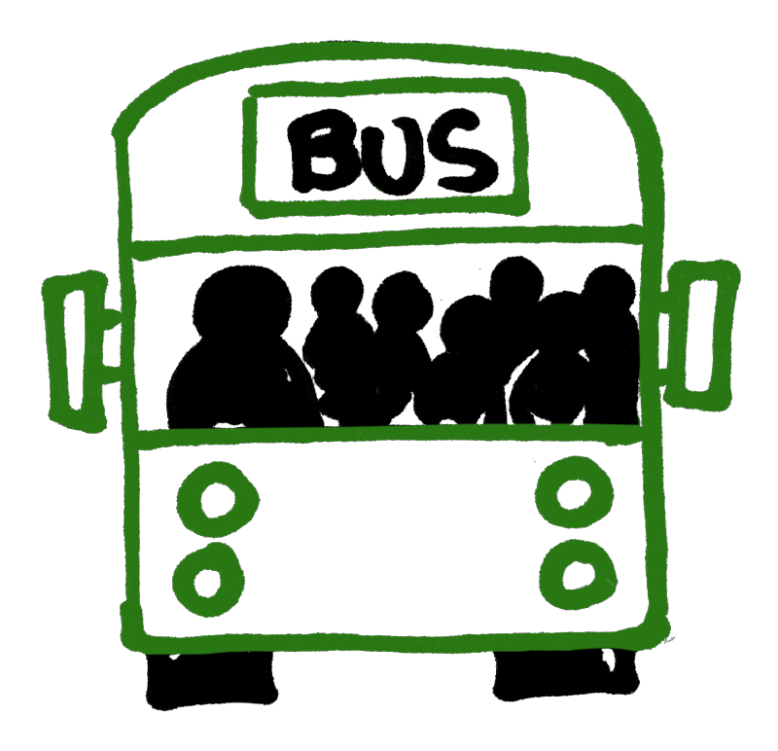
TRAVEL, SAFETY, AND CORONAVIRUS
KS2 DISCUSSION PACK
Created: 14/09/20
Content checked: 17/02/21
Notes:
This discussion pack has been put together by Transport for Greater Manchester to enable teachers to facilitate a discussion with KS2 pupils during form time.
The pack has been created to cover the topic of “Travel, safety, and coronavirus” and should take around ten minutes to deliver.
If pupils have any questions that you require assistance answering, or if you need further support on travel to school email the Sustainable Journeys team: sustainable.journeys@tfgm.com

Slide 2
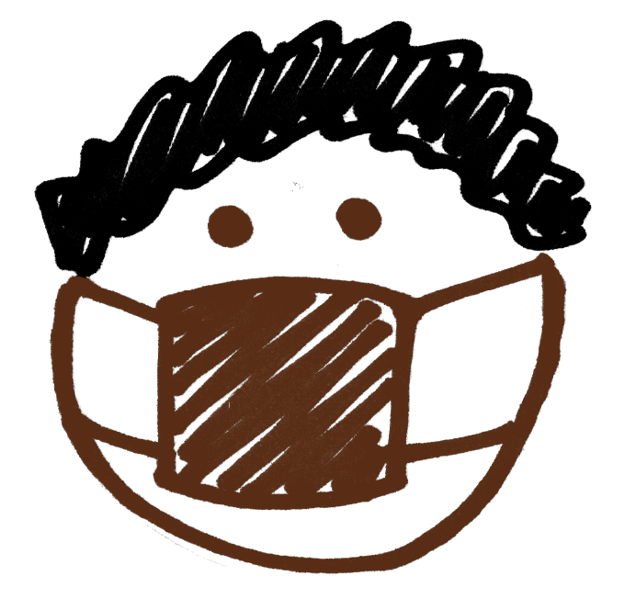
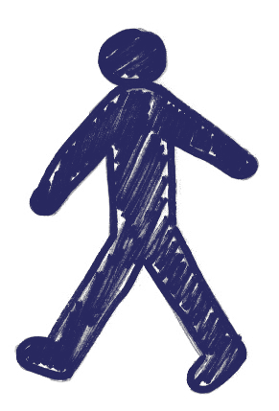
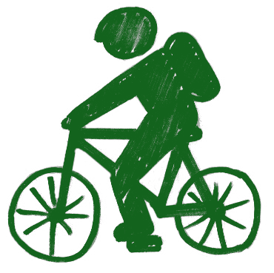
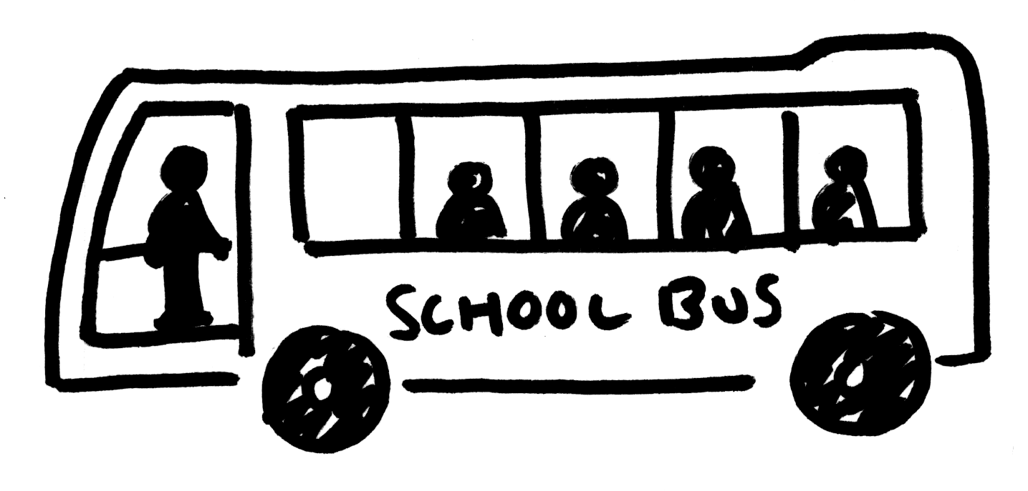
Travel, safety, and coronavirus
Learning outcomes:
Can I identify different ways of travelling in Greater Manchester?
Can I discuss how coronavirus has impacted how we travel?
Can I better understand how to keep safe when travelling?
Notes:
Aim:
To help pupils to understand how to travel safely in Greater Manchester.
Learning outcomes:
To identify different ways of travelling in Greater Manchester;
To discuss how coronavirus has impacted how we travel;
To better understand how to keep safe when travelling.

Slide 3
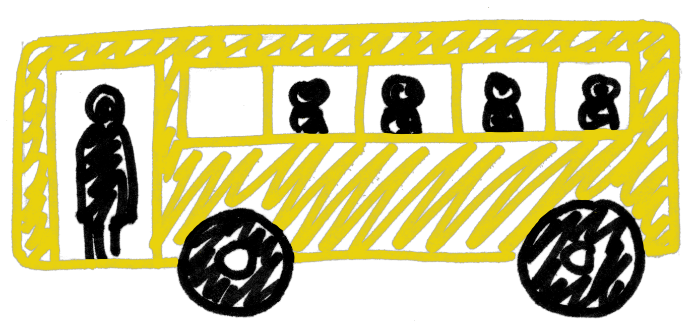
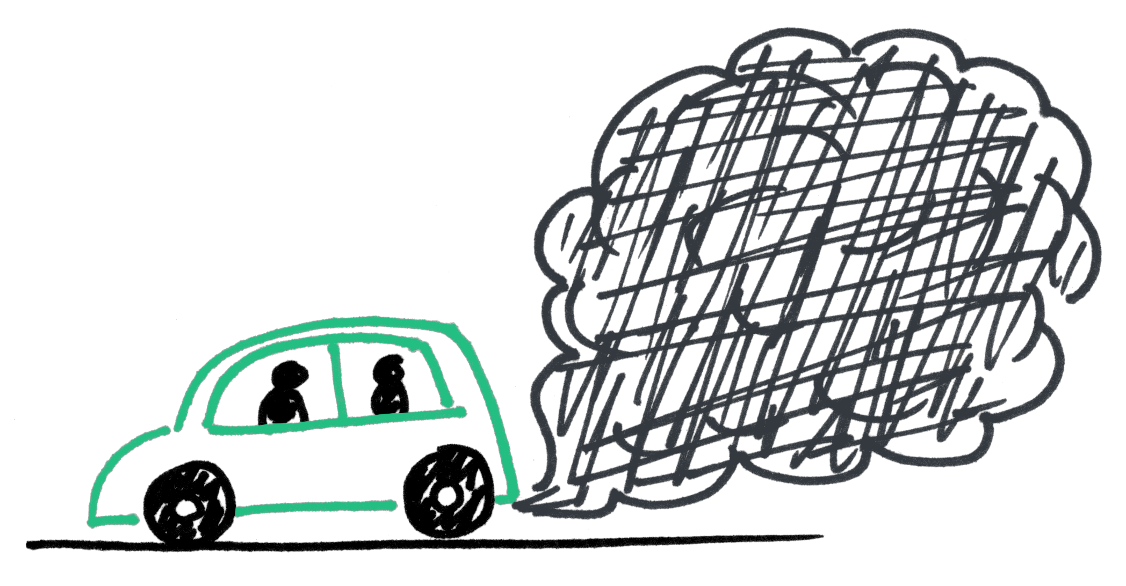
Different ways to travel
What do we already know about how and why people choose to travel in Greater Manchester?
Think about…
How did you get to school today?
What other ways have you travelled before?
Lets share our ideas
Notes:
Learning objective one: to identify different ways of travelling in Greater Manchester.
Knowledge check: Ask pupils if they know what “Greater Manchester” is. Clarify that England is made up of lots of counties, Greater Manchester is the name of the county that we live in.
Facilitate a classroom discussion with pupils by asking them to list:
Different ways of travelling in Greater Manchester; and
Why people might choose one way of travelling over another
Some ways of travelling that pupils might identify – and reasons for doing so – are:
Walking / running – for short journeys e.g. going to the local shop less than a mile away
Cycling / scooting / skating / boarding – for journeys that might take a bit too long to walk e.g. going to a park three miles away
Car / taxi / motorcycle / scooter – for longer journeys e.g. when travelling from one side of Greater Manchester to the other
Bus / coach / train / Metrolink – for longer journeys e.g. when travelling into the city centre where parking is limited
Other ways to travel that pupils might identify – but are not common ways to get round Greater Manchester – are:
Aeroplane
Rocket
Helicopter
Hot air balloon
These are fun ways to travel, but not when we’re going to the shops!
Prompt questions if required:
When you have previously been on holiday – how did you get there?
If you go to the shops – how do you go?
What type of vehicle has two wheels? (answer: bike / scooter)

Slide 4
Travelling in Greater Manchester
What do you think are the most popular ways to travel around Greater Manchester?
Why do you think this might be?
5
Metrolink tram
1
2
3
4
Car or Van
Walking
Bus or coach
Cycling
7
6
Other
Train
Notes:
Learning objective one: to identify different ways of travelling in Greater Manchester
Using the different ways of travelling pupils have just listed:
Ask pupils to discuss which they think are the most popular ways to travel in Greater Manchester – and why this might be?
They are:
Car or van driver or passenger 57%
Walk 29%
Bus / minibus / coach 7%
Bicycle 2.2%
Metrolink 1.7%
Train 1%
Other 2.1%
For more information see: https://tfgm.com/TRADS

Slide 5
Coronavirus and travel
How has the way we travel changed because of coronavirus?
Did you start travelling a new way during lockdown?
What changes have you seen in how your family and friends travel?
Think about…
Let’s share our ideas
Notes:
Learning objective two: to discuss how coronavirus has impacted on how we travel.
Facilitate a classroom discussion with pupils by asking them:
To consider how coronavirus has changed the way we travel.
Some things that pupils might identify:
They could not travel during lockdown
Families might have started walking or cycling to the shops
They have changed the routes they use so they are more enjoyable
They have had to rearrange a holiday or family trip
Prompt questions if required:
Have you started travelling to school or the shops in a new way?
(If school is using bubbles) Have you had to change who you travel with – perhaps because you are now in different bubbles?
How do you feel about travelling?

Slide 6
How to keep safe when travelling
What do we already know about how to keep safe when travelling?
There are some new safety rules to help you keep safe from coronavirus.
Do you know what these are?
11+
1. Keep your distance
2. Wash your hands
Notes:
Learning outcome three: to better understand how to keep safe when travelling.
Ask pupils what they know about how to stay safe when travelling. Some might identify the following:
When walking – stop look and listen before crossing the road
When cycling – wear a helmet
When in the car – wear a seatbelt and sit on a car seat if you need one
Tell pupils that there are some new rules to keep them safe from coronavirus when travelling, ask pupils if they know what they are.
For KS2 pupils the following are most appropriate:
Keep your distance from other passengers where possible
Clean your hands regularly – do they know which song to sing whilst hand-washing? (e.g. Happy Birthday)
Pupils might also be aware of the following – but due to their age are less relevant:
Wear a face covering on-board and in stations and interchanges, (unless you’re under 11 or are exempt for another reason)
Use contactless payment or exact fare when buying tickets - public transport operators will not be giving out change

Slide 7
Travel, safety, and coronavirus – recap
Learning outcomes:
Can I identify different ways of travelling in Greater Manchester?
Can I discuss how coronavirus has impacted how we travel?
Can I better understand how to keep safe when travelling?
Notes:
Bring the session to a close and recap the main points from each learning objective.
Learning outcomes:
To identify different ways of travelling in Greater Manchester (answer: car / bus / Metrolink / cycling / walking);
Prompt question if required – ask what are the main ways of travelling in Greater Manchester
To discuss how coronavirus has impacted how we travel (answer: the number of journeys we take may have reduced, the way we choose to travel might have changed)
Prompt question if required – ask pupils to think about how many journeys they did when in and out of lockdown
To better understand how to keep safe when travelling (answer: wash hands, keep distance)
Prompt question if required – ask what are the new safety rules relating to coronavirus
Ask pupils to put their hand up if they feel that they better understand how to travel safely in Greater Manchester.
If pupils have any questions that you require assistance answering or if you need further support on travel to school email the Sustainable Journeys team: sustainable.journeys@tfgm.com

