Slide 1
Available
from this
library
Reaxys
Your trusted resource for chemistry answers
®

Slide 2












Want to do faster and better chemistry research?
There’s a lot of valuable information out there.
Find and use it with Reaxys!
Notes:
Remove Footer

Slide 3





Want to do faster and better chemistry research?
There’s a lot of valuable information out there.
Organic chemistry
Physical chemistry
Find and use it with Reaxys!
Reaxys collates references, reactions and substance property data across disciplines in a unique database with intuitive search functions.
Pharmacology
Biology
Material science
Engineering
Medicine

Slide 4

Start today!
Reaxys makes it easy.
Unique content
The combination of peer-reviewed literature, patents and other periodicals with excerpted data on substances and their properties create a unique portal to chemistry knowledge.

Slide 5

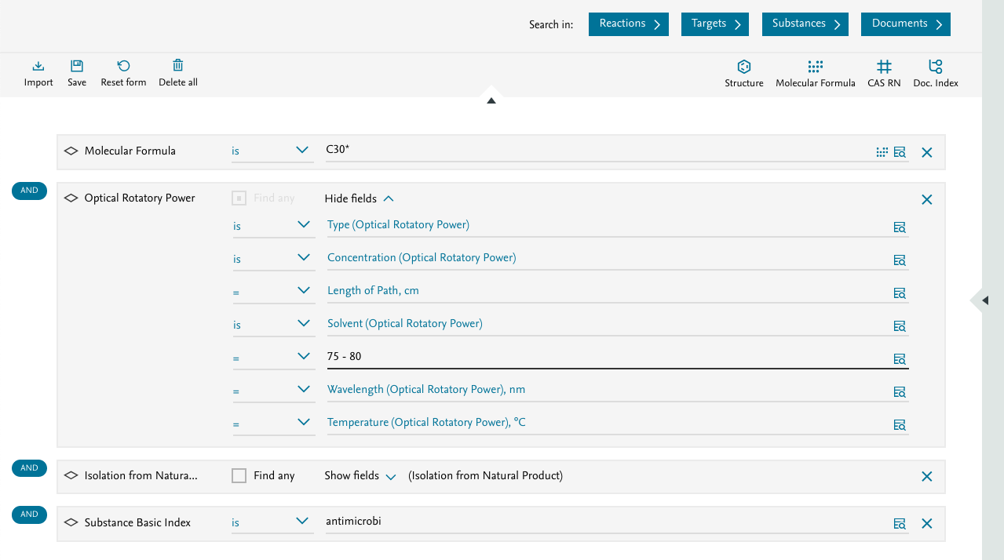
Start today!
Reaxys makes it easy.
Esterification of benzoic acid
Unique content
The combination of peer-reviewed literature, patents and other periodicals with excerpted data on substances and their properties create a unique portal to chemistry knowledge.
More search power
Reaxys eliminates barriers to searching with a keyword- and structure-based Quick Search and an easy-to-use Query Builder for combining multiple queries.

Slide 6
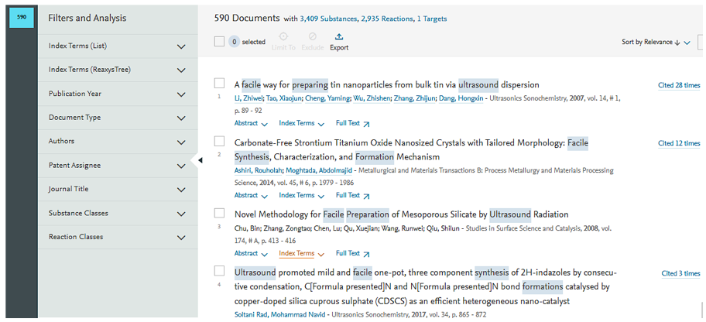

Start today!
Reaxys makes it easy.
Unique content
The combination of peer-reviewed literature, patents and other periodicals with excerpted data on substances and their properties create a unique portal to chemistry knowledge.
More search power
Reaxys eliminates barriers to searching with a keyword- and structure-based Quick Search and an easy-to-use Query Builder for combining multiple queries.
Efficient access
The highly interlinked content lets you quickly navigate through the available information to capture and download what you need.

Slide 7
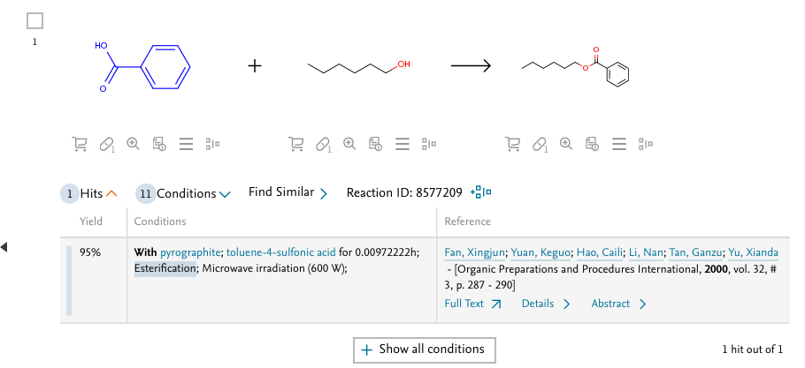
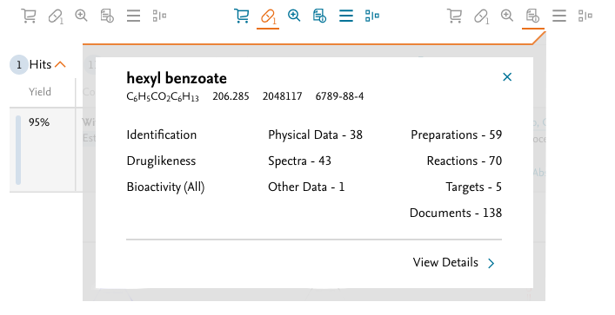
Start today!
Reaxys makes it easy.
Unique content
The combination of peer-reviewed literature, patents and other periodicals with excerpted data on substances and their properties create a unique portal to chemistry knowledge.
More search power
Reaxys eliminates barriers to searching with a keyword- and structure-based Quick Search and an easy-to-use Query Builder for combining multiple queries.
Efficient access
The highly interlinked content lets you quickly navigate through the available information to capture and download what you need.

Slide 8
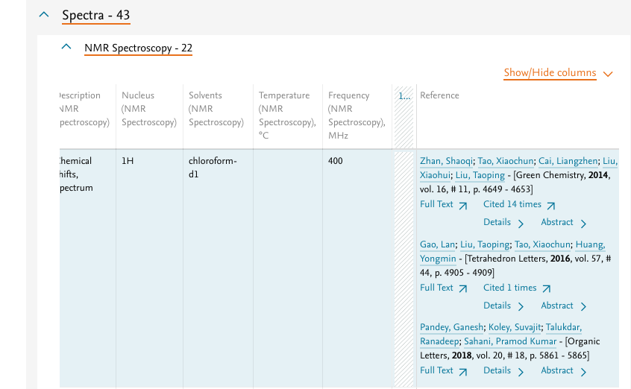
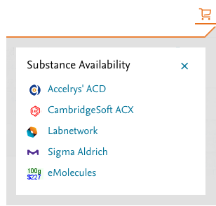
Start today!
Reaxys makes it easy.
Unique content
The combination of peer-reviewed literature, patents and other periodicals with excerpted data on substances and their properties create a unique portal to chemistry knowledge.
More search power
Reaxys eliminates barriers to searching with a keyword- and structure-based Quick Search and an easy-to-use Query Builder for combining multiple queries.
Efficient access
The highly interlinked content lets you quickly navigate through the available information to capture and download what you need.

Slide 9
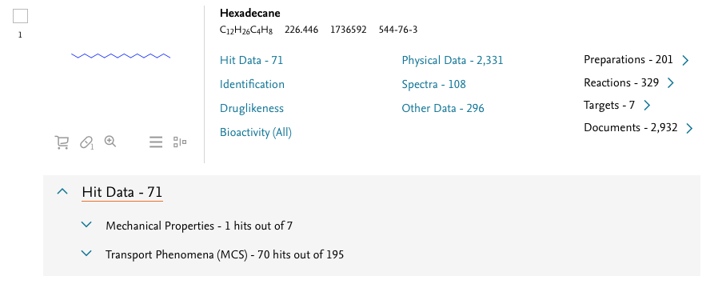
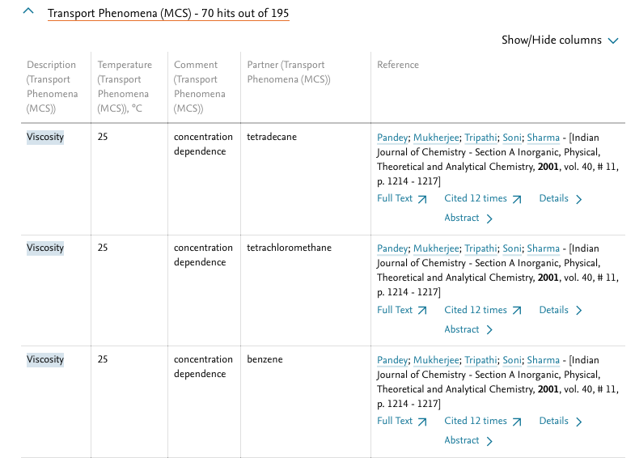
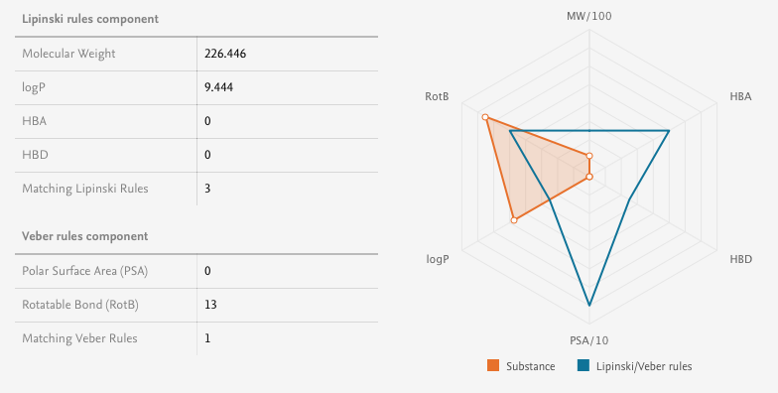
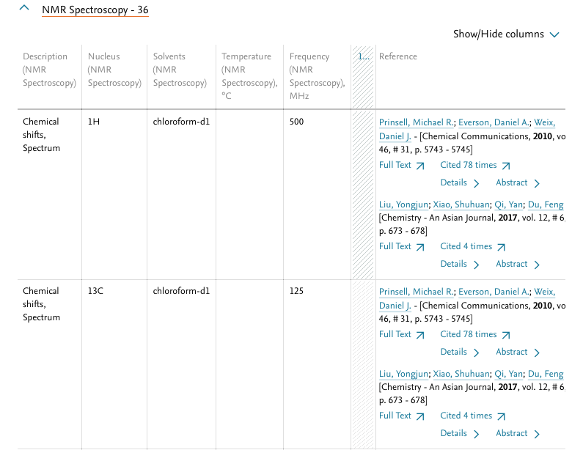
Go beyond the title and abstract
Reaxys delivers relevant chemistry excerpted from all components of publications: the title, abstract, text, graphs, reaction schemes, tables, structure diagrams and supplementary information

Slide 10
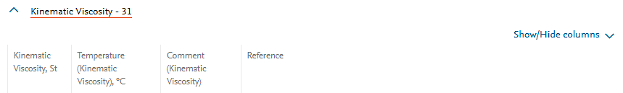
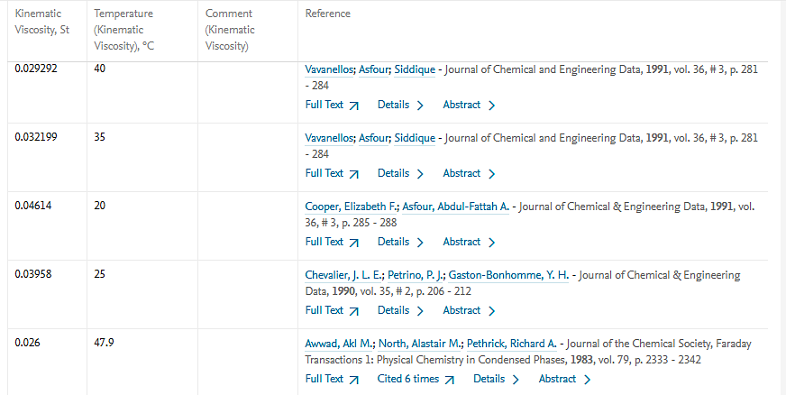
Use data immediately
Download
Viscosity of hexadecane
All excerpted data in Reaxys are searchable so you can query actual empirical data and not just publications. You can also download the data with just a few clicks.

Slide 11
Use data immediately
Temperature dependency of kinematic viscosity of hexadecane
All excerpted data in Reaxys are searchable so you can query actual empirical data and not just publications. You can also download the data with just a few clicks.

Slide 12



Solve real-world problems
Thanks to the multi-disciplinary indexing using terms from authoritative thesauri, Reaxys helps every scientist discover the answers they need. Indexing is based on the chemistry thesaurus ReaxysTree, the biomedical thesauri Emtree and MeSH, the engineering thesaurus Compendex, the geological thesaurus GeoBase, and authors data from Scopus.
Since current real-world problems require cross-disciplinary approaches, this makes Reaxys ideally suited to modern research.

Slide 13


Get the most out of Reaxys
Explore the power of Reaxys with:
Straightforward tutorials
Useful webinars
Real-world workflow examples
Classroom activities
Our customer care experts and professional services team are ready answer your questions and support your needs.

Slide 14
Reaxys is a trademark of Elsevier Life Sciences IP Limited, used under license. Copyright © 2019, Elsevier B.V January 2019
Reaxys is a trademark of Elsevier Life Sciences IP Limited, used under license. Copyright © 2019, Elsevier B.V January 2019

