Slide 1



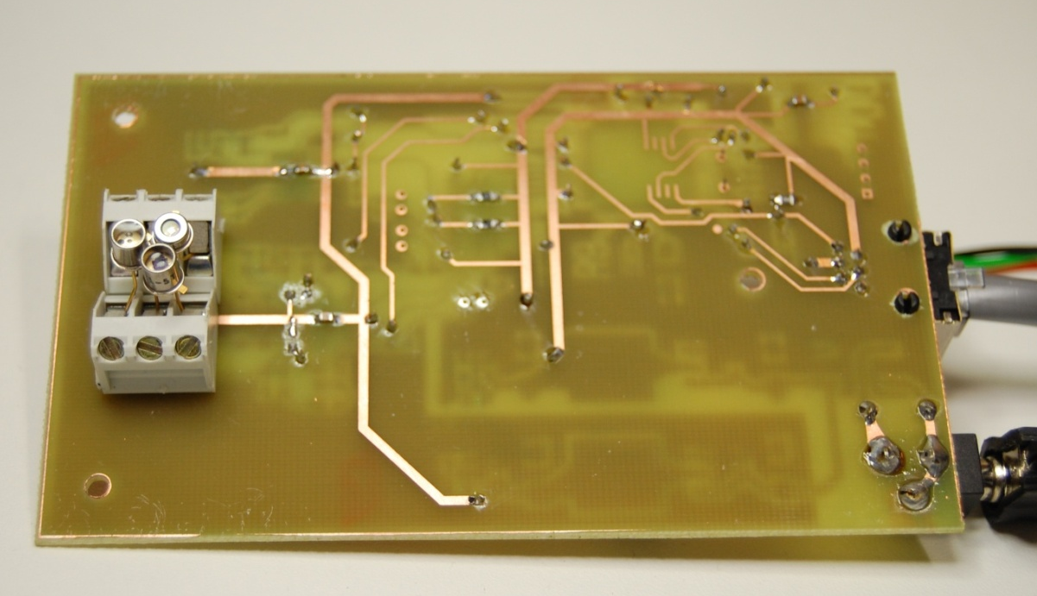
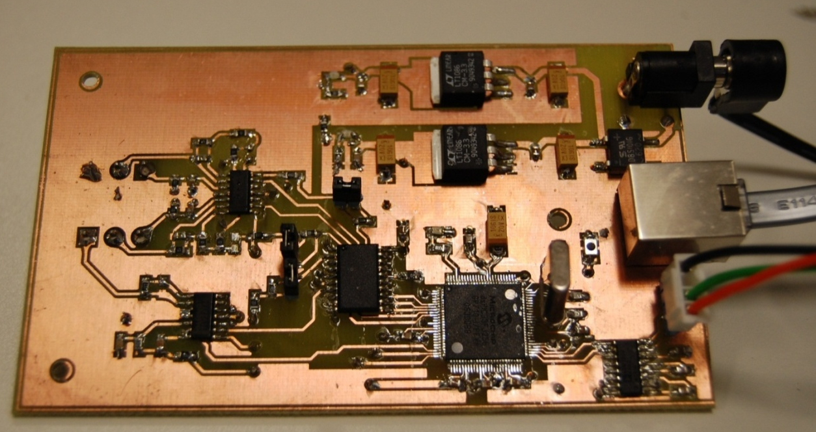
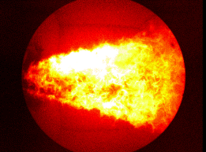



Digital Imaging Based Flame Stability and Burner Condition Monitoring
John Smithyª, Peter Browny^{b} and Peng Xyzzª
ª Department of Mechanical Engineering
School of Energy and Sustainability, University of Sheffield, UK
^{b} Department of Instrumentation and Control
School of Engineering, University of Kent, UK
Introduction
Measurement of flame oscillation frequency
Co-firing of biomass with coal at existing coal-fired power plant has been widely adopted as one of the main technologies for reducing CO₂ emissions. The variability in fuel properties and co-firing conditions can cause a range of combustion problems including flame stability, low thermal efficiency, high levels pollutant emissions and furnace fouling and corrosion. Advanced flame monitoring and characterisation technologies are therefore required for an in-depth understanding of the impact of biomass on combustion stability and subsequent optimization of the co-firing processes.
As part of an EPSRC funded project - Optimisation of biomass/coal co-firing processes through integrated monitoring and computational modelling, research is being conducted to develop an advanced system for flame stability and burner condition monitoring in coal-biomass co-firing power plant.
Flame signals are captured by UV, visible and IR photo detectors.
Embedded techniques are employed for on-line flame signal processing.
Standard Flicker (Hz) | Measured Flicker (Hz) | Relative Error (%)
10.37 | 10.2 | -1.64
20.18 | 20.0 | -0.90
30.45 | 30.4 | -0.16
50.79 | 50.9 | 0.22
70.53 | 70.5 | -0.04
100.25 | 100.0 | -0.24
200.19 | 200.4 | 0.10
300.79 | 300.9 | 0.04
400.85 | 400.7 | -0.04
501.27 | 501.1 | -0.03
Photo diodes
Embedded signal processing board
5
2
FFT
1.5
Amplitude
Power
Technical strategy
0
1
-5
0.5
0
0.5
1
1.5
2
2.5
0
20
40
60
80
100
120
140
160
180
Fuel, air
Emissions
Time (Sec)
Frequency (Hz)
Optical probe & beam splitters
Photo detector
Oscillation frequency
Example of a flame signal and its power spectrum
Flame stability assessment
Measurement of flame temperature
Flame
CCD camera
  Temperature
  Ignition
  Luminosity
Two-colour method - Temperature is determined from flame radiation intensities at two wavelengths based on the Planck’s radiation law.
Recommendation to combustion operator
Objective
Beam splitter
Filter
Ocular
Imaging sensor
Digital imaging and optoelectronics based technique for flame stability and burner condition monitoring
λ₁
Flame
Prism
λ₂
System design
Sensing arrangement for two-colour imaging
A miniaturised and integrated flame detection and imaging system.
• System can be installed at the burner through the sight-tube to
  - avoid the modification of the furnace
  - visualise the flame root region
  - avoid possible interference from other burners
• Photo detectors for oscillation frequency measurement
• Miniature RGB CCD/CMOS camera for temperature measurement
• Real-time embedded image and signal processing
Temp (°C)
Image at λ₁
>1609
>1588
T=f(λ₁, λ₂, G₁, G₂)
>1566
>1545
>1523
>1501
>1480
>1458
Image at λ₂
>1437
Temperature distribution
>1415
Example of flame images and temperature distribution
Cooling air in
Oscillation frequency detection board
Mini
motherboard
Conclusions
Objective lens
A system incorporating digital imaging and optoelectronic devices is being developed for flame stability and burner condition monitoring in coal-biomass co-firing power plant.
A sensing and signal processing board has been constructed for the measurement of flame oscillation frequency.
Initial tests have shown the relative error of the oscillation frequency measurement is not greater than 2%.
Future work will focus on the construction of the embedded subsystem for flame temperature measurement.
dsPIC
CPU
Data output
Jacket
Endoscope
Beam splitter
CCD camera
System design
Collaborators: University of Leeds, University of Nottingham, Zhejiang University, Tianjin University and Xi’an Jiaotong University
RWE npower, and Alstom Power
Contact Details School of Energy and Sustainability, University of Sheffield, Sheffield, UK
Tel: +44 (0)114 999 9999, Website: http://????????

