Slide 1
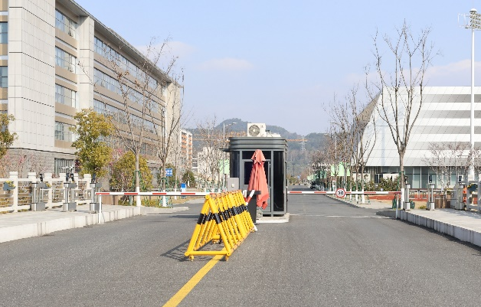
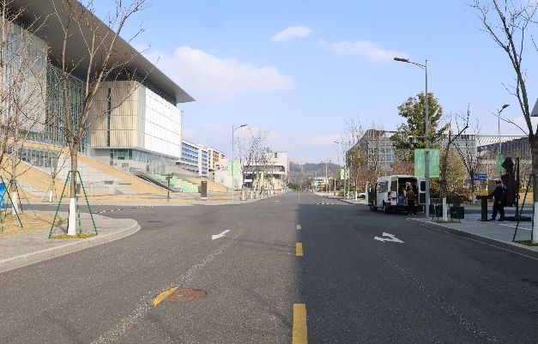
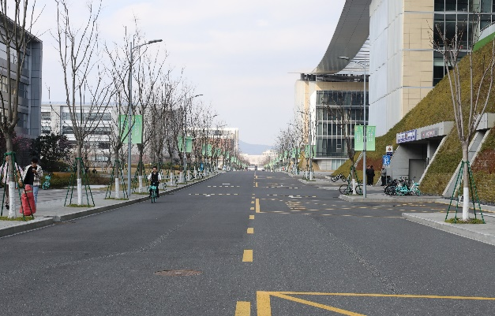
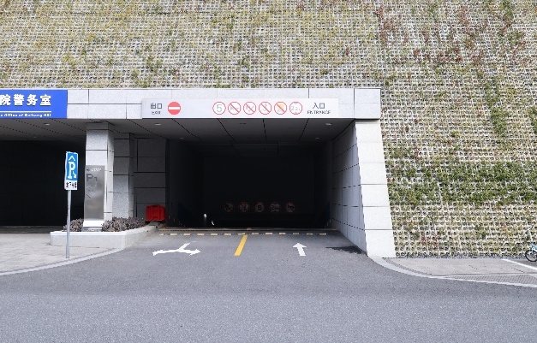
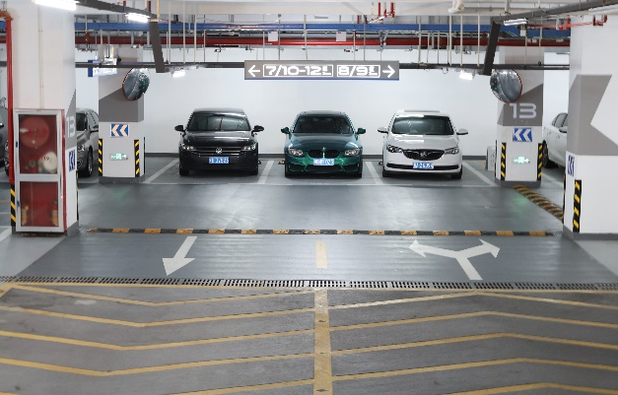
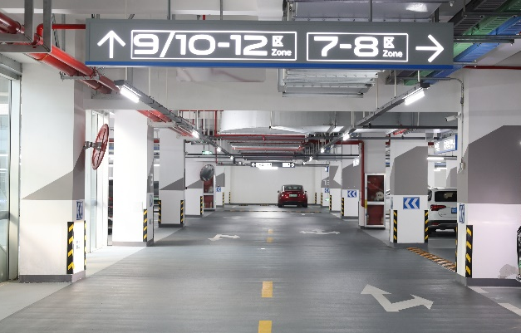
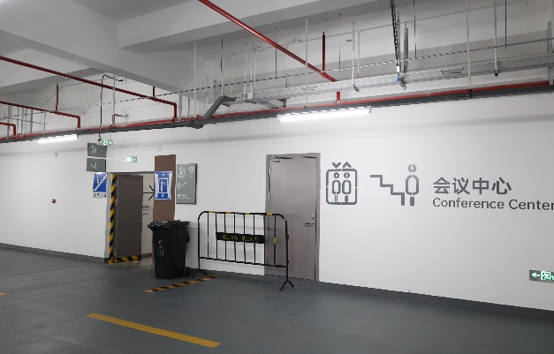
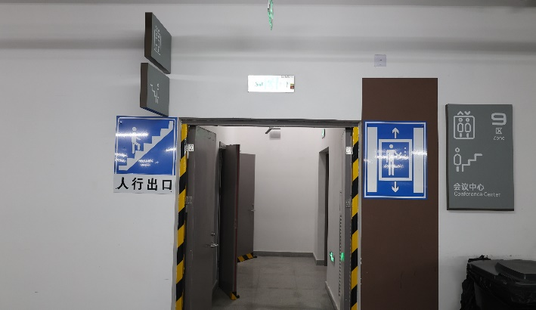
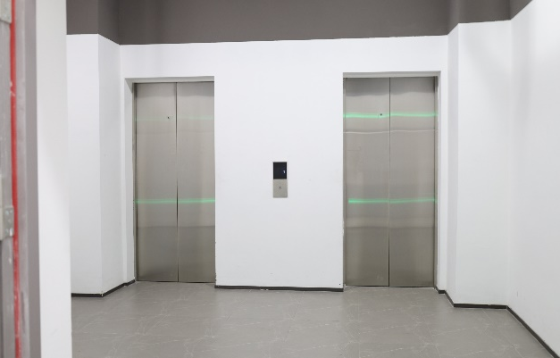
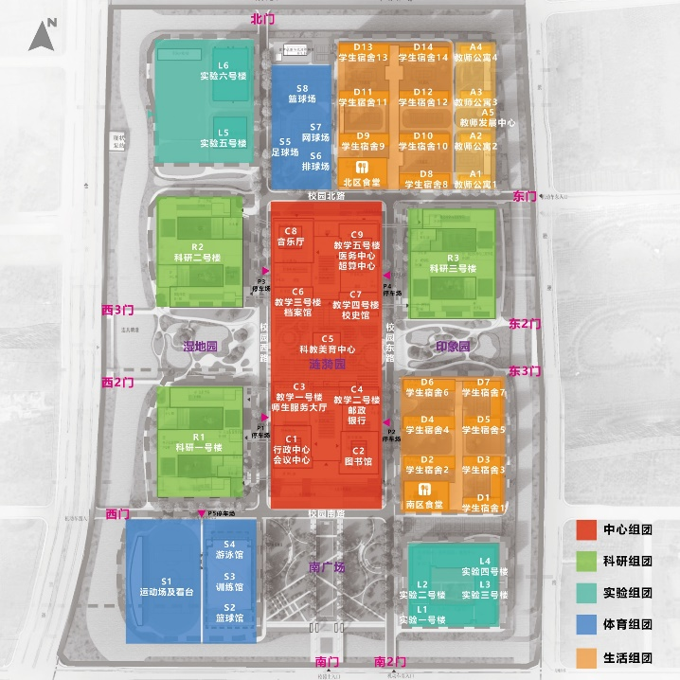
Vehicle Guide for
Conference Center
1
Location name for GPS search: "杭州市北京航空航天大学国际创新研究院（西门）International Innovation Institute of Beihang University, Hangzhou (West Gate)"
2
Turning left at the first intersection after entering the campus
.
3
Go straight for about 100 meters, then turn right and enter the P1 parking lot.
4
After entering the parking lot, turn right and head towards Zone 8/9.
5
Parking the vehicle near Zone 9.
6
After parking the vehicle, enter this passageway and turn left.
7
Turn left and take this elevator to go up to the conference center hall on the first floor.
Please do not exceed the speed limit.-30 km/h
No. 166, Shuanghongqiao Street, Pingyao Town, Yuhang District, Hangzhou City

