Slide 1
Introducing

Slide 2
Content
What is Scopus
Scopus content
Scopus author profiles
Appendix: research metrics
Further resources

Slide 3
What is Scopus

Slide 4
Scopus delivers a comprehensive view on the world of research
Scopus is a source-neutral abstract and citation database curated by independent subject matter experts.
Identify and analyze which journals to read/submit to
78 million Items
Track and assess a researcher’s impact
25,000+ Serial titles
1.4 billion cited references dating back to 1970
Decide what, where and with
whom to collaborate
Track impact of research and monitor global research trends
220,000+ Books
5,000+ Publishers
Find the current research; what has been published in a research area
~70,000 Affiliation profiles
16 million Author profiles
Determine how to differentiate
research topics, find ideas

Slide 5
Scopus is the gold standard:
Evaluation, ranking, reporting, landscape analysis and other strategic efforts
UK BIS
Queen’s University Belfast
STINT
Rankings organizations
v
Reach NC
Russian Foundation for Basic Research
The World Bank
Ural Federal University
Université
Paris Saclay
New Jersey Economic Development Authority
MD Anderson
National Science Foundation
ISTIC
CAPES Brazil
IISER
TCI-Thailand
FCT Portugal
Danish BFI
Nigerian Government
Gazi University
Peking University
NRF-
Korea
European Commission & ERC
Italy ANVUR
Germany IFQ
Keio University
Nanyang Technologica
University
Kiel
University

Slide 6
Scopus content

Slide 7
Global representation means global discovery Across all subjects and content types
North America
6,600+
54% more than nearest competitor
Middle East & Africa
860+
236% more than nearest competitor
Western Europe
12,170+
75% more than nearest competitor
East Europe incl. Russia
1,750+
220% more than nearest competitor
Global representation
(number of active titles)
Latin America
790+
193% more than nearest competitor
Asia Pacific
2,230+
265% more than nearest competitor
Australia/
New Zealand
260+
225% more than nearest competitor

Slide 8
Global representation means global discovery Across all subjects and content types
Number of journals by subject area
Journals
Conference
Books
Scopus includes content from more than 5,000 publishers and 105 different countries
40 different languages covered
Updated daily
Multiple regional content types covered (journals, conferences, books, book series)
9.5M open access documents
Physical sciences
13,312
25,300 Peer-reviewed journals
294 Trade journals
5,527 Active gold open access journals
>8,000 Articles in press
Full metadata, abstracts and cited references
101K Conference events
9.8M Conference papers
Mainly Engineering, maths, physics and computer sciences
852 Book series
40K Volumes
1.8M Items
220,000+ Stand-alone books
Mainly social sciences and arts & humanities
Health sciences
14,448
Social sciences
12,464
Life sciences 7,295

Slide 9
Scopus brings you a world of data to mine
Scopus delivers all metadata as provided by publishers, including: author(s), affiliation(s), document title, year, electronic identification (EID), source title, volume/issue/pages, citation count(s), source, document type and digital object identifier (DOI).
4.5 TB
Data stored in content repository
1.7 billion
cited references
70,000
Institutional profiles
16 million
author profiles

Slide 10
Built to meet your needs

Slide 11
Key ways to use Scopus
Scopus benefits users by enabling them to:
1
Search documents and author profiles with ease
2
Effectively analyse search results
3
Export relevant reference material

Slide 12
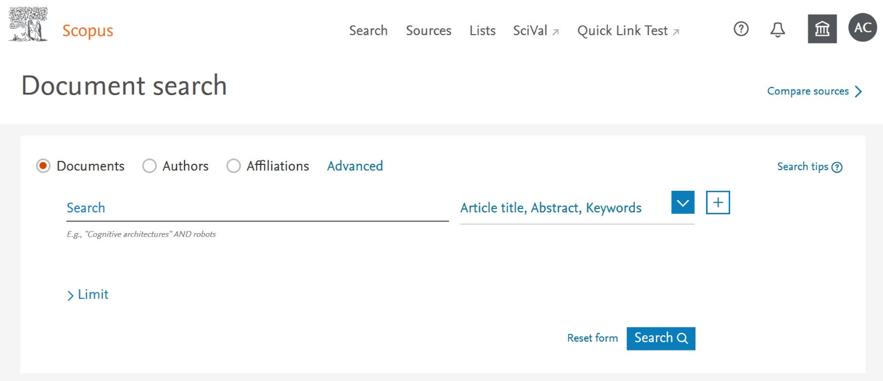
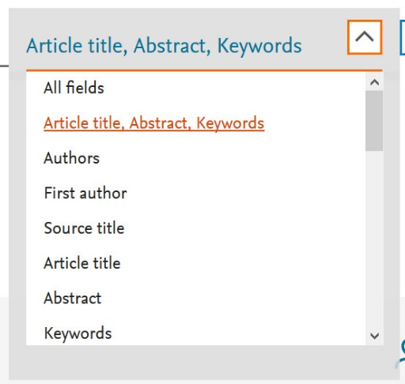
Search for documents and author profiles with ease
Simple single search box
Search different fields for greater specificity

Slide 13
Search for documents and author profiles with ease
Search Documents, Authors, and Affiliations

Slide 14
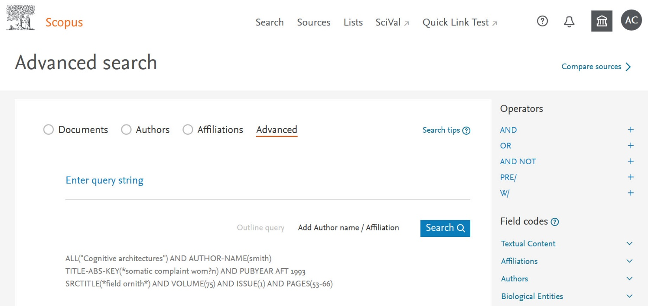
Search for documents and author profiles with ease
Build advanced queries
Built-in tips and guidance on query building

Slide 15
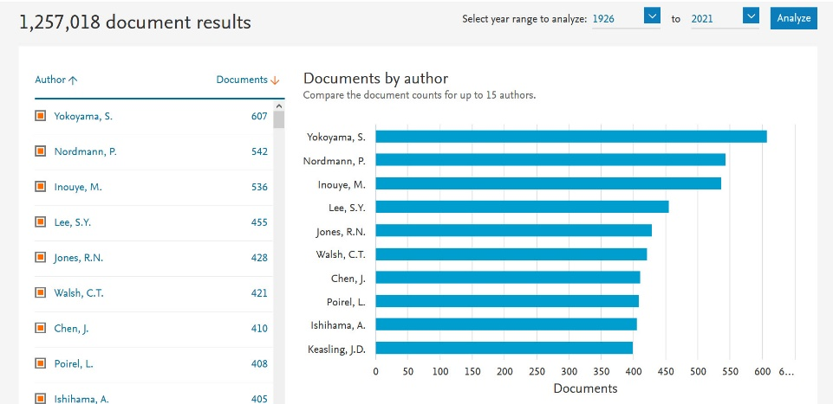
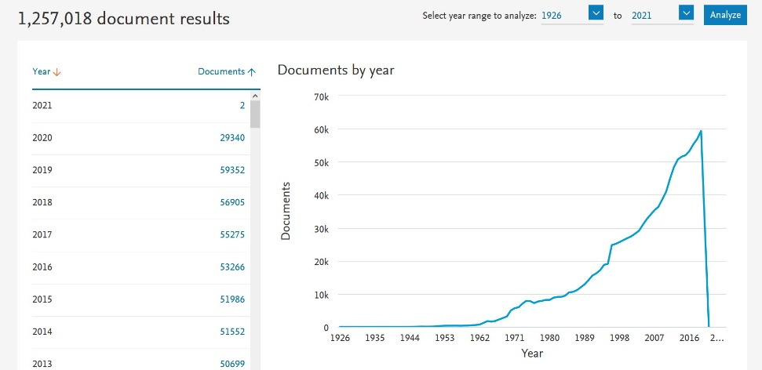
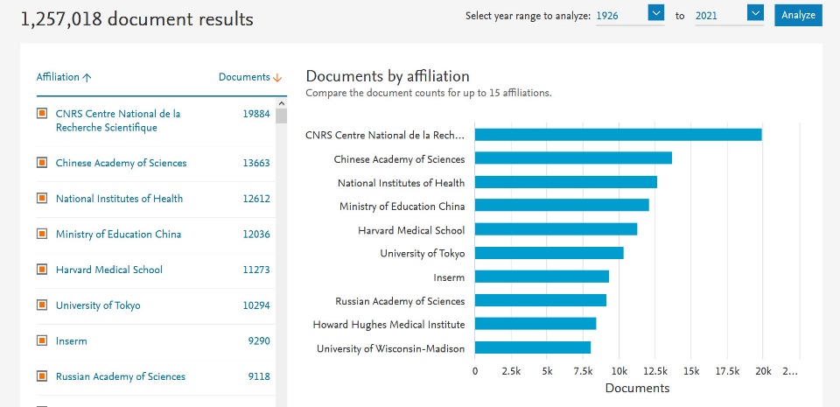
Analyze your results
View trends over time by article count, author, affiliation, source, and more
Built-in tips and guidance on query building

Slide 16
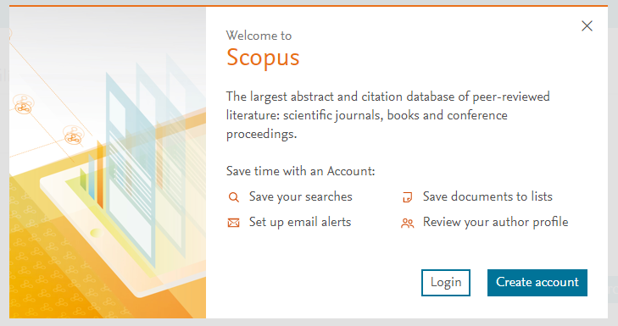
Unlock greater functionality with your own account
Get the research delivered to you with email alerts
Save searches and document lists
Review and update your author profile with ease

Slide 17
Scopus benefits your research at every stage
Effective multi-disciplinary discovery and opportunity finding
The Global View: discovery and tracking of scientific developments across disciplines & the world.
Accelerate research process, avoids duplication of research efforts.
Find new funding opportunities.
Develop new processes and solutions faster, securing new patents.
Efficient research and publication process
Speed up publication process, find the best journals using journal metrics and journal analysis tools.
Effective research assessment, improved output and ranking
Identify researchers and institutes for potential collaboration and track their work/output.
Find the best collaborators
Monitoring and measuring research impact.
Effectively analyze research from peer researchers.
Improve publication output and h-index.
Better career development
Manage career, track citations, find job opportunities, find collaborators, secure funding, find the best journals to publish in.

Slide 18
Built to address your needs
Scopus supports your goals across your career, wherever that may take you
Researcher (post-doc)
How do I make sure I don’t miss any relevant information?
Researcher (senior)
How do I compare myself and my research team against peers?
How many times have I been cited by others?
Who should I collaborate with to increase my chances of publishing successfully and getting cited?
Which journals should I publish in to make myself more visible to the research community?
How can I get tenure and advance my career?
How do I secure more funding?
How can I get a quick overview of a new subject area?
How do I find funding?
Corporate researcher
How can I make the most of my company’s resources?
How can I get a quick overview of a new subject area?
What are my competitors working on?
Who is the key opinion leader in a specific area?
How can I increase productivity and decrease cost/time to market?

Slide 19
Scopus author profiles

Slide 20
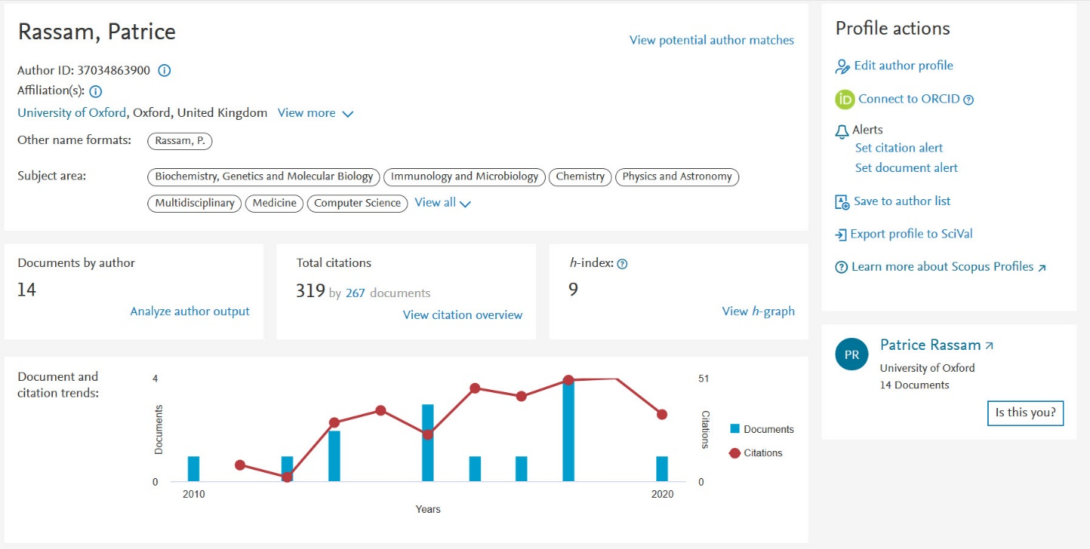
Scopus author profiles
Author profiles deliver key details on author output, metrics, and identification
Identifiers; Affiliation, Author IDs, ORCID, and alternate names
Output: subject area coverage; output over time; citations
Metrics: h-index; citations, and more

Slide 21
Scopus: the premier source of profiles
The Scopus data model
The data that goes into Scopus follows the model that articles are written by authors who are affiliated with institutions.
This relational data model means that Scopus can tell you who is researching what is global literature and where they are doing it with higher accuracy than anyone else.
Scopus is the only database that implements algorithmic & systematic author disambiguation.
Article
78 million
records from journals, books, and book series, conference proceedings and trade publications
Author
16 million
Author profiles
Affiliation
70,000
Affiliation profiles

Slide 22
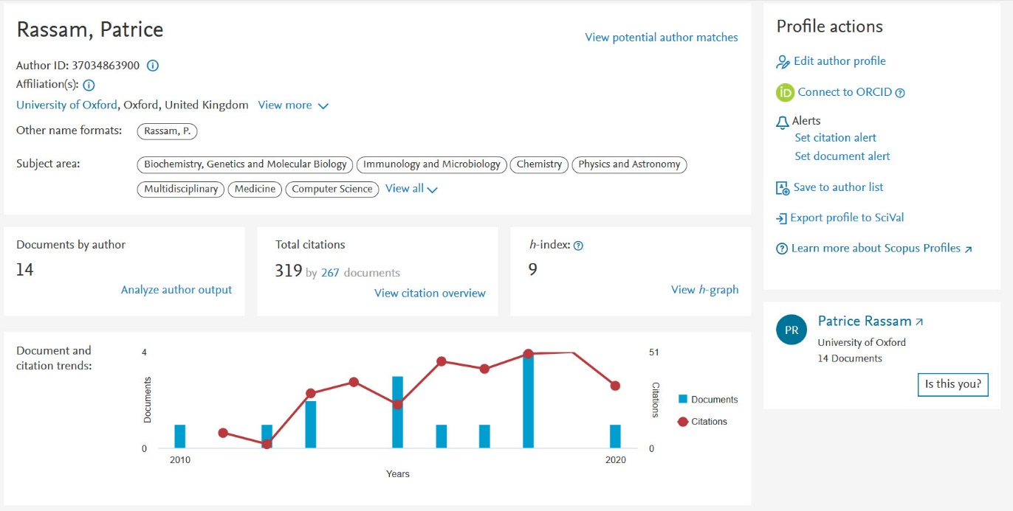
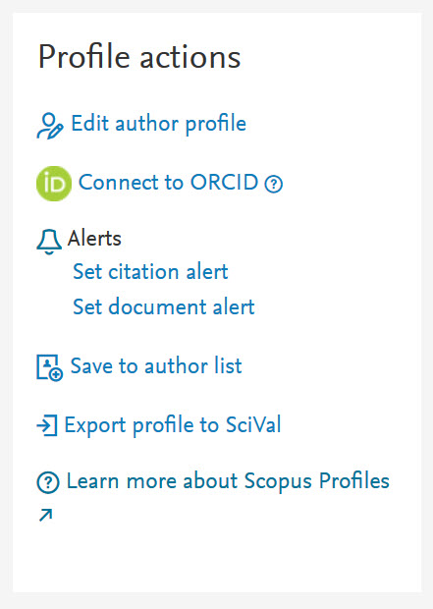
You can make corrections directly from an author profile
Update the profile or suggest updates within a given profile

Slide 23
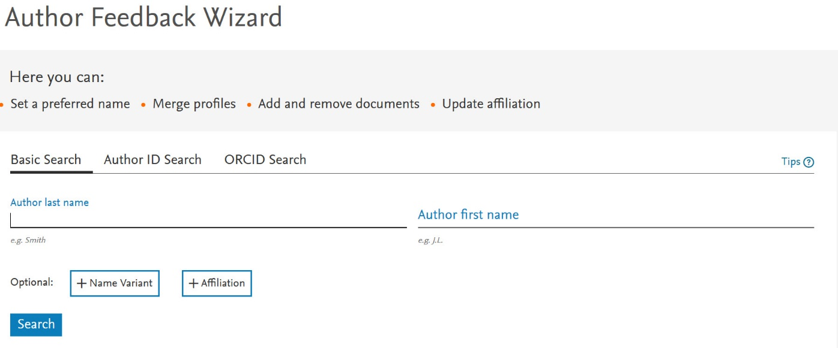
You can also make corrections by searching in the Author Feedback Wizard
For simple merges and splits: www.scopusfeedback.com
Turnaround time: 36 hours

Slide 24
Types of corrections you can make
Author profile corrections
Requests to update author’s affiliation isn’t allowed as affiliation history in an author profile is built based on articles linked to respective author profile.
Merges; combining two or more author profiles together and updating associated Scopus articles as well
Splits; separating articles from one author profile to another author profile (existing or new one)
Overrides or detail mistakes (changing name, email of author profile)
Content is missing and should be in Scopus based on Content Coverage guidelines

Slide 25
Appendix:
research metrics in Scopus

Slide 26
Elsevier research metrics in Scopus
A comprehensive suite of metrics embedded throughout Scopus is designed to provide a better view of users research interests.
Two golden rules for using research metrics
When used correctly, research metrics together with qualitative input give a balanced, multi-dimensional view for decision-making
Always use more than one research metric as the quantitative input
Always use both qualitative
and quantitative input into your decisions

Slide 27
A basket of metrics for research excellence
Available for articles, researchers, journals, institutions, subject fields…
Theme | Sub-theme
A. Funding | Awards
B. Outputs | Productivity of research outputs
 | Visibility of communication channels
C. Research Impact | Research influence
 | Knowledge transfer
D. Engagement | Academic network
 | Non-academic network
 | Expertise transfer
E. Societal Impact | Societal Impact
Qualitative input

Slide 28
Journal metrics in Scopus
CiteScore™ metrics are the new standard that help to measure journal citation impact.
Source-Normalized Impact per Paper (SNIP)
Developed by CWTS, University of Leiden Netherlands.
Measures contextual citation impact by weighting citations based on the total number of citations in a subject field.
The impact of a single citation is given higher value in subject areas where citations are less likely, and vice versa.
Comprehensive, clear, current and free metrics for helping to analyze where research outputs are published.
Calculated using data from Scopus, CiteScore metrics help validate citations received by journals and proceedings, and empower users with information to make well-informed decisions regarding where to publish.
SCImago Journal Rank (SJR)
Developed by SCImago, Spain.
A prestige metric that can be applied to journals, book series and conference proceedings.
With SJR, the subject field, quality and reputation of the journal have a direct effect on the value of a citation.

Slide 29
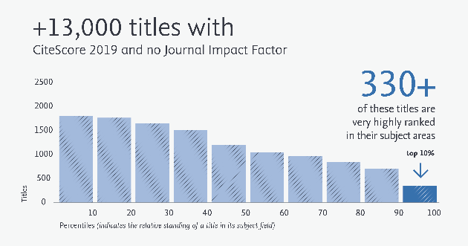
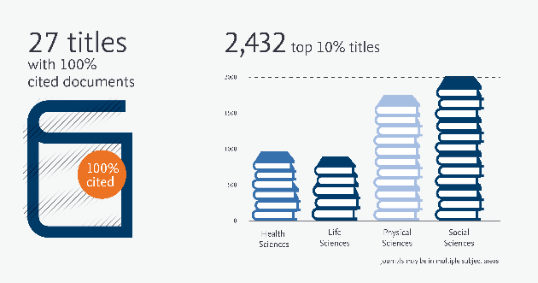
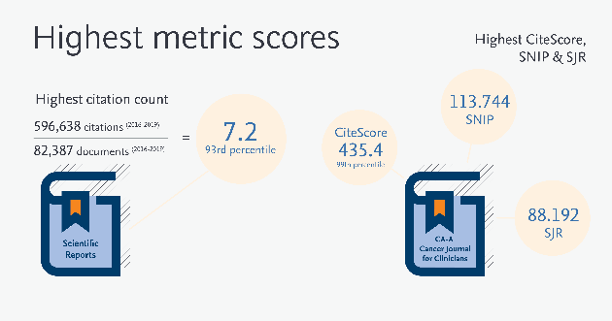
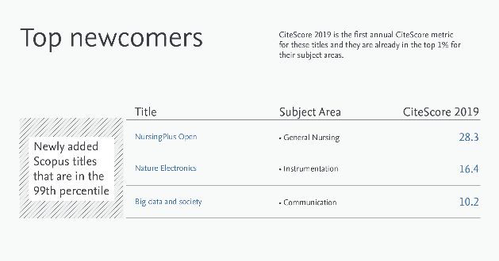
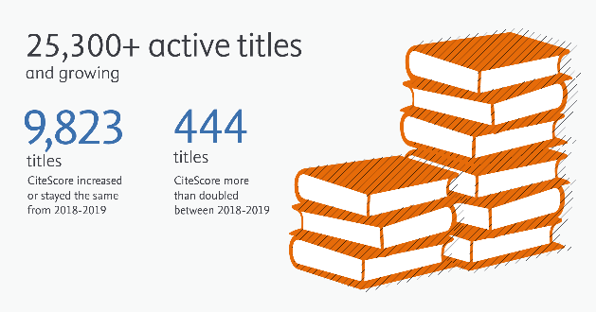
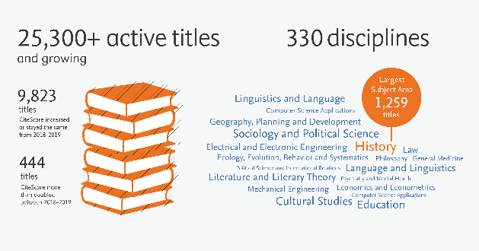
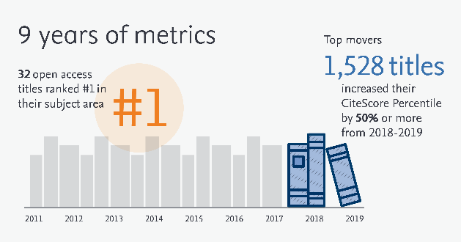
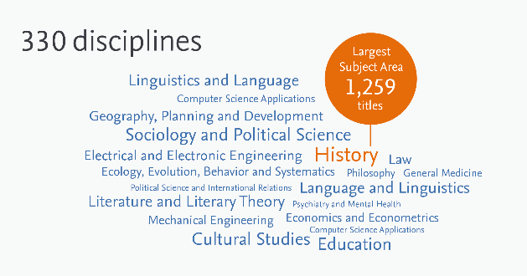
CiteScore provides greater clarity, currency & comprehensiveness

Slide 30
Each metric provides a complementary measure of performance
 | Measures | Validation in Scopus? | Size-normalized? | Subject field-normalized? | Communicates magnitude? | Update frequency
CiteScore | Citations per document | Yes | Yes | No | Yes | Annually, and monthly for CiteScore Tracker metrics
CiteScore Percentile | Relative position within subject field based on CiteScore | Yes | Yes | Yes | No
Citation Count | Raw impact of a journal on the research community | Yes | No | No | Yes
Document Count | Raw scale of a title within the research community | Yes | No | No | Yes
% cited | Consistency with which a title’s contents are reliably cited | Yes | Yes | No | No
SNIP | Relative citations per document | No | Yes | Yes | No | Annually
SJR | Prestige of citing sources | No | Yes | Yes | No

Slide 31
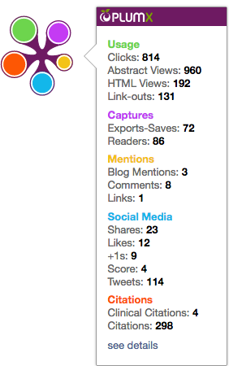
Article-level metrics in Scopus:
PlumX compare like with like
PlumX metrics are comprehensive, item-level metrics that provide insights into the ways people interact with individual pieces of research output:
Visualizes scholarly engagement
Includes 5 categories of metrics
Designed to communicate engagement without a score
PlumX in Scopus:
Usage
(clicks, views, downloads, library holdings, video plays)
Captures
(bookmarks, favorites, reference manager saves)
Mentions
(blog posts, news mentions, comments, reviews, Wikipedia mentions)
Social Media
(tweets, likes, shares)
Citations
(citation indexes, patent, citations, clinical citations, policy citations)

Slide 32
Further resources

Slide 33
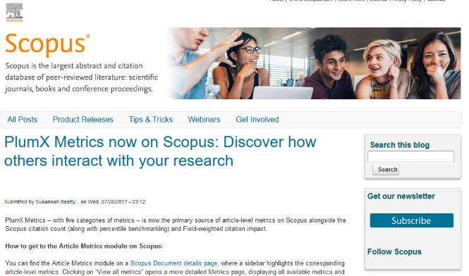
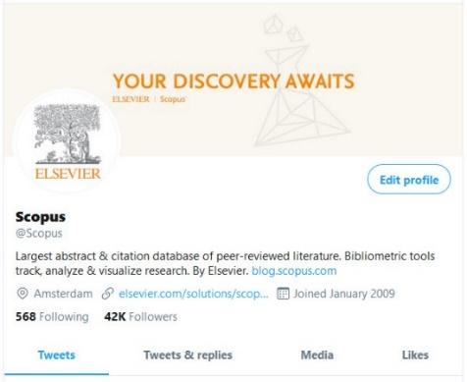
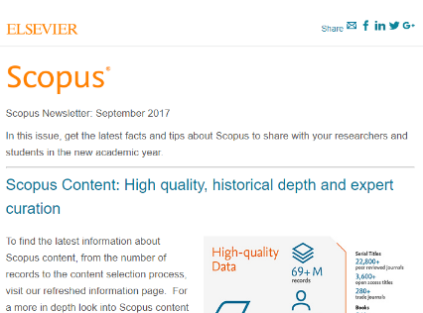
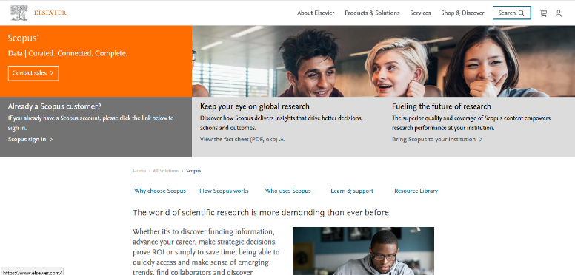
Where to find more information:
Learn and connect with us via the Scopus blog, newsletter, Twitter, infosite & more!
Blog.Scopus.com
Twitter.com/Scopus
Librarian toolkit
Newsletter
Scopus info site: elsevier.com/scopus

