Slide 1
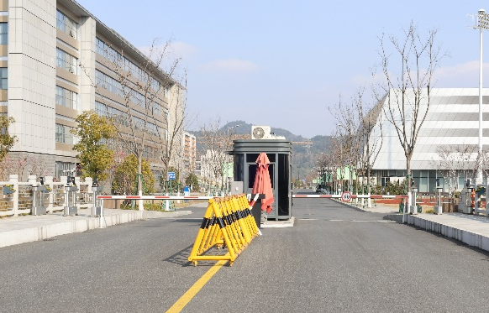
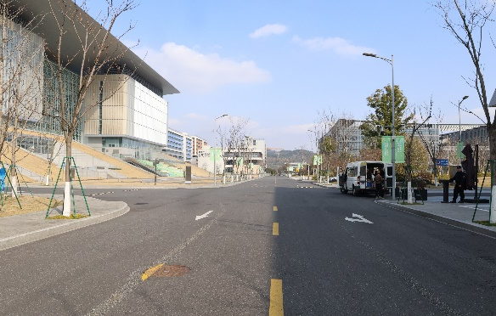
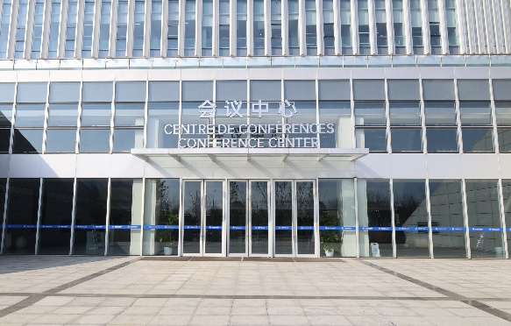
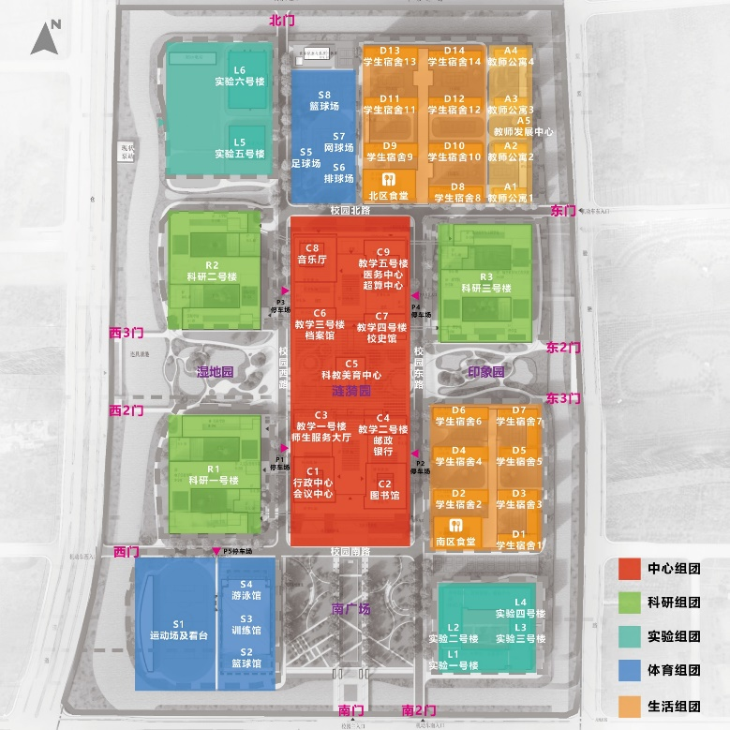
Guide for
Conference Center
1
Location name for GPS search: "杭州市北京航空航天大学国际创新研究院（西门）International Innovation Institute of Beihang University, Hangzhou (West Gate)"
2
After entering the campus, go straight along the South Campus Road and pass the first intersection.
3
Go straight for about 20 meters after crossing the intersection. The conference center is on the left.
Please do not exceed the speed limit.-30 km/h
No. 166, Shuanghongqiao Street, Pingyao Town, Yuhang District, Hangzhou City

