Slide 1



FAQs for Scopus Content Partners
Scopus内容合作伙伴
常见问题答疑(中文版)
Last Revised: June, 2025 上次更新：2025年6月
Content & Data Sourcing Team 内容数据收录团队

Slide 2
Topics covered 主要内容
Scopus Overview Scopus概览
Scopus Content Selection Scopus内容遴选
Approximate Timelines for Scopus Onboarding Scopus上线预估时间轴
Scopus Acceptance and Permissions Scopus接受与许可
Content Access 内容访问
Making Changes in Scopus 在Scopus中对内容进行变更
Promoting that Your Content is in Scopus推广您被Scopus收录的内容
Other Resources 其他资源

Slide 3
Scopus Overview Scopus概览
What is Scopus? Scopus是什么
Scopus is Elsevier’s source-neutral abstract and indexing database, curated by independent subject matter experts. By having content included in Scopus, scholarly publishers make their content discoverable at over 7000 of the world’s top research institutions. Content in Scopus is linked through citation mapping, so that users can see who cited a piece of content or look at what an author may have referenced to support her or his research.
Scopus是Elsevier经由独立的学科专家进行汇编，内容中立的文献摘要和引文数据库。Scopus收录的内容，使得全球超过7000家顶尖的科研机构能发现学术出版商的内容。Scopus提供科学、技术、医药、社会科学、艺术和人文领域的世界科研成果全面概览，是可以追踪、分析和可视化研究成果的智能工具。
How can I learn more about Scopus? 如何更多了解Scopus？
The Scopus Blog is the best place to start. 访问Scopus Blog是最佳选择。
I’m looking for Scopus end-user support. 我想寻求Scopus终端用户支持。
You can find help on the Scopus Support Hub. 您可以访问Scopus支持中心。

Slide 4
Scopus Overview Scopus概览
How is CiteScore Calculated? Citescore 是如何计算的？
CiteScore is a metric assigned to all titles in Scopus. This metric is calculated by Elsevier. To learn more about how CiteScoreTM is
calculated and how it should be used, we recommend reading this Scopus blog post from June 2024 : Citescore 2024 values now live!
CiteScore 是一个用来评价在Scopus中连续出版物影响力的度量指标。这项指标由爱思唯尔计算。了解CiteScoreTM如何计算、使用，推荐阅读这篇Scopus博客： June 2024 : Citescore 2024 values now live!
Where can I learn more about CiteScore? 从哪里可以了解更多CiteScore相关信息？
Please visit the CiteScore FAQs page.
请访问CiteScore FAQs 页面。

Slide 5
Scopus Content Selection Scopus内容遴选
How do I suggest a title for Scopus? 如何申请Scopus收录？
You can learn more about content selection criteria and submit a title for consideration via the Scopus Suggestion link
您可以通过Scopus申请系统，了解更多遴选标准或提交申请。
How can I tell if my content is eligible for Scopus? 如何判断我的内容是否符合Scopus要求?
We recommend reading the Scopus Content Guide. This explains what is included in Scopus both in terms of content types and
disciplines covered as well as more information on the selection process.
推荐您阅读Scopus内容指南。该指南说明了Scopus收录的内容类型、学科及其他遴选阶段的信息。

Slide 6
Scopus Content Selection continued Scopus内容遴选 续
How long does it take for content to be evaluated? 内容评审大概需要多久？
This varies. We want to ensure that all content submitted is given the appropriate attention.
每本期刊时间不同。每本提交申请的期刊都会被高度重视。
How can I get an update on my title’s evaluation progress? 如何获悉自己期刊的评审进程？
You can track the progress of the evaluation process by entering the unique Tracking ID provided at the time of submission into the Title Evaluation Tracker.
提交期刊评审后，系统自动生成Tracking ID，您可以在Title Evaluation Tracker中输入Tracking ID来跟踪本刊的评估进程。
What does it does cost to be indexed in Scopus? 被Scopus收录是否收费？
There is no cost to be included in Scopus. Our primary goal is to include high quality, publisher-agnostic content.
Scopus收录免费。我们的初衷是收录高质量内容，无论出版商是谁。

Slide 7
Scopus Content Selection continued Scopus内容遴选 续
What is the first issue of the title that will be indexed? 从哪一期开始被收录？
Starting in 2023, a journal’s starting coverage year will be from the year of selection minus 4. This means that for a title selected in 2023, its coverage would start in 2019 and include the content for all years going forward. Special considerations apply to journals that are previously rejected for Scopus inclusion, the start coverage year will begin from the year following the year of rejection. For journals that were previously discontinued and then selected for coverage again, indexing will begin from the year of re-selection.
自2023年开始，期刊内容收录年份将定为遴选年减4。即，如期刊2023年通过遴选，将收录2019年以后出版的所有内容。如期刊曾被 Scopus 拒收，收录年份会有所不同：其收录起始年份将从被拒收的次年开始计算。 如期刊曾被中止收录、后来又重新被遴选，其收录将从被重新接受的年份开始。

Slide 8
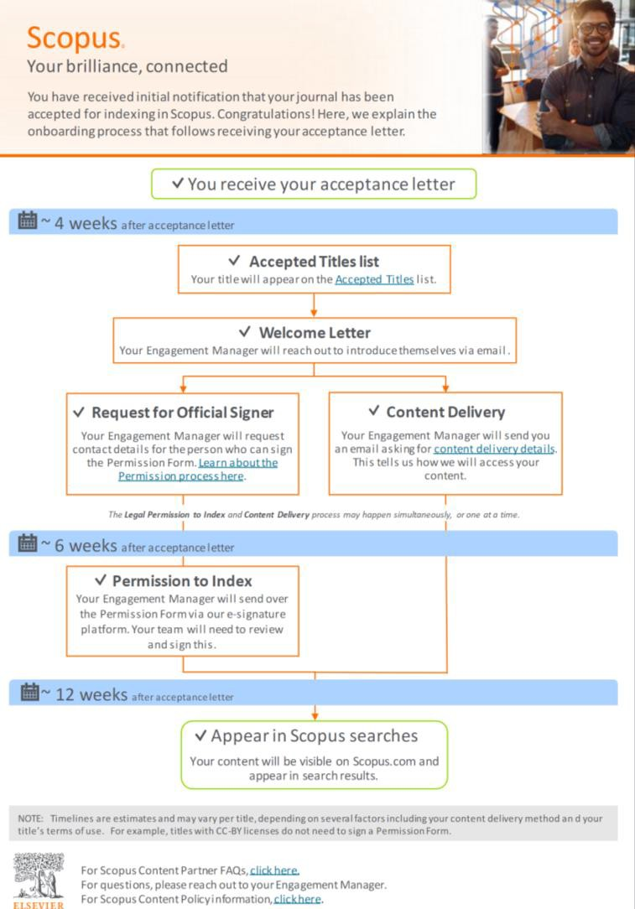
Approximate Timelines for Scopus Onboarding Scopus 上线预估时间轴
How long will it take for my content to appear
on Scopus?
内容出现在Scopus中需要多长时间？
In most cases, the titles will follow the timelines as shown in this flyer; however, this depends on the content delivery method that you would choose and other factors.
多数情况下，期刊上线遵循宣传单页中的时间轴。但受数据传输方式等因素影响，每刊所需时间不同。

Slide 9
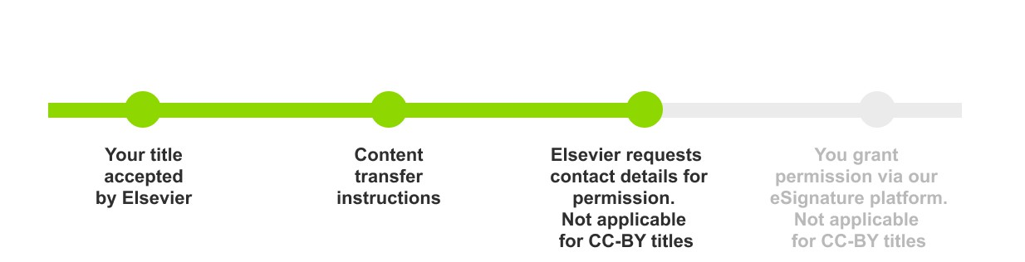

Scopus Acceptance and Permissions Scopus接受与授权
My content was just accepted into Scopus. What are the next steps for me?
我的期刊被Scopus收录了，下一步应该做什么？
Congratulations! The first step for you is to celebrate. 恭喜！首先应该庆祝一下。
If this is your first title accepted by Elsevier:
如为贵社被Elsevier收录的首本期刊：
If you already have a title indexed by Elsevier:
如贵社已有期刊曾被Elsevier收录：
Content Delivery: Your Publishing Relations Manager will reach out to confirm your content delivery preference. Generally, we recommend using the same method for all titles.
内容传输：数周后，您的出版关系经理将会询问您希望如何传输内容。通常，我们建议所有期刊采用同一种传输方式。
Permission to Index: Your Publishing Relations Manager will work with you to make sure Elsevier has permission to index your title.
最终，您的出版关系经理将会与您确认，授权Elsevier收录贵刊内容。
Welcome Letter: A few weeks after your acceptance, you will receive a welcome letter from your Publishing Relations Manager .
欢迎函：被接受数周后，您将收到出版关系经理发送的欢
迎邮件。
Content Delivery: About a week later, your Publishing Relations Manager will ask about your content delivery preferences.
内容传输：数周后，您的出版关系经理将会询问您希望如
何传输内容。
Permission to Index: Finally, your Publishing Relations Manager will work with you to ensure Elsevier has permission to index your title.
收录授权：最终，您的出版关系经理将会与您确认，授权
Elsevier收录贵刊内容。

Slide 10
Scopus Acceptance and Permissions continued Scopus接受与授权 续
What is the role of my Publishing Relations Manager?出版关系经理是一个什么角色？
Your Publishing Relations Manager is your primary point of contact going forward. Their role is to make sure your relationship with Elsevier runs smoothly. This person will help you with onboarding, future license renewals and making updates in our records like changes in title, ISSN, URL, publication frequency, and contact information. This person can also help with any other questions you might have.
出版关系经理是您以后的直接联系人。他们帮助您与Scopus的沟通顺畅。出版关系经理将会协助您数据上线、未来授权协议续签、各种期刊相关信息的更新，例如刊名、URL、出版频率以及联系方式。出版关系经理也可以帮您解决其他问题。
How long will it be before my content appears in Scopus searches? 我刊内容什么时候能被
Scopus搜索到？
This depends on a variety of factors, including how you chose to deliver content to us. To learn more, please visit our Scopus Onboarding Timeline flyer.
受数据传输方式等多项因素影响，每刊所需时间不同。如需了解更多内容，请访问Scopus上线时间轴单页。

Slide 11
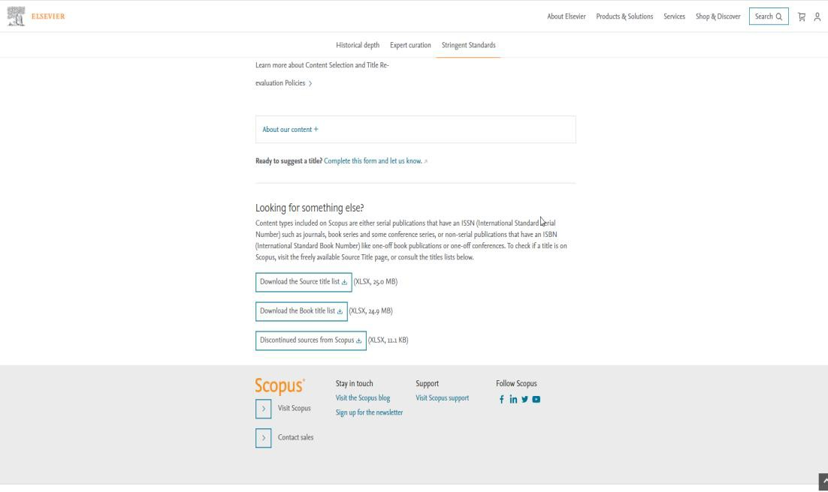
Scopus Acceptance and Permissions continued Scopus接受与授权 续
Where can I see proof that my title is in Scopus? 从哪儿可以找到我们期刊已被Scopus收录的证明？
There are a few ways. 有以下几种方式：
You can find this at the bottom of期刊列表在该网页下方： https://www.elsevier.com/solutions
/scopus/how-scopus- works/content
The first place your title will appear is one the Source Title List on the “Accepted Titles” tab. This is updated monthly and is the most up-to-date list of titles in Scopus. You can learn more on the Scopus Blog.
您的期刊首先会出现在来源期刊列表“已接受期刊（Accepted Titles）”中。该表格每月更新，是最新的Scopus收录期刊列表。更多信息，可以阅读Scopus Blog。
As soon as a content transfer method set up, you can search in Scopus for your titles ISSN. This takes a little longer.
内容传输方式确认后，您可以在Scopus中搜索期刊ISSN。这种方式需要更久一点时间。
The other place you can look is the Scopus Sources within Scopus product. This list takes the longest to update, so don’t worry if you can’t find your title here at first.
您还可以在Scopus数据库中查找Scopus内容来源。这个表格需要更新时间最长，如果您的期刊一开始不在表里，请不要担心。

Slide 12
Scopus Acceptance and Permissions continued Scopus接受与授权 续
Why do I have to sign a Permissions Form? 为什么要签授权表格？
You will receive a Permission Request form from your Publishing Relations Manager via DocuSign, our eSignature platform. This is the legal document that gives us permission to include your content in Elsevier solutions, like Scopus. If you do not grant us legal permission, we cannot include your content in Scopus.
您将会收到出版关系经理通过DocuSign（我们使用的电子签字平台）发送的授权许可表格。这份授权文件将会许可我们将您出版的内容收录进Elsevier解决方案中，例如Scopus。没有您的授权许可，我们无法将您的出版内容收录于 Scopus中。
Who should sign the Permissions Form? 谁来签署授权表格？
This is up to you. At some organizations, there may be a licensing professional. You may also prefer to have it signed by the journal editor, the publisher or the person who submitted the title for coverage consideration.
由您决定。某些组织有专门授权人员。也可以选择由期刊编辑、出版商或提交期刊收录申请的人员签署。

Slide 13
Scopus Acceptance and Permissions continued
Scopus接受与授权 续
What does Elsevier mean by “licence renewal date”?
Elsevier的“授权更新日期”是什么意思？
For Scopus Content Partners, the licence renewal date refers to when the licence agreement confirming your willingness to have your title indexed in Elsevier databases expires. It simply means that we must renew our licence with you.
对Scopus内容合作伙伴来说，授权更新日期意味着贵刊同意被收录于Elsevier数据库的授权协议过期了。简言之，我
们需要与您续签授权协议。
For many publishers, we send this form out every year to confirm your willingness to continue indexing. If you prefer not to renew every year, you could choose to grant us a perpetual license.
我们每年都会向很多出版社发送表格，确认您是否同意被继续收录。如果您不想每年续约，请选择授予我们永久许可。
Renewals are a standard activity and do not mean your title is being re-evaluated.
续签只是常规操作，并不代表您的期刊会被重新评估。
Note: Prior to 2021, we referred to this as the “subscription end date”.
注：2021年之前，我们曾称之为“订阅结束日期”。

Slide 14
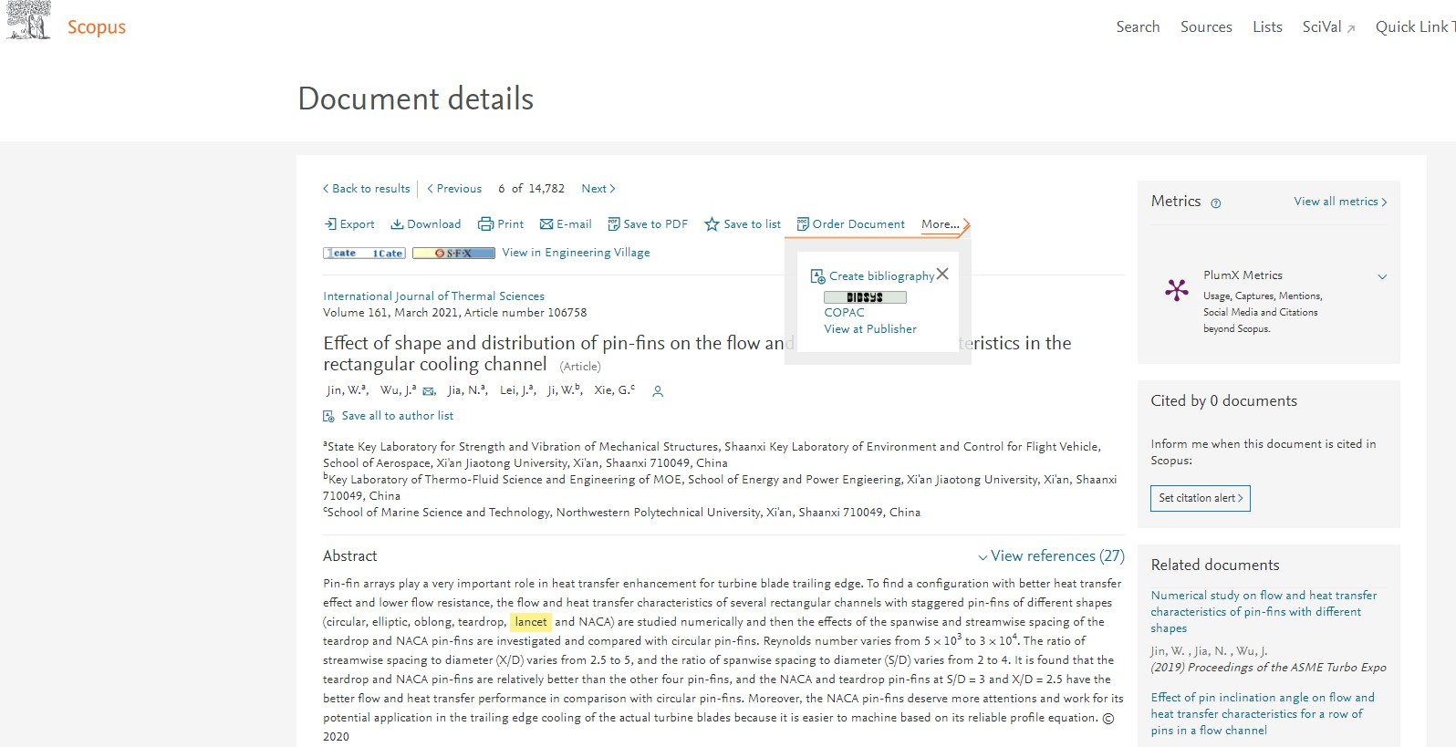
Content Delivery 内容传输
Why does Elsevier need access to my
full-text content?
为什么Elsevier需要获取我的全文内容？
We need access to your content so we can access the metadata including citations as well as the abstract. This allows us to capture the full set of citations as well as information around authors, journal and publisher.
我们需要获取包括引文、摘要在内的所有元数据。通过访问全文，我们可以获取全部引用信息，以及作者、期刊、出版社相关信息。
We never make the full text available to our customers or other third parties.
我们不会将全文展示给客户或其他第三方。
Scopus document record, accessed Jan 2021

Slide 15
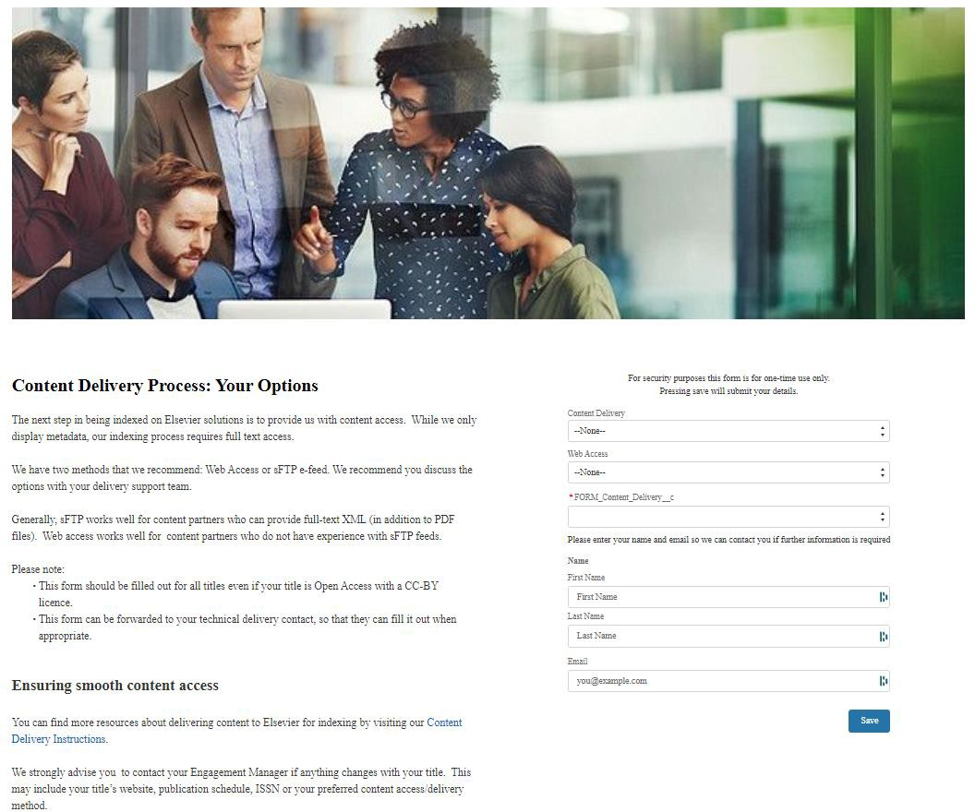
Content Delivery continued内容传输 续
How does content delivery set up work?
如何设置内容传输？
Your Publishing Relations Manager will send you a form asking about your preferences. If you have technical delivery team, you may prefer to have them fill out the form. If you are already providing content to Elsevier for indexing, we strongly recommend you use the same method for all titles.
出版关系经理会发送表格，征询您的意愿。如果贵单位有技术传输团队，您可以请相关团队填写该表格。如果您已经在为Elsevier提供内容用于收录，我们强烈建议您所有期刊都用同一种方式进行传输。
You can find more information about content delivery options here.
更多选择内容传输方式信息请参阅此处。
For specific questions, please reach out to Publishing Relations Manager.
如有疑问，请联系出版关系经理。
Screenshot of the Content Delivery Form, April 2022
The form domain will include “relx-elsevier-operations.force.com”
内容传输方式表，2022年4月
该表格链接内，包括“relx-elsevier-operations.force.com”

Slide 16
Content Delivery continued 内容传输 续
How can I provide content access to Elsevier? 如何向Elsevier提供数据？
Once the Permissions Form is signed, you and your Publishing Relations Manager will decide what is the best access method for you, based on technical specifications and whether the content is Open Access. You can find more information about content delivery options here.
签署授权表格后，您和您的出版关系经理将会根据技术条件、内容是否开放获取，一起商定最佳传输方式。您可以在数据传输选择此处找到更多内容传输相关信息。
Generally, we can accept content in the following ways: 通常，我们可以通过如下方式接受内容：
Web crawling with Login Credentials – (Username/password access). This is our preferred access method. 登录账密-（用户名/密码访问）这是我们首选获取方式。
Web crawling with IP recognition IP认证
sFTP upload - This option is only available under special circumstances. sFTP上传-特殊情况下的选择。
For Open Access titles, we may not need special access. Once the Permissions Form is signed, we may be able to use a web crawler to access the metadata we need.
开放获取的期刊，我们不需要特别的授权访问。签署授权表格后，我们即可利用网络爬虫获取所需数据。

Slide 17
Content Delivery continued 内容传输 续
Do you have any tips for ensuring content transfer runs smoothly?
您有什么其他确保内容顺利传输的建议么？
It is important that you let your Publishing Relations Manager know as soon as possible about changes to your title such as ISSN, website URL, publication frequency or contact detail changes. Changes may disrupt content transfer.
当您的期刊发生任何变更，例如ISSN、网站URL、出版频率或联系人信息，请尽快通知您的出版关系经理。刊物变动会影响数据传输。
This is particularly important, because a disruption in content transfer could trigger the title re-evaluation process.
这点非常重要，因为内容传输中断可能会导致期刊重新评审。
What are the IP addresses I need to whitelist?
哪些IP网站需要列入白名单?
You can find the current list of IP addresses here.
您可以在此找到当前使用的IP地址列表。

Slide 18
Making Changes in Scopus
Scopus中期刊内容变更
Does Scopus process notices of retraction, erratum and corrigendum? Scopus是否会处理期刊撤稿、勘误或更正？
Yes, but only if these notices are published in a journal issue. We do not index retraction, erratim and corrigedum that are delivered as seperate letters.
是的，但仅以正刊出版的形式进行通知。我们不会收录任何单独信函形式的撤稿、刊物或更正通知。
Why do my articles not appear with the Open Access (OA) tag in Scopus (despite being OA)?
为什么我的开放获取（OA）文章在Scopus中没有开放获取（OA）标记？
We source our OA document tags from Unpaywall, a database run by Impactstory (a non-profit organization) which harvests Open Access content from over 50,000 publishers and repositories. You can learn more about OA tags in Scopus on the Scopus blog.
我们的OA文件标记来源于Unpaywall，由非营利组织Imapctstory运营的数据库，从50，000家出版社或机构知识库收割OA内容。您可以
访问Scopus Blog了解更多ScopusOA标记相关内容。
My SCImago (SJR) or Source-Normalized Impact per Paper (SNIP) metrics do not accurately reflect my citation performance. How can I get them updated?
我的SCImago（SJR）和SNIP指标不能准确反映我的引用表现，应该如何更新这两个指标？
Both SJR and SNIP are created by independent organizations that use Scopus data. For more information about SCImago (SJR) visit the SCImago website. For more information about Source-Normalized Impact per Paper (SNIP), visit the CWTS Journal Indicators webpage.
SJR和SNIP都是独立机构应用Scopus数据创立的指标。更多SCImago（SJR）信息，请访问SCImago 网站. 更多SNIP相关信息，请访问CWTS 期刊指标网站。

Slide 19
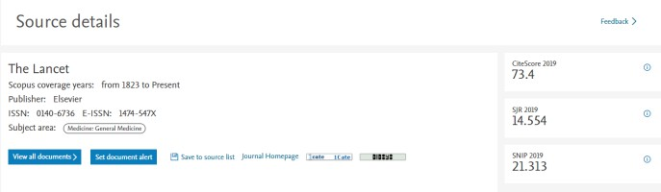
Making Changes in Scopus Continued Scopus中期刊内容变更 续
How can I request changes to Scopus including content and author corrections?
如何请求Scopus对内容、作者勘误等做变更？
Please start with the Scopus Support Center. Here you can request that missing documents be added as well as request corrections
to affiliation and author profiles. You can also let us know about citation and CiteScore corrections that need to be made.
请访问Scopus 支持中心. 在此，您可以申请增补缺失的文章或请求对隶属机构、作者简介进行勘误。您也可以联系我们修正引用和CiteScore。
My basic publisher details, shown on the Scopus Source details page, are not up-to-date. How can I correct them?
Scopus 来源出版物信息页面中，我们出版社的基本信息不是最新版。如何更新？
Please contact your Publishing Relations Manager with any changes. These changes may include information updates to things like title, ISSN, publisher, publication frequency, website URL or a change in contact information. These changes may not reflect in the Scopus Source details page immediately.
如有任何变更，请联系您的出版关系经理。变更信息包括期刊名称、ISSN、出版商、出版频
率、网站链接或联系人信息。所有上述变更都不会在Scopus 来源出版物信息页面自动更新。
Scopus Sources Record, Accessed Jan 2021
Scopus出版物来源页面，2021年1月访问
Scopus Sources Record, Accessed Jan 2021

Slide 20
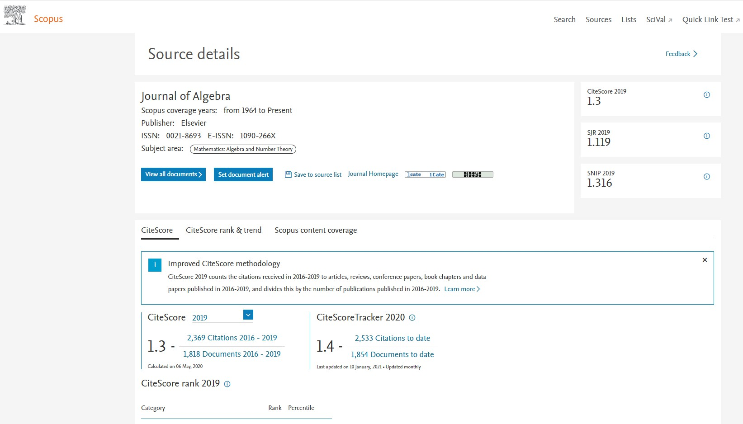
Making Changes in Scopus Continued Scopus中期刊内容变更 续
Where is my Scopus Source page?
我的Scopus来源出版物页面在哪儿？
A Scopus Source page is the page that shares basic information about journals included in Scopus. It shows important information like journal metrics and publisher details.
Scopus 来源出版物页面展示了Scopus收录期刊的基本信息，
包括期刊指标和出版社等重要信息。
Since March 2025, these pages are updated on a monthly basis to ensure that all source related information such as Title, ISSN and publisher details remain up-to-date and accurate.
2025年3月起，这些期刊相关信息页面每月刷新，确保期刊名称、ISSN、出版商信息等内容及时更新、记录准确。
If you are confirming your new content is displayed in Scopus, we
recommend searching by ISSN or Journal Title.
如果您确认期刊内容已经通过Scopus展示，建议您在
Scopus平台上通过期刊ISSN或者期刊名称检索查询。
Scopus Sources Record, Accessed Jan 2021 Scopus出版物来源页面，2021年1月访问

Slide 21
Making Changes in Scopus Continued
Scopus中期刊内容变更 续
How can I change my name in Scopus? 如何在Scopus中变更作者姓名？
There are many reasons an author may wish to change their name. Following a request from the author, Elsevier will apply the updated name to versions of the article on ScienceDirect, Scopus and other relevant platforms.
出于一些原因，作者可能会希望变更他们的名字。应作者请求，Elsevier会将ScienceDirect，Scopus和其他相关平台变更作者姓名。
You can learn more about our name change policy on the Scopus blog.
请参阅Scopus blogl了解更多姓名变更政策。
Scopus Sources Record, Accessed Jan 2021

Slide 22
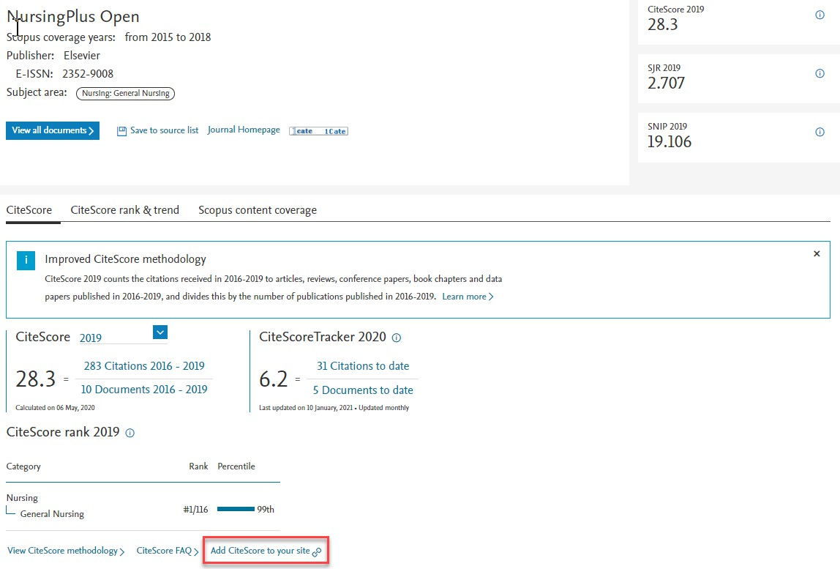
Promoting that Your Content is in Scopus
推广收录的内容
Can I add the Scopus logo to my journal home page? 可否将Scopus的标识展示在我的期刊首页？
Yes! You can find the Scopus logos here. CiteScore logos are available here. Orange is the preferred color, but you may use any
version as long as you do not modify it in any way.
是的！您可以在Scopus logos 找到标识，点击该链接找到CiteScore标识。推荐选择橙色，您可以根据需求使用标识中的任一版本，但请保证不对Logo做任何修改。
  What is the best way to display my journal’s CiteScore on the journal’s website?
在期刊网站展示CiteScore的最好方式是什么？
You can use the CiteScore widget, which can be accessed on your title’s Scopus Sources page. This ensures your journal metrics are always up-to-date on your journal’s website.
您可以在贵刊Scopus来源出版物页面找到并使用 CiteScore插件。使用该插件可以确保您期刊的CiteScore及时更新。
22

Slide 23
Other Resources 其他资源
Do you have questions not answered here? Please reach out to your Publishing Relations Manager.
其他问题请联系您的出版关系经理。
23

Slide 24
Thankyou! 谢谢
23

