Slide 1



FAQs for Scopus Content Partners
Last Revised: June, 2025
Content & Data Sourcing Team

Slide 2

Topics covered
Scopus Overview
Scopus Content Selection
Approximate Timelines for Scopus Onboarding
Scopus Acceptance and Permissions
Content Access
Making Changes in Scopus
Promoting that Your Content is in Scopus
Other Resources
This document is also available in Mandarin Chinese.

Slide 3
Scopus Overview
What is Scopus?
Scopus is Elsevier’s source-neutral abstract and indexing database, curated by independent subject matter experts. By having content included in Scopus, scholarly publishers make their content discoverable at over 7000 of the world’s top research institutions. Content in Scopus is linked through citation mapping, so that users can see who cited a piece of content or look at what an author may have referenced to support his or her research.
How can I learn more about Scopus?
The Scopus Blog is the best place to start.
I’m looking for Scopus end-user support.
You can find help on the Scopus Support Hub.

Slide 4
Scopus Overview
How is CiteScore calculated?
Citescore is a metric assigned to all titles in Scopus. This metric is calculated by Elsevier. To learn more about how Citescore is calculated and how it should be used, we recommend reading this Scopus Blog post from June 2024: Citescore 2024 values now live!
Where can I learn more about Citescore?
Please visit the Citescore FAQs page

Slide 5
Scopus Content Selection
How do I suggest a title for Scopus?
You can learn more about content selection criteria and submit a title for consideration via the Scopus Suggestion link
How can I tell if my content is eligible for Scopus?
We recommend reading the Scopus Content Guide. This explains what is included in Scopus both in terms of content types and disciplines covered as well as more information on the selection process.

Slide 6
Scopus Content Selection continued
How long does it take for content to be evaluated?
This varies. We want to ensure that all content submitted is given the appropriate attention.
How can I get an update on my title’s evaluation progress?
You can track the progress of the evaluation process by entering the unique Tracking ID provided at the time of submission into the Title Evaluation Tracker.
How much does it cost to be indexed in Scopus?
There is no cost to be included in Scopus. Our primary goal is to include high quality, publisher- agnostic content.

Slide 7
Scopus Content Selection continued
What is the first issue of the title that will be indexed?
Starting in 2023, a journal’s start coverage year will be from the year of selection minus 4. This means that for a title selected in 2023, its coverage would start in 2019 and include the content for all years going forward. Special considerations apply to journals that are previously rejected for Scopus inclusion, the start coverage year will begin from the year following the year of rejection. For journals that were previously discontinued and then selected for coverage again, indexing will begin from the year of re-selection.

Slide 8
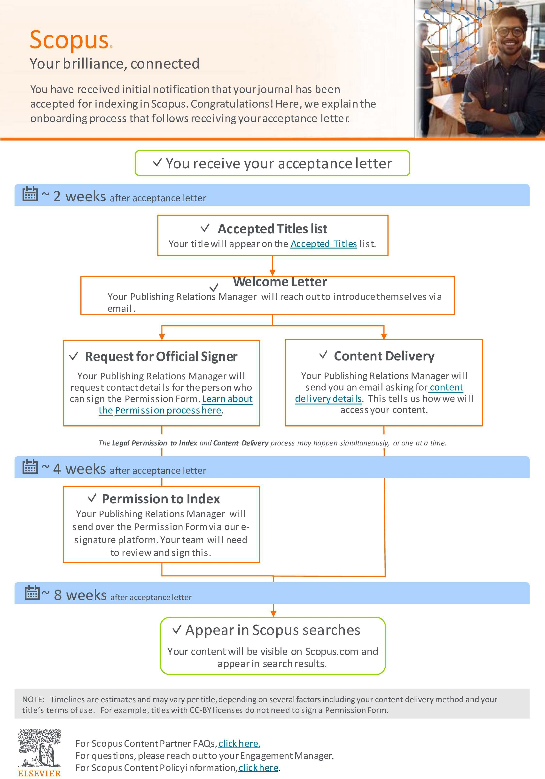
Approximate Timelines for Scopus Onboarding
How long will it take for my content to appear on Scopus?
In most cases, the titles will follow the timelines as shown in this flyer; however, this depends on the content delivery method that you would choose and other factors.

Slide 9
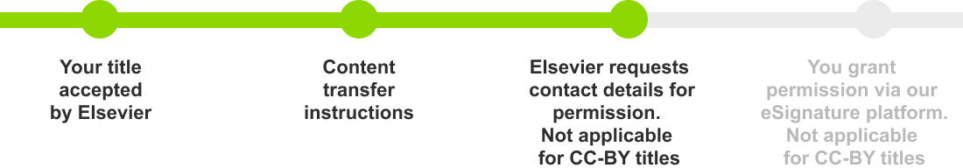
Scopus Acceptance and Permissions
My content was just accepted into Scopus. What are the next steps for me?
Congratulations! The first step for you is to celebrate. After that, we will work with you set up content delivery and formal permission to index.
If this is your first title accepted by Elsevier:
If you already have a title indexed by Elsevier:
Content Delivery: Your Publishing Relations Manager will reach out to confirm your content delivery preference. Generally, we recommend using the same method for all titles.
Permission to Index: Your Publishing Relations Manager will work with you to make sure Elsevier has permission to index your title.
Welcome Letter: A few weeks after your acceptance, you will receive a welcome letter from your Publishing Relations Manager.
Content Delivery: About a week later, your Publishing Relations Manager will ask about your content delivery preferences.
Permission to Index: Finally, your Publishing Relations Manager will work with you to ensure Elsevier has permission to index your title.

Slide 10
Scopus Acceptance and Permissions continued
What is the role of my Publishing Relations Manager?
Your Publishing Relations Manager is your primary point of contact going forward. Their role is to make sure your relationship with Elsevier runs smoothly. This person will help you with onboarding,
future license renewals and making updates in our records like changes in title, ISSN, URL, publication frequency, and contact information. This person can also help with any other questions you might have.
How long will it be before my content appears in Scopus searches?
This depends on a variety of factors, including how you chose to deliver content to us. To learn more, please visit our Scopus Onboarding Timeline flyer.

Slide 11
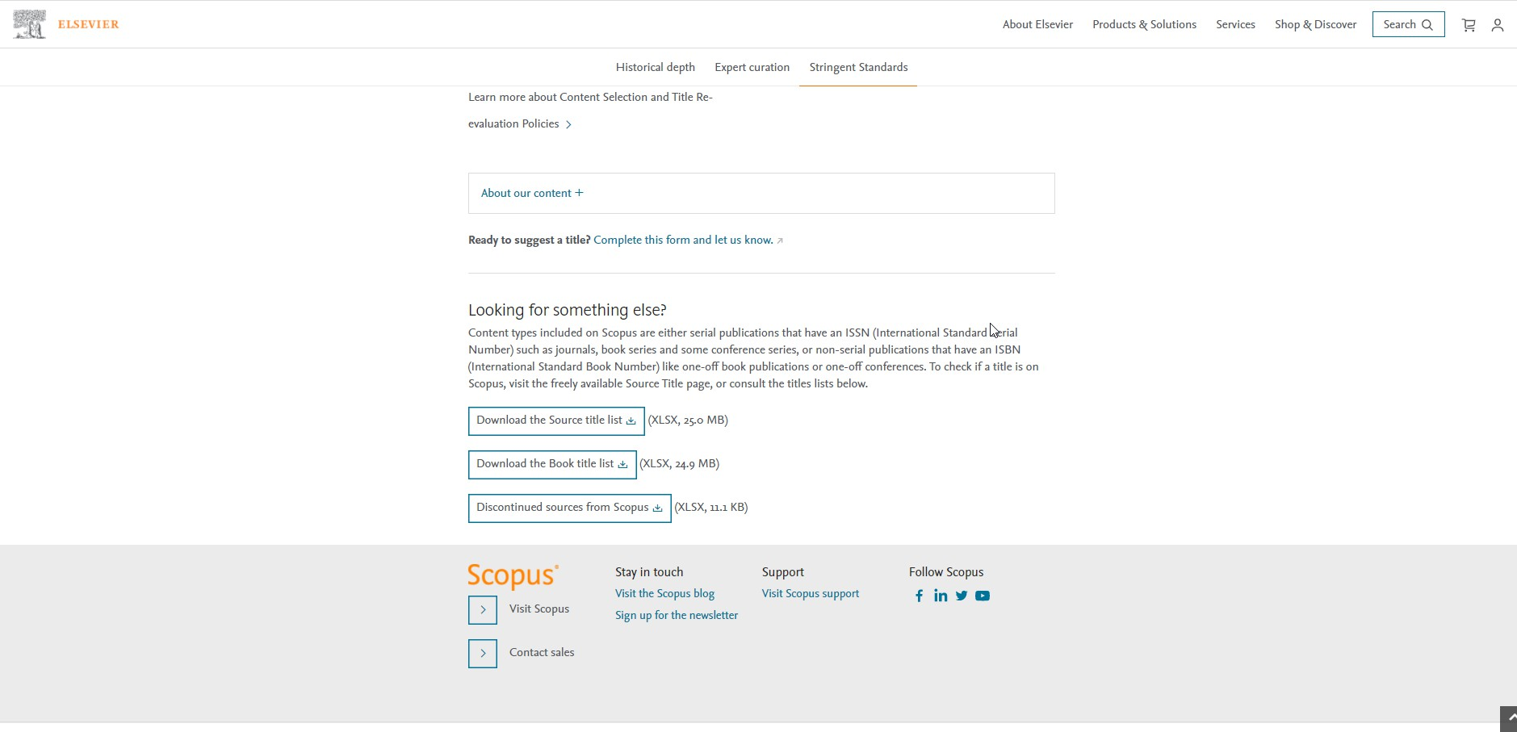
Scopus Acceptance and Permissions continued
Where can I see proof that my title is in Scopus?
There are a few ways.
The first place your title will appear is one the Source Title List on the “Accepted Titles” tab. This is updated monthly and is the most up-to-date list of titles in Scopus. You can learn more on the Scopus Blog.
You can find this at the bottom of https://www.elsevier.com/solutions
/scopus/how-scopus- works/content
As soon as a content transfer method set up, you can search in Scopus for your titles ISSN. This takes a little longer.
The other place you can look is the Scopus Sources within Scopus product. This list takes the longest to update, so don’t worry if you can’t find your title here at first.

Slide 12
Scopus Acceptance and Permissions continued
Why do I have to sign a Permissions Form?
You will receive a Permission Request form from your Publishing Relations Manager via Conga Sign, our eSignature platform. This gives us permission to include your content in Elsevier solutions, like Scopus. If you do not grant us legal permission, we cannot include your content in Scopus.
If your title is CC-BY, you do not need to sign a permission form.
Who should sign the Permissions Form?
This is up to you. At some organizations, there may be a licensing professional. You may also prefer to have it signed by the journal editor, the publisher or the person who submitted the title for coverage consideration.

Slide 13
Scopus Acceptance and Permissions continued
What does Elsevier mean by “license renewal date”?
For Scopus Content Partners, the license renewal date refers to when the license agreement confirming your willingness to have your title indexed in Elsevier databases expires. It simply means that we must renew our license with you.
For many publishers, we send this form out every year to confirm your willingness to continue indexing. If you prefer not to renew every year, you could choose to grant us a perpetual license.
Renewals are a standard activity and do not mean your title is being re-evaluated.
Note: Prior to 2021, we referred to this as the “subscription end date”.

Slide 14
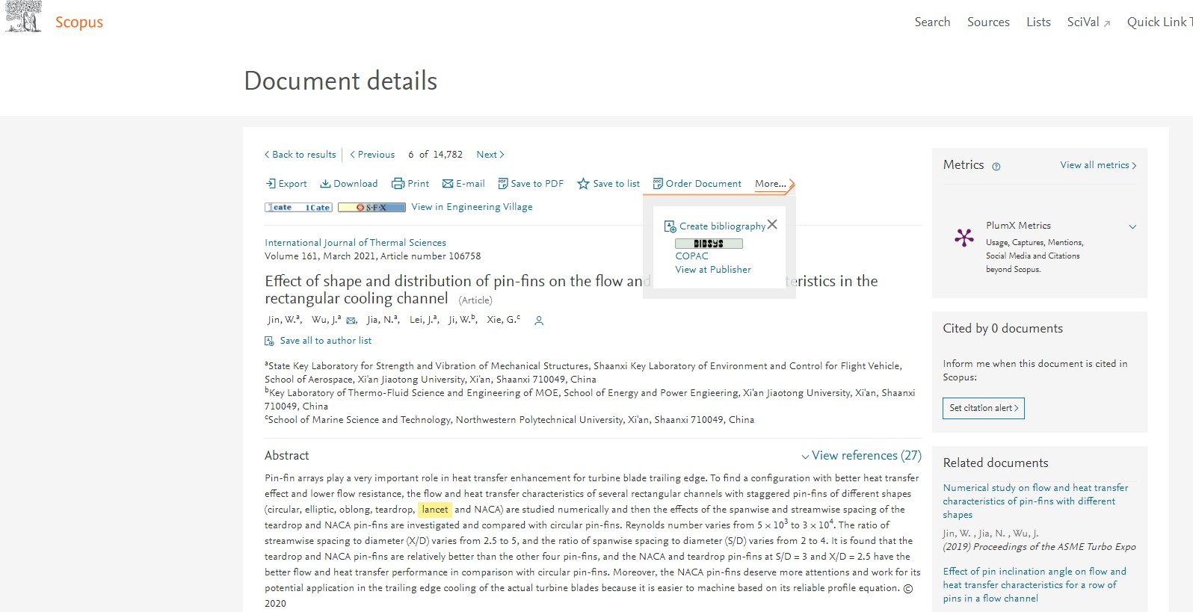
Content Delivery
Why does Elsevier need access to my full-text content?
We need access to your content so we can access the metadata including citations as well as the abstract. This allows us to capture the full set of citations as well as information around authors, journal and publisher.
We never make the full text available to our customers or other third parties.
Scopus document record, accessed Jan 2021

Slide 15
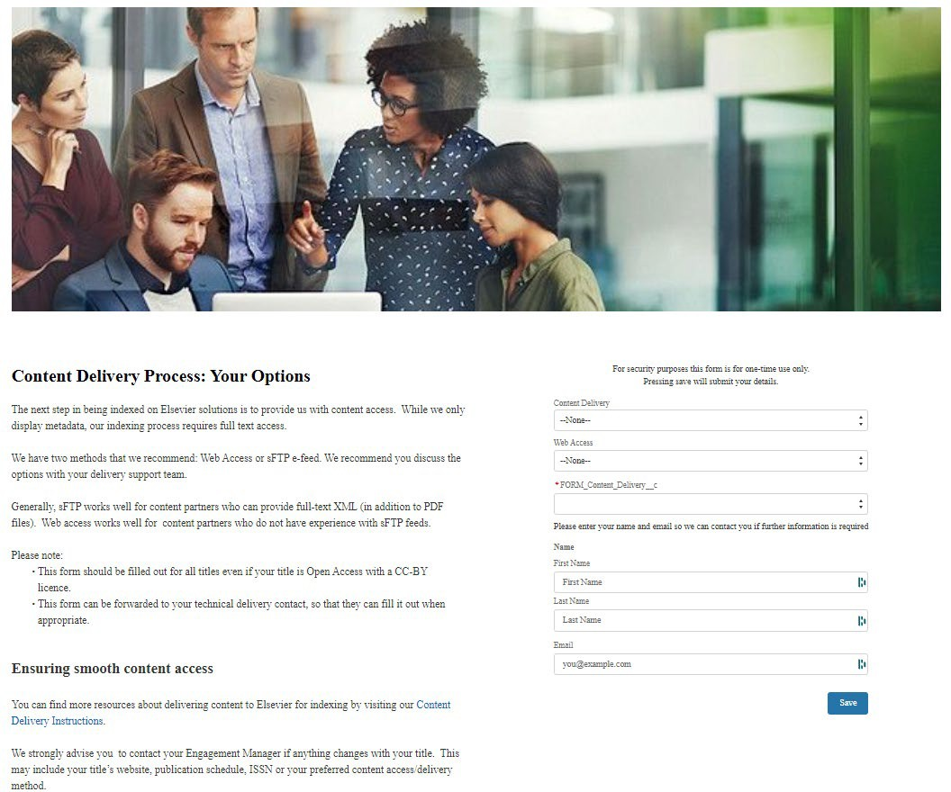
Content Delivery continued
How does content delivery set up work?
Your Publishing Relations Manager will send you a form asking about your preferences. If you have technical delivery team, you may prefer to have them fill out the form. If you are already providing content to Elsevier for indexing, we strongly recommend you use the same method for all titles.
You can find more information about content delivery options here
For specific questions, please reach out to your Publishing Relations Manager.
Screenshot of the Content Deliver Form, April 2022
The form domain will include “relx-elsevier-operations.force.com”

Slide 16
Content Delivery continued
How can I provide content access to Elsevier?
You and your Publishing Relations Manager will decide what is the best access method for you, based on technical specifications. You can find more information about the content delivery options here
Generally, we can accept content in the following ways:
Web crawling with Login Credentials – (Username/password access).
Web crawling with IP recognition
sFTP upload
For Open Access titles, we may not need special access if you have full text PDFs on your website. Once the Permissions Form is signed, we may be able to use a web crawler to access the metadata we need.

Slide 17
Content Delivery continued
Do you have any tips for ensuring content transfer runs smoothly?
It is important that you let your publishing relations manager know as soon as possible about any changes to your title such as ISSN, website URL, publication frequency or contact detail changes. Changes may disrupt content transfer.
This is particularly important, because disruption in content transfer could trigger the title re-evaluation process.
What are the IP addresses I need to whitelist?
You can find the current list of IP addresses here

Slide 18
Making Changes in Scopus
Does Scopus process notices of retraction, erratum and corrigendum?
Yes, but only if these notices are published in a journal issue. We do not index retraction, erratim and corrigedum that are delivered as seperate letters.
Why do my articles not appear with the Open Access (OA) tag in Scopus (despite being OA)?
We source our OA document tags from Unpaywall, a database run by Impactstory (a non- profit organization) which harvests Open Access content from over 50,000 publishers and repositories. You can learn more about OA tags in Scopus on the Scopus blog.
My SCImago (SJR) or Source-Normalized Impact per Paper (SNIP) metrics do not accurately reflect my citation performance. How can I get them updated?
Both SJR and SNIP are created independent organizations that use Scopus data. For more information about SCImago (SJR) visit the SCImago website. For more information about Source-Normalized Impact per Paper (SNIP), visit the CWTS Journal Indicators webpage.

Slide 19
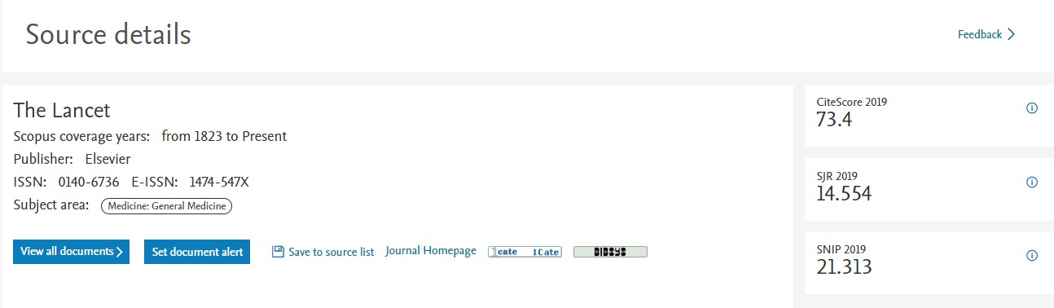
Making Changes in Scopus Continued
How can I request changes to Scopus including content and author corrections?
Please start with the Scopus Support Center. Here you can request that missing documents be added as well as request corrections to affiliation and author profiles. You can also let us know about citation and CiteScore corrections that need to be made.
My basic publisher details, shown on the Scopus Source details page, are not up-to- date. How can I correct them?
Please contact your Publishing Relations Manager with any changes. These changes may include information updates to things like title, ISSN, publisher, publication frequency, website URL or a change in contact information. These changes may not reflect in the Scopus Source details page immediately.
Scopus Sources Record, Accessed Jan 2021

Slide 20
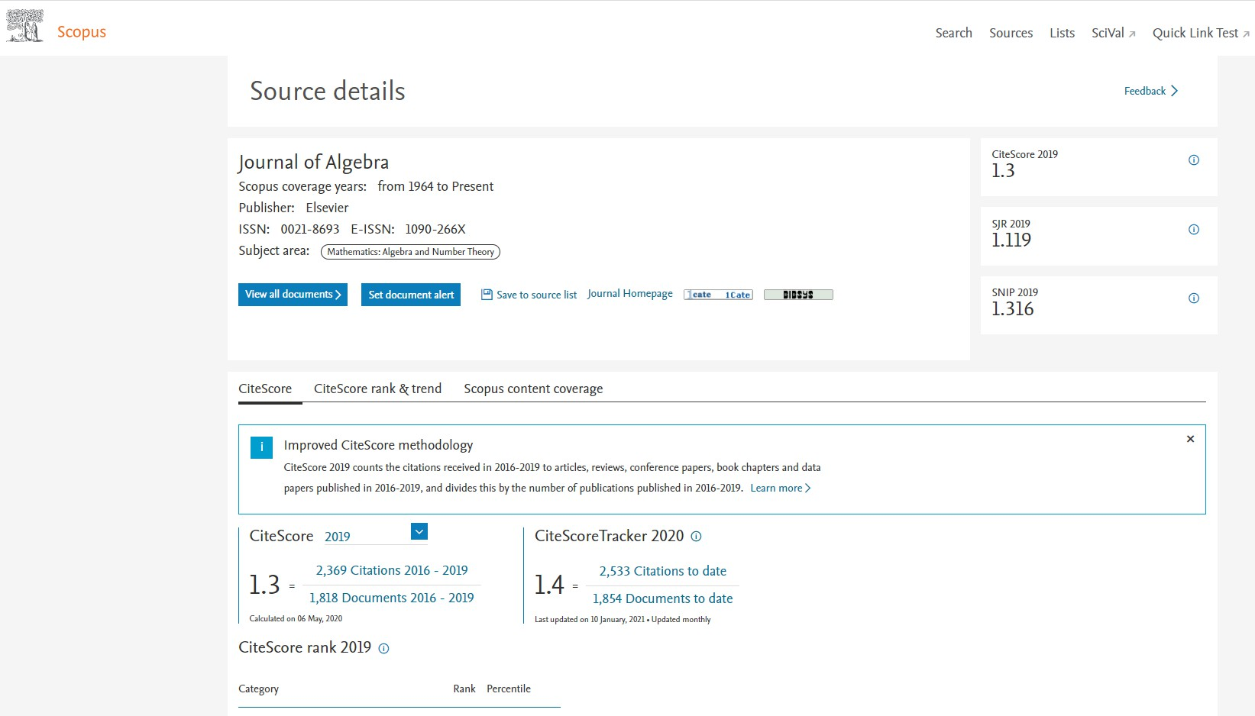
Making Changes in Scopus Continued
Where is my Scopus Source page?
A Scopus Source page is the page that shares basic information about journals included in Scopus. It shows important information like journal metrics and publisher details.
Since March 2025, these pages are updated on a monthly basis to ensure that all source related information such as Title, ISSN and publisher details remain up-to-date and accurate.
If you are confirming your new content is displayed in Scopus, we recommend searching by ISSN or Journal Title.
Scopus Sources Record, Accessed Jan 2021

Slide 21
Making Changes in Scopus Continued
How can I change my name in Scopus?
There are many reasons an author may wish to change their name. Following a request from the author, Elsevier will apply the updated name to versions of the article on ScienceDirect, Scopus and other relevant platforms.
You can learn more about our name change policy on the Scopus blog.
Scopus Sources Record, Accessed Jan 2021

Slide 22
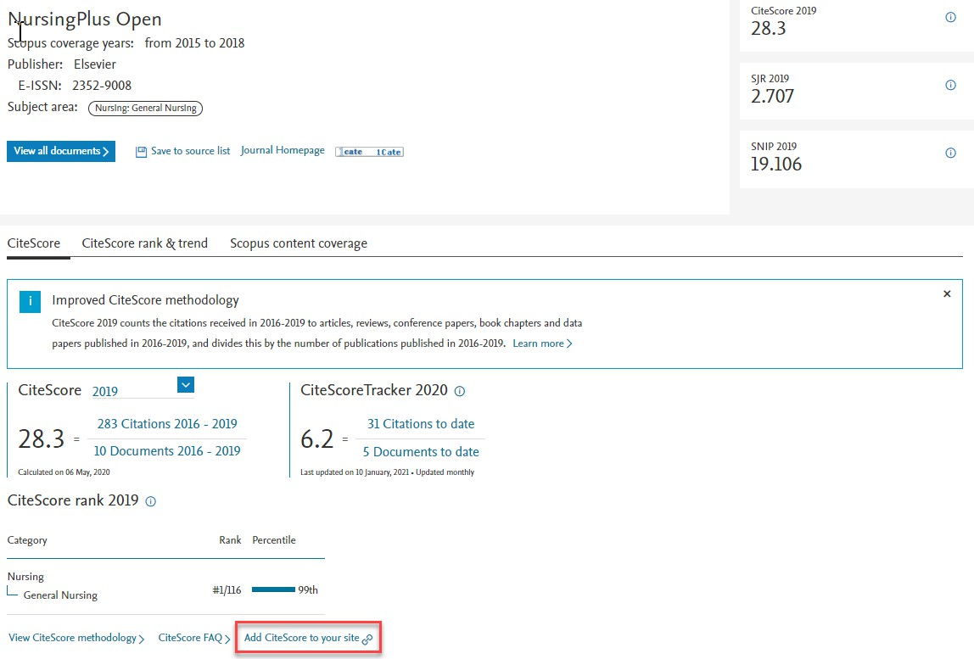
Promoting that Your Content is in Scopus
Can I add the Scopus logo to my journal home page?
Yes! You can find the Scopus logos here. CiteScore logos are available here. Orange is the preferred color, but you may use any version as long as you do not modify it in any way.
What is the best way to display my journal’s CiteScore on the journal’s website?
You can use the CiteScore widget, which can be accessed on your title’s Scopus Sources page. This ensures your journal metrics are always up-to-date on your journal’s website.

Slide 23
Other Resources
Do you have questions not answered here? Please reach out to your Publishing Relations Manager.

Slide 24
Thank you!

