Slide 1
Author Profiles
<Insert presenter and library name>
Notes:
Any author with a Scopus author profile can use the free author lookup and author wizard to request changes to their profile and link their profiles to other systems such as ORCID and Mendeley. You do not need a subscription to Scopus to view and update your author profile or to create an account.

Slide 2
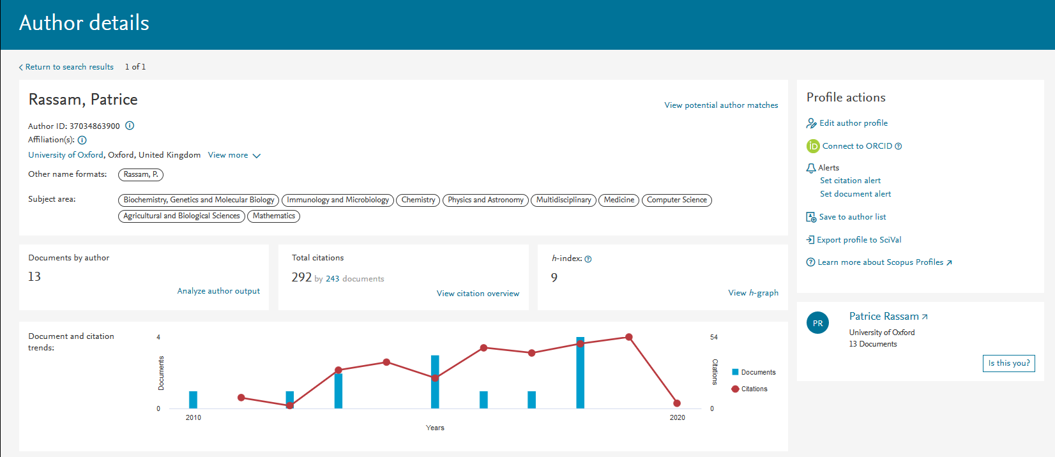
Scopus author profiles
Identifiers
Affiliation
Author IDs
ORCID
Alternate names
Output
Subject area coverage
Output over time
Citations
Metrics
h-index
Citations
And more
Notes:
Your Scopus author profile includes a list of your documents, citations you’ve received, a list of your co-authors, your h-index and other metrics that are often used to assess the impact of your work.

Slide 3
Why check and update your profile?
1
2
So you can include accurate and complete information on funding applications and within your promotion and tenure file.
Scopus data is used by funding agencies, institutions and other researchers to assess your research and impact.
Notes:
Having an up-to-date profile allows you to put your best foot forward and establish your reputation as an expert in your field.

Slide 4
Where does author profile data come from?
Scopus includes content from 5,000+ publishers and 105 different countries, and it’s updated daily!
Journals
Conferences
Books
23,452 Peer-reviewed journals
294 Trade journals
5,527 Active gold open access journals
>8,000 Articles in press
Full metadata, abstracts and cited references
119K Conference events
9.8M Conference papers
Mainly engineering, mathematics, physics and computer sciences
852 Book series
40K Volumes
1.7M Items
216,000+ Stand-alone books
Mainly social sciences and arts & humanities
Notes:
Scopus gets daily updates to its content from thousands of publishers which it uses to generate new author profiles and update existing author profiles.

Slide 5
Scopus: the premier source of profiles
The data that goes into Scopus follows the model that articles are written by authors who are affiliated with institutions.
Article
78 million
records from journals, books, and book series, conference proceedings and trade publications
Author
16 million
Author profiles
Affiliation
70,000
Affiliation profiles
Notes:
Scopus includes over 16 million author profiles. Author profiles are automatically created or updated whenever new data is uploaded.

Slide 6
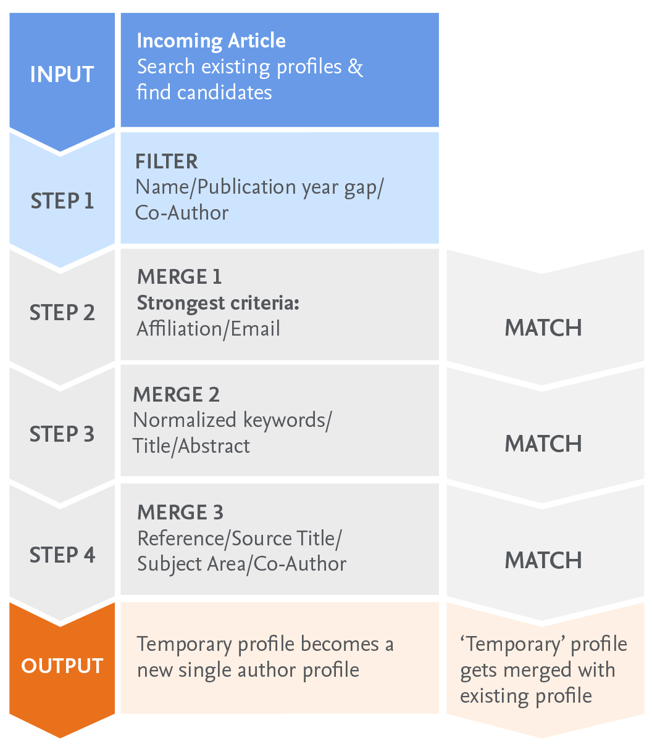
How are Scopus author profiles created?
Scopus uses a combination of automated and curated data to automatically build author profiles.
Notes:
Powerful algorithmic data processing matches articles to existing profiles with a high degree of accuracy based on name, email, affiliation, subject area, citations and co-authors.
Profiles are created automatically when two or more articles are linked to one profile.

Slide 7
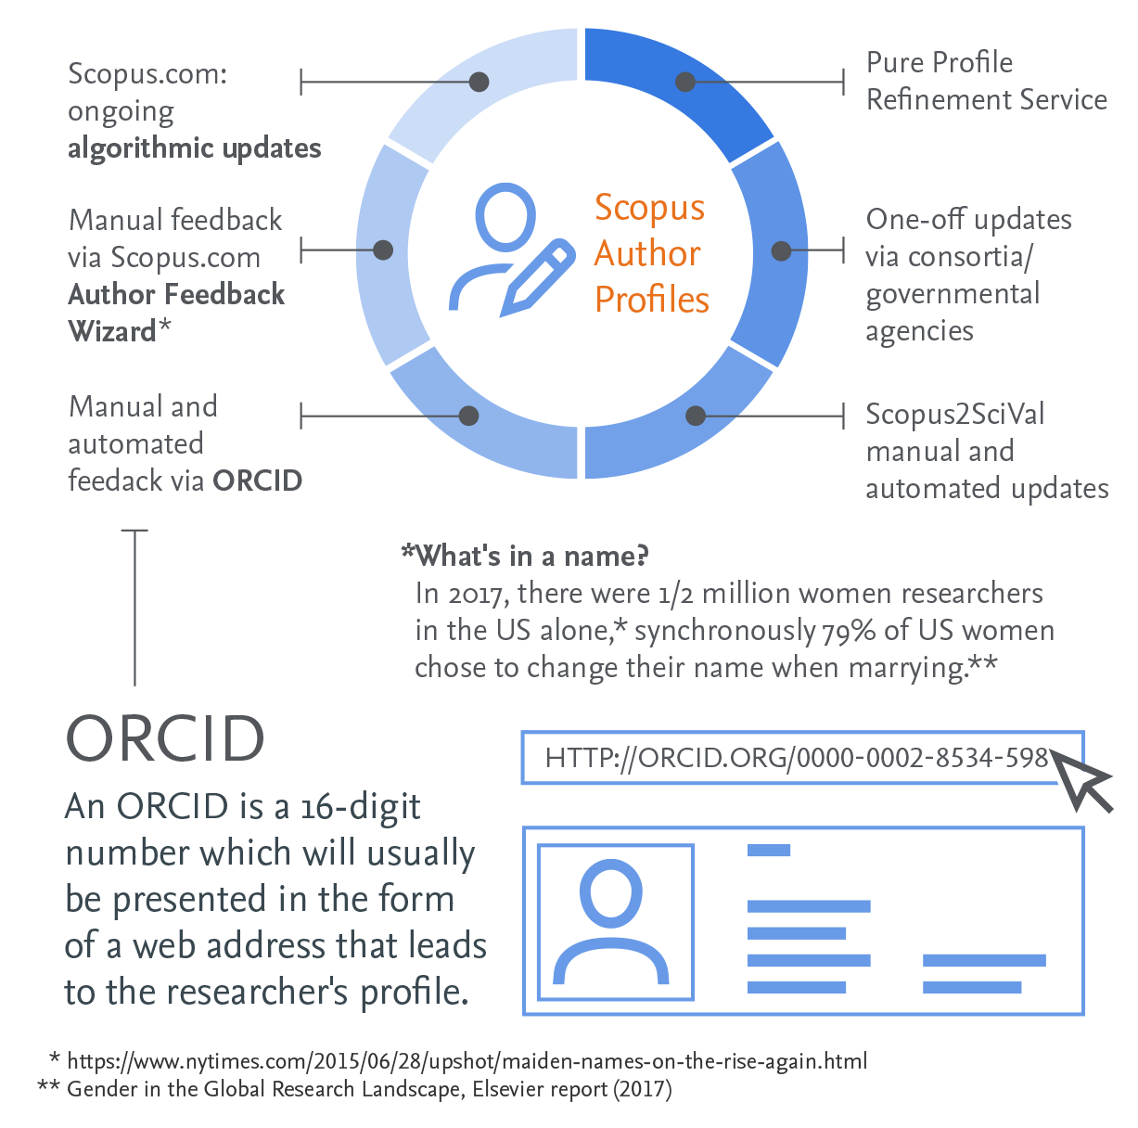
How are Scopus author profiles created?
Scopus uses a combination of automated and curated data to automatically build author profiles.
Notes:
Scopus author profiles can be linked to profiles on other platforms, such as Mendeley and ORCID, and Scopus data can be imported into NIH My Bibliography and SciENcv.

Slide 8
You can make corrections to your Author Profile using the Author Feedback Wizard
For simple merges and splits: www.scopusfeedback.com
Turnaround time: 36 hours
Search Documents, Authors, and Affiliations

Slide 9
Access the wizard directly from your author details page
Update the profile or suggest updates within a given profile

Slide 10
Types of corrections you can make
Author profile corrections
Merges: combining two or more author profiles together and updating associated Scopus articles as well
Splits: separating articles from one author profile to another author profile (existing or new one)
Overrides or detail mistakes (changing name, email of author profile)
Content is missing and should be in Scopus based on Content Coverage guidelines
Requests to update author’s affiliation isn’t allowed as affiliation history in an author profile is built based on articles linked to respective author profile.

Slide 11
Now let’s walk through updating your profile
Go to https://www.scopus.com/freelookup/form/author.uri
1
Locate your author details page.
2
Verify your author details are correct.
3
Create a Scopus account so you can request corrections if needed.
4
Request corrections to your Scopus Author Profile.
5
Keep your profile up to date.
Notes:
Let’s walk through the tip sheet you have just been handed to “Ace your Scopus author profile in 5 fast steps.” As a reminder, you do not need a subscription to Scopus to view and update your author profile or to create an account.

Slide 12
More questions?
If you need more assistance with your Scopus author profile or other online profiles, please contact:
<Insert Contact Details>

