Slide 1
Science - Year 3
Rocks – Block 3R
Rocks and Fossils
Session 2
Rock Detectives PowerPoint
© Original resource copyright Hamilton Trust, who give permission for it to be adapted as wished by individual users.
We refer you to our warning, at the foot of the block overview, about links to other websites.

Slide 2

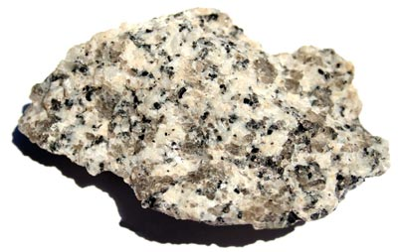
Rock Detectives

Slide 3
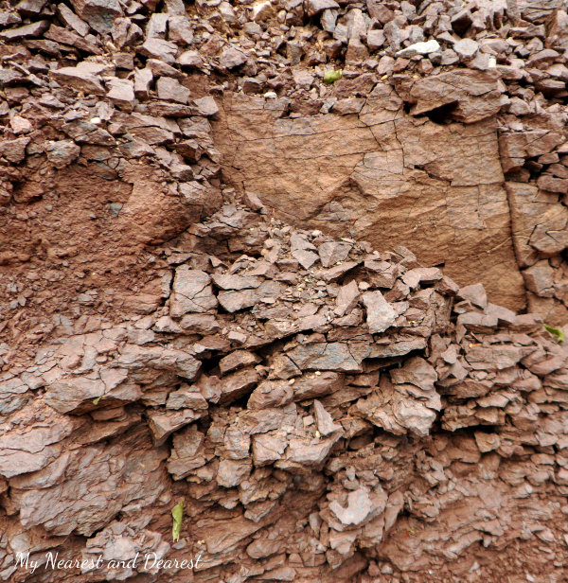
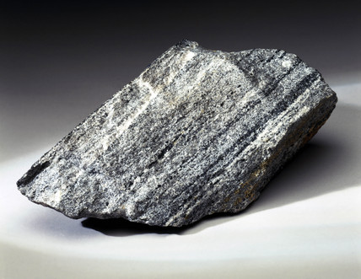
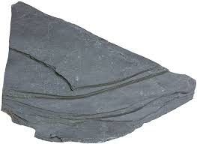
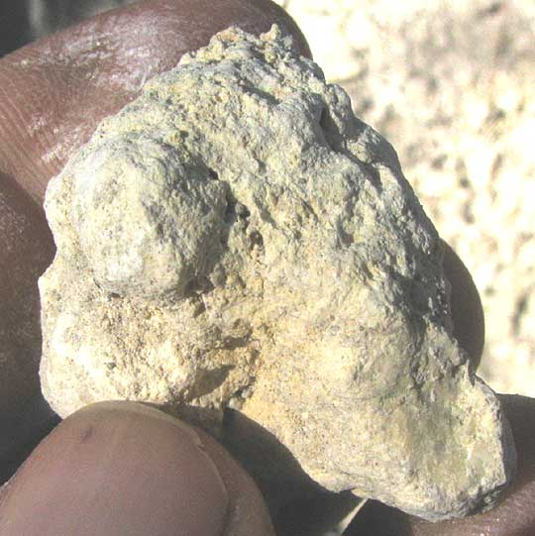
Clue 1
How hard is the rock?
Some rocks are soft and crumbly whilst others are very hard and strong

Slide 4


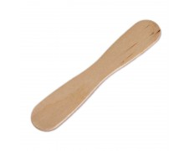
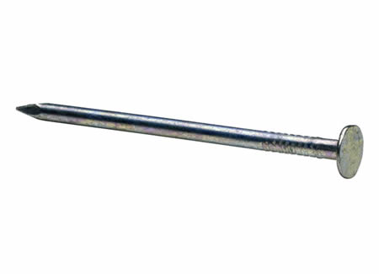
Try a hardness test on your rock samples
Can you scratch them with different items?
Which items will scratch them and which will not?
Can you crumble them?
Can you put them in order from the softest to the hardest?

Slide 5
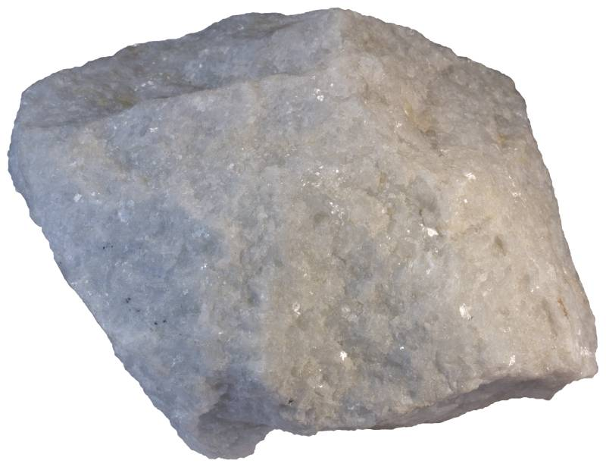
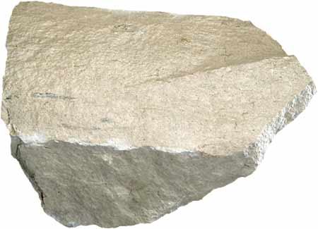
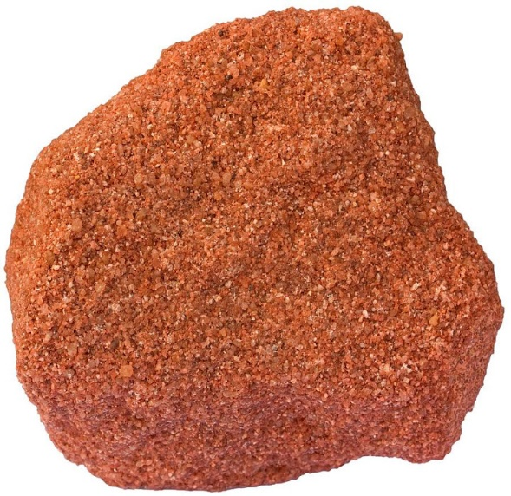
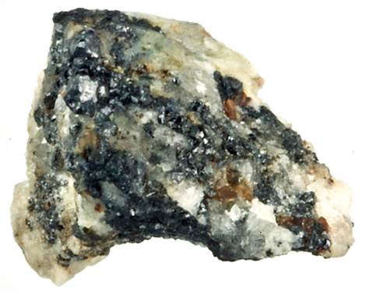
What will hardness tell you?
Sedimentary rocks are usually a lot softer than igneous and metamorphic rocks

Slide 6

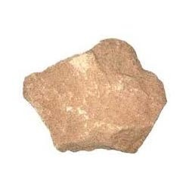
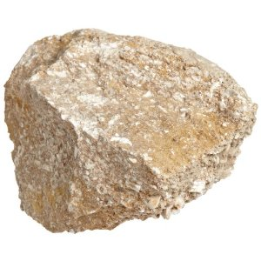
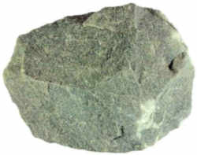
Clue 2
Will water soak into it?
Try dropping a small amount of water on your rock samples and watch to see if it soaks in

Slide 7
What will this tell you about your rocks?
If water can soak into a rock or pass through it, we say it is a permeable rock. Sedimentary rocks are usually permeable.
If water can not soak into a rock, the rock is said to be impermeable. Metamorphic and igneous rocks are often impermeable.

Slide 8
Clue 3
The acid test
Vinegar is an acid. Try dropping a small amount of vinegar on your rocks. Then look carefully to see if it fizzes.
What will this tell you about your rocks?

Slide 9
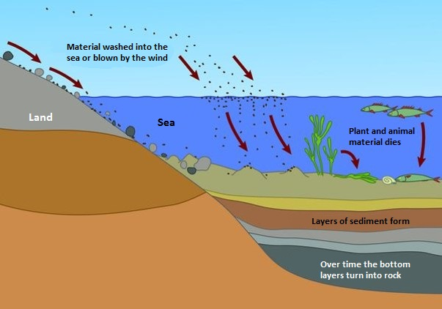
Remember that sedimentary rocks can contain the bodies of sea creatures that died long ago. Their shells dropped into the muddy sediment and became buried. After millions of years they were turned to rock.
If a rock was once the shells of creatures, it will fizz when acid is dropped onto it.
Some metamorphic rocks will fizz too if they were once sedimentary rocks that contained shells and were then changed by great heat or pressure.

Slide 10
Clue 4
What is it like close up?

Slide 11
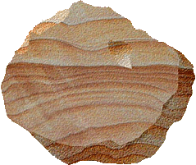
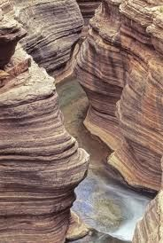
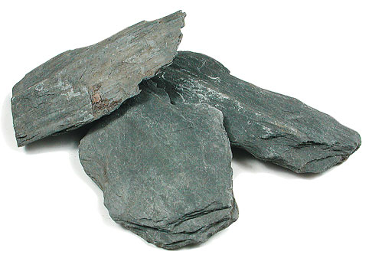
If your rock has stripes or layers it will probably be a sedimentary rock
Some landscapes show the layers of sediment that have turned to rock. You may have seen them at the seaside.
But some metamorphic rocks may also have layers if they used to be sedimentary rocks but were changed by heat or pressure!

Slide 12
If your rock has crystals it will probably be an igneous rock or an igneous rock that has become a metamorphic rock because it has been changed by heat or pressure.

Slide 13

Rock Scientists (Petrologists) find out about their rock samples by looking closely at them and by doing tests on them.
If your teacher gives you a test, they make it fair by making sure everyone has:
The same instructions
The same equipment
The same length of time to do it

Slide 14
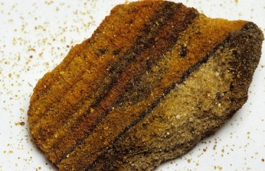
Scientists have to make sure their tests are fair too!
Suppose a scientist decided to test rocks for hardness by rubbing them on sandpaper. They rubbed one rock 20 times and another 10 times and then compared the amount of rock dust, would that be fair?
How could they make the test fair?

Slide 15


When you test rocks, you will need to think about how to make your tests fair!

Slide 16
It’s time to become rock detectives!

