Slide 1
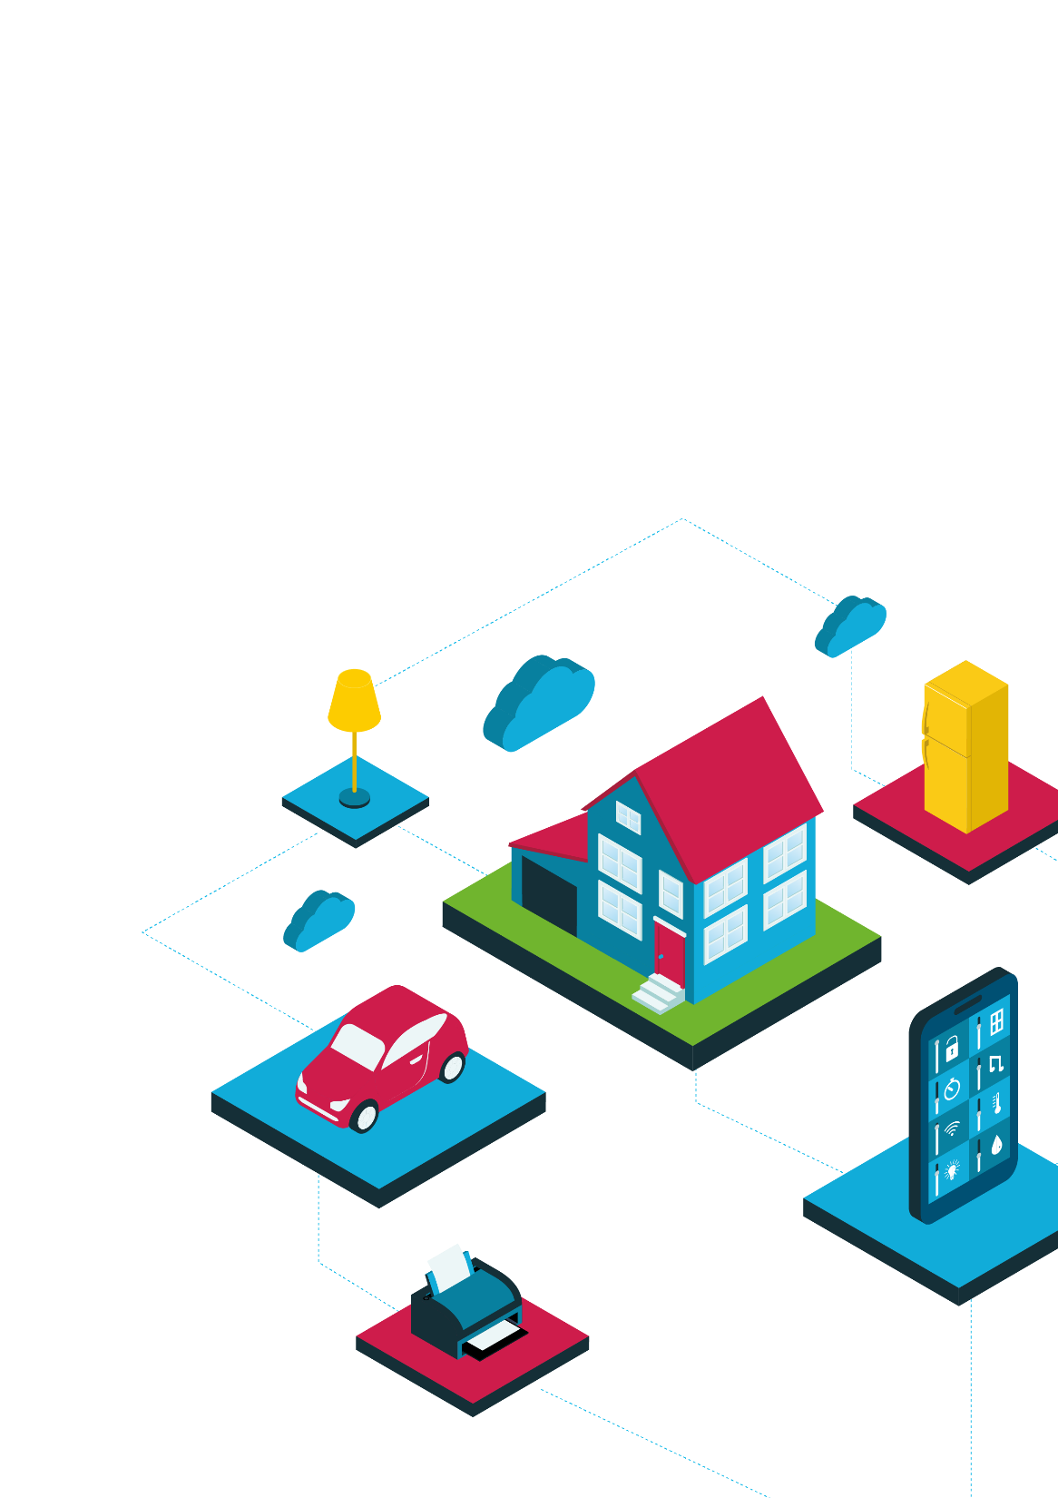
Algorithms for the Internet of Things (IoT)
Event-driven programs

Slide 2
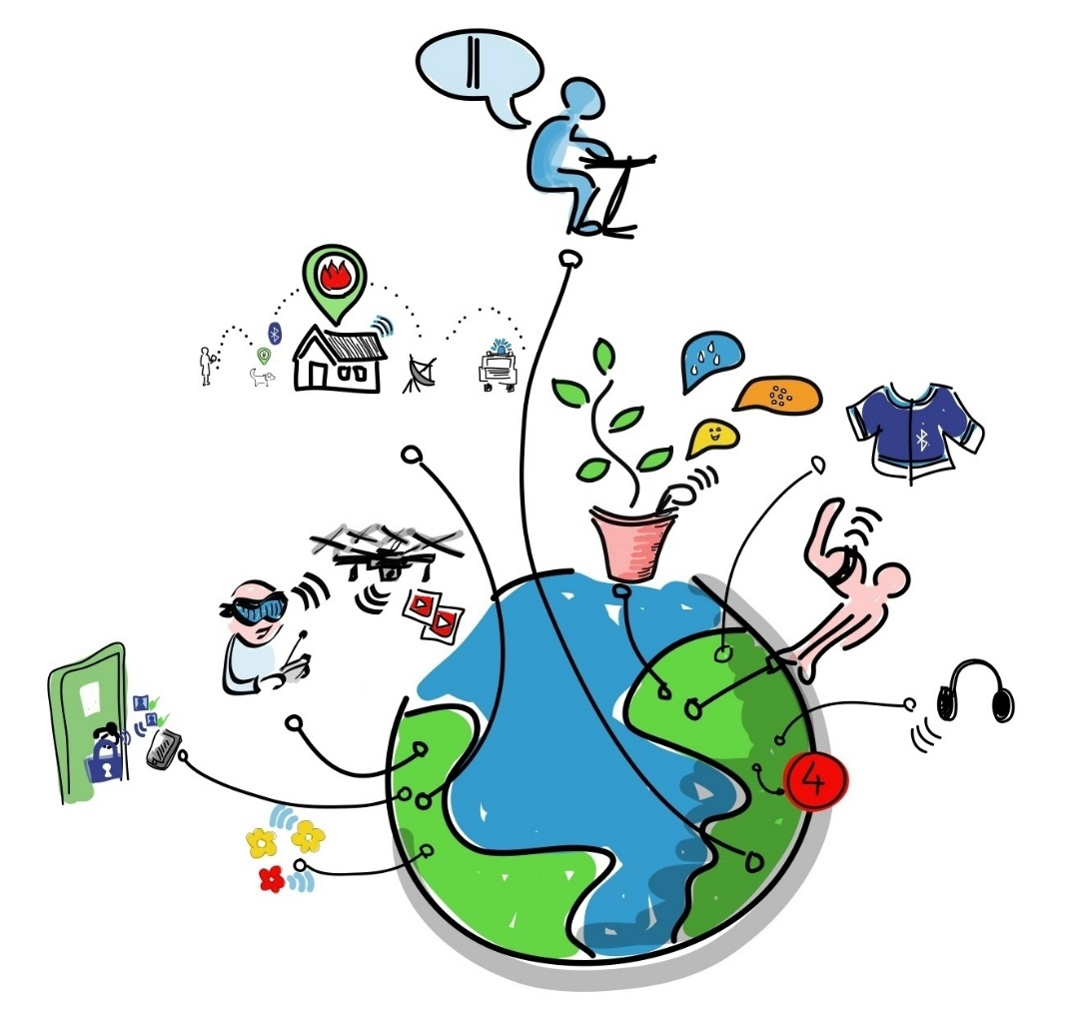
Making the IoT work through events
The parts of an IoT system may be separate.
They need to communicate relevant data to make things happen.
One way to manage involves sending messages triggered by events.

Slide 3
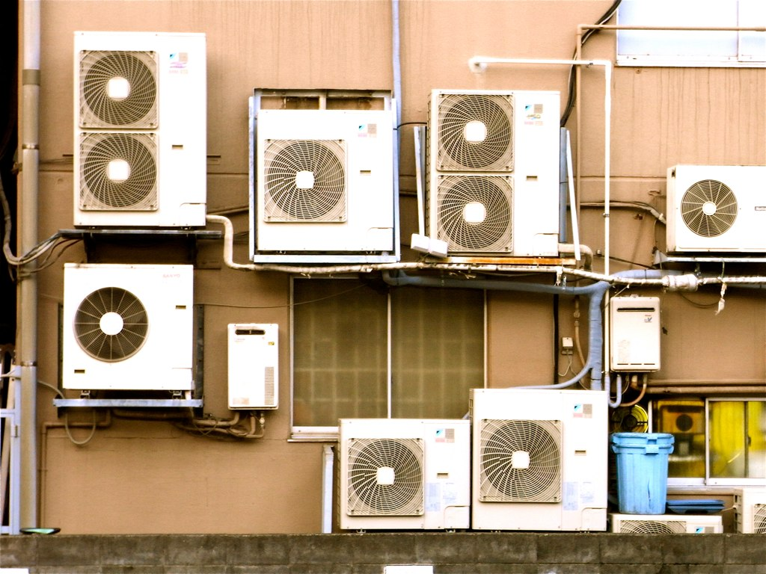
Example: room temperature control and fire alarm
I will connect a heat sensor to the heating, ventilation and air conditioning (HVAC) controller and to the fire alarm.
If the temperature goes above normal this will trigger the HVAC to cool the air in the room. A small beep will notify that this is happening.
If it goes above a safe limit (indicating a possible fire) the HVAC will remove air rapidly to reduce smoke. The fire alarm will sound.

Slide 4
Event-driven software for IoT
A sensor-equipped device detects an event.
The device then transmits a message related to the event.
A receiving device receives the message.
It reacts by carrying out an action. This may generate another message…
Device
Device
message
Device
Device

Slide 5
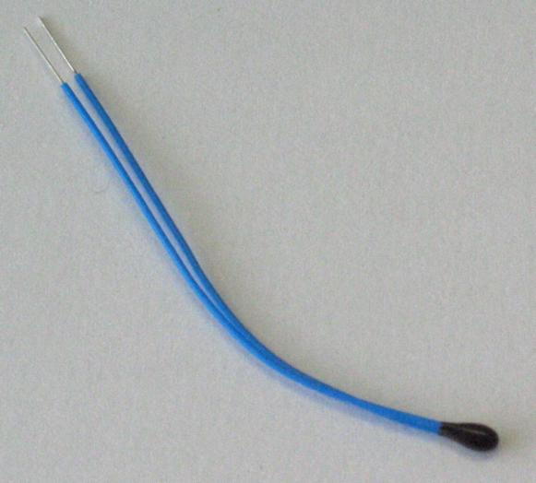
Detecting events
Something is monitored or measured with a sensor (for example temperature)
A message is generated, such as
[temp= 25ºC]
Sometimes the data is processed by a device before a message is generated. This is called edge processing.
This might involve checking against a condition, for example is temp > 25ºC?
A thermistor is a low-cost temperature sensor
A message would then be generated such as [temp is too high]

Slide 6


Transmitting event messages
Packets of structured data are sent across networks.
These may be wired or wireless networks, such as Wi-Fi or Bluetooth.
The transmission system may include error checking to ensure reliable message sending.

Slide 7
Receiving event messages
Devices ‘subscribe’ to messages from particular places. For example, a smart air fan may subscribe to messages from temperature sensing units as well as voice-controlled devices. It ‘listens’ for messages from those devices – and ignores other messages on the network.
The message will be processed according to an algorithm and action may be taken. For example:
IF message received AND temperature > 25ºC, turn on fan motor AND sound warning bleep
Input (event message)
Process (check against trigger temperature)
Output (switch on fan motor and bleep)

Slide 8
Discussion questions
What are the benefits of edge processing? Think about the number of messages sent across the network.
Error detection is used to signal when a received message is incomplete. How can this be used to improve reliability?
Sometimes messages between devices are two-way. Why might this be useful?
Research the term mesh network. What are the benefits of mesh networks versus star networks that connect to a central hub?

Slide 9


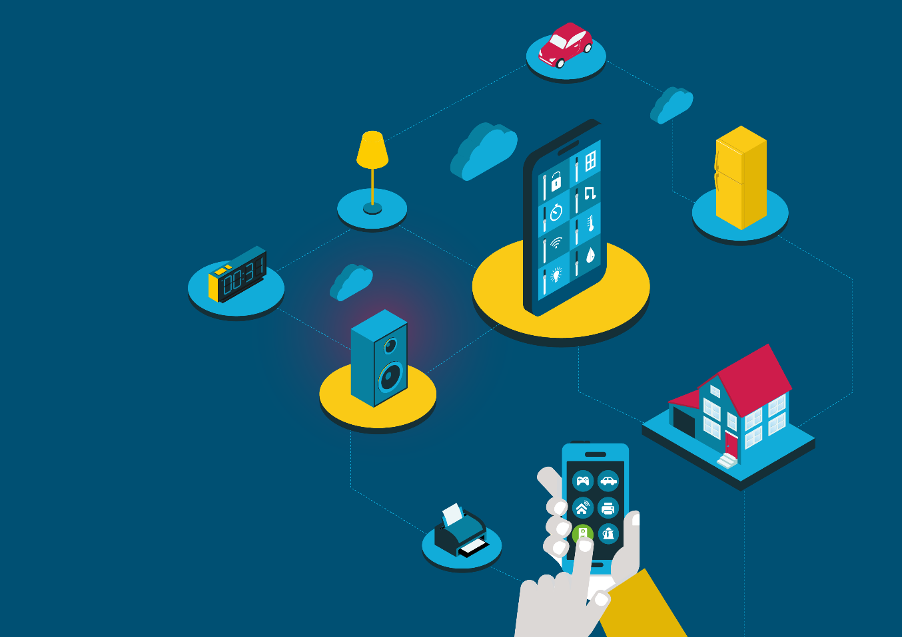

Cisco Little Big Futures
Image credits:
“Air Conditioned” by wyinoue is licensed under CC BY 2.0
Thermistor: By Ansgar Hellwig [CC BY-SA 2.0] via Wikimedia Commons
IOT drawing: By Wilgengebroed on Flickr [CC BY 2.0], via Wikimedia Commons
Bluetooth and Wi-Fi logos are registered trademarks in the public domain.

