Slide 1
Big O Notation
Mr Gristwood
https://rob-bell.net/2009/06/a-beginners-guide-to-big-o-notation/
https://www.youtube.com/watch?v=IEOO5UToo6A – big O notation from 31 mins

Slide 2
Objectives and Outcomes
ALL
Will understand the purpose of a big O notation and can explain how these are used in computer algorithms
Even Better If
You can explain how big O notations can be used to explain complexity and can derive uses
Exceptional If
You can predict best and worst case scenarios for big O notaion and can explain the reasons why.

Slide 3
Starter
Searching and Sorting Algorithms:
Which one’s can you remember?
Can you explain how they work?

Slide 4
What is Big O?
This is a mathematical equation to show complexity of an algorithm.
Typically it’s used to show worst case scenario time for how long it would take to find an element in the list.

Slide 5
O(1)
Describes an algorithm that will always execute in the same time or space regardless of the data
Time
Data

Slide 6
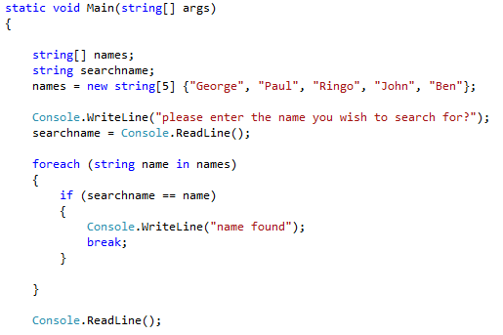
O(N)
An algorithm who’s performance will grow in direct proportion to the size of the data that you have.
This is the perfect example of a linear search
The worst case scenario is that the element is the last in the list, therefore it will take O(number of elements)
Time
Data

Slide 7
O(N )
2
This represents an algorithm whose performance is directly linked to the square of the size of data input set.
This is good for algorithms what involve nested loops.
Bubble and Insertion sorts are common examples of this.
E.g. the square root of 9 is 3.
Time
Data

Slide 8
O(2n)
This is for algorithms whose growth doubles with each addition to the input.
The growth curve is short getting larger fast.
Fibonnacci Sequences are a good
examples of this as it is recursive
and adds to the size of the numbers.
Time
Data

Slide 9
Logarithms O(log N)
This is for algorithms that half each time
Because the algorithm halves each time from a large data it starts off with a really large search time then flattens out over time.
  A data set containing 10 items will take 1 second
  A data set containing 100 items takes 2 seconds.
  A data set containing 1000 items takes 3 seconds.
Think about how a Divide and conquer
works, can you see how this would
enhance the more elements you have.
Time
Data

Slide 10
So what does this all mean?
O notation always works on worst case, and this is good, because it’s easier to work out.
So what about Best case?
Try and come up with the best case scenario then check them online.
Justify your reasoning for the best case approach.
Using the research, do a bit of work to find out what is the name for the best case scenario
n
Worst case scenario you have to look through everything to get the right answer (answer Linear search)
O( )
O(N )
2
Worst case you have to look through half of the results to get the right answer (Bubble Sort, Insertion Sort)
O(log N)
Worst case the results half each time, and the speed has no bearing on the amount of data, it’s related to the speed of the algorithm.

Slide 11
Plenary

