Slide 1
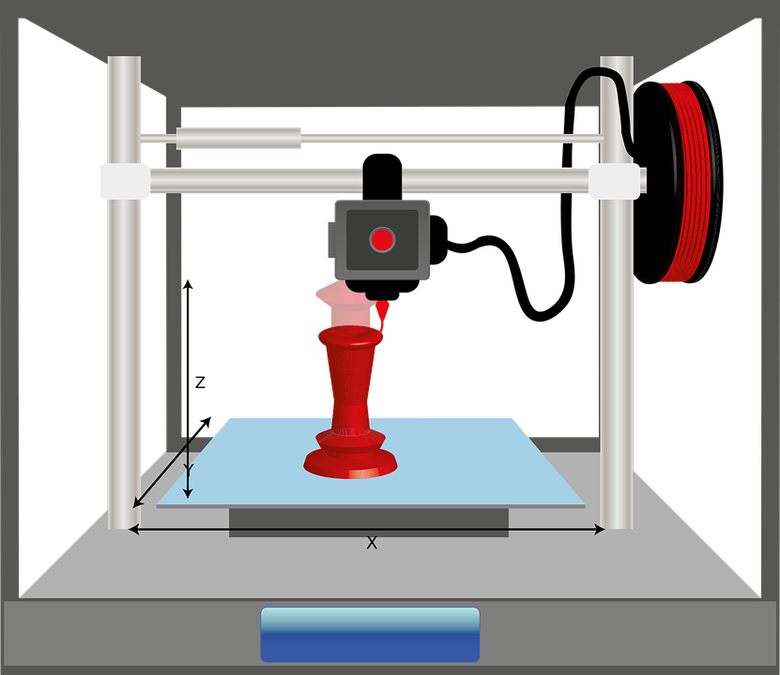
Objectives
To design a toothpaste squeezer.

Slide 2
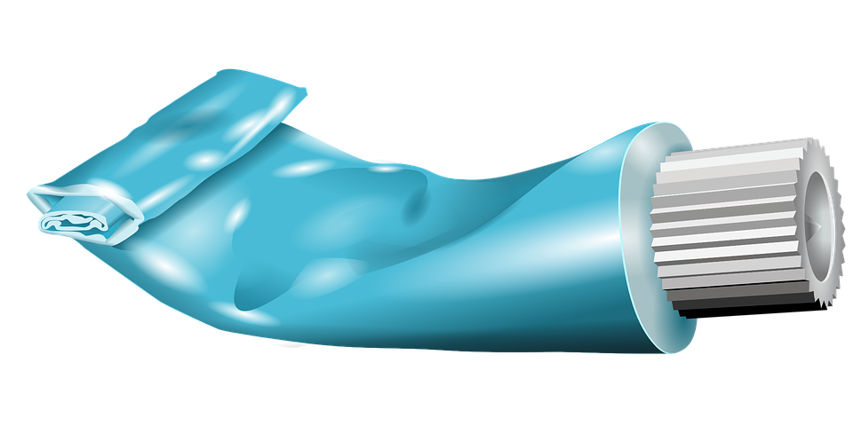
Problem
How much toothpaste do you waste every year from not being able to squeeze the full amount out?

Slide 3
Starter – 5 minutes
Using the ruler and the toothpaste, squeeze around 5 – 10% out (into the cup) and then measure the width and the thickness of the tube at it’s thinnest point.
Record down your findings on the worksheet.
Is there a standard size or are different brands of toothpastes different?

Slide 4
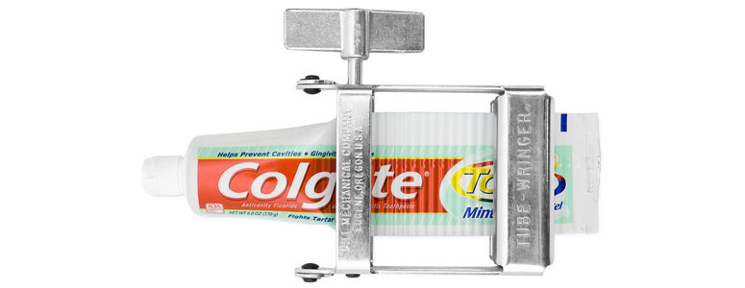
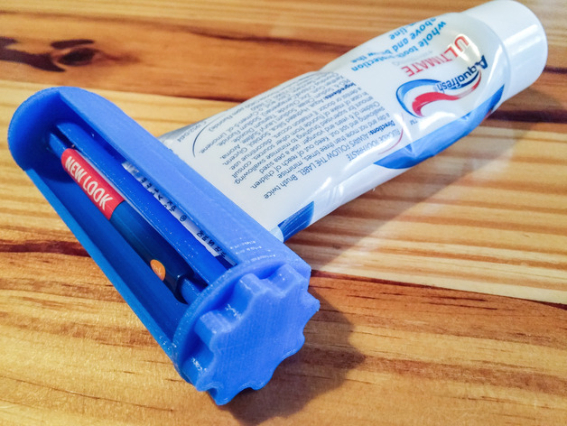
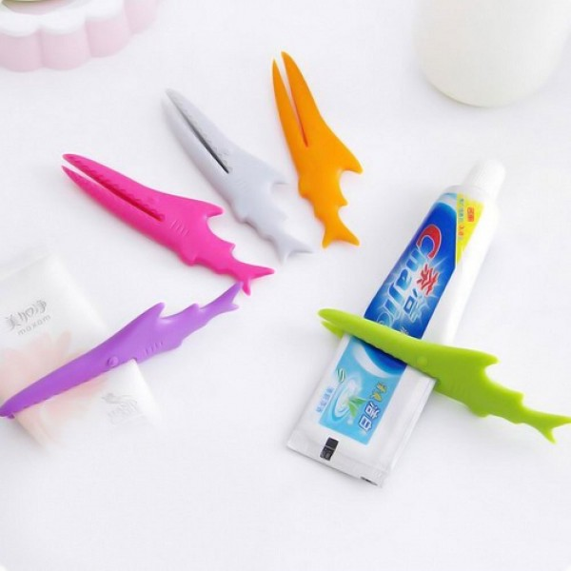
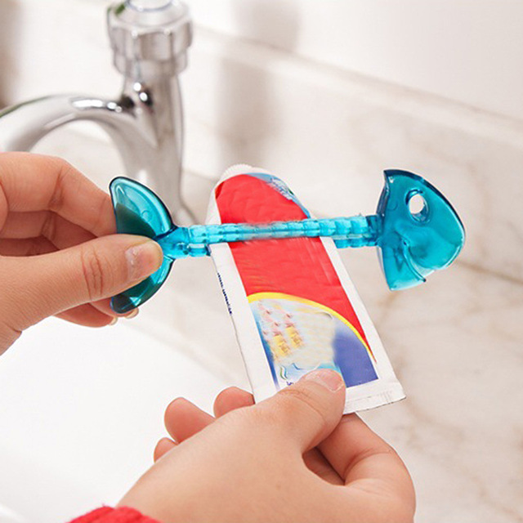
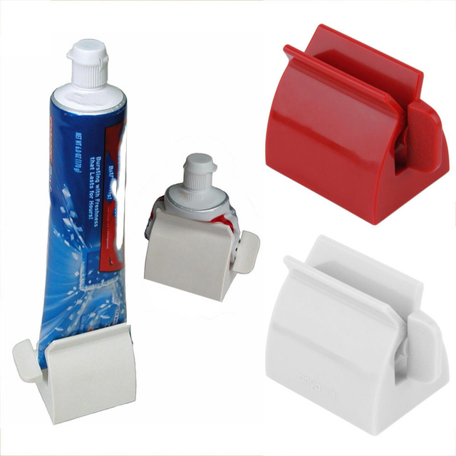
Review of current solutions
Images from google search

Slide 5
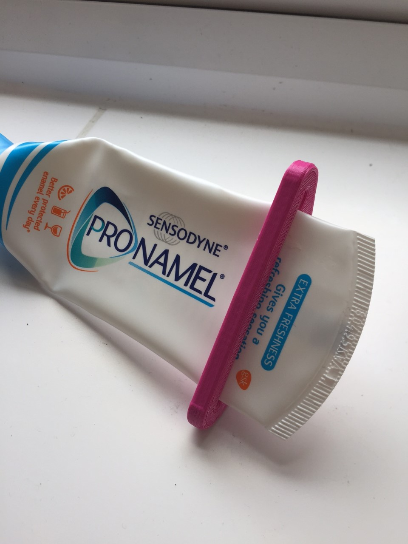
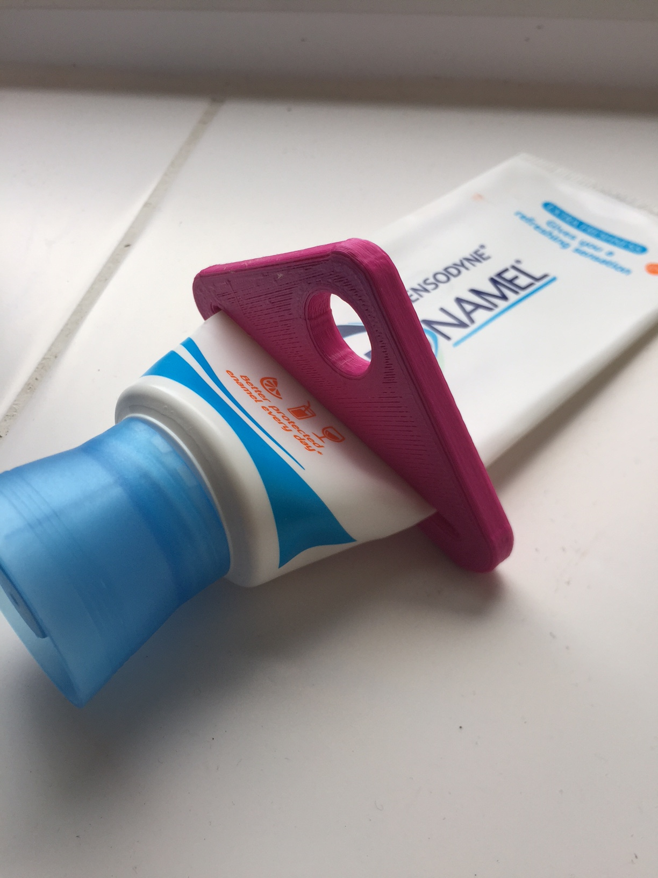
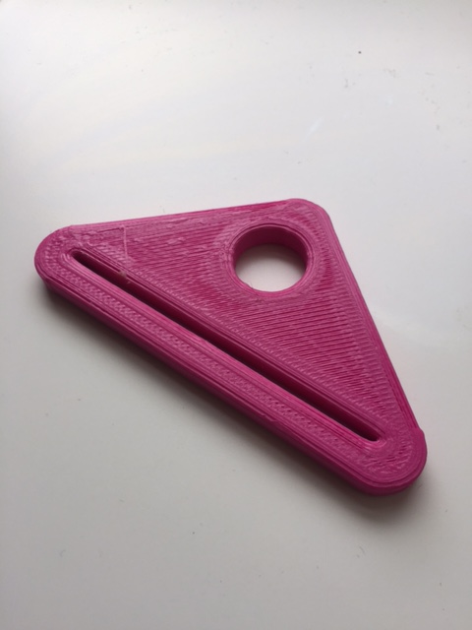
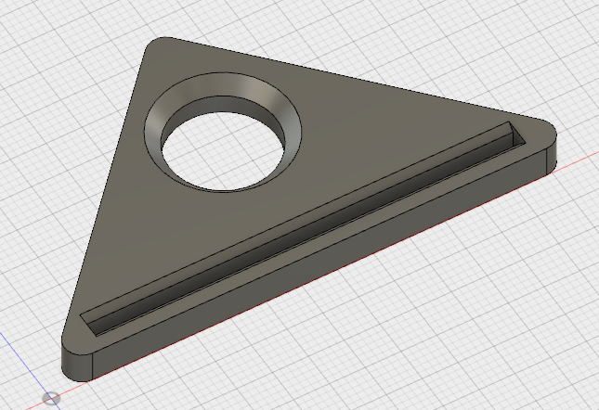
Example outcome

Slide 6
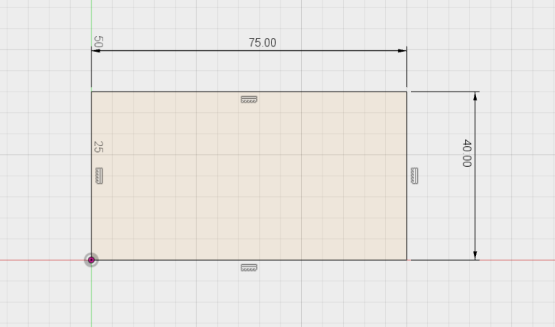
Task 2
Log onto fusion 360 and draw this shape.

Slide 7
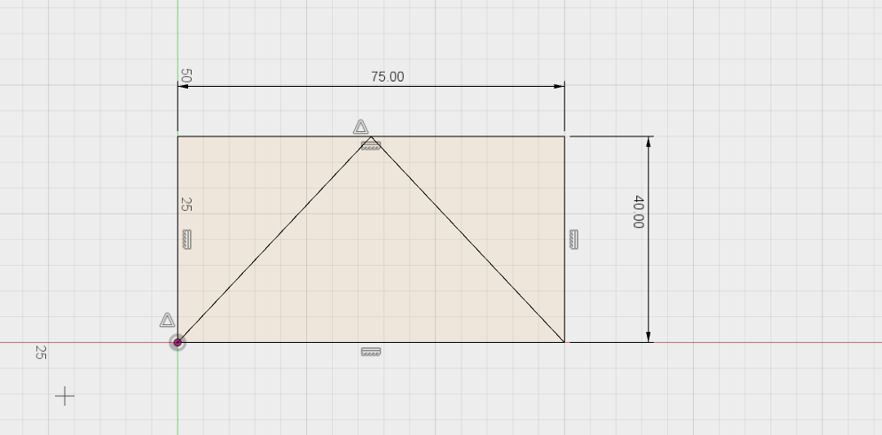
Add two lines at 45 degree like below.

Slide 8
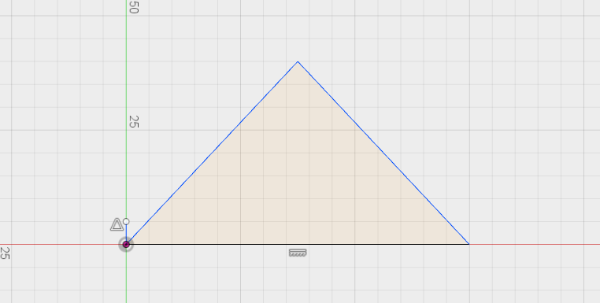
Trim the design.

Slide 9
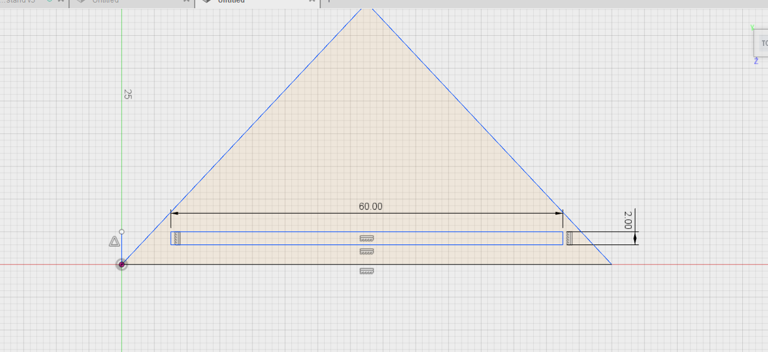
Add in the slot for the toothpaste tube to be squeezed through.

Slide 10
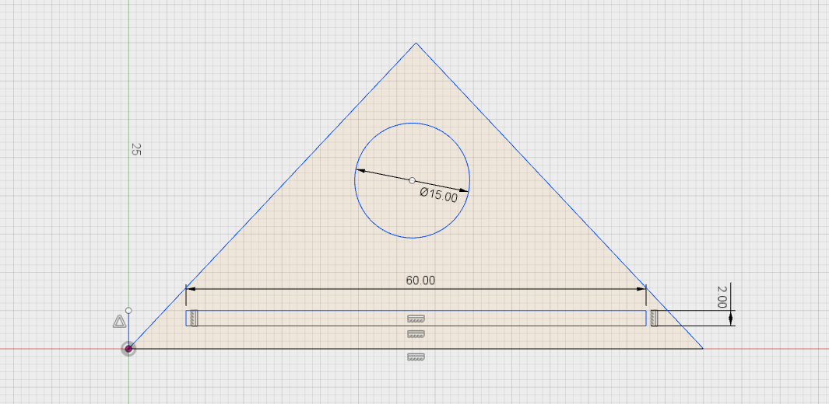
Add in a hole for a finger grip.

Slide 11
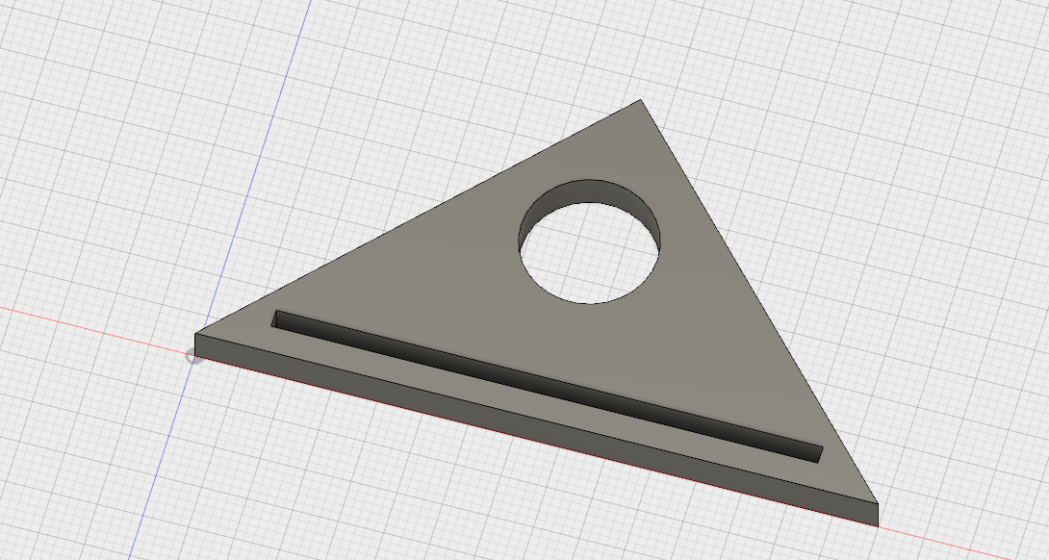
Extrude by 5 mm

Slide 12
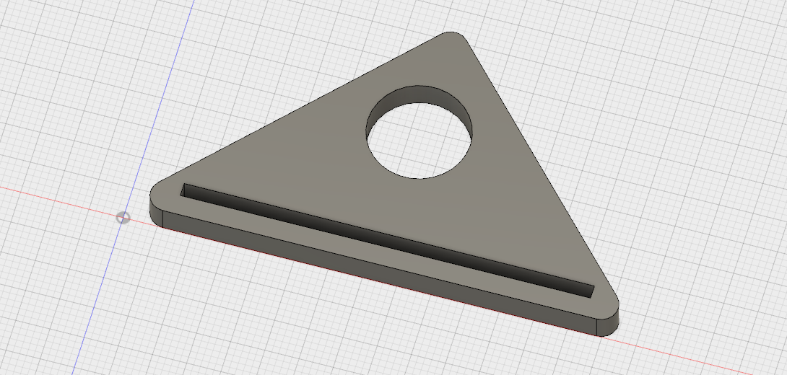
Fillet the corners by 2.5mm

Slide 13
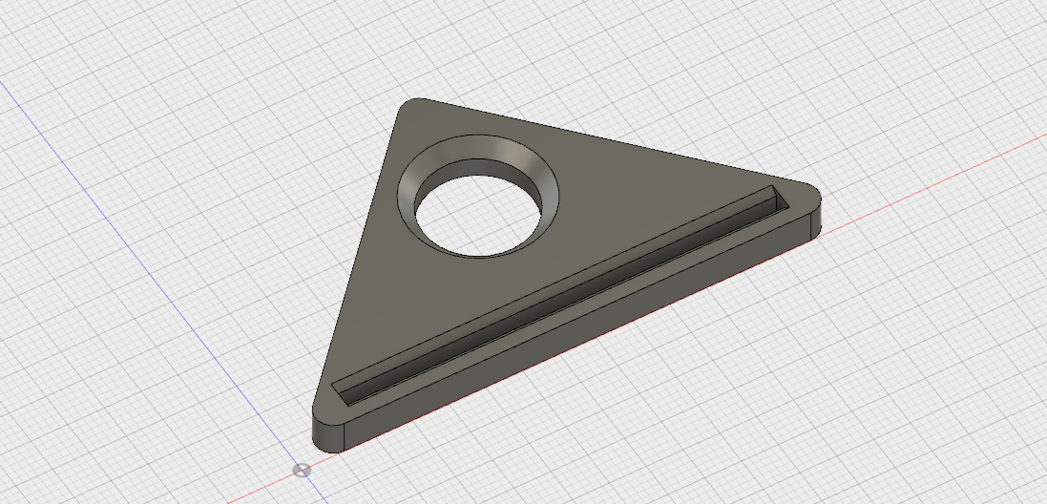
Add a chamfer to the hole and the slot.

Slide 14
Plenary
Write a description outlining what you learnt today.

