Slide 1

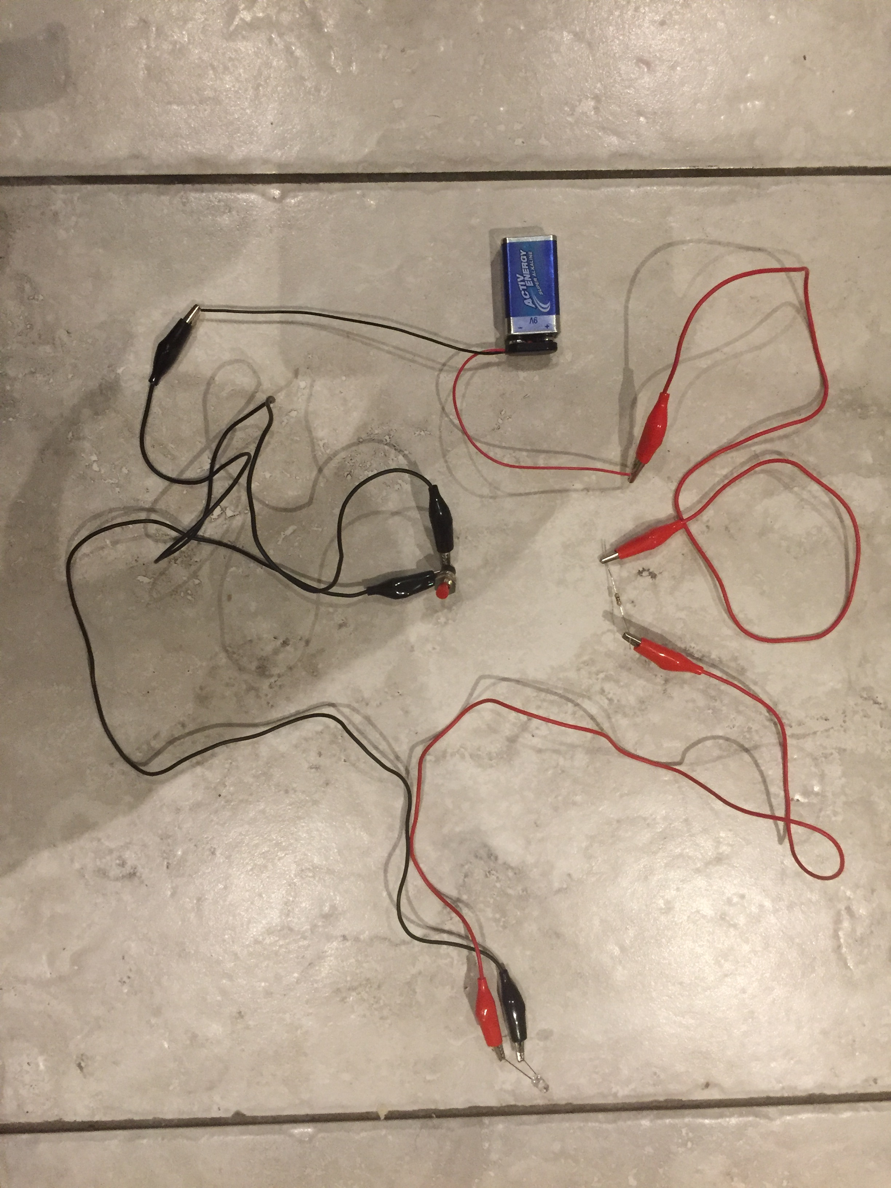
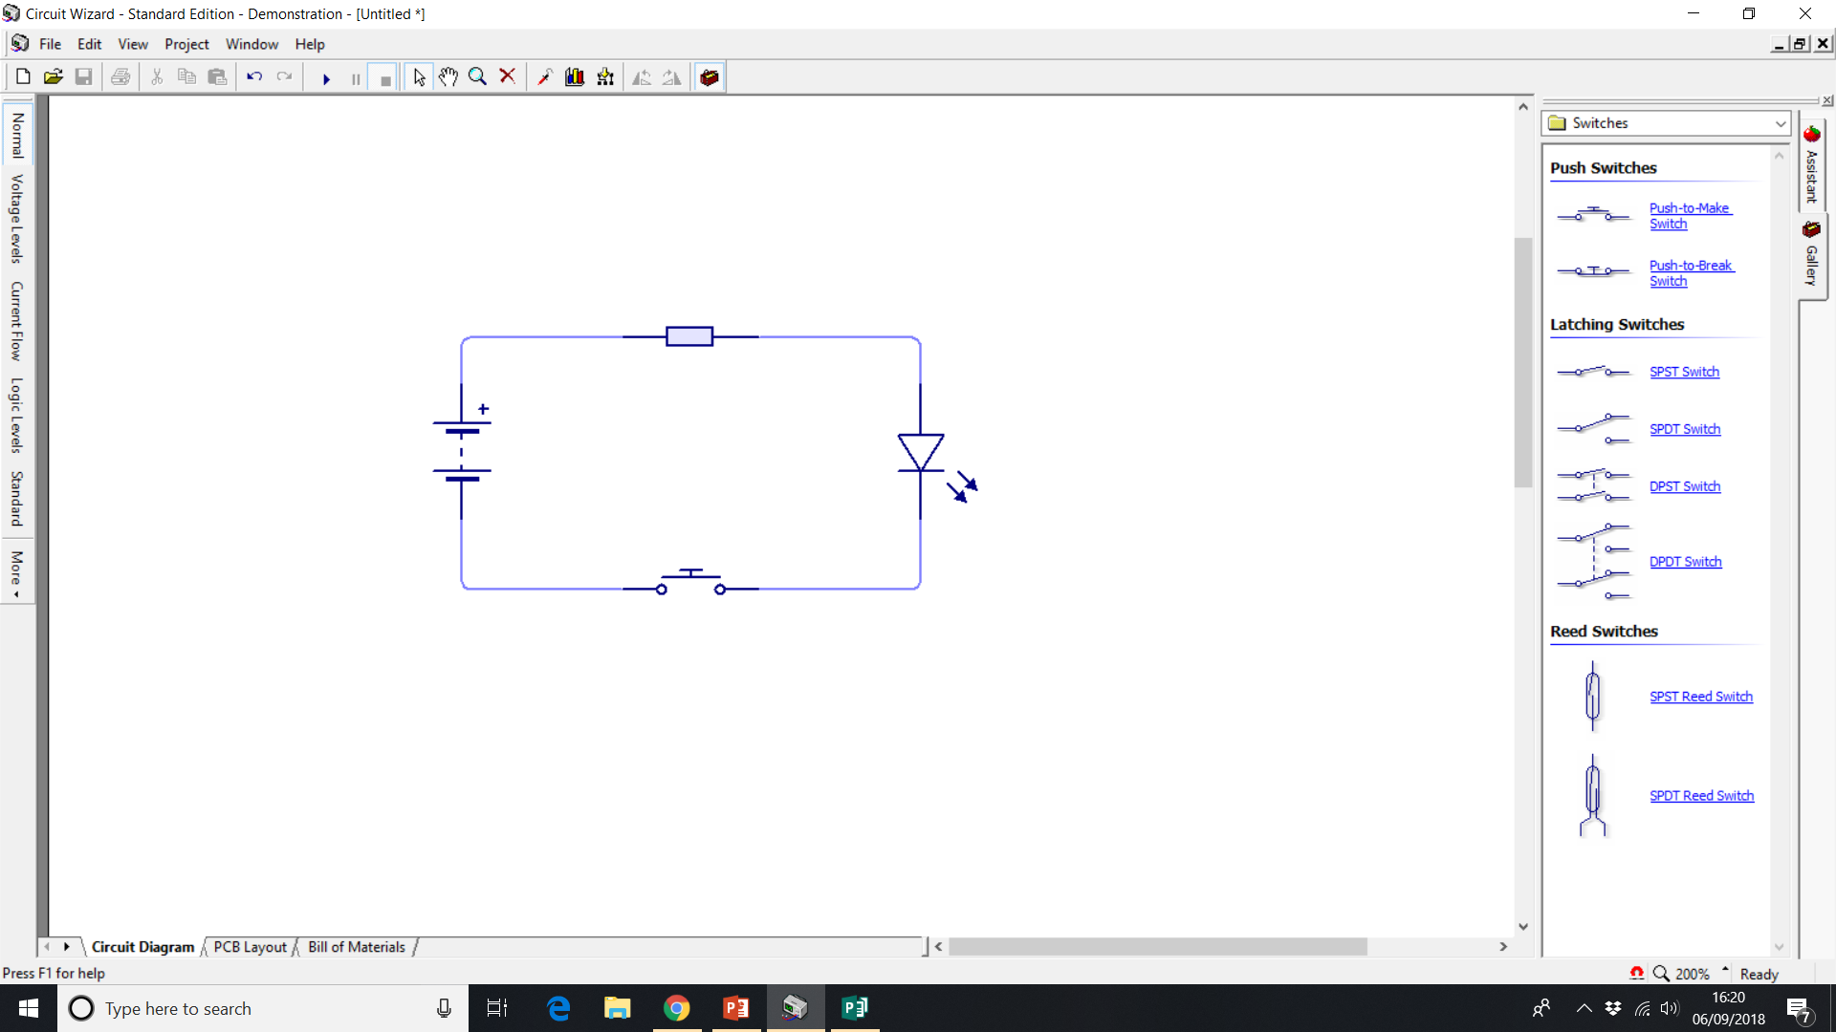
Clever Circuits
Resistor
9 V battery
LED
Push switch
Making a circuit and
drawing it using circuit symbols

Slide 2
What are circuit diagrams?
Look at the IET Faraday poster – Circuits and Symbols.
What are circuit symbols?
What is a circuit diagram?
Why do we use circuit diagrams to draw circuits?
Notes:
Discuss with the class or they could write down their responses. Circuit diagrams save space and are easier to understand than pictures. As everyone in the UK uses the same symbols, they are a language that anyone who knows them can understand. They are also much quicker to draw than the components. The poster can be downloaded from https://faraday-primary.theiet.org/posters
Examples of the poster could be placed on the whiteboard, on the wall or handed out to learners for them to use.

Slide 3

Making a light emitting diode (LED) circuit – part 1
LED
Connect one end of a red crocodile clip to the red wire of the battery clip.
Connect the other end to one leg of the resistor.
Connect one end of another red crocodile clip to the free leg of the resistor.
Connect the other end to the long leg of the LED.
Long
leg
Resistor
Short
leg
+
-
Push switch
9 V battery
and clip
Notes:
The 9 V battery could be fitted to a battery clip for ease of connection to crocodile clips. The recommend resistor value for this power supply is 330 ohms, but any value from 330 to 1k ohms will work. A push-to-make switch should be used as this will allow current to flow when pressed. The long leg of the LED is the anode (positive +) and the short leg is the cathode (negative -). Red wires on battery clips indicate positive connections, whereas black wires indicate negative connections.

Slide 4
Making a light emitting diode (LED) circuit – part 2
Connect one end of a black crocodile clip to the short leg of the LED.
Connect the other end to one leg of the switch.
Connect the one end of another black crocodile clip to the free leg of the switch.
Connect the other end to the black wire of the battery clip.
Push the switch to watch the LED light!
LED
Long
leg
Resistor
Short
leg
+
-
Push switch
9 V battery
and clip
Notes:
The 9 V battery could be fitted to a battery clip for ease of connection to crocodile clips. The recommend resistor value for this power supply is 330 ohms, but any value from 330 to 1k ohms will work. A push-to-make switch should be used as this will allow current to flow when pressed. It doesn’t matter which way round the switch is, so long as the two crocodile clips are attached to different legs and do not touch each other. The long leg of the LED is the anode (positive +) and the short leg is the cathode (negative -).

Slide 5
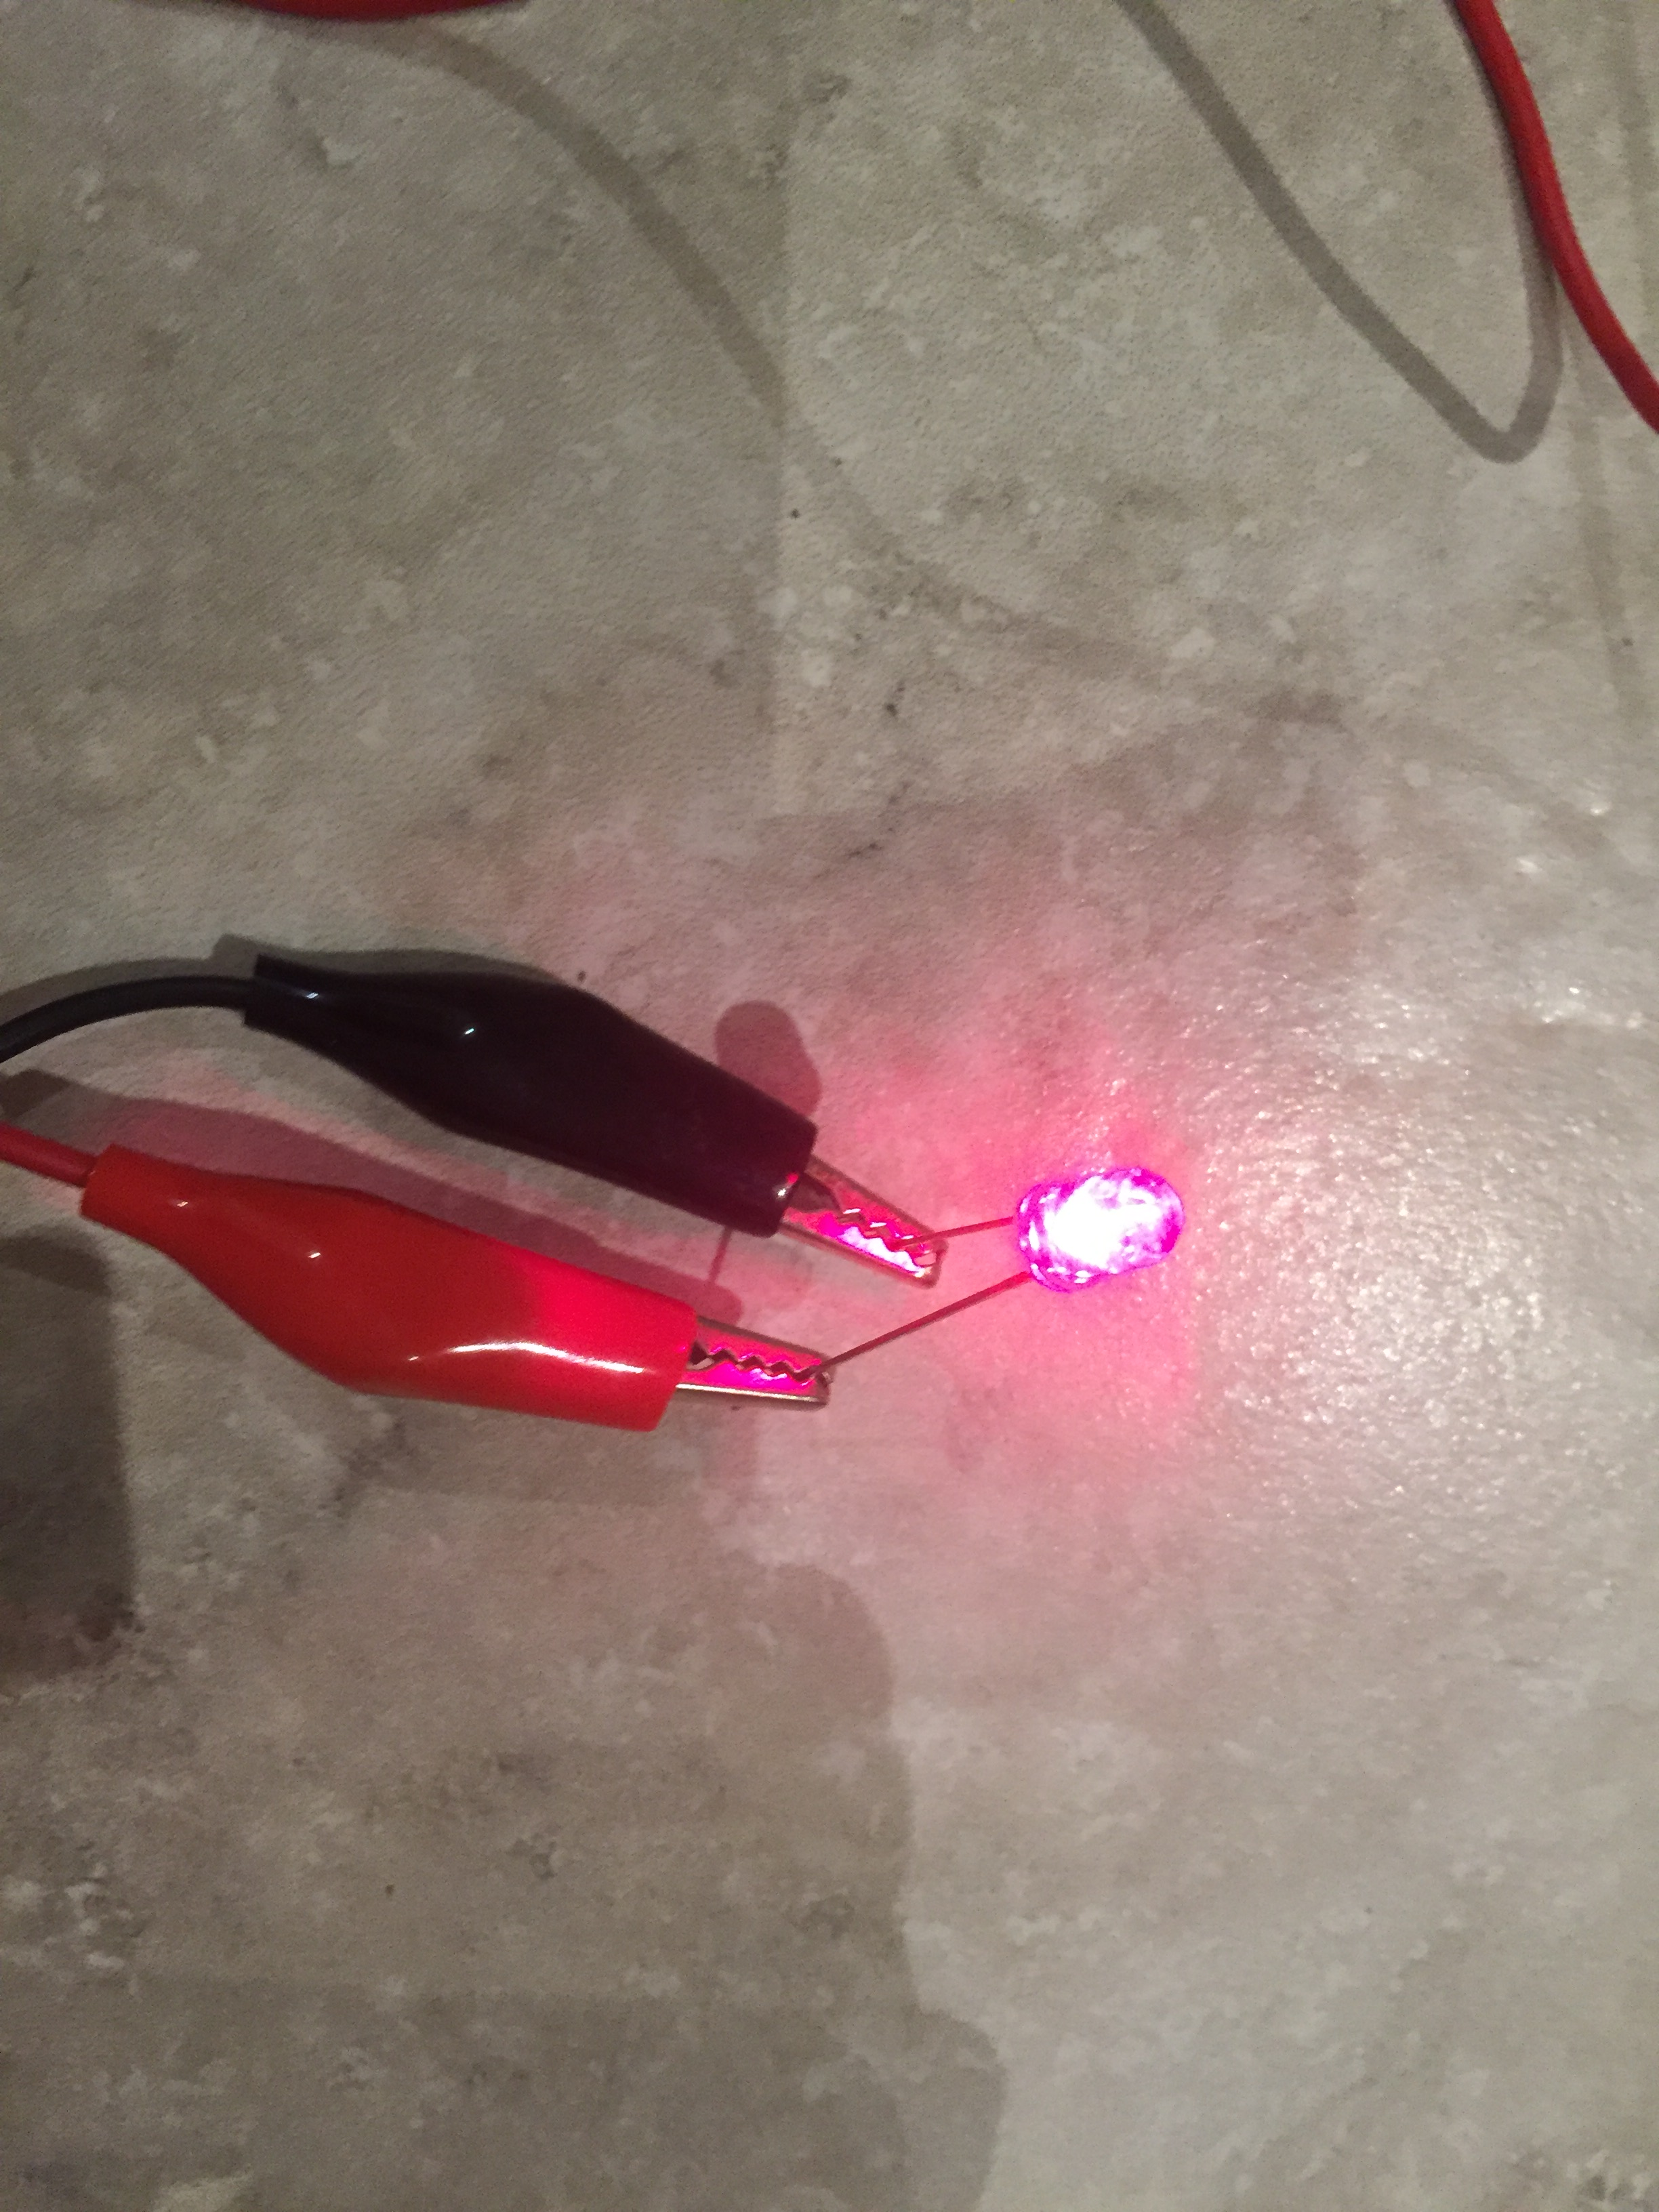
Example of a Circuit Made by a Pupil
The LED should light when the switch is pressed.
If it doesn't, check all your connections are correct and the LED is the right way round.
Notes:
Common errors include connecting the battery or the LED the wrong way around and not connecting the crocodile clips securely to the component legs. If the LED lights even when the switch is not pressed, check that the two switch legs are not touching.

Slide 6
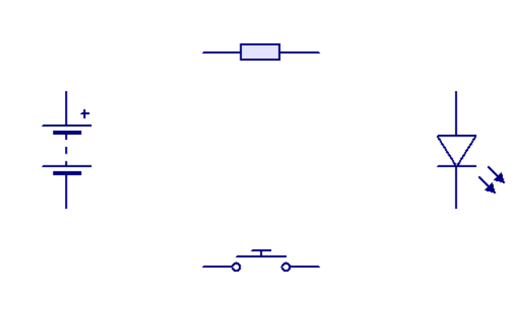
Drawing a circuit diagram using symbols
Draw the symbols for the battery, resistor, LED and switch. Place them as shown on this slide.
Join the component symbols together using straight lines. You MUST ONLY use horizontal and vertical lines.
Label all of the components used.
Resistor
Battery
LED
Push switch
Notes:
If necessary, discuss with the learners what is meant by horizontal and vertical lines and show an example. Rulers should be used.

Slide 7
Example circuit diagram
Resistor
9 V battery
LED
Push switch
Notes:
Learners should compare their diagram with this and correct if required. Ideally the corners would be at right angles, rather than curved.

