Slide 1

Fruit Lights
Using lemons and limes to
power an LED

Slide 2
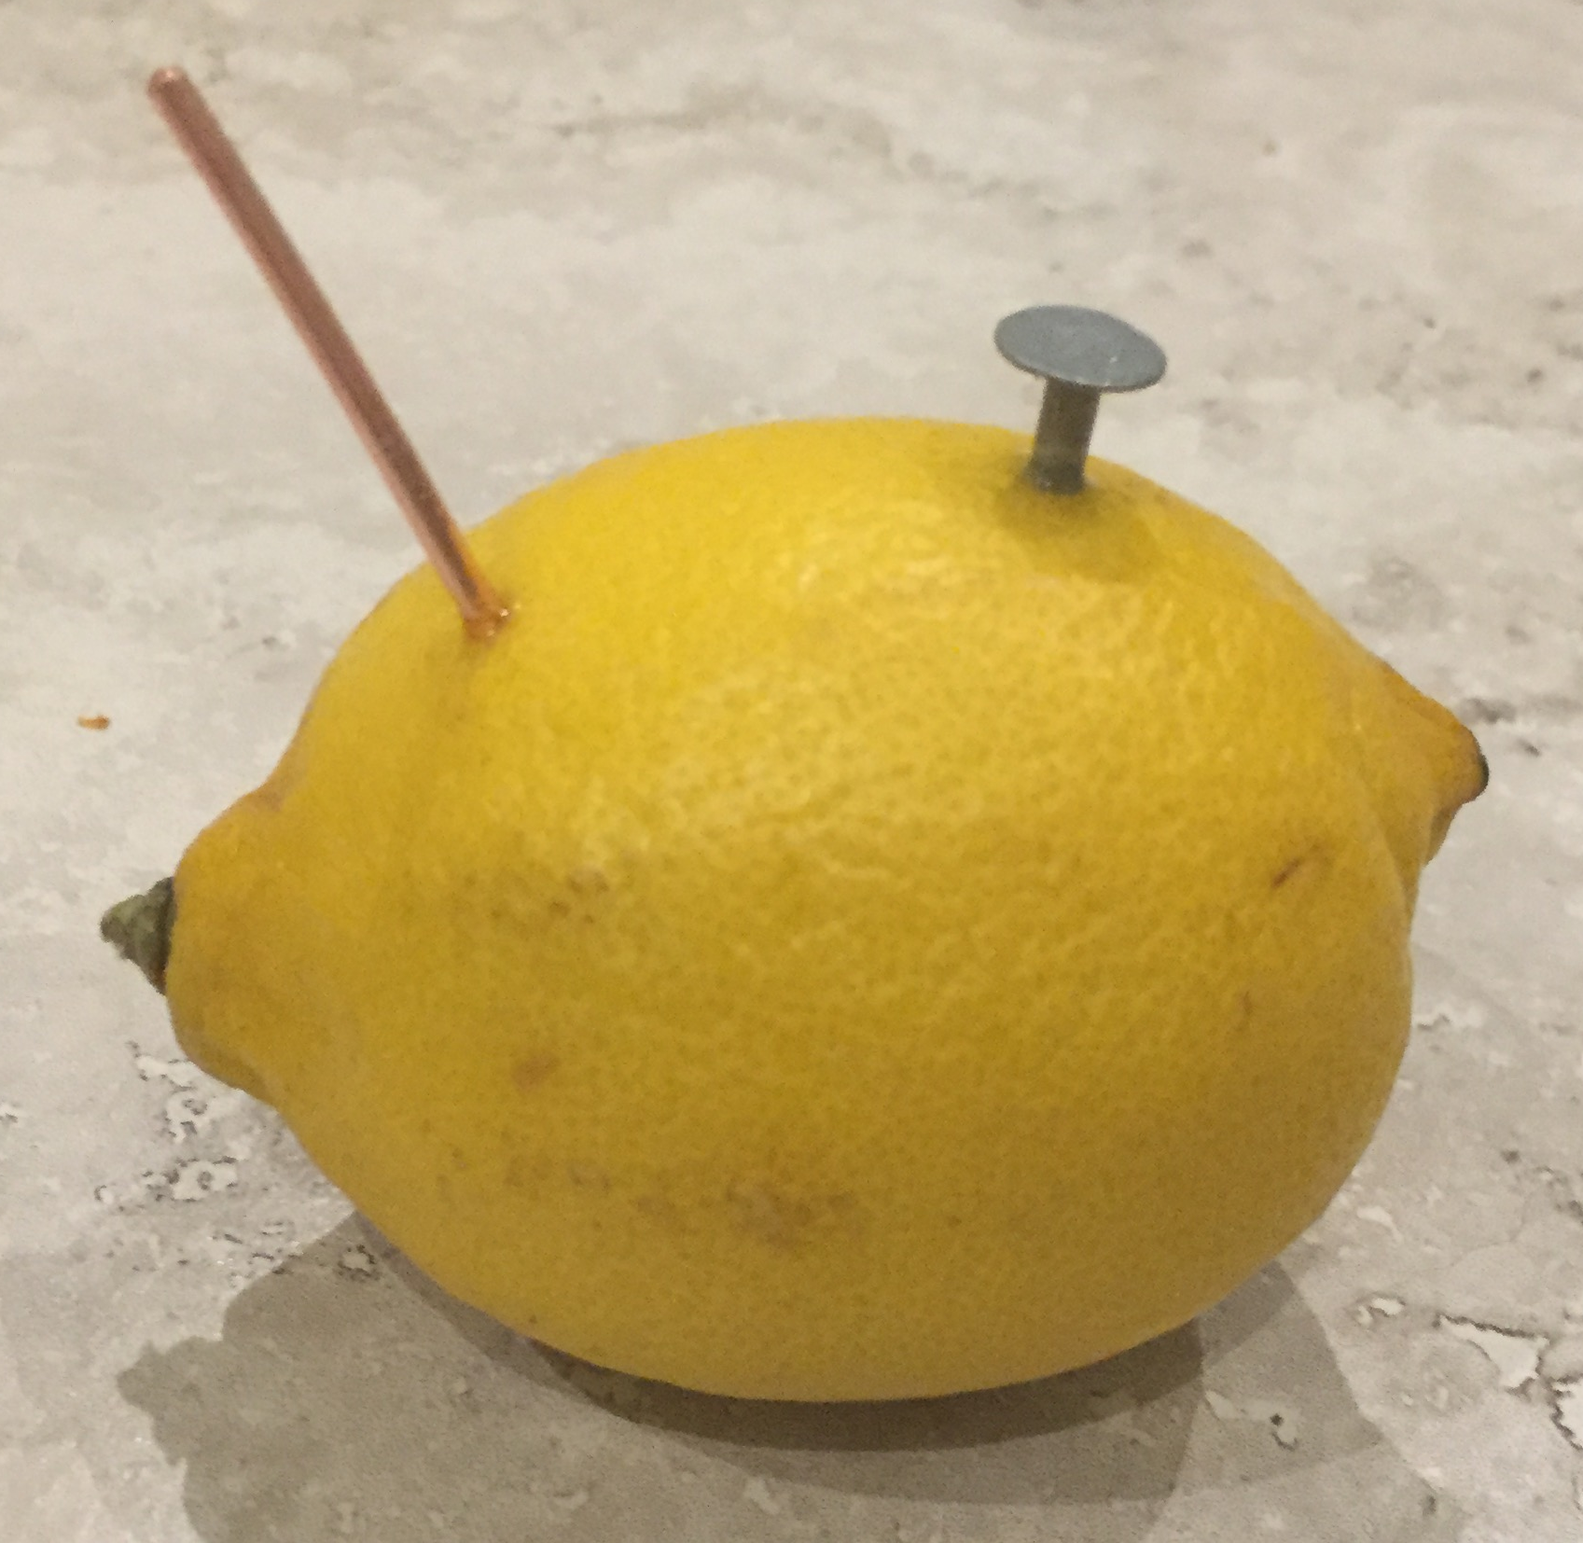
Step 1 – Making the lemon
batteries
Copper wire +
Nail -
Cut one 50 mm length of 2 mm diameter copper wire.
Insert the copper wire into one side of the lemon.
Insert one nail into the other side of the lemon.
Make sure both the copper wire and nail have gone right through the skin and into the juicy part of the lemon!
Repeat this process four times to create four ‘lemon batteries’.
x 4
Lemon
Notes:
Lemons or limes can be used, or a mixture of both. Nails used must be zinc coated. Use 1 mm or 2 mm diameter copper wire; padded gloves could be used to push this into the fruit, or a ‘pilot’ hole made using a skewer or sharp knife to reduce the force needed. Copper coins can also be used instead if available. The copper is the anode (positive) end of the battery and the nail is the cathode (negative) end. The fruit is the electrolyte. Each lemon or lime should provide between approximately 0.7 and 0.9 V. This can be tested by using a multimeter if required. Learners could cut the appropriate lengths of wire or these could be cut in advance by the teacher.

Slide 3
Step 2 – Joining the lemon batteries in series
Connect a red crocodile clip from the copper wire in lemon 4 to the nail in lemon 3.
Connect a red crocodile clip from the copper wire in lemon 3 to the nail in lemon 2.
Connect a red crocodile clip from the copper wire in lemon 2 to the nail in lemon 1.
Lemon 1
Lemon 2
Lemon 3
Lemon 4
Notes:
The total voltage of the series circuit can be calculated by adding up the voltage of each individual battery. This arrangement would produce approximately 2.8 – 3.6 V depending on the voltage of each individual piece of fruit.

Slide 4
Step 3 – Attaching the LED
Connect a black crocodile clip to the nail in lemon 4. Attach this to the short leg of the LED.
Connect a red crocodile clip to the copper wire in lemon 1. Attach this to the long leg of the LED.
Lemon 1
Lemon 2
Lemon 3
Lemon 4
To long leg of LED
To short leg of LED
Notes:
The long leg of the LED is the anode (positive +) and the short leg is the cathode (negative -). If the LED is connected the wrong way round it will not light. It is recommended that a hi-bright LED is used as it will be easier to observe this lighting up. The LED used should be of the low voltage type (approximately 3 – 4 V). A lamp can be used instead of the LED.

Slide 5
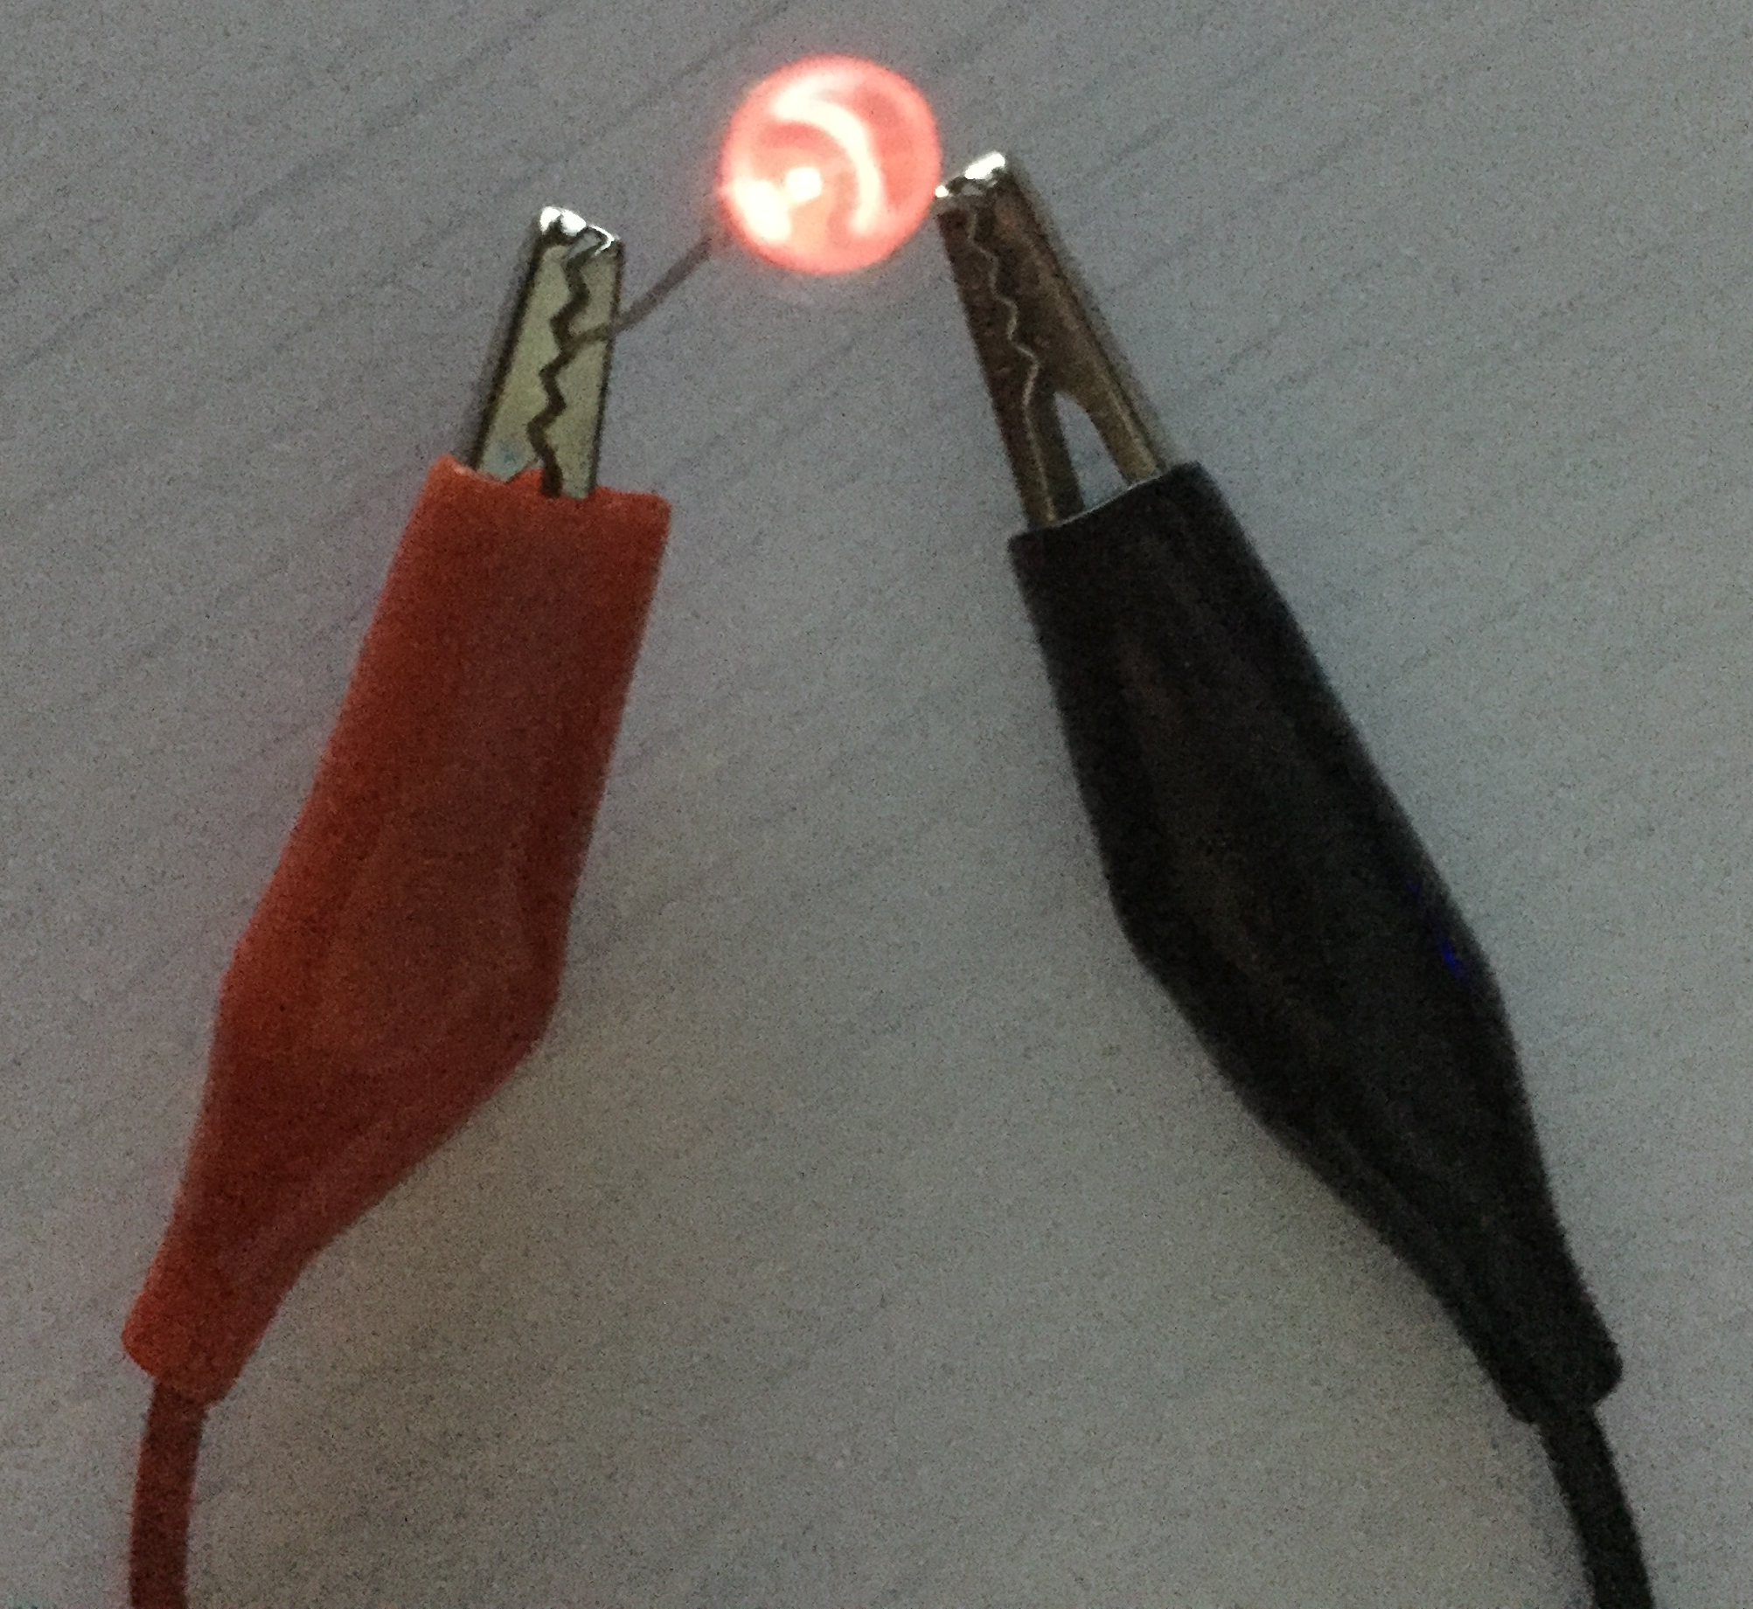
Step 4 – Test the circuit
The LED should light up. Why do you think this happens?
What would happen to the LED if you increased or decreased the number of fruit batteries in the circuit?
Lemon 1
Lemon 2
Lemon 3
Lemon 4
To long leg of LED
To short leg of LED
Notes:
Turn the lights down if possible to best observe the effect of the LEDs lighting up. Increasing the number of lemon batteries would increase the brightness, but too much voltage could destroy it! Reducing the number of lemon batteries would reduce the brightness or the LED may fail to light at all.

Slide 6
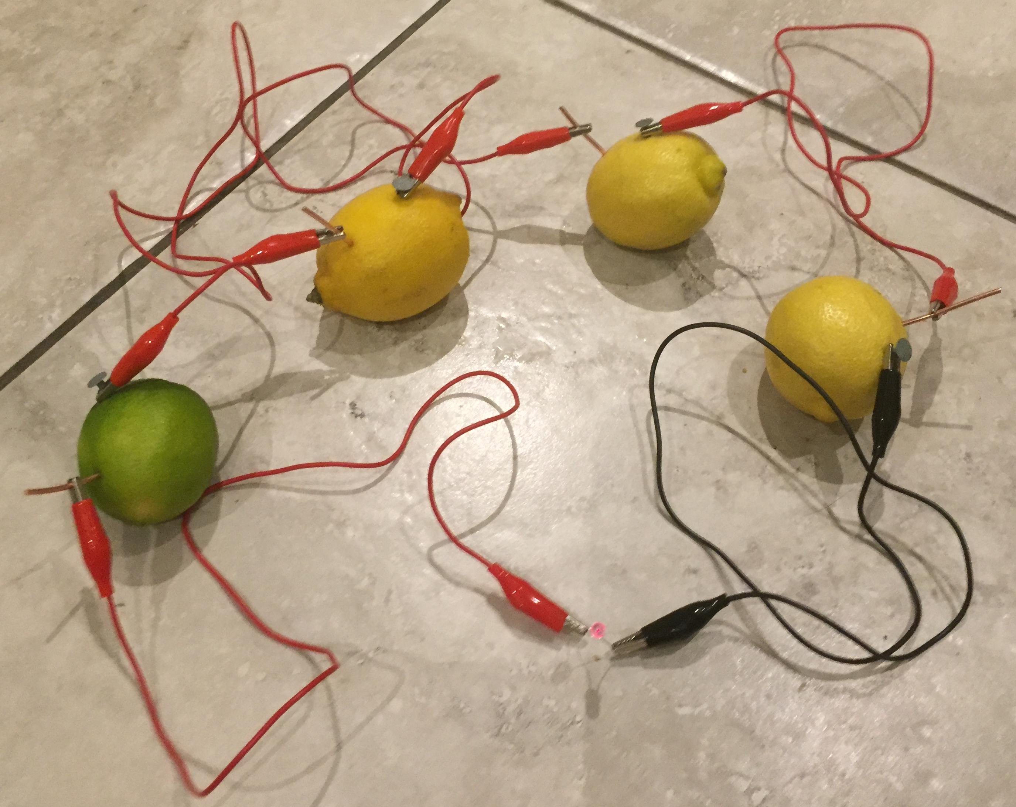
Example fruit battery

