Slide 1

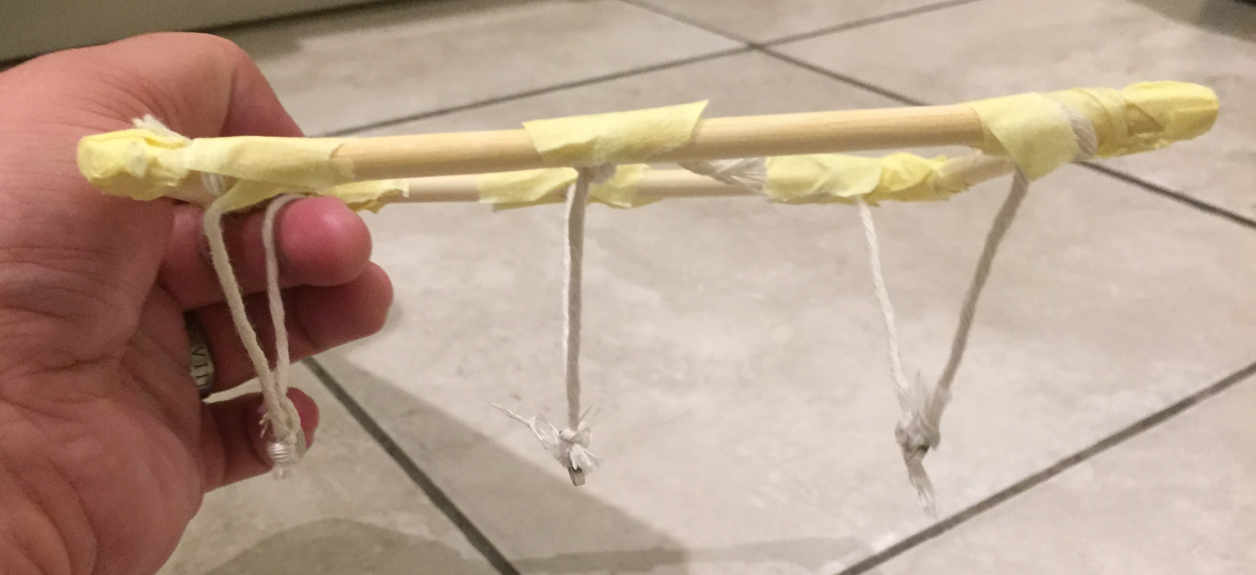
Not Newton’s Cradle
Making a cradle using magnets that repel each other

Slide 2
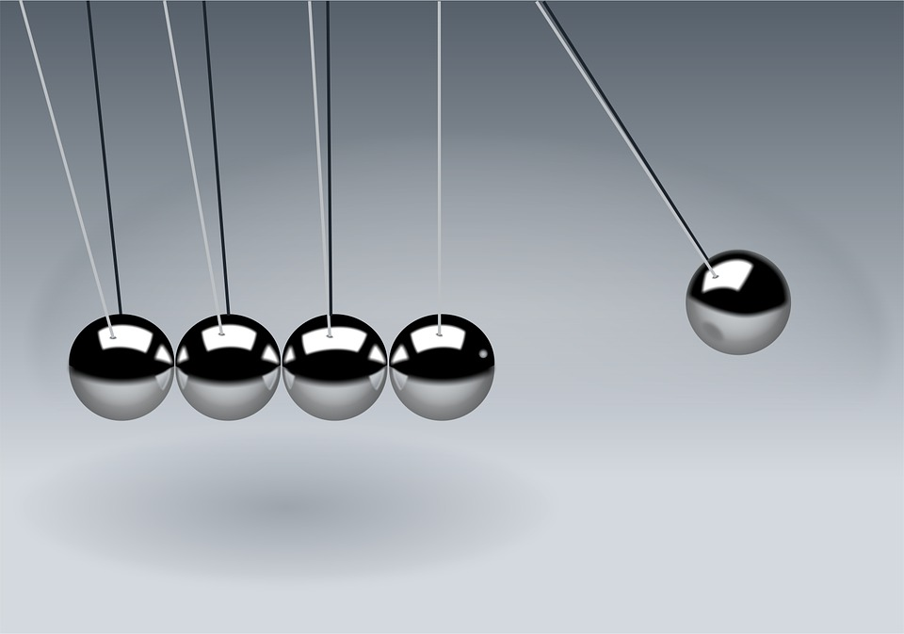
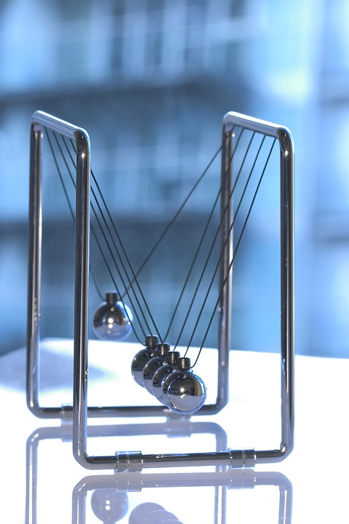
‘Regular’ Newton’s Cradle
Notes:
Discuss how this works and show an example if available.
Images from Pixabay.com (public domain)

Slide 3
Step 1 – Making the wooden frame
Lay out the shape shown to the right. This uses two 75 mm and two 150 mm lengths of dowel.
Join the lengths of dowel together by wrapping masking tape around them.
75 mm length of dowel
150 mm length of dowel
Notes:
Learners could use hot glue guns instead of masking tape to make the joins if available. The above instructions would need to be modified in this instance.

Slide 4
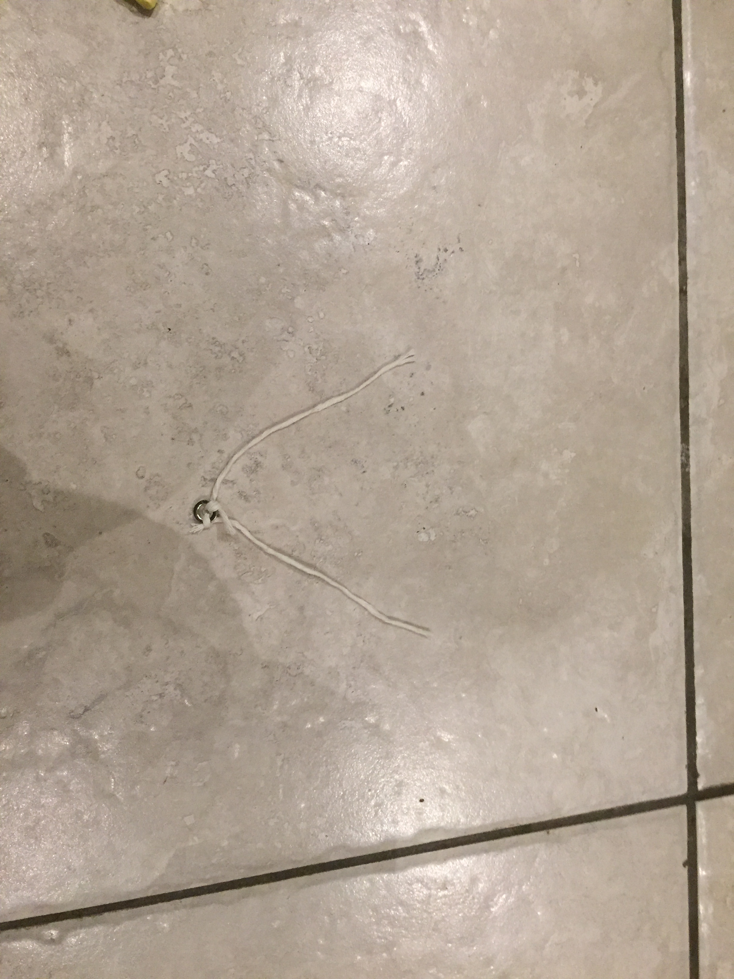
Step 2 – Attaching string to the magnets
string
string
Place a piece of string through the hole in one of the magnets. Tie the string in a knot.
Place another piece of string through the hole in the same magnet. Tie this in a knot as well.
Repeat the above stages with three different magnets.
x 3
magnet
Notes:
100 - 120 mm lengths of string can be used. Tying the knots in step 2 and step 3 will result in this reducing. See note on step 3 regarding the suggested final length of each piece of string after the magnets have been tied and secured to the frame. Any leftover string from the knot could be trimmed using scissors. Cotton thread could be used as an alternative to string.

Slide 5
Step 3 – Attaching the magnets to the frame
Wrap the free ends of the string joined to magnet 1 around the frame in the positions shown. The flat side of the magnet should be facing downwards.
Use a ruler to check the string lengths between the frame and the magnet are around 50 mm each. If not, wrap extra string around the frame.
Tie each piece of string to the frame and secure with masking tape.
Magnet 1
Notes:
The final length of each piece of string joining the magnet to the frame should be around 50 mm, giving learners plenty of remaining length from their original piece to tie around the frame. If the string is too long it may cause problems with the magnets attracting and joining to each other whilst construction is taking place. Alternatively a hot glue gun can be used to join the string to the frame. The magnets used in this example have a flat side and an indented side, which shows which pole is which. For the effect to work during testing, the poles of the outer magnets (1 and 3) should be facing towards the same poles from the middle magnet (2) (e.g. N to N or S to S), causing them to repel each other.

Slide 6
Step 3 – Attaching the magnets to the frame
Wrap the free ends of the string joined to magnet 2 around the frame in the positions shown. The flat side of the magnet should be facing upwards.
Use a ruler to check the string lengths between the frame and the magnet are around 50 mm each. If not, wrap extra string around the frame.
Tie each piece of string to the frame and secure with masking tape.
Magnet 2
Notes:
The final length of each piece of string joining the magnet to the frame should be around 50 mm, giving learners plenty of remaining length from their original piece to tie around the frame. If the string is too long it may cause problems with the magnets attracting and joining to each other whilst construction is taking place. Alternatively a hot glue gun can be used to join the string to the frame. The magnets used in this example have a flat side and an indented side, which shows which pole is which. For the effect to work during testing, the poles of the outer magnets (1 and 3) should be facing towards the same poles from the middle magnet (2) (e.g. N to N or S to S), causing them to repel each other.

Slide 7
Step 3 – Attaching the magnets to the frame
Wrap the free ends of the string joined to magnet 3 around the frame in the positions shown. The flat side of the magnet should be facing downwards.
Use a ruler to check the string lengths between the frame and the magnet are around 50 mm each. If not, wrap extra string around the frame.
Tie each piece of string to the frame and secure with masking tape.
Magnet 3
Notes:
The final length of each piece of string joining the magnet to the frame should be around 50 mm, giving learners plenty of remaining length from their original piece to tie around the frame. If the string is too long it may cause problems with the magnets attracting and joining to each other whilst construction is taking place. Alternatively a hot glue gun can be used to join the string to the frame. The magnets used in this example have a flat side and an indented side, which shows which pole is which. For the effect to work during testing, the poles of the outer magnets (1 and 3) should be facing towards the same poles from the middle magnet (2) (e.g. N to N or S to S), causing them to repel each other.

Slide 8
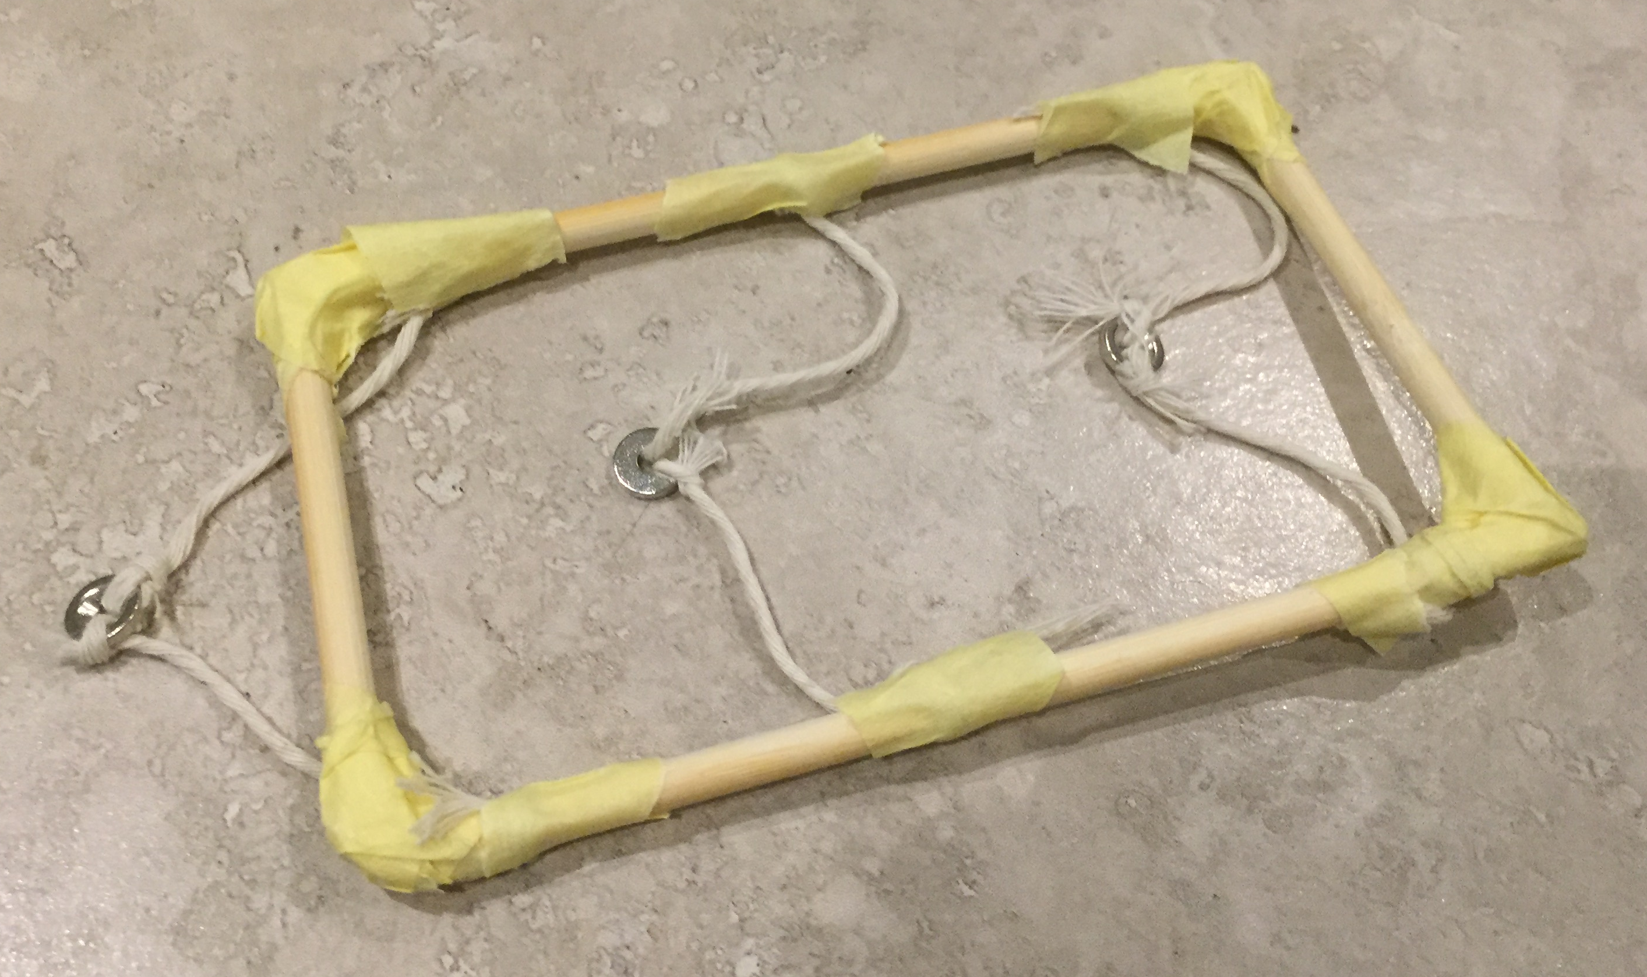
Example made by a Learner
Notes:
The magnets should repel against each other. They may, depending on their strength, then flip and attract. This is a very different outcome to when using a traditional Newton’s cradle!

Slide 9
Testing
1
2
3
Lift the frame, taking care to keep the magnets apart.
Move magnet 3 to the right and let go of it. What happens?
Move magnet 1 to the left and let go of it. What happens?
Why do you think this happened?
Notes:
The magnets should repel against each other. They may, depending on their strength, then flip and attract. This is a very different outcome to when using a traditional Newton’s cradle!

Slide 10
Additional Information - What are Magnets?
Magnets are made from materials such as iron and nickel.
They can stick to some metals, but not others.
Magnets have a north pole and a south pole.
N
S
Notes:
If available show examples of magnets and magnetic materials. The IET Faraday resource ‘Magnetic Materials’ explores magnetic and non-magnetic materials further and can be used as an introductory lesson to this activity.

Slide 11
Opposite Poles Attract
When the north pole of a magnet is placed near the south pole of another magnet, they will attract each other.
N
S
N
S
Notes:
Demonstrate by showing two magnets and how they attract or repel each other.

Slide 12
Similar Poles Repel
When two poles that are the same are placed near each other, they will repel each other. For example, north to north and south to south.
N
S
S
N
S
N
N
S
Notes:
Demonstrate by showing two magnets and how they attract or repel each other.

