Slide 1

Product Analysis
Introduction to how to carry out a product analysis

Slide 2
What is Product Analysis?
What is an ‘existing’ product?
What do we mean by the term ‘product analysis’?
Why do designers analyse existing products?
Notes:
Discuss with learners to gauge prior knowledge and to introduce what is meant by the term product analysis. Discuss reasons why product analysis is carried out, such as:
To learn about how a product works
To understand how products can be improved
To gain ideas/inspiration for future design
To avoid mistakes that have previously been made

Slide 3

The 5 Ws
Who – Who is the user of the product?
What – What does the product do? What materials is it made from?
Where – Where is the product used? Where was it made?
When – When is the product used?
Why – Why does the product exist? Why is it designed the way that it is?
Notes:
Sometimes H for ‘How’ can be added to the list – teacher may wish to add this as an extension for more able learners.

Slide 4
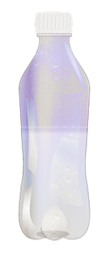
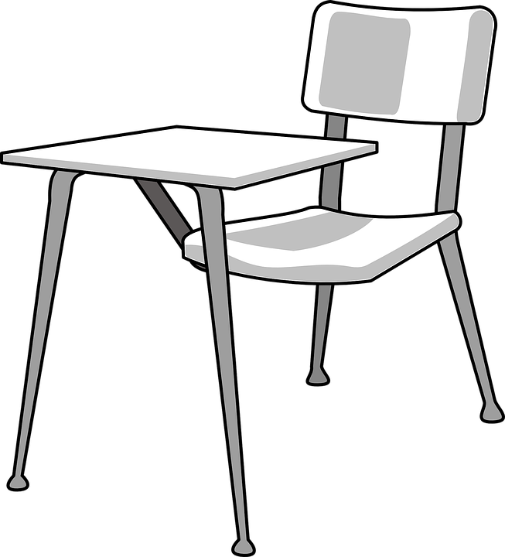
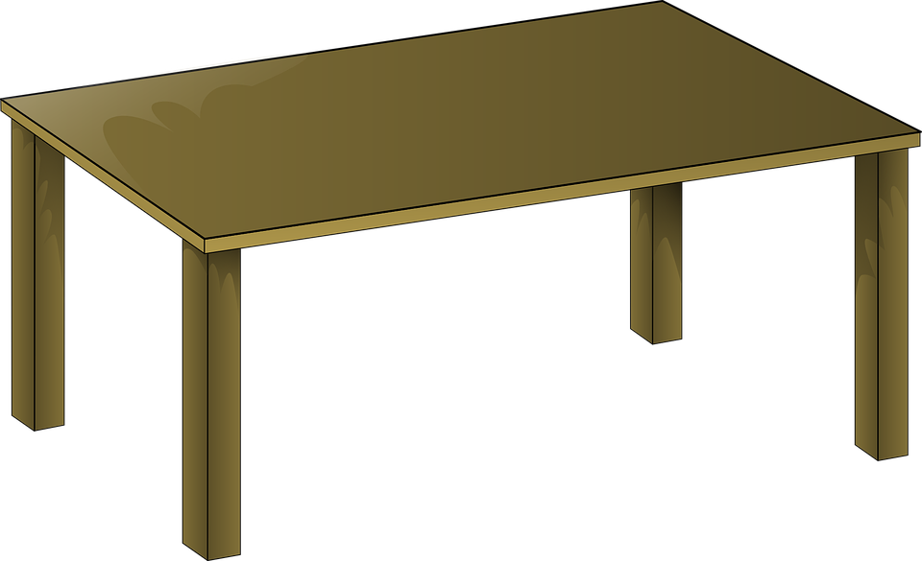
5 Ws - your turn!
Have a look around the classroom and choose a product near to you.
Use the 5 Ws to analyse the product.
Write down your findings in as much detail as you can.
Notes:
Teacher could show some examples for learners who cannot think of or find a suitable a product, such as a plastic water bottle, classroom chair or table, iPad etc.

Slide 5
ACCESS FM
A = Aesthetics – How does the product appeal to the five senses?
C = Cost – How much does the product cost to make or to buy?
C = Customer – Who will buy or use the product?
E = Environment – How does the product affect the environment? Is it made from recycled materials?
S = Size – What is the length, width and height of the product?
S = Safety – Is the product safe to use?
F = Function – How does the product work? What does it do?
M = Material – What materials and components have been used to make the product?
Notes:
Use of ACCESS FM is more advanced than the 5 Ws, so could be used to challenge more able learners.
The following Prezi can also be used to help explain what is meant by ACCESS FM https://prezi.com/gp11mvjq7mwv/what-is-access-fm/

Slide 6
ACCESS FM - your turn!
Have a look around the classroom and choose a product near to you.
Use ACCESS FM to analyse the product.
Write down your findings in as much detail as you can.
Notes:
The product should be different to the one used for the 5 Ws. Teacher could show some examples for learners who cannot think of or find a suitable a product, such as a plastic water bottle, classroom chair or table, iPad etc.

Slide 7
Plenary
Test your knowledge of ACCESS FM!
https://wordwall.net/resource/44217/dt/match-up-access-fm
Notes:
Teacher should click on the link to load the interactive mix and match game. Learners could either attempt on individual computers, or as a class via the interactive whiteboard.

