Slide 1

WHAT
UNDERSTANDING ALL ABOUT DIFFERENT ENERGY SOURCES
WHY
EACH CAN HAVE POSITIVE OR NEGATIVE IMPACTS ON THE ENVIRONMENT.
WHERE
YOU WILL ALSO REQUIRE THIS KNOWLEDGE IN YOUR EXAMS
Believe Approach the task positively | Achieve Try to exceed my target! | Succeed Create some exciting designs | Enjoy Have fun, but work Safely | Support Work independently and support each other

Slide 2
Key words
Non-renewable
Renewable
Kinetic energy
Sustainable
Resources that can replace themselves and can be used again and again.
Resources that will run out one day.
This is energy generated because something is moving.
Not being harmful to the environment or using up natural resources.
Generator
Machine for converting mechanical energy into electricity.
Notes:
Oil- app 42 years
Natural gas- app 60 years
Coal app 250 years
Uranium 108 years

Slide 3


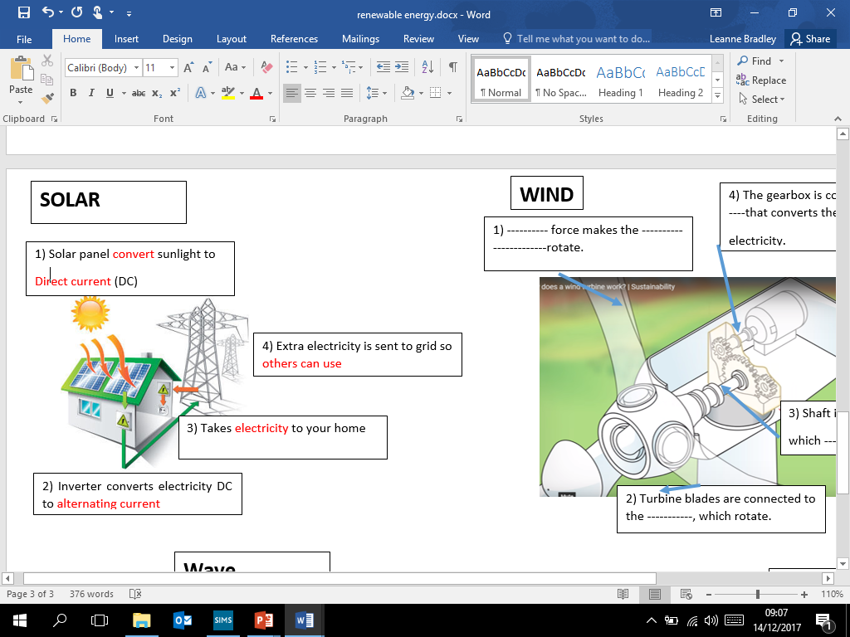

SOLAR
For years we have used the sun to dry our clothes by hanging washing out, now we can use the sun to make the electricity to run a tumble drier and even provide the hot water to wash our clothes with!
Notes:
DC” power (commonly used in batteries) into alternating current or “AC” power. AC power is the kind of electrical that your television, computer, and toasters use when plugged into the wall outlet.
Advantage extra for discussion
Improved efficiency of solar technology (within the next few years, experts believe will be much more efficient.
Government incentives, such as free- in tariffs (financial incentives)
Does not release any harmful carbon dioxide or other pollutants.
Disadvantage extra for discussion
Would need some other form of energy- can only be created in daytime/sunny environment. (needs to be part of the integrated energy system and have back up)
Large area required to absorb sun and generate power.

Slide 4
SOLAR
For years we have used the sun to dry our clothes by hanging washing out, now we can use the sun to make the electricity to run a tumble drier and even provide the hot water to wash our clothes with!
ADVANTAGES:
Solar energy is a renewable energy source
There are no fuel costs
No harmful polluting gases are produced (carbon
dioxide)
DISADVANTAGES:
Solar power has high set up costs
Limitations- solar does not give consistent, continuous power.
They only work during the day
Notes:
DC” power (commonly used in batteries) into alternating current or “AC” power. AC power is the kind of electrical that your television, computer, and toasters use when plugged into the wall outlet.
Advantage extra for discussion
Improved efficiency of solar technology (within the next few years, experts believe will be much more efficient.
Government incentives, such as free- in tariffs (financial incentives)
Does not release any harmful carbon dioxide or other pollutants.
Disadvantage extra for discussion
Would need some other form of energy- can only be created in daytime/sunny environment. (needs to be part of the integrated energy system and have back up)
Large area required to absorb sun and generate power.

Slide 5
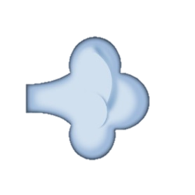
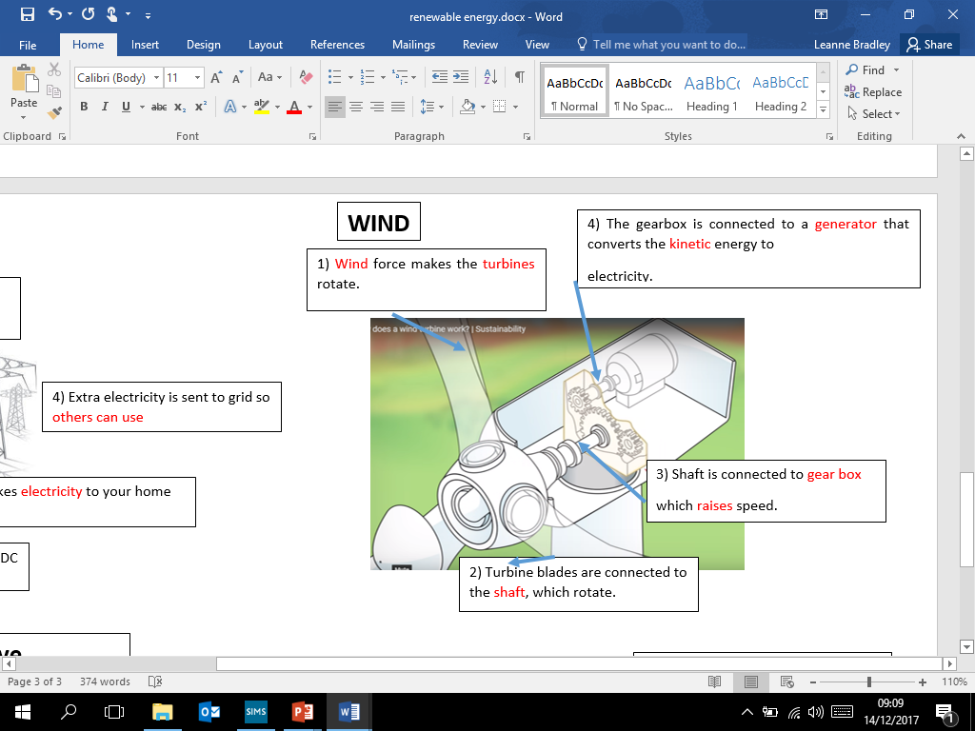
WIND
Wind turbines convert the kinetic energy in the wind into mechanical power. This mechanical power can be used to power homes, businesses, schools.
Notes:
Wind turbines operate on a simple principle. The energy in the wind turns two or three propeller-like blades around a rotor. The rotor is connected to the main shaft, which spins a generator to create electricity

Slide 6
WIND
Wind turbines convert the kinetic energy in the wind into mechanical power. This mechanical power can be used to power homes, businesses, schools.
ADVANTAGES:
Wind energy is a renewable energy source
There are no fuel costs
No harmful polluting gases are produced
DISADVANTAGES:
Wind farms are noisy
Wind farms may spoil the view for people living near them.
If there is no wind, there is no electricity.
Notes:
Wind turbines operate on a simple principle. The energy in the wind turns two or three propeller-like blades around a rotor. The rotor is connected to the main shaft, which spins a generator to create electricity

Slide 7
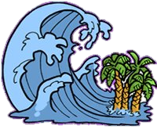
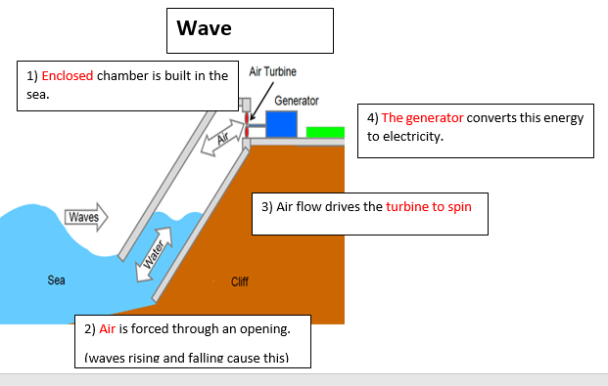
WAVE
The water in the sea rises and falls because of waves on the surface. Wave machines use the kinetic energy in this movement to drive electricity generators

Slide 8
WAVE
The water in the sea rises and falls because of waves on the surface. Wave machines use the kinetic energy in this movement to drive electricity generators
ADVANTAGES:
Wave energy is a renewable energy source
There are no fuel costs
No harmful polluting gases are produced
Reliable energy source
DISADVANTAGES:
It has been difficult to scale up the designs for wave machines to produce large amounts of electricity.
Tidal barrages destroy the habitat of species, including birds.

Slide 9


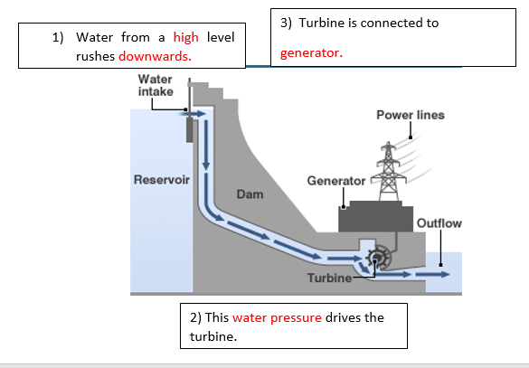
HYDROELECTRIC
Hydroelectric power stations use the kinetic energy in moving water from rivers, dams and lakes.

Slide 10


HYDROELECTRIC
Hydroelectric power stations use the kinetic energy in moving water from rivers, dams and lakes.
ADVANTAGES:
Water power in its various forms is a renewable energy resource
no fuel costs.
No harmful polluting gases are produced.
Reliable energy source.
DISADVANTAGES:
The designs for wave machines don’t allow them to produce large amounts of electricity.
Tidal barrages destroy the habitat of wading birds.
Hydroelectricity dams flood farmland and push people from their homes.

Slide 11
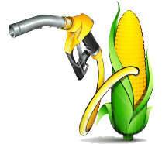
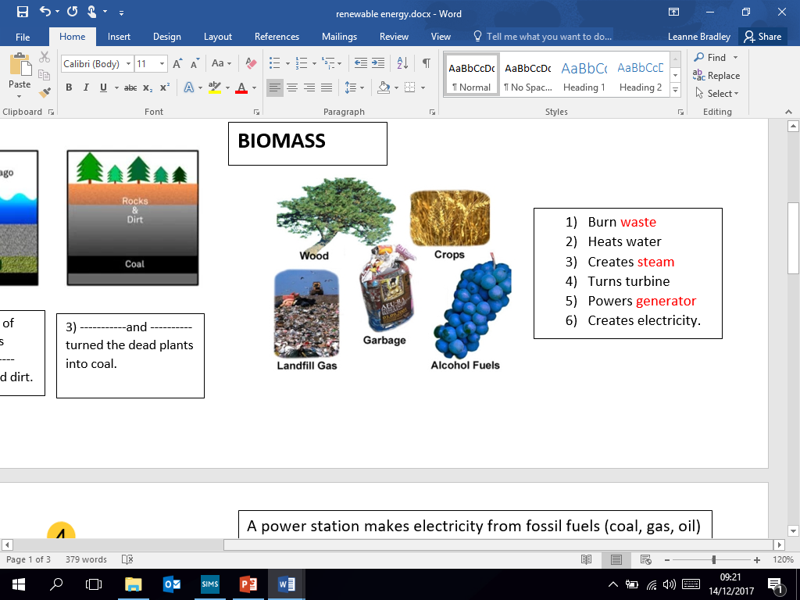
BIOMASS
Energy created by burning wood, and other organic matter. Burning biomass releases carbon emissions, but is classed as a renewable energy source because plant stocks can be replaced with new growth.
Carbon neutral
Notes:
It can also be used as a source of renewable energy, to reduce our dependence on fossil fuels, and to help reduce air pollution. Using biomass as fuel still puts carbon dioxide back into the atmosphere, but it's the same carbon dioxide taken from the air as the biomass was produced. The use of biomass for energy production is carbon neutral.

Slide 12
BIOMASS
Energy created by burning wood, and other organic matter. Burning biomass releases carbon emissions, but is classed as a renewable energy source because plant stocks can be replaced with new growth.
ADVANTAGES:
Biomass is a renewable energy source
Biomass is better for the environment than fossil fuels
Biomass is Very easily available
using biomass we reduce waste going into Landfill.
DISADVANTAGES:
The Biomass process can be costly
Biomass plants take up lots of space
Burning any fuel creates carbon emissions
Notes:
It can also be used as a source of renewable energy, to reduce our dependence on fossil fuels, and to help reduce air pollution. Using biomass as fuel still puts carbon dioxide back into the atmosphere, but it's the same carbon dioxide taken from the air as the biomass was produced. The use of biomass for energy production is carbon neutral.

Slide 13
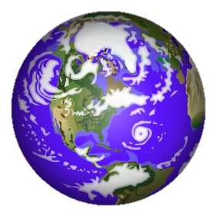

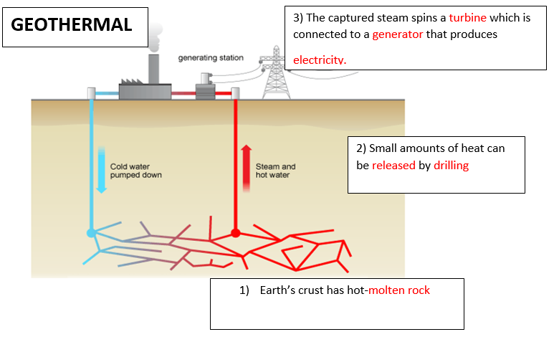
GEOTHERMAL energy is energy made by using heat inside the Earth's crust.
Notes:
This type of geothermal power station exists in places such as Iceland, California and Italy.
In some places, the rocks are hot, but no hot water or steam rises to the surface. In this situation, deep wells can be drilled down to the hot rocks and cold water pumped down. The water runs through fractures in the rocks and is heated up. It returns to the surface as hot water and steam, where its energy can be used to drive turbines and electricity generators.

Slide 14
GEOTHERMAL energy is energy made by using heat inside the Earth's crust.
ADVANTAGES:
Geo thermal energy is a renewable energy source.
There are no fuel costs.
No harmful polluting gases are produced.
DISADVANTAGES:
Most parts of the world do not have suitable areas where geothermal energy can be produced.
It is not 100% renewable as fossil fuels are required to power the heat pump.
The initial outlay for installation can be very high.
Notes:
This type of geothermal power station exists in places such as Iceland, California and Italy.
In some places, the rocks are hot, but no hot water or steam rises to the surface. In this situation, deep wells can be drilled down to the hot rocks and cold water pumped down. The water runs through fractures in the rocks and is heated up. It returns to the surface as hot water and steam, where its energy can be used to drive turbines and electricity generators.

Slide 15
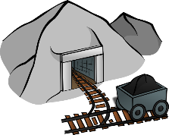
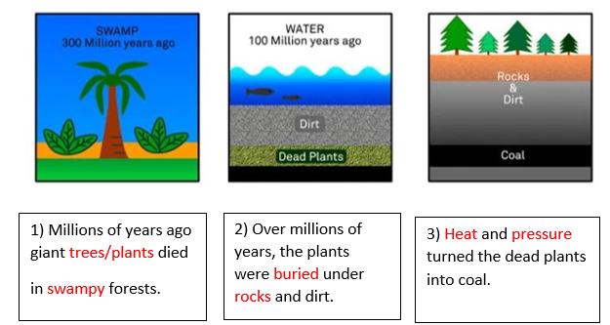
COAL
The burning of coal creates smoke, which leads to terrible pollution in the cities as it is non-renewable it is now lessening as it is no longer sustainable.
Notes:
Coal is a non-renewable energy source because it takes millions of years to form. That means what is in the ground now is all there is and we can’t realistically make more.
The energy in coal comes from energy that was stored in giant plants that lived hundreds of millions of years ago in swamp forests, even before the dinosaurs! When these giant plants and ferns died, they formed layers at the bottom of the swamps.
Water and dirt began to pile up on top of the dead plant remains. Over thousands of years pressure and heat would build up on top of the plant remains, undergoing chemical and physical changes and pushing out the oxygen, turning these remains into what we call coal.

Slide 16
COAL
The burning of coal creates smoke, which leads to terrible pollution in the cities as it is non-renewable it is now lessening as it is no longer sustainable.
ADVANTAGES:
Coal energy is an affordable energy source
The price of coal is cheap compared to other fuel sources.
Coal is easy to burn
DISADVANTAGES:
Coal produces large amounts of greenhouse gas emissions, including carbon dioxide, when burned in power stations.
The method extracting coal is harmful to the environment
Non renewable.
Notes:
Coal is a non-renewable energy source because it takes millions of years to form. That means what is in the ground now is all there is and we can’t realistically make more.
The energy in coal comes from energy that was stored in giant plants that lived hundreds of millions of years ago in swamp forests, even before the dinosaurs! When these giant plants and ferns died, they formed layers at the bottom of the swamps.
Water and dirt began to pile up on top of the dead plant remains. Over thousands of years pressure and heat would build up on top of the plant remains, undergoing chemical and physical changes and pushing out the oxygen, turning these remains into what we call coal.

Slide 17

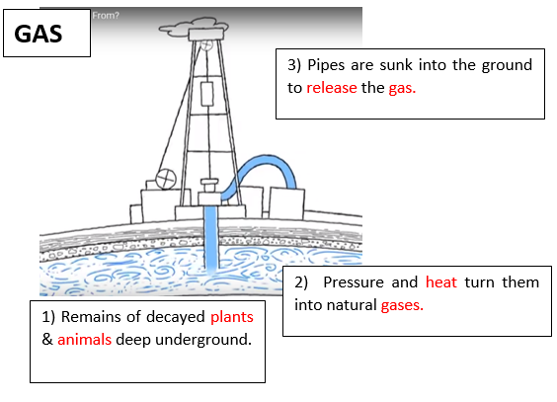
GAS
Methane and some other gases are trapped between rocks under the earth's surface.
Pipes are then sunk into the ground to release the gas. This gas is often used in houses for heating and cooking.

Slide 18
GAS
Methane and some other gases are trapped between rocks under the earth's surface.
Pipes are then sunk into the ground to release the gas. This gas is often used in houses for heating and cooking.
ADVANTAGES:
Gas is a ready-made fuel.
It is a relatively cheap form of energy.
It's a slightly cleaner fuel than coal and oil.
DISADVANTAGES:
When gas is burned, it gives off pollutants, including greenhouse gases.
There is only a limited supply of gas therefore it is
non-renewable
Extraction techniques are highly damaging to the environment

Slide 19

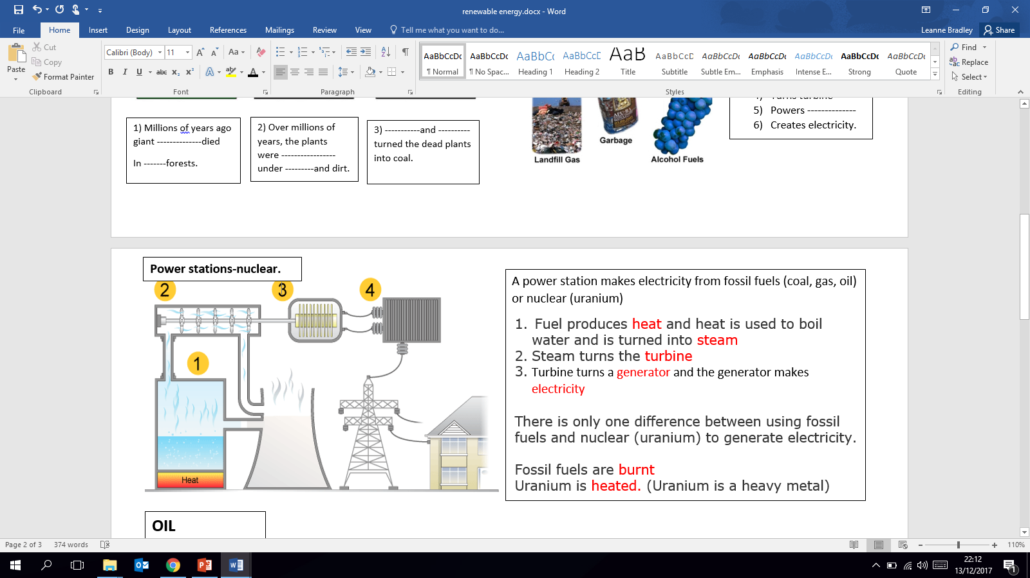
NUCLEAR
A power station makes electricity from fossil fuels (coal, gas, oil) or nuclear (uranium)

Slide 20
NUCLEAR
A power station makes electricity from fossil fuels (coal, gas, oil) or nuclear (uranium)
ADVANTAGES:
Unlike fossil fuels, nuclear fuels produces very little
carbon dioxide.
Generates a lot of electricity.
DISADVANTAGES:
Like fossil fuels, nuclear fuels are non-renewable energy resources.
nuclear waste remains radioactive and is hazardous to health for thousands of years.

Slide 21
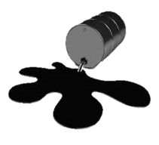
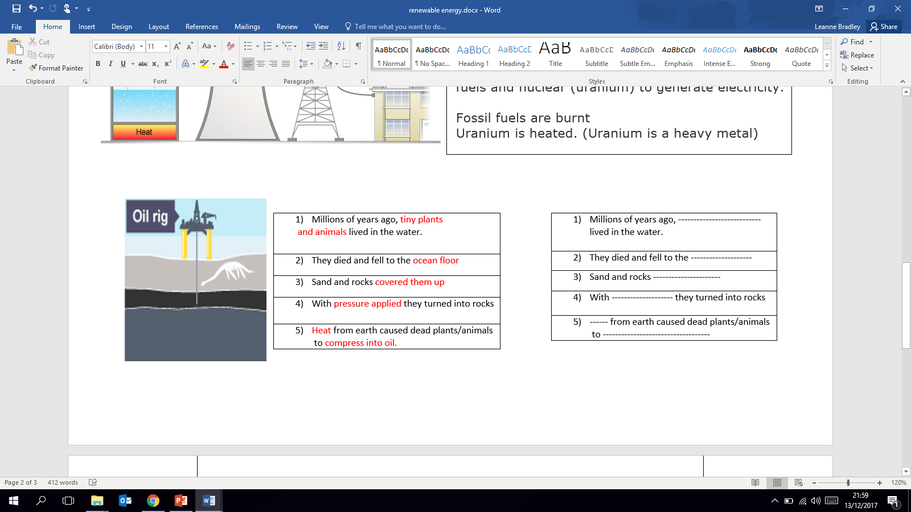
OIL
Oil has taken millions of years to form from dead animals and plants.
To get to the oil, a company must first drill down to it. Oil is burned to
heat water to create steam- the steam is used to generate electricity

Slide 22
OIL
Oil has taken millions of years to form from dead animals and plants.
To get to the oil, a company must first drill down to it. Oil is burned to
heat water to create steam- the steam is used to generate electricity
ADVANTAGES:
Oil is a ready-made fuel.
Oil is relatively cheap to extract and to convert into energy
DISADVANTAGES:
When oil is burned, it gives off atmospheric pollutants, including greenhouse gases.
As a fossil fuel, oil is non-renewable therefore there is only a limited supply.

Slide 23
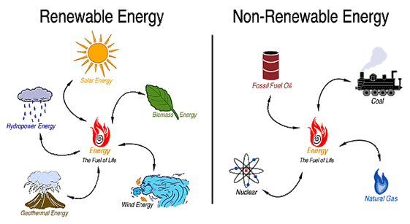

Slide 24
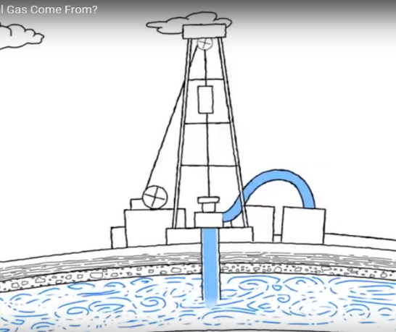
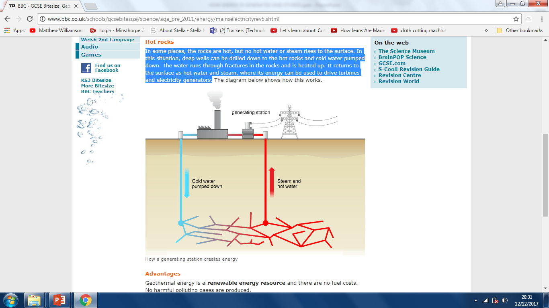
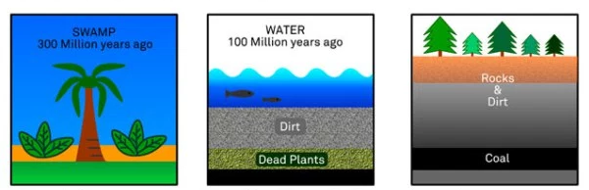

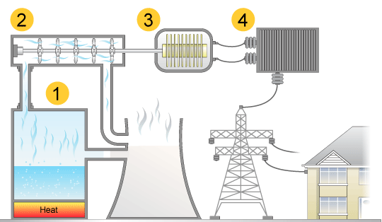
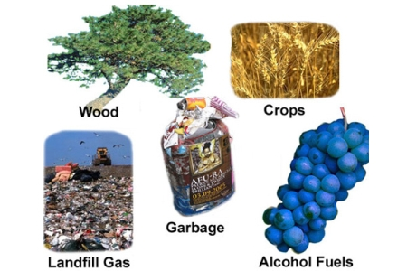
WHAT ARE THE ENERGY SOURCES?
GAS
COAL
GEOTHERMAL
BIOMASS
POWER STATION-NUCLEAR
OIL

Slide 25
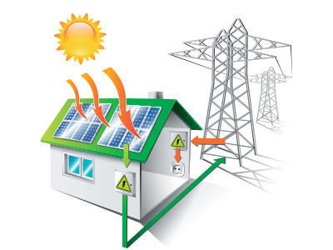
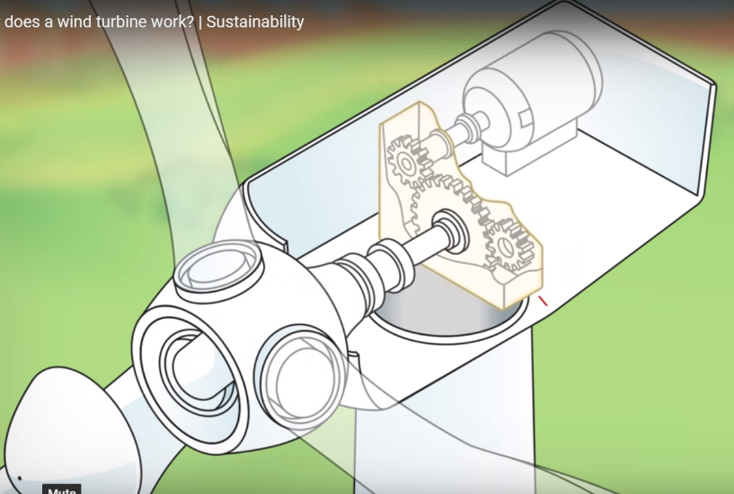
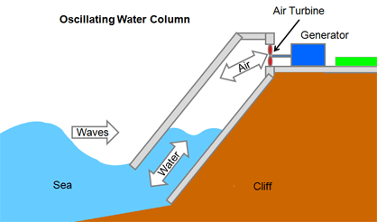
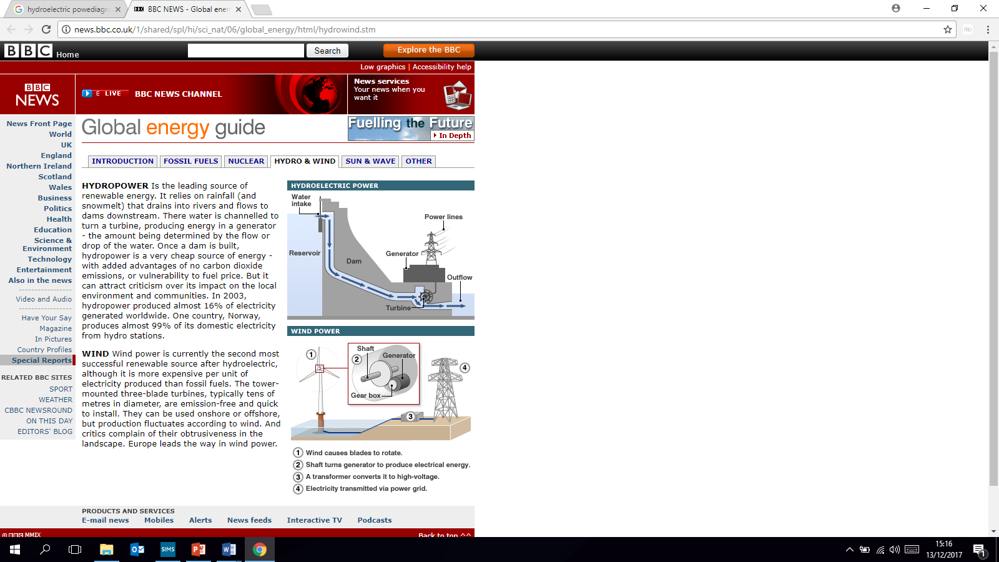
SOLAR
WIND TURBINE
WAVE
HYDOELECTRIC

