Slide 1

WHAT
LEARN ABOUT ENERGY SOURCES IN MANUFACTURE
& FOR PRODUCTS.
WHY
SUSTAINABILITY IS A VITAL CONSIDERATION IN MANUFACTURING AT ALL SCALES
WHERE
YOU WILL ALSO REQUIRE THIS KNOWLEDGE IN YOUR EXAMS
Believe Approach the task positively | Achieve Try to exceed my target! | Succeed Create some exciting designs | Enjoy Have fun, but work Safely | Support Work independently and support each other

Slide 2
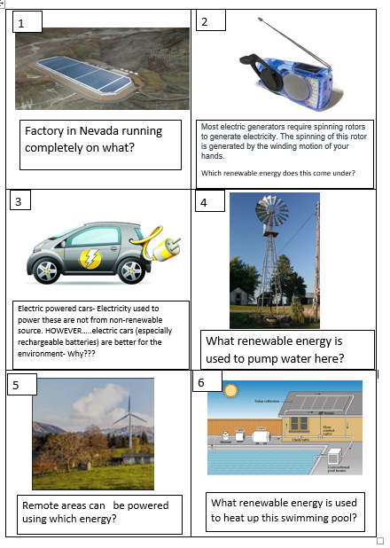
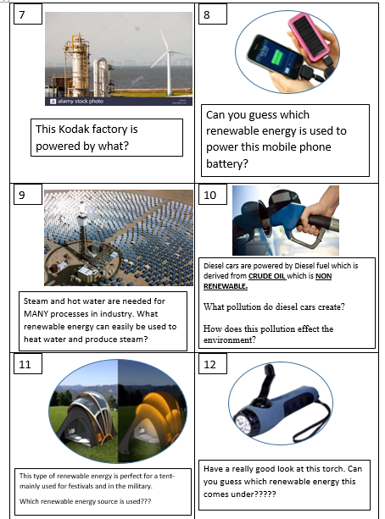
In pairs- look, read and discuss each question. Write your agreed answers down. (1-12)

Slide 3
While we are going through the answers, make a mind map, so you can use them for revision.
Energy sources for manufacture and products.

Slide 4
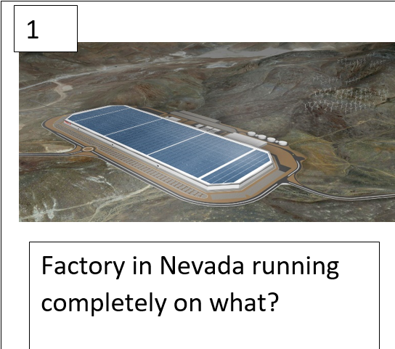
Answers
Solar power.
Flat roof and open space is more efficient.

Slide 5


While we are going through the answers, make a mind map, so you can use them for revision.
Factory powered by solar.
Energy sources for manufacture and products.

Slide 6
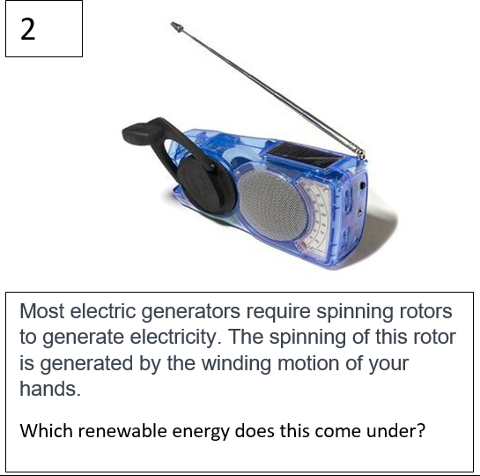
Answers
Kinetic
Good if no access to electricity. (2 billion people world wide)

Slide 7



While we are going through the answers, make a mind map, so you can use them for revision.
Factory powered by solar.
Energy sources for manufacture and products.
Kinetic wind up radio

Slide 8
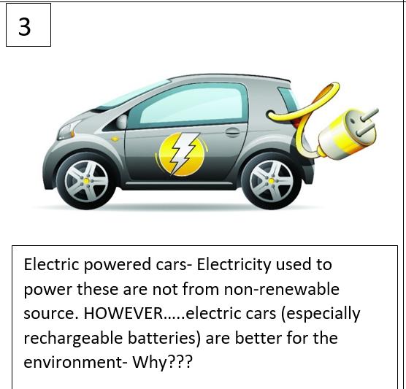
Answers
Rechargeable batteries can be re-used (not in landfill leaking harmful metals)
Creates less pollution and smog than petrol/diesel
Fewer batteries need to be manufactured and transported.
Notes:
don’t need to throw them away (non rechargeable often end up in landfill and release harmful metals. Fewer batteries need to be manufactured and transported. Create less pollution and smog which contributes to global warming.

Slide 9


While we are going through the answers, make a mind map, so you can use them for revision.
Factory powered by solar.
Energy sources for manufacture and products.
Kinetic wind up radio
Electric cars
Rechargeable battery
Battery not in landfill leaking toxic metals
Creates less pollution and smog.

Slide 10
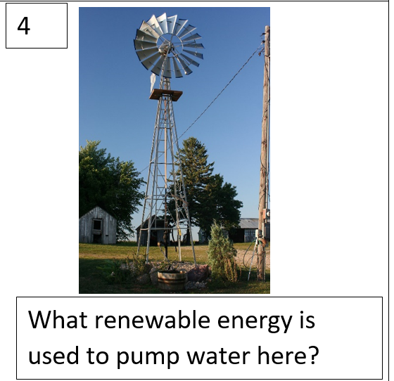
Answers
Wind.
Like a modern windmill that has been used for years to pump water and grind grain.

Slide 11
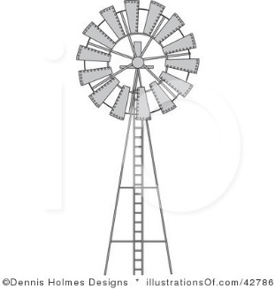

While we are going through the answers, make a mind map, so you can use them for revision.
Factory powered by solar.
Energy sources for manufacture and products.
Kinetic wind up radio
Electric cars
Rechargeable battery
Battery not in landfill leaking toxic metals
Creates less pollution and smog.

Slide 12
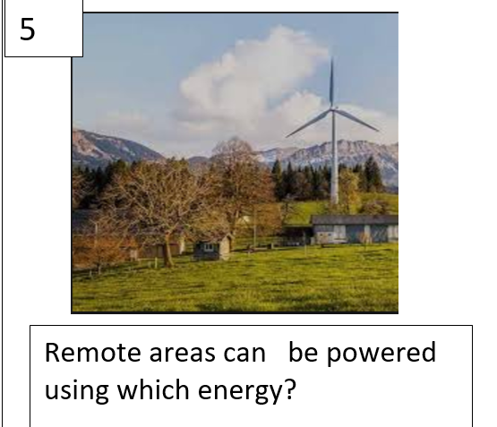
Answers
Wind turbines
Some areas are so remote, they are not powered by the grid.

Slide 13

While we are going through the answers, make a mind map, so you can use them for revision.
Factory powered by solar.
Energy sources for manufacture and products.
Kinetic wind up radio
Remote area
Electric cars
Rechargeable battery
Battery not in landfill leaking toxic metals
Creates less pollution and smog.

Slide 14
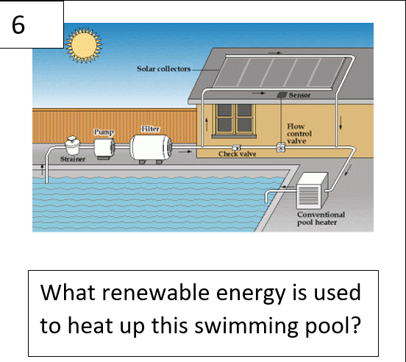
Answers
Solar.

Slide 15
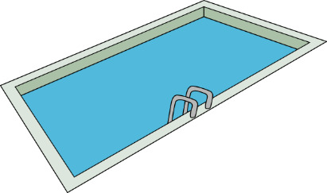
While we are going through the answers, make a mind map, so you can use them for revision.
Factory powered by solar.
Energy sources for manufacture and products.
Kinetic wind up radio
Remote area
Electric cars
Rechargeable battery
Battery not in landfill leaking toxic metals
Creates less pollution and smog.

Slide 16
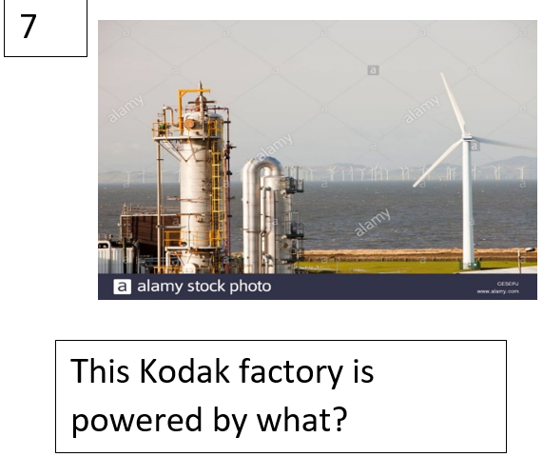
Answers
Wind turbines
More and more companies are finding renewable ways to supply energy in their factories

Slide 17

Answers
Solar.
Solar calculators, dryer, cooker, Fan, lamp, street light, radio, watch to name a few are available.

Slide 18
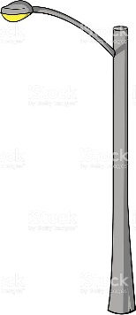

While we are going through the answers, make a mind map, so you can use them for revision.
Factory powered by solar.
Energy sources for manufacture and products.
Kinetic wind up radio
Remote area
Electric cars
Rechargeable battery
Battery not in landfill leaking toxic metals
Creates less pollution and smog.

Slide 19
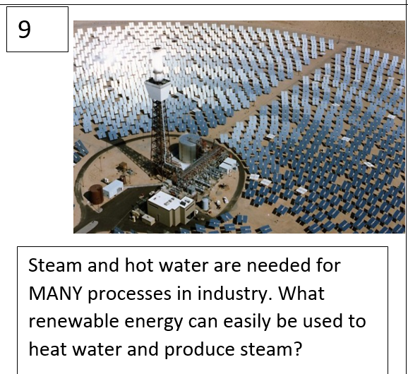
Solar.
You would be surprised how many processes need hot water or steam, from making paper, dying fabric to canning food!

Slide 20


While we are going through the answers, make a mind map, so you can use them for revision.
Factory powered by solar.
Energy sources for manufacture and products.
Kinetic wind up radio
Remote area
Electric cars
Rechargeable battery
Battery not in landfill leaking toxic metals
Creates less pollution and smog.

Slide 21
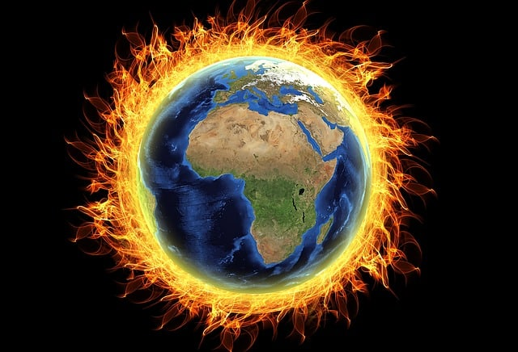

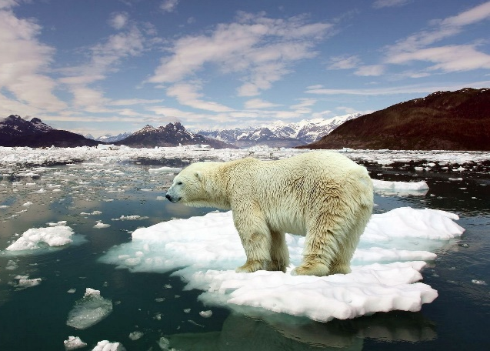
Carbon dioxide which contributes to global warming.

Slide 22

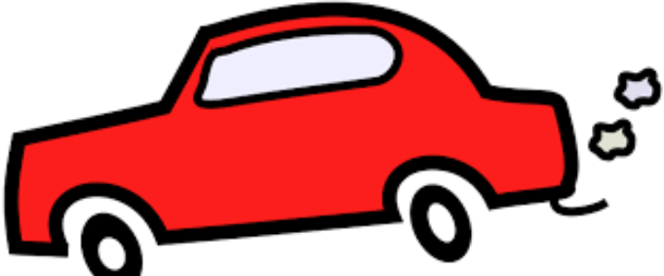


While we are going through the answers, make a mind map, so you can use them for revision.
Energy sources for manufacture and products.
Factory powered by solar.
Kinetic wind up radio
Remote area
Electric cars
Rechargeable battery
Battery not in landfill leaking toxic metals
Creates less pollution and smog.

Slide 23
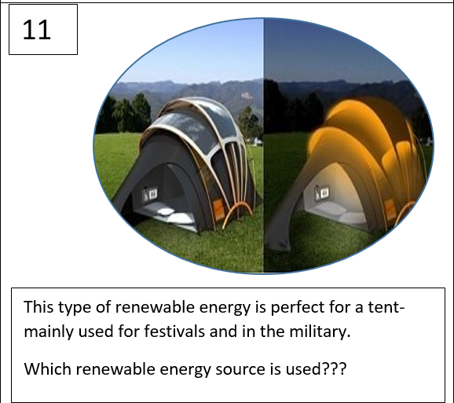
Solar
These tents are unique and specially coated solar threads are woven into the normal fabric.

Slide 24
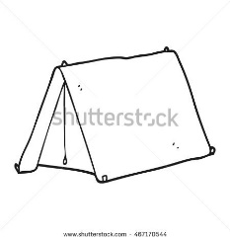
While we are going through the answers, make a mind map, so you can use them for revision.
Energy sources for manufacture and products.
Factory powered by solar.
Kinetic wind up radio
Remote area
Electric cars
Rechargeable battery
Battery not in landfill leaking toxic metals
Creates less pollution and smog.

Slide 25
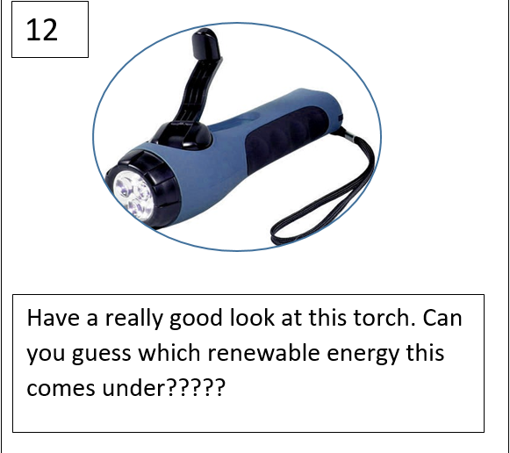
Wind up torch which uses Kinetic energy.

Slide 26

While we are going through the answers, make a mind map, so you can use them for revision.
Energy sources for manufacture and products.
Factory powered by solar.
Kinetic wind up radio
Remote area
Electric cars
Rechargeable battery
Battery not in landfill leaking toxic metals
Creates less pollution and smog.
and torch.

